Slide 1
Overview of MEIC Ion Complex and Ion Collider Ring
Yuhong Zhang

Slide 2
A Green Field for MEIC Ion Complex
This is a fact: there is no proton/ion beam at JLab.
Disadvantages
  Cost of creating an ion complex is usually much higher than a lepton complex
  A fixed portion of cost goes to a must-have low-energy part of an ion complex such as sources, linac and boosters, creating a significantly high bar for entering into electron-ion collider business
  Being a lepton lab with a fixed target program, JLab in-house expertise and technical staffs on ion beams and collider are minimal.
Opportunities
  MEIC colliding ion beams are not limited by any existing ion facility
  (unlike eRHIC proposal at BNL)
  A true green field design gives us freedom to take advantages of new technologies and design concepts for delivering excellent output of a collider in terms of high luminosity, high polarization, and machine stability.
  A superior electron-ion collider design at JLab is our only hope to off-set disadvantage of high project cost.

Slide 3
Requirements/Goals of MEIC Ion Beams
An ion complex including an ion collider ring should meet the following project requirements
Overall
  Forming and (long time) storing high current (up to 1 A) ion beams for collisions
  Covering a wide range of Ion species up to A=208 (Pb, Lead)
  Highly polarized ions including H, D, ³He and possibly Li
  Energy range from 12 to 60 (100) GeV for protons and corresponding energy per nucleon for ions (6 to 30 (50) GeV/u)
Geometric
  Be large enough to accommodate 3 IPs and all necessary components
  Share a tunnel with the electron collider ring
Beam quality and polarization
  Long (>8 hours) beam lifetime
  Achieving and maintaining high polarization (>80%)
  Achieving both longitudinal and transverse polarizations at all IPs
  Achieving longitudinal polarization at lease at one IP for deuterons

Slide 4
High Level Design Choices
Ion beams should match electron beam from CEBAF
  Very high bunch repetition rate (up to 1.5 GHz) and CW, same as an electron beam from CEBAF (about 100 time high than RHIC bunch frequency)
  Small transverse emittances and very short bunch (~ 5 to 10 mm)
  (about 20 times short than RHIC bunch length)
  Very mall bunch charge, less than 4.2x10⁹ protons (0.67 nC) per bunch
  (about 50 time smaller than RHIC bunch charge)
  High current of ion beam is achieved by high bunch repetition frequency
  ➔ this design concept forms the foundation of high luminosity for MEIC
Staged electron cooling
  For assisting beam accumulation, reducing emittances and bunch length, and suppressing IBS induced heating, to ensure high luminosity
  At the pre-booster, and at the ion collider ring, before and during collisions
Figure-8 shape ion collider ring
  For accelerating and storing polarized deuteron beam for collisions (longitudinal polarization at one to two medium energy IPs)
  Energy independent spin tune, ensuring spin preservation and easy manipulation

Slide 5
Technical Design Choice
No crossing of transition energies for any ion species during acceleration in any ring of ion complex
Ion linac for fast acceleration after ion sources for suppressing space charge effect at very low energy
Superconducting magnets for a compact collider ring, for small Laslett tune-shift (so higher ion current) and lower civil engineering cost (peak field less than 6 T)

Slide 6
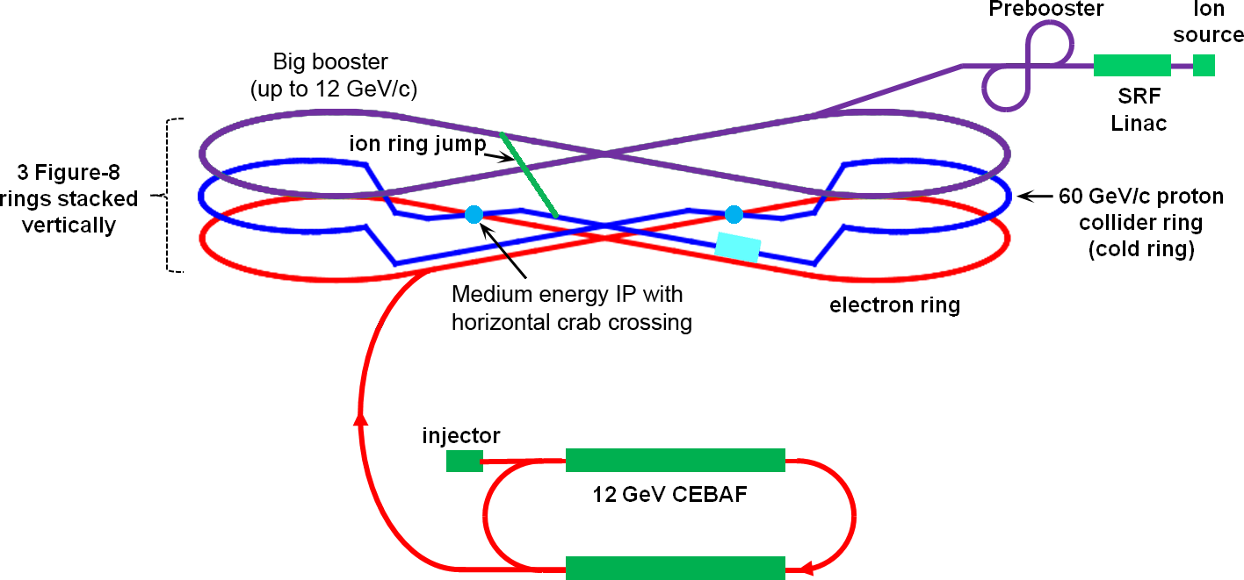
Schematic Layout of MEIC Ion Complex
Low /Medium energy beam transport
cooling
source
cooling
SRF Linac
pre-booster-Accumulator ring
Big booster
Medium energy collider ring
Technical design considerations
  Avoid crossing transition energies (γ_{t}) at all stages of energy boosting
  Peak SC magnet field less than 6 T for baseline design

Slide 7
Scheme and Status of Ion Beam Formation
 | Final Energy (GeV/c) | Cooling | Process
Sources
SRF linac | 0.2 |  | Stripping
Prebooster (Accumulator-Ring) | 3 | DC electron | Negative ion stripping injection Multi-turn stripping (heavy ions) Stacking/accumulating
Big booster (Low energy collider ring) | 12 ~ 20
Medium energy collider ring | 60 (100) | Electron | RF debunching/rebunching
Consideration/feasibility studies for polarized H⁻ and D⁻ carried out by Dudnikov (Mouns Inc.) & Danilov (Oak Ridge)
Conceptual design of SRF linac and cooled pre-booster carried out by Ostroumov (ANL) & Erdelyi (NIU), beam dynamics and cooling studies planed
Optics design, polarization and RF system for ion collider ring carried out at JLab
A self-consistent parameter set for ions from source to collider ring yet to be created
Design of the big booster not start yet

Slide 8

Flatness of Ion Beams
IBS growth rates can be estimated as
where κ is the x-y coupling parameter
Dispersive cooling scheme can redistribute emittance decrement among longitudinal & transverse dimensions
Equilibrium emittances of ion beams can be reached by a balance of multiple IBS heating and electron cooling
  τ_{c} = (τ_{α})_{min}
Such a balance leads to an aspect ration of horizontal and vertical emttiances
Energy (GeV) | Circum. (m) | Betatron Tune | Best ε_{x} / ε_{y} | Design ε_{x} / ε_{y}
100 | 1000 | 28 | 12.8 | 12
60 | 1000 | 28 | 5.0 | 5
40 | 1000 | 28 | 2.3
20 | 1000 | 28 | - | 1
250 | 2500 | 50 | 22.1 | 20
150 | 2500 | 50 | 9.3 | 10
50 | 2500 | 50 | 1 | 1
* x-y coupling κ is assumed 0.1
Our estimation indicates emittance ratio of MEIC is small, so at most an oval shape beam profile
At very high energy of ELIC, proton beam can be quite flat, so opens possibility of employing crab-waist scheme for IR
ε_{y} / ε_{x} = κ² + Q² / γ²

Slide 9
More Topics
Ion SRF Linac Bela Erdelyi
Ion Pre-booster Bela Erdelyi
Collider Ring Optics and Related issues Vasiliy Morozov
Beam Synchronization Andrew Hutton
Ion Beam Stability Byung Yunn
Ion Polarization Vasiliy Morozov
ERL Based Circulator e-Cooler Yuhong Zhang

