Slide 1
Synchronization
Andrew Hutton
Slava Derbenev
Yuhong Zhang

Slide 2
The Problem
Electrons travel at the speed of light
Protons and ions are slower
There are three areas that need to be addressed
Collisions
Acceleration
Cooling
Assumptions
MEIC circumference is around 900m
Booster (LEIC) is the same circumference as MEIC
Electron ring is the same circumference as MEIC
Superconducting RF systems have limited frequency swing

Slide 3
Collisions
Slava suggested changing the harmonic number
For a circumference about 900m, the harmonic number is about 4500
The proton energy that corresponds to a harmonic number of 4499 is 43.57 GeV
With two interaction points, we need to slip by two units
The proton energy that corresponds to a harmonic number of 4498 is 30.54 GeV
This is not a viable solution for the 40 – 60 GeV energy range
It is a viable solution at lower energies

Slide 4
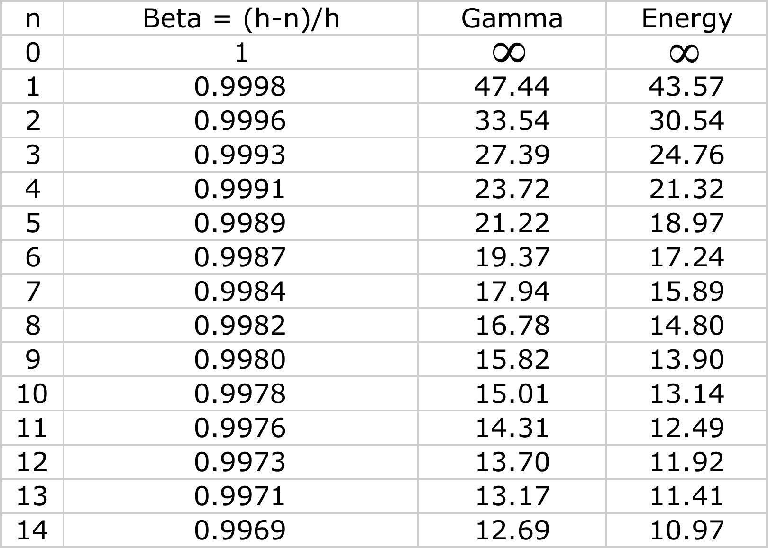
Harmonic Number versus Energy

Slide 5
Two Interaction Regions
The two Interaction Regions are 180° apart for both beams in the present configuration
Arcs are equal and straight sections are equal
Offsetting the beam in the Arcs would work
Putting two Interaction Regions in a single straight will not work without an additional variable chicane
Chicane is complicated in this region
Magnet offset ~1 meter for 2 mm path length change
MEIC can have up to two interaction regions
Must be equidistant in ring
There can be one more interaction region in LEIC

Slide 6
Change Path Length
It is possible to change the path length in the ion ring
For one Interaction Point, need 20 cm
For two Interaction Points, need 40 cm
If path length is created in the arcs
20 cm corresponds to an offset of about ±15 mm
40 cm corresponds to an offset of about ±30 mm
Increasing the bore of a 6 Tesla magnet by 30 mm is expensive!
60 mm may be prohibitive
Need to look into mounting all the magnets on movers
Unpleasant, but possibly affordable

Slide 7
Proposal - Three Ring Collider
The MEIC ring should be used to cover the higher energies
40 GeV (???) and up
RF frequency will be fixed (1497 MHz)
Electron ring and ion ring will use SRF cavities
Ion ring magnets must have increased bore or be on movers to accommodate velocity change
The LEIC ring will be used to cover lower energies
The LEIC ring will need variable RF frequency
Ion ring will require RF cavities that can span a wide frequency range
At present, that means using room temperature RF

Slide 8
Circumference
The change in average radius to make up one wavelength is independent of the circumference
But the energy corresponding to one wavelength difference is lower for a shorter machine
Includes arcs and straight sections
Every effort must be made to reduce the machine length
This will reduce the circumference change required to span the energy range of the MEIC ring
Need experimenters to define the lower energy of MEIC
Too low and the machine may be prohibitively expensive

Slide 9
Electron Cooling
Electron cooling requires exact matching of the electron and ion velocities
The time between adjacent buckets is 1/frequency
Therefore RF frequencies must also be matched
In the MEIC ring, if the RF frequency is constant (1497 MHz) the same electron cooling system will work at all energies
Fixed frequency SRF cavities will work for energy recovery of the electron beam used for cooling

Slide 10
Circulator Ring Circumference
The length of the circulator ring will need to be changed to accommodate different electron velocities
The maximum change will be 1/h_{ion}
The circumference change in the circulator ring is h_{e}λ/h_{ion}
Numerical example
MEIC is ~900 metres long, h_{ion} = 4500
Circulator ring is ~20 meters long, h_{e} = 100
Circulator ring must change circumference by 4.5 mm for a one wavelength change in MEIC circumference
This is a radius change of ~0.7 mm
This is a small number so it can easily be accommodated within the circulator ring magnet bore

Slide 11
LEIC Electron Cooling
The RF frequency in the LEIC ion ring has to change
The circumference change in the circulator ring can be accommodated within the magnet bore
The RF frequency in the electron cooling system has to change
The RF frequency of the electron linac must change
SRF cavities will not work
Electron energy is low
Propose no energy recovery for the electron beam
Extend the number of turns that the electron beam is in the circulator ring
Electron cooling would then be available throughout the acceleration cycle

Slide 12
Circulator Ring
Assume racetrack layout as proposed in the ZDR
Electron cooling occurs on one straight section
Electron beam injected/extracted on opposite straight section
Straight sections must have zero dispersion
If injected beam is on axis, it will be on axis for cooling
Injection orbit is independent of beam energy
However, correct longitudinal position is not guaranteed by good injection orbit
Requires Arcs to be achromatic, but not isochronous
Arc energy setting must lead beam energy during ramp so path length shortens to maintain correct timing

Slide 13
Injection
Bunch transfer into MEIC should occur at the ring RF frequency of 1497 MHz
Automatic for electron ring
Ion bunches will be injected into the booster at RF frequency corresponding to the lowest booster energy
This is not 1497 MHz
Single bunch-to-bunch transfer is always possible
Slower injection process than bunch train injection
Need to define RF frequency at injection and make sure that the injection ion complex is designed to operate at this frequency

Slide 14
Clearing Gaps
Colliders usually have one (or more) gaps in the bunch train
Ion clearing in electron beams
Electron cloud clearing in proton or positive ion beams
Required for aborting high power beams
MEIC will have gaps, probably ~10% of the circumference
Will reduce MEIC luminosity by ~10%
RF frequencies are the same so gaps are synchronous
LEIC will have gaps, also about 10% of the circumference
Will reduce LEIC luminosity by at least 20%
Gaps are asynchronous
Could increase beam-beam effects
Needs study

Slide 15
Impact of Clearing Gaps
The clearing gaps impact the RF systems
Stored energy in the cavities changes along the bunch train
Bunch energy changes along the bunch train
Transverse position in regions of non-zero dispersion changes along the bunch train
Polarization precession changes along the bunch train
Effect minimized with RF systems with high stored energy
SRF cavities
Copper cavities with storage cavities
It is difficult to vary the frequency of both types of cavity

