Slide 1
Gradient Team Report
3/27/2017

Slide 2
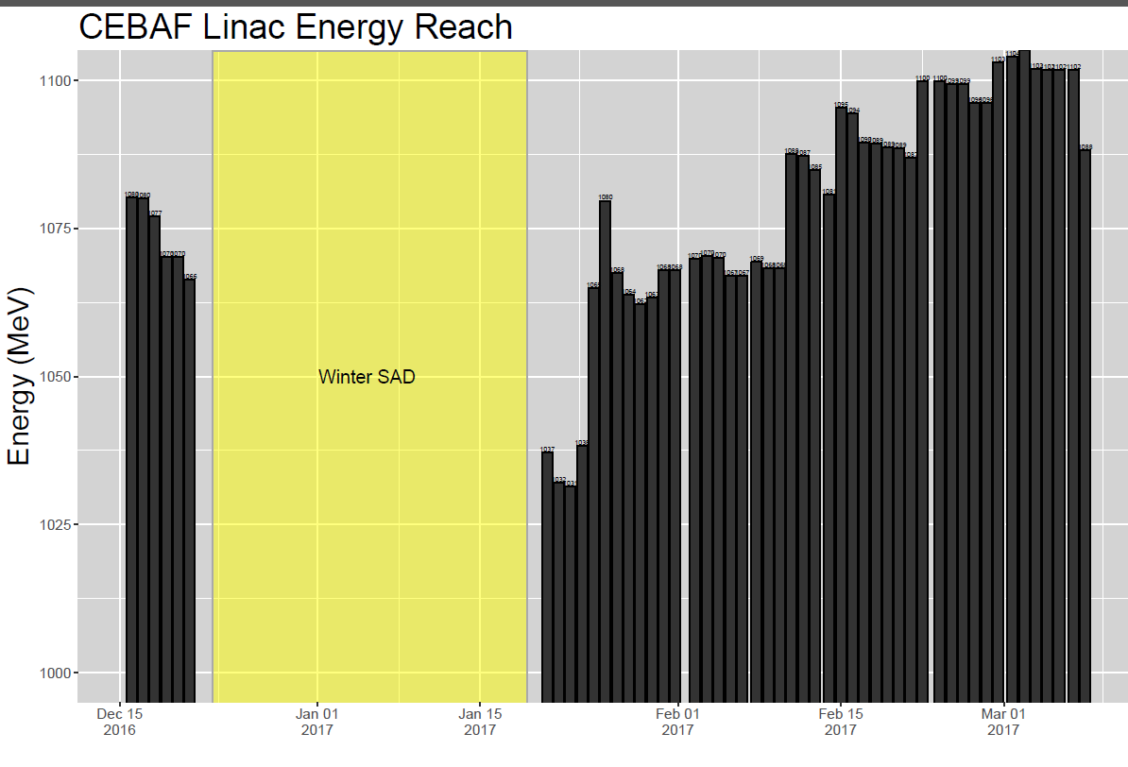
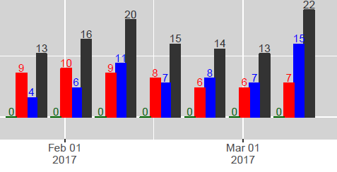
State of the Gradient System
2 Cavities Recovered
SL C100s in independent Heat mode
Lost 2L07
Maintenance Day Cavity Recovery
Put 2L23 Heat in Independent Mode +10MeV
2L26 insulating vac repair +27MeV

Slide 3
Summer SAD Tasks
Improvement Tasks | Gain/Loss (MeV/pass) | NL | SL | Improves | Group/Sys Owner
Klystron distibution. Pair the best with the best and worst with the worst. | - |  |  | Availability | RF
Optimize gradient vs radiation production in cryomodules. | - |  |  | Field Emmision | SRF
Continue to tune FCC parameters to minimize C100 recovery time. | - |  |  | Availability | RF
Install and test 8-heater power supply system. | - |  |  | Availability | RF
Evaluate any improvements gained from new turbo pump installation. Make recommendation based on results. | - |  |  | Availability | Ops/SRF
Evaluate Q0 Improvement of cryomodule by In-situ Demagnetization (in the LERF) - begin utilizing the LERF as an SRF/RF testbed | - |  |  | Q0 | SRF
Develop an empirical test to determine the high/low operating point of the C100 cryomodules as a function of pressure at the T. | - |  |  | Cryo Load | Cryo / Ops
Quench Test (real or not?) | - |  |  | Gradient/Availability | SRF/RF
Web-based gradient reporting tool v1 complete | - |  |  | Availability/Gradient | HLA/Adam
PZTs - change/improve control algorithm | - |  |  | Gradient | RF
Maintenance Tasks
Reduce C50 trip rates by improving FPC waveguide vacuum. | -
1L25-1 weirdness investigation / troubleshooting. This will likely be time consuming... | -
2L12 microphonics measurement (This zone experienced large gradient losses in the last 4 cavities when the pump cart was initially attached, shaking things?) | -
Need Waveguide Records on cryomodules (C100) while we have opportunity | -

Slide 4
Summer SAD Tasks
Improvement Tasks | Gain/Loss (MeV/pass) | NL | SL
Install C50 | 25 | 25
Complete targeted helium processing to get rid of field emitters (list to come from team). 4 Zones at 4MeV/zone | 16 | 8 | 8
Install all remaining Super MOPs power supplies. | 13 | 6.5 | 6.5
Regain margin on cavitiies limited by CWWT | 5 | 5
2L25 Gradient Push | 0
Replace cryomodule poly windows with ceramic windows | -27 | -8 | -19
 | per pass | NL | SL
SUM MeV | 32 | 36 | -4

Slide 5
Summer SAD Tasks
Maintenance Tasks
2L07 cryo-cycle and repair | 37 |  | 37
Repair 2 cavities 1L25 | 20 | 20
Repair 2 cavities 2L18 | 14 |  | 14
Repair 2 cavities 1L18 (with ceramic window swap, not including gain in line 13) | 13 | 13
2L09-1 requires a 30K cryocycle to unstick the tuner | 7 |  | 7
1L12-8 Arc Detector Swap | 7 | 7
2L17-3 Persistent CWWT: EES-RF swapped out RFCM and has passed it off to SRF as it persists. Requires further investigation, possible swap to warm IR sweep if it's not the cable/chassis. [1L10-6 has one too, but EES-RF has not ruled out the RFCM yet) | 6 |  | 6
1L13-6 has a damaged probe cable which requires replacement (does this require a stone drop to pull a new one?) | 5 | 5
1L10-6 is having intermittent problems registering latched CWWT faults; RFCM swap required; may need further diagnosis or warm IR sweep if that doesn't work. | 5 | 5
2L02-8 circulator swap | 4 |  | 4
1L12-20 and 2L18-50 will require ion pump swap outs and possible temporary supplementary pumping to establish good vacuum again for operation | 2 | 2
 | per pass
SUM MeV | 107.5 | 51 | 68

Slide 6
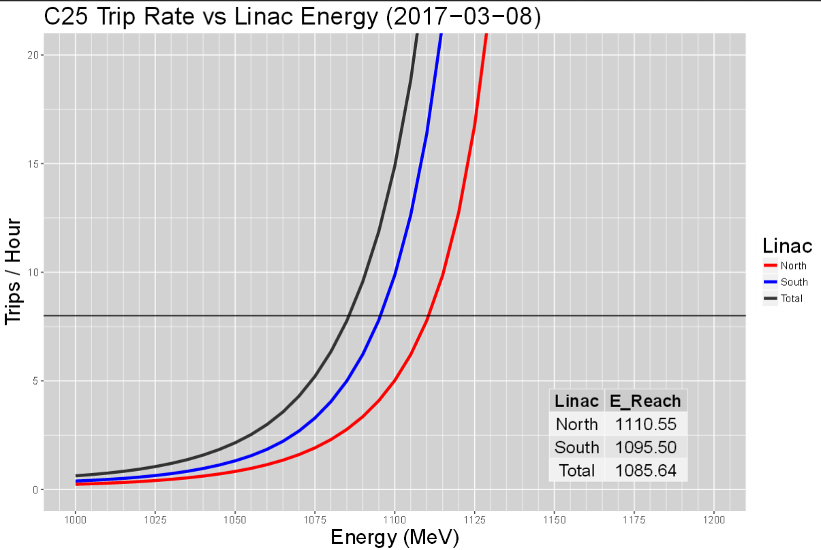
State of the Gradient System

Slide 7
Energy Reach
 | Gain/Loss (MeV/pass) | NL | SL
C25 Linac energy reach as of 3-09-2017 | 1085 | 1110 | 1095
Expected Gains (Improvements) |  | 36 | -4
Expected Gains (Maintenance) |  | 50.6 | 67.6
annual loss (10 months) | -28
Expected Reach (Fall 2017) - appoximated with annual loss | 1135 | 1197 | 1158
Linac reach based on 45 MeV of overhead | 1090
If refurbished C50 is installed in the SL instead of NL, Linacs could be more balanced | 1135 | 1172 | 1183
Important Notes:
We still need to complete the linac pressure test to determine the high/low operating point of the C100 cryomodules as a function of pressure at the T.
Cryo work schedule and configuration may impact some work.

