Slide 1
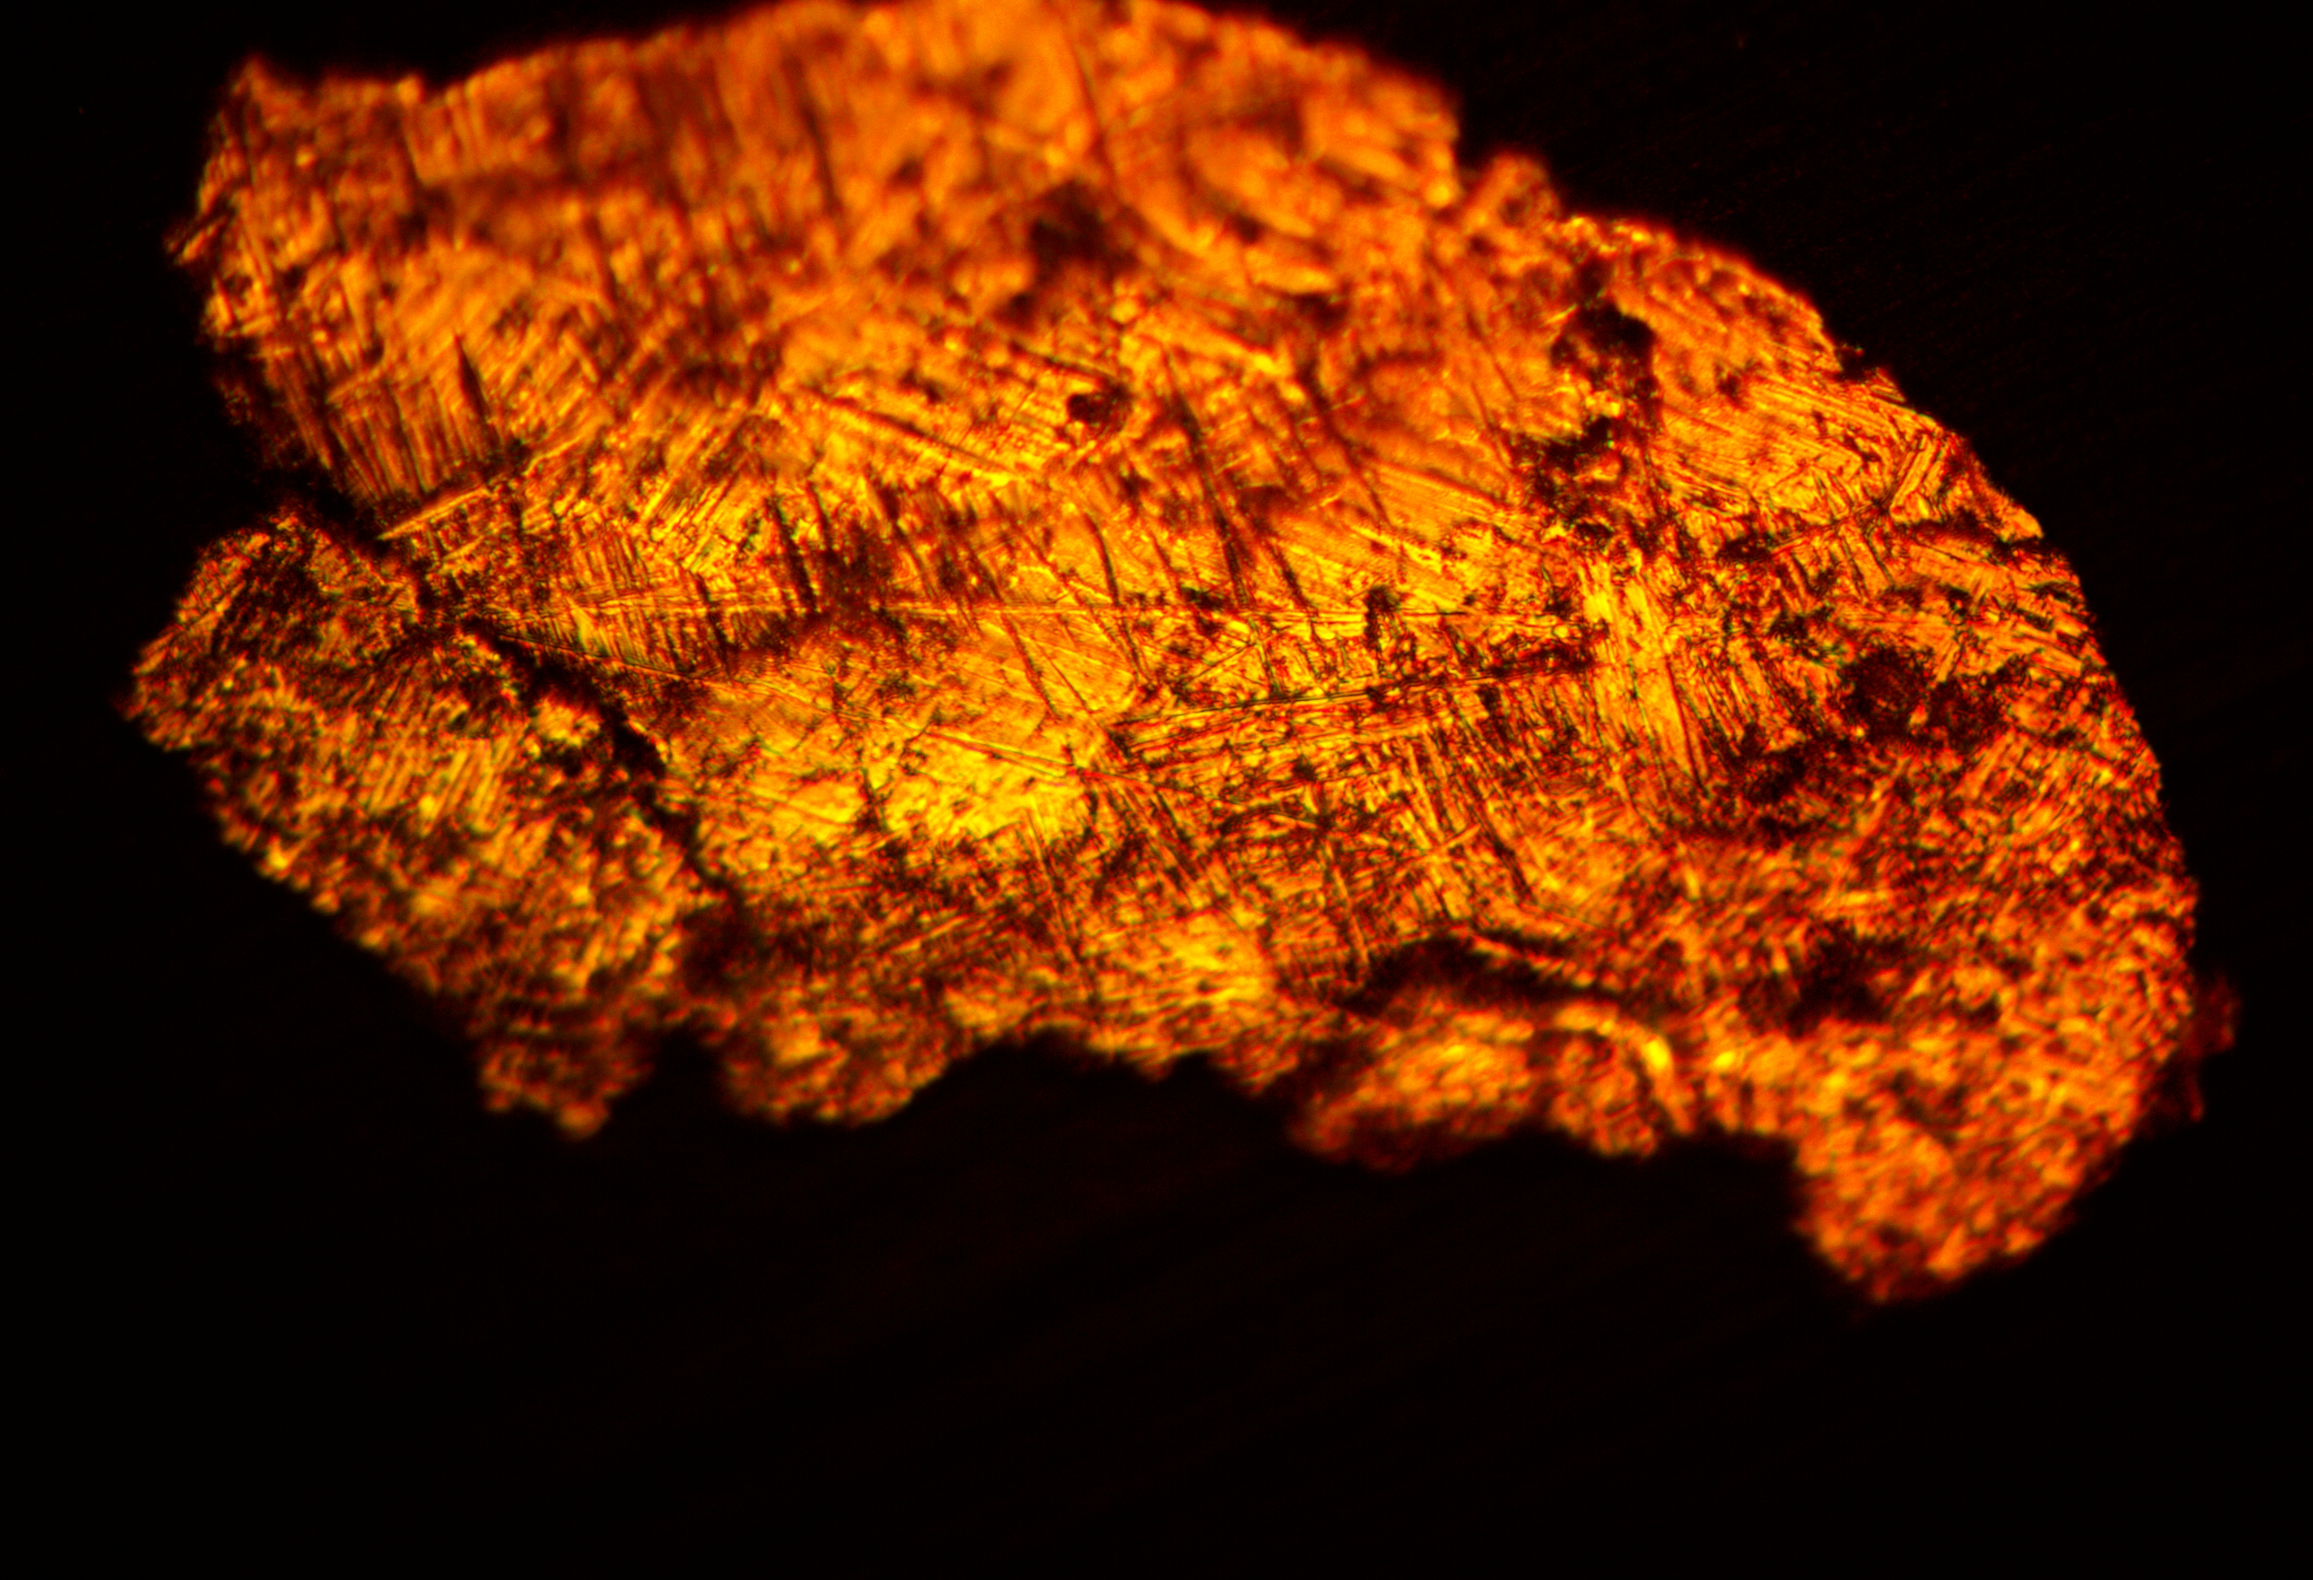
Particulate Studies
Rongli Geng
Jefferson Lab Accelerator Advisory Committee Review
October 22 – 24, 2019

Slide 2
Motivation
[1] R.L. Geng et al., “Nature and Implication of Found Actual Particulates on the Inner Surface of Cavities in a Full-Scale Cryomodule Previously Operated With Beams”, in Proc. SRF2015, 2015, pp.164 168.
[2] A. Freyberger (Ed.), “Summary Report from the CEBAF OPS 2015 StayTreat”, JLab Internal Report, 2015, JLAB-TN-15-033.

Slide 3
Outline
Where we were in last JLACC
FY19 effort and its outcome
  Particulate sources
  Particulate transportation
  Particulate inventory
  Toward particulate reduction & removal
Summary

Slide 4
Where We were in Last JLACC

Slide 5
FY19 Effort and Its Outcome: Context and Declared Approach
In October 2018, a plan was brought forward for funding to research on the root cause of gradient degradation in CEBAF and develop cost effective countermeasures for stop and reverse the degradation.
This work is primarily focused on the understanding of field emission particulates (sources, transportation inside the CEBAF beamline, adhesion to the cavity surface, activation by frozen gases) and their removal from the cavity surface and out of the cryomodule cavity string space.
It is based upon prior effort in this direction as documented in CEBAF Performance Plan (CPP). Such as particulate collection and identification from beamline UHV surfaces, cavity-grade warm girder beamline components cleaning, beamline NEG pumps, new procedures for existing ion pumps and gate valve operation, cryomodule warm up etc.
The next step is to carry out theoretical and experimental studies of beam-enabled particulate transportation over long distance inside the beamline and prototype effective and inexpensive cleaning techniques and procedures.

Slide 6
FY19 Effort and Its Outcome: Stated Scope
An UHV commercial particle counter will be purchased for off-line test.
A specialized particle counter suitable for deployment in CEBAF beamline will be designed and built in collaboration with the Detector Group.
Liquid nitrogen cleaning or cryogenic aerosol cleaning will be investigated for removing metallic particulates from the cavity surface and transporting the removed particulates out of the cavity space by gas entrainment.
Continue particulate inventory including a C100 cryomodule.

Slide 7
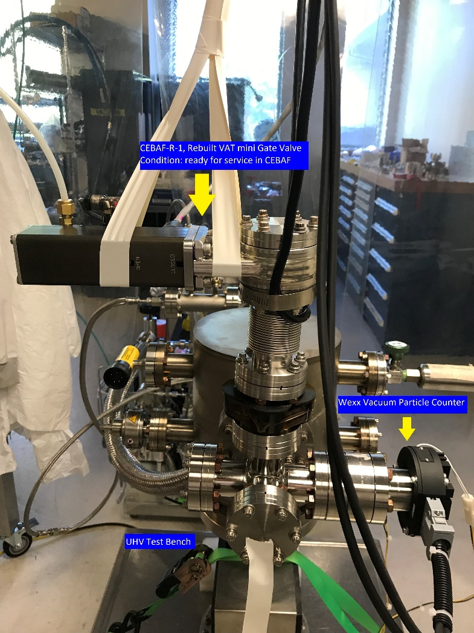
FY19 Effort and Its Outcome: Particulate Sources
An UHV commercial particle counter will be purchased for off-line test.
A specialized particle counter suitable for deployment in CEBAF beamline will be designed and built in collaboration with the Detector Group.
Liquid nitrogen cleaning or cryogenic aerosol cleaning will be investigated for removing metallic particulates from the cavity surface and transporting the removed particulates out of the cavity space by gas entertainment. This will be initially demonstrated with 7-cell cavities then extended to whole module with cavity string remaining in its original place.
A commercial UHV particle counter (Wexx, model ISPM-I-ICF-UHV) was ordered in November 2018 and was received on May 30, 2019. A UHV test bench was set up in the Vacuum Lab in the TED building.

Slide 8
CEBAF Beamline Gate Valves Evaluation for Particulate Attributes
Frequent particle events while valve being cycled
Initial particle count arising from chamber venting

Slide 9
CEBAF Beamline Gate Valves Evaluation for Particulate Attributes – cont.
GV designated ID | GV Condition | # of cycles actuated | Particulate detected?
CEBAF-R-1 | Re-built, on shelf ready for service in CEBAF | 1200 | No
CEBAF-R-2 (serial # 01032-UE44-005/0131 A-1084025) | Removed from CEBAF on 5/29/14 from cryomodule 1L26, VBV1L26B because of large through leak. It has been stored on shelf since then with aluminum foil wraps. | 210 | Yes
CEBAF-R-3 (serial # F01-54774-68) | Removed from CEBAF on 1/26/10 from cryomodule 1L05, VBV1L05B because of through leak. It has been stored on shelf since then with aluminum foil wraps. | 1200 | Yes (many)

Slide 10
CEBAF Beamline Gate Valves Evaluation for Particulate Attributes – cont.
Generated particulates dominated by stainless-steel and fluorine-bearing polymer/elastomer particulates
Now for the first time, we have direct evidence of particulate generation from the Viton seal and the body of those used CEBAF gate valves. .

Slide 11
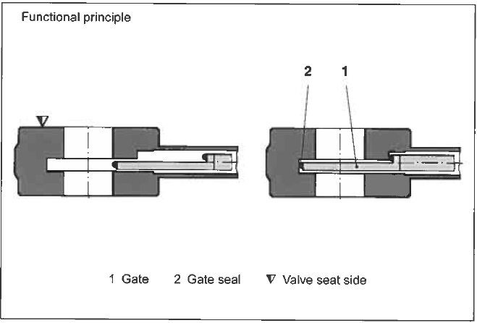
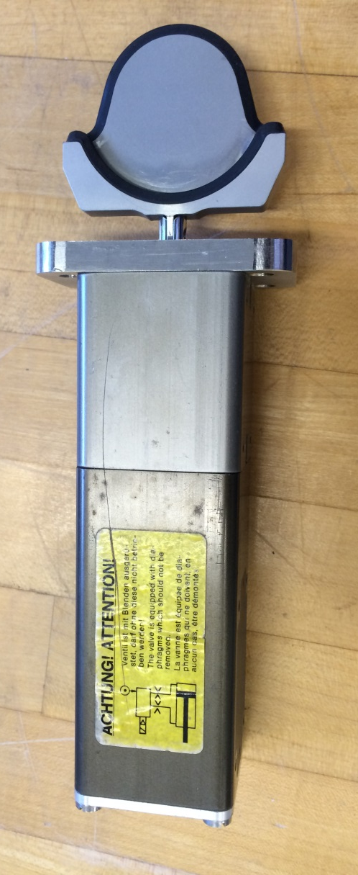
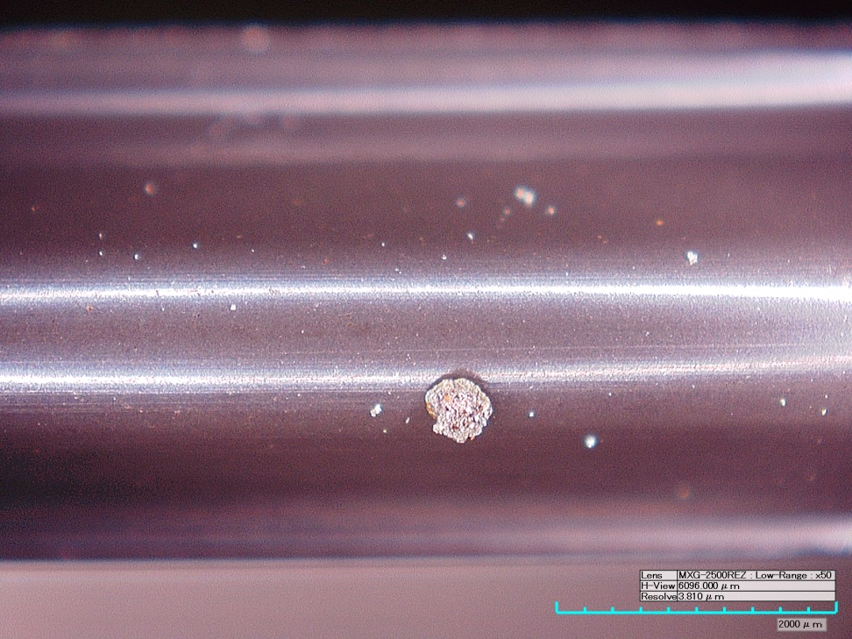
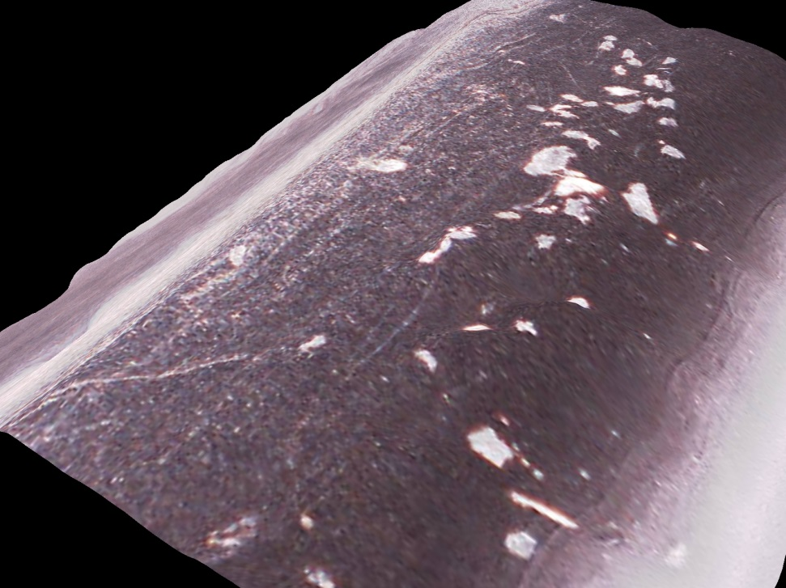
Earlier (2016) Gate Valve Particulate Studies
Six-Month Follow-Up on Action Items of Feb 2016 CEBAF Field Emitter Workshop
September 12, 2016, JLAB
https://www.jlab.org/indico/event/173/

Slide 12
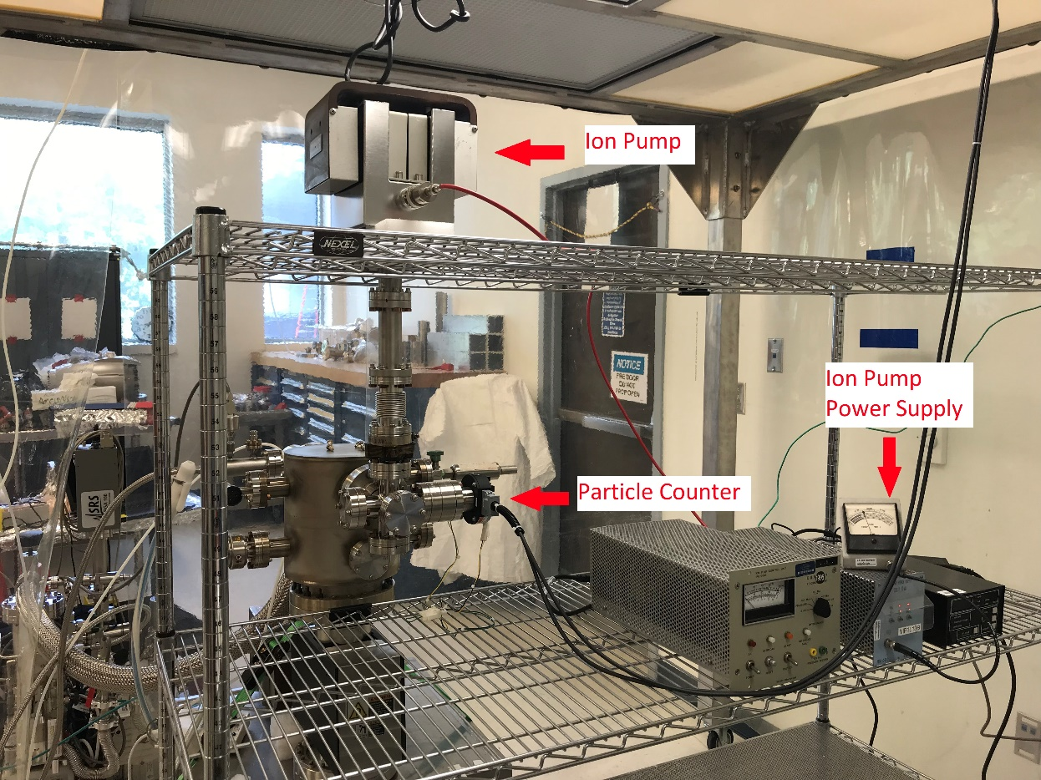
CEBAF Beamline Ion Pumps Evaluation for Particulate Attributes

Slide 13
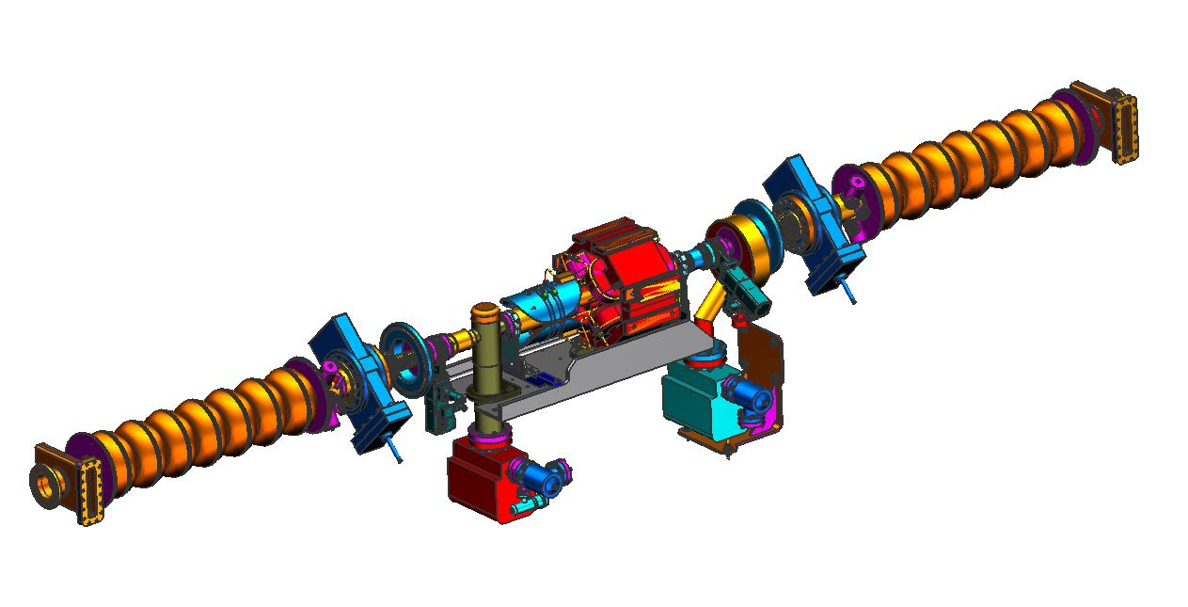
Ion Pumps in CEBAF Beamline
A Valve
B Pump
B Valve
A Pump

Slide 14
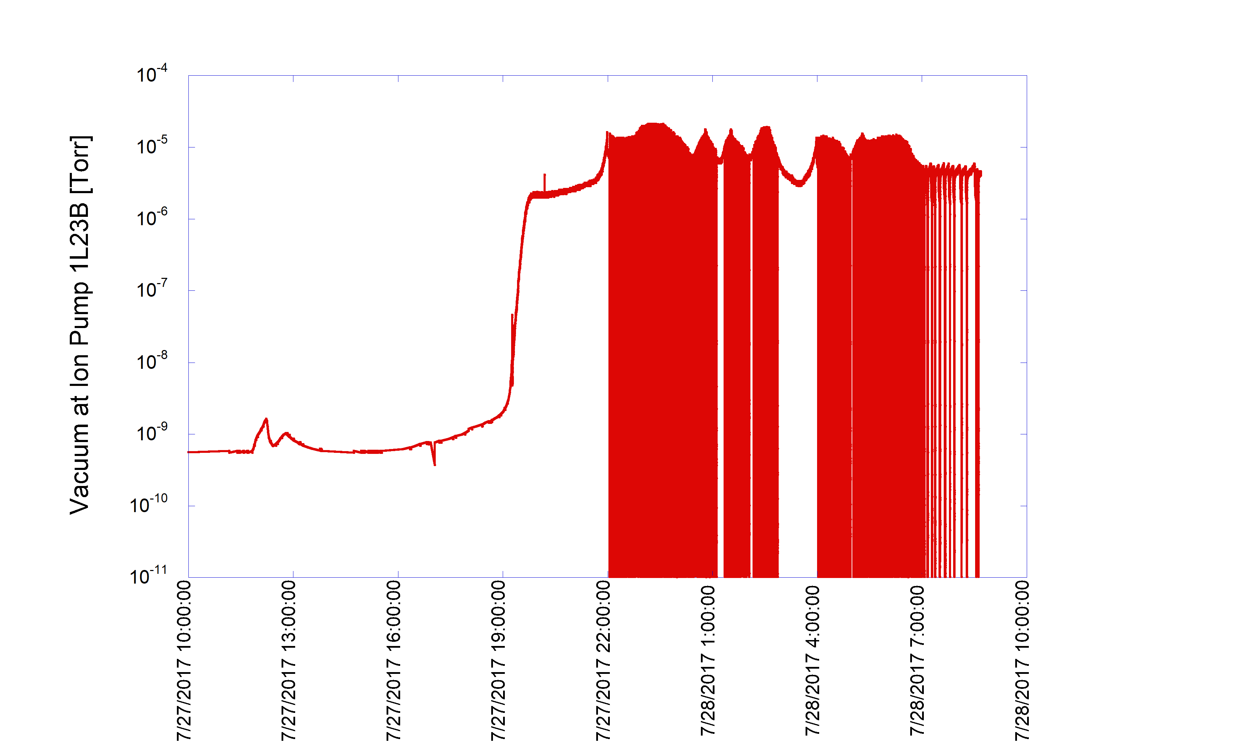
CEBAF Beamline Ion Pump Operation Conditions after Unplanned Cryo Outage
Ion Pump B in C100 module 1L23 self re-start at poor vacuum
during un-planned warm up triggered by CHL1 power outage

Slide 15
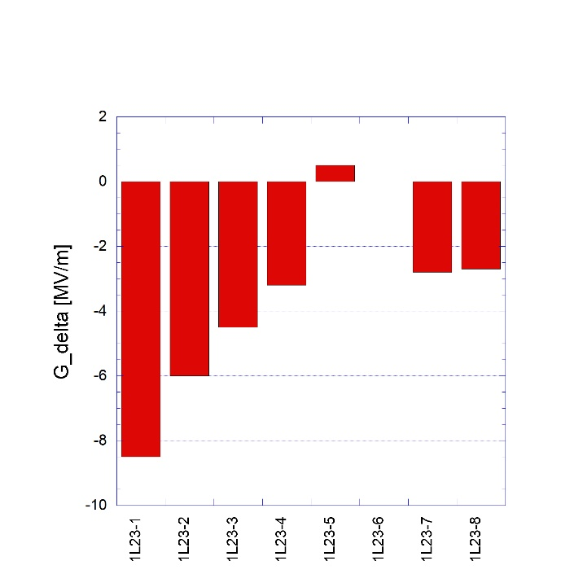
Cavity Gradient Degradation following Irregular Ion Pump Operation
Cavity nearest to B pump
R. L. Geng, A. Freyberger, and R. A. Rimmer, “Understanding and Mitigation of Field Emission in CEBAF SRF Linacs”, in Proc. 10th Int. Particle Accelerator Conf. (IPAC'19), Melbourne, Australia, May 2019, pp. 3039-3042. doi:10.18429/JACoW-IPAC2019-WEPRB097

Slide 16
CEBAF Beamline Ion Pumps Evaluation for Particulate Attributes
IP designated ID | IP Condition | Particulate detected?
CEBAF-VIP1L13A (aka CEBAF-IP-1 for particulate Run 1-3) | Removed from 1L13 girder (A pump) ~ 7/16/16. Identifier: Perkin Elmer X90690 A 0765, Rating 30L/s CONV, model: C14591-1 | No
CEBAF-VIP1L23B-C100-6 | Removed recently from C100-6 which was extracted from CEBAF north linac for refurbishment. This pump was correlated with the gradient degradation in zone 1L23 while C100-6 was installed therein. Identifier: Gamma Vacuum, 45S, DI, Mfg. date Jan 10 | Yes

Slide 17
CEBAF Beamline Ion Pumps Evaluation for Particulate Attributes – cont.

Slide 18
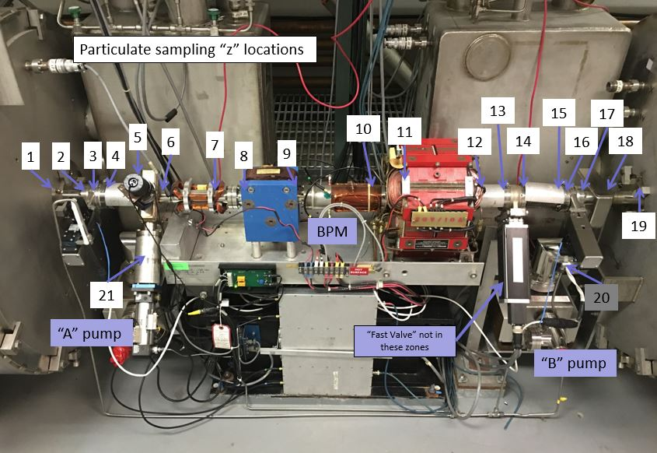
FY19 Effort and Its Outcome: Particulate Inventory
Five warm girders between cryomodules were sampled prior to cleaning and reassembly. The following types of particulates were found in these girders:
Cu flakes and long slivers
SS flakes
Zinc pieces and slivers
sand
Ni
Molybdenum sulfide
Ta flakes
Ti
Cu/Ag flake with hydrocarbon fibers
Si/Al/Mg & Si/Ca/Al at ion pumps
Si/Mg/O
Large sheet-like hydrocarbon pieces

Slide 19
Identifying Specific Particulate Contamination
Two original-style CEBAF cryomodules were sampled when removed for rework.
“Franklin” had previously been reworked and reinstalled in 2009.
  Suffered a known vacuum servicing accident that transported particulates into cavities.
“Independence” had been on the linac beamline since 1992.
  Relatively weak performer, suffered no known acute incidents.
Composition of the particulates found inside the cavities matched the large particulates found in the girders, consistent with the chief issue of CEBAF cryomodule performance degradation being transport of contamination from the girders into the SRF cavities.
  The metallic particulate load was ~3× higher in Franklin than in Independence.
  Mineral and masonry type particulates were a factor of 10 higher in Franklin than Independence.
  Interestingly, hydrocarbon signature particulates were most prevalent in Independence.
  Over 100 polymer or elastomer particulates were found in Franklin and adjoining girders, but essentially none in Independence. Source unknown.

Slide 20
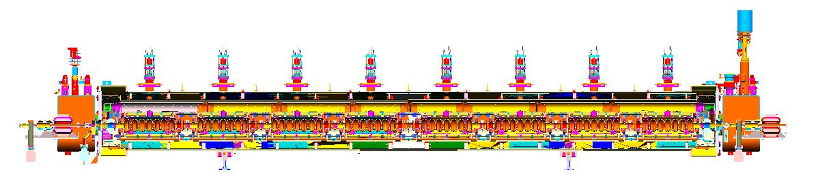
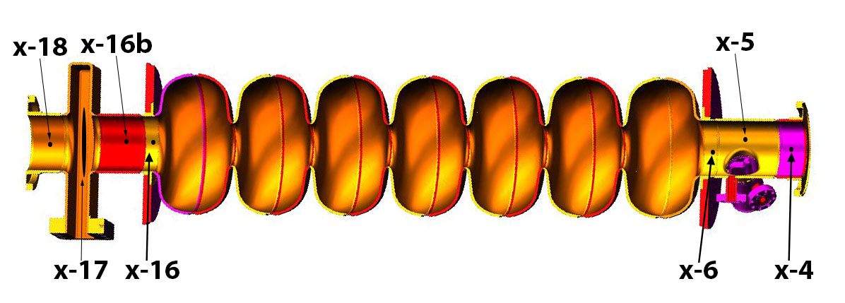
Identifying Specific Particulate Contamination
C100 cryomodule in CEBAF zone NL23 was removed for cleaning
68 particulate samples were collected during disassembly
Cavity 1
Cavity 2
Cavity 3
Cavity 4
Cavity 5
Cavity 6
Cavity 7
Cavity 8
Gate
Valve
Gate
Valve
Girder 23
Girder
24
Pump
Drop
Pump
Drop
C100-6 NL23 bled up in tunnel from girder 24 to girder 23 then brought to Test Lab with end CF flanges not hermetically sealed.
S0867
C1-4
S0867 = C1-4 → Cavity 1 HOM Beam Pipe

Slide 21
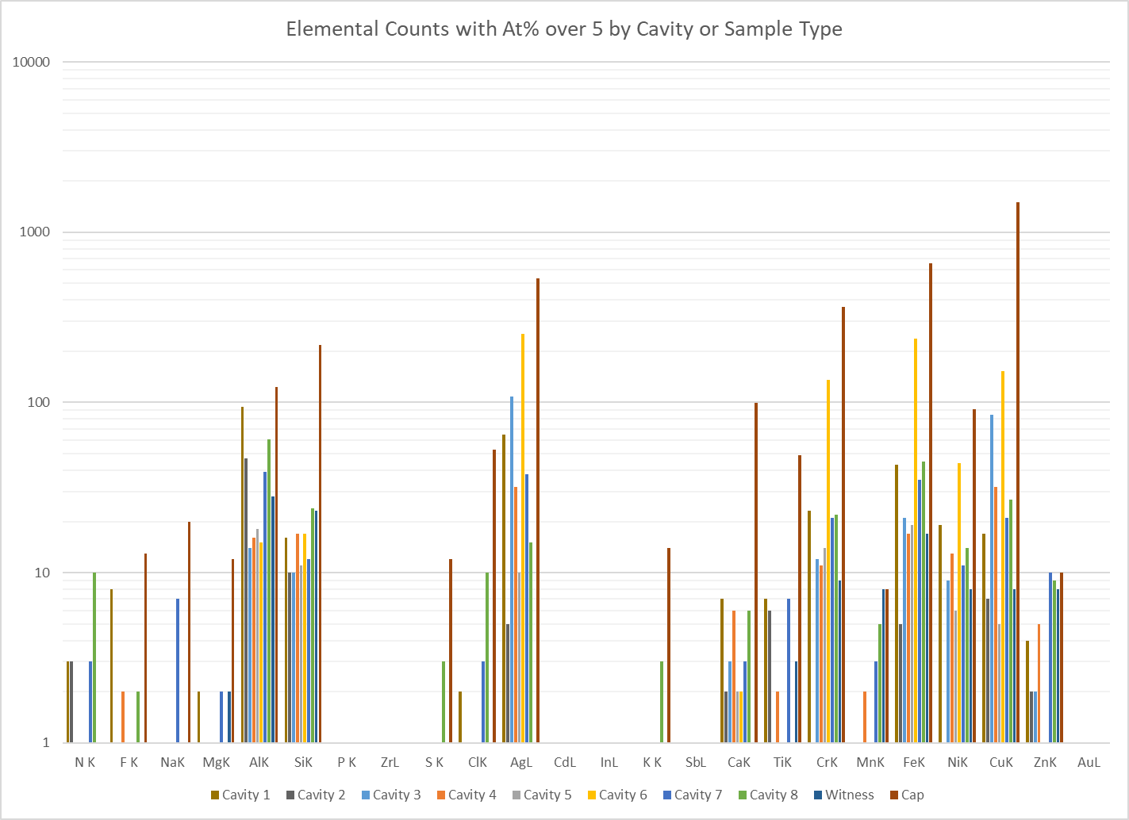
C100-6 NL23 205× Particle Results
Cavity 6: Excess in Ag, Steel, & Cu
Cavities 1, 2, & 8 + Witnesses: Extra Al
Cap: Lots of Cu, Steel, Ag, & Mineral
Particles per Category
For At% Threshold of 5%
Number of Particles
Cavity 1 = 2421
Cavity 2 = 673
Cavity 3 = 2551
Cavity 4 = 439
Cavity 5 = 436
Cavity 6 = 2321
Cavity 7 = 1979
Cavity 8 = 1280
Witness = 527

Slide 22
FY19 Effort and Its Outcome: Particulate Transportation
An UHV commercial particle counter will be purchased for off-line test.
A specialized particle counter suitable for deployment in CEBAF beamline will be designed and built in collaboration with the Detector Group.
Liquid nitrogen cleaning or cryogenic aerosol cleaning will be investigated for removing metallic particulates from the cavity surface and transporting the removed particulates out of the cavity space by gas entertainment. This will be initially demonstrated with 7-cell cavities then extended to whole module with cavity string remaining in its original place.
The functioning requirement of vacuum particulate counter for use in CEBAF tunnel was developed in September 2018 and transmitted to the JLAB Detector Group.
A test bed was set up in the Detector Group lab area using the spare CEBAF warm girder sub-assembly along with spare UHV components and a vacuum pump. A couple of windows were provided on loan by the Injector Group.
The proof-of-principle experiment was completed in January 2019 using the first specialized photonics module (50 µm optical beam size) purchased from Omnisensing Photonics LLC.
Following the successful proof-of-principle testing in January 2019, optimization for signal to noise ratio was carried out, leading to a set of design specification in July 2019.
An RFP with along with JLAB design specification was transmitted to Omnisensing Photonics LLC in July 2019. A detailed engineering design was received on July 16, 2019 including a completed set of engineering design specification, cost and schedule.
FY20 budget requested is made for first article procurement.

Slide 23
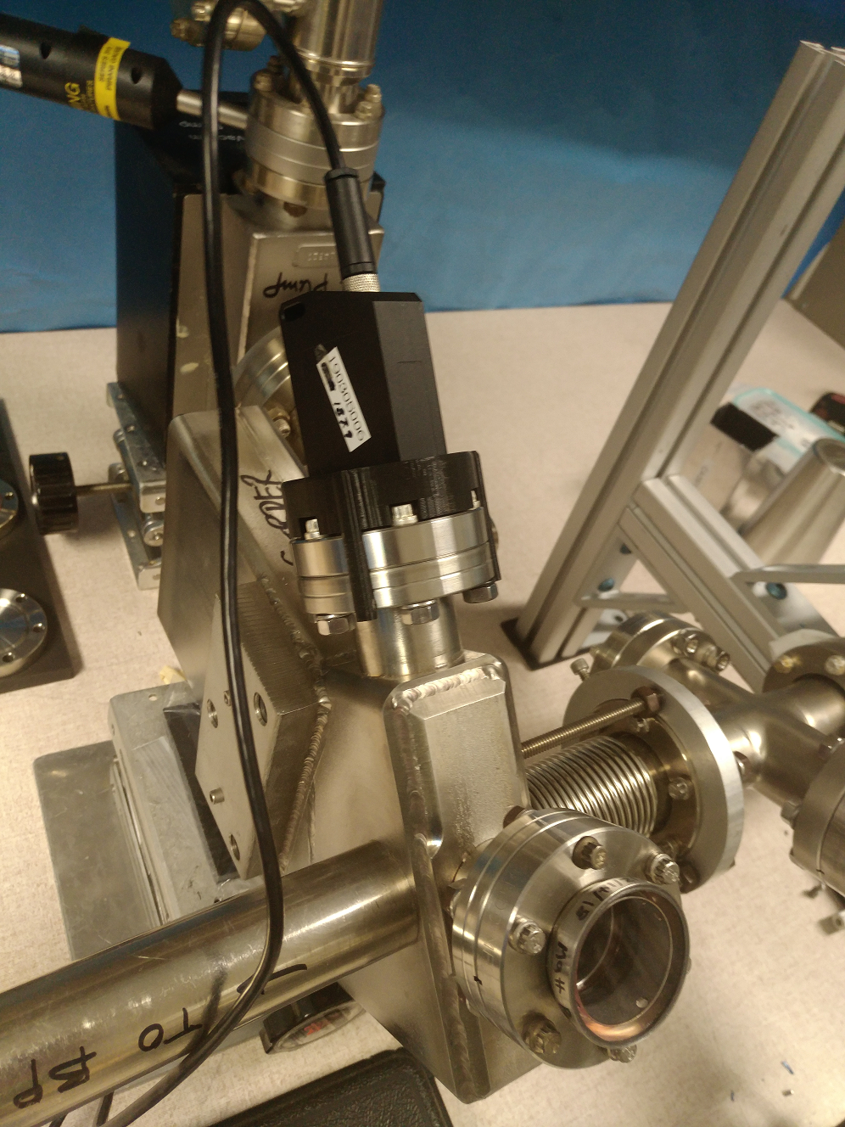
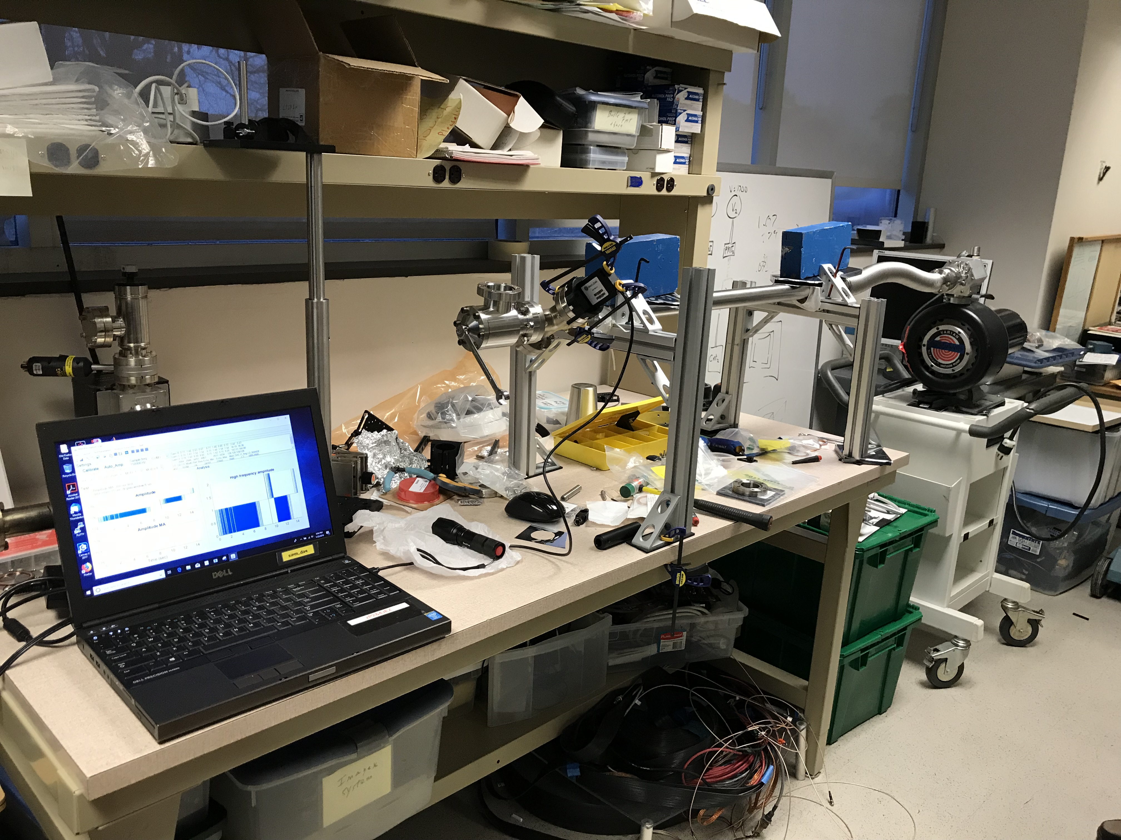
Testing on Sensor for Remote Particle Detection
Test bed set up in Detector Group lab area for proof-of-principle testing of particulate detection using the Omnisensing Photonics lidar module.

Slide 24
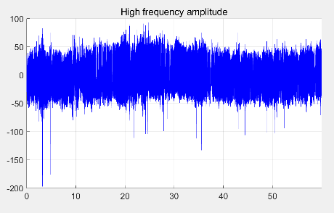
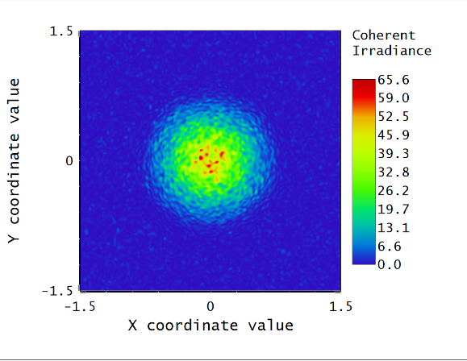
Testing on Sensor for Remote Particle Detection – cont.
Prof-of-principle established.
25um
50um
75um
Signals when the gold wire was passing by

Slide 25
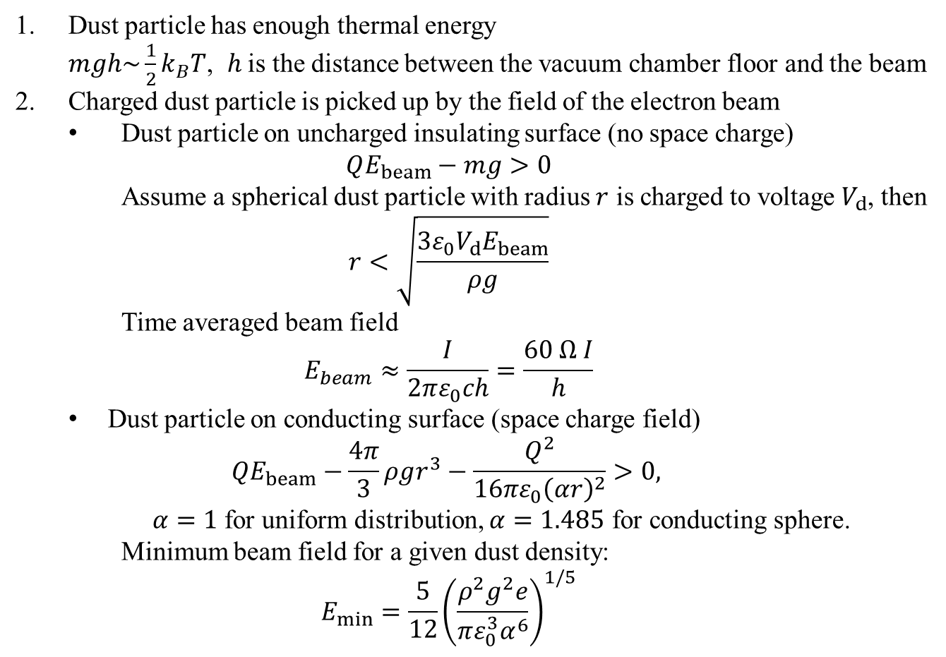
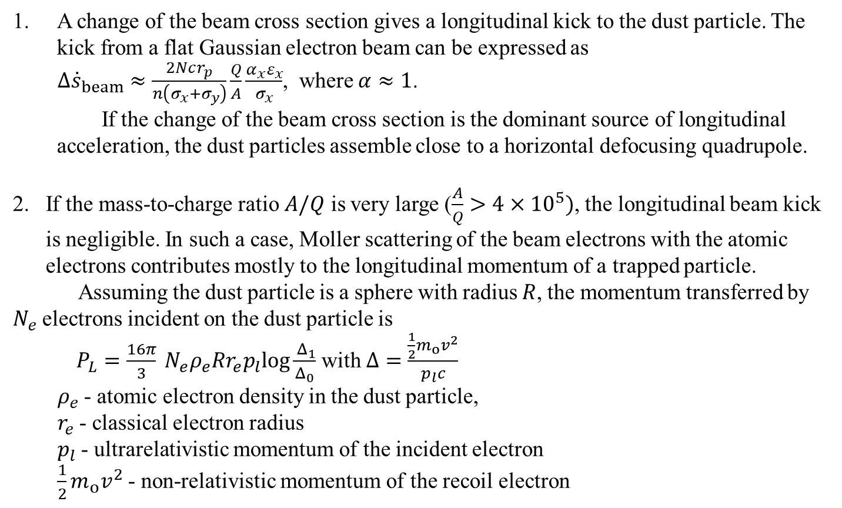
Theoretical of Beam-Enabled Particulate Transportation
Courtesy He Zhang, CASA
Pickup of the Dust Particles
Longitudinal Motion of the Dust Particles
Outcome of theoretical work useful for guiding experimental studies

Slide 26
FY19 Effort and Its Outcome: Particulate Sources
An UHV commercial particle counter will be purchased for off-line test.
A specialized particle counter suitable for deployment in CEBAF beamline will be designed and built in collaboration with the Detector Group.
Liquid nitrogen cleaning or cryogenic aerosol cleaning will be investigated for removing metallic particulates from the cavity surface and transporting the removed particulates out of the cavity space by gas entrainment.
The concept of liquid nitrogen was further advanced for removing metallic particulates from the cavity surface and transporting the removed particulates out of the cavity space by gas entrainment.
Potential vendors for the cryogenic pressure pump are identified. One quote was received.
A potential industrial vendor was identified as a potential collaborator for development and ultimately delivery of processing equipment. A site visit of JLAB is scheduled for next month.

Slide 27
Summary
A new test bed equipped with a UHV particle counter established and in operation.
Beamline VAT mini gate valve confirmed a source of particulate generation.
  Outcome to be used for gate valve maintenance procedure.
  Alternative valves (EPDM elastomer, all metal) to be evaluated for informed future choice.
Ion pump evaluation for particulate attributes started.
  Outcome to be used for ion pump procedure definition.
  Direct particulate evaluation of NEG-ion pumps to be done.
Particulate inventory continues to grow including a C100 cryomodule.
Completed design of a specialized particle counter suitable for deployment in CEBAF beamline for particulate movement studies.
  FY20 fund is requested for procurement of first article.
  Waiting for go ahead.
Limited progress in developing liquid nitrogen cleaning due to resource limit.
  Plan is to ramp up effort in FY20

Slide 28
Responses to 2018 JLAAC Recommendations
Geng | R11: Before a large scale deployment of new NEG pumps, it should be verified these have low particle emissions. | Data collection continues on the longitudinal gradient performance of cryomodules with NEG-ion pumps mounted to the cavity string beamline and warm girder beamline since first installation of NEG pumps in 2016. NEGs installed on first C75 pair with low trip rate. Being rolled out on reworked CM's. The new test bed equipped with a UHV particle counter has created an opportunity for controlled evaluation of particulate emission attributes of NEG pumps.
Geng | R12: Encourage further studies to determine if there are additional sources for particles in the cryomodules. | In progress, a new test bed equipped with a UHV particle counter has been put together. Gate valves extratced from CEBAF beamline are evalauted, establishing particulate generation characteristics. Generated particulates are collected and analyzed, confirming Viton seal to be a source. Sampling of CM's and girders continues.
Geng | R13: Study whether the beam can ionize macro-particles and then move them to the cryomodules. | In-tunnel instrumentation for monitoring particulates and their movement is desgined in collaboration with Jlab Detector Group and an industrial vendor. FY20 fund request has been made for first article purchase.
Rimmer | R14: Establish a systematic study plan to understand the reason of the degradation and the way to mitigate the degradation. In particular, the in-tunnel behavior of new and refurbished cryomodules will provide important information and should be monitored closely. Perhaps a dedicated test facility to investigate the long-term gradient maintenance is needed. The LERF would be considered as one of the candidate locations. | See above. Proposal for high level project was not accepted. Work continues under RSRSRF.

Slide 29
Sources |  | Solution Implemented |  | Solution being tested/evaluated | Ultimate solution
 |  | Level 1 (completed) | Level 2 (optimization needed)
Particulates generated by beamline components | Ion pump generated particulates | Outlaw ion pump Hi-potting | Modify ion pump operation procedure | NEG/ion pump replacement Investigate other sources of particulate shedding | NEG pumps + dedicated radiation hard inverted magnetron vacuum gauge
 | Beam line gate valve cycling generated particulates | Raise valve closure beam line vacuum threshold to 5E-7 Torr | Smart valve closure control – based on nature of vacuum excursion | Low-particulate shedding valves | Low-particulate gate vale + smart closure control
Dormant particulates activated during operation | Activated by frozen gases | Helium processing treatment | Improve pumping speed w/ NEG Thermal cycle to reduce gas load | Reduce gas load from girder UHV surfaces Search and fix large gas load in C100 cavity string | Low gas load girder surface + leak tight cavity string
 | Activated by low-energy electrons or X-rays
Particulates Input | Cavity string assembly, pump down, cryomodule transportation | C50 re-work | C100 re-work exploiting LCLS-II experience | Cost-effective tool and procedure to de-particulate entire cavity string effectively for (1) module re-work without taking module apart; (2) initial module assemble. Liquid nitrogen cleaning Cryogenic aerosol cleaning | Advanced cleaning of integrated cavity string + low-particulate warm girder + low-particulate connection in the tunnel
 | Cryomodule/warm girder installation in tunnel | New procedure and equipment for tunnel connection “cavity-grade” cleaning of girder UHV parts

