Slide 1
Challenges working on ageing equipment
Expectations
Leaks
Documentation
Band-aids vs cures
The unknowns
Ari Palczewski – SRF Scientist

Slide 2
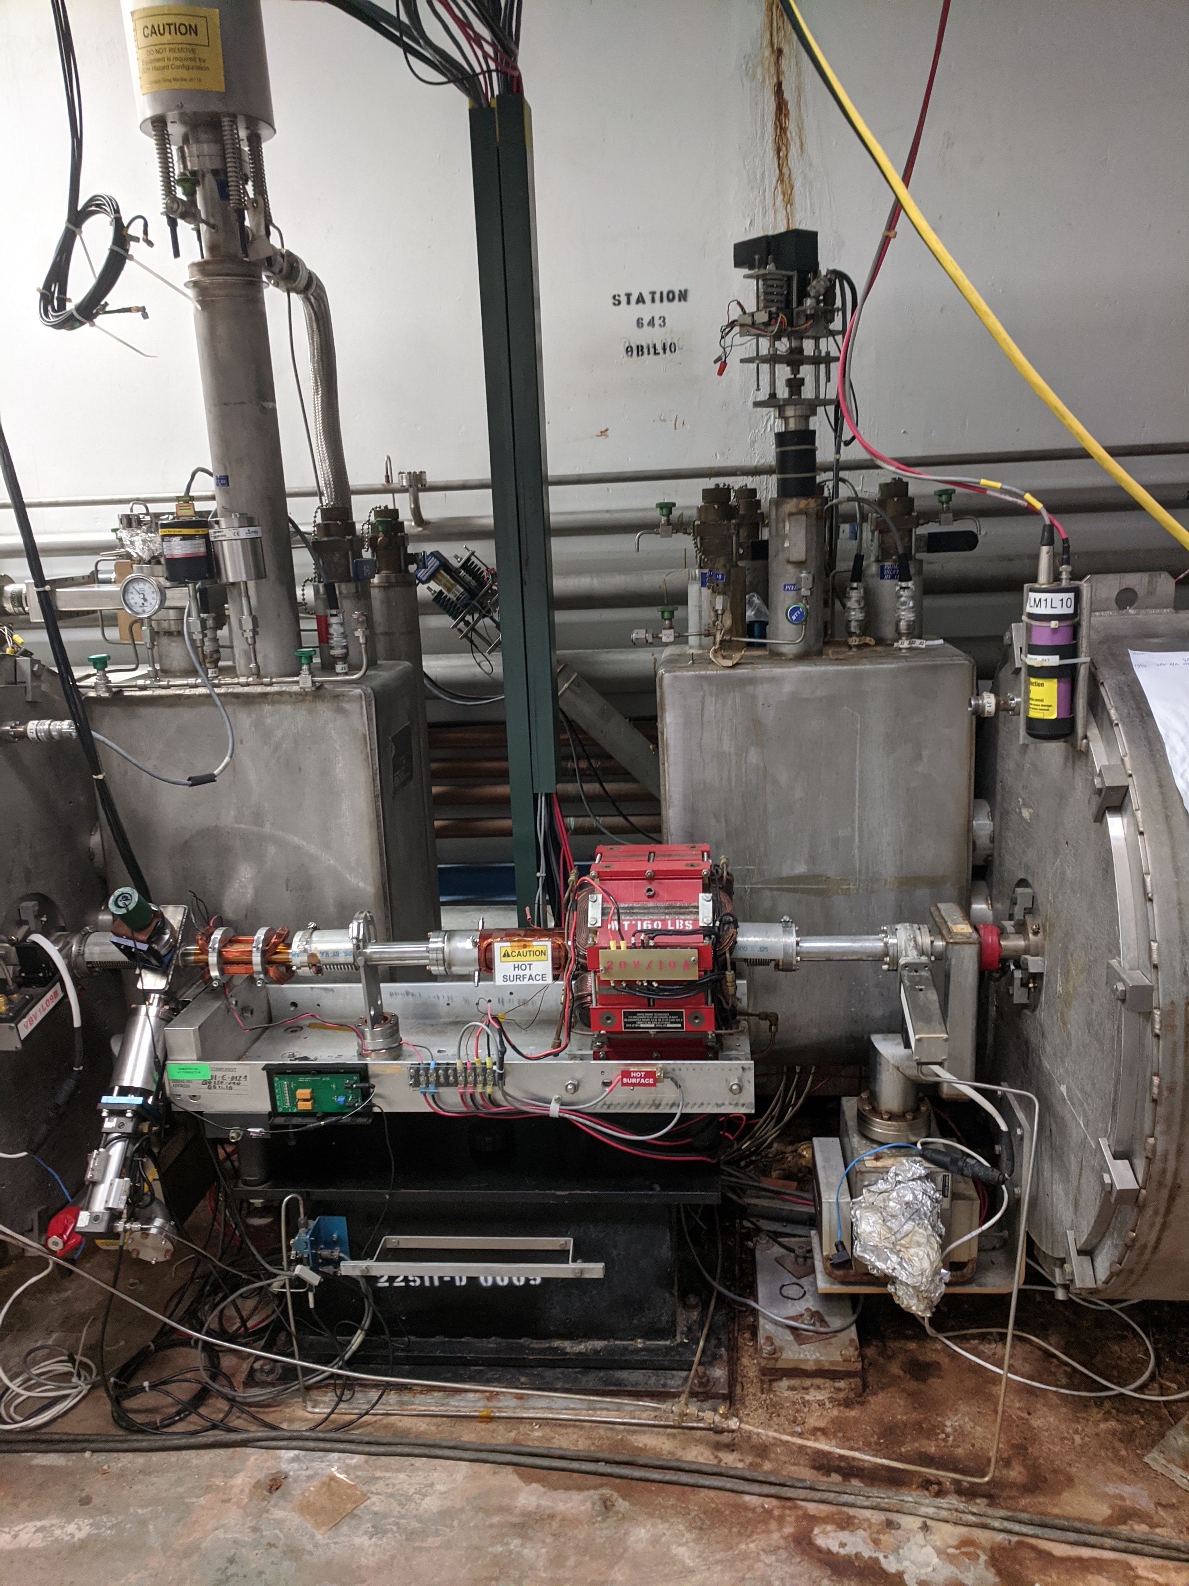
Expectations
The biggest challenge is changing expectations.
The field of SRF is still relatively young and continually improving. Every new installation improves on the previous revisions creating a new standard.
The challenge of implementing modern practices is ultimately telling ourselves what we did in the past is no longer good enough – as with all good science.
When the exception in CEBAF was always the rule – as it is in one-off repairs, how do make uniform rules and strive for repeatability.
For instance in the XFEL/LCLS-II production anything within 50meters of a SRF cavity required all metal valves, combined total vacuum pressure of contaminants below 1e-10 for every assembly and the same assembly techniques as SRF cavities – I want this for all refurbishment work in CEBAF at a minimum - I might be the only one.

Slide 3
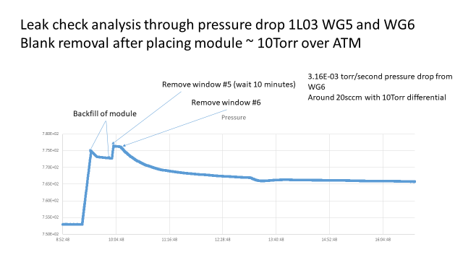
Leaks
Modern procedure for LCLS-II and C100R require no leaks; if there is a leak you stop, do whatever it takes to fix it or you don’t use the part (until the schedule dictated otherwise, unfortunately).
If we did this for CEBAF we would have to basically start over.
This week it was decided a >20sccm leak is ok to keep in the machine - ~ 6-7 order of magnitude larger than allowed on CM rebuilds.
Back to expectations – how do you tell staff you must be more careful and you must do better and then allow a item 7 orders of magnitude out of spec? (beamline to WG VAC leak, but still)

Slide 4
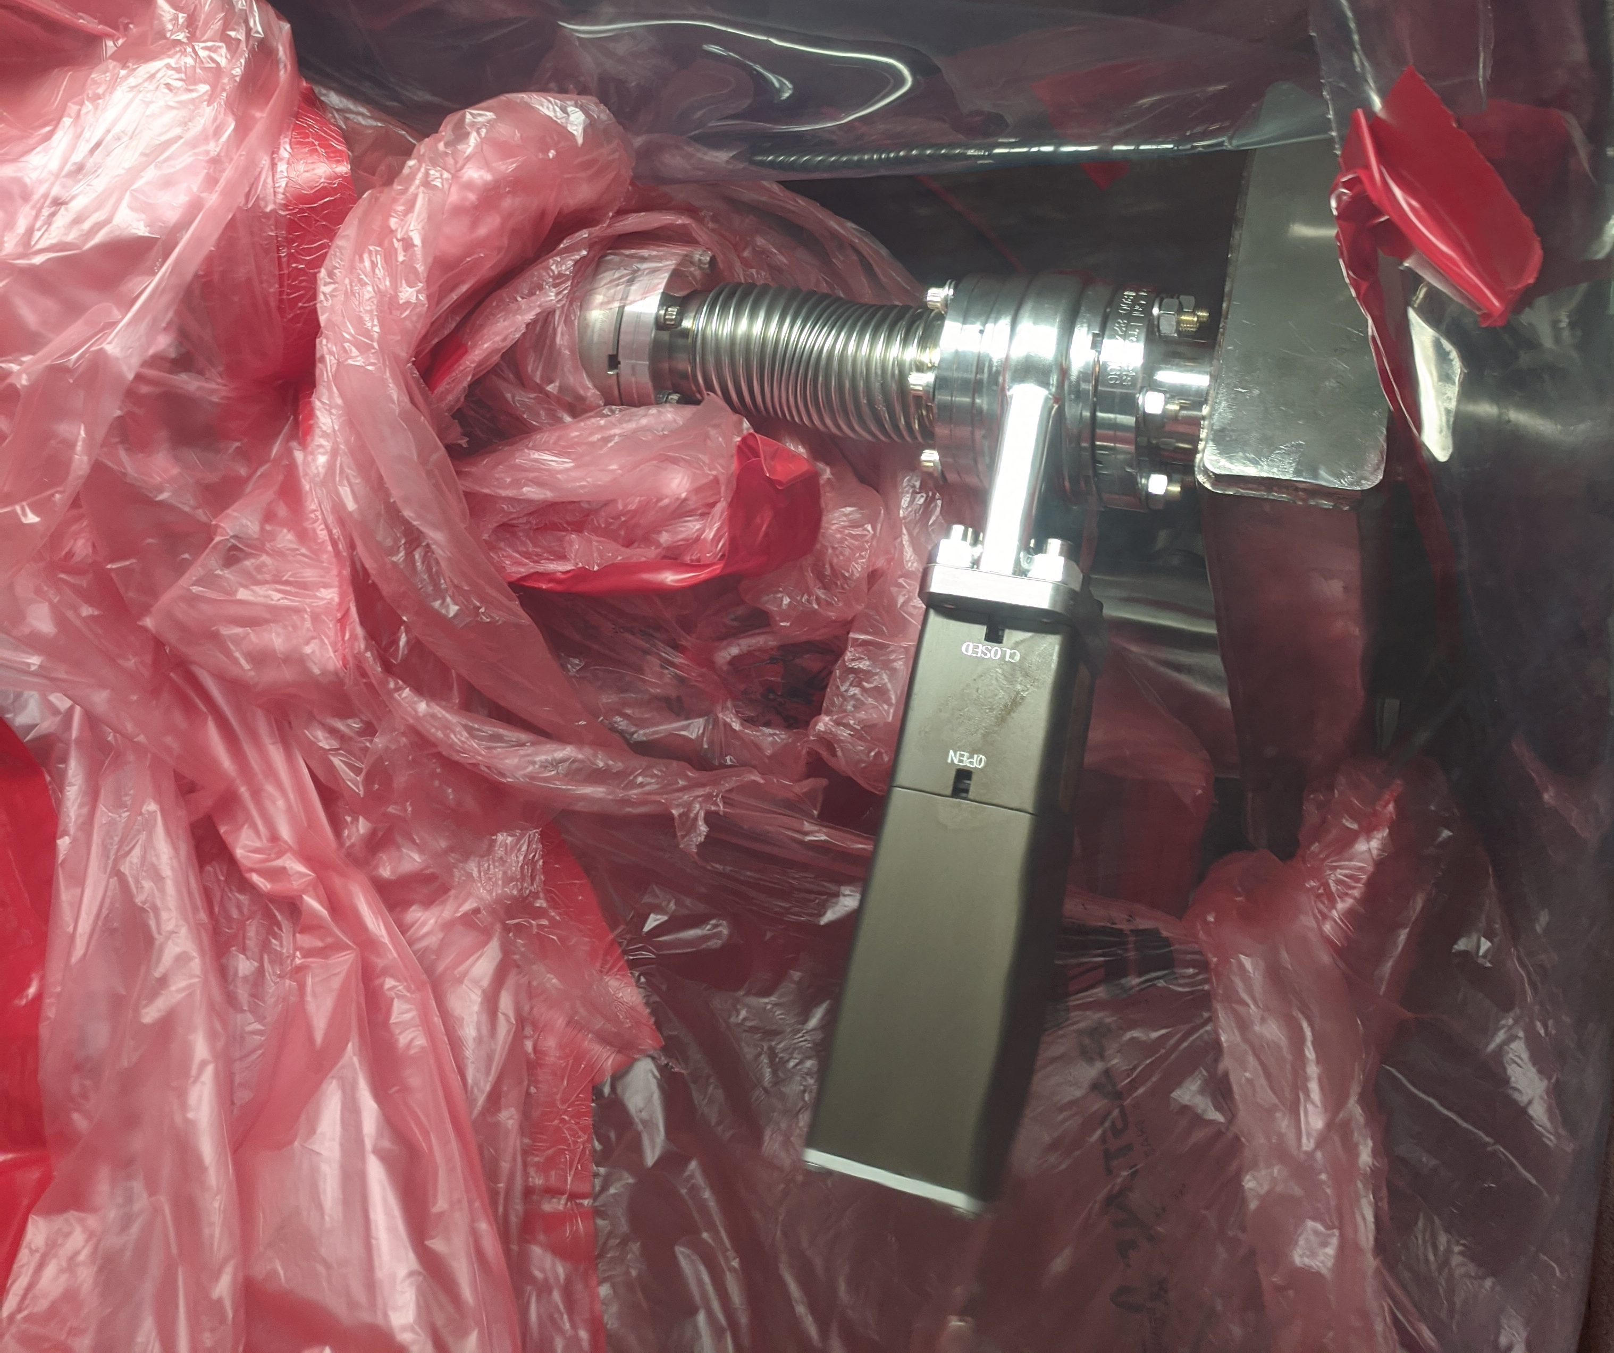
Documentation (or lack there of)
I think I have counted 5 version of this connections – all undocumented with 4 different types for hardware.
How do you prepare high quality, robust and repeatable procedures when nothing is standardizes?
Highly variable
The items in Yellow are the non-standard connections in the NL
The one-offs are every. For instance this bellows was originally installed in the wrong orientation and got kinked on a new valve installation using the “standard procedure”. In the 90’s they should have put in a custom parts rather than an off the shelf part in this location. This undocumented installation required a second re-installation and new bellows.

Slide 5
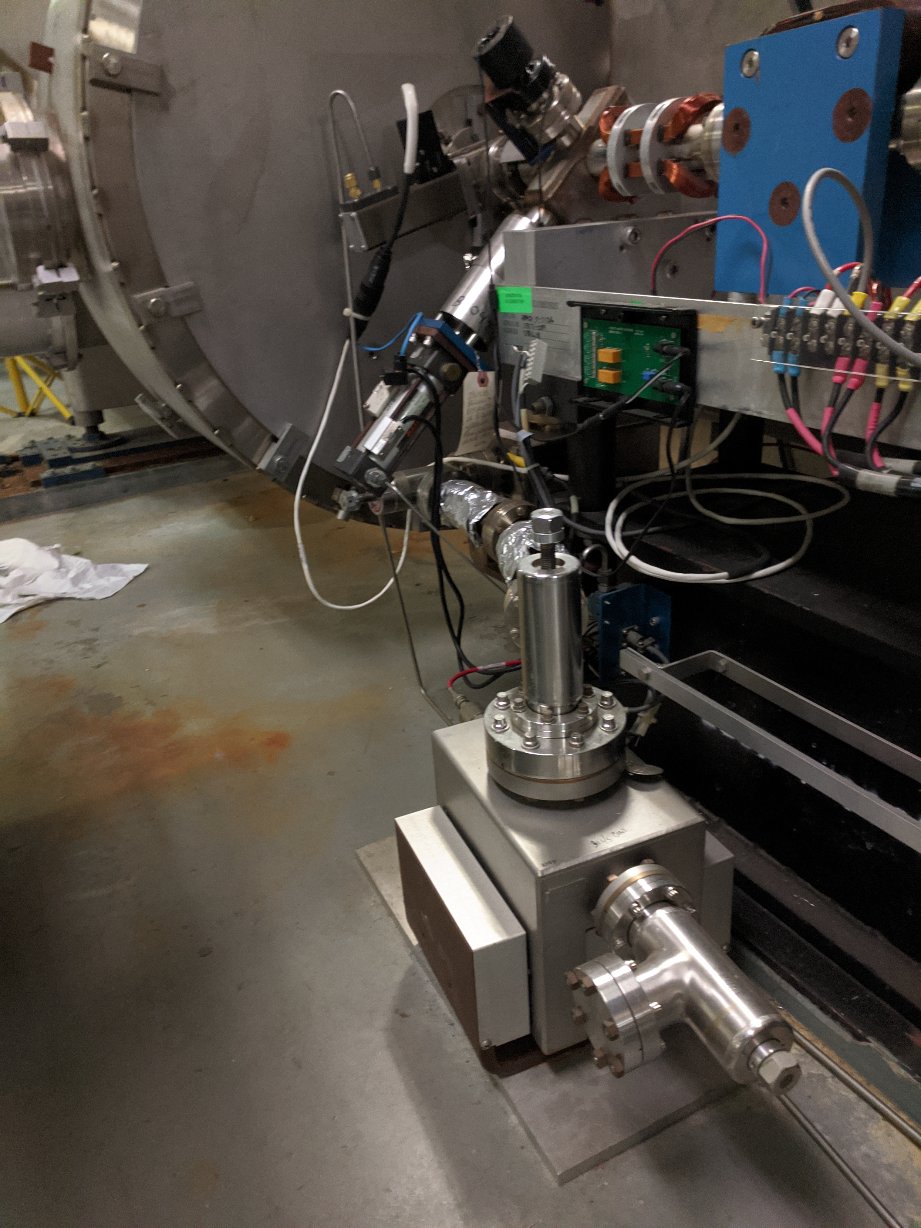
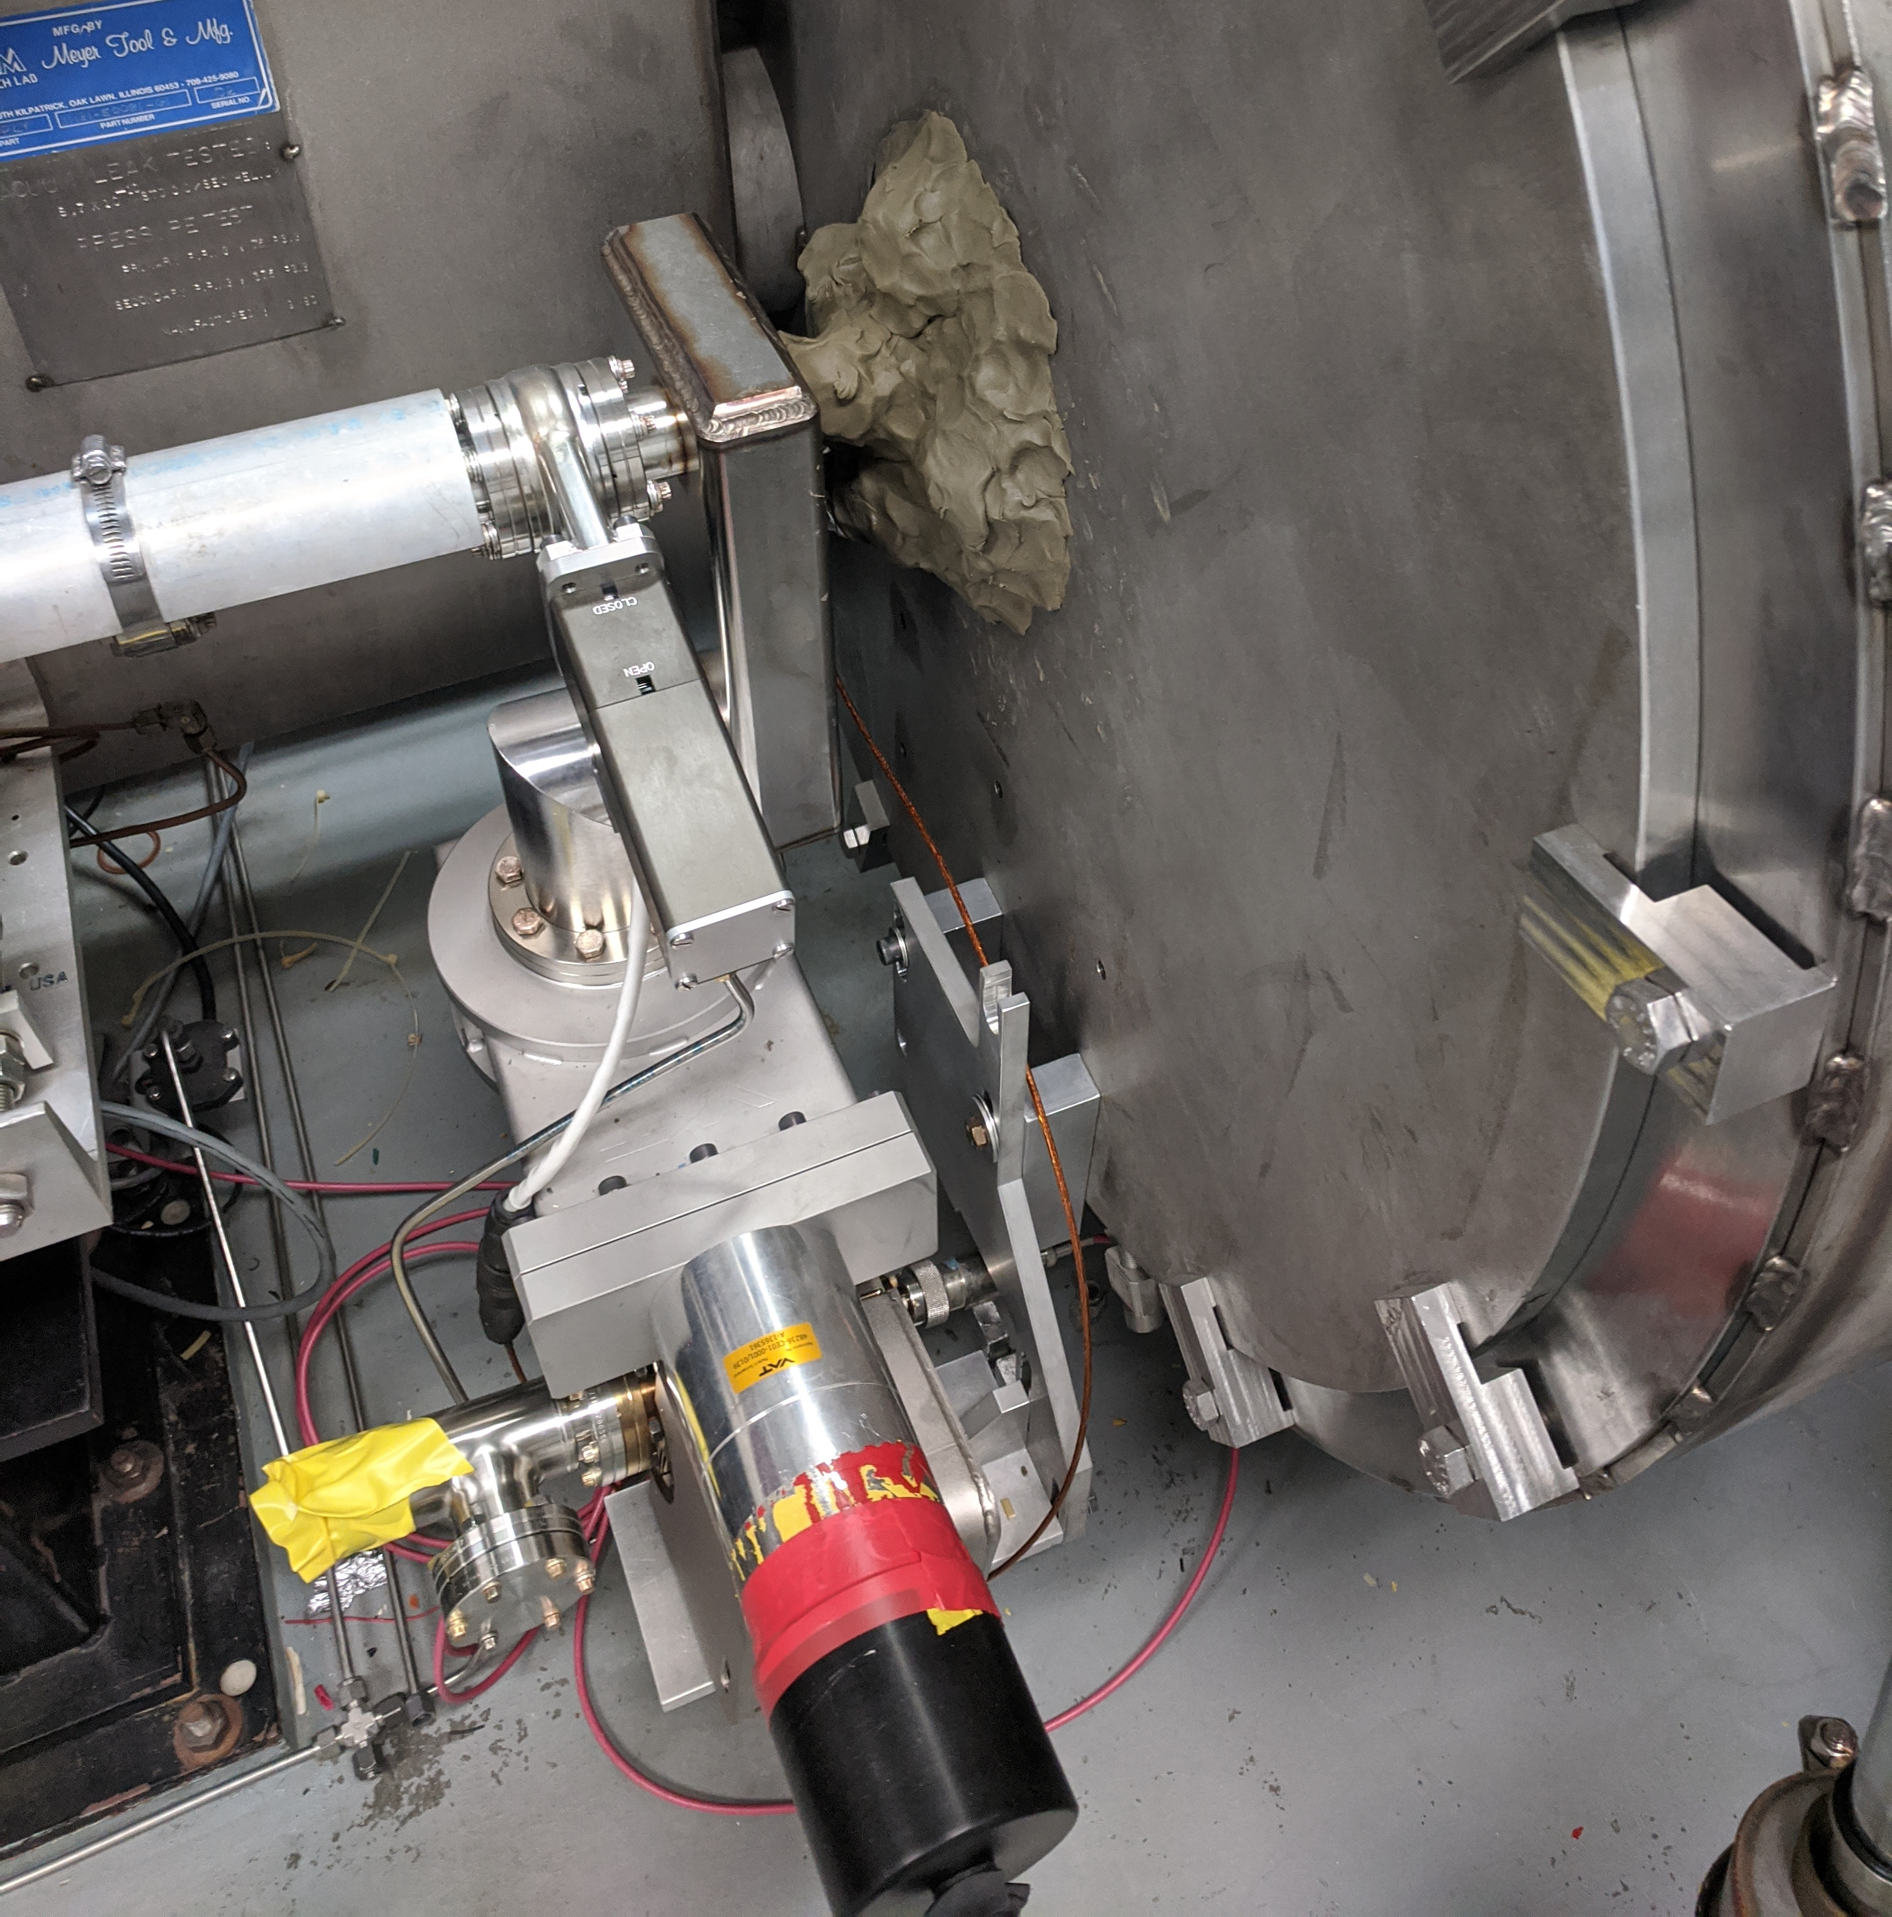
Band-aids vs cures
For years parts in the tunnel we have been patching and rigging up fixes to keep CEBAF going. This produces high pressure quick fix mentality which is not productive when it comes to repetitive, uniform rebuilds.
As we replace aging and broken parts and create permeant fixes, the quick fix and move on mentality is detrimental to doing a good job on permeant repairs.
Insulating VAC o-ring temporary repair, on a repair.
Pumping on a pump because a failed pump, with a conductance reduce ~4X.

Slide 6
Unknown’s
Highly staged procedures done in the tunnel cleanrooms are more difficult than expected
  Its hot and you have to work on your knees.
  The airfow is not optimized.
  Unlike in the SRF cleanroom, technicians in the tunnel do not practice the same techniques daily.
  Moving clean parts into the tunnel take 2x the effort compared to the SRF main cleanroom and the unknowns do not allow a quick parts grab if we want to maintain quality.
The choice to venting the entire NL all at once and the keep it at ATM while we move down the LINAC has add a dance no-one wanted, but it was require because of the unknown leaks in so many of the valves.
For the next 6 months we will stumble through the NL refurb doing our best to work through every one-off. When we do the refurbishment for the south; I strongly suggest we replace everything with new vacuum part (including bpm, viewers, ect. we are not replacing now and fully document every nut, bolt, gap and deviation before we even plan that scope.

