Slide 1
C75-01 (1L05) and P1-R (1L07) Commissioning Results
M. Drury
08/06/21

Slide 2
Outline
Commissioning Tasks
1L05 Results
1L07 Results
1L05-1

Slide 3
Commissioning Tasks
Ensure that all cavities can be tuned to 1497 MHz
Interlocks Checked
Emax and Useable Gradients
Field Emission
Q₀’s
Microphonics Measurements (C75-01)

Slide 4
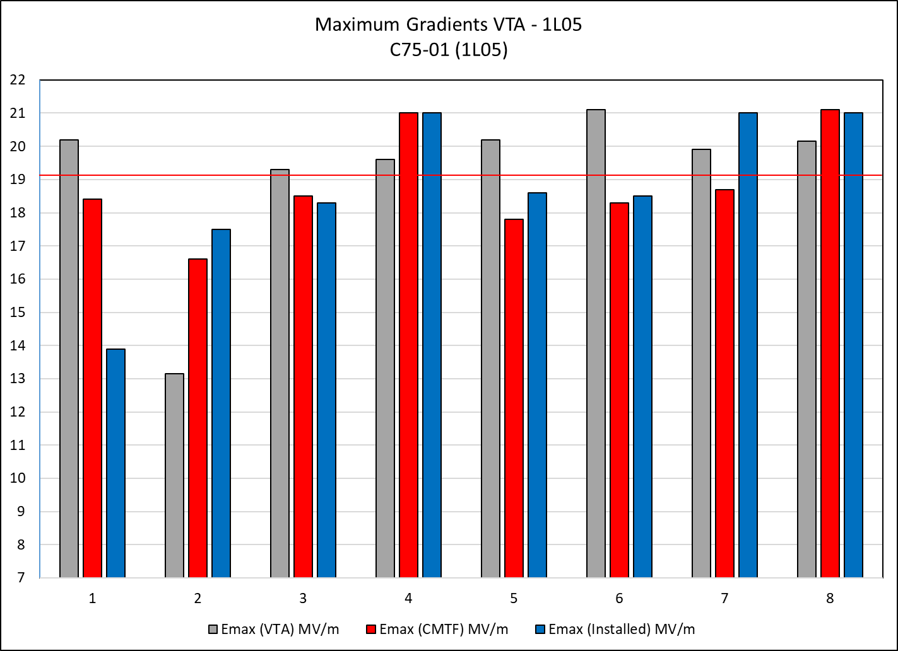
C75-01 (1L05) Gradients

Slide 5
C75-01 (1L05) Gradients

Slide 6
C75-01 Gradient Data
CMTF
Cavity | CAV SN | QextFPC | QextFP | Emax (CMTF) MV/m | Limit | 1 hour Run (MV/m)
1 | 5C75-RI-008 | 1.6E+07 | 7.5E+11 | 18.4 | Quench | 18.0
2 | 5C75-J-004 | 1.2E+07 | 3.9E+11 | 16.6 | Quench | 16.1
3 | 5C75-RI-001 | 2.3E+07 | 9.1E+11 | 18.5 | Quench | 18.1
4 | 5C75-RI-003 | 2.0E+07 | 1.1E+12 | 21.0 | Admin | 21.0
5 | 5C75-RI-002 | 1.8E+07 | 3.0E+11 | 17.8 | Quench | 17.2
6 | 5C75-RI-005 | 1.2E+07 | 2.6E+11 | 18.3 | Quench | 17.7
7 | 5C75-RI-007 | 1.6E+07 | 5.2E+11 | 18.7 | Quench | 18.1
8 | 5C75-RI-006 | 1.6E+07 | 4.3E+11 | 21.1 | Quench | 20.6
Installed |  |  |  |  |  | 72.1
Cavity | CAV SN | QextFPC | QextFP | Emax (MV/m) | Limit | 1 hour Run (MV/m) | 8 Cavity Run (MV/m) | SRF DRVH (MV/m)
1 | 5C75-RI-008 | 1.1E+07 | 6.8E+11 | 13.9 | Quench / MP | 13.5 | 13.0 | 13.0
2 | 5C75-J-004 | 1.7E+07 | 3.3E+11 | 17.5 | Quench / MP | 17.0 | 17.0 | 11.1
3 | 5C75-RI-001 | 2.5E+07 | 6.1E+11 | 18.3 | Quench | 17.8 | 17.8 | 17.8
4 | 5C75-RI-003 | 1.8E+07 | 1.1E+12 | 21.0 | Admin | 21.0 | 21.0 | 20.5
5 | 5C75-RI-002 | 2.2E+07 | 2.3E+11 | 18.6 | Quench / MP | 17.5 | 17.5 | 15.4
6 | 5C75-RI-005 | 1.6E+07 | 2.2E+11 | 18.5 | Quench | 18.0 | 17.5 | 17.5
7 | 5C75-RI-007 | 1.9E+07 | 3.5E+11 | 21.0 | Admin | 20.5 | 20.5 | 18.9
8 | 5C75-RI-006 | 1.7E+07 | 4.4E+11 | 21.0 | Admin | 21.0 | 21.0 | 19.4
Total Voltage = 65.7 MV

Slide 7
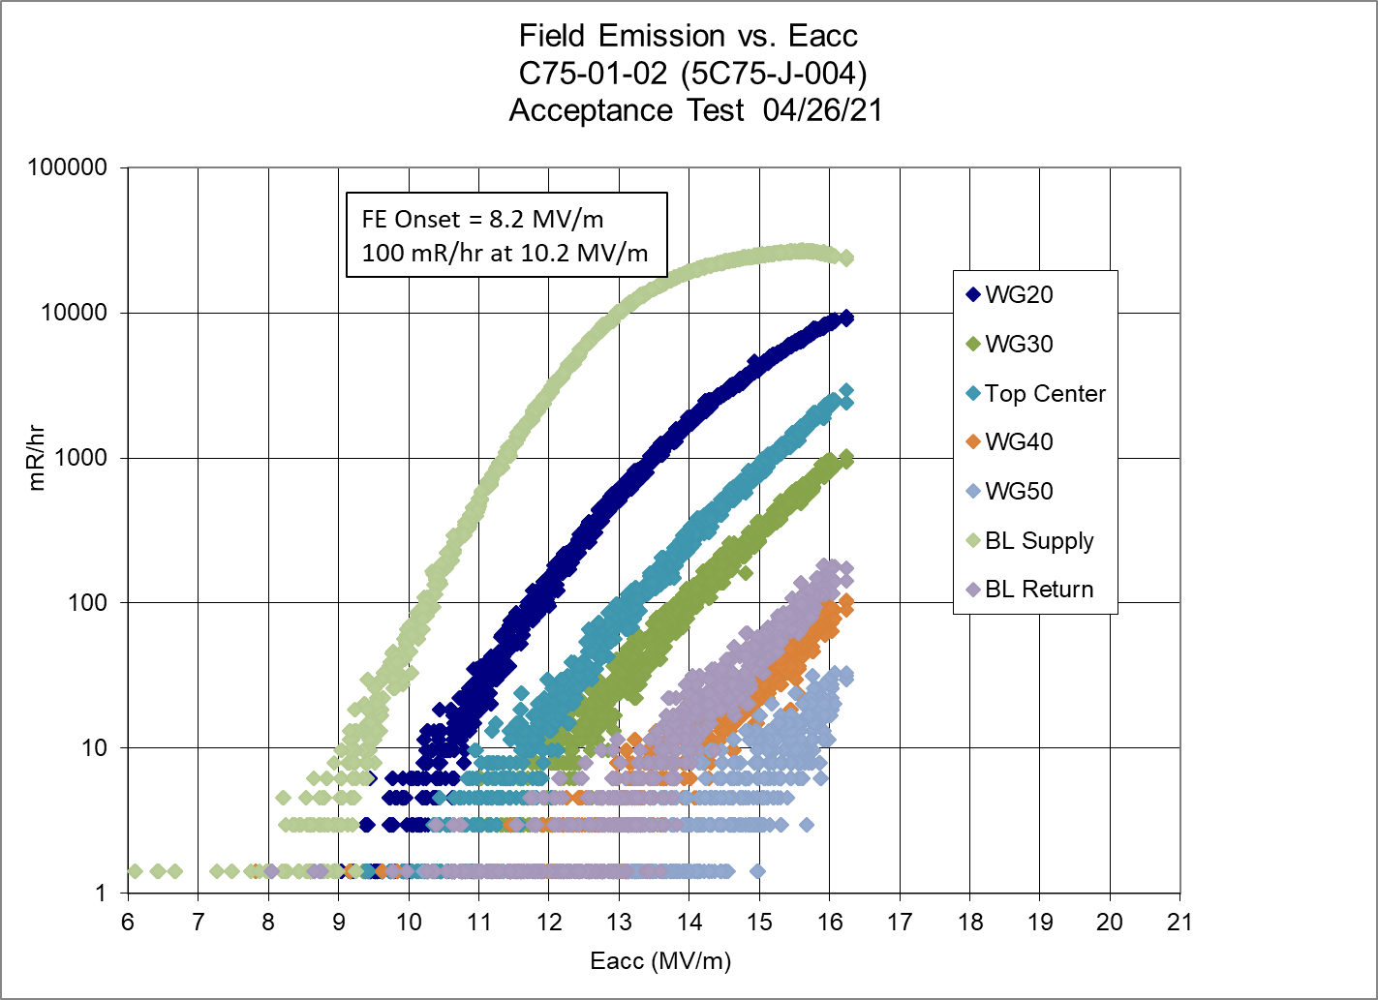
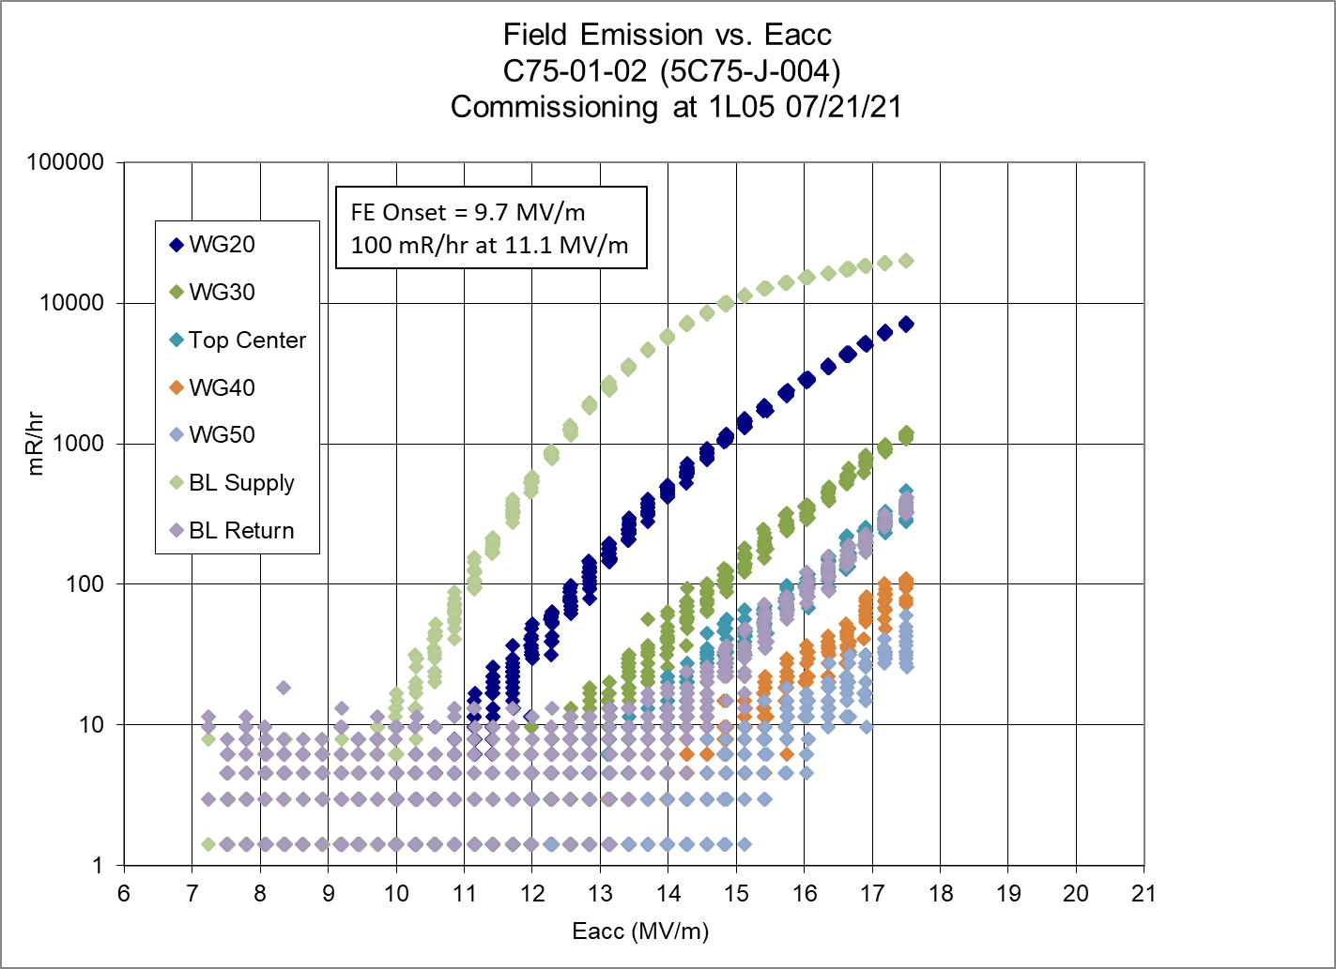
Field Emission Cavity 2
No neutron activity measured for these cavities in CMTF

Slide 8
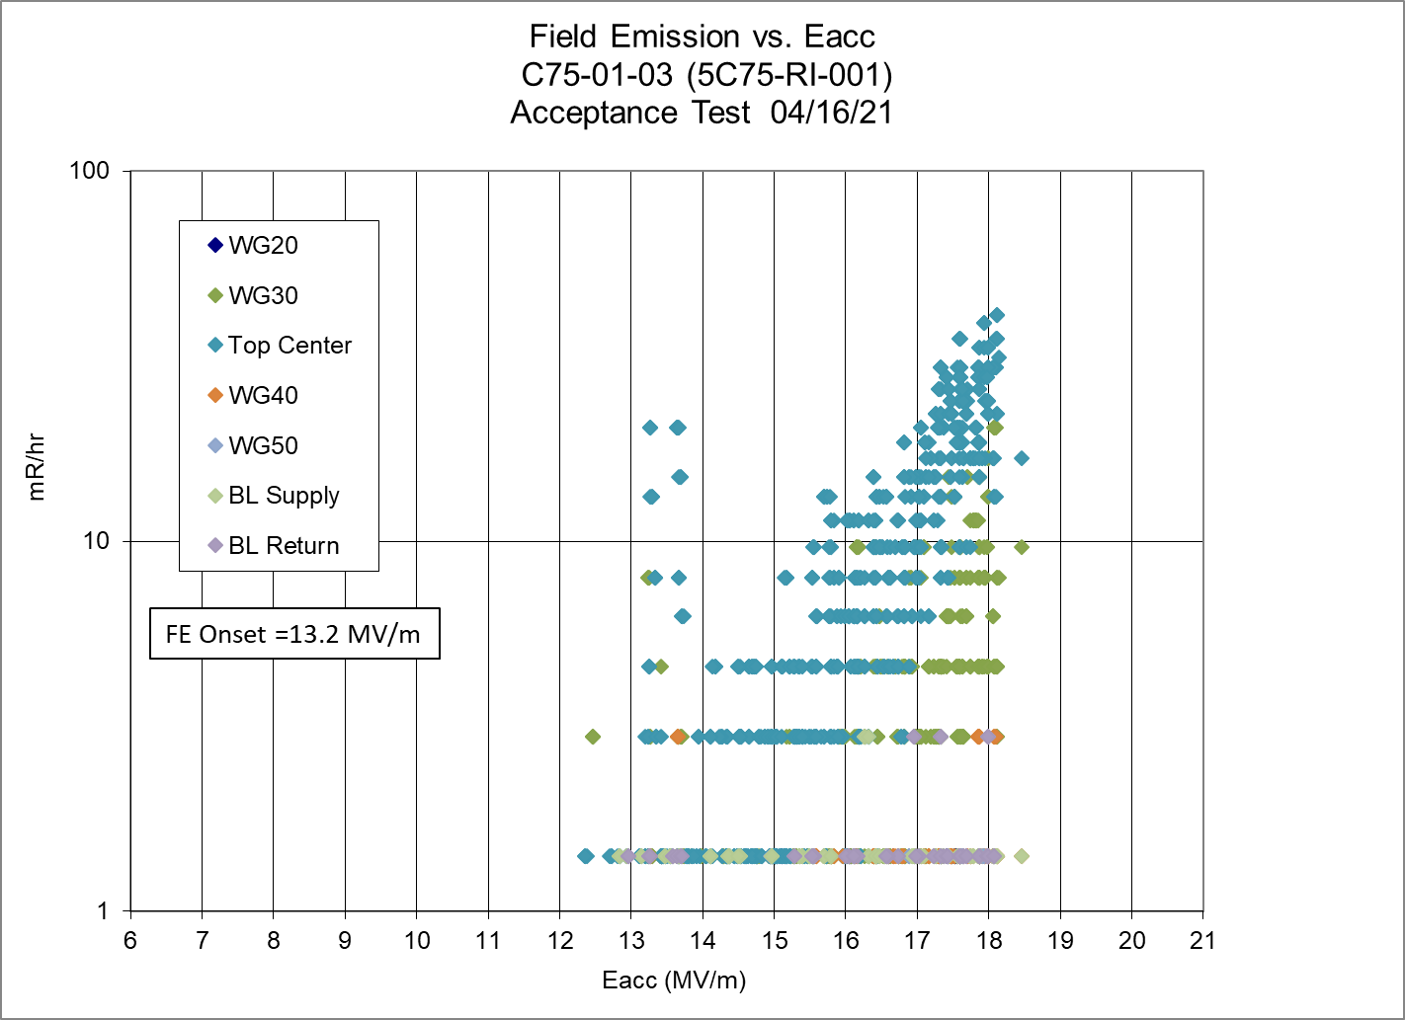
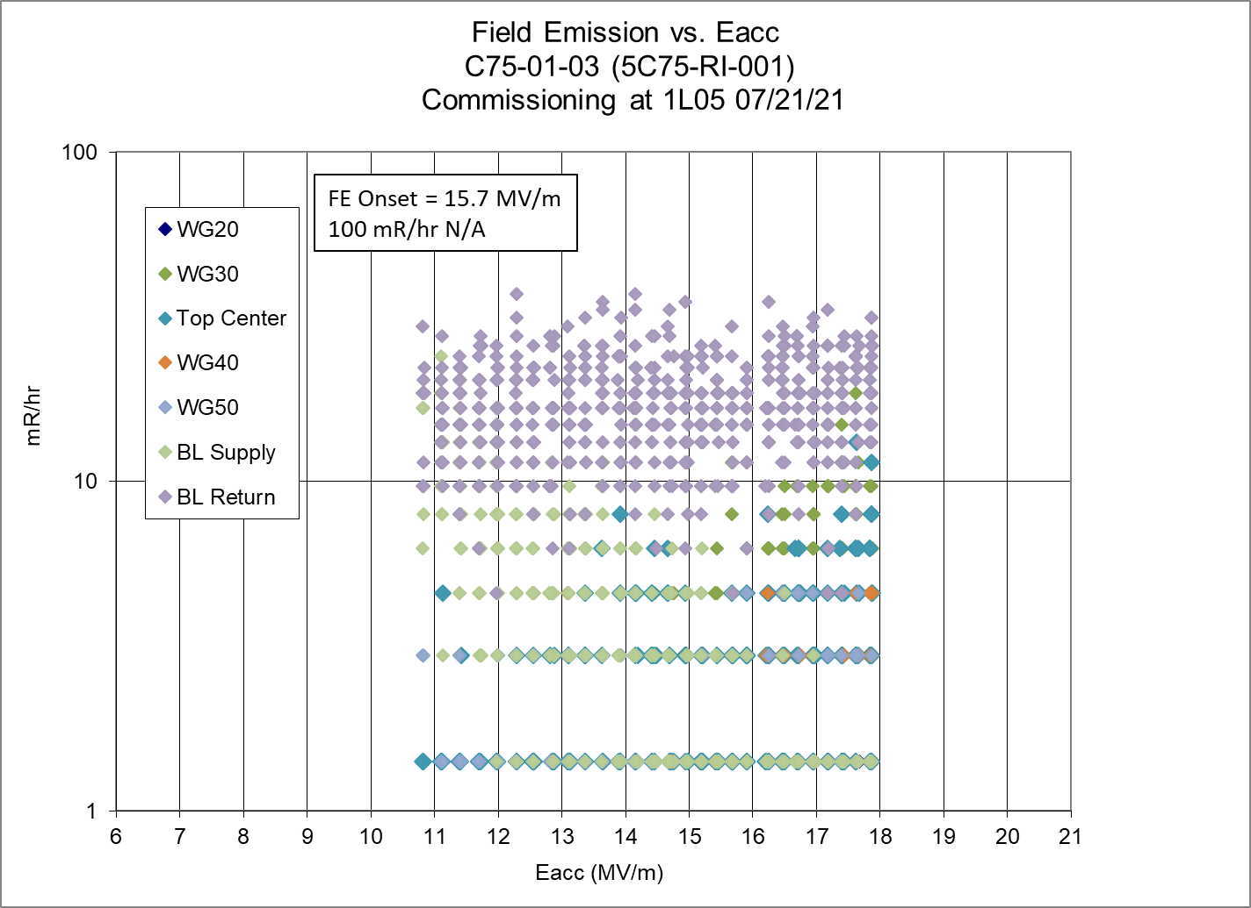
Field Emission Cavity 3

Slide 9
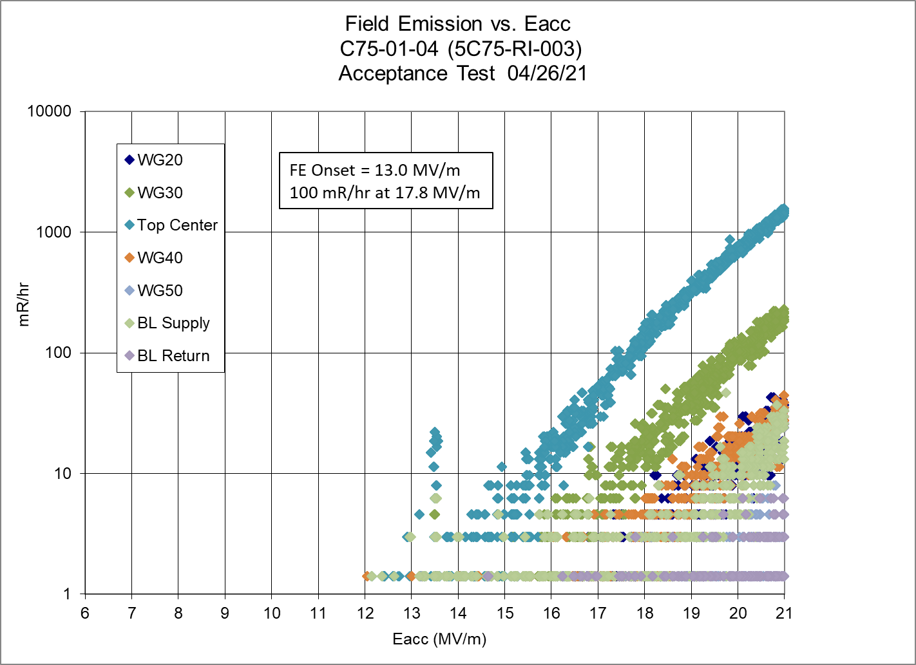
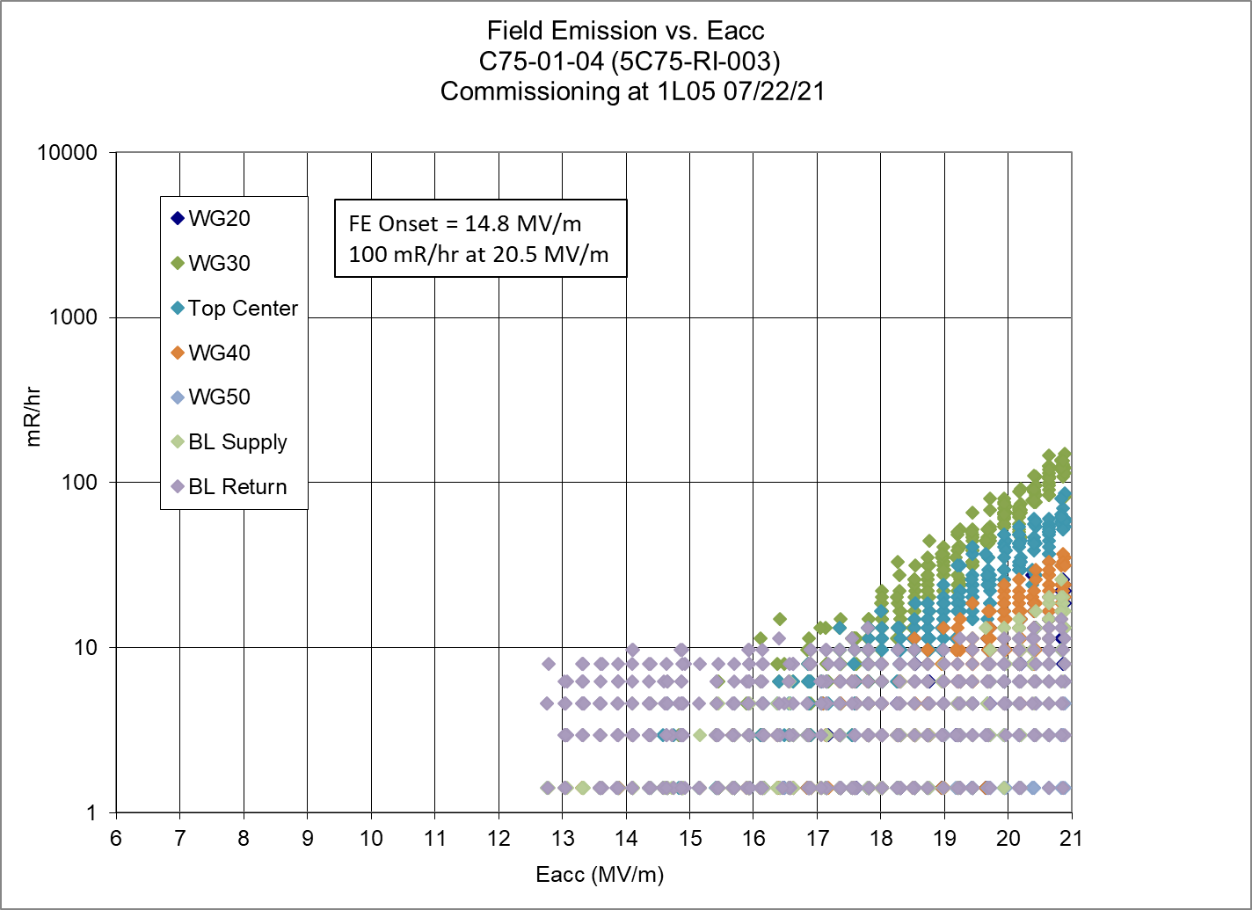
Field Emission Cavity 4

Slide 10
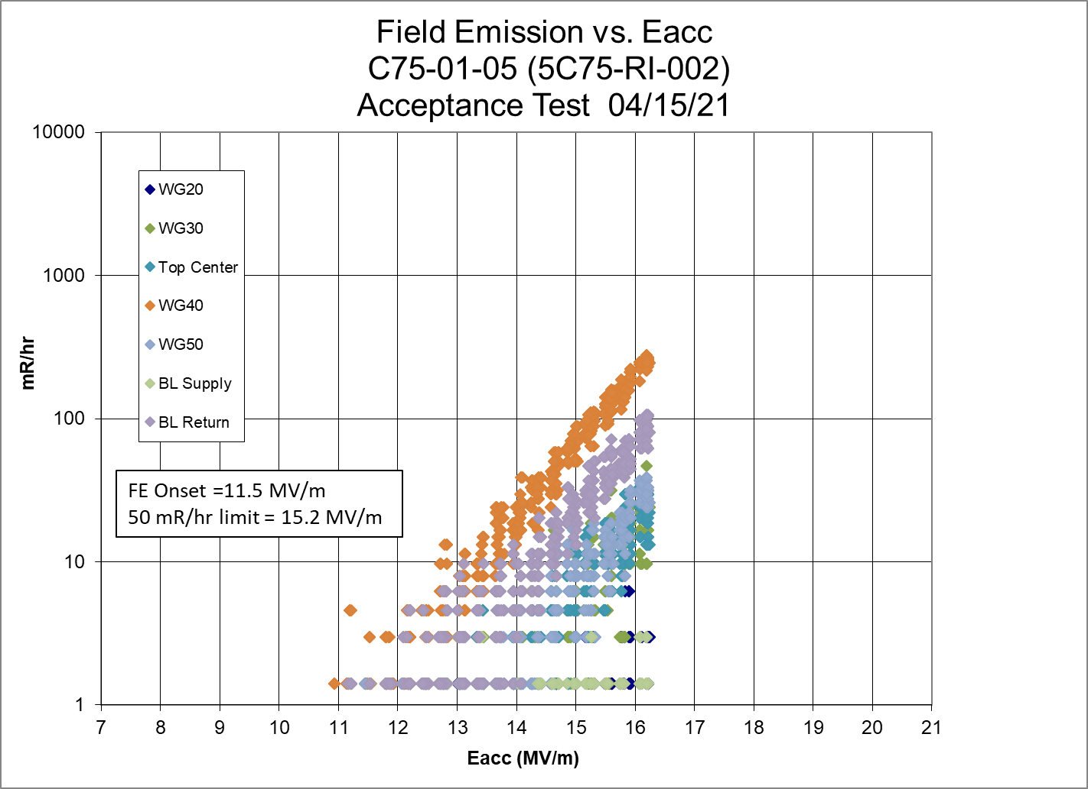
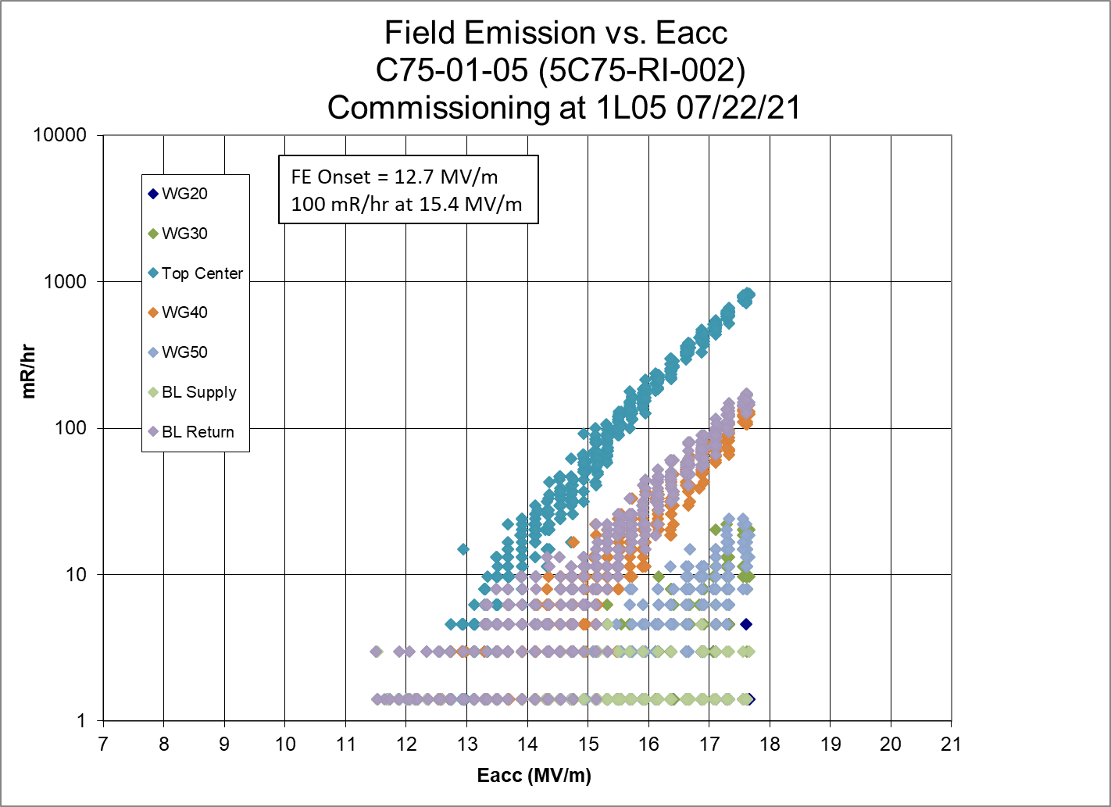
Field Emission Cavity 5

Slide 11
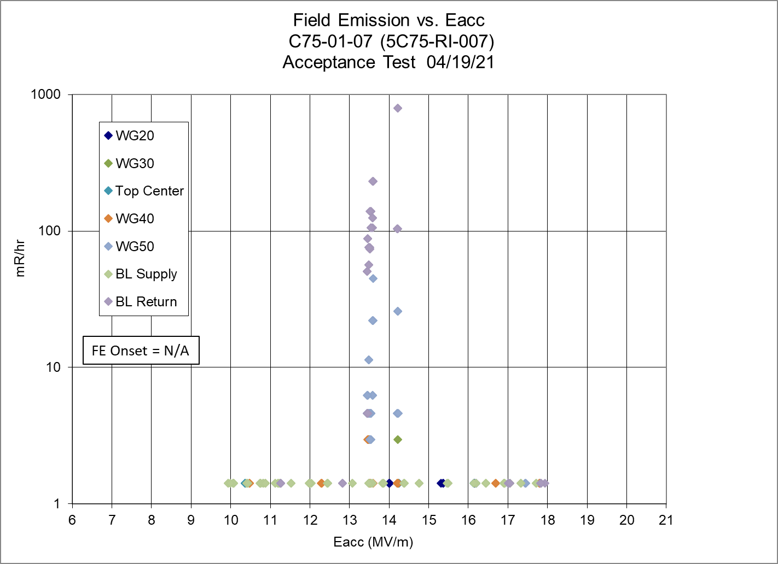
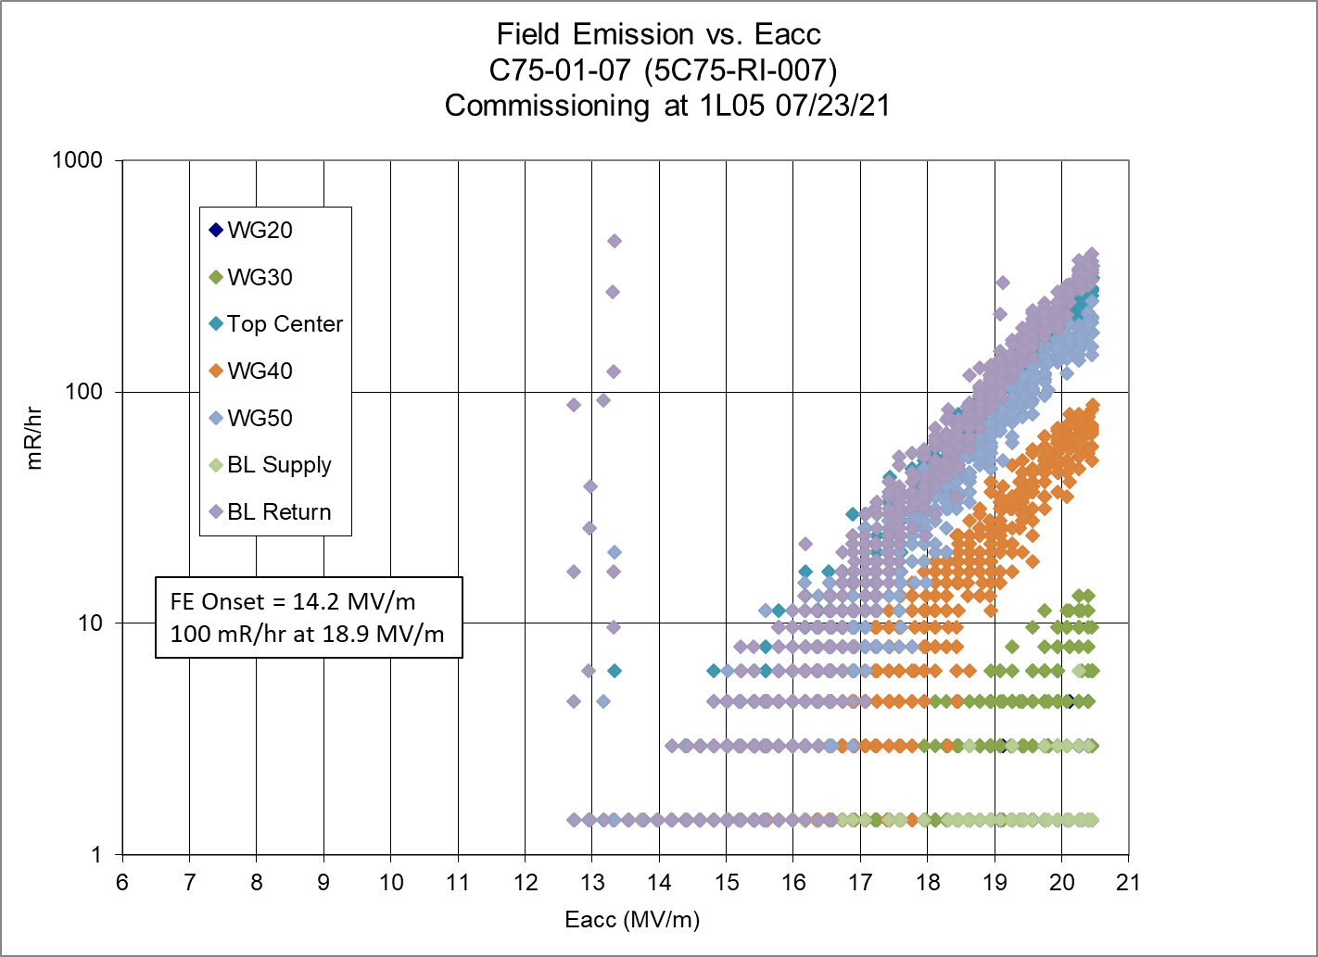
Field Emission Cavity 6

Slide 12
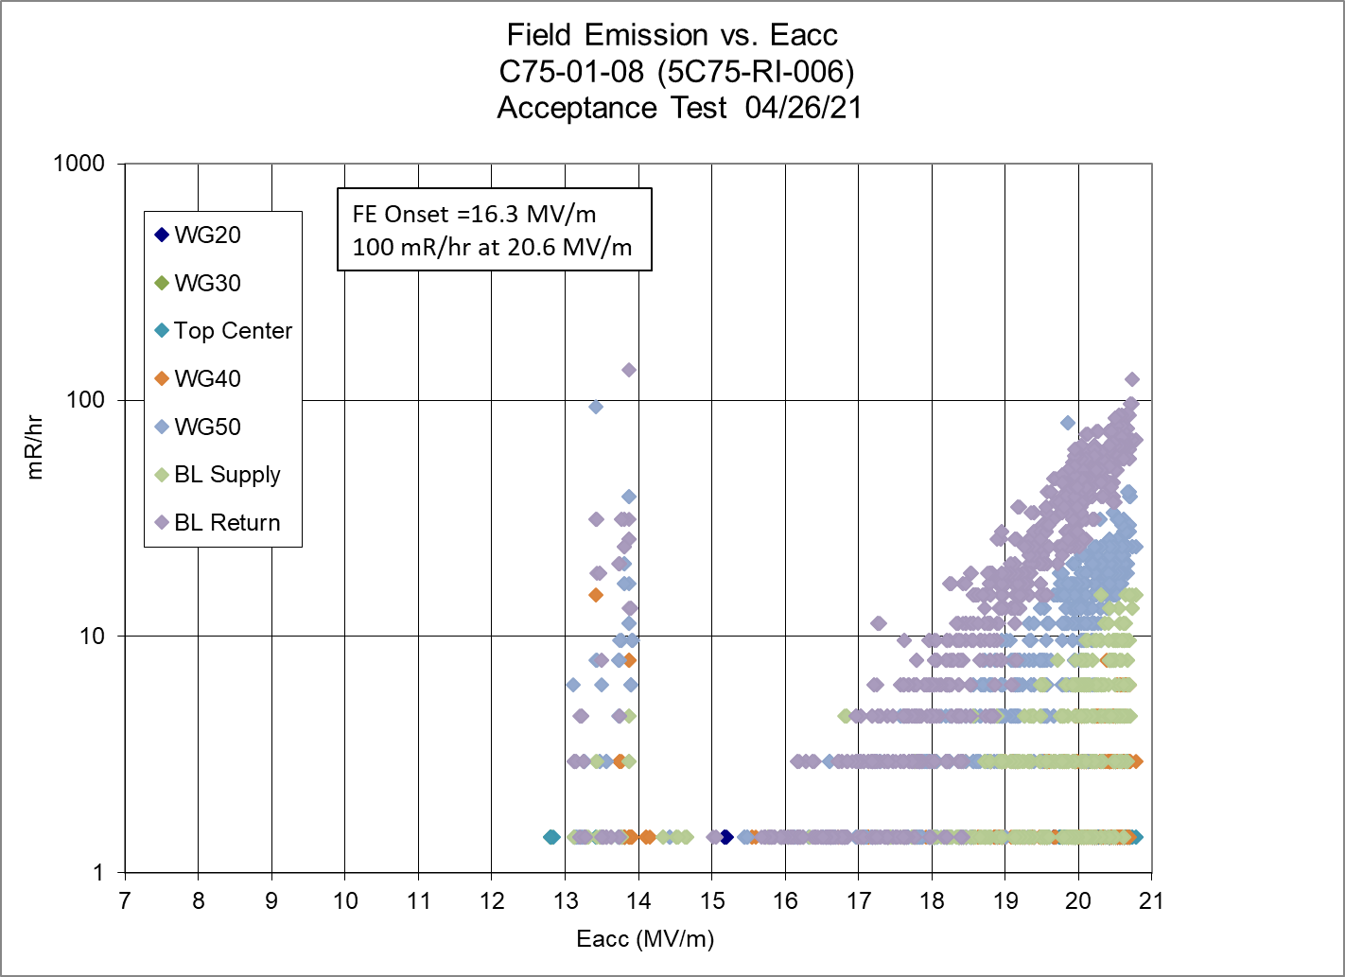
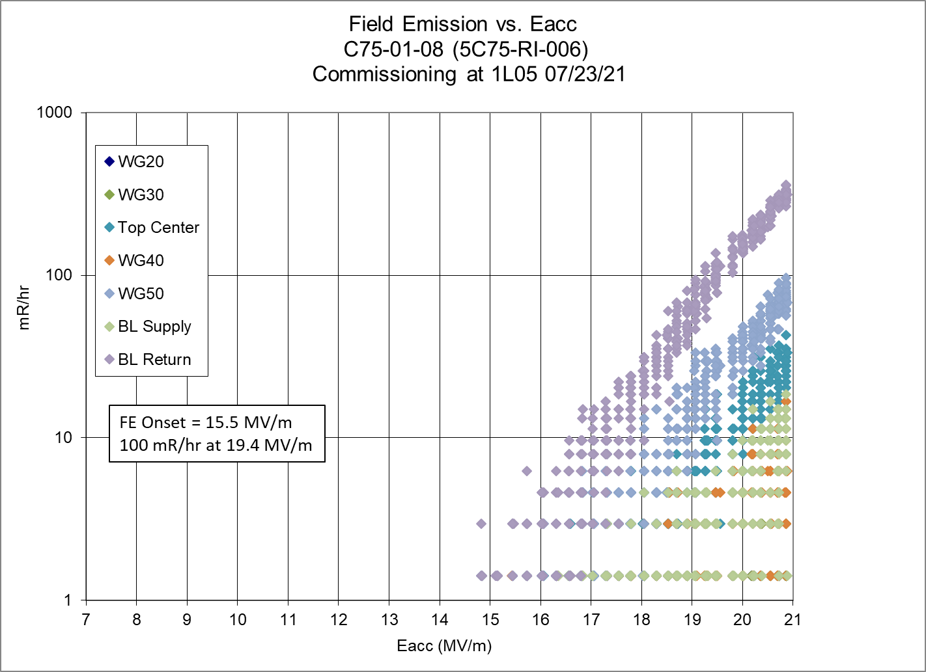
Field Emission Cavity 8

Slide 13
Field Emission Limits on Gradient C75-01
CMTF
Cavity | No FE consideration | No FE | 50 mR/hr limit | 100 mR/hr limit | 1 R/hr limit
1 | 18.0 | 18.0 | 18.0 | 18.0 | 18.0
2 | 16.1 | 8.2 | 10.0 | 10.3 | 11.3
3 | 18.1 | 13.2 | 18.1 | 18.1 | 18.1
4 | 21.0 | 13.0 | 17.2 | 17.8 | 20.4
5 | 17.2 | 11.1 | 14.6 | 15.2 | 17.2
6 | 17.7 | 17.7 | 17.7 | 17.7 | 17.7
7 | 18.1 | 18.1 | 18.1 | 18.1 | 18.1
8 | 20.6 | 16.3 | 20.2 | 20.6 | 20.6
Total Energy | 71.9 | 56.6 | 65.6 | 66.5 | 69.3
Installed
Cavity | No FE consideration | No FE | 50 mR/hr limit | 100 mR/hr limit | 1 R/hr limit
1 | 13.5 | 13.5 | 13.5 | 13.5 | 13.5
2 | 17.0 | 9.7 | 10.9 | 11.1 | 12.4
3 | 17.8 | 15.8 | 17.8 | 17.8 | 17.8
4 | 21.0 | 14.8 | 19.7 | 20.5 | 21.0
5 | 17.5 | 12.7 | 14.9 | 15.4 | 17.5
6 | 18.0 | 18.0 | 18.0 | 18.0 | 18.0
7 | 20.5 | 14.2 | 18.2 | 18.9 | 20.5
8 | 21.0 | 15.5 | 18.8 | 19.4 | 21.0
Total Energy | 71.7 | 56.0 | 64.6 | 66.0 | 69.4

Slide 14
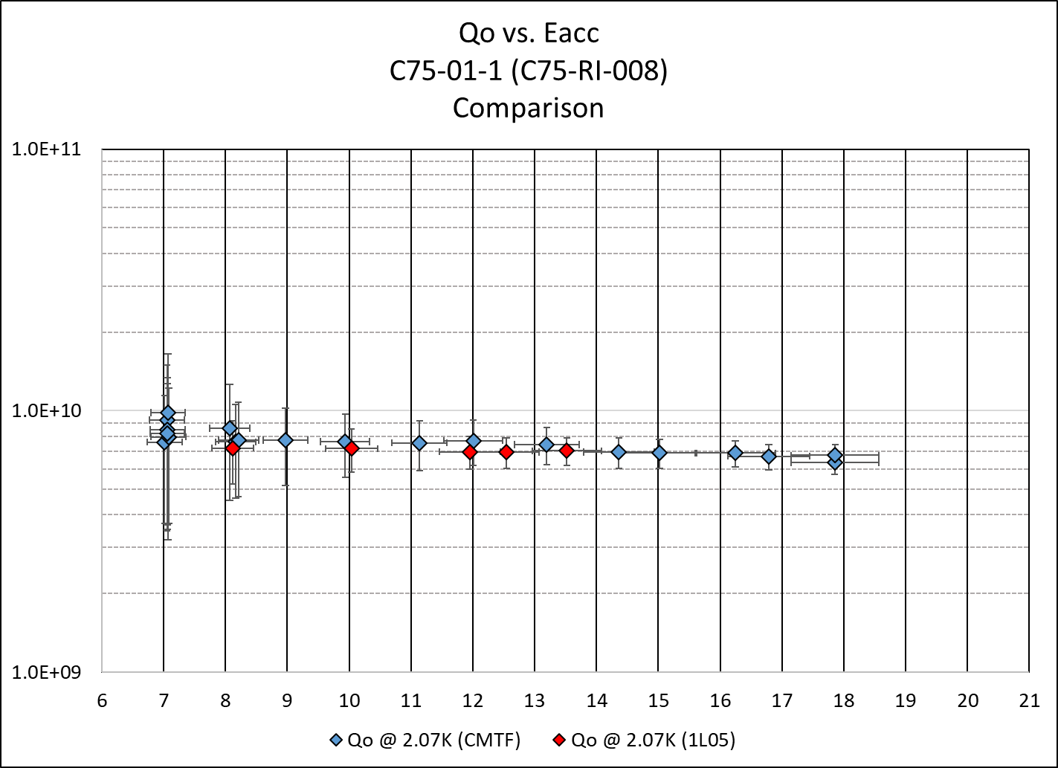
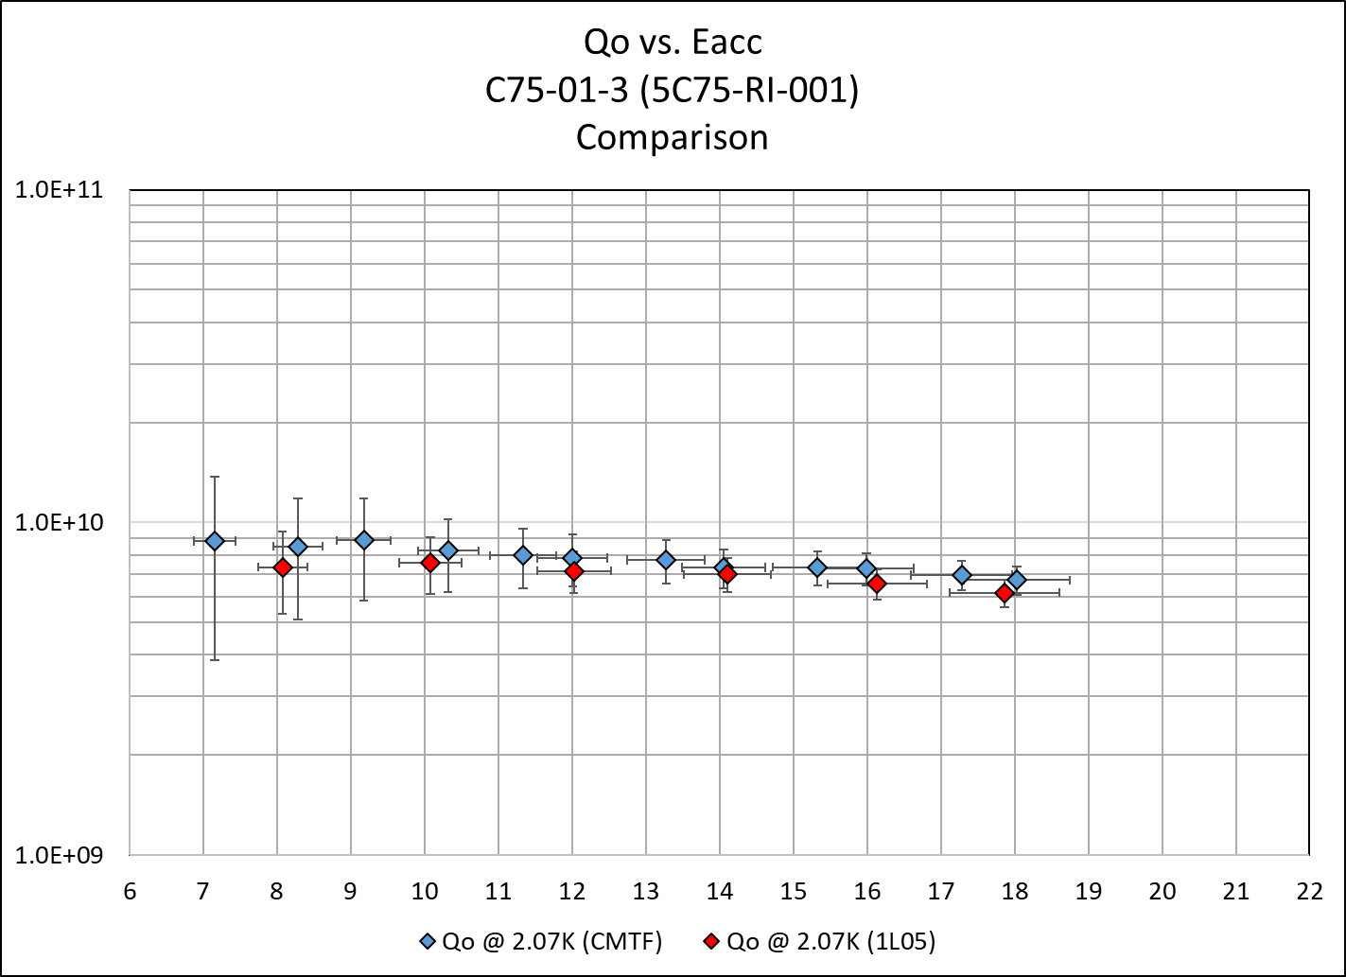
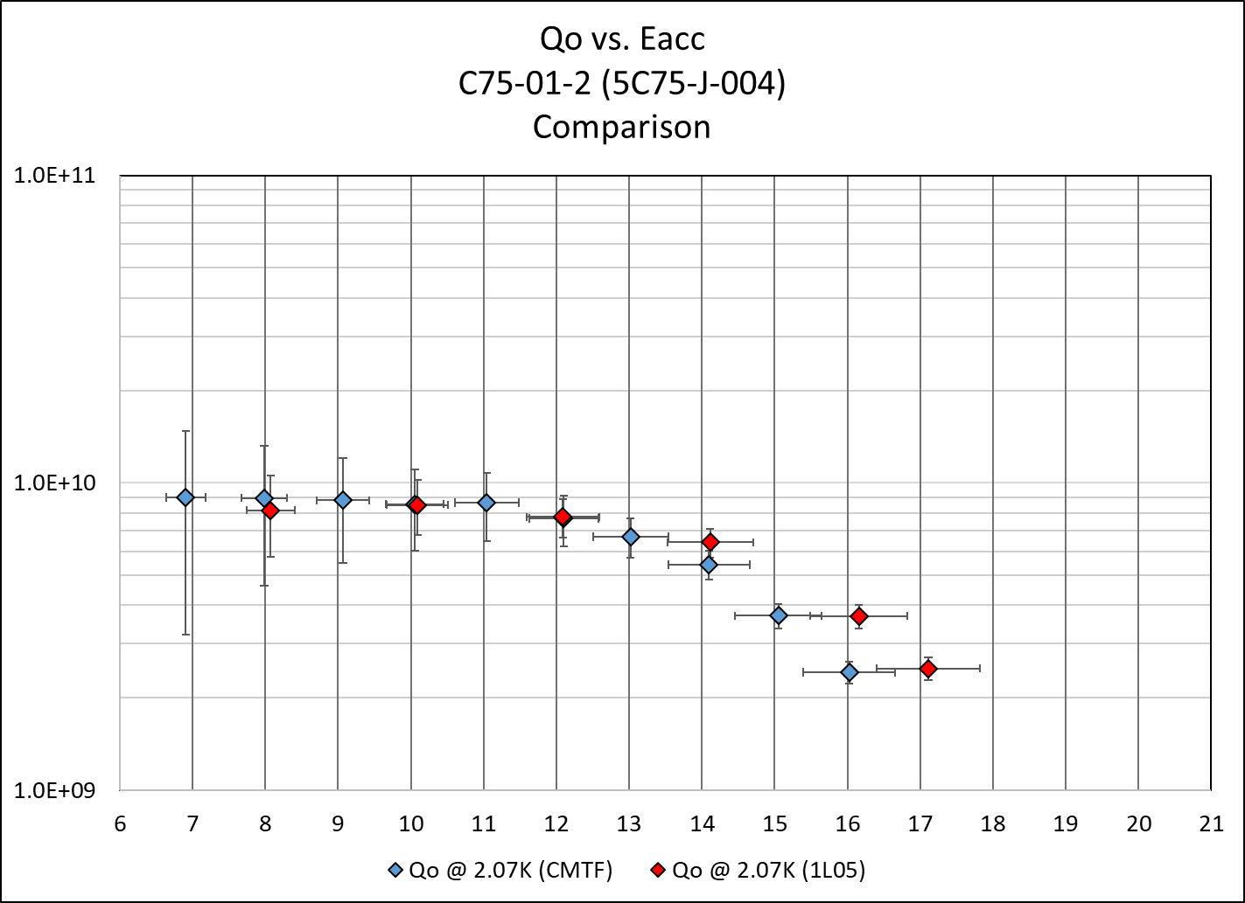
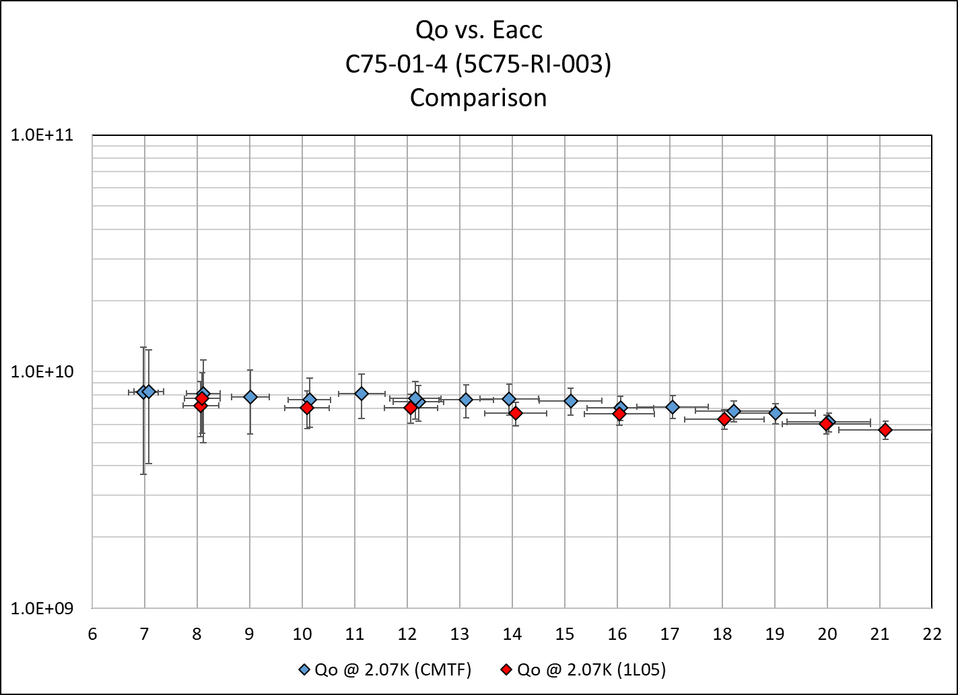
Q0 Measurements C75-01 1- 4

Slide 15
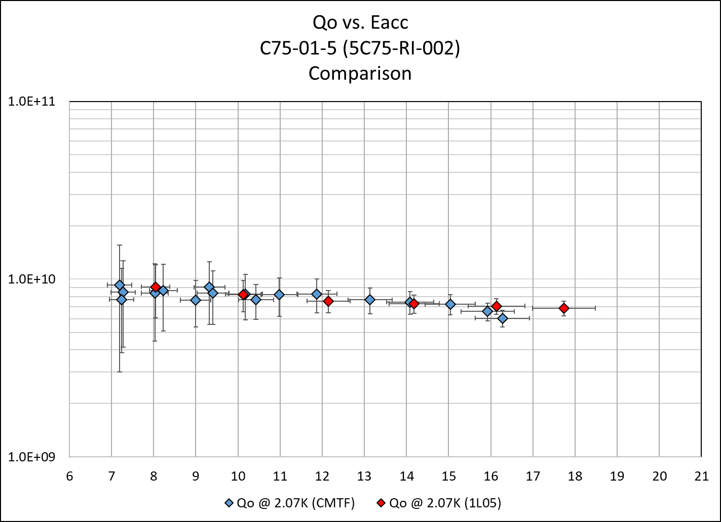
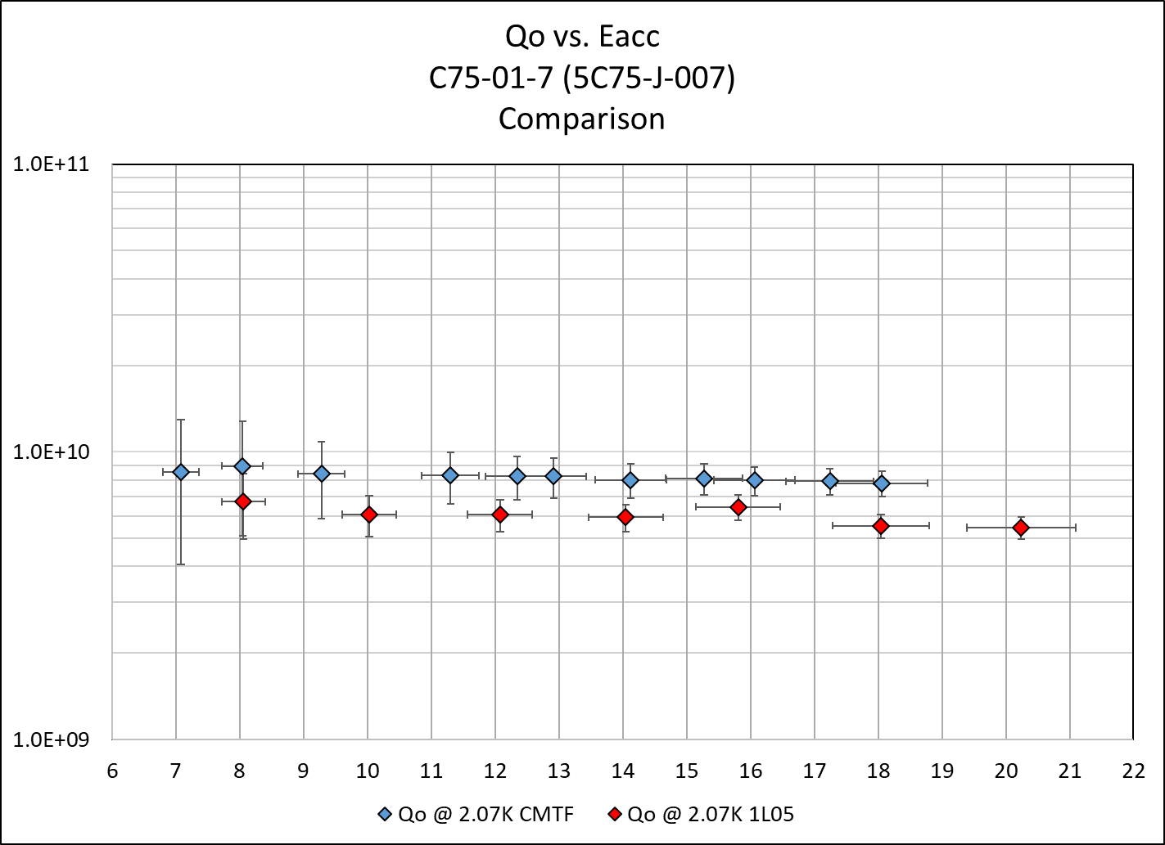
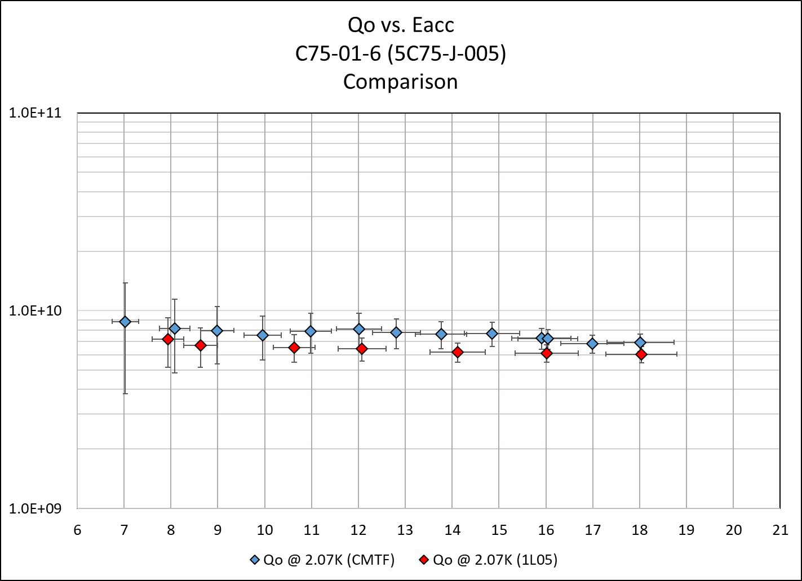
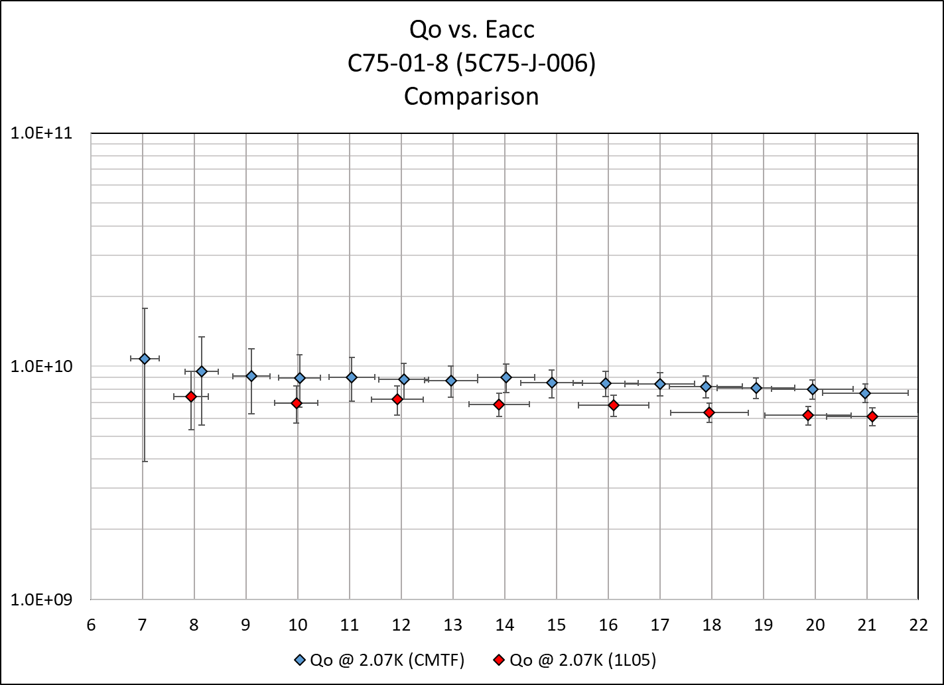
Q₀ Measurements C75-01 (5 - 8)

Slide 16
Q₀ Measurements C75-01
CMTF
Cavity | CAV SN | Qo @ 8 MV/m (2.07 K) | Qo @ 1hr run (2.07K) | Qo @ 19.1 MV/m (2.07K) | Heat Load @ SRF DRVH’s (W)
1 | 5C75-RI-008 | 8.3E+09 | 6.7E+09
2 | 5C75-J-004 | 9.0E+09 | 2.2E+09
3 | 5C75-RI-001 | 8.7E+09 | 6.7E+09
4 | 5C75-RI-003 | 8.1E+09 | 6.6E+09 | 6.7E+09
5 | 5C75-RI-002 | 8.4E+09 | 6.1E+09
6 | 5C75-RI-005 | 8.3E+09 | 6.8E+09
7 | 5C75-RI-007 | 8.6E+09 | 7.8E+09
8 | 5C75-RI-006 | 9.8E+09 | 7.7E+09 | 8.0E+09
Installed
Cavity | CAV SN | Qo @ 8 MV/m (2.07 K) | Qo @ 1hr run (2.07K) | Qo @ 19.1 MV/m (2.07K)
1 | 5C75-RI-008 | 7.3E+09 | 7.0E+09 |  | 11.1
2 | 5C75-J-004 | 8.1E+09 | 2.4E+09 |  | 7.0
3 | 5C75-RI-001 | 7.4E+09 | 6.4E+09 |  | 23.8
4 | 5C75-RI-003 | 7.4E+09 | 5.8E+09 | 6.1E+09 | 33.0
5 | 5C75-RI-002 | 9.0E+09 | 6.9E+09 |  | 15.5
6 | 5C75-RI-005 | 7.0E+09 | 6.1E+09 |  | 23.3
7 | 5C75-RI-007 | 5.9E+09 | 5.1E+09 | 5.2E+09 | 29.2
8 | 5C75-RI-006 | 7.3E+09 | 6.1E+09 | 6.3E+09 | 27.6
Total Heat at 65.7 MV = 170.5 W

Slide 17
Tuner Curves C75-01

Slide 18
Typical Static Lorentz C75-01

Slide 19
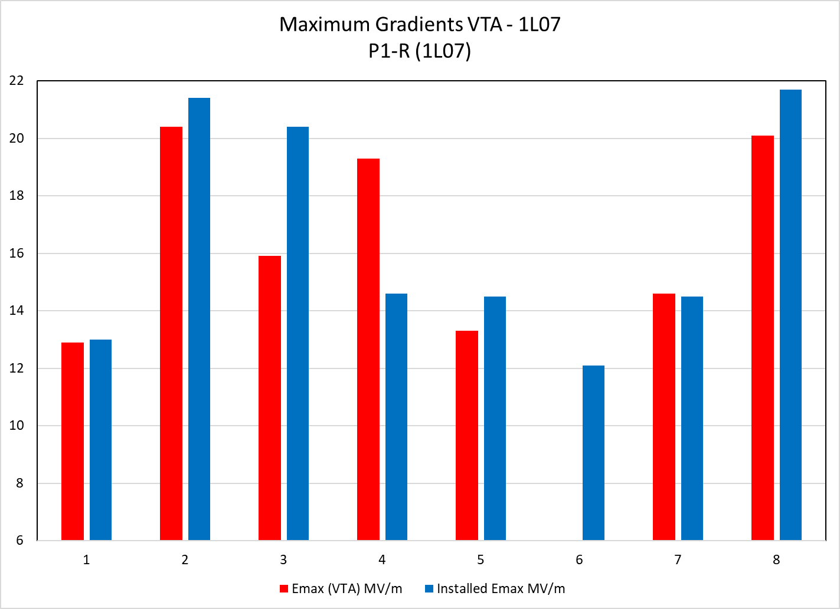
P1-R (1L07) Gradients

Slide 20
P1-R (1L07) Gradients

Slide 21
P1-R Gradients
Installed
Cavity | CAV SN | QextFPC | QextFP | Installed Emax MV/m | Installed Limit | Installed 1 hour Run (MV/m) | Installed Eight Cav Run | 100 mR/hr Limit (MV/m) | SRF DRVH (MV/m)
1 | JL-005 | 1.8E+07 | 9.3E+11 | 13.0 | Quench | 12.5 | 12.5 | 12.5 | 12.5
2 | JL-007 | 2.9E+07 | 6.2E+11 | 21.4 | KRRP | 20.9 | 20.9 | 20.9 | 20.9
3 | JL-006 | 1.9E+07 | 1.0E+12 | 20.4 | Heat Load | 20.3 | 12.5 | 12.5 | 12.5
4 | JL-003 | 1.5E+07 | 3.3E+11 | 14.6 | Quench | 14.1 | 12.1 | 14.1 | 14.1
5 | EP-002 | 1.5E+07 | 4.4E+11 | 14.5 | Quench | 14.0 | 14.0 | 14.0 | 14.0
6 | JL-004 | 1.2E+07 | 4.2E+11 | 12.1 | Quench | 11.8 | 11.6 | 11.8 | 11.8
7 | JL-009 | 2.4E+07 | 7.2E+11 | 14.5 | Quench | 14.0 | 14.0 | 14.0 | 14.0
8 | JL-008 | 2.9E+07 | 7.6E+11 | 21.7 | Quench | 21.2 | 18.0 | 21.2 | 21.2
VTA |  |  |  | 92.5 |  | 90.2 | 80.9 | 84.7 | 84.7
Cavity | CAV SN |  | QextFP (VTA) | Emax (VTA) MV/m | Limit (VTA)
1 | JL-005 |  | 5.0E+11 | 12.9 | Quench
2 | JL-007 |  | 9.0E+11 | 20.4 | Quench
3 | JL-006 |  | 4.8E+11 | 15.9 | Pwr Limit 100 W
4 | JL-003 |  | 7.9E+11 | 19.3 | Quench
5 | EP-002 |  | 9.0E+11 | 13.3 | Quench
6 | JL-004
7 | JL-009 |  | 6.3E+11 | 14.6 | Quench
8 | JL-008 |  | 5.4E+11 | 20.1 | Quench
 |  |  |  | 81.6

Slide 22
P1-R Field Emission

Slide 23
P1-R Q₀ Measurements

Slide 24
P1-R Q₀ Measurements
Cavity | CAV SN | Installed Qo @ 8.0 MV/m | Installed Qo @ 12.5 MV/m | VTA Qo @12.5 MV/m | Installed Qo @ 1 hr run | Heat Load @ SRF DRVH’s (W)
1 | JL-005 | 8.8E+09 | 7.9E+09 | 4.5E+09 | 7.9E+09 | 14.5
2 | JL-007 | 1.4E+10 | 1.3E+10 | 7.2E+09 | 1.1E+10 | 29.6
3 | JL-006 | 1.3E+10 | 1.3E+10 | 4.5E+09 | 1.3E+10 | 9.1
4 | JL-003 | 1.5E+10 | 1.3E+10 | 5.0E+09 | 1.2E+10 | 11.8
5 | EP-002 | 1.5E+10 | 1.2E+10 | 4.8E+09 | 1.1E+10 | 13.2
6 | JL-004 | 1.3E+10 |  |  | 1.2E+10 | 8.8
7 | JL-009 | 1.3E+10 | 1.2E+10 | 7.4E+09 | 1.1E+10 | 12.6
8 | JL-008 | 1.6E+10 | 1.4E+10 | 4.1E+09 | 9.9E+09 | 33.0
Total Heat at 84.7 MV = 132.6 W

Slide 25
C75-01 Event
Ramp up Gradient in Pulse mode
Quench at ~ 18.6 MV/m
Accompanied by a spike in the BLVac
Turn Gradient on again and switched to CW
Arc Trip / WGVac Fault occurs
Turn RF on again, unable to raise gradient above ~14 MV/m

Slide 26
C75-01-1 Event

Slide 27
C75-01-1 Event

Slide 28
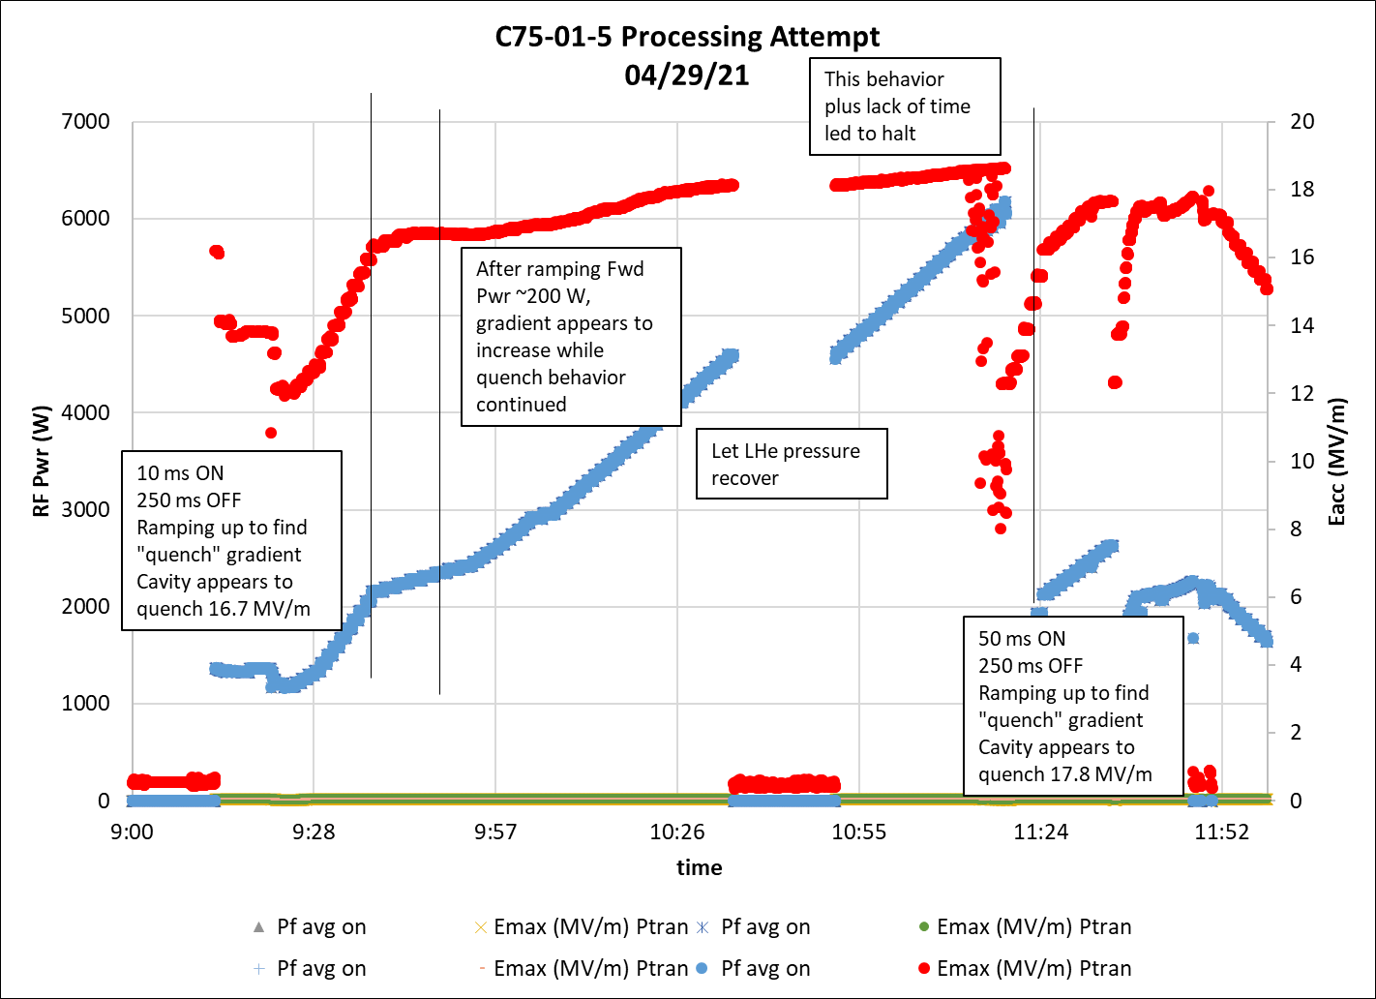
C75-01-5 Processing Attempt in CMTF

