Slide 1
C100 gradient recovery effort
Anna Solopova
5-3-2018

Slide 2
Outline
Progress to date
Waveforms!
Limitations and mysteries
Plans

Slide 3
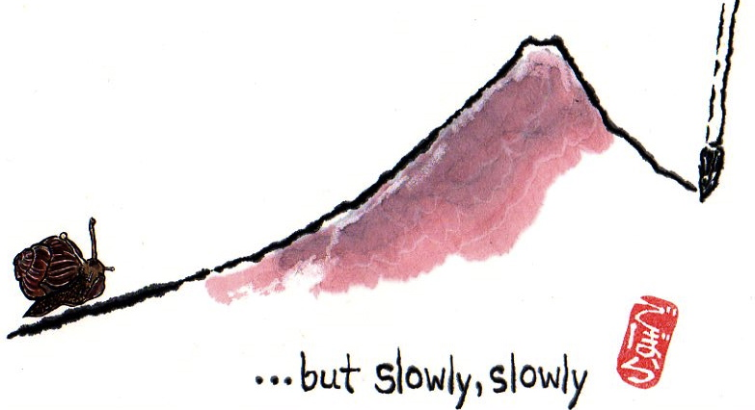
Gradient push progress
Started on March 23
South up 18.6MeV/m from 2017
gradient was just sitting there, sad and forgotten
North down 10.5MeV/m from 2017
cryo events, vacuum, FE
MeV/m | Total | North | South
March 2017 | 933.5 | 423.6 | 424.2
March 2018 | 860.1 | 390.8 | 384.9
May 2018 | 940.5 | 413.2 | 442.8
North is up 22.4 MeV/m from the start
South is up 58 MeV/m
Energy reach: NL 1079MeV; SL 1080MeV

Slide 4
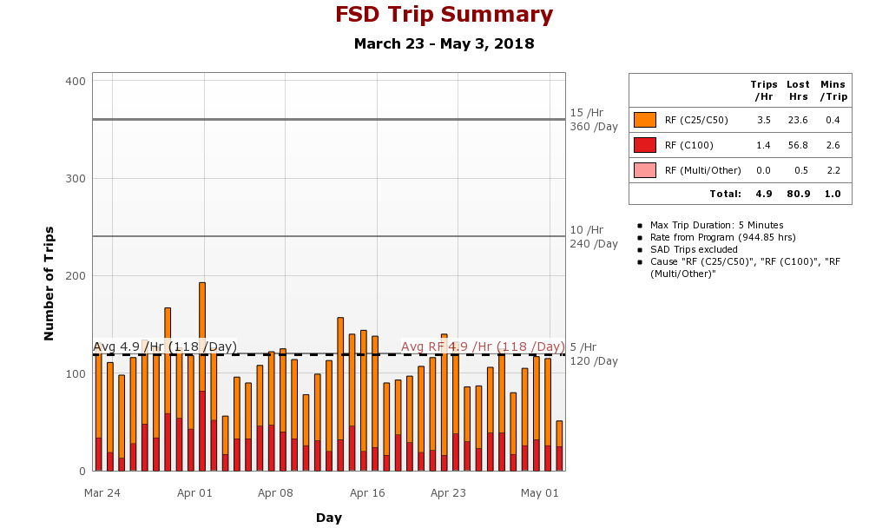
Trips
Trips: things get worse before they get better.
Total RF trip rate now is the same as in March 2017
C100 trip rate is 0.1/hr lower

Slide 5
Waveforms
Allow to investigate each trip at higher resolution than archiver
Show events when a cavity caused others to trip, but stayed on
Helps keep the gradient up in “innocent” cavities.
Possible to create patterns for each type or trips
Automation of the gradient recovery process in the future

Slide 6
Waveforms
CFQE2
CRFP
CRFPP
CRRP
CRRPP
DETA2
DFQES
GASK
GLDE
GMES
IASK
IMES
OpsSummary1
PASK
PLDE
PMES
QASK
QMES
Viewer page Available from JMenu – System Expert - RF

Slide 7
Waveforms
Started with 2L25 and 5 signals per cavity per trip on 4-10-18
17 waveforms are collected from all C100 cavities on each trip starting 4-24-18
IOC time sync and harvester flag issues
Not all files are saved for each trip
Work is ongoing
If we have 30% of trips, we are still good
Version 2 web viewer and Tom’s LabView viewer for analysis
OPS are already using it

Slide 8
Limitations and mysteries
Quiet times vs trips at the same gradient for no good reason
Can it be solved through WFS?
Microphonics-induced trips
Klystrons not providing 10kW: cavity runs out of power and trips
To be addressed this summer through optimization and maybe klystron swaps
Quench vs some other fault resolution
Electrical noise and single-point event filtering
Recent storm left SL C100 off for an hour, still ringing 3 hours later that night.

Slide 9
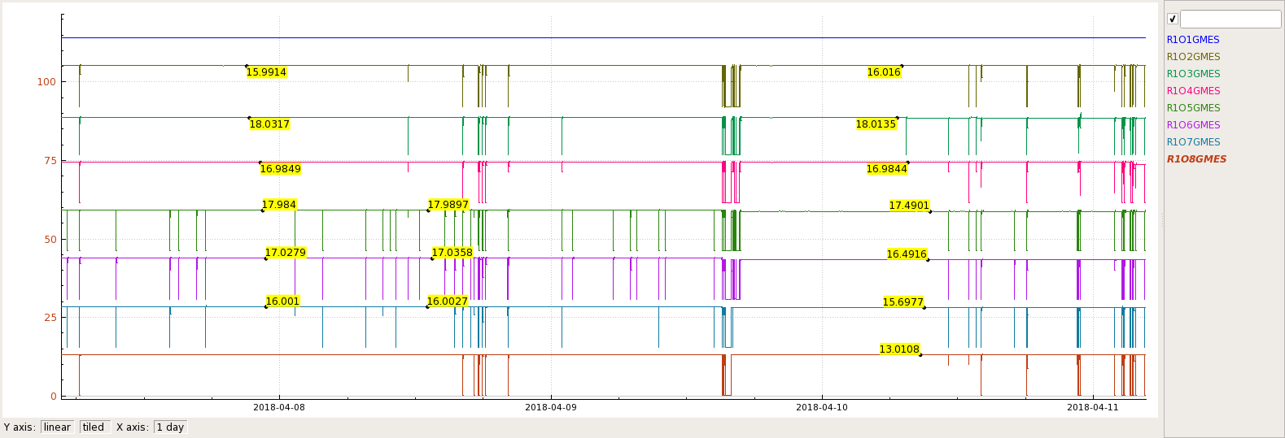
Suddenly, trips! Hundreds of them!
1L24 | 1 | 2 | 3 | 4 | 5 | 6 | 7 | 8 | Total
GSET April 7 | 0 | 16 | 18 | 17 | 18 | 17 | 16 | 14 | 116
GSET May 3 | 0 | 16 | 17.2 | 17.5 | 17.5 | 16 | 15.5 | 13.5 | 113.2
Beginning of April: same gradient, stable for days. No obvious changes associated with instability. Frequent trips.
Now: redistributed gradient, reduced 2MeV – stable.
Popped a field emitter on cavity 6, lost 1MeV on May 2.

Slide 10
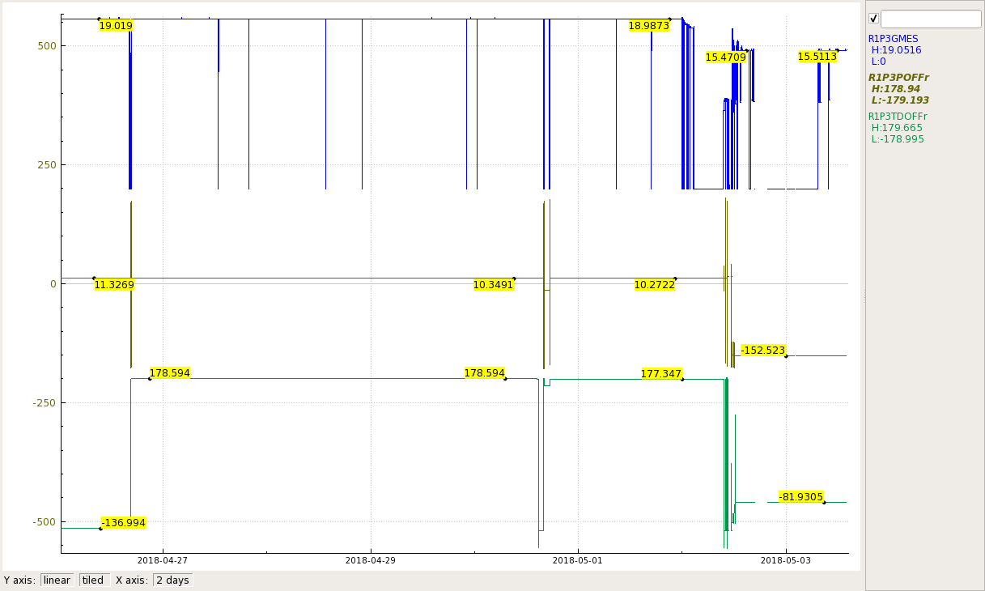
1L25-3 TDOFF
1L25-3 POFF was optimized following a “violent quench event” event on April 26, when cavity 4 quenched and LL went over 96%. Tom will elaborate.
TDOFF shifted ~40 degrees, leaving cavity off tune.
Manually tuned a day later, then it was optimized and off tune again
Ops followed the optimization procedure which works well on all other cavities.
Cavity was running at 19MeV all this time, tripping more often after wrong TDOFF.
May 2 owl shift it was bypassed due to repeated trips and SOS-ing, recovered next day to only 15.5MeV
Swapped FCC and an attenuator, checked cable connections – no luck
Elog references 3569764 3570893 3570260

Slide 11
Klystron power limits
Typical event: 2L25 Cavity 4 ran out of power at 6kW multiple times.
22 klystrons trip at CRFP below 10kW. 46 are not not linear above 10kW (spec is 10.5)
Courtesy of T. Powers

Slide 12
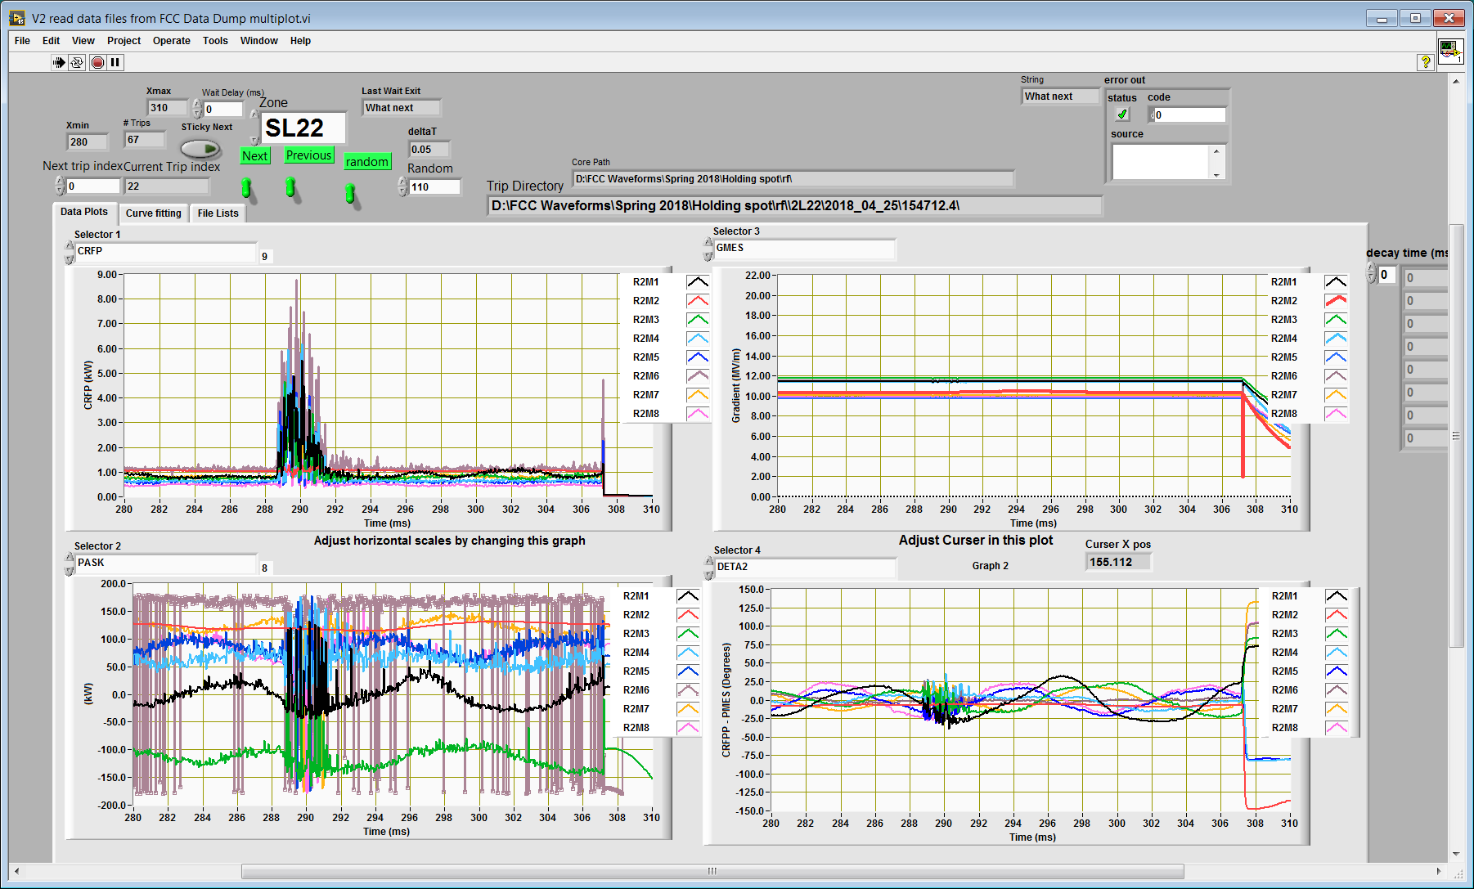
Single point events
2L22 electrical noise from the storm on April 25

Slide 13
Plans in an ideal world
Trip data analysis
Patterns
Normal decay times from planned RF off
“Window of normality” for certain signals
Automation: run trip analyzer on the background, alert ops “this cavity was unstable first X% of trips”
More powerful and flexible WFS viewer
Klystron optimization and swap
Phase lock – cut recovery time to ~30 seconds
Filter single point events?
Work with OPS to be mindful of the gradient
C100 recovery procedures and other tools

Slide 14
Tools for the OPS
C100 POFF optimization guidance
Cavity history tool files an OPS-PR for ODVH change
Pop-up reminder if the reason for derating was “Beam instability”
Arc detector fault notification on the Wall
AutoRecovery script requires operator intervention on arc test fault and repeated quench faults over a short period of time
Automatic TDOFF adjustment based on CRFP/DETA2 fit

Slide 15
Thanks to the team:
Clyde Mounts
Ramakrishna Bachimanchi
Tom Powers
George Lahti
Adam Carpenter
Chris Slominski
Theo Larrieu
OPS

