Slide 1
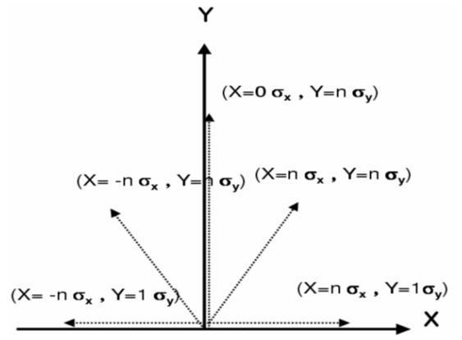
dynamic aperture with tune scan.
5 line scan, then make a map for each line, or a map for a average value of the 5 values?
Tune scan range
(25.0, 23.0) → (25.5, 23.5)
Basic DA scan method

Slide 2
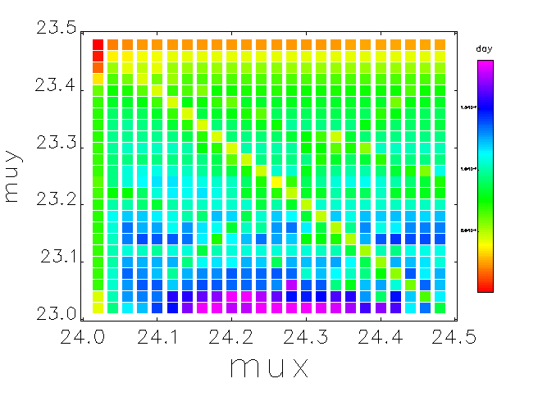
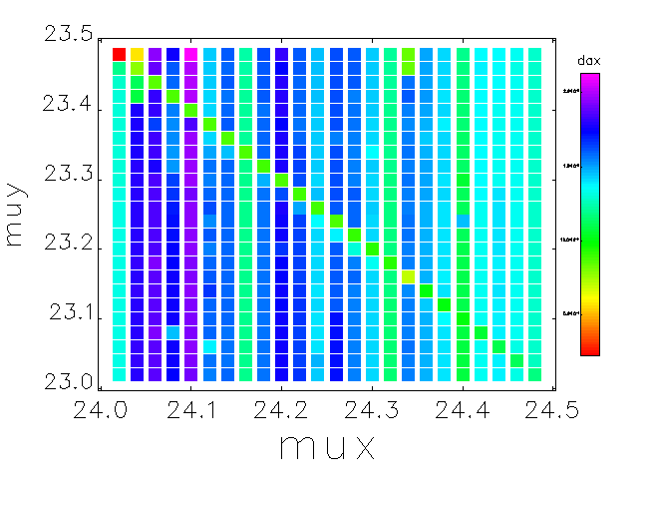
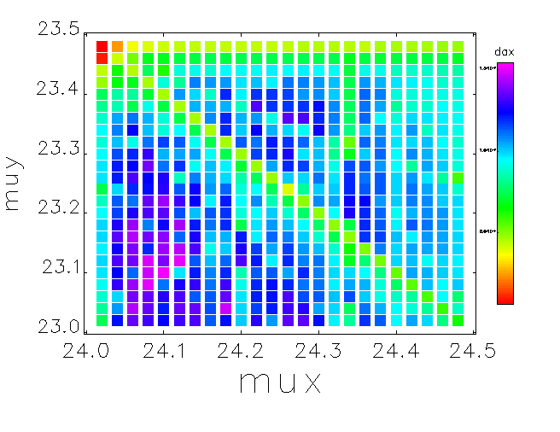
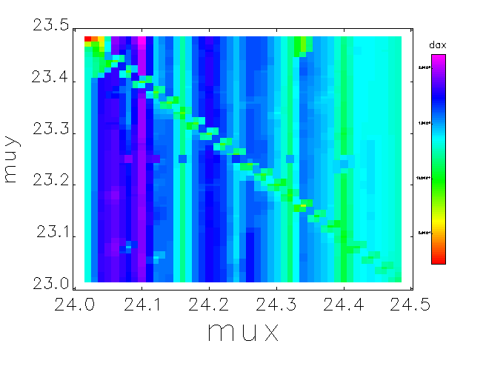
dynamic aperture with tune scan.
Next step

Slide 3
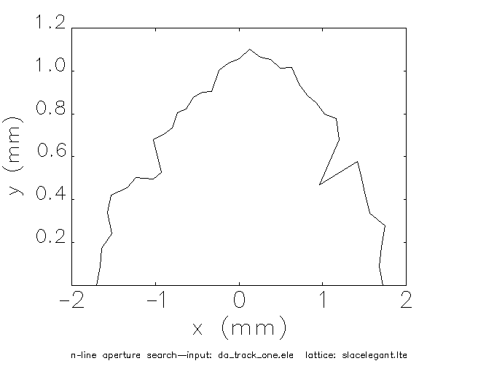
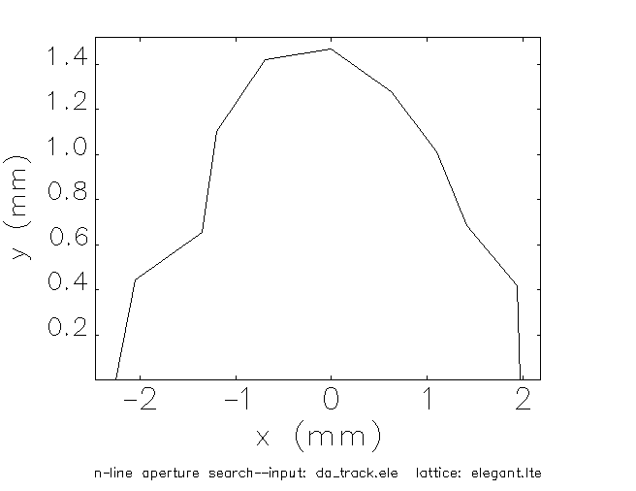
dynamic aperture with tune scan.
24.22, 23.16
24.1, 23.14

Slide 4
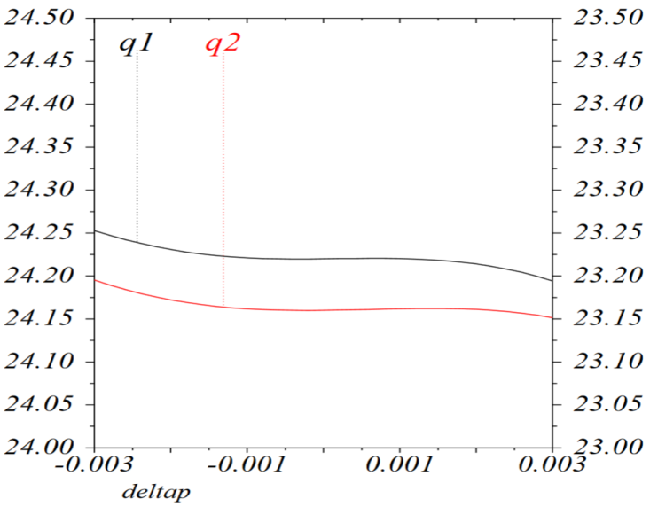
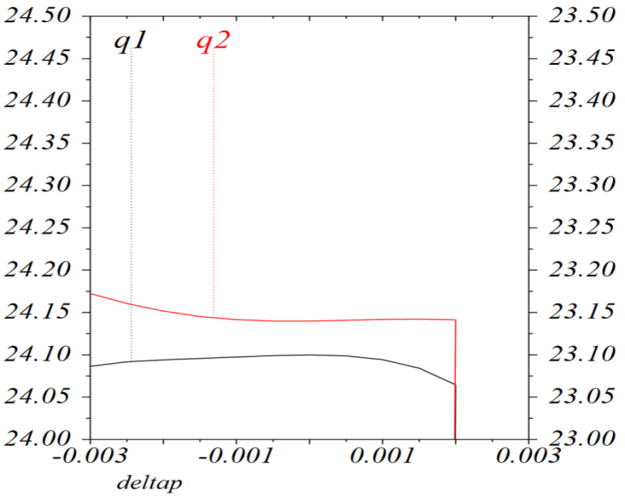
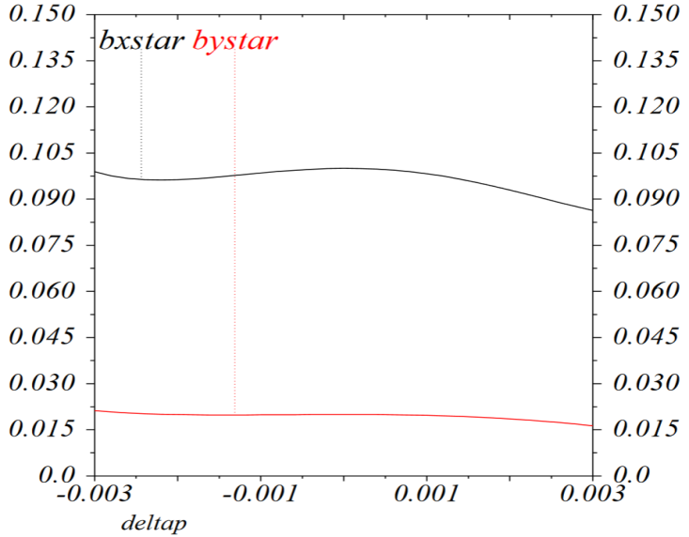
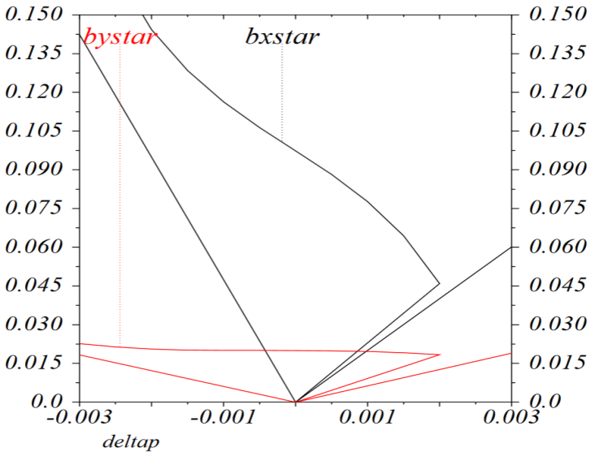
dynamic aperture with tune scan.
24.22, 23.16
24.1, 23.14

Slide 5
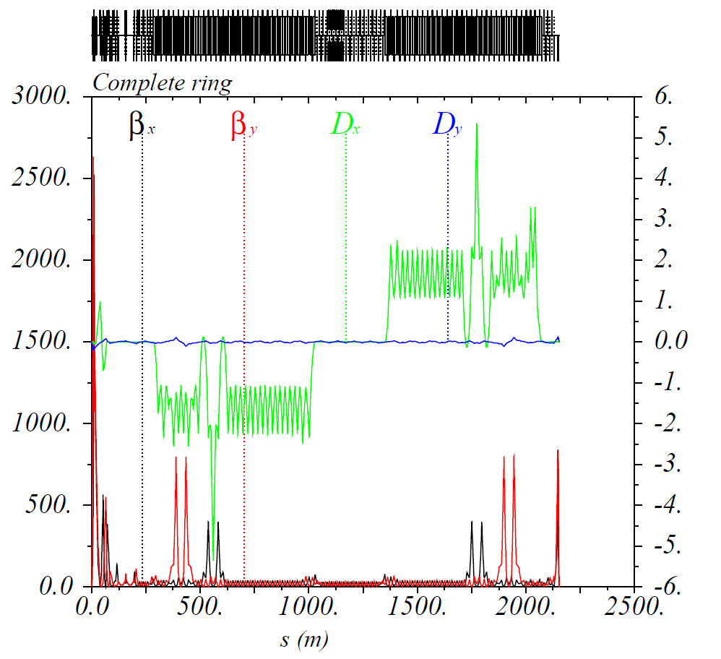
Re-matching (Global)
Δϕ_{y} = 7.5π
Δϕ_{y} = 5.5π
Δϕ_{x} = 12.5π
Δϕ_{x} = 8.5π
Upstream of IP: Δϕ_{y} = 5.5 π → 5.576 π
Downstream of IP: Δϕ_{y} = 7.5π → 7.460 π

Slide 6
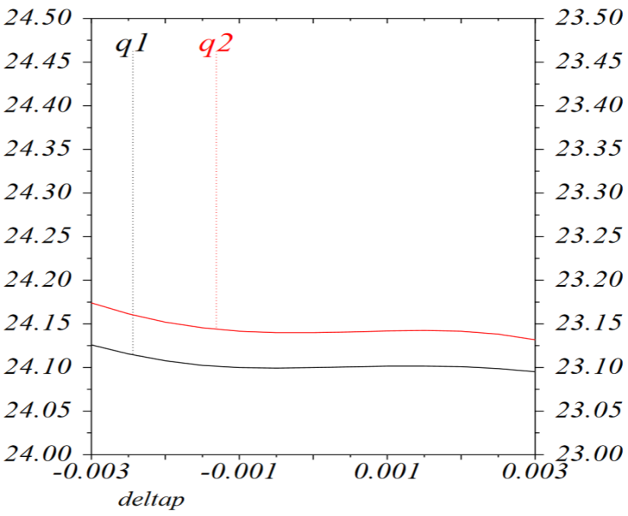
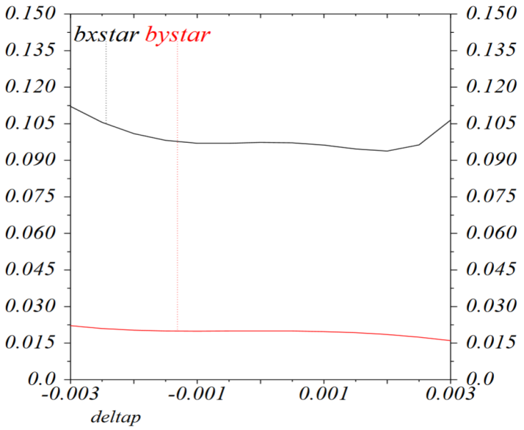
dynamic aperture with tune scan.
24.1, 23.14
24.1, 23.14
dp/p ±0.3% ~ 10 σ

Slide 7
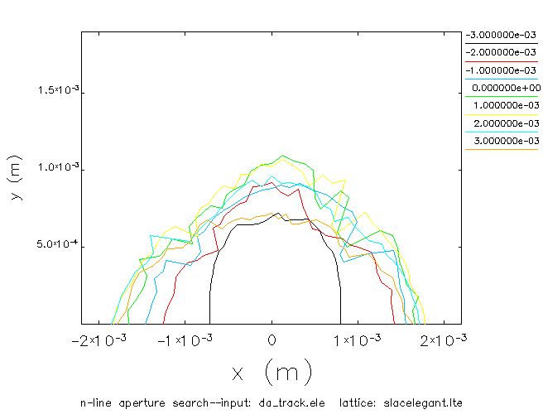
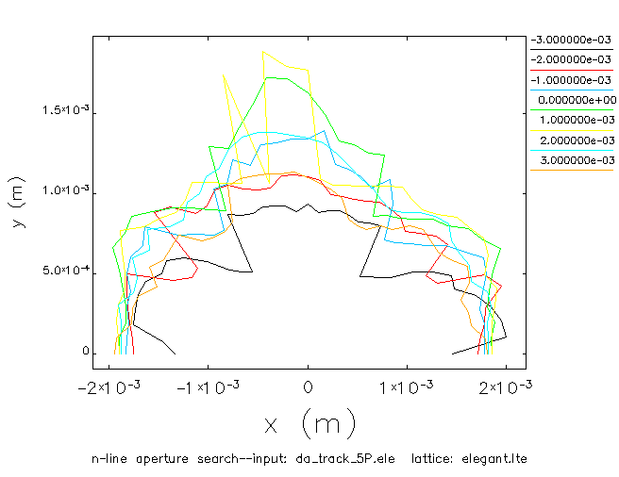
dynamic aperture with tune scan.
24.22, 23.16
24.1, 23.14

Slide 8
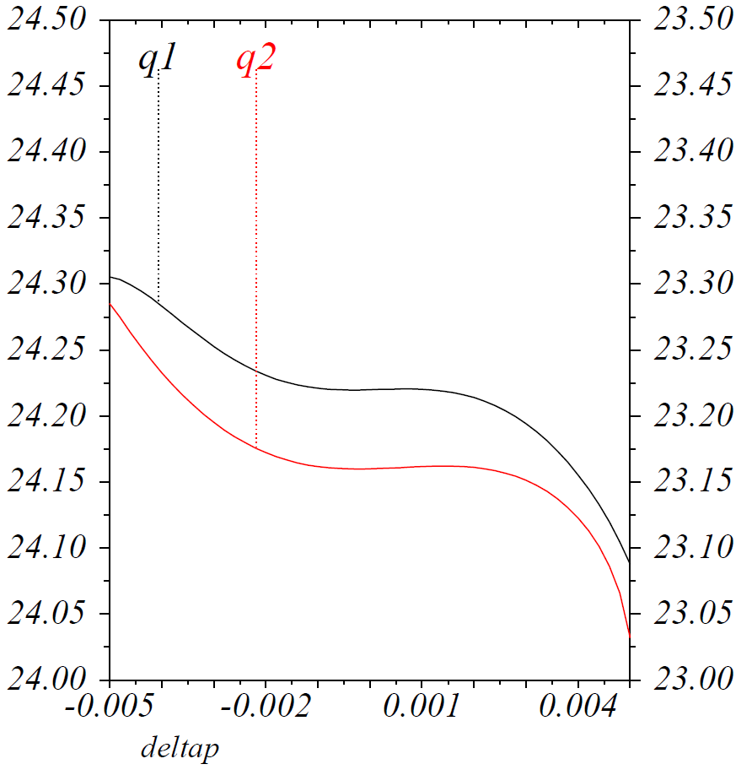
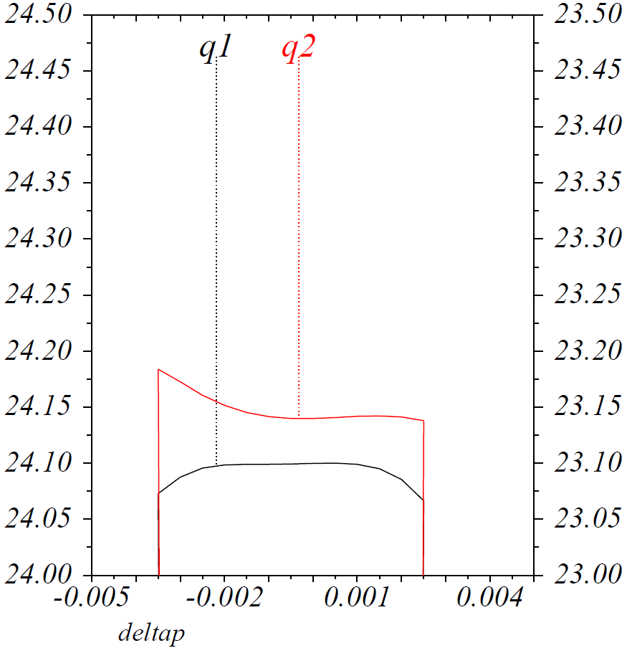
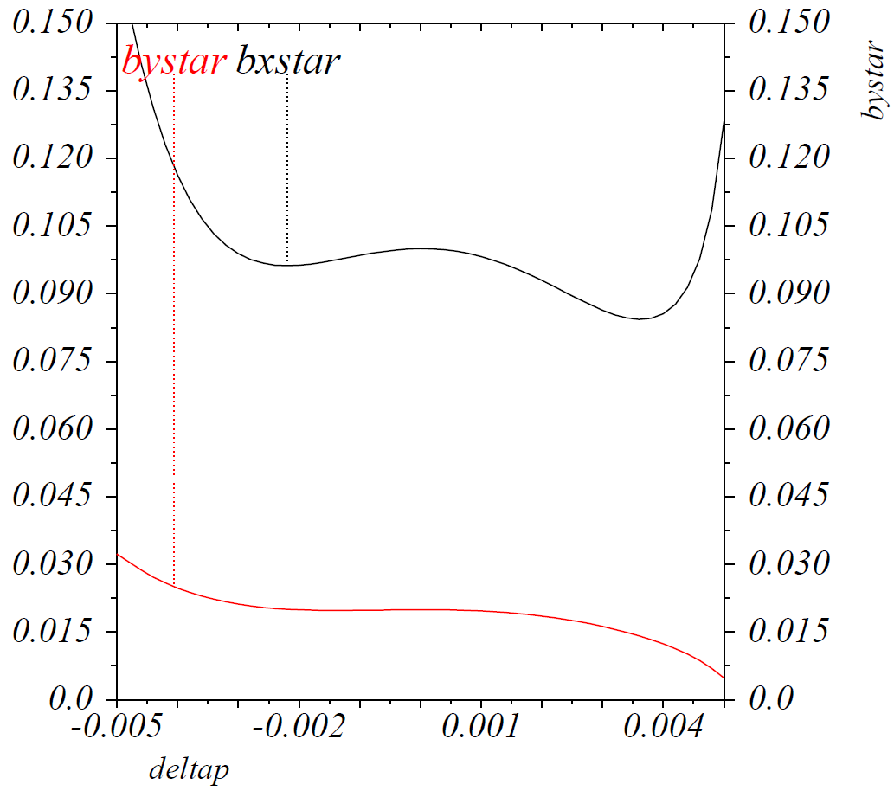
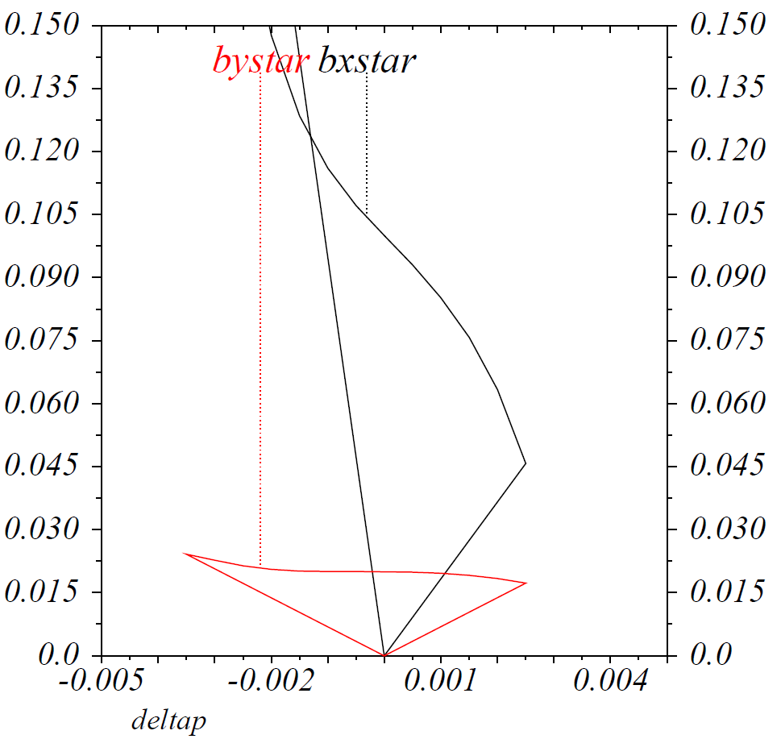
dynamic aperture with tune scan.
24.22, 23.16
24.1, 23.14

Slide 9
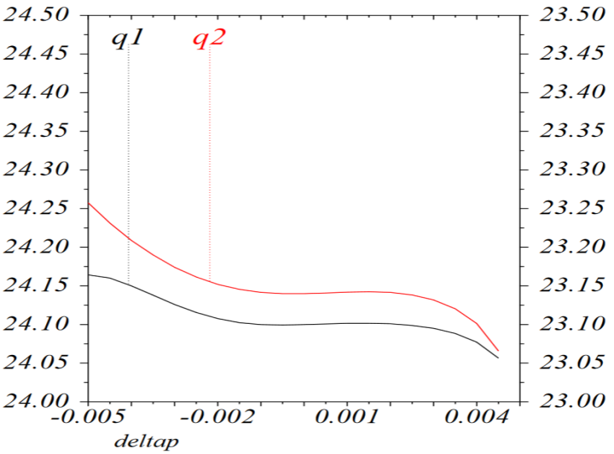
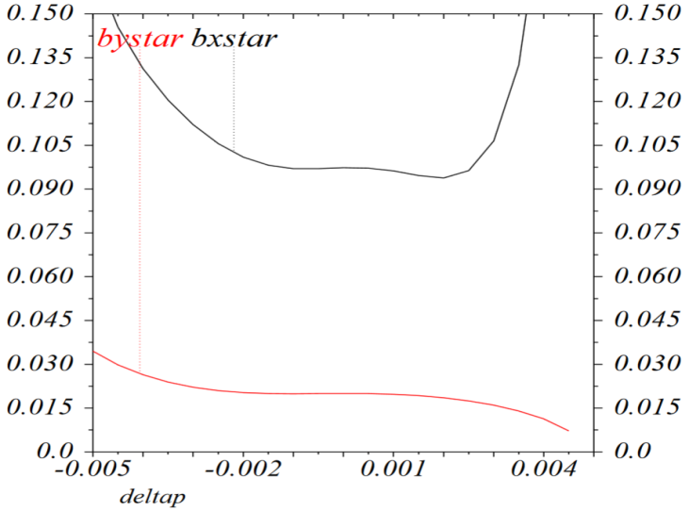
dynamic aperture with tune scan.
24.1, 23.14
24.1, 23.14

Slide 10
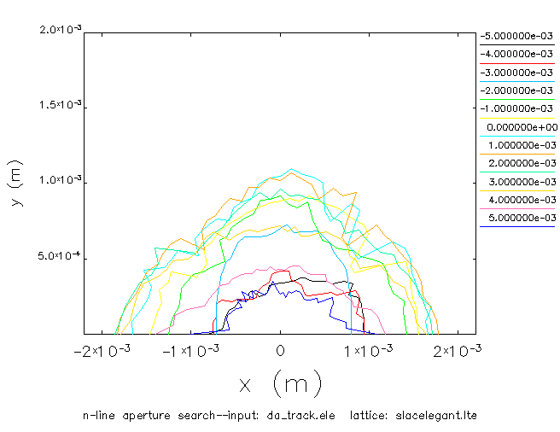
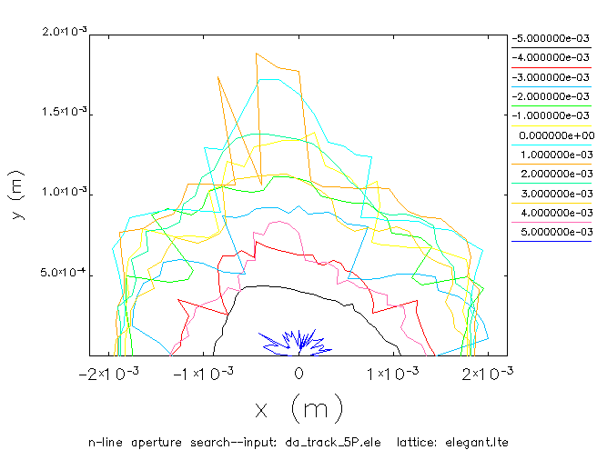
dynamic aperture with tune scan.
24.22, 23.16
24.1, 23.14

