Slide 1
Detector Solenoid Compensation with skew quads
G.H. Wei, V.S. Morozov, Fanglei Lin
Y. Nosochkov (SLAC), M-H. Wang
JLEIC Nonlinear R&D Meeting, JLAB, Jan 17 2017

Slide 2
An Compensation Scheme (Skew quads)
0.3 m
0.3 m
0.5 m
0.5 m
0.4 m
0.2 m
0.9 m
0.9 m
0.5 m
1 m
Skew quads: 0.1 m; corrector: 0.2 m
Skew quads are just beside the FFQ without space.
downKicker01→dipole01: 1.9 m
dipole01→downKicker02: 0.5 m
downKicker02→downSkew01: 0.2 m
Notes:
2

Slide 3
An Compensation Scheme (Skew quads)
0.3 m
0.3 m
0.5 m
0.5 m
0.4 m
0.2 m
0.9 m
0.9 m
0.5 m
1 m
Correctors: 0.2 m
ipuscorr1->vkick= -0.0007491948842; hkick= 2.958152587e-06;
ipuscorr2->vkick= 0.00182813549; hkick= -5.545443962e-06 ;
ipdscorr1->vkick= 0.0009885706997; hkick= 9.391893355e-06 ;
ipdscorr2->vkick= -0.0004494537749; hkick= -3.571220222e-06;
Notes:
3

Slide 4
An Compensation Scheme (Skew quads)
0.3 m
0.3 m
0.5 m
0.5 m
0.4 m
0.2 m
0.9 m
0.9 m
0.5 m
1 m
Correctors: 0.2 m
ipuscorr1->vkick= -0.0007491948842; -1.2 T;
ipuscorr2->vkick= 0.00182813549; 3.0 T;
ipdscorr1->vkick= 0.0009885706997; 1.6 T;
ipdscorr2->vkick= -0.0004494537749; -0.7 T;
Notes:
4

Slide 5
An Compensation Scheme (Skew quads)
0.3 m
0.3 m
0.5 m
0.5 m
0.4 m
0.2 m
0.9 m
0.9 m
0.5 m
1 m
Skew quads: 0.1 m
qffus01s->k1s = 0.03902141928 ; qffus02s->k1s = -0.01476904268 ; qffus22s->k1s = -0.02026700407 ; qffus03s->k1s = 0.01908813591 ;
qffds01s->k1s = -0.04199200154 ; qffds02s->k1s = 0.0220116615 ; qffds22s->k1s = 0.01262536581 ; qffds03s->k1s = -0.00742312655 ;
Notes:
5

Slide 6
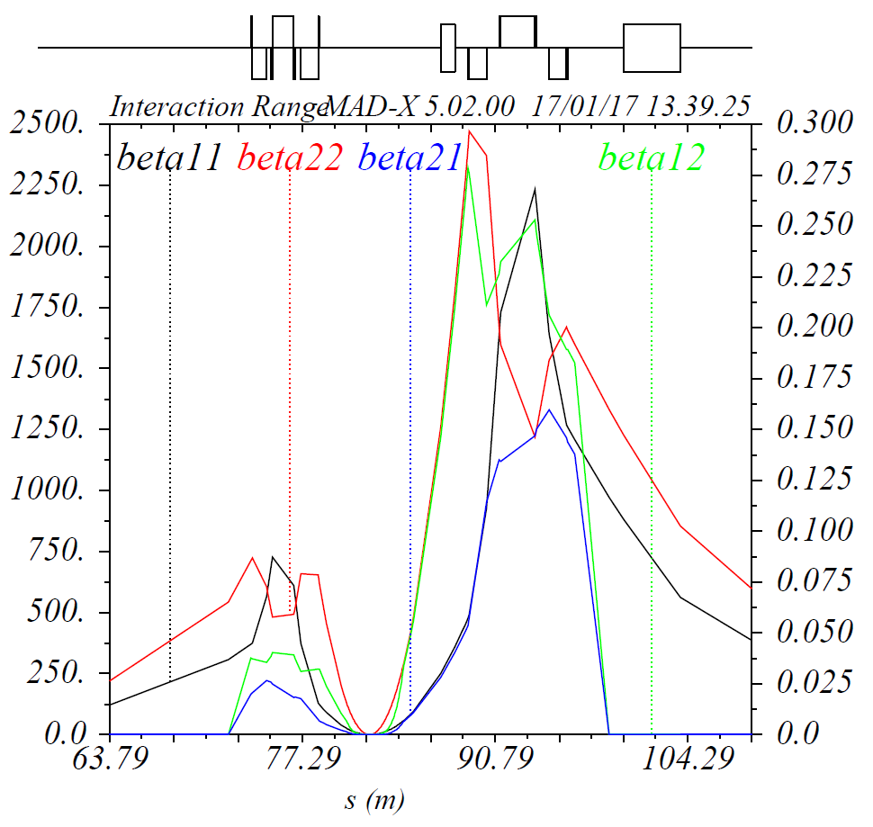
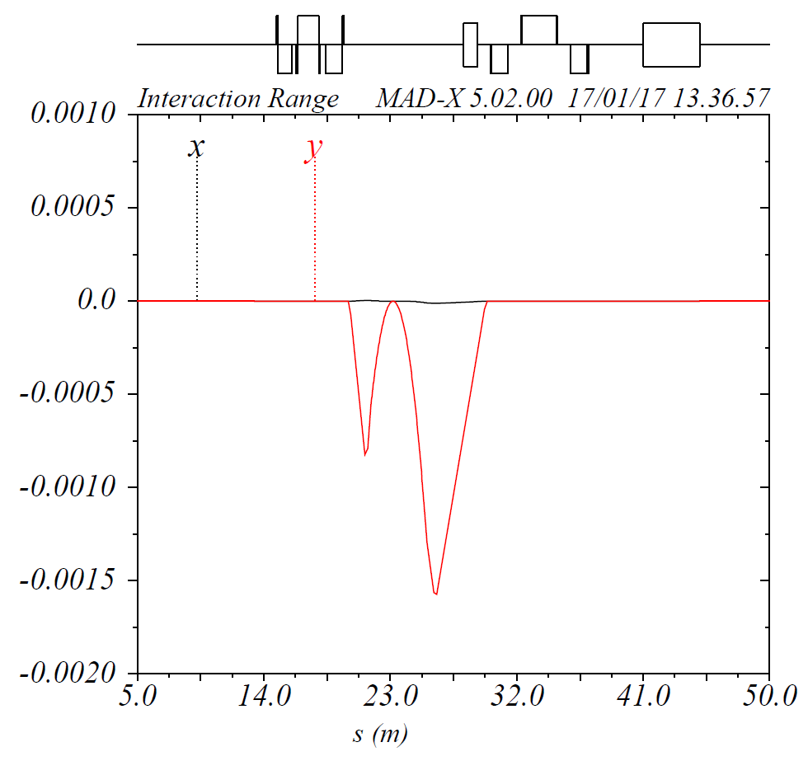
Correction of Coherent orbit distortion
Closed Orbit
Decoupling
Two Models have almost same results.

Slide 7
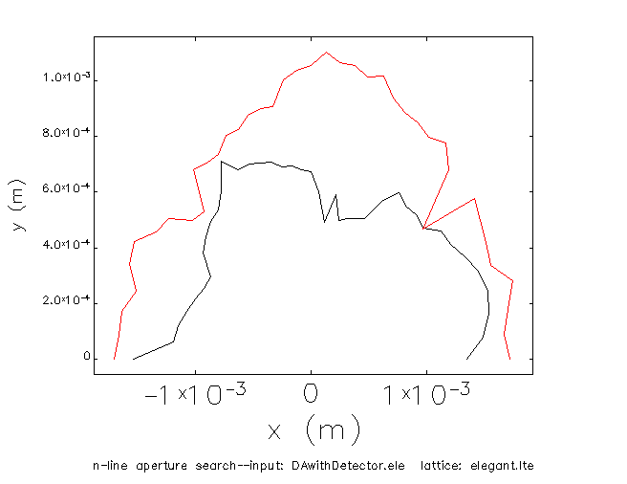
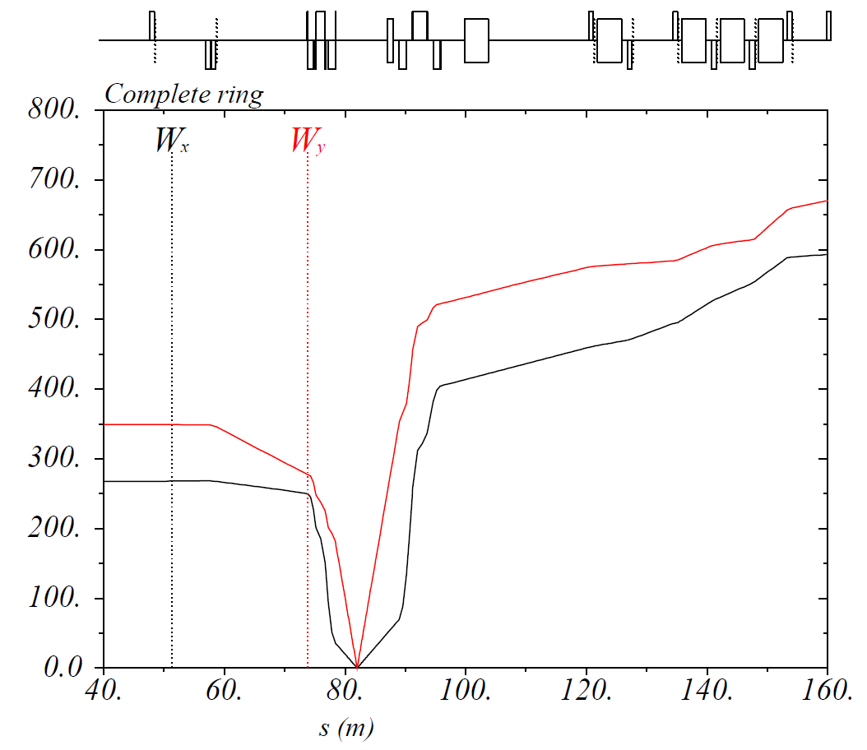
Correction of Coherent orbit distortion
W function
Dynamic Aperture

Slide 8
Thank you

Slide 9
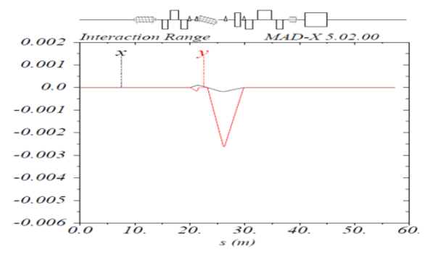
Correction of Coherent orbit distortion
Slice Model
MADX_ealign
Two Models have almost same results.

Slide 10
An Compensation Scheme (Skew quads)
0.3 m
0.3 m
0.5 m
0.5 m
0.4 m
0.2 m
0.4 m
0.5 m
0.5 m
1 m
Correctors: 0.2 m
ipuscorr1->vkick= -0.0007491948842; hkick= 2.958152587e-06;
ipuscorr2->vkick= 0.00182813549; hkick= -5.545443962e-06 ;
ipdscorr1->vkick= 0.0009885706997; hkick= 9.391893355e-06 ;
ipdscorr2->vkick= -0.0004494537749; hkick= -3.571220222e-06;
Notes:
10

Slide 11
Correction of Coherent orbit distortion
Two Models have almost same results.

