Slide 1
RF parameter determination for MEIC Booster and Collider Rings Shaoheng Wang 6/18/2015

Slide 2
Contents
RF Cavities in Electron Collider Ring
RF related ring design parameters
Constraints in RF parameter determination
Strategy to determine RF parameters
Further work with more PEP-II RF system deployment
RF Cavities in Ion Collider Ring
RF Cavitiys for Energy Ramping and Barrier Bucket

Slide 3
RF related Electron Ring Parameters
Electron Ring Parameters
Circumference |  | 2151.452 |  | m
Rev Frequency |  | 0.139 |  | MHz
RF frequency |  | 476.3 |  | MHz
Harmonic Number |  | 3416
Radius of Dipole |  | 110.452 |  | m
Dipole Bend Angle |  | 2.801 |  | degree
Crossing Angle |  | 81.700 |  | degree
Angle Factor |  | 1.454
Beta Function at RF Cav |  | 5.000 |  | m
Momentum Compaction |  | 2.142E-03
Linear SR Power Limit |  | 10 |  | kW/m
Total SR Power Limit |  | 10 |  | MW

Slide 4
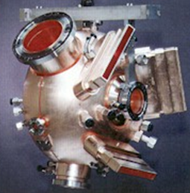
Constraints in RF Parameter Determination
Bunch length confinement
SR energy compensation
Total SR Power < 10 MW
Linear SR Power < 10 kW/m
cavity wall loss power < 90 kW
forward power < 500 kW
total forward power < 12 MW
cavity number < 32
R. Instability Condition > 0.05
Direct Feedback Loop Gain < max gain
Longitudinal Impedance:
PEP II Cavity
$$\frac{2cosψ_{s}}{Y}\text{−} \text{sin}\left(−2ψ\right)>0$$
$$A_{max}=\frac{Q_{L}}{4fδ}−1$$
the excitation of multibunch instabilities

Slide 5
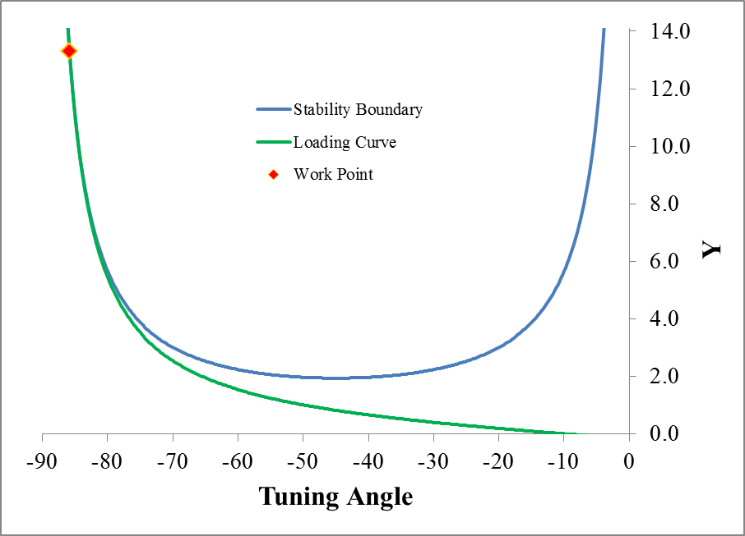
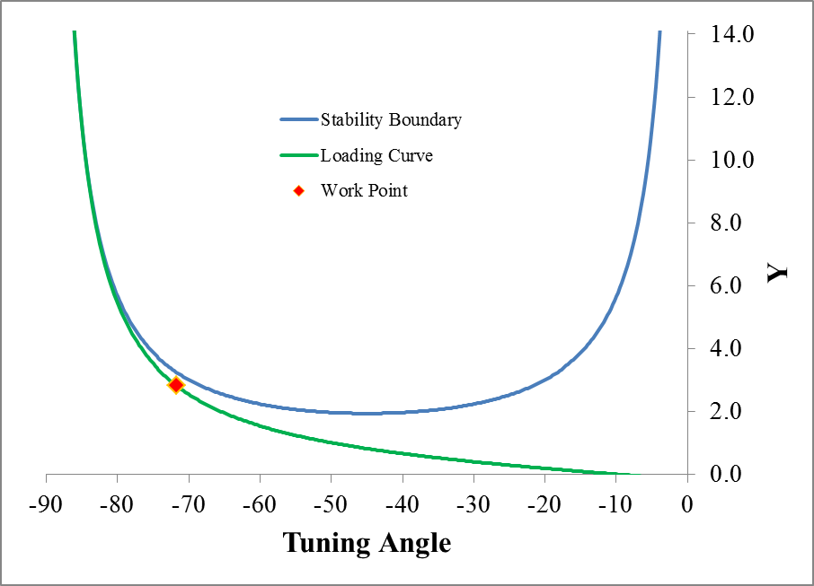
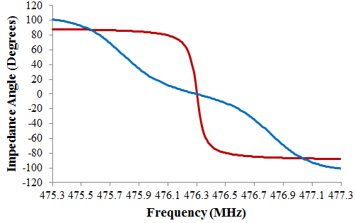
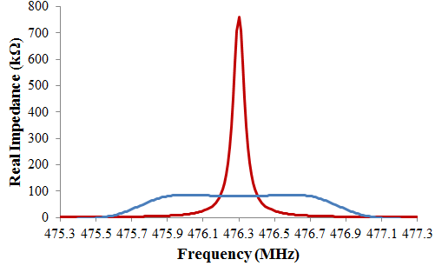
Robinson Instability Alleviated with Direct Feedback
Energy = 5 GeV, Current = 3 A, Cavity Number = 10
A = 0, R. Instability Condition = 0.0
A = 8.5, R. Instability Condition = 0.09
Impedance Phase Angle
Real Impedance
A = 0
A = 8.5
A = 0
A = 8.5

Slide 6
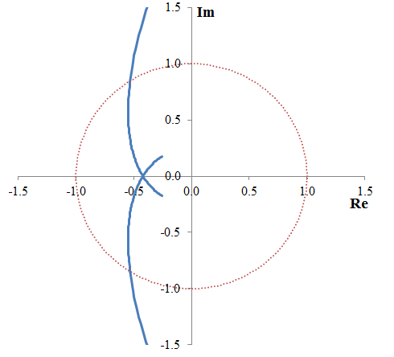
Direct Feedback Loop Stability
Loop transfer function Nyquist Plot
45º
phase margin
$$A_{max}=\frac{Q_{L}}{4fδ}−1$$

Slide 7
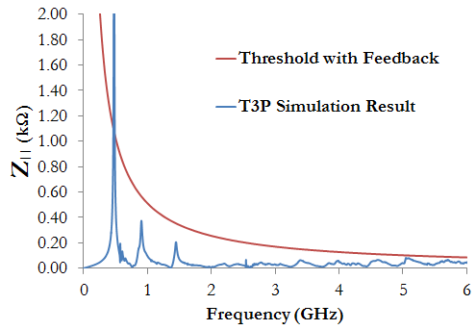
Longitudinal Impedance Requirement for All Energies
$$Z_{||}^{thresh}=\frac{2Eυ_{s}}{N_{cav}f_{\text{HOM}}I_{ave}ατ_{s}}$$
To ensure same impedance threshold per cavity for different energy, current, bunch length
$$τ_{s}^{}≈\frac{E}{E_{loss per turn}f_{\text{rev}}}$$
$Z_{||}^{thresh}=\frac{2f_{rev}υ_{s}F_{φ}C_{SR}E^{4}}{N_{cav}f_{\text{HOM}}I_{b}αR_{dipole}}$
$$E_{loss per turn}=\frac{F_{φ}C_{SR}E^{4}}{R_{dipole}}$$
$$υ_{s}=\frac{cη\frac{δE}{E}}{σω_{0}}$$
$$f_{\text{HOM}}Z_{||}^{thresh}∝\frac{E^{5}}{N_{cav}I_{ave}R_{dipole}σ}$$
$$\frac{δE}{E}=γ\sqrt{C_{q}\frac{I_{3}}{2I_{2}+I_{4}}}$$
Define Longitudinal Frequency Impedance Constant LFIC:
$$LFIC=\frac{E^{5}}{N_{cav}I_{ave}σ}$$
Then, Impedance threshold is obtained as
$$Z_{||}^{thresh}=\frac{LFIC}{E^{5}}\frac{2Eσυ_{s}}{f_{\text{HOM}}ατ_{s}}$$
We need to vary cavity number for operations at different energies to lower the total impedance and suppress the multi-bunch instability.

Slide 8
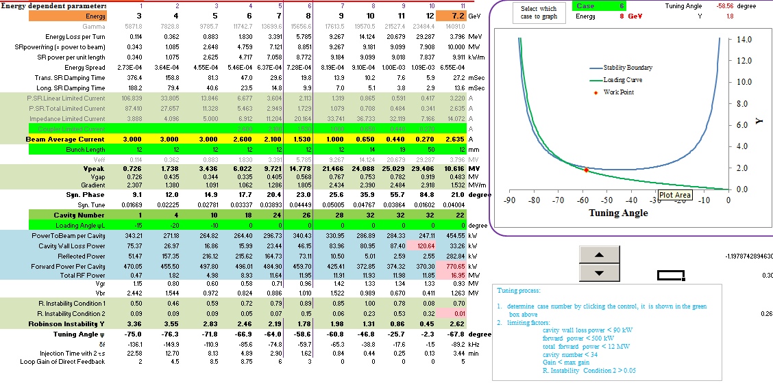
Excel Tuning Tool
The choice of operation point for each energy is manually tuned in a home-made Excel Tool

Slide 9
Results
Energy | 3 | 4 | 5 | 6 | 7 | 8 | 9 | 10 | GeV
Energy Loss per Turn | 0.114 | 0.362 | 0.883 | 1.830 | 3.391 | 5.785 | 9.267 | 14.124 | MeV
SRpower/ring (= power to beam) | 0.34 | 1.08 | 2.65 | 4.76 | 7.12 | 8.85 | 9.27 | 9.18 | MW
SR power per unit length | 0.34 | 1.08 | 2.62 | 4.72 | 7.06 | 8.77 | 9.18 | 9.10 | kW/m
Energy Spread | 2.73E-04 | 3.64E-04 | 4.55E-04 | 5.46E-04 | 6.37E-04 | 7.28E-04 | 8.19E-04 | 9.10E-04
Trans. SR Damping Time | 376.14 | 158.68 | 81.25 | 47.02 | 29.61 | 19.84 | 13.93 | 10.16 | mSec
Long. SR Damping Time | 188.07 | 79.34 | 40.62 | 23.51 | 14.80 | 9.92 | 6.97 | 5.08 | mSec
Beam Average Current | 3.00 | 3.00 | 3.00 | 2.60 | 2.10 | 1.53 | 1.00 | 0.65 | A
Bunch Length | 12.0 | 12.0 | 12.0 | 12.0 | 12.0 | 12.0 | 12.0 | 14.0 | mm
Vpeak | 0.73 | 1.74 | 3.43 | 6.02 | 9.71 | 14.76 | 21.44 | 24.07 | MV
Vgap | 0.73 | 0.43 | 0.34 | 0.33 | 0.40 | 0.57 | 0.77 | 0.75 | MV
Gradient | 2.31 | 1.38 | 1.09 | 1.06 | 1.29 | 1.80 | 2.43 | 2.39 | MV/m
Syn. Phase | 9.1 | 12.0 | 14.9 | 17.7 | 20.4 | 23.1 | 25.6 | 35.9 | degree
Syn. Tune | 0.017 | 0.022 | 0.028 | 0.033 | 0.039 | 0.044 | 0.050 | 0.048
Cavity Number | 1 | 4 | 10 | 18 | 24 | 26 | 28 | 32
Loading Angle ψL | -15.00 | -20.00 | -10.00 | 0.00 | 0.00 | 0.00 | 0 | 0 | degree
PowerToBeam per Cavity | 343.21 | 271.18 | 264.82 | 264.40 | 296.73 | 340.43 | 330.95 | 286.89 | kW
Cavity Wall Loss Power | 75.18 | 26.91 | 16.82 | 15.95 | 23.39 | 46.06 | 83.79 | 80.82 | kW
Reflected Power | 51.65 | 157.82 | 216.80 | 216.30 | 165.29 | 73.44 | 10.60 | 5.06 | kW
Forward Power Per Cavity | 470.04 | 455.91 | 498.45 | 496.65 | 485.40 | 459.93 | 425.34 | 372.77 | kW
Total RF Power | 0.47 | 1.82 | 4.98 | 8.94 | 11.65 | 11.96 | 11.91 | 11.93 | MW
Vgr | 1.15 | 0.80 | 0.60 | 0.58 | 0.71 | 0.96 | 1.42 | 1.33 | MV
Vbr | 2.44 | 1.54 | 0.97 | 0.82 | 0.89 | 1.01 | 1.52 | 0.99 | MV
Robinson Instability Y | 3.37 | 3.56 | 2.83 | 2.46 | 2.19 | 1.78 | 1.99 | 1.32
Tuning Angle ψ | -75.0 | -76.3 | -71.8 | -66.9 | -64.0 | -58.6 | -60.8 | -46.8 | degree
δf | -136.35 | -150.21 | -111.11 | -85.72 | -74.89 | -59.78 | -65.43 | -38.88 | kHz
Injection Time with 2 ts | 22.57 | 12.69 | 8.12 | 4.89 | 2.90 | 1.62 | 0.84 | 0.44 | min
Loop Gain of Direct Feedback | 2.00 | 4.50 | 8.50 | 8.75 | 6.00 | 3.00 | 0.00 | 0.00
Limited by | coupler capability | Total RF power |

Slide 10
Results

Slide 11
Further work with more PEP-II RF System Specifications
An RF station consists of either two or four single-cell cavities driven by a 1.2 MW klystron
From operational experience, set V2 = 1.1V4. It is then possible to determine the angle between V2 and V4 that maximizes the beam current for each gap voltage, based on the forward klystron power limit
The klystrons are built by SLAC, Phillips and Marconi, and each design has different characteristics and performance.
Max Forward power:
~1030 kW for SLAC klystrons
~930 kW for Phillips/Marconi klystrons

Slide 12
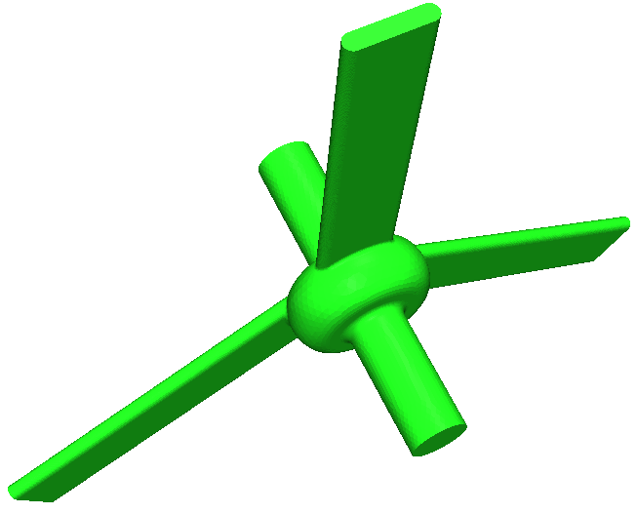
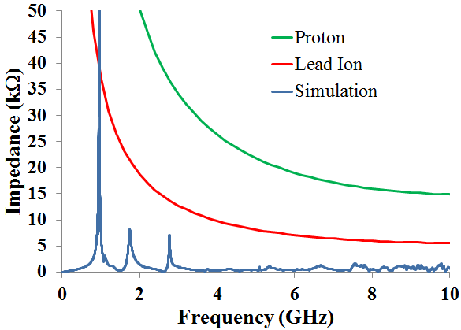
Multi-bunch Instability in Ion Collider Ring
The multi-bunch instability in ion ring is suppressed by Landau damping, the only thing we can do on cavity side is to design a cavity with low impedance. That is the reason we adopt the cavity with on-cell-damper.

Slide 13
RF in Ion Collider Ring, 2K
 |  |  |  |  |  |  | Particle | Proton | Lead ion
 |  |  |  |  |  |  | Energy | 100 | 40 |  | GeV/u
Rev Frequency |  | 0.139 |  | MHz |  |  | gamma | 107.6 | 44.1
RF frequency |  | 952.300 |  | MHz |  |  | Current | 0.50 | 0.50 |  | A
Harmonic Number |  | 6832 |  |  |  |  | Circumference | 2150.68 | 2150.22 |  | m
Momentum Compaction |  | 6.413E-03 |  |  |  |  | Energy Spread | 2.00E-04 | 2.00E-04
Bunch Length |  | 12 |  | mm |  |  | Phase Slip Factor | 6.3E-03 | 5.9E-03
CavityActiveLength |  | 0.157 |  | m |  |  | Vpeak | 18.94 | 17.92 |  | MV
Cavity Insertion Length |  | 1.91 |  | m |  |  | Syn. Phase | 0.00 | 0.00 |  | degree
temperature |  | 2 |  | K |  |  | Vgap | 1.18 | 1.19 |  | MV
BCS Resistance |  | 8.90 |  | nΩ |  |  | Gradient | 7.520 | 7.588 |  | MV/m
Residual Resistance |  | 4.39 |  | nΩ |  |  | Syn. Tune | 0.036 | 0.034
Surface Resistance |  | 13.3 |  | nΩ |  |  | Forward Power | 45.88 | 46.73 |  | kW
Geometric Factor |  | 216.98 |  |  |  |  | Cavity Power Loss | 0.8 | 0.8 |  | W
R/Q |  | 105.687 |  |  |  |  | Reflected Power | 45.9 | 46.7 |  | kW
Qzero |  | 1.63E+10 |  |  |  |  | Coupling Beta | 2.26E+05 | 2.26E+05
Shunt Impedance |  | 1.73E+06 |  | MΩ |  |  | δf | -21.3 | -21.1 |  | kHz
 |  |  |  |  |  |  | Qext | 7.22E+04 | 7.22E+04
 |  |  |  |  |  |  | Qloaded | 7.22E+04 | 7.22E+04
 |  |  |  |  |  |  | Active Cavity Number | 16 | 15
 |  |  |  |  |  |  | Total RF Power | 734.1 | 700.9 |  | kW

Slide 14
Robinson Stability

Slide 15
Low Frequency Cavities for Ramping Process
Ion booster ring:
Ramping process, Harmonic number = 1
Low frequency cavity, ~ 0.571 to 1.248 MHz
Ion collider ring:
Ramping process, Harmonic number = 9
Low frequency cavity, ~ 1.223 to 1.255 MHz

Slide 16
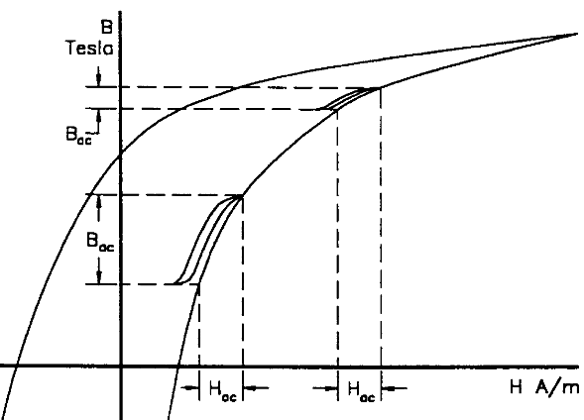
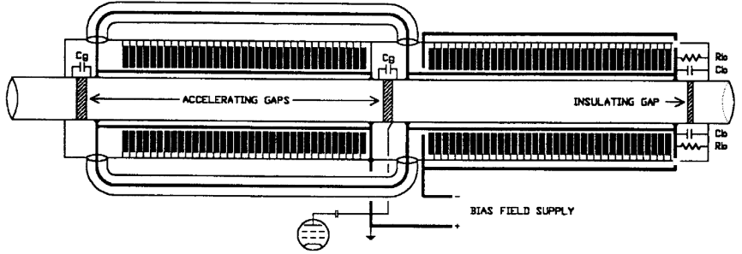
Inductance Loaded Cavities
Used in CSNS, IPNS, ISIS, J-PARC…
I_{gen}
I_{beam}
differential
permeability:
R
C
V_{gap}
L
Ferrite B-H loop
ISIS cavity

Slide 17
Ferrite Loaded Low Frequency RF Cavities For Ramping
Booster |  |  |  |  |  | H+ |  |  | 208Pb67+
Circumference |  | 238.88 | m |  | Energy | 0.285 | ~ | 8 | 0.114 | ~ | 3.2 | GeV
Harmonic Number |  | 1 |  |  | RF Frequency Range | 0.805 | ~ | 1.248 | 0.571 | ~ | 1.22 | MHz
Gaps per Cavity |  | 2 |  |  | Ramping Time |  |  | 0.404 |  |  | 0.57 | Sec
Cavity Number |  | 2 |  |  | Vgap |  |  | 8.0 |  |  | 5.75 | kV
Cavity Length |  | 2.2 | m |  | Beam Power |  |  | 8.0 |  |  | 1.85 | kW
Total Cavity Length |  | 4.4 | m |  | Power Loss per Cavity |  |  | 41.2 |  |  | 41.2 | kW
Ferrite Toroid Inner Radius |  | 0.25 |  |  | Syn. Phase |  |  | 30.0
Ferrite Toroid Outer Radius |  | 0.5 |  |  | Total RF Power |  |  | 98.5 |  |  | 86.2 | kW
Ferrite Stack Length |  | 1
Maximum Vgap |  | 10 | kV
Collider |  |  |  |  |  | H+ |  |  | 208Pb82+
Circumference |  | 2149.9 | m |  | Energy | 8 | ~ | 100 | 3.2 | ~ | 40 | GeV
Harmonic Number |  | 9 |  |  | RF Frequency Range | 1.248 | ~ | 1.255 | 1.223 | ~ | 1.25 | MHz
Gaps per Cavity |  | 2 |  |  | Ramping Time |  |  | 12.0 |  |  | 12.2 | Sec
Cavity Number |  | 7 |  |  | Vgap |  |  | 7.9 |  |  | 7.9 | kV
Cavity Length |  | 2.2 |  |  | Beam Power |  |  | 27.5 |  |  | 10.8 | kW
Total Cavity Length |  | 15.4 | m |  | Power Loss per Cavity |  |  | 23.6 |  |  | 23.6 | kW
Ferrite Toroid Inner Radius |  | 0.25 |  |  | Syn. Phase |  |  | 30.0
Ferrite Toroid Outer Radius |  | 0.5 |  |  | Total RF Power |  |  | 357.4 |  |  | 241 | kW
Ferrite Stack Length |  | 1
Maximum Vgap |  | 10 | kV

Slide 18
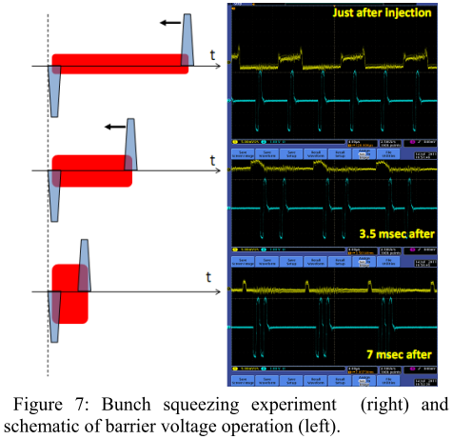
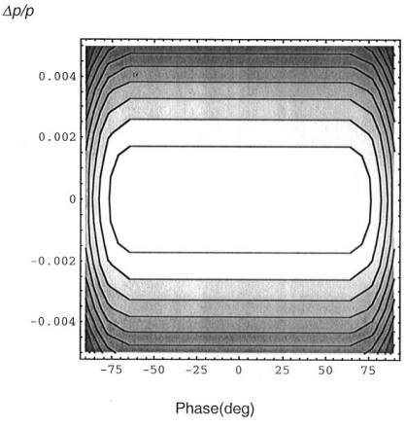
Induction Cell for Barrier Bucket
Barrier bucket is needed to produce the abort gap during re-bunching process in ion ring.
V_{bb}
τ_{bb}
τ_{flat}
τ_{bb}
−φ₁-δφ
φ₁+δφ
−φ₁
φ₁
−ΔE₁

Slide 19
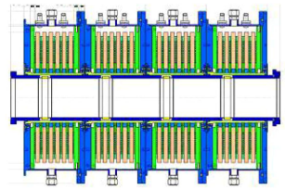
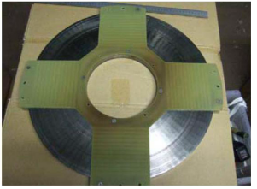
R & D
Induction cell in ring operation is verified in KEK, key component R&D is needed for MEIC
Metal-glass

