Slide 1

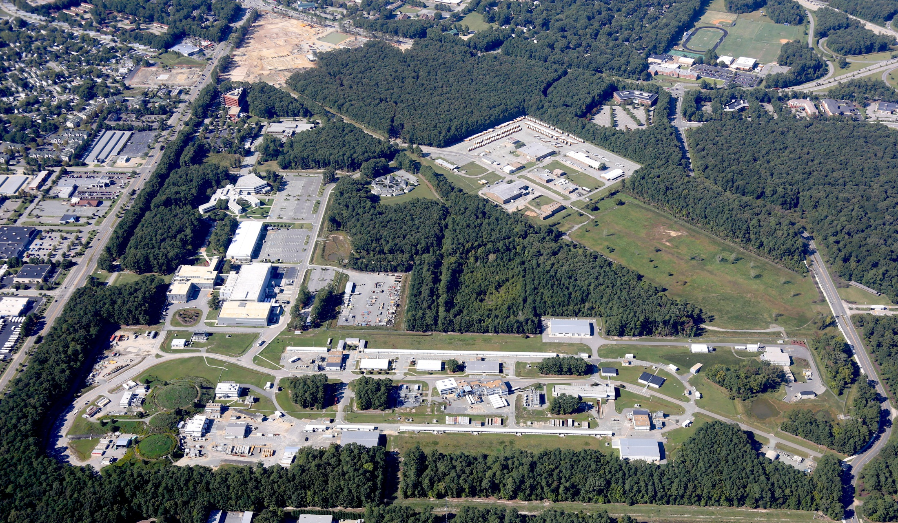
Overview of RF systems for MEIC
R. Rimmer
6/18/2015
MEIC SRF systems review, 6/18/15

Slide 2
MEIC RF systems
MEIC baseline design updated in Jan 2015
PEP-II warm RF adopted for electron ring
  Proven technology, looking for a new home
  Enough cavities and klystrons available
  476.3 MHz buckets can be filled from CEBAF linac with simple timing system
Ion ring frequency now 952.6 MHz
Crab cavity system now 952.6 MHz
Cooler source and ERL now 952.6 MHz (?)
  Cooler baseline became 200 mA, no circulator ring
Ion injector chain not affected

Slide 3
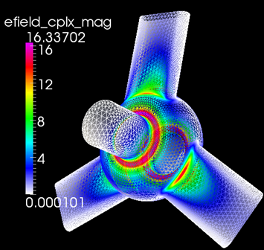
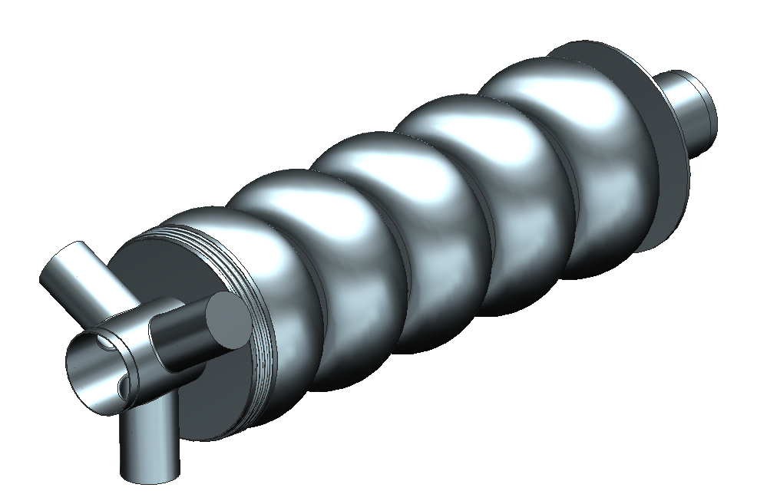
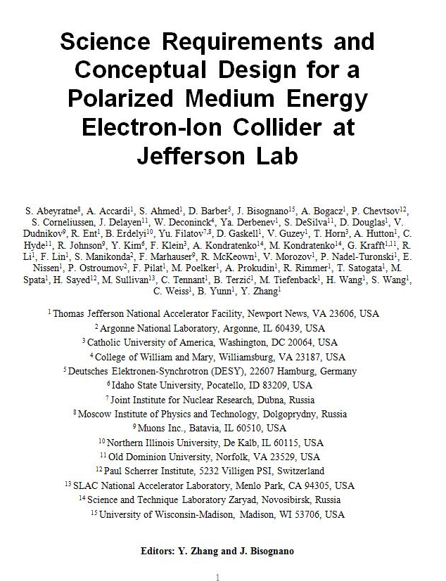
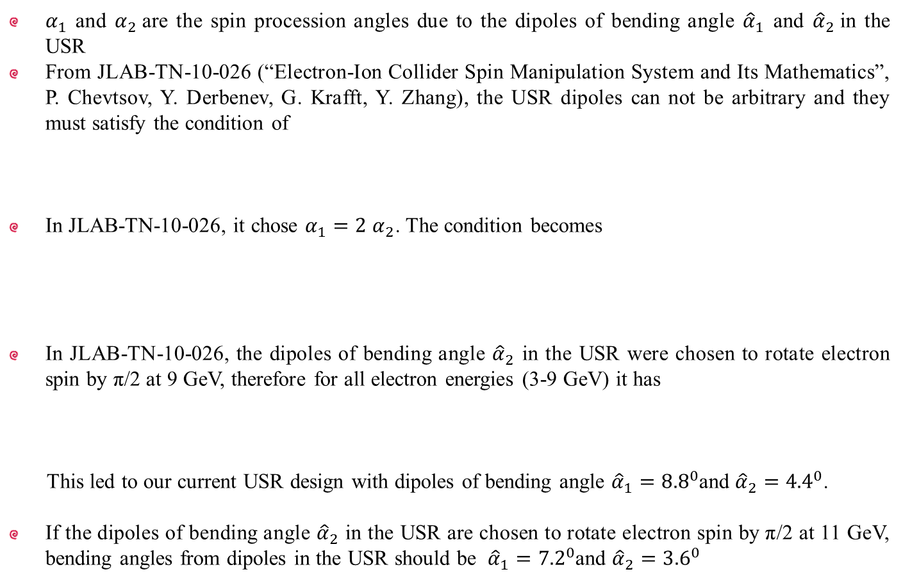
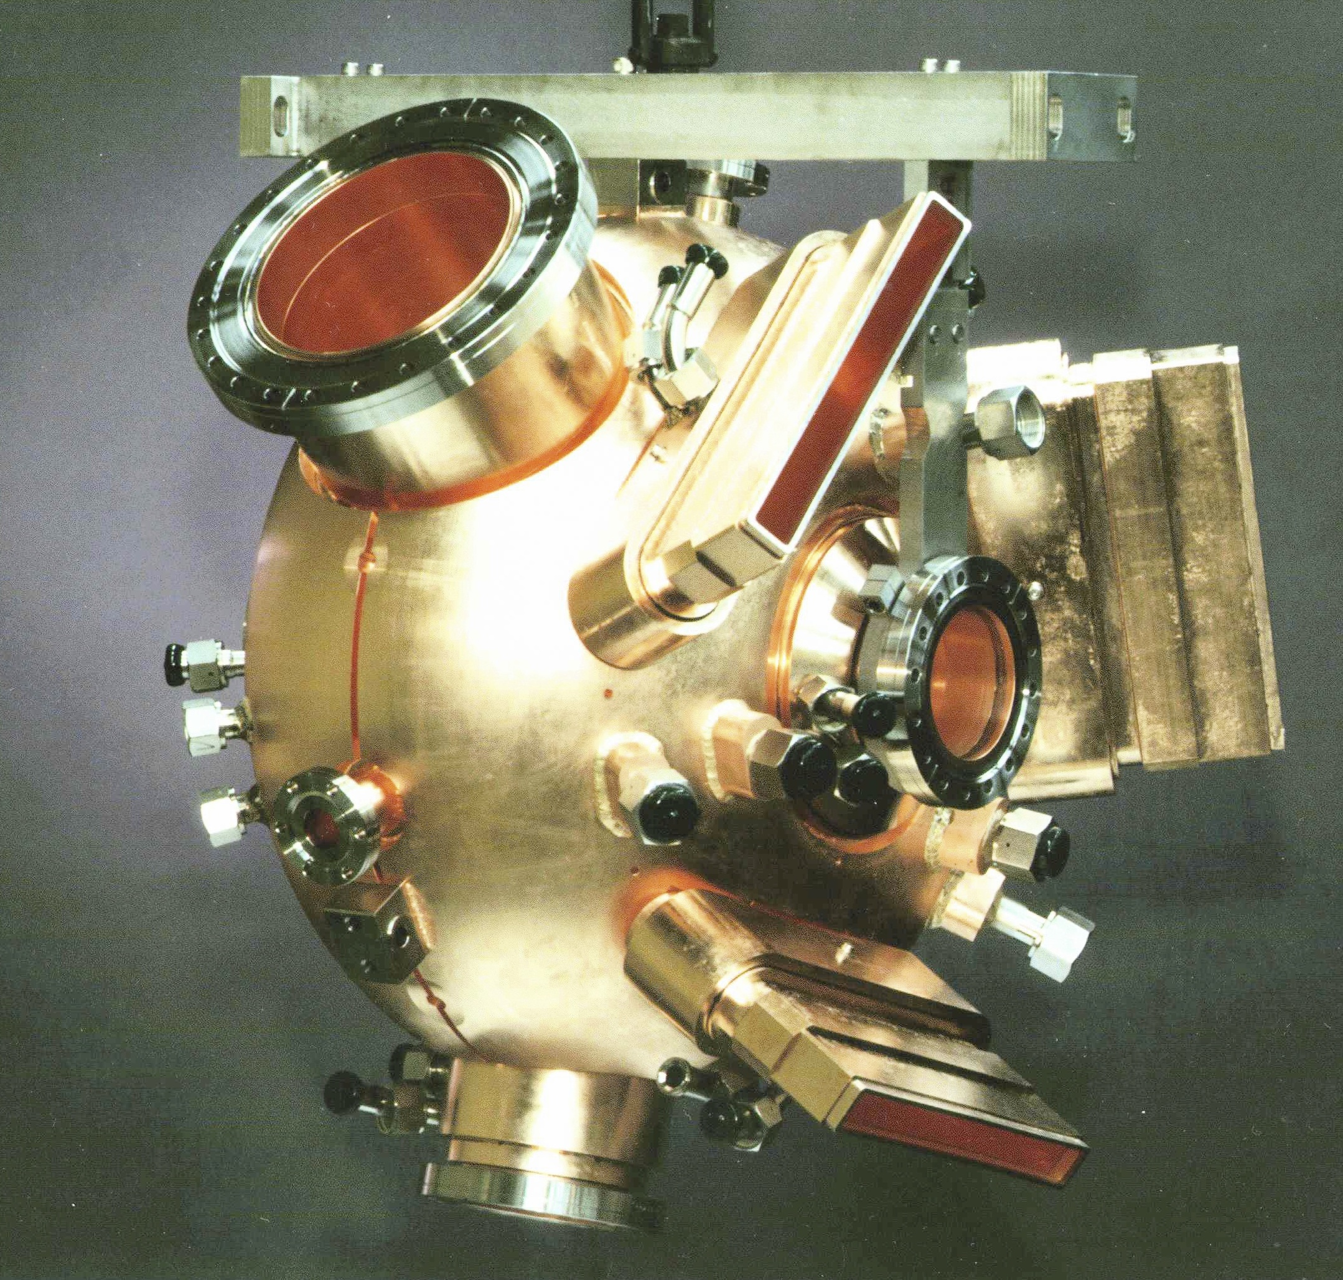
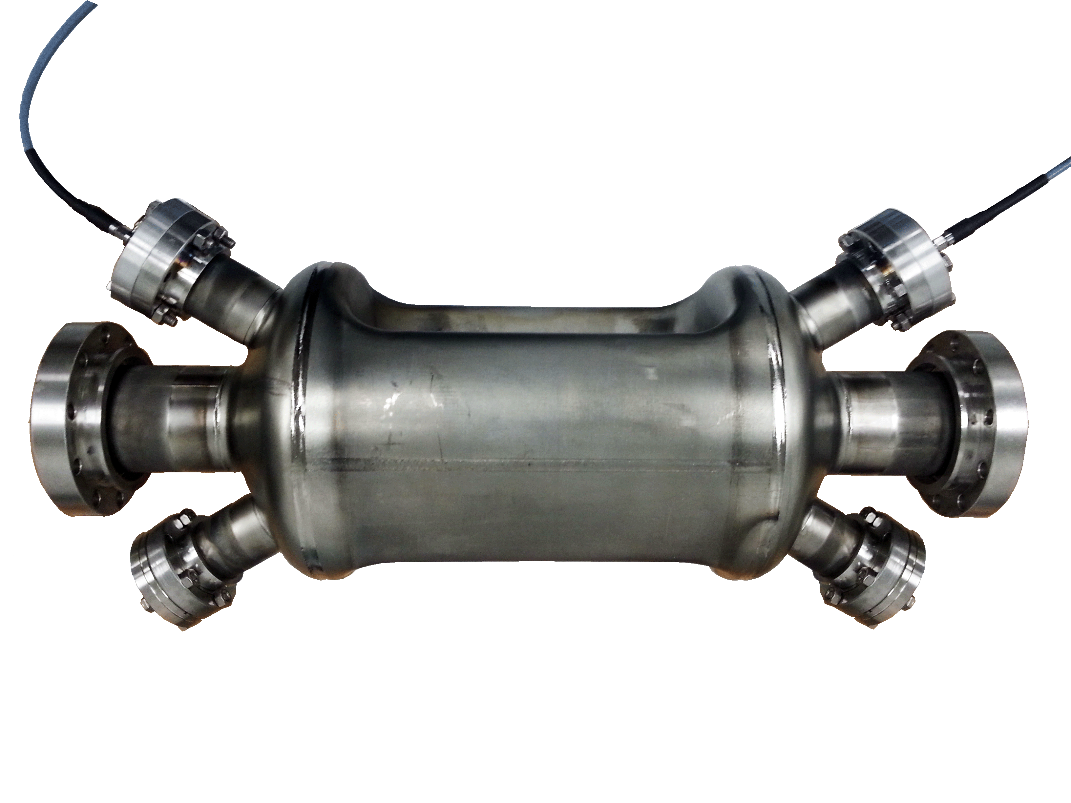
MEIC Conceptual Design
MEIC
Collider
Rings
i-SRF +
NCRF
Cooling
updated
Crab
IP
e-RF
e-RF
Crab
?
Future IP
Booster
SRF Linac
Stage I MEIC
  CEBAF as full-energy e⁻/e⁺ injector
  3-10 GeV e⁻/e⁺
  8-100 GeV protons
  <40 GeV/u ions
Stage II EIC
  up to 20 GeV e⁻/e⁺
  up to 250 GeV protons
  up to 100 GeV/u ions
Ion Source
Electron Injector
Hall D
12 GeV CEBAF
Halls A, B, C

Slide 4
High level RF parameters
 | electron ring NCRF |  |  |  | Proton SRF |  | Lead ion
Energy | 4 | 5 | 10 | GeV | 30 | 100 | 40 | GeV/u
Frequency | 476.3 | 476.3 | 476.3 | MHz | 952.6 | 952.6 | 952.6 | MHz
Current | 3.00 | 3.00 | 0.71 | A | 0.50 | 0.50 | 0.50 | A
SR power per ring | 1.08 | 2.65 | 10.00 | MW | - | - | - | MW
Energy Loss per Turn | 0.36 | 0.88 | 14.12 | MV | - | - | - | MV
Veff | 0.36 | 0.88 | 14.12 | MV | - | - | - | MV
Vpeak | 1.74 | 3.44 | 20.56 | MV | 4.94 | 18.95 | 17.93 | MV
Syn. Phase | 12.01 | 14.89 | 43.39 | degree | 0.0 | 0.0 | 0.0 | degree
Vgap | 0.43 | 0.34 | 0.79 | MV | 1.23 | 1.18 | 1.20 | MV
Gradient | 1.4 | 1.1 | 2.5 | MV/m | 7.8 | 7.522 | 7.591 | MV/m
Beam Power per Cavity | 271.2 | 264.8 | 384.6 |  | - | - | -
Forward Power | 455.5 | 497.8 | 492.0 | kW | 51.0 | 46.94 | 109.88 | kW
Cavity Power Loss | 27.0 | 16.9 | 89.3 | kW | 23.4 | 21.6 | 22.0 | W@4K
Reflected Power | 157.3 | 216.1 | 18.0 | kW | 50.9 | 46.9 | 109.9 | kW
Qext | 8.89E+03 | 8.89E+03 | 8.89E+03 |  | 7.07E+04 | 7.07E+04 | 3.08E+04
Minimum Cavity Number | 4 | 10 | 26* |  | 4 | 16 | 15
*Assumes 2 cavities per klystron.

Slide 5
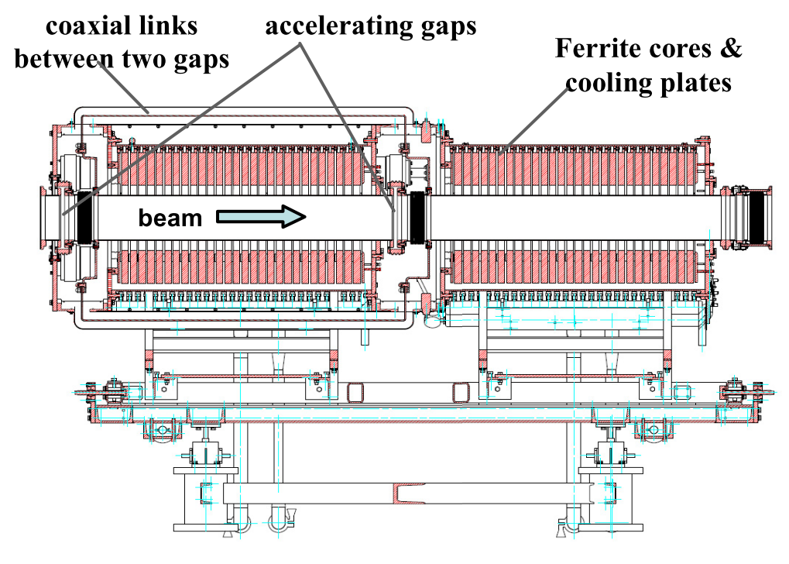
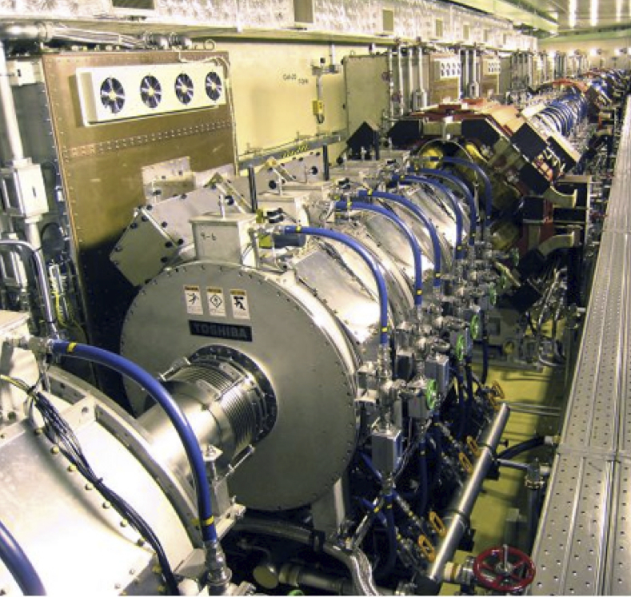
Low Frequency RF examples
Needed to capture and accelerate ions in booster and collider ring
  Low frequency (~1 MHz)
  Tunable for ramping
JPARC cavity (Metglass loaded).
Used as basis for MEIC.
CSNS cavity (ferrite loaded)

Slide 6
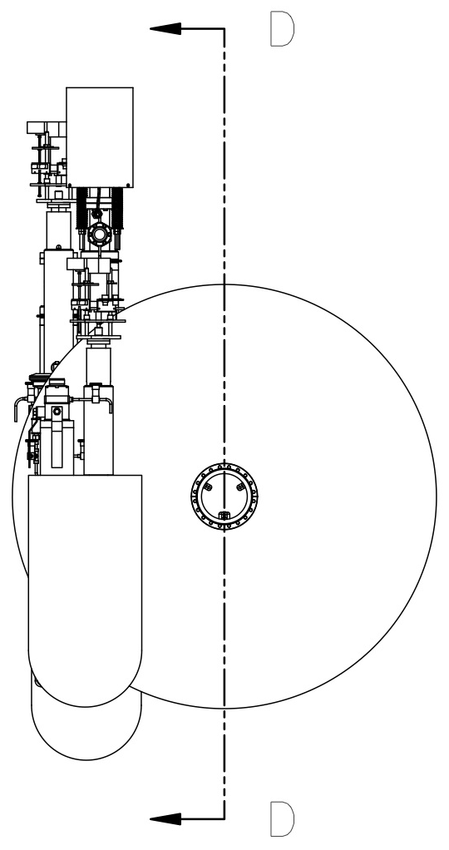
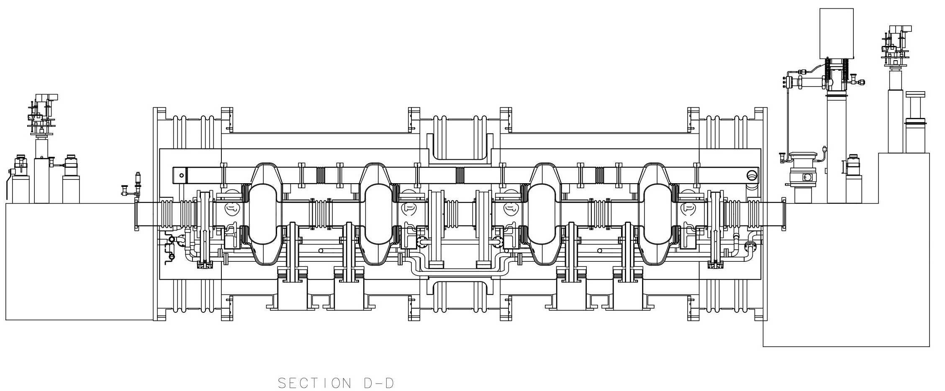
ion-ring design concept
952.6 MHz HOM damped 1-cell cavities, modular JLab type cryomodule
High frequency/high voltage for short bunch (re-bucket at energy)
Lower power couplers , no synch. rad. Power.
Tunable within one harmonic (harmonic jumps for path length changes with energy)
Current limited by space charge (limits charge per bunch)
Impedance is still a concern so HOM damping is still needed.
952.6 MHz single cell 4-seater CM
(~4.3m flange to flange)
New HOM damped cavity concept

Slide 7
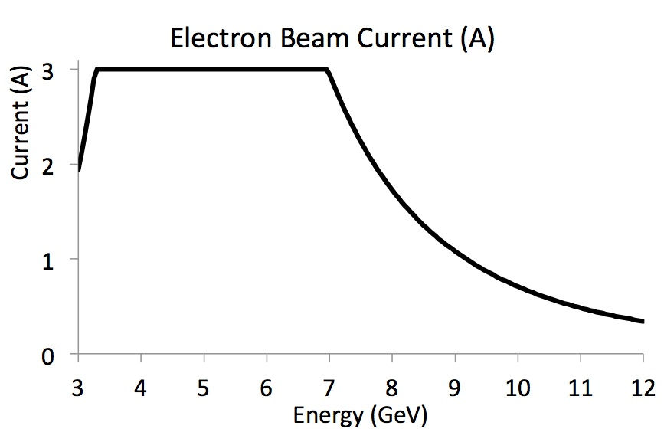
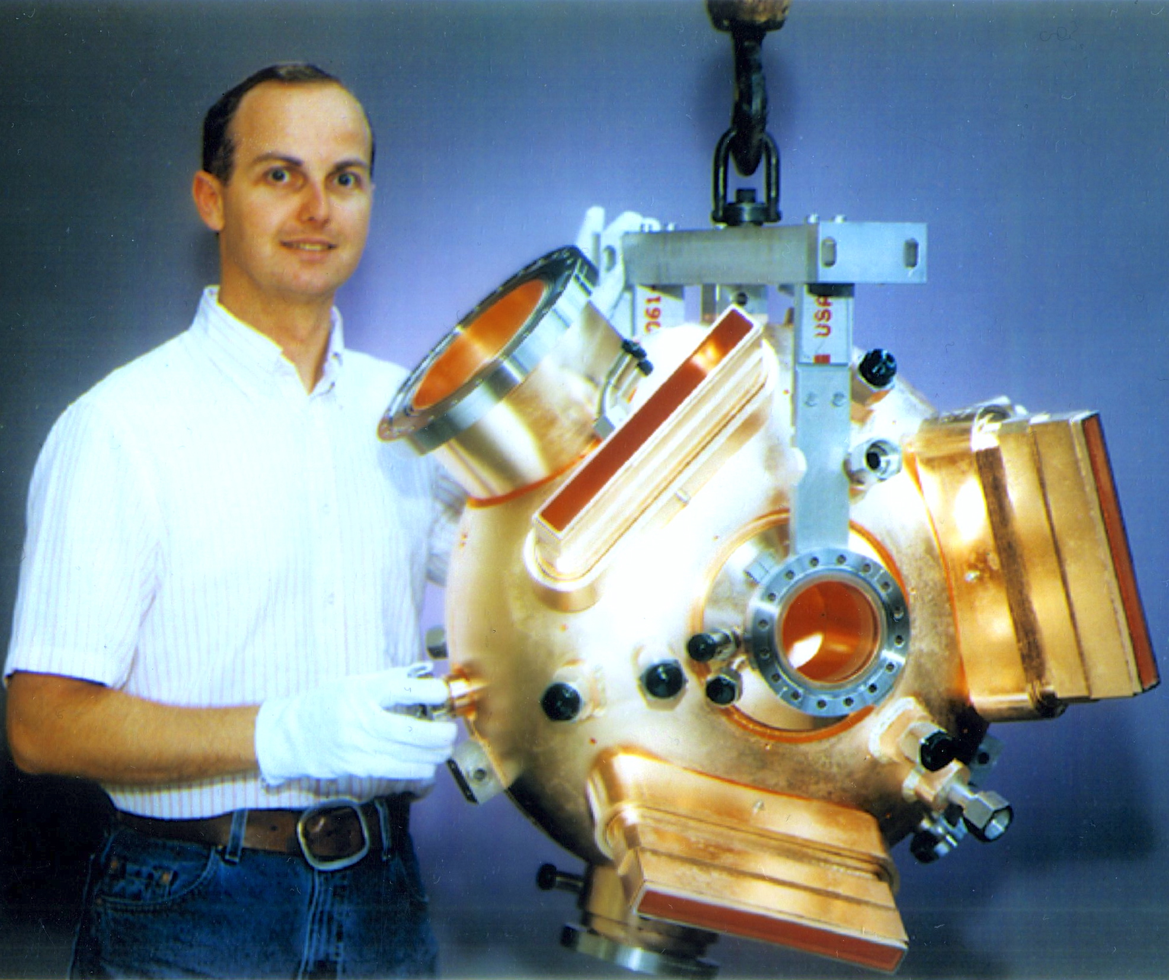
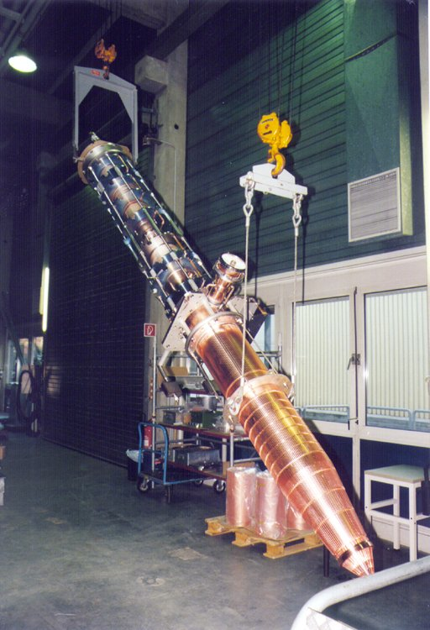
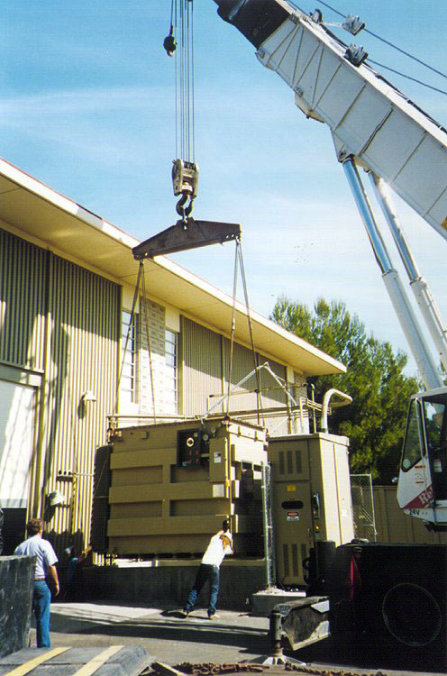
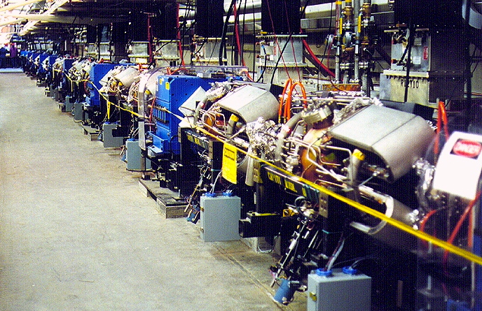
e-ring RF design
Re-use proven PEP-II RF stations
476 MHz HOM damped 1-cell cavities
  34 cavities available
1.2 MW klystrons, 13 available
  Including power supplies etc.
Current limited by synch. rad. power at high energy, impedance at low energy
Refurbishment will be needed
nominal
Impedance limited
Synchrotron power limited
PEP-II RF cavity
1.2 MW Klystron
2 MVA HVPS
PEP-II Cavities in the SLAC tunnel

Slide 8
e-cooler ERL
Booster similar to storage ring, 1 CM, 4 x 1-cell 952.6 MHz cavities, high power couplers.
Assume cost similar to ring CM
ERL LINAC needs 1 CM, 5-cell 952.6 MHz cavities, similar module but stretched, lower power couplers (like ion ring?).
One-off so cost will be higher
Should we develop new 476 MHz systems?
Cooling section
ion bunch
electron bunch
solenoid
Future fast kicker
Future fast kicker
Future circulator ring
Gun/booster
SRF Linac
dump

Slide 9
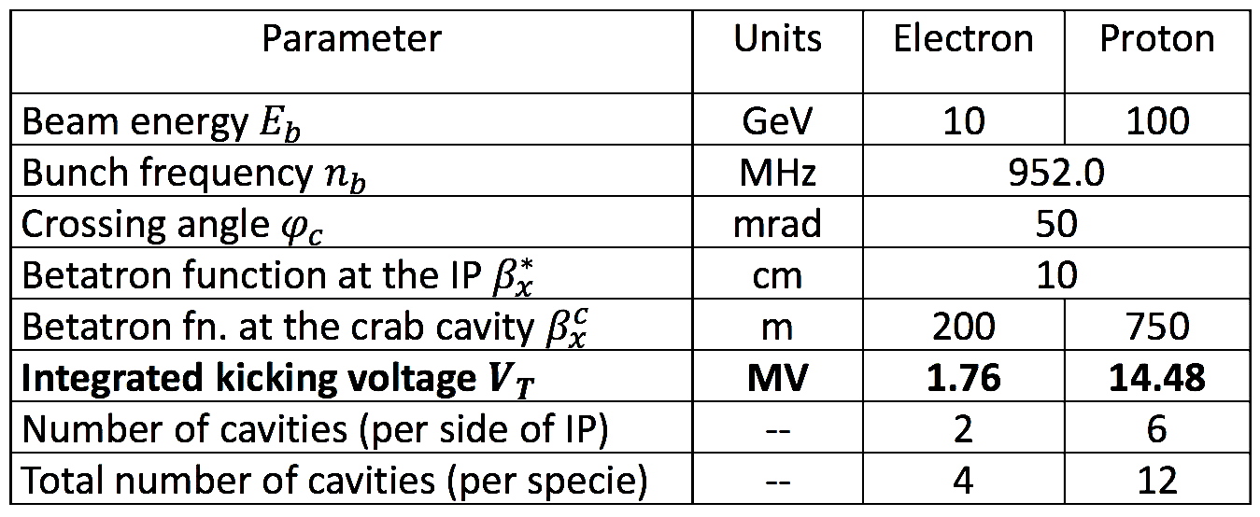
Crab cavity
Design by ODU (A. Castilla Ph.D project)
952.6 MHz “RF dipole” like LHC
Modest RF system (no beam loading)
Must have good HOM damping
Count for 1 IP in baseline
Assume cryostat cost/cavity same as ion storage ring
Per side

Slide 10
Cavity and CM counts
Up to 10 GeV electrons, 3 A max current, 100 GeV protons, 0.5 A max.
 | cavity type | Frequency | voltage/cav | power/cav | # cavities | # CM | total volts | total power | Design basis | cost basis
 |  | MHz | MV | kW |  |  | MV | kW
ion booster | NC/Ferrite | 0.58-1.27 | 0.016 | 45.2 | 2 | - | 0.032 | 90.4 | CSNS | JPARC
ion ring | NC/Ferrite | 1.22-1.26 | 0.016 | 27.5 | 7 | - | 0.111 | 192.5 | CSNS | JPARC
ion ring | SRF | 952.6 | 1.18 | 109.9 | 16 | 4 | 18.95 | 1758 | New | SNS†
e-ring | NC/PEP-II | 476.3 | 0.79 | 497.8 | 26 | - | 20.56 | 12792 | PEP-II | Re-use
i-crab | SRF | 952.6 | 2.41 | 12.5 | 12 | 4 | 28.96 | 150 | ODU | SNS†
e-crab | SRF | 952.6 | 1.68 | 12.5 | 4 | 2 | 3.37 | 50 | ODU | SNS†
cooler ERL* | SRF 5 cell | 952.6 | 14 | 30 | 4 | 1 | 56 | 120 | FEL | SNS†
cooler booster | SRF 1 cell | 952.6 | 2.5 | 500 | 4 | 1 | 10 | 2000 | FEL | SNS†
total |  |  |  |  | 75 | 12 | 138.12 | 17153
Total cryo load estimated ≤2.9 kW equivalent at 4.5K +2.4 kW 50K Shield + 3.3 g/s coupler flow, (wall plug ~1.45 MW). Probably will be reduced by running cavities at 2K
*200 mA gun, 10 MeV booster, 50 MeV ERL
† escalated to current FY

Slide 11
MEIC modular cryostat
Goals:
Take the best features of previous JLab designs
Modular approach to hold various different cavities
Design suitable for industrial production
Simple concepts, low parts count to reduce costs

Slide 12
JLab SNS module experience is the starting point
• Ion Storage Ring CMs (4 x 4-seater)
• e-cooler Booster (1 x 4- seater)
• e-cooler Linac CM (1 x 4-seater 5-cell)
• Crab Cavity CMs (2 x 2-seater and 4 x 4-seater)
Updated modular design under development
MEIC SRF design basis
SNS high β module
A. McEwen

Slide 13
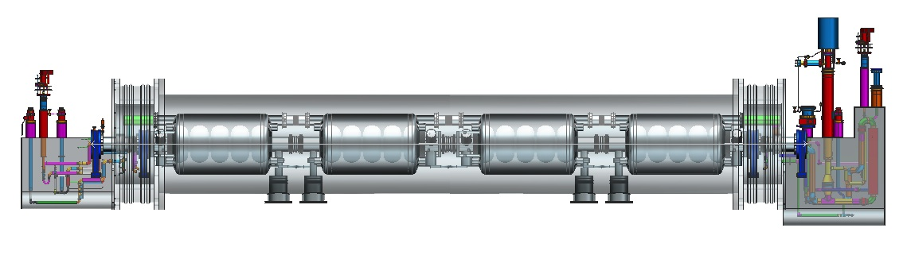
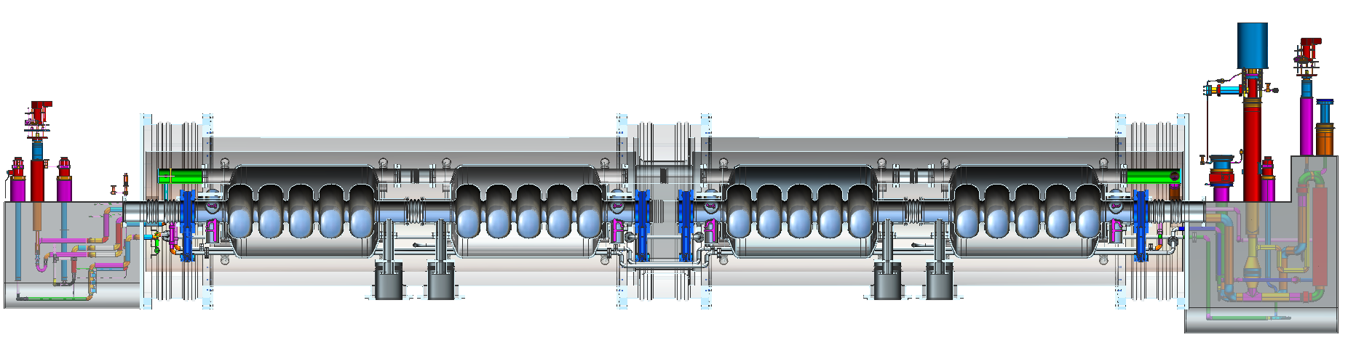
Modular cryostat
Monolithic SNS-type construction, or:
Modular cryostat with “cavity pairs” and bridging sections
Bridged version can be separated for repair or shipping
SNS type supply and return end cans shown

Slide 14
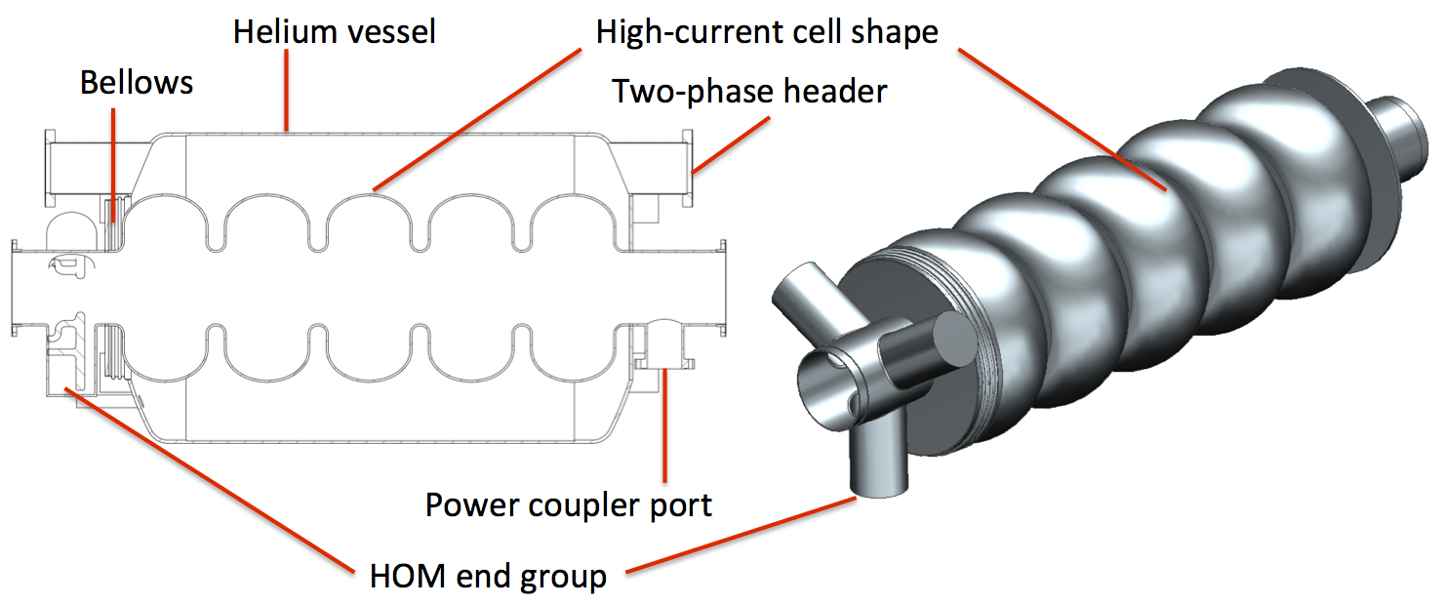
Cavity and helium vessel
Example: five-cell with symmetric HOM end group and coaxial FPC.
One helium vessel per cavity (SNS style).
End mount tuner (not shown).
The large helium vessel can accommodate alternative cavity shapes with few or no modifications.
Stainless steel He vessel and bellows.

Slide 15
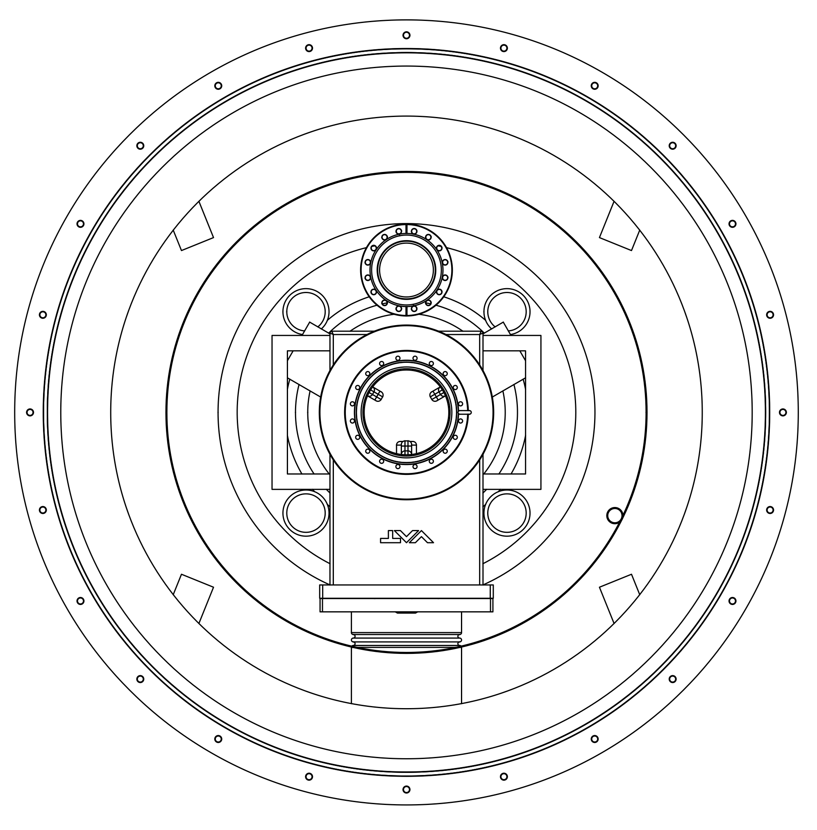
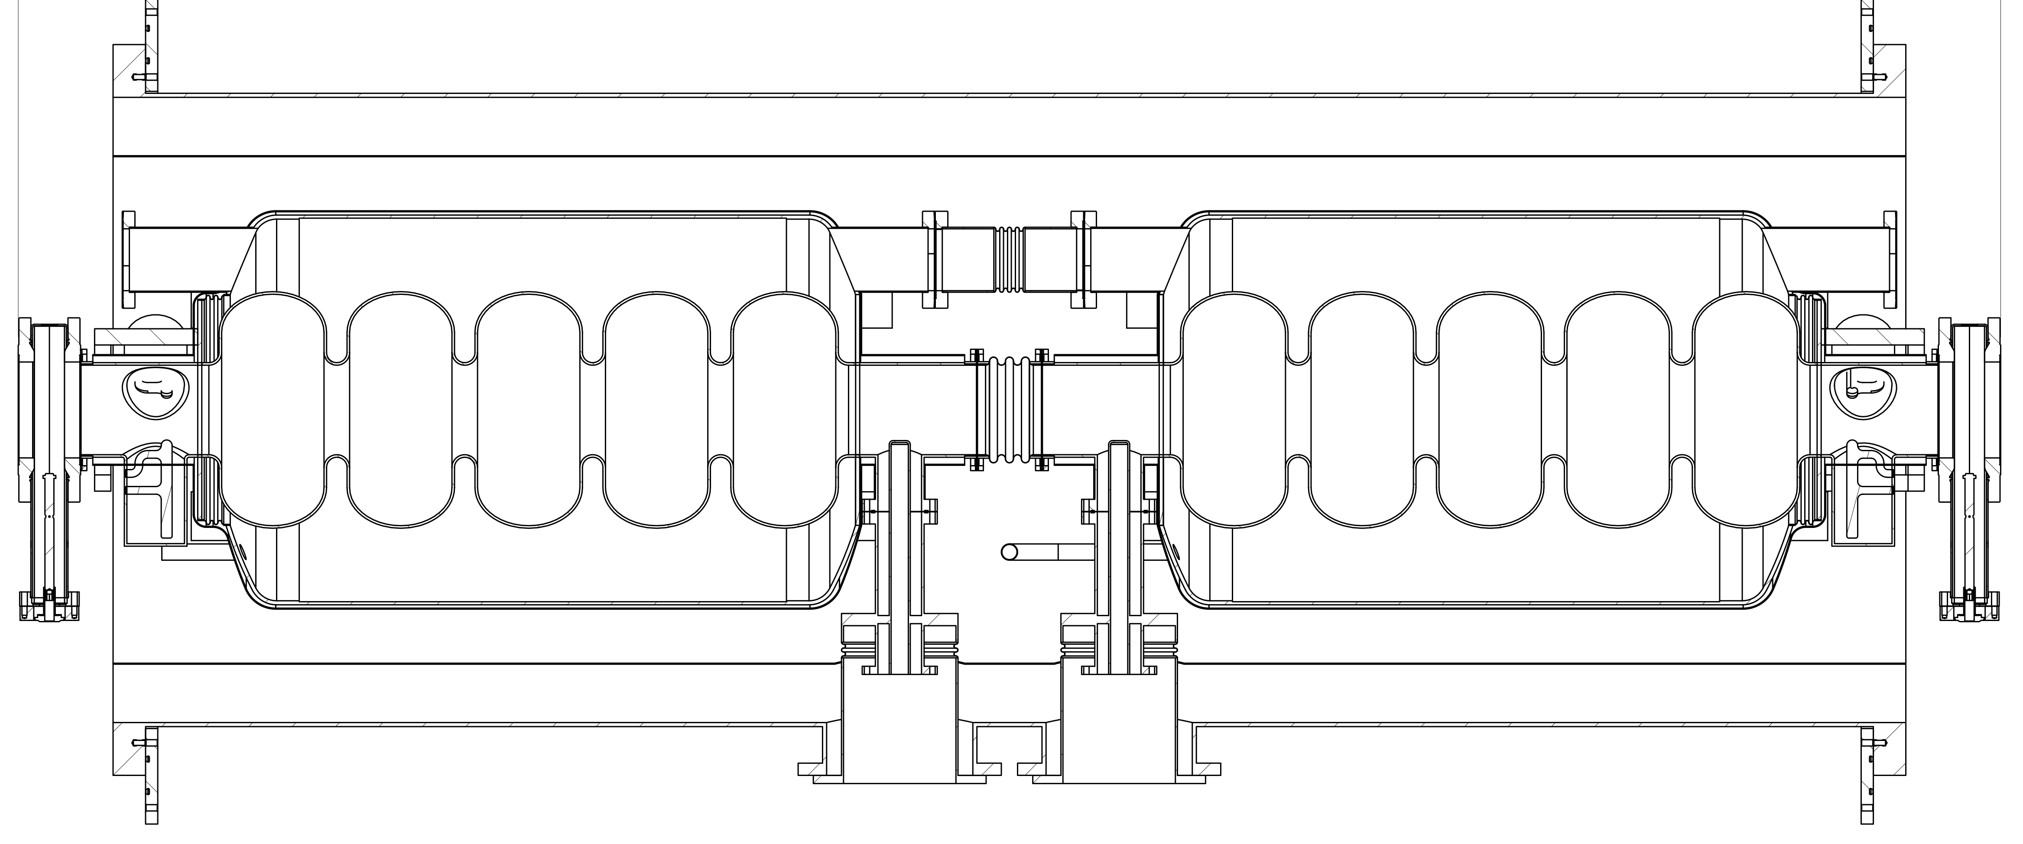
Cavity “pair”
Cavities assembled as hermetically sealed pairs
He vessels connected (no separate two-phase pipe)
Large He inventory, large free surface area
VTA tested as a unit, If good: straight to module
Minimal degradation from VTA to module
Pairs supported by rods from vacuum vessel (no space frame)

Slide 16
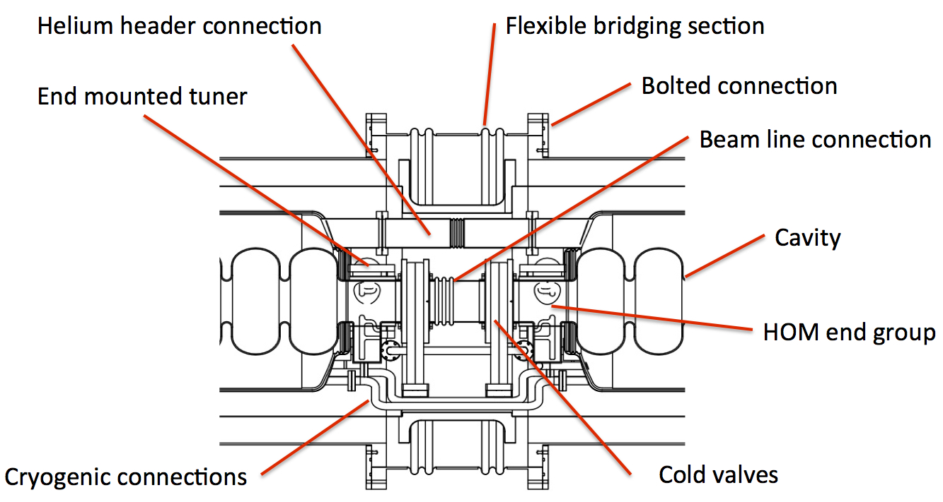
Close-up of bridging section
Bridging section showing cold valves, beamline bellows
Bolted vacuum vessel connection, helium circuit connections
Access to tuners, HOM cables etc.
Could also contain magnet, BPM or HOM load (e.g. XFEL)

Slide 17
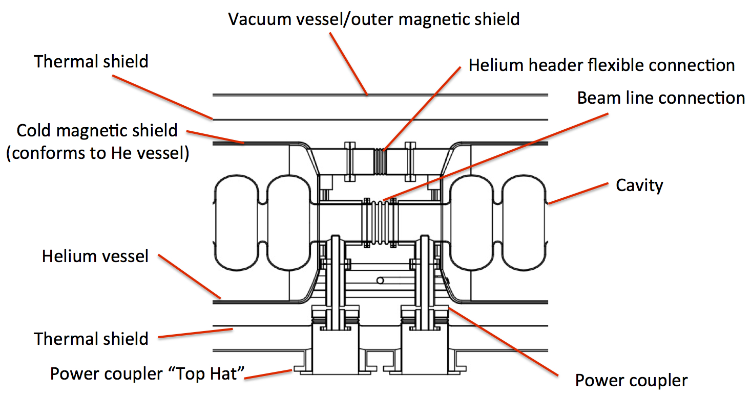
Coupler section
Close up of coupler section in the middle of each “pair”
Longitudinal fixed point is in the plane of the coupler
Bellows between cavities and helium vessels provide compliance for cool-down and alignment.

Slide 18
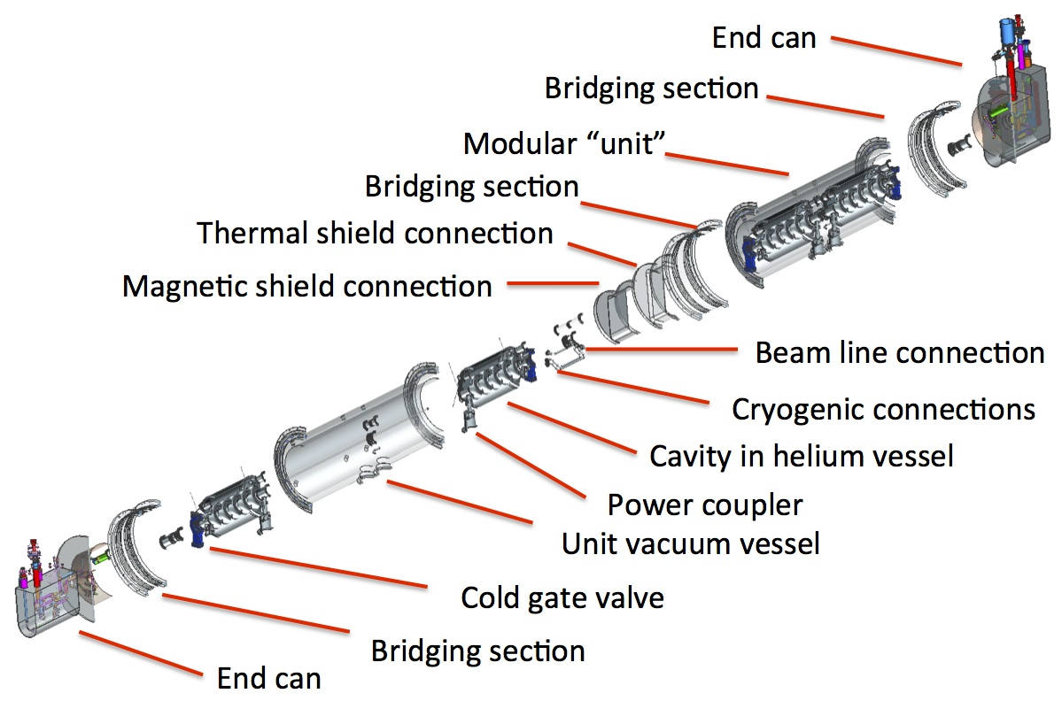
Exploded view showing details of modular construction

Slide 19
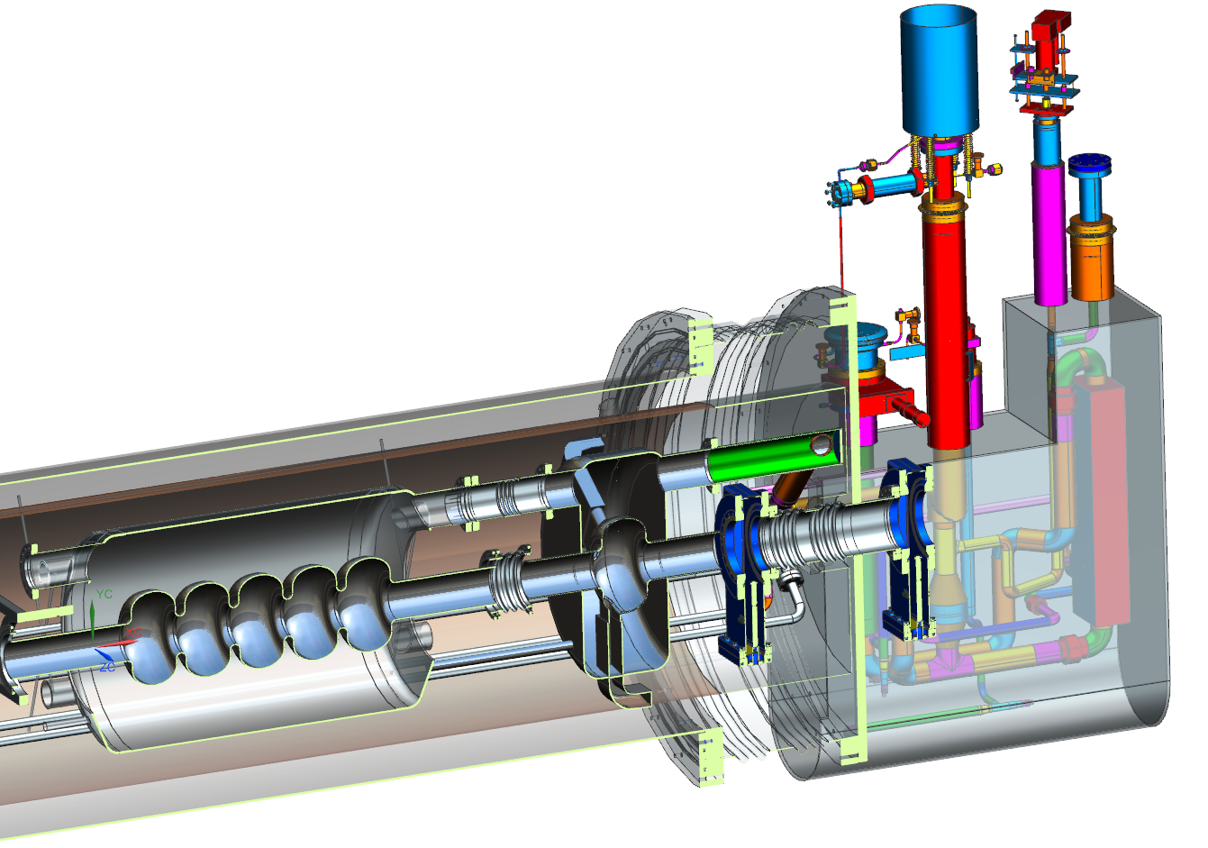
Examples: ion ring cavity
Single cell 952.6 MHz
On-cell HOM dampers
(back-up is beam-pipe loads)
Individual He vessel
Similar for cooler booster

Slide 20
Example: Crab cavity
ODU Crab cavity (RF dipole)
Need to develop HOMs and FPC specific to MEIC

Slide 21
Further cost savings options?
Use PEP-II RF systems ✔
Save 1 CM in ion ring by using higher gradient or (maybe) multi-cell cavities?
Save cryo power with higher Qo ✔
Longer bunch lengths
Lower booster injection energy (saves on LINAC)
NC ion linac
Reduced or no HE e-cooling at start ✔

Slide 22
Summary
Use of PEP-II RF systems saves money but requires re-optimization of other systems – 952.6 MHz.
Simple low-cost modular cryostat for all SRF cavities
  Versatile design accommodates various cavity types
  Modular components supplied by Industry
  Allows for common tooling and assembly practices.
  Synergy with LHeC and other projects
  Use common ancillary components as much as possible
Take advantage of ODU/LHC crab cavity R&D but need to integrate into MEIC cryostat.
2-3 year R&D plan to prepare for CDR

Slide 23
R&D task list

Slide 24
R&D task list: ion ring
Ion ring
952.6 MHz single cell, strong HOM damping, possible large tuning range. RF design, concepts, prototype
HOM and FPC options
Mechanical design, Lorentz detuning, pressure sensitivity, microphonics, thermal
Tuner design, large tuning range option?
HOM dampers thermal, mechanical design, fabrication scheme, absorber material, tests
Power coupler coax SNS, new JLab design or Waveguide?
RF system high level design, power source, LLRF controls, feedback/forward, transients
Tunnel and surface building layouts

Slide 25
R&D task list: e-ring
Electron ring (re-use PEP-II magnets & chambers)
Concept using PEP-II RF re-tuned to 476.3 MHz,
HOM power estimate, coupling factor (can it be corrected externally?)
Cu cavity refurbishment estimate
RF station refurbishment estimate, new LLRF, etc.
Stability & transient analysis, feed-forward system
SRF option (new 476.3 MHz single cell cavities?)
Tunnel and surface building layouts

Slide 26
R&D task list: cooling
Cooler ERL
952.6 MHz 5-cell with strong HOM damping, 200 mA. (476.3 MHz back-up?).
RF design, concepts, HOM and FPC options, prototype
Mechanical design, Lorentz detuning, pressure sensitivity, microphonics, thermal,
Tuner design
HOM dampers thermal, mechanical design, fabrication scheme, absorber
Power coupler coax SNS or new JLab design or WG?
RF system high level design, power source, LLRF controls, feedback/forward
Tunnel and surface building layouts
Cooler booster, Non ERL,
Single cell 952.6 MHz cavities, low beta and beta=1 RF design, concepts,
HOM and FPC options
Mechanical design, Lorentz detuning, pressure sensitivity, microphonics, thermal,
New 476.3 MHz single cell cavities? (non-baseline)
(S)RF gun option (non-baseline)
CCR RF kicker (Yulu thesis)

Slide 27
R&D task list: Crab cavities
Crab cavity (design by ODU)
System design
HOM damping/coupler by JLab?
Cryomodule integration by JLab?
RF system high level design, power source, LLRF controls, feedback/forward.
Tunnel and surface building layouts

Slide 28
R&D task list: cryomodule
Cryomodule design
Modular (hybrid, CEBAF like) concept, adaptable for all cavities
Back-up SNS like design (synergy with LHeC, etc.).
Cryogenic configuration/ heat budget
End can redesign
Prototype (not until project)

Slide 29
R&D task list: other issues
Injection scenarios from CEBAF
Low-frequency RF for booster, capture and acceleration
Barrier bucket systems for capture, re-bucketing.
Harmonic jumping/ path length correction scheme not yet well defined – may impact RF choices.
Ion complex (leave to ANL?)

Slide 30
“952 MHz” R&D task list: summary
Cavity prototypes
  i-ring RF: HOMs, FPC
  Cooler Mech: Pressure, Lorentz, microphonics
  Booster Thermal: Static, intercepts, trace cooling
  Crab (ODU)
Tuner: same for all cavities (Crab may be exception?)
FPC: common format, ~10 kW, 50 kW, 500 kW versions?
Cryostat: Modular SNS based hold all cavity types,
Hybrid/CEBAF new end cans/bridging
LLRF, HPRF, transient analysis, stability, feedback/forward
Not included:
NCRF: PEP-II refurb. Ion capture/accel. Barrier bucket?

Slide 31
Draft high-level schedule
Pre-project R&D activity | FY15 Q3 | FY15 Q4 | FY16 Q1 | FY16 Q2 | FY16 Q3 | FY16 Q4 | FY17 Q1 | FY17 Q2 | FY17 Q3 | FY17 Q4
Super-ferric 1.2m dipole prototype (Texas A&M, Dubna, GSI)
952 MHz cavity prototype (Jlab SRF)
Crab cavity R&D (JLAB SRF and ODU)
Ion Injector design and R&D (ANL, FRIB)
Fixed energy cooler design (Texas A&M)
SLAC R&D (IR, detector integration, non-linear corrections, DA)
bunched e-cooling experiment (JLAB, IMP Langzhou)
FF quad design and downselect
Magnetized e- source for ERL cooler - design and downselect
ion polarization design and simulation (Kondratenko)
e- cooling simulation
instabilities, beam-beam
As shown by Fulvia
design
fab

Slide 32
Draft schedule by task
 | FY15 Q3 | FY15 Q4 | FY16 Q1 | FY16 Q2 | FY16 Q3 | FY17 Q4 | FY17 Q1 | FY17 Q2 | FY17 Q3 | FY17 Q4
i ring cavity
cooler cavity
booster cavity
crab cavity
tuner
FPC
Cryostat
LLRF
HPRF
design
fab
test
write up CDR

Slide 33
Discussion
Deliverables :
tested cavity prototypes (4)
critical ancillary components (HOMs, tuner, FPC)
Cryostat conceptual design, engineering calculations.
no detailed drawings
no prototype cryomodule until project
LLRF and HPRF concepts and POP demos
Does not include:
PEP-II refurbishment – collaboration with SLAC?
Low frequency warm cavities for ions – collaboration with KEK?
No testing with beam – LERF or UITF?
Budget is very lean. Is this the right approach at this time?

Slide 34
Backup

Slide 35
Low frequency RF systems
Booster |  |  |  |  |  | H+ |  |  | 208Pb67+
Circumference |  | 234 | m |  | Energy | 0.28 | ~ | 8 | 0.112 | ~ | 3.2 | GeV
Harmonic Number |  | 1 |  |  | RF Frequency Range | 0.817 | ~ | 1.274 | 0.578 | ~ | 1.25 | MHz
Gaps per Cavity |  | 2 |  |  | Ramping Time |  |  | 0.396 |  |  | 0.56 | Sec
Cavity Number |  | 2 |  |  | Vgap |  |  | 8.0 |  |  | 5.75 | kV
Cavity Length |  | 2.2 | m |  | Beam Power |  |  | 8.0 |  |  | 1.85 | kW
Total Cavity Length |  | 4.4 | m |  | Power Loss per Cavity |  |  | 41.2 |  |  | 41.2 | kW
Ferrite Toroid Inner Radius |  | 0.25 |  |  | Syn. Phase |  |  | 30.0
Ferrite Toroid Outer Radius |  | 0.5
Ferrite Stack Length |  | 1
Maximum Vgap |  | 10 | kV
Collider |  |  |  |  |  | H+ |  |  | 208Pb82+
Circumference |  | 2149.9 | m |  | Energy | 8 | ~ | 100 | 3.2 | ~ | 40 | GeV
Harmonic Number |  | 9 |  |  | RF Frequency Range | 1.248 | ~ | 1.255 | 1.223 | ~ | 1.25 | MHz
Gaps per Cavity |  | 2 |  |  | Ramping Time |  |  | 12.0 |  |  | 12.2 | Sec
Cavity Number |  | 7 |  |  | Vgap |  |  | 7.9 |  |  | 7.9 | kV
Cavity Length |  | 2.2 |  |  | Beam Power |  |  | 27.5 |  |  | 10.8 | kW
Total Cavity Length |  | 15.4 | m |  | Power Loss per Cavity |  |  | 23.6 |  |  | 23.6 | kW
Ferrite Toroid Inner Radius |  | 0.25 |  |  | Syn. Phase |  |  | 30.0
Ferrite Toroid Outer Radius |  | 0.5
Ferrite Stack Length |  | 1
Maximum Vgap |  | 10 | kV

Slide 36
e-ring parameters (baseline)
Electron Ring Parameters |  |  |  |  |  |  | Energy | 4 | 5 | 10 |  | GeV
Circumference |  | 2151.452 |  | m |  |  | gamma | 7828.8 | 9785.7 | 19570.5
Rev Frequency |  | 0.139 |  | MHz |  |  | Current | 3.00 | 3.00 | 0.71 |  | A
RF frequency |  | 476 |  | MHz |  |  | Energy Spread | 3.64E-04 | 4.55E-04 | 9.10E-04
Harmonic Number |  | 3416 |  |  |  |  | Phase Slip Factor | 2.1E-03 | 2.1E-03 | 2.1E-03
Radius of Dipole |  | 110.452 |  | m |  |  | SR power per ring | 1.08 | 2.65 | 10.00 |  | MW
Dipole Bend Angle |  | 2.801 |  | degree |  |  | Energy Loss per Turn | 0.36 | 0.88 | 14.12 |  | MeV
Crossing Angle |  | 81.700 |  | degree |  |  | SR power per unit length | 1.075 | 2.625 | 9.911 |  | kW/m
Angle Factor |  | 1.454 |  |  |  |  | Veff | 0.36 | 0.88 | 14.12 |  | MV
Beta Function at RF Cav |  | 5.000 |  | m |  |  | Vpeak | 1.74 | 3.44 | 20.56 |  | MV
Momentum Compaction |  | 2.142E-03 |  |  |  |  | Syn. Phase | 12.01 | 14.89 | 43.39 |  | degree
Bunch Length |  | 12 |  | mm |  |  | Vgap | 0.43 | 0.34 | 0.79 |  | MV
Linear SR Power Limit |  | 10 |  | kW/m |  |  | Gradient | 1.4 | 1.1 | 2.5 |  | MV/m
Total SR Power Limit |  | 10 |  | MW |  |  | Syn. Tune | 0.022 | 0.028 | 0.042
CavityActiveLength |  | 0.31 |  | m |  |  | Power fed to beam per Cavity | 271.2 | 264.8 | 384.6 |  | kW
Cavity Insertion Length |  | 1.125 |  | m |  |  | Forward Power | 455.5 | 497.8 | 492.0 |  | kW
R/Q |  | 218.8 |  | Ω |  |  | Cavity Power Loss | 27.0 | 16.9 | 89.3 |  | W
Shunt Impedance |  | 7.00E+00 |  | MΩ |  |  | Reflected Power | 157.3 | 216.1 | 18.0 |  | kW
 |  |  |  |  |  |  | Coupling Beta | 3.60E+00 | 3.60E+00 | 3.60E+00
 |  |  |  |  |  |  | δf | -391.2 | -466.0 | -33.9 |  | kHz
 |  |  |  |  |  |  | Qext | 8.89E+03 | 8.89E+03 | 8.89E+03
 |  |  |  |  |  |  | Qloaded | 6.96E+03 | 6.96E+03 | 6.96E+03
 |  |  |  |  |  |  | Long. SR Damping Time | 79.39 | 40.65 | 5.08 |  | mS
 |  |  |  |  |  |  | Tran. SR Damping Time | 158.78 | 81.30 | 10.16 |  | mS
 |  |  |  |  |  |  | Min. Cavity Number | 4 | 10 | 26*
*Assumes 2 cavities per klystron. In fact some 4-cavity stations would be beneficial for more installed voltage. 34 cavities in all are available.

Slide 37
ion-ring parameters (baseline)
 |  |  |  |  |  |  | Particle | Proton | Proton | Lead ion
 |  |  |  |  |  |  | Energy | 30 | 100 | 40 |  | GeV/u
Rev Frequency |  | 0.139 |  | MHz |  |  | gamma | 33.0 | 107.6 | 44.1
RF frequency |  | 952.000 |  | MHz |  |  | Current | 0.50 | 0.50 | 0.50 |  | A
Harmonic Number |  | 6832 |  |  |  |  | Circumference | 2150.46 | 2151.36 | 2150.90 |  | m
Momentum Compaction |  | 6.413E-03 |  |  |  |  | Energy Spread | 2.00E-04 | 2.00E-04 | 2.00E-04
Bunch Length |  | 12 |  | mm |  |  | Phase Slip Factor | 5.5E-03 | 6.3E-03 | 5.9E-03
CavityActiveLength |  | 0.157 |  | m |  |  | Vpeak | 4.94 | 18.95 | 17.93 |  | MV
Cavity Insertion Length |  | 1.91 |  | m |  |  | Syn. Phase | 0.00 | 0.00 | 0.00 |  | degree
temperature |  | 4.2 |  | K |  |  | Vgap | 1.23 | 1.18 | 1.20 |  | MV
BCS Resistance |  | 348.31 |  | nΩ |  |  | Gradient | 7.837 | 7.522 | 7.591 |  | MV/m
Residual Resistance |  | 4.39 |  | nΩ |  |  | Syn. Tune | 0.031 | 0.036 | 0.034
Surface Resistance |  | 352.7 |  | nΩ |  |  | Forward Power | 50.96 | 46.94 | 109.88 |  | kW
Geometric Factor |  | 216.94 |  |  |  |  | Cavity Power Loss | 23.4 | 21.6 | 22.0 |  | W
R/Q |  | 105.687 |  |  |  |  | Reflected Power | 50.9 | 46.9 | 109.9 |  | kW
Qzero |  | 6.15E+08 |  |  |  |  | Coupling Beta | 8.70E+03 | 8.70E+03 | 2.00E+04
Shunt Impedance |  | 6.50E+04 |  | MΩ |  |  | δf | -20.4 | -21.2 | -21.0 |  | kHz
 |  |  |  |  |  |  | Qext | 7.07E+04 | 7.07E+04 | 3.08E+04
 |  |  |  |  |  |  | Qloaded | 7.07E+04 | 7.07E+04 | 3.08E+04
 |  |  |  |  |  |  | Min. Cavity Number | 4 | 16 | 15

Slide 38
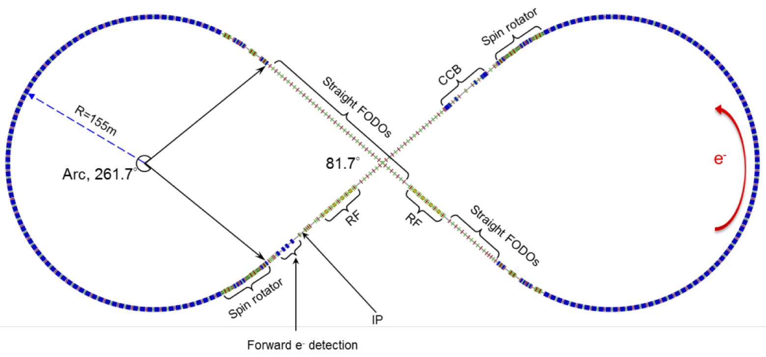
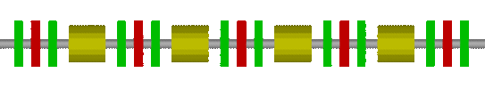
Electron Ring Layout
Electron Ring circumference 2154.3 m, each arc 754.84 m, each straight 322.31 m.
Figure-8 crossing angle 81.7°
6.54 m
Four 1m-long cavities (4 m)

Slide 39
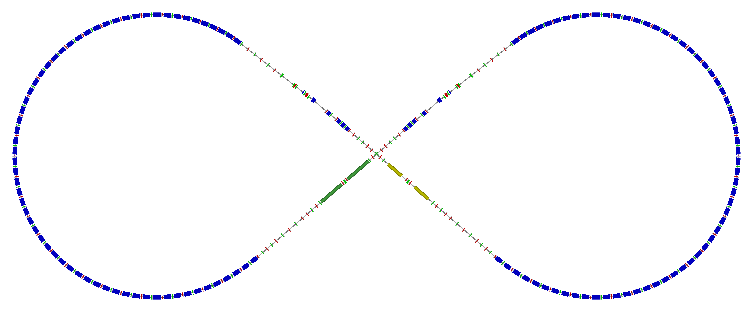
Ion Collider Ring
Circumference of 2153.5 m = 2 x 710.3 m arcs + 2 x 366.4 m straights
81.7° figure-8 crossing angle
disp. supp./
geom. match #2
disp. supp./
geom. match #2
Arc, 261.7°
tune
tromb.+
match
el. cool.
norm.+
SRF
det. elem.
R = 155.5 m
beam exp./
match
disp. supp.
ions
IPs
disp. supp./
geom. match #1
disp. supp./
geom. match #1

