Slide 1
RF system for MEIC Ion Linac: SRF and Warm Options
Jiquan Guo
6/18/2015

Slide 2
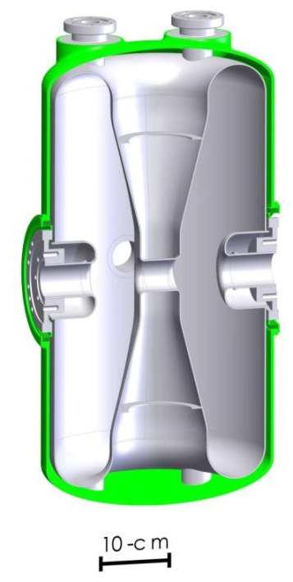
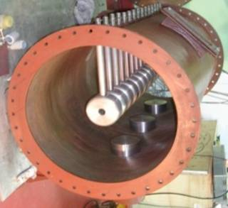
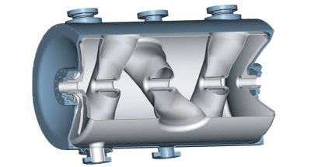
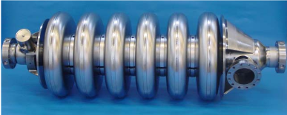
Hadron Linac: Typical Layout
~0.1MeV
0.5-5MeV
5-200MeV
80-300MeV
>300MeV
Source
RFQ
Alvarez/IH/CH/CC DTL
SRF spoke or QWR/HWR
SRF elliptical cavities
Alvarez DTL
IH-DTL
CH-DTL
SRF CH-DTL
SRF HWR
SRF Spoke
Elliptical (medium β)

Slide 3
Technology choice
SRF single/double gap/elliptical
Warm multi-gap (DTL)
CW operation Low duty cycle pulsed
Low beam current High (pulsed) current
High β Low β
Different particles w/ same E_{k}/q Different particles w/ same E_{k}/u
SRF cavity: high Q₀, high RF efficiency overall; but cryo-cooling has very low efficiency, static cryo load might be dominant for pulsed operation.
Warm cavity: RF efficiency much lower than SRF, but can be mitigated with pulsed operation; easier to manufacture, especially for multigap; not sensitive to magnetic field.
Single/double gap: flexible phase control, each cavity has good TTF for a wide range of β.
Multi-gap: high Z_{eff} /L especially at low β, TTF only good for fixed β; need to lower gradient for high Q/A (lighter) ions, which gives higher beam current capability, but will also worsen space charge effect at the low energy end and limit the beam current.

Slide 4
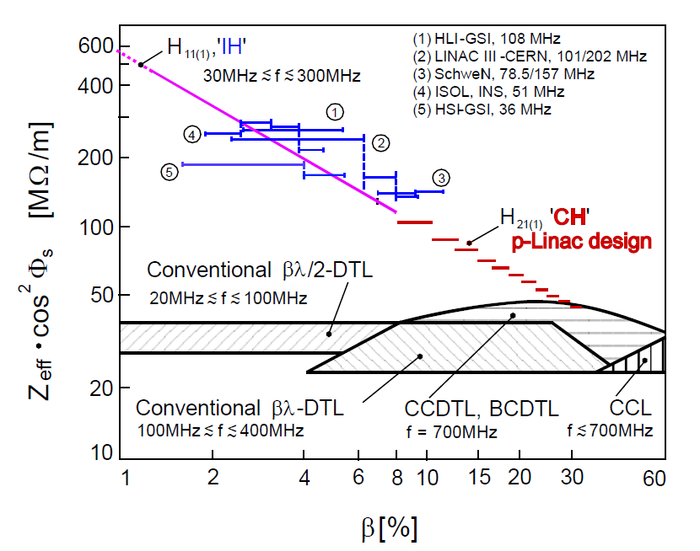
DTL Efficiency
G. Clemente, CARE-Note-2007-001-HIPPI
IH-DTLs are proven up to 8-10MeV/u
FAIR 70MeV proton linac CH-DTL is under commissioning, a heavy ion version of CH-DTL for up to 22MeV/u U³⁸⁺ has been proposed
Other DTLs like CC-DTL work at higher energy.
DTL (Drift Tube Linac) is a multi-gap accelerator structure with very high R/Q/L at low β. Efficiency drops as β goes higher, especially for IH/CH structures
Phase of different gaps are synced by the particle’s drift time. The structures have fixed (or very narrow) β profile.
Typical SRF QWR has Z_{eff} in the order of 10¹¹-10¹²Ω/m, 3~4 order of magnitude better

Slide 5
MEIC Booster Ring Injection Requirements
E_{k}/u: ~50MeV for Pb^{62+#,} ~100MeV for H⁻ (low energy injection scheme)
Short pulse width: up to 0.5ms from ion source
Low ion source current: up to 4mA for polarized H⁻, as low as 0.1mA for Li³⁺
Low rep-rate: 5 Hz nominal for the linac.
Very low duty factor: 10⁻³ when the booster ring is actively accumulating beam from the linac. 10⁻⁴-10⁻⁶ overall, as the linac idles most of time (during collision or when the booster ring is cooling/ramping)
Booster ring takes 0.06-0.4µC for each accumulation, limited by space charge. Needs 27-90 accumulations per injection cycle. For some particle species, one linac pulse is enough for one accumulation, some other species may need 10s of pulses
Need to carefully examine the cost and performance of both warm and SRF technologies, with the consideration of the newest development in ion source and booster ring
# Pb charge state depends on stripping energy, which will be chosen to minimize total accelerating voltage, depending on the final particle energy. Here assumes a stripping energy of ~9MeV/u

Slide 6
DTL/SRF options for H⁻ and heavy ions
DTL linac for ~50MeV/u Pb⁶³⁺ and ~100 MeV H⁻
Ion sources
RFQ
DTL1
DTL2
DTL3
2
IH
1 station for multi-particle to 9.5MeV/u
4 stations for multi-particle to 50MeV/u
2 stations for H⁻ to ~100MeV
MEBT
Stripper
Each DTL station contains 1-4 tanks powered by a 2.5-3MW, 325/352MHz pulsed klystron.
High power splitters might be needed.
CH DTL structures might be used.
SRF linac for 40MeV/u Pb⁶¹⁺ and ~120MeV H⁻
Pb stripping energy: ~8.5 MeV/u
Ion sources
RFQ
QWR
QWR
HWR
IH
2
10 cryostats
1 cryo
2 cryos
2 cryos
MEBT

Slide 7
RF parameters for warm DTL linac sections
Section | RFQ | IH DTL | DTL1 | DTL2 | DTL3
Lowest Q/A particle to accelerate | Pb³⁰⁺ | Pb³⁰⁺ | Pb³⁰⁺ | Pb⁶³⁺ | H⁻
Frequency (MHz) | 81.25 | 81.25 | 325 | 325 | 325
Max beam current (mA) | 4 | 2 | 2 | 2 | 2
Exit E_{k} (MeV/u) | 0.3 | 5 | 9.5 | 50 | 95
Exit β | 0.025 | 0.103 | 0.141 | 0.314 | 0.428
Max total V_{eff} (MV) | 2.1 | 32 | 31 | 134 | 45
Avg Z_{eff}/L (MΩ/m) |  | ~250 | ~75 | ~55 | ~35
Number of stations | 1 | 3 | 1 | 4 | 2
Structure length per station (m) | 4 | ~2.5 | ~6.5 | ~10 | ~9
P_{cu, peak} per station (kW) | ~60 | ~180 | ~2000 | ~2000 | ~2000
RF pulse width (µs) | ~500 | ~500 | ~500
Max beam power per station (kW) | ~8 | ~20 | ~50 | ~50 | ~45
RF source | 4 Tetrodes, 200-400kW/ea |  | 7 Klystrons, 2.5MW/ea
Z_{eff}/L is estimated based on CERN Linac III and FAIR proton linac design
Total RF power: ~19MW with ~0.5ms pulse width, costs ~$10M including modulators
Overall wall plug power will be dominated by equipment idle power, in low 10s of kW
Z_{eff}=V_{eff}²/P_{wall}

Slide 8
RF parameters for SRF linac sections
Section | QWR1 | QWR2 | HWR
Lowest Q/A particle to accelerate | Pb³⁰⁺ | Pb⁶¹⁺ | Pb⁶¹⁺
Frequency (MHz) | 81.25 | 81.25 | 162.5
Max beam current (mA) | 2
Number of modules | 1 | 2 | 2
Cryomodule length (m) | ~8
Cavities per module | 9
V_{eff} per cavity (MV) | 2.8 | 2.8 | 3.3
Exit E_{k} (MeV/u) for Pb | 8.5 | 23 | 40
Exit E_{k} (MeV/u) for H | 30 | 70 | 120
P_{Nb,peak} per cavity (W) | ~10 | ~10 | ~30
Static heat per cavity (W) | <=2
RF pulse width (ms) | 4 | 4 | 5
beam power per cav (kW) | 5.6 | 5.6 | 6.6
Installed RF power per cavity (kW) | 12 | 12 | 12
Total RF power :
45*~12kW with ~5ms pulsewidth
4*~300kW with ~0.5ms pulse
Assumes 4K operation and 15° ϕ_{s}; 2K operation may have much higher Q₀ and lower P_{cav}, but higher wall plug power
Total 4K heat load: <90W static; ~30W dynamic avg during 5Hz active operation, overall dynamic load negligible
~30kW wall plug power to cool

Slide 9
Summary
The requirements of MEIC injection, especially the pulsed beam time structure, made warm DTL a very attractive option.
Wall plug power for either warm or SRF linacs won’t be significant for injection operation.
Capital cost of the warm linac will be dominated by RF sources and DTL structures, while major cost for the SRF linac will be the cryomodules. A precise cost estimate is needed for further comparison.
SRF linac has more flexibility for possible energy upgrade and side program.

