Slide 1
RF Shielded Bellows for JLIEC
M. Wiseman, C. Hutton
11/11/19

Slide 2
JLEIC Shielded Bellows
Bellows we have looked at so far have been based on PEP-II bellows.
Arc bellows
Round version based on the arc bellows
Double bellows for the IP area
Ion Ring requirements
Different needs?
Disclaimer - The information gathered on bellows designs are from various material found on the internet. I don’t know if these are the final designs or in some cases even built.

Slide 3
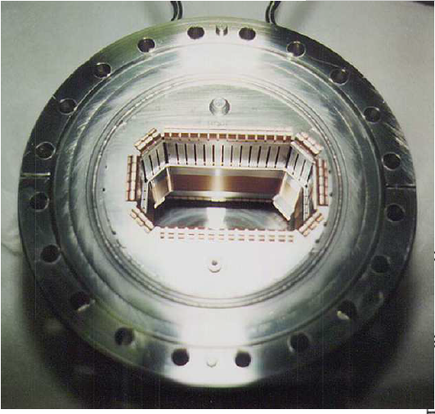
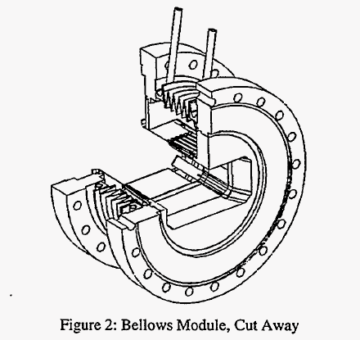
PEP-II Design
We have generated a CAD Model based on the PEP-II arc bellows design
Based on PEP-II drawings and various papers and limited consulting of SLAC personnel.
4.6 x 8.6 cm aperture in the SR mask
Beam
PEP-II Design (left)
19 mm of motion for 150 C in-situ back out or for installation
Additional 6.3 mm for chamber alignments
Total ~25 mm of beam line motion

Slide 4
PEP-II Design
We have generated a CAD Model with a round aperture scaled from the ARC design
We have not looked at SR ray tracing on this design so the entrant mask may have to change
9 cm diameter aperture

Slide 5
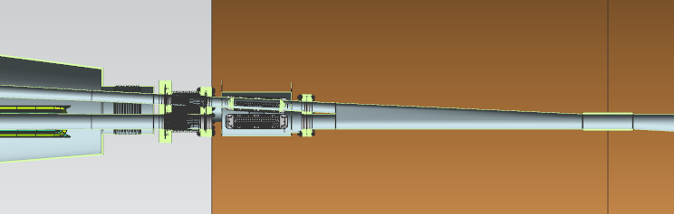
IP Double Aperture Design
On the Ion upbeam side of the IP we have an area where the e beam and Ion beam lines are close together and it has been difficult to design separate RF shielded designs, so we developed a straw man design that combined the two
Original concept presented to this group Feb. 19, 2018
Have concerns on impedance and trapped HOM power in this area
Originally tried to keep beam line bellows near IP out of the cryostat
Should I try to keep this constraint?
RF shielded bellows
NEG Vacuum pumps
ion Beam
e Beam
Magnet cryostat vacuum vessel
IP
1.6 m

Slide 6
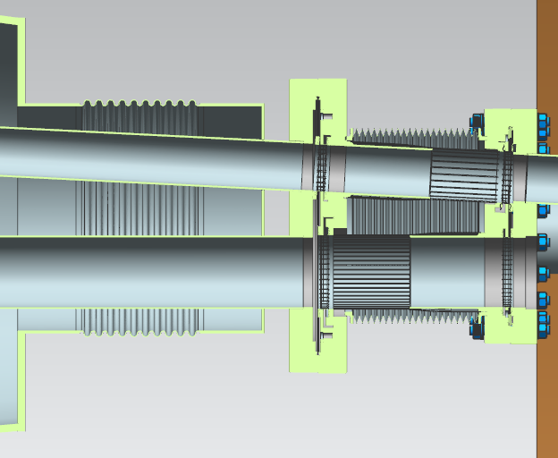
IP Double Design
SR mask ID’s
Ion beam 4cm
E beam 6cm
Two shielded beamlines
Common flanges, vacuum space, and bellows
Thermal contraction in cryostat
Cryostat may be as long as ~12.2 m, so ~37 mm total thermal contraction in two bellows – PEPII design just meets this
Bellows on cryostat vacuum space to accommodate movement
If we move the beamline bellows inside the cryostat we will still likely need a warm bellows for installation, etc..
May also have heating in the IP chamber to accommodate
Many problems with this design still to be worked out
Assembly
Accommodation finger motion as the angle changes do to movement
Etc.
Have had difficulties with impedance calculations, accuracies of the CAD model, etc.
More from F. Marhauser later
Do we need the same RF design for both the electron and ion line?
If not we may be able to simplify the design
Fixed face of cryostat
Fixed Flange
Movable Flange

Slide 7
ION Ring Requirements
How much have we looked at the ion line requirements?
ARC magnet cell length ~12.2 m
~37 mm of thermal contraction
Single cold bellows in the interconnect area
Ion down beam cryostat maybe ~13.9m long
~42 mm of thermal contraction
Probably two to three bellows
Beam line aperture10 mR from IP to meet detector requirements, 340 mm at exit
Cold aperture due to magnet requirements
Haven’t looked a other areas of the ion line
Additional bellows requirements
Installation, misalignment, etc.
I have found limited information on the RHIC bellows and some on LHC bellows. Are their others?
Arc Magnet Cell
Interconnect area
~13.9 m
ion Beam
Ion IP magnet cryostat

Slide 8
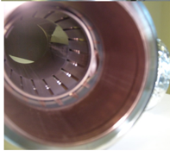
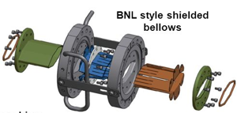
RHIC Designs
Hard time finding details on any design
Various papers indicate that most bellows where shielded and that limited number of specialty bellows may not have been
Found a singular picture on one slide
Also found singular picture below – source unknown so not sure where used
“In-situ coating and scrubbing of long narrow beam pipes for eliminating electron clouds and reducing vacuum wall RF resistivity”, A. Hershcovitch et. al., BNL, ECLOUD, 2018

Slide 9
LHC
Accommodates large thermal movement
At least ~45 mm for 15 m dipoles
Relatively simple compared to PEP-II design
Still not simple
Adequate for JLEIC?
LHC Status and commissioning Plans”,
G. Arduini, CERN 9/10/2007

Slide 10
LHC
The usual problem with this type of design
Problems discovered during initial installation and required X-Ray of installed bellows
5 out of the first 250 X-rayed had problems
I have seen nothing on operational experience
LHC Status and commissioning Plans”, G. Arduini, CERN 9/10/2007

Slide 11
Misc. Designs
There are many other designs out there
Most seem to have fingers
The KEK ‘comb’ style RF shield is different but seems to have limited movement and is expensive
Others to look at?
Source unknown

