Slide 1
JLEIC Impedance Summary
Rui Li
JLEIC Impedance Meeting
3-25-2019

Slide 2
Outline
Broadband impedance
Scaling from existing machine
Major contributors
Other ion machine impedances
Roman Pot
Narrowband impedance

Slide 3
Broadband Impedance in JLEIC
Impedance budget studies
Complete inventory of impedance-generating components
Engineering design and drawing of each components
EM field modeling for wakefield or impedance spectrum
Current status of impedance studies in JLEIC
Engineering design is in its early phase
Component counts are done (subject to modification)
Impedance are estimated using impedance budget of
existing machines for reference

Slide 4
Broadband Impedance Estimation: JLEIC e-Ring
Component Counts
(T. Michalski)
Impedance Estimation
(K. Deitrick)
Elements | e-Ring
Flanges (pairs) BPMs Vacuum ports Bellows Vacuum Valves Tapers Collimators DIP screen slots Crab cavities RF cavities RF valves Feedback kickers IR chamber | 1215 405 480 480 23 6 16 470 2 32 68 2 1
Broadband Impedance | Reference: PEP-II | Reference: SUPERKEKB
 | 99.2 | 28.6
 | 0.09 | 0.02
 | 7.7 | 19
 | 60 | 13
JLEIC plans to use PEP-II vacuum systems
Effective impedance is bunch length
dependent

Slide 5
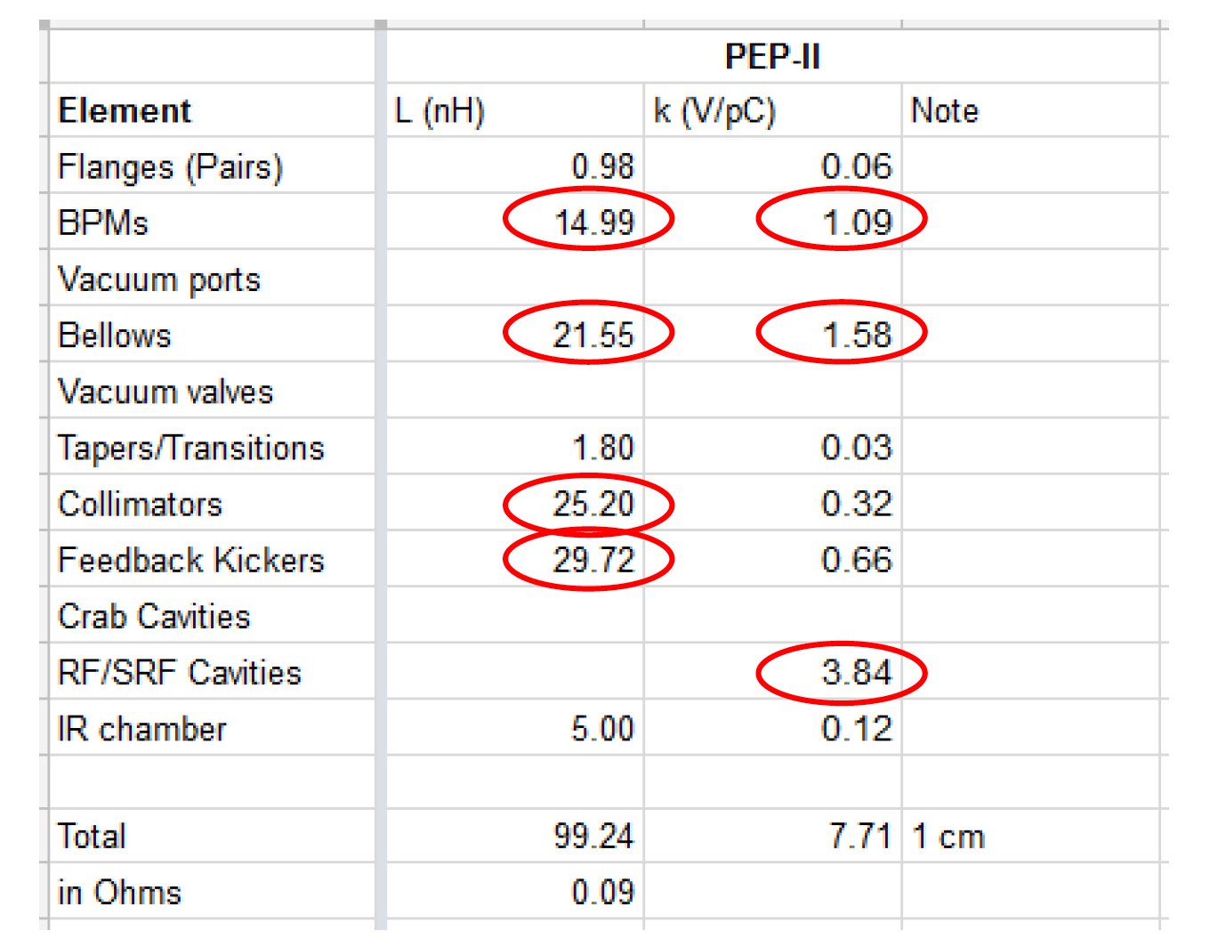
Electron Ring Breakdown (using PEPII elements)
L/L_tot
15%
22%
25%
30%

Slide 6
Broadband Impedance Estimation: JLEIC ion-Ring
Component Counts
(T. Michalski)
Impedance Estimation
(K. Deitrick)
Elements | p-Ring
Flanges (pairs) BPMs Vacuum ports Bellows Vacuum Valves Tapers Collimators DIP screen slots Crab cavities RF cavities RF cavity bellows RF valves Feedback kickers Roman Pot IR chamber | 234 214 92 559 14 6 16 - 8 40 40 24 2 2 1
Broadband Impedance | Reference: PEP-II
 | 97.6
 | 0.08
 | 8.6
 | 80
The short bunch length (1.0cm) at
collision is unprecedented for the ion
beams in existing ion rings
Bunch length varies through the whole
bunch formation process

Slide 7
Broadband Impedance for Other Lepton Rings

Slide 8
Broadband Impedance for Other Ion Rings
RHIC (measurement)
(“Longitudianl Impedance of RHIC”, M. Blaskwicz, etc)
(“Transverse Impedance Measurement in RHIC and the AGS”,
N. Biancacci, etc)
LHC (measurement)
(“Beam Measurement of LHC Impedance…”, J. F. E. Muller, etc)

Slide 9
Roman Pot
The Roman Pot is an experimental technique for the detection of forward protons from elastic or diffractive scattering.
It has been successfully employed in other machines like the SPS, TEVATRON, RHIC and DESY.
The challenging constraints of LHC, such as the narrow high intensity beam with energy of 7 TeV, the Ultra High Vacuum and the high radiation fluxes have required the development of new Roman Pots.
measured value for (Z_long/n)eff LHC= 90mΩ

Slide 10
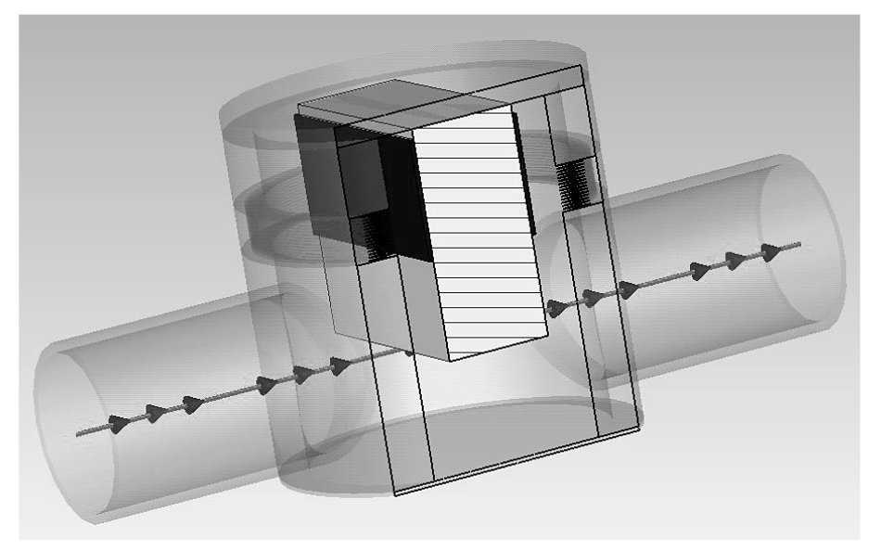
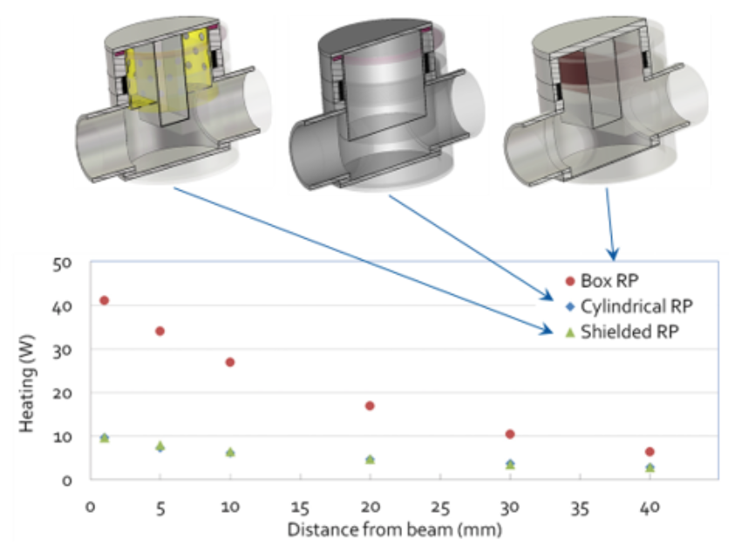
Roman Pot

Slide 11
Narrowband Impedance in JLEIC
RF Cavities
PEPII RF cavities
Ion ring cavities
Crab cavities
Other Components
IR vacuum chamber
Collimators
IR Bellows
Roman Pot

Slide 12
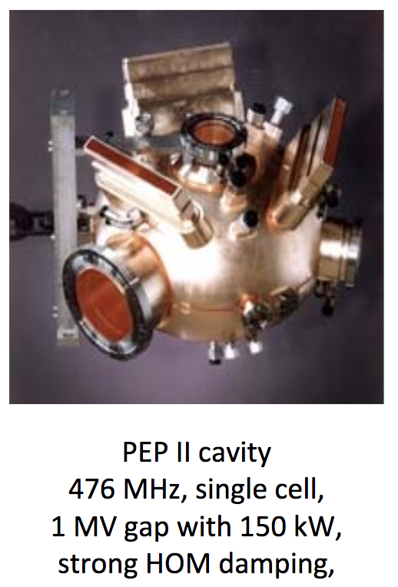
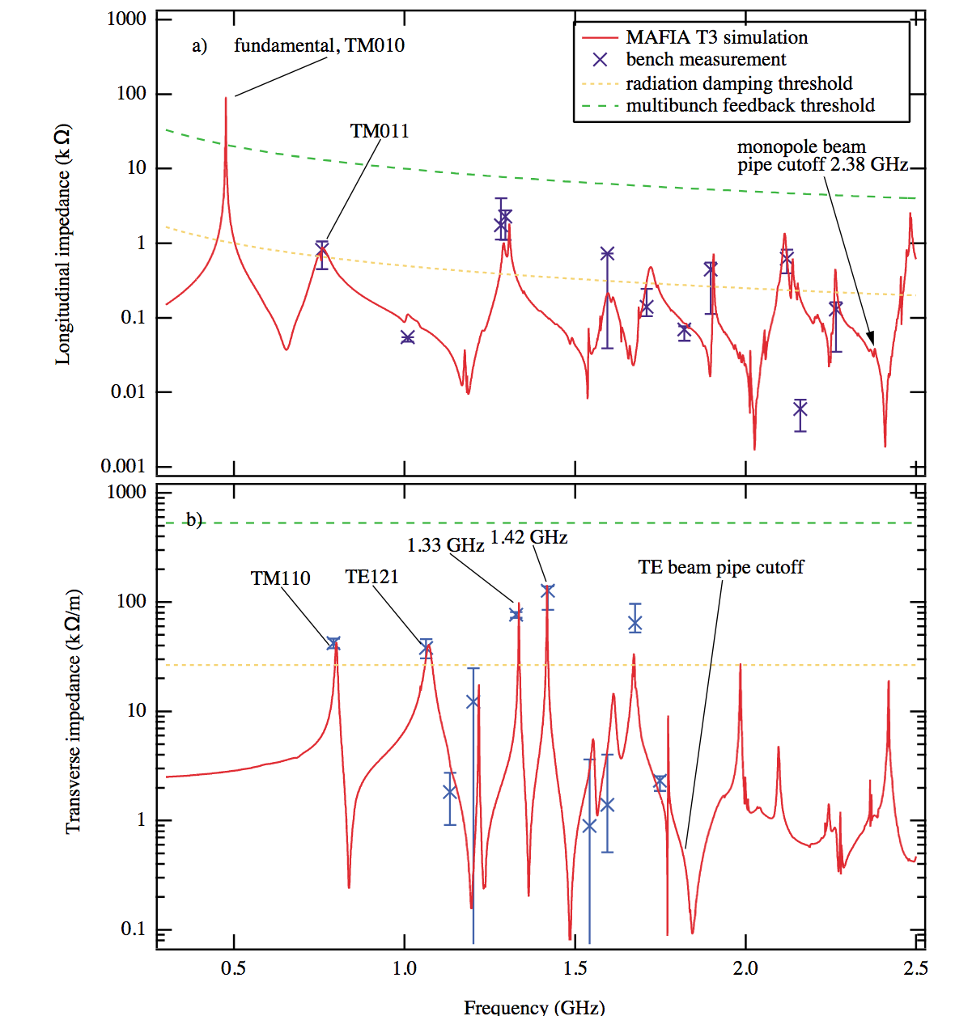
Narrowband Impedance: JLEIC e-Ring RF Cavity
RF cavity in e-Ring (PEP-II cavities)

Slide 13
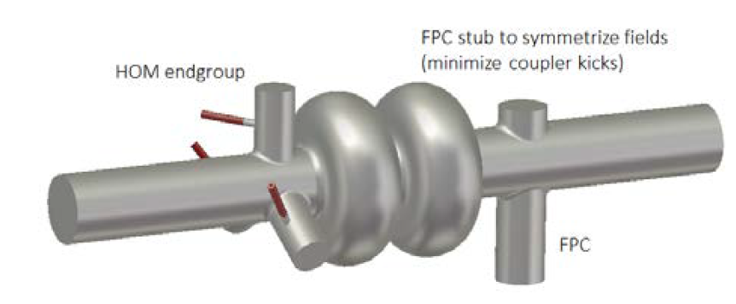
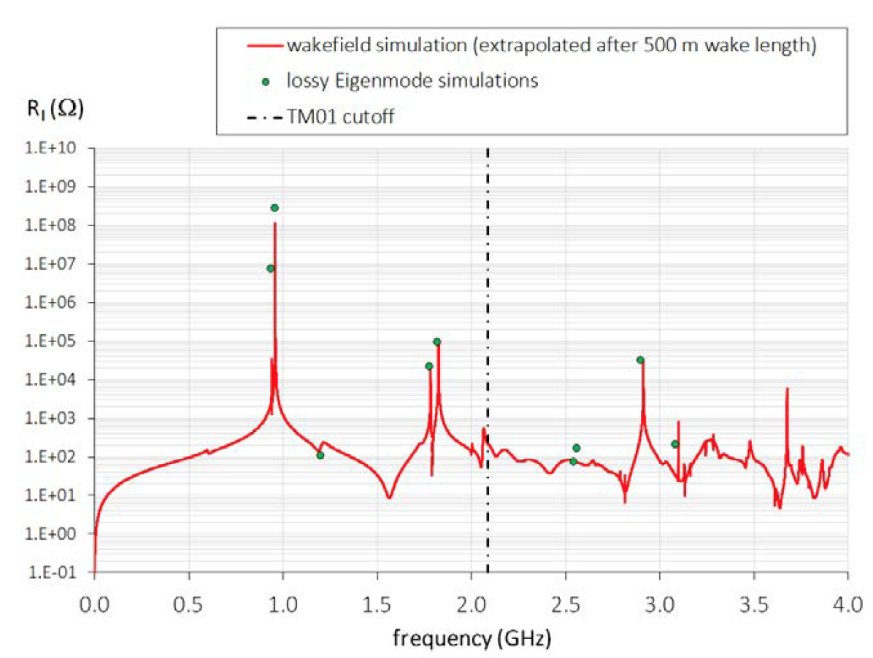
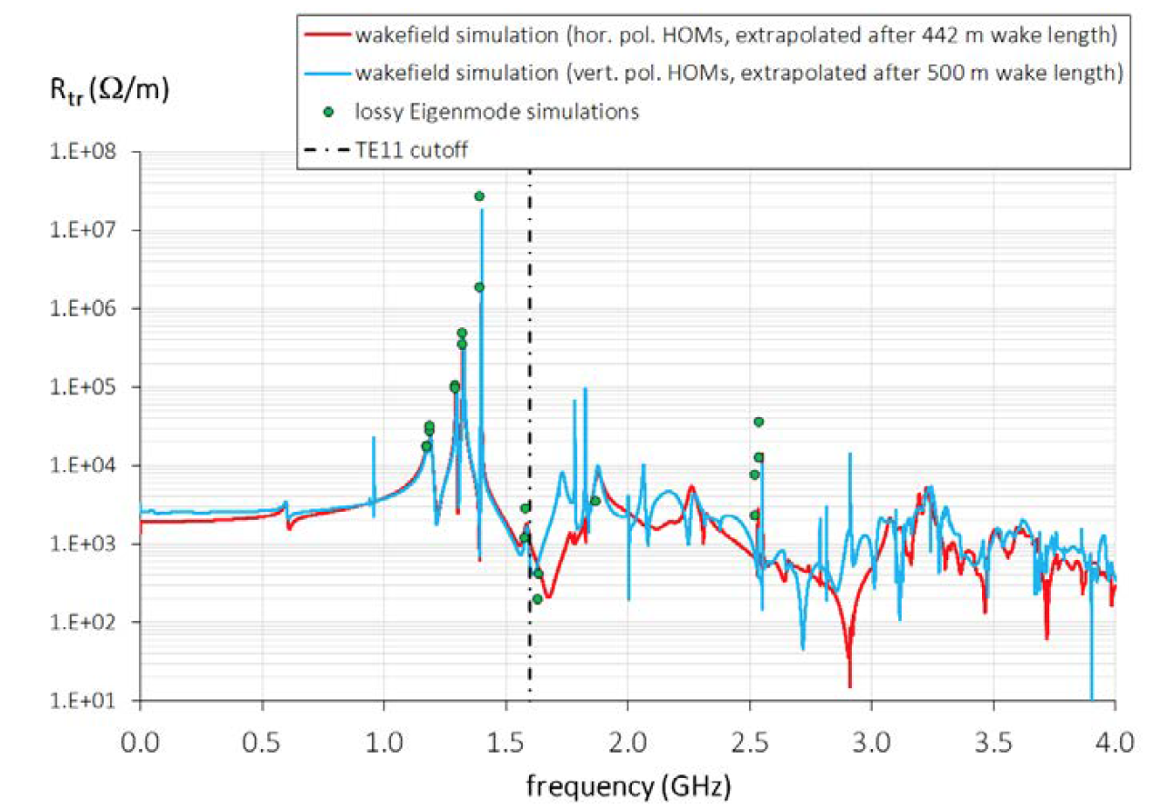
Narrowband Impedance: Ion-Ring RF Cavity
956 MHz 2-cell Cavity
(F. Marhauser)
as tradeoff between accelerating
and HOM-damping efficiency
causes LCBI

Slide 14
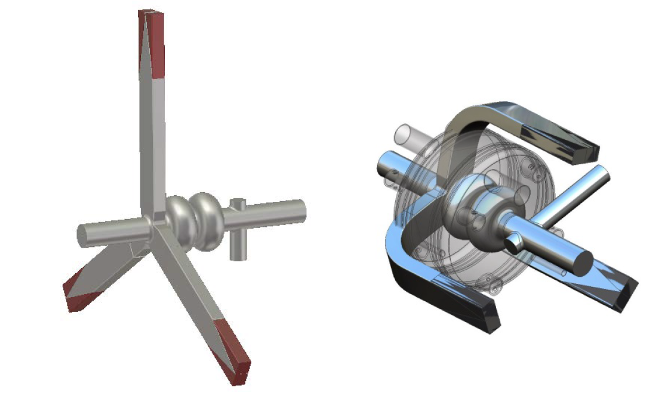
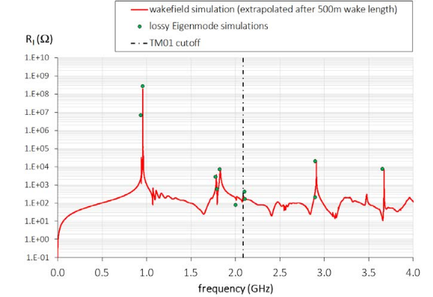
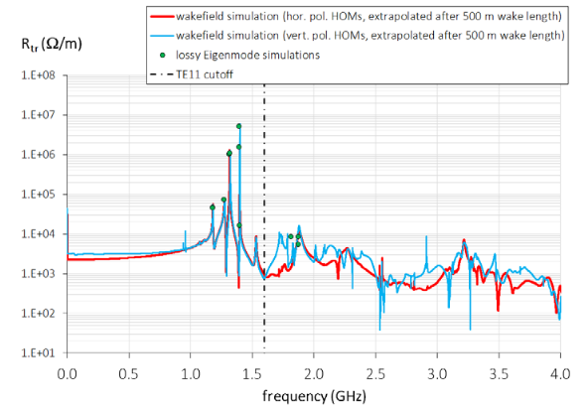
Narrowband Impedance: Ion-Ring RF Cavity
956 MHz 2-cell Cavity
(F. Marhauser)
waveguide couplers
reduced LCBI growth rate

Slide 15
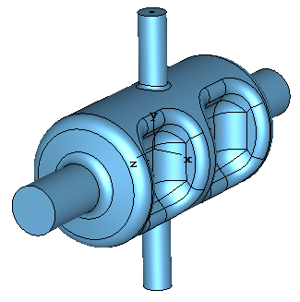
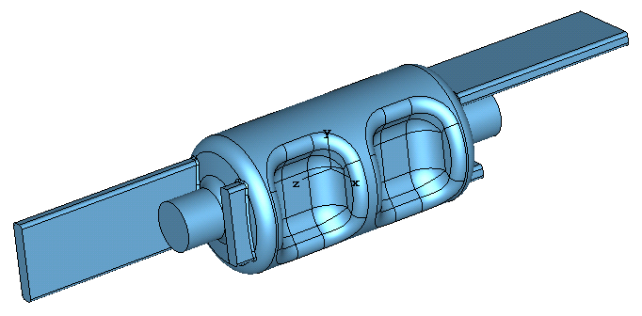
Narrowband Impedance: Crab Cavity
(HK Park)
Prototype converging to a 952.6 MHz 2-cell RFD cavity.
Bare cavity impedance
Damping under study
2 hook couplers
2 wave guides

Slide 16
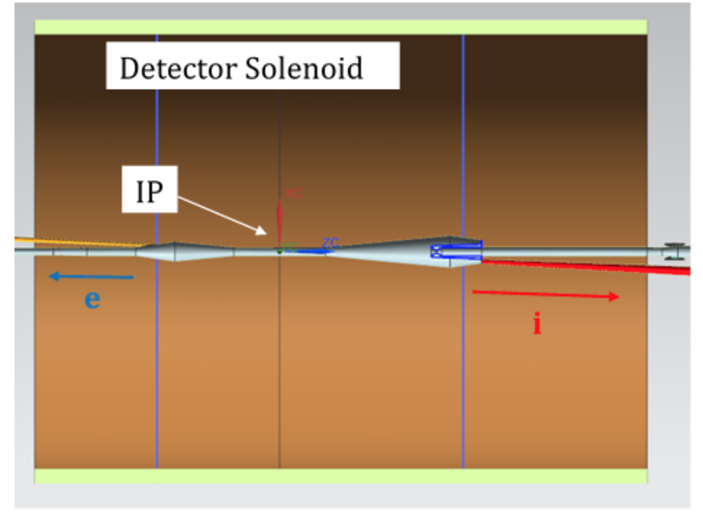
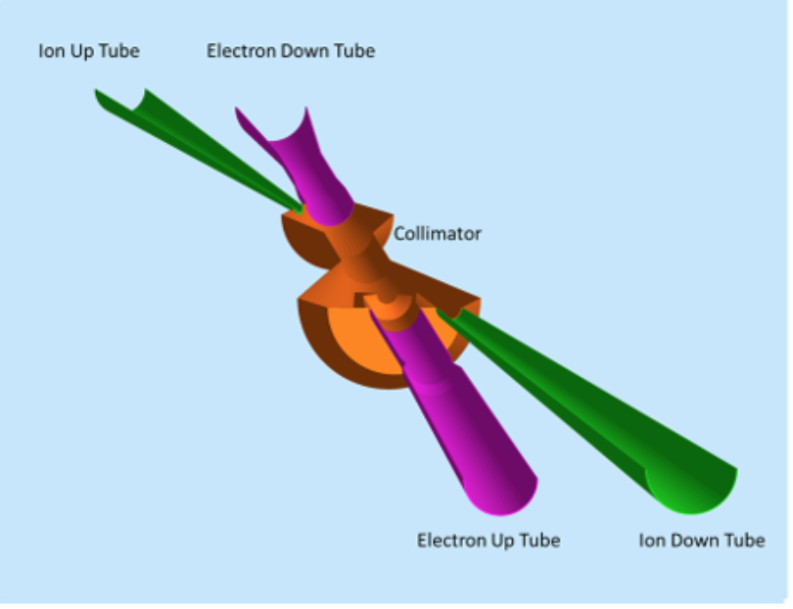
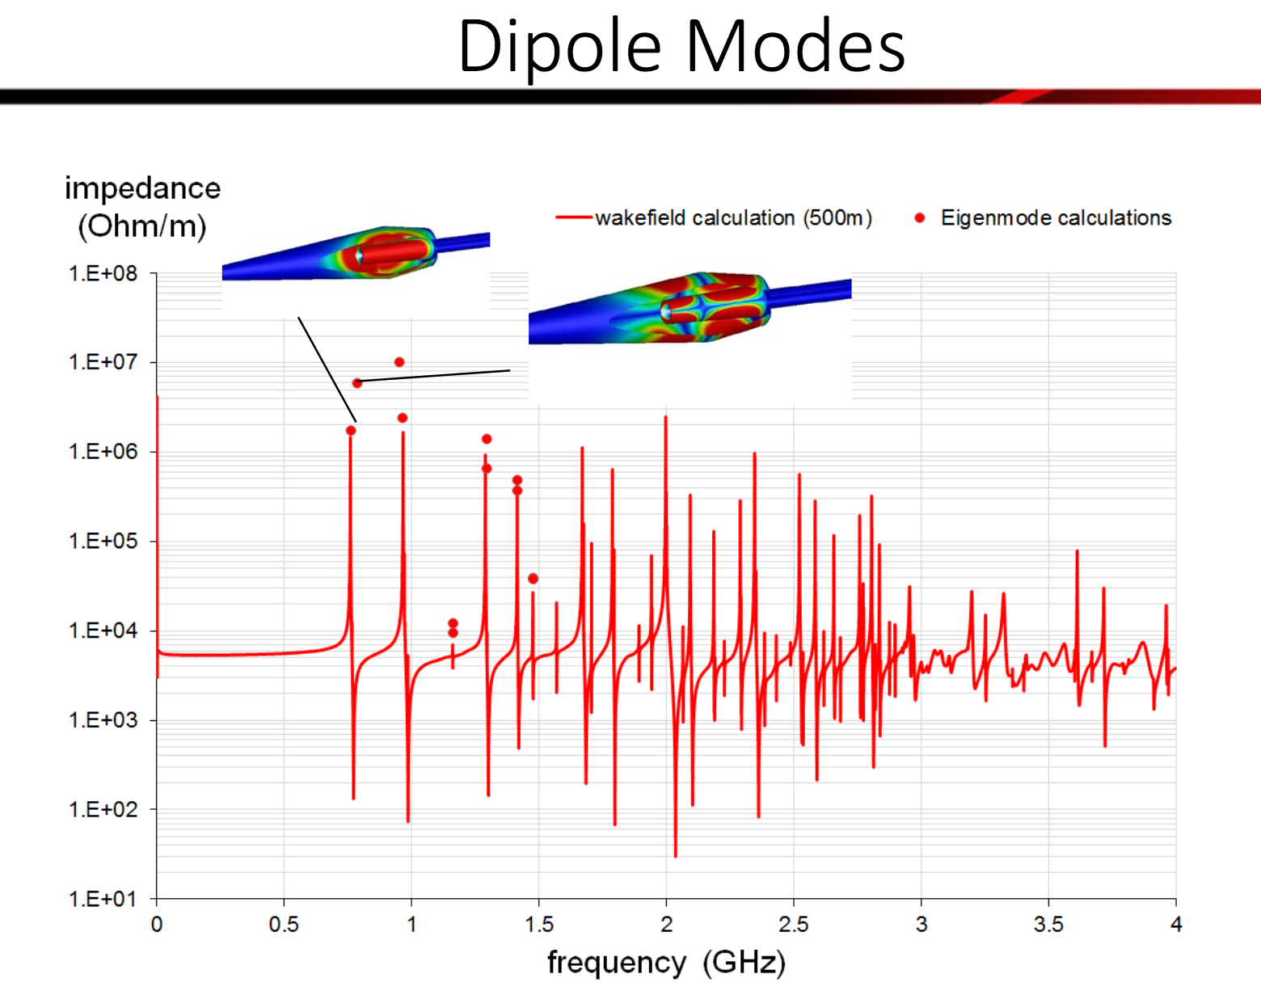
Narrowband Impedance: IR Chamber
JLEIC IR Chamber CAD Model
(Marhauser)

Slide 17
New IR Chamber Design Underway

Slide 18
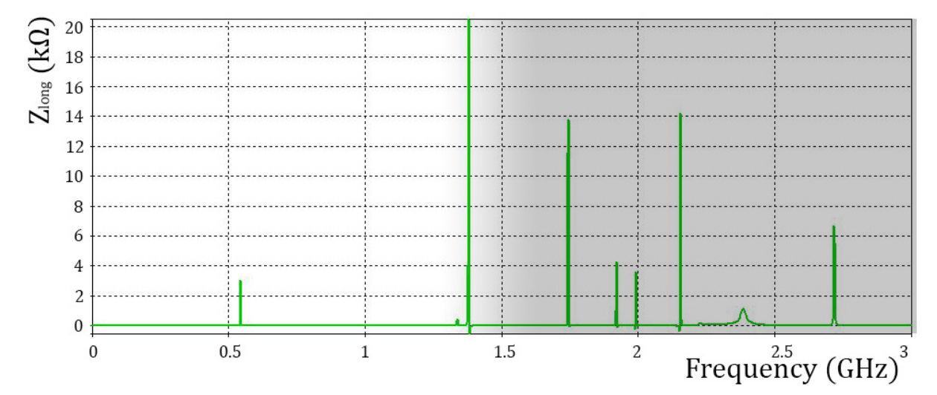
Narrowband Impedance: Roman Pot
*For LHC, the dark area is beyond bunch frequency range (bunch rms length=7cm)
*For JLEIC, the dark area still contributes

Slide 19
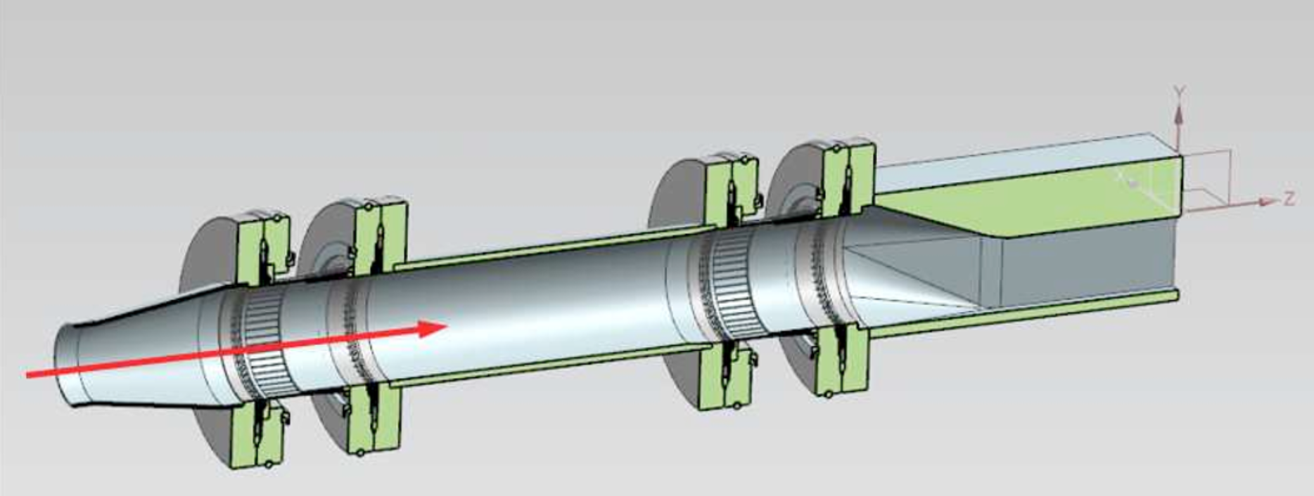
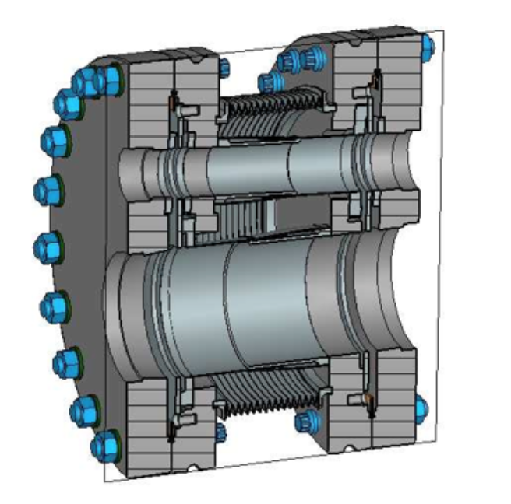
Ongoing Design of Other Components
Collimator
Shielded IR Bellow

Slide 20
Summary of JLEIC Impedance Status
We are at the beginning phase of impedance studies
Preliminary estimations are done
Engineering design and EM modeling are underway

