Slide 1
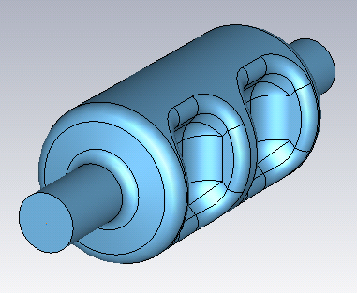
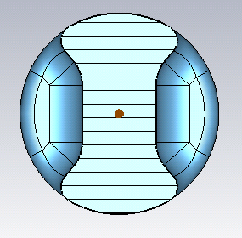
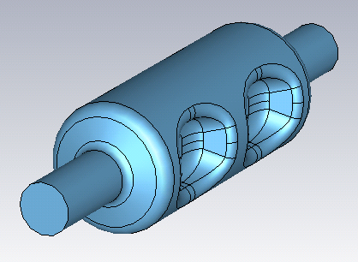
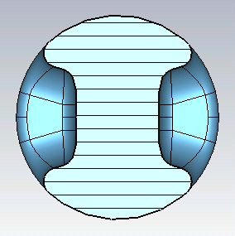
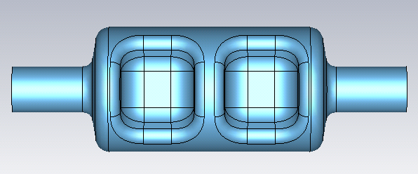
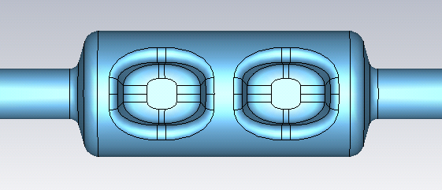
PoP cavity: 952.6 MHz 2 cell
Pole geometry further optimized.
Long beam pipe is VTA test cavity version.

Slide 2
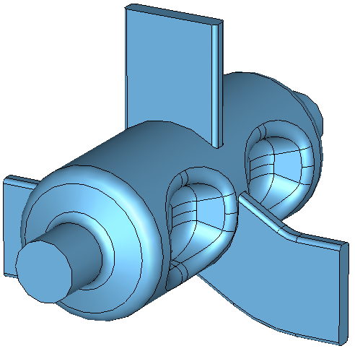
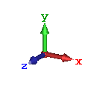
Wave guides

Slide 3
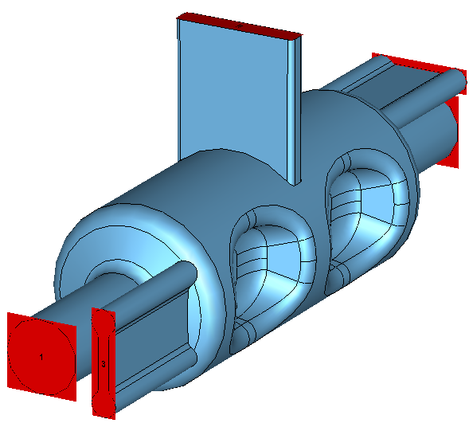
Wave guides

Slide 4
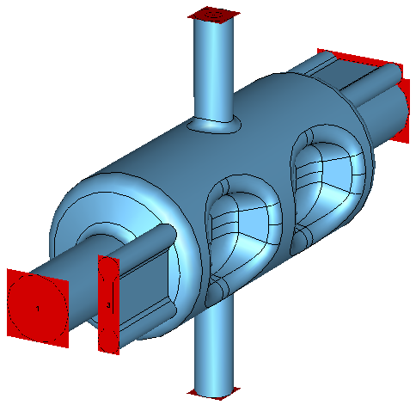
Wave guides + Coaxial coupler

Slide 5
RF Dipole cavity actuals Aiming peak magnetic field up to 70 mT seems reasonable.
Frequency [MHz] | Type | V_transverse [MV] | E_peak [MV/m] | B_peak [mT]
400 | LHC P-o-p single cell | 7 | 75 | 130
400 | LHC SPS prototype #1 | 4.4 | 42 | 73
400 | LHC SPS prototype #2 | 5.8 | 56 | 96
499 | Cebaf deflector P-o-p | 4.2 | 40 | 61
750 | EIC P-o-p | 2.7 | 60 | 126

Slide 6
Number of cavities
 |  |  | 100 GeV |  | 10 GeV
 |  |  | Proton |  | Electron
 |  |  | 952.6 MHz |  | 952.6 MHz
RF Properties
LOM |  |  | 845.5 |  | 845.5
Next HOM |  |  | 1379.5 |  | 1379.5
E_{p}/E_{t} |  |  | 5.66 |  | 5.66
B_{p}/E_{t} | [mT/(MV/m)] |  | 11.64 |  | 11.64
[R/Q]_{t} | [Ω] |  | 147.52 |  | 147.52
G | [Ω] |  | 168.97 |  | 168.97
R_{t}R_{s} | [Ω²] |  | 2.49E+04 |  | 2.49E+04
B_{p}/E_{p} |  |  | 2.06 |  | 2.06
Target Bp |  |  | 70 |  | 70
Et at target Bp |  |  | 6.01 |  | 6.01
Vt at target Bp |  |  | 1.89 |  | 1.89
Required kick |  |  | 18.67 |  | 2.80
Number of cavities |  |  | 9.9 |  | 1.5

Slide 7
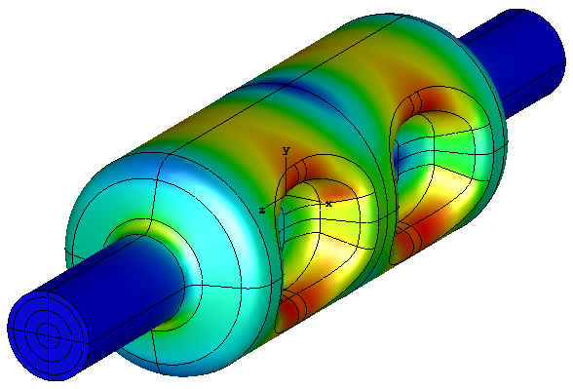
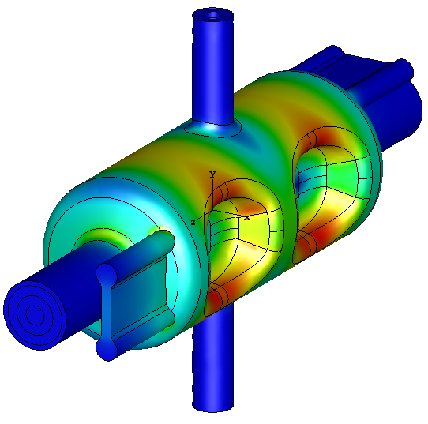
Updated Multipole Components (Normalized to V_{t}=1 MV)
 | Bare Cavity | Cavity with HOMs | Unit
V_{acc} | 2.5×10⁻⁴ | 12.7 | kV
V_{t} | 1.0 |  | MV
b₁ | 3.33 | 3.33 | mT m
b₂ | -1.9×10⁻⁴ | 0.85 | mT
b₃ | 968.5 | 971.7 | mT/m
b₄ | 0.4 | 103.5 | mT/m²
b₅ | -4.1×10⁴ | -4.1×10⁴ | mT/m³
b₆ | -641.5 | 1702.8 | mT/m⁴
b₇ | -7.0×10⁷ | -7.2×10⁷ | mT/m⁵

