Slide 1
JLEIC Impedance Status
Frank Marhauser
JLEIC Impedance Meeting
2/22/2019

Slide 2
Outline
IR chamber
Draft Design of new IP chamber
3-cell 476.3 MHz cavities for cooler ERL
Collimator
Shielded bellows

Slide 3
IR chamber
Mark Wiseman sent me the attached PowerPoint file. We had a quick discussion agreeing that latest update is valuable improvement RF-wise compared to the previous design.
Mark will start triggering the modelling of the IR chamber for wakefield calculations.
Note that there is no way possible yet to numerically evaluate the impedancefrom a wakefield calculation with both the ion and electron beam being present, while traversing with an angle to each other.

Slide 4
Draft Design of new IP chamber
Based on information from Yulia (more pictures next slide)
Symmetric about IP other than synchrotron radiation mask on electron inlet
Synchrotron mask unchanged (1000 mm from IP, 24 mm ID/10 mm long )
Central tube – 200 mm long, 64.4 mm ID
Electron entrant and exit vacuum tubes 60 mm ID at chamber
Ion line has 11.6 mRad radial aperture on inlet and outlet (22.4 mm ID)
Ion beam
64.4 mm ID
Synchrotron mask
e beam
60 mm ID x2
200 mm
22.4 mm ID x2
1924 mm
19_01_29 IP Vacuum Chamber

Slide 5
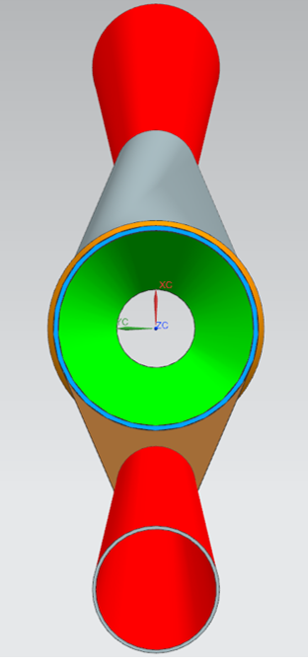
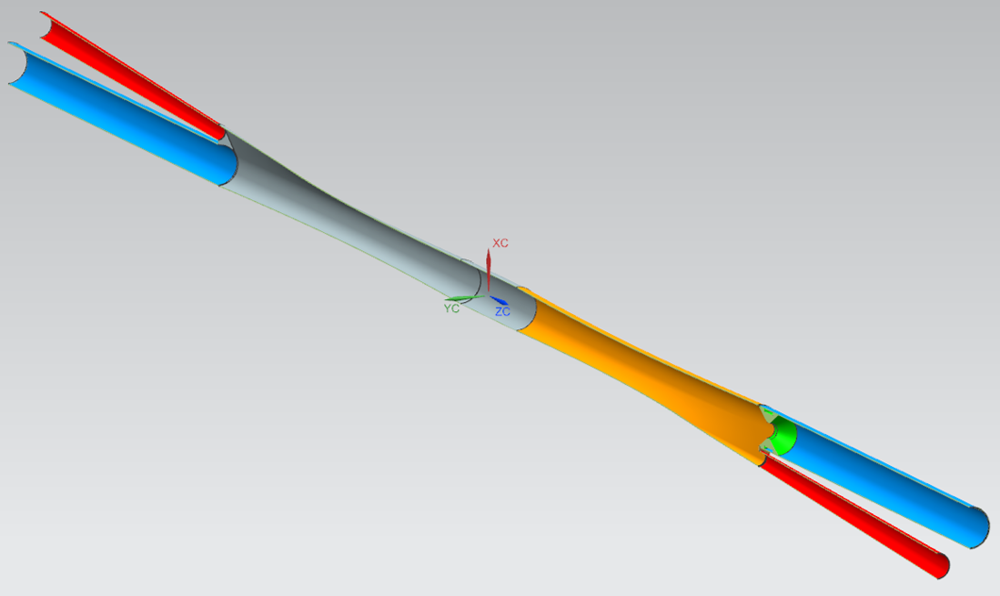
Draft Design of new IP chamber
View from electron inlet side
End plates match the two beam tube diameters with straights off the tangents
LT 5 mm between vacuum tubes
Chamber transitions from the end plates to central 64.4 mm ID tube
Interaction Point
Ion beam
64.4 mm ID
e beam
60 mm ID x2
200 mm
22.4 mm ID x2
1924 mm
19_01_29 IP Vacuum Chamber

Slide 6
Ion entrant line not centered on beam line.
19_02_06 IP Vacuum Chamber
Central chamber 6.0 cm ID, 20 cm long
Ion and electron entrant and exit tubes all 6.0 cm ID tubes.
Still have to add the transition to the rest of the vacuum lines.
Synchrotron Radiation Mask Unchanged
Ion exit line not centered on beam line.

Slide 7
19_02_06 IP Vacuum Chamber
Transition chambers are symmetric about the IP and ~ 860 mm long
Ion entrant line not centered on beam line.
Central chamber 6.0 cm ID, 20 cm long
Synchrotron Radiation Mask Unchanged
Ion and electron entrant and exit tubes all 6.0 cm ID tubes.
Still have to add the transition to the rest of the vacuum lines.
View from electron inlet side
Ion exit line not centered on beam line.

Slide 8
19_02_06 IP Vacuum Chamber
19_02_06 IP Vacuum Chamber rev A
An alternative would be to extend the orange transition chamber further out as indicted by the orange lines
The electron entrant tube remains unchanged

Slide 9
Another proposed change would be to stretch the electron down beam side further from the IP
19_02_06 IP Vacuum Chamber rev A
Central chamber 6.0 cm ID, 20 cm long
Ion and electron entrant and exit tubes all 6.0 cm ID tubes.
Still have to add the transition to the rest of the vacuum lines.
Synchrotron Radiation Mask Unchanged
Ion entrant and exit line not centered on beam line.

Slide 10
3-cell 476.3 MHz cavities for cooler ERL
Major change to RF frequency and thus cavities!
I have modeled a HOM-damped 3-cell cavity to evaluate the total monopole mode power dissipation, but I need to update the bunch pattern.
The CAD modelling does not need to be done by the engineering group. This is up to the us.

Slide 11
Collimator
Received the first collimator CAD model from Bill Crahen from the engineering group (next slide).
I did a quick impedance calculation with the beam being on the proposed path.
I found high impedance modes (~1 MOhms) and provided the feedback that one should consider means to damp the modes. This needs more investigations as to the Eigenmode field profiles of concern.
I include the beam tubes with tapers on either side. The beam tubes nominally also have 1-2 shield bellows that I did not include for now. They also might be needed to be meshed and evaluated individually since extremely complex and detailed in design.

Slide 12
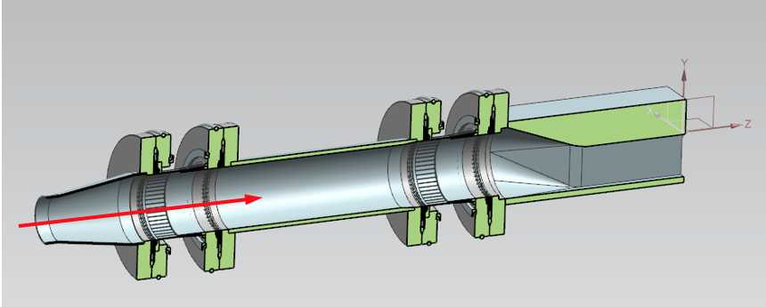
CAD Model for a Collimator

Slide 13
Shielded bellows
The shielded bellows that is conceived on one end of the IR beam chamber housing both the ion and electron beam tube is under design.
I received a CAD model from Chuck Hutton from the engineering group. (See new_model2.bmp in the next slide). This CAD file as sent could not be utilized yet for a wakefield calculation.
Specifically, the CAD model must be 'cleaned', the spring-finger gaskets were missing, and the RF vacuum model was not included.
Since the IR chamber now conceives beam tubes being equal in diameter for both the electron an ion beam per latest design, this model might be already obsolete.

Slide 14
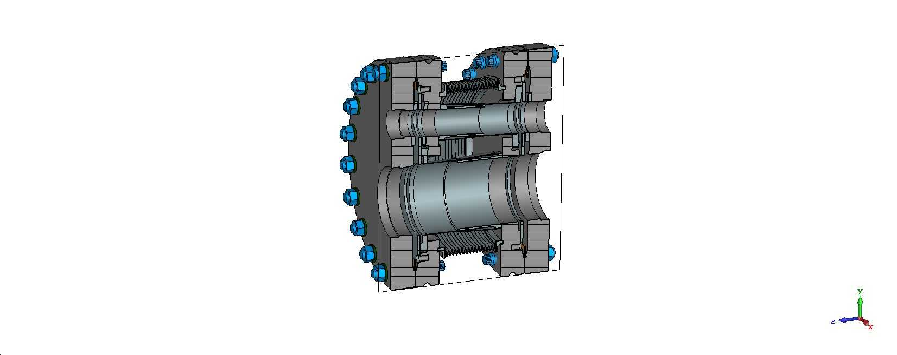
New Shielded Bellow

