Slide 1
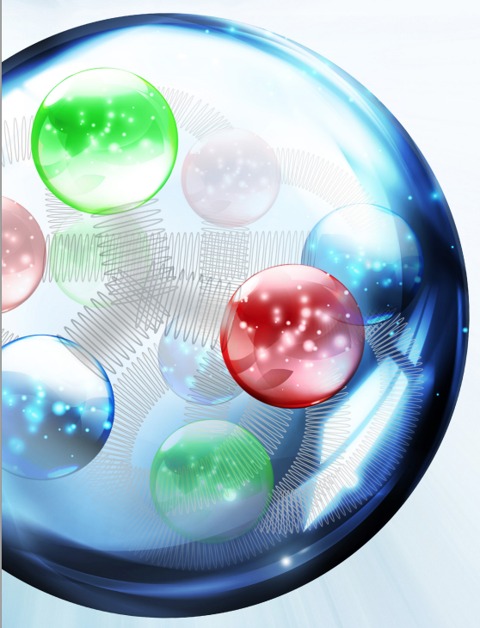
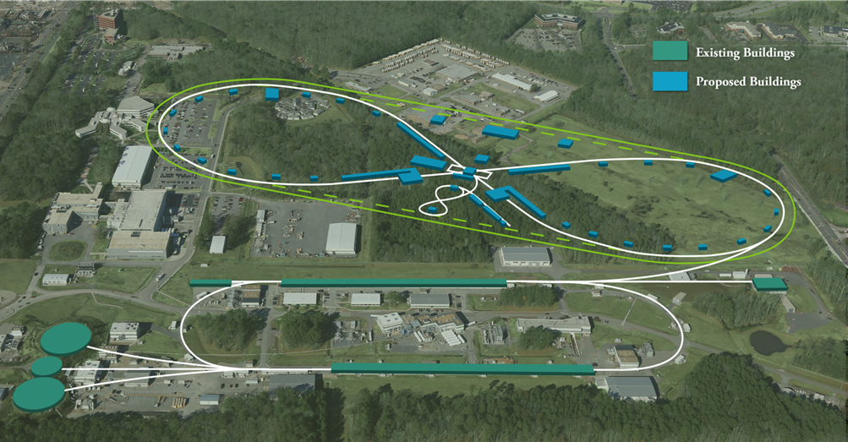
Peter McIntyre Visit Overview Slides
Tim Michalski
March 14, 2017

Slide 2
JLEIC SC Dipole Requirements
SC Dipoles are used in both Booster Ring and Ion Collider Ring designs.
Baseline center of mass energy (√s) is max 63 GeV – 10 GeV electrons, 100 GeV ions
Whitepaper √s is max 100 GeV – 10 GeV electrons, 200 GeV ions
ICR Aperture – 10 cm x 6 cm, Booster Aperture – At least that of ICR
 |  | Field | Length | Ramp Rate | LHe Inlet Temp
100 GeV Ions | Booster | 3T | 1.2m | 1T/sec | 4.5 K
 | ICR | 3T | 8m** | 0.05T/sec | 4.5 K | 0-3T in 1 minute
200 GeV Ions | Booster | 3T | 1.2m | 1T/sec | 4.5 K
 | ICR | 6T | 8m** | 0.05T/sec | 4.5 K | 0-6T in 2 minutes
**Use of 2 x 4m dipoles in the Ion Collider Ring with 1° offset between them to accommodate a smaller overall sagitta.

Slide 3
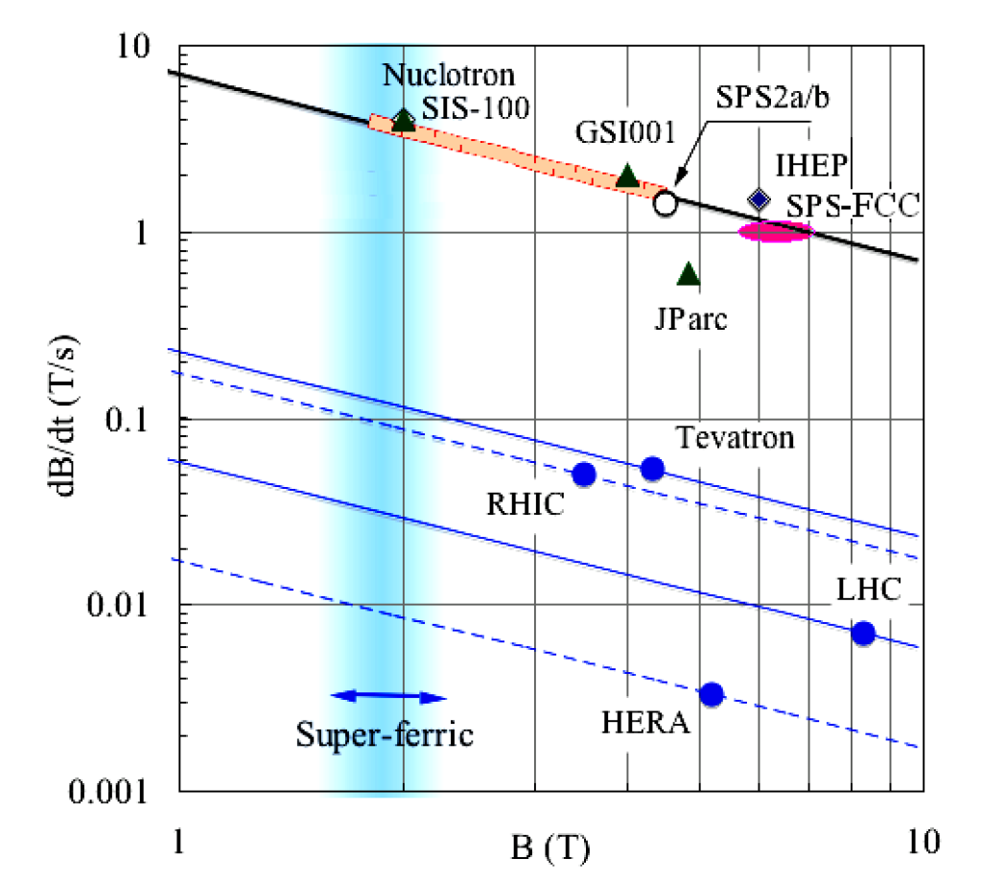
Comparison to Other Ramping SC Magnets
SIS300 – 4.5T, 1T/s
JLEIC Booster – 3T, 1T/s
JLEIC ICR 200GeV – 6T, .05T/s
JLEIC ICR Baseline – 3T, .05T/s

Slide 4
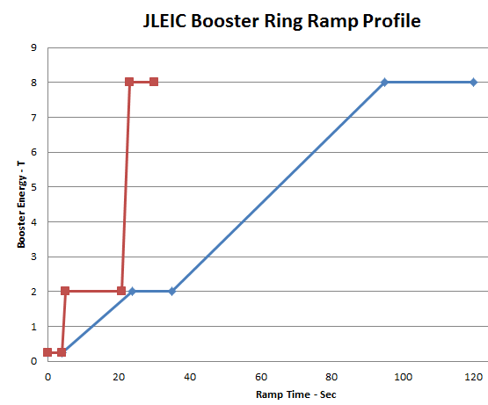
Ramp Profiles
Ramp profile – flat bottom for 3-4 seconds at injection energy, 20 seconds of ramping, 2 GeV cooling for 10-15 seconds, ramp to 8 GeV. There is concern about “snap back” of magnets and persistent currents resulting from the ramp down. (This profile is slower than 1T/sec)
1T/sec, 15 sec Cooling
Described Above

Slide 5
Ramp Profiles
Ramp rate in booster and collider magnet can be limited to 1 T/s. In the collider, the ramp rate could be lower (~0.1 T/sec) if the ramp can be faster around transition.
Multipoles versus ramp position
Assess requirements
Survey existing magnet data
Assessment of ramping and “dynamic effects” on SC magnets and conductor. Experience from Dubna supports that the booster ramping profile (~10sec flat bottom, ramp to 2 GeV, 10-20 sec for cooling at 2 GeV, ramp and extraction at 8 GeV) is potentially feasible.
Eddy currents
Persistent currents
Coupling between conductor strands
Current sharing between conductor strands
AC losses
Snap back
Multipole distribution with respect to the ramp position (field) must be defined.

Slide 6
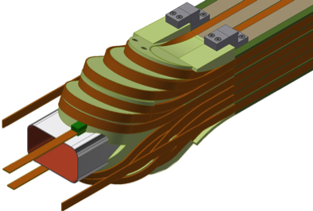
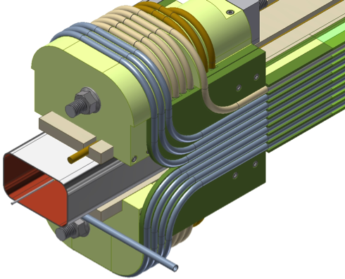
TAMU SF Work to Date
Proposed 2 options – Rutherford Cable and Cable-In-Conduit Conductor (CICC) – down selected to CICC after initial review
Conceptual Design – Completed September, 2015
Prototype Winding of Cu Tubing on Vacuum Tube/Coil Guides – Completed March, 2016
TAMU Subsequent SBIR for CICC Development (ongoing)
NbTi Rutherford cable NbTi Cable-in-Conduit
Pros: Uses mature cable technology (LHC). Semirigid cable makes simpler end winding.
Semirigid round cable can be precisely located.
Cryogenics contained within cable.
Cons: Ends tricky to support axial forces. Cable requires development and validation.
Entire cold mass is a He vessel.

Slide 7
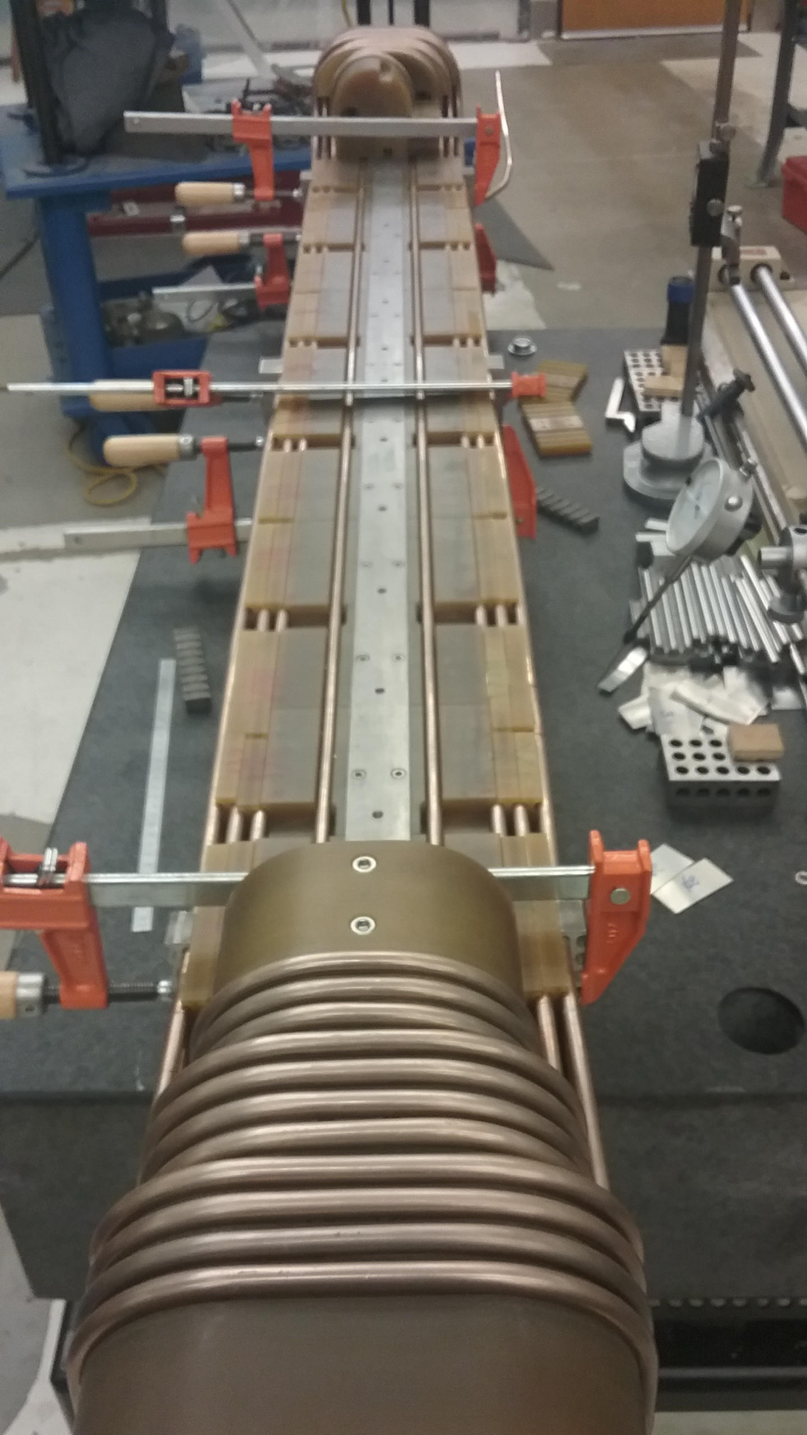
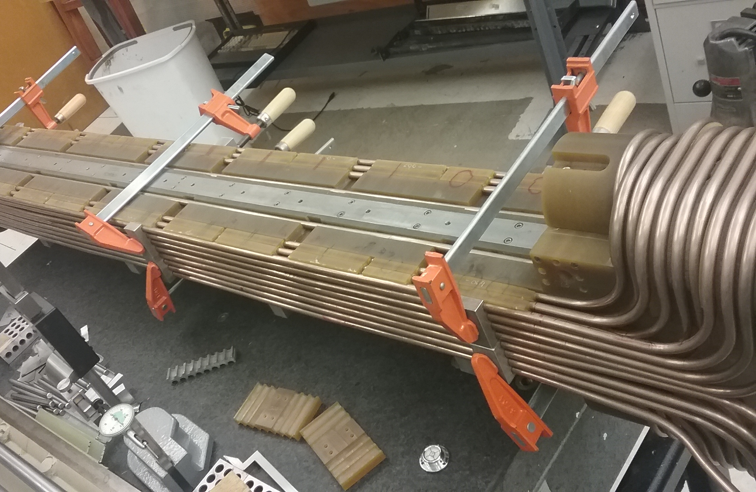
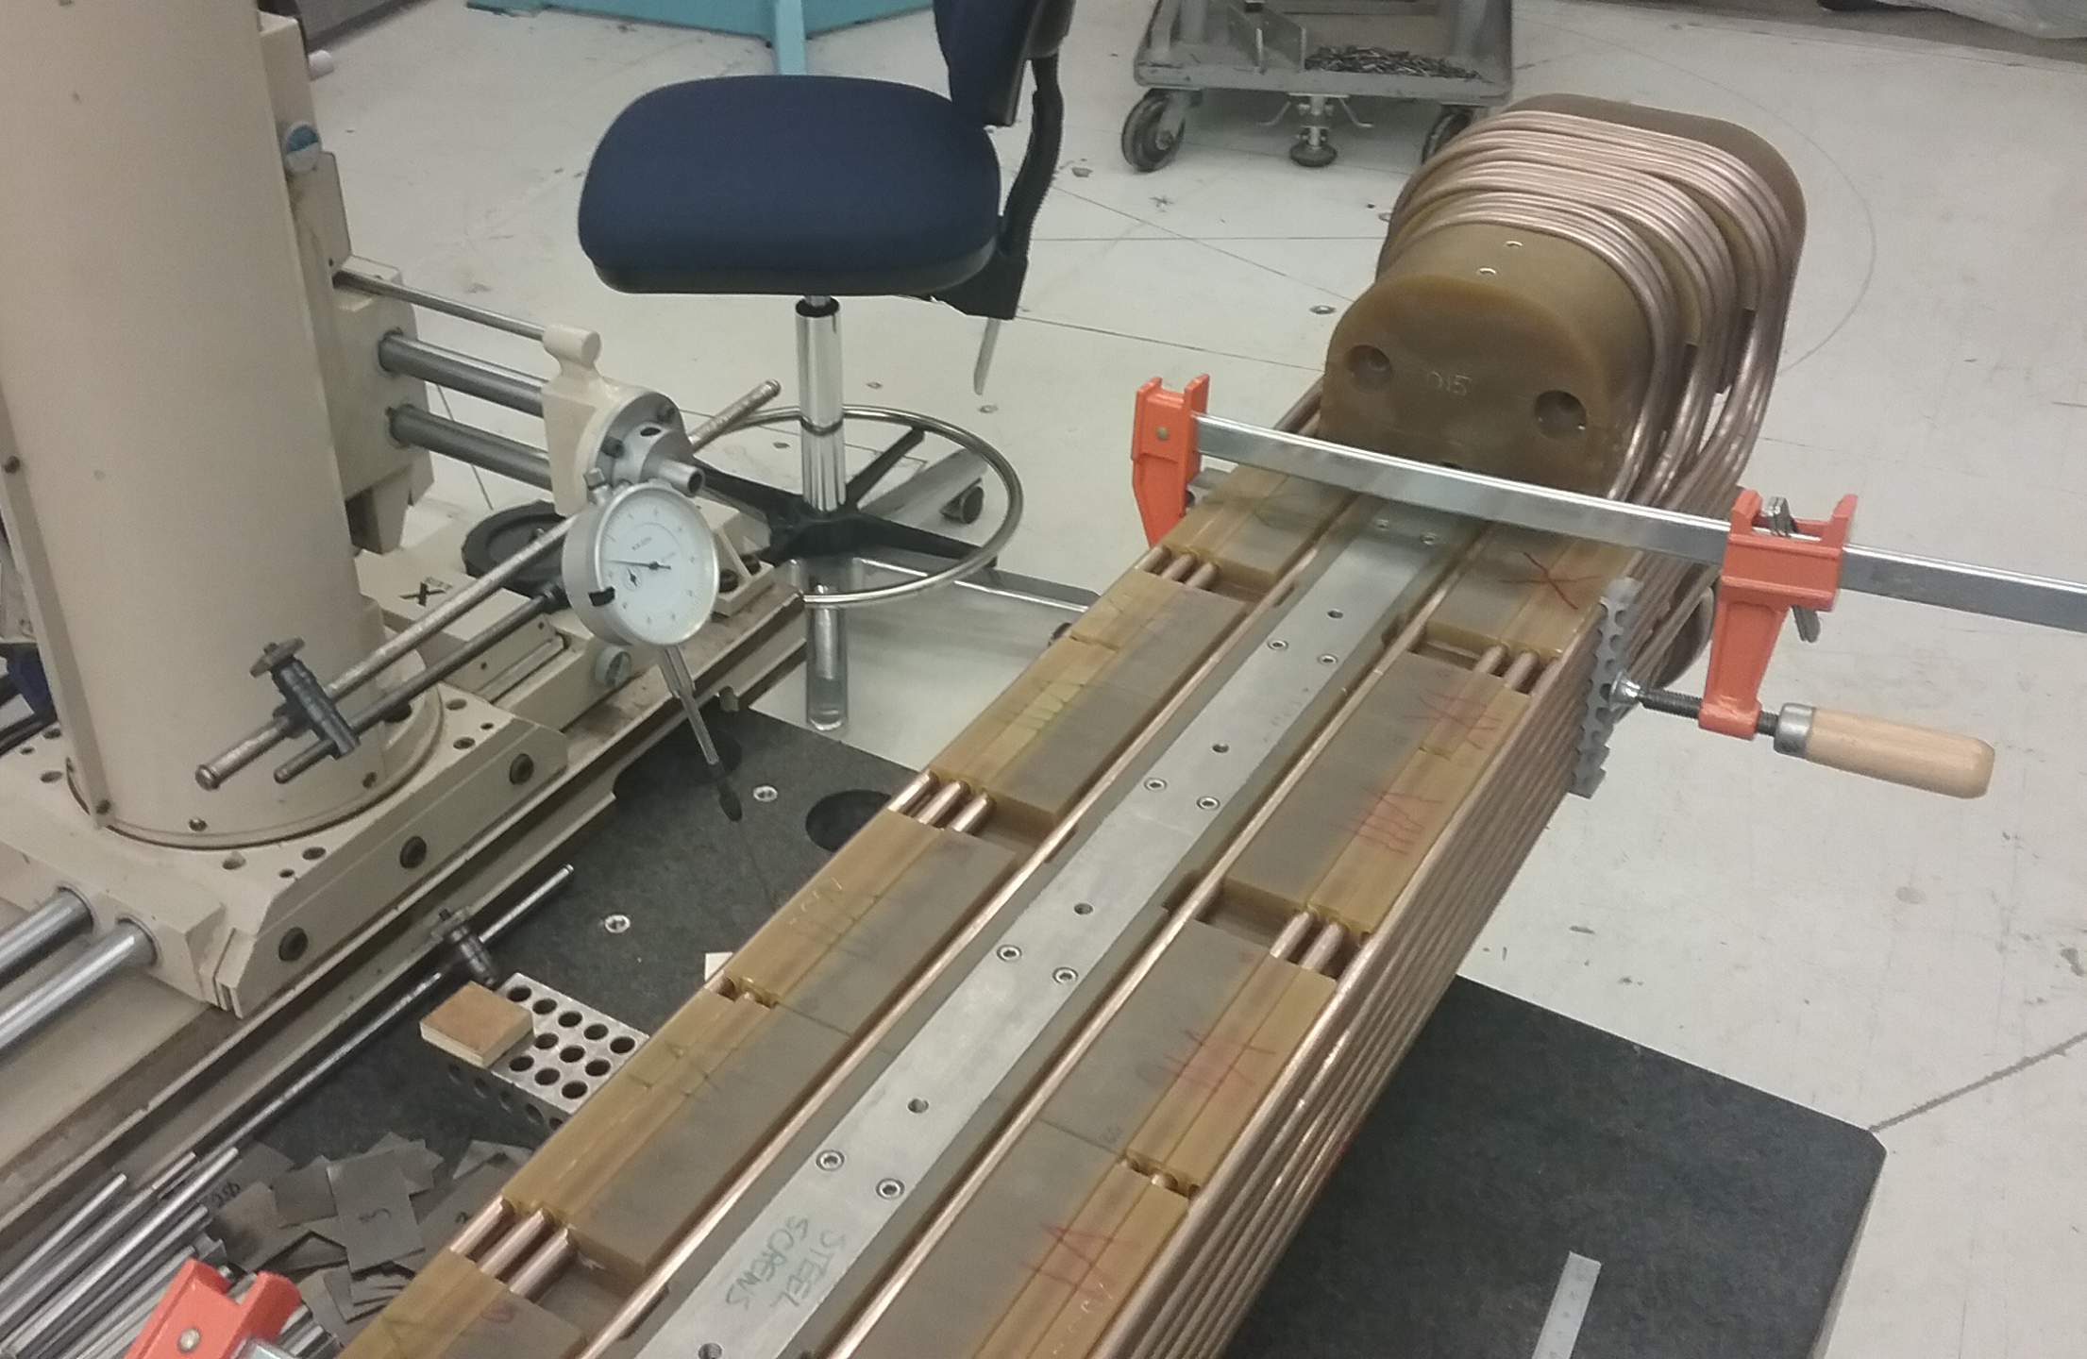
TAMU Superferric Dipole – Prototype Winding
SF Magnet Core – SS Vacuum Chamber with G11 Coil Supports
24 Coils – Using representative copper tubing
Coil positions measured – resultant calculated multipoles are in spec
All bends made using motorized bending fixtures
Next Steps:
Model Dipole with SC Cable-in-Conduit Conductor (CICC)

Slide 8
Recommendations from December, 2015 Review
The design might not be viable if the open issues about the cable (see below) do not have resolutions with acceptable risk.
A few potential show-stoppers were seen, in particular, the complexity of the splice and the cryogenic considerations still need some work, the suitability of Cu-Ni as a pressure vessel and performance of the conductor after bending.
The committee agrees that a successful cold mass prototype is not sufficient to retire the risk from the MEIC TPC.
Comments from the previous review are still valid.
The cold mass alone is not sufficient to retire the risk.
It is possible a significant portion of the technical risk could be reduced based on cold test results.
Cost risk can only be retired after feedback to/from the actual industrial firms that will make the magnets.
Certain risks, such as field quality, can also be reduced by further modeling and optimization.
Several issues must be addressed prior to committing to construction of a cold mass prototype dipole magnet.
Assemble mockup flux return to test pre-loading
Fabrication of CIC cable, drawing sheath on long-length CIC cable using real superconductor
Validate splice design
Repeat of mockup winding tests using actual cable to evaluate parameters for bend tooling, QC conductor placements.
And possibly further modeling of impact of iron properties different from present assumptions

Slide 9
Recommendations from December, 2015 Review
The committee recommends an intermediate stage to address the following.
Calculations are mandatory before authorizing the prototype for the CIC cable.
It should be shown that Cu-Ni is a valid pressure boundary using ASME code for liquid helium temperatures.
The calculation needs to be made showing that the Cu-Ni tube stays within code stress limits during the pressure increase in the tube during a quench for the final magnet’s tube length
The stability of the conductor should be calculated showing that a local quench point should recover the superconducting state because of the exposure to flowing liquid helium, essentially the Stekly Criteria for cable in conduit. Maximum peak temperature should be defined and justified.
In calculating winding peak temperatures, the following times should be allowed for:
Time to reach quench detection voltage threshold
Time for electronics to react and fire quench heaters
Time for quench heaters to heat up to a high enough temperature to propagate quench
The committee recommends having another review prior to funding the cold mass fabrication task.

