Slide 1
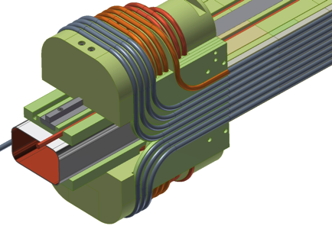
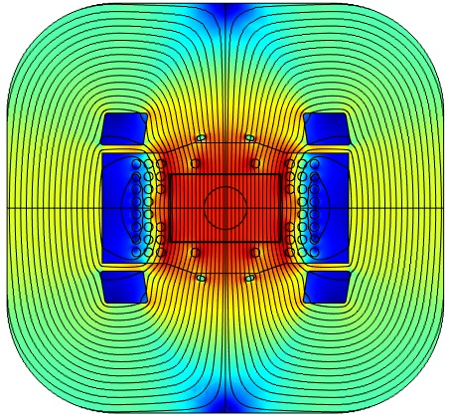
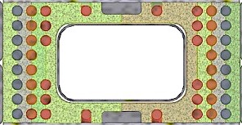
Superconducting Magnet Rings for MEIC Mockup Winding Review

Slide 2
Agenda

Slide 3
Overview of Task 2
Objectives of Task 2:
Build a ~1.2 m mockup winding using the structural elements, CIC cable, and winding tooling appropriate for an actual MEIC dipole.
Evaluate the precision for locating each turn in the body of the winding.
Evaluate the procedures for forming the flared ends on each turn.
Evaluate the alternatives for the spring tube in the CIC cable, measure critical current in extracted strands from the formed ends.
Modifications in the objectives during the project:
Cost for procuring strand with properties specified for MEIC was not provided in the contract. In consultation with MEIC management, we opted to build the mockup winding with empty tube having the material and thickness for actual CIC, drawn to the finish dimension for the CIC.
Cost for fabrication of the G-11 structural elements was higher than foreseen. MEIC management authorized us to shorten the length of the mockup winding. We managed to find cost savings that enabled us to stay with the 1.2 m body length.

Slide 4
Major activities to date
Structural elements for winding
Develop detailed fabrication print sets for all G-11 components. ✓
Contract fabrication of one body segment, QC fabricated part to qualify vendor. ✓
Contract for fabrication of all G-11 components, in 3 priority groups:
Structural elements to be impregnated with beam tube and wind layer 1 ✓
Structural elements needed to complete layer 2 
Structural elements needed to complete layer 3 
Fabricate SS beam tube and flanking SS structural bars. ✓
Assemble priority 1 parts on beam tube and vacuum impregnate structural beam. ✓
Motorized bending tools
Develop piece-part prints for bending tools:
Main bender for 180° U-bends ✓
Compound bender for 90° flare bends with steps for transitions ✓
Special benders for dog-bone ends and for close bends 
Fabricate main bender and compound bender, integrate with motor/gearbox assys✓
Develop control programs for the required bends. 
CuNi tube for dummy cable, draw to final cable diameter ✓
Form sample cables, form 180° U-bends, extract strands, test I_{c}. ✓
Develop 3D FEA model of the dipole, evaluate support for ends. 

Slide 5
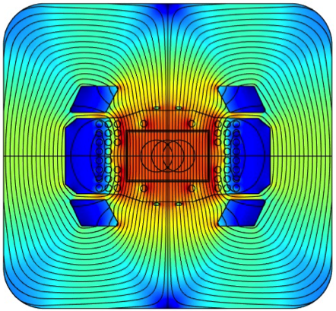
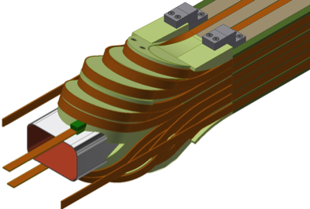
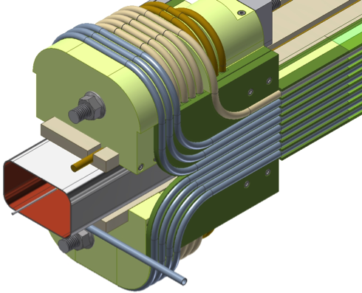
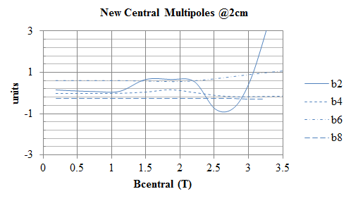
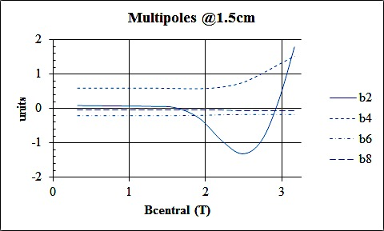
Update on magnetic, mechanical design
Rutherford-based design reported at EIC Cost Review 1/2015:
CIC-based design optimized to minimize sextupoles:

Slide 6
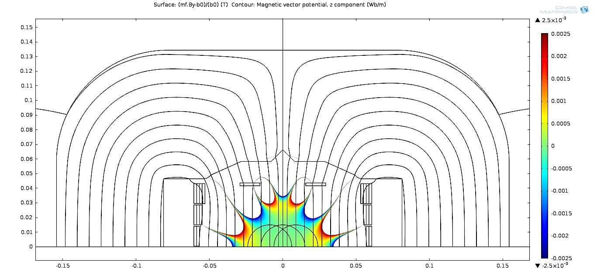
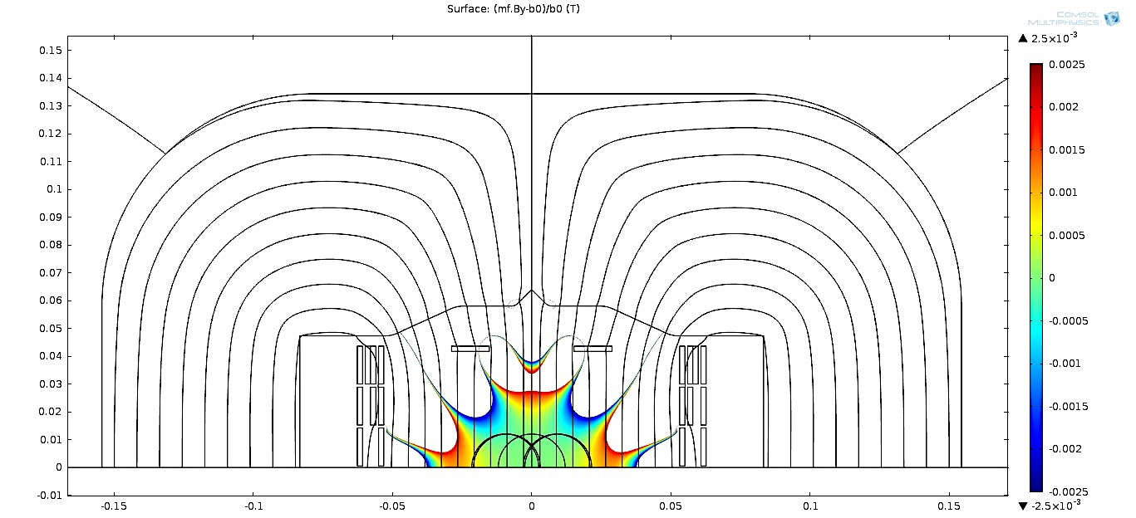
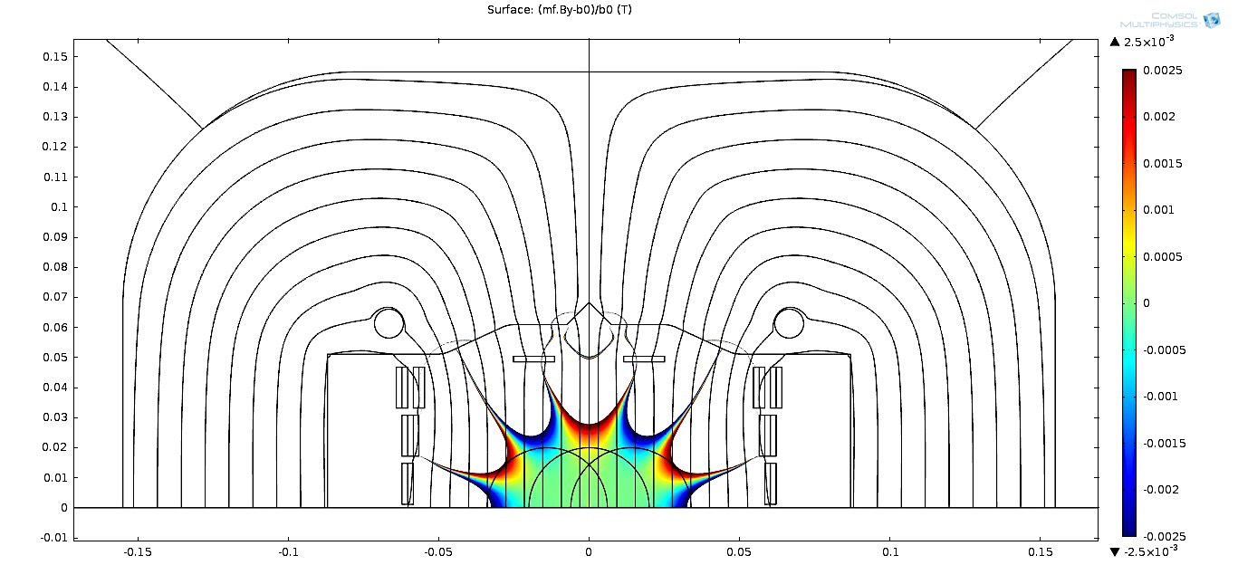
Design stages of Rutherford cable based 3T MEIC dipole
Initial design
Design adjusted for conventional winding
Initially plan A MEIC dipole using Rutherford cable, 0.8 mm strands,
15 kA @ 3 T, b_{n}<10 units
Became plan B and was not further optimized
Design adjusted for barrel winding

Slide 7
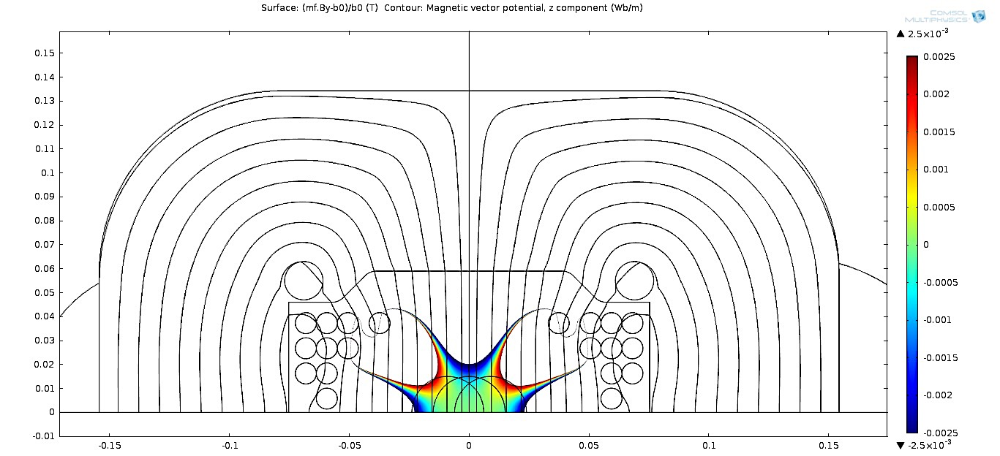
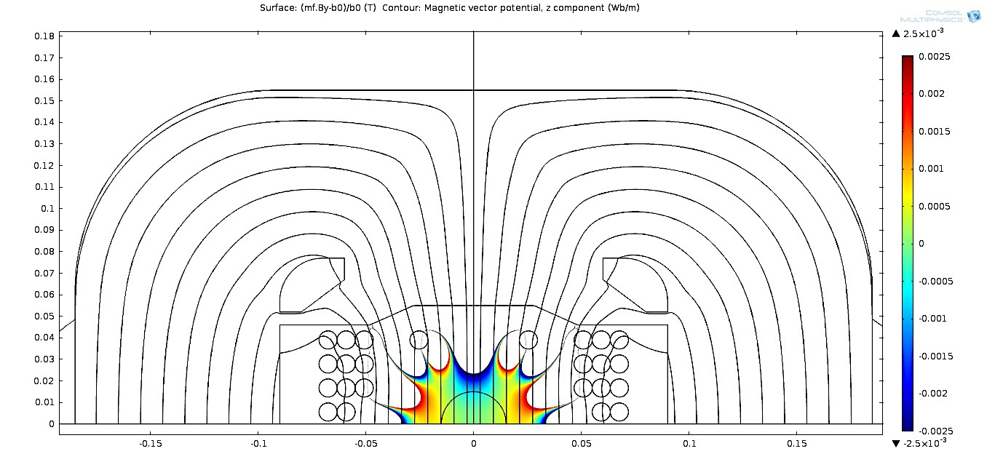
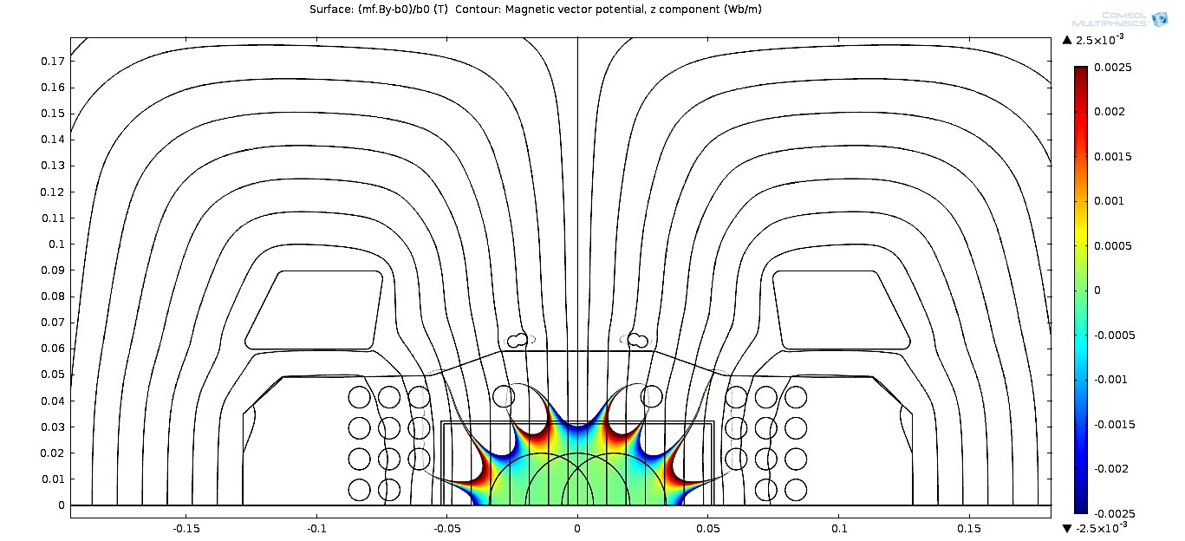
Design stages of CiC based >3T MEIC dipole
Initial 3 T design
Initial 3.5 T @15kA design, conventional winding
3.5 T design, barrel winding
3.0 T design, barrel winding, b₂<2 units (May)
Initially started as plan B, became plan A and further optimization steps were performed.

Slide 8
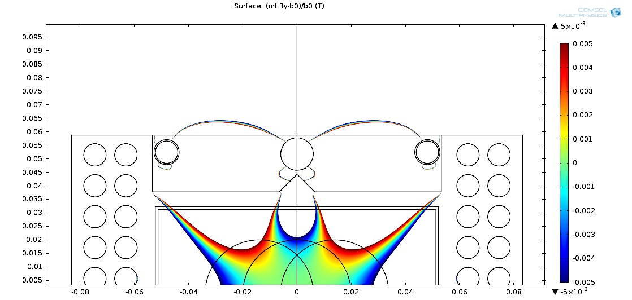
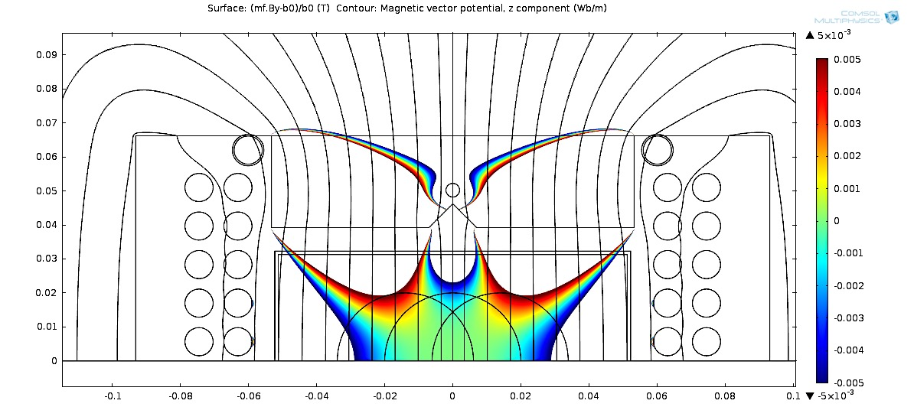
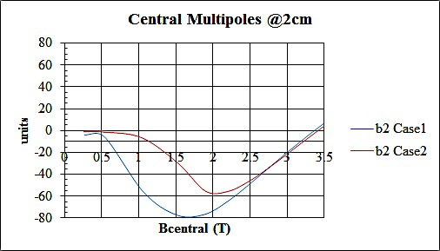
Alternative approach: to improve transfer function, pole face was brought closer to the beam tube
Case 1, sextupole coil is inside of the pole region
Case 2, sextupole coil is outside of the pole region

Slide 9
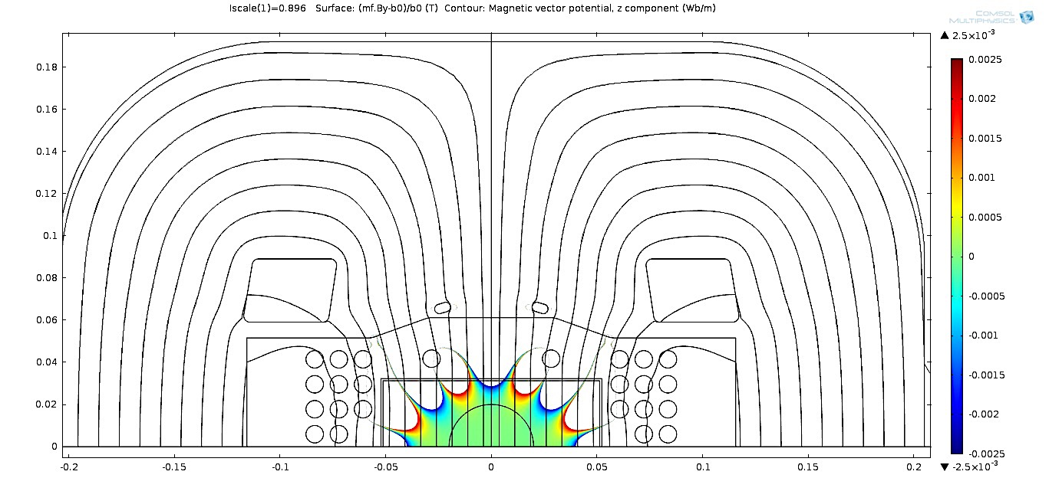
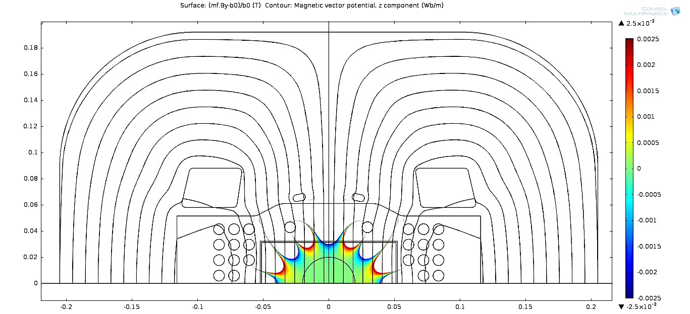
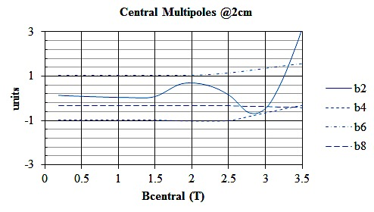
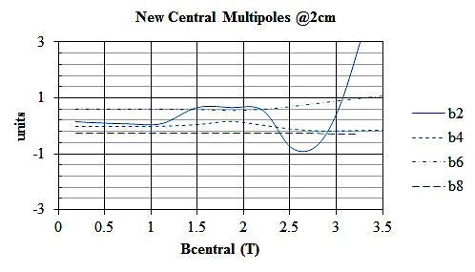
As reported in August, all allowed multipoles <1.5 unit
Improved version, all allowed multipoles <1 unit
Green is good!
13.7 kA @ 3.0 T, b_{n} < 1 unit all fields

Slide 10
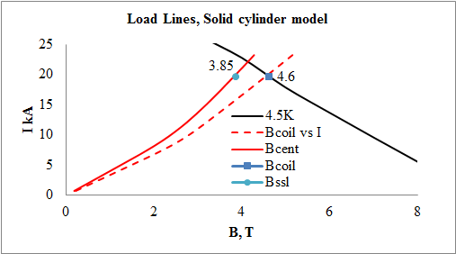
I _{cable} | 13.7 | kA
E_{stored} | 64.15 | kJ/m
Inductance | 0.68 | mH/m
B_{coil} | 3.49 | T
T_{quench} | 5.94 | K
I_{SSL} | 19.7 | kA
B_{coil} | 4.6 | T
B_{bore} | 3.85 | T
N_{turns}/bore | 2x12
N_{strands} | 15
d_{strands} | 1.20 | Mm
Cu/Non Cu | 1.5
Area | 8.23 | cm²
Expect ~1% SSL reduction due to solid conductor approximation.
Magnet will operate at 79% of SSL
Lorenz body forces on each turn of the MEIC dipole @ 3 T
(top set from 1.2 m 3d model, bottom set from 2d model):
(Fx kN/m, Fy kN/m) | (Fx kN/m, Fy kN/m) | (Fx kN/m, Fy kN/m) | (Fx kN/m, Fy kN/m)
(31.95,-3.06) (38.25,-3.47) | (30.24,-7.37) (36.13,-8.63) | (18.44,-7.65) (20.77,-8.23) | (4.19,-7.84) (4.97,-7.92)
 | (30.82,-3.26) (36.54,-3.74) | (18.29,-4.13) (20.80,-4.25) | (3.34,-4.40) (4.21,-4.38)
 | (31.61,0.98) (37.05,1.28) | (19.28,-0.86) (21.94,-0.71) | (3.54,-2.09) (4.42,-1.91)
 |  | (21.78,0.42) (24.56,0.47) | (4.33,-0.50) (5.03,-0.44)

Slide 11
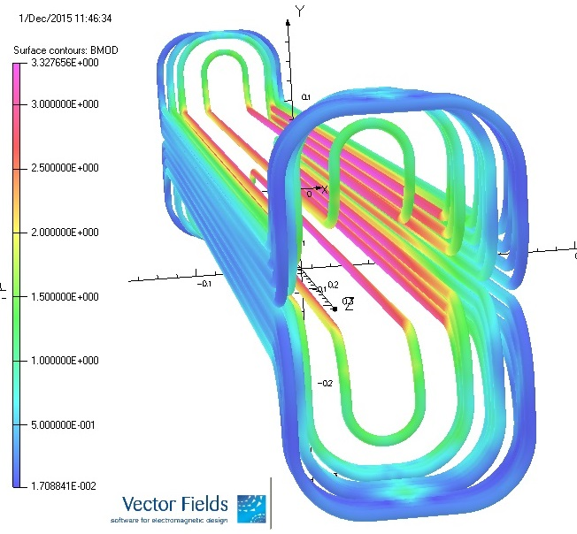
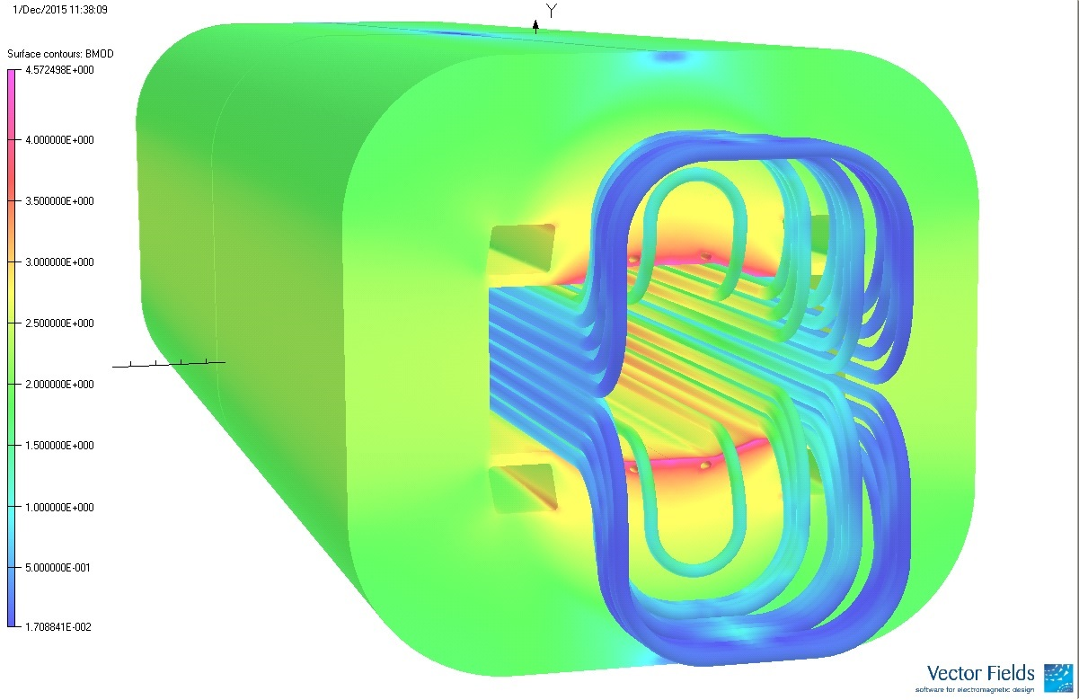
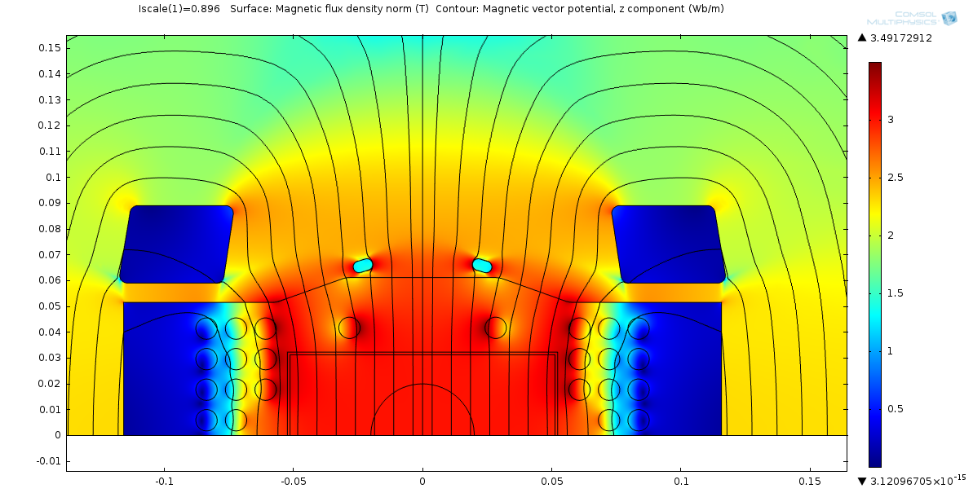
1.2m long straight section Symmetric 3D model of MEIC dipole at 2.92T central field
Max field in the conductor 3.33T (3.42T if scaled to 3T central field ) located at
(0.0242,0.042,0)
Location and magnitude (3.49T) of max field point is consistent with 2d simulations done in
COMSOL

Slide 12
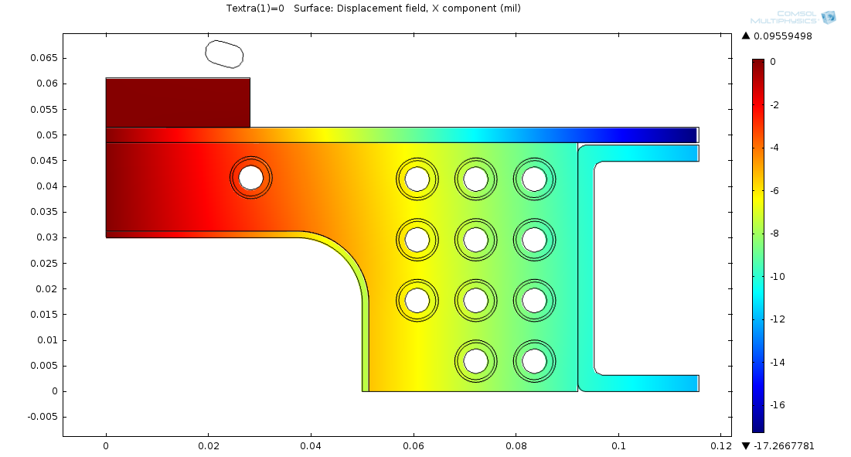
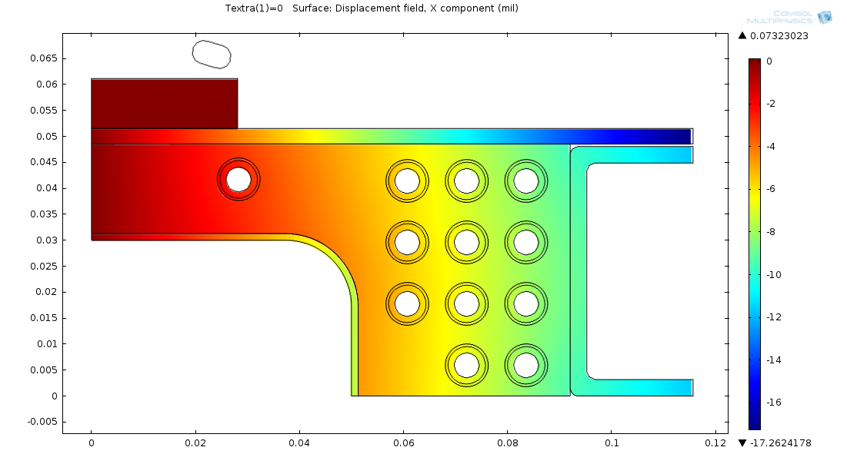
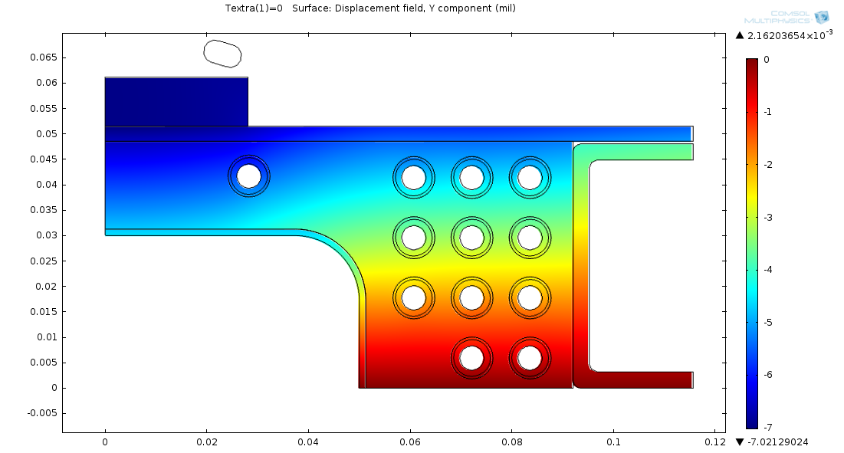
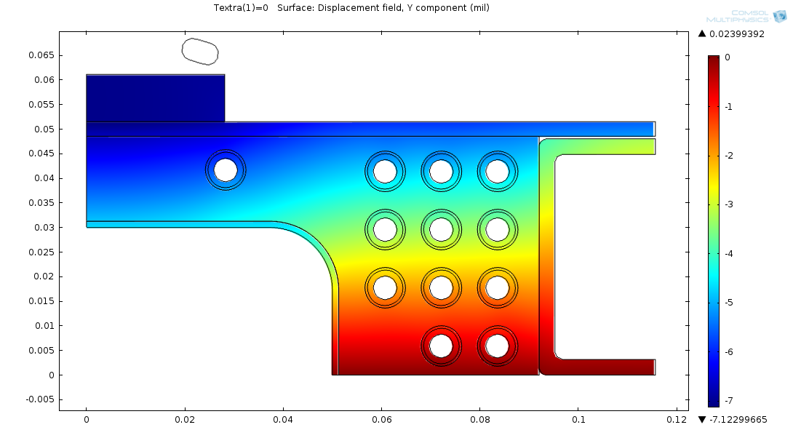
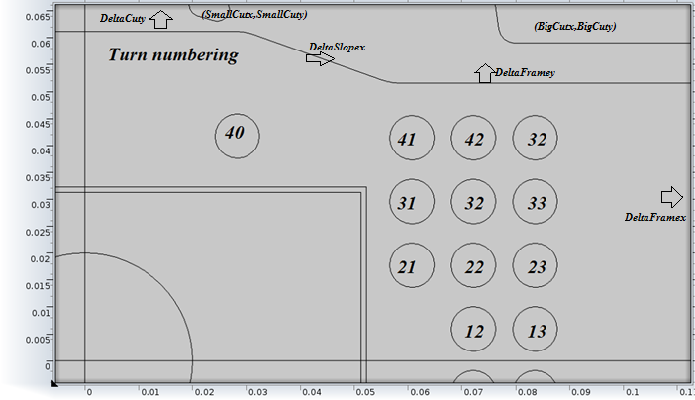
Multipoles due to cooldown and Lorenz forces
4.2K 0T
4.2K 3T
Simple thermal stress model was used to extract coil displacements at 4.2K 0T and 4.2K 3T
Turn index ij | Displacement (x,y) mil
 | Beam tube bonded to Coil Assembly |  | Beam tube mold released from Coil assembly
 | D_{Cold} | D_{Cold+3T} | D_{Cold} | D_{Cold+3T}
40 | (-3.48,-5.6) | (-3.03,-5.67) | (-3.22,-5.58) | (-2.56,-5.57)
41 | (-7.13,-4.85) | (-6.37,-4.93) | (-6.46,-4.71) | (-5.79,-4.81)
31 | (-7.15,-3.6) | (-6.19,-3.54) | (-6.35,-3.37) | (-5.54,-3.44)
21 | (-6.96,-2.12) | (-6.03,-2.1) | (-6.45,-2.04) | (-5.42,-1.99)
42 | (-8.53,-4.75) | (-7.54,-4.8) | (-7.79,-4.58) | (-7.01,-4.77)
32 | (-8.4,-3.42) | (-7.33,-3.42) | (-7.69,-3.29) | (-6.75,-3.40)
22 | (-8.28,-2.05) | (-7.21,-2.02) | (-7.50,-1.95) | (-6.68,-1.93)
12 | (-8.11,-0.63) | (-7.18,-0.63) | (-7.59,-0.66) | (-6.76,-0.57)
43 | (-9.74,-4.64) | (-8.76,-4.71) | (-8.99,-4.58) | (-8.33,-4.70)
33 | (-9.51,-3.16) | (-8.55,-3.36) | (-8.98,-3.25) | (-7.97,-3.35)
23 | (-9.39,-1.88) | (-8.43,-1.96) | (-8.80,-2.02) | (-7.91,-1.88)
13 | (-9.34,-0.76) | (-8.55,-0.55) | (-8.85,-0.62) | (-8.25,-0.61)

Slide 13
Displacements ~ Force (forces are small enough)
Magnetic forces ~ B² or ~I²
Displacements were parameterized as
Fields with displaced magnet parts were evaluated.
$$∆\left(I\right)={(1−{\left[I_{op}/I_{3T}\right]}^{2})∆}_{cold}+{\left[I_{op}/I_{3T}\right]}^{2}∆_{Cold+3T}$$
Errors in multipoles due to cooldown and Lorenz forces:
B, T | Db₀ | Db₁ | Db₂ | Db₃ | Db₄ | Db₅ | Db₆ | Db₇ | Db₈ | Db₉ | Db₁₀
0.187 | -5.6e-4 | -6.9e-5 | 9.6e-2 | 5.5e-7 | -5.5e-2 | 9.0e-7 | 2.7e-2 | -9.8e-7 | -6.7e-3 | -9.7e-7 | -9.3e-4
0.374 | -1.1e-3 | 1.7e-6 | 9.5e-2 | -5.5e-7 | -5.5e-2 | 1.0e-6 | 2.7e-2 | -1.0e-6 | -6.7e-3 | -9.6e-7 | -9.3e-4
0.747 | -2.2e-3 | 1.4e-5 | 9.2e-2 | 2.8e-7 | -5.5e-2 | 1.1e-6 | 2.7e-2 | -1.0e-6 | -6.8e-3 | -9.6e-7 | -9.3e-4
1.121 | -3.3e-3 | -4.2e-5 | 8.7e-2 | -1.4e-5 | -5.4e-2 | 2.8e-6 | 2.7e-2 | -1.2e-6 | -6.8e-3 | -9.6e-7 | -9.2e-4
1.494 | -4.4e-3 | -4.6e-4 | 8.5e-2 | 6.1e-5 | -5.2e-2 | -5.3e-6 | 2.7e-2 | -5.2e-7 | -6.9e-3 | -9.8e-7 | -9.2e-4
1.863 | -5.3e-3 | -7.8e-3 | 1.0e-1 | 2.4e-3 | -5.5e-2 | -3.8e-4 | 2.8e-2 | 3.9e-5 | -7.2e-3 | -3.6e-6 | -9.0e-4
2.208 | -6.1e-3 | -4.5e-3 | 5.7e-2 | -4.1e-4 | -4.7e-2 | 7.4e-5 | 2.8e-2 | -9.2e-6 | -7.3e-3 | -2.7e-7 | -9.3e-4
2.513 | -6.9e-3 | -1.6e-3 | 1.2e-2 | -9.0e-5 | -3.7e-2 | 1.2e-5 | 3.1e-2 | -7.2e-6 | -8.0e-3 | -3.7e-7 | -9.2e-4
2.777 | -6.9e-3 | -2.1e-3 | -2.3e-2 | 1.3e-4 | -2.4e-2 | -8.6e-6 | 3.3e-2 | -3.2e-6 | -8.8e-3 | -1.2e-6 | -9.3e-4
3.010 | -7.6e-3 | 3.4e-3 | 5.4e-3 | -1.4e-6 | -1.7e-2 | -1.2e-5 | 3.5e-2 | 1.2e-6 | -9.5e-3 | -1.9e-6 | -9.3e-4
3.226 | -8.4e-3 | 2.1e-3 | 3.6e-2 | 8.9e-5 | -9.9e-3 | -7.5e-6 | 3.6e-2 | 3.4e-7 | -1.0e-2 | -1.9e-6 | -9.3e-4
3.432 | -9.1e-3 | 3.1e-3 | 4.1e-2 | 2.6e-4 | -3.6e-3 | 1.7e-5 | 3.8e-2 | -3.8e-6 | -1.1e-2 | -1.6e-6 | -9.2e-4
3.533 | -9.5e-3 | -1.7e-3 | 2.6e-2 | 7.3e-5 | -3.6e-4 | -1.6e-5 | 3.8e-2 | -5.5e-7 | -1.1e-2 | -1.8e-6 | -9.0e-4
Max error due to cooldown and Lorenz forces in b₂ ~0.1 units

Slide 14
3-D FEA to simulate deflections from axial forces on end windings
Presentation this afternoon by James Gerity
The end windings are supported in a nest of G-11 forms, bolted to the
SS bars and beam tube and vacuum-impregnated with filled epoxy.
Only the end region is impregnated.
Deflections due to Lorentz forces on ends are shown. G-11 support matrix is suppressed in this image for clarity.
Maximum displacement ~ 4 µm

Slide 15
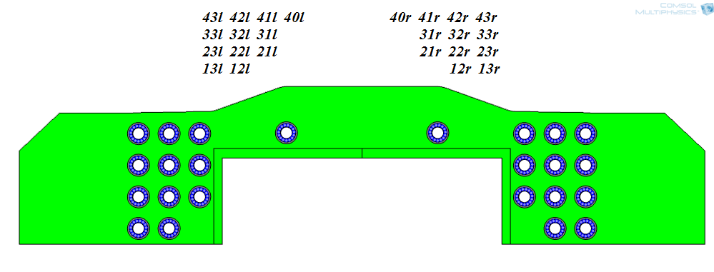
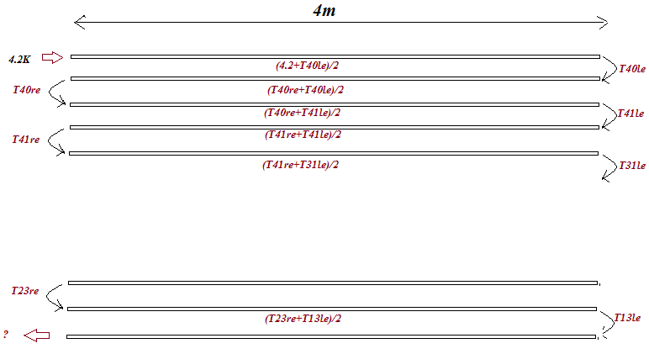
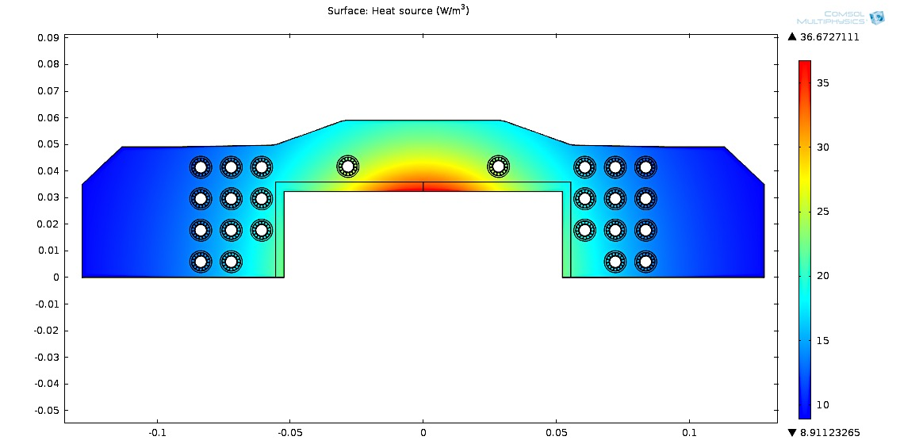
2.5d thermal model of MEIC dipole and cooling scheme: 2d heat transfer in solids +1d in the cooling channels
Cooling channel numbering
Isolated Region used in 2-D thermal,
T_{ij} LHe temperatures at far end of the cooling channel
Assumed heat density, total 0.15 W/m
Near side
Far side
Average Heat flux from tube to LHe used in 2-D thermal model, T- tube temperature, T_{b}, T_{e} – Lhe temperatures at Near and far side of the tube
$$f=cons∙{\left[\frac{T}{\frac{Tb+Te}{2}}\right]}^{−0.716}(T−(T_{b}+T_{e})/2)$$
Total heat taken by Lhe over half turn
$$Q=\oint{fds}∙\frac{L}{v}∙\frac{1}{πr^{2}}$$
h is enthalpy of LHe
$$T_{e}=h^{−1}(Q+h\left(T_{b}\right))$$

Slide 16
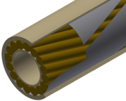
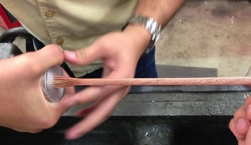
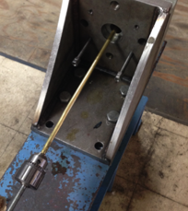
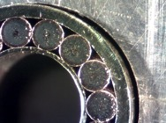
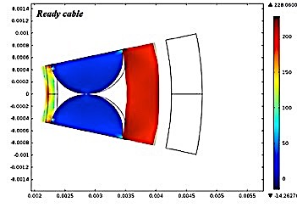
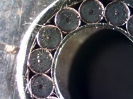
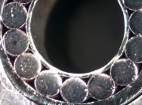
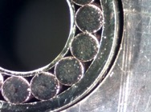
CIC development for the MEIC dipole
15 NbTi/Cu wires are cabled onto a perforated spring tube.
The cable is inserted in a sheath tube, and the sheath is drawn onto the cable to just compress the wires against the spring tube.

Slide 17
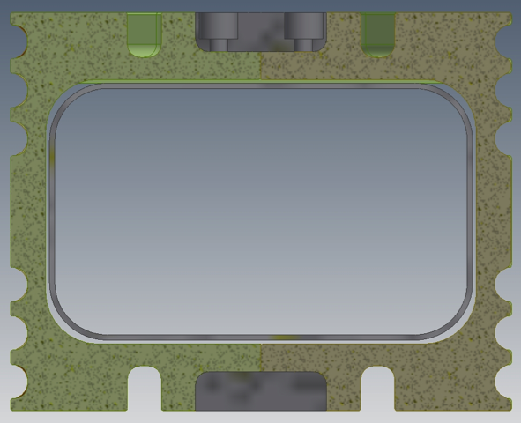
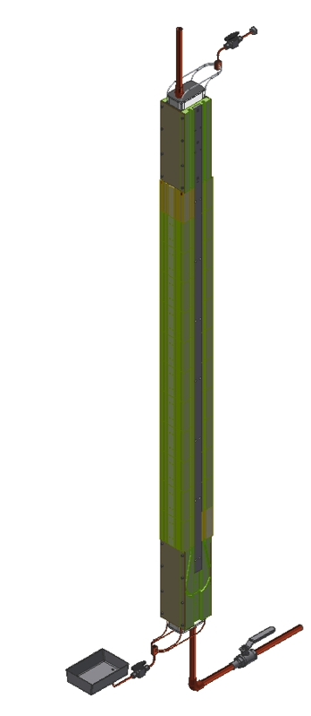
Superferric Dipoles: How we build them
Strategy:
All cables are positioned sandwiched between layers of precision-machined structure.
Ends are formed to the side of the dipole, then popped into place in the structure layer.
Overall coil assembly is preloaded within steel flux return, all windings immobilized.
Fabricate inner form segments from 4”-thick G-11 fiber-reinforced epoxy slabs.
Assemble stack of segments for dipole body, using the CIC channels for alignment.
Improvement: Channels for cables are split equally on the facing segments.
3. Insert the SS beam tube, seal the ends, and epoxy impregnate the gap between segments and beam tube.

Slide 18
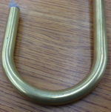
Forming the flared ends requires production tooling
All ends are formed with 2” radius bends.
Bend the U to form a 90° ear, with offset for layer-layer transitions.
1. Bend a U with the correct horizontal spacing.
‘Odd-man’ turns require forming a ‘dog-bone’ end.
We have validated that bends preserve internal structure, do not damage NbTi wires.

Slide 19
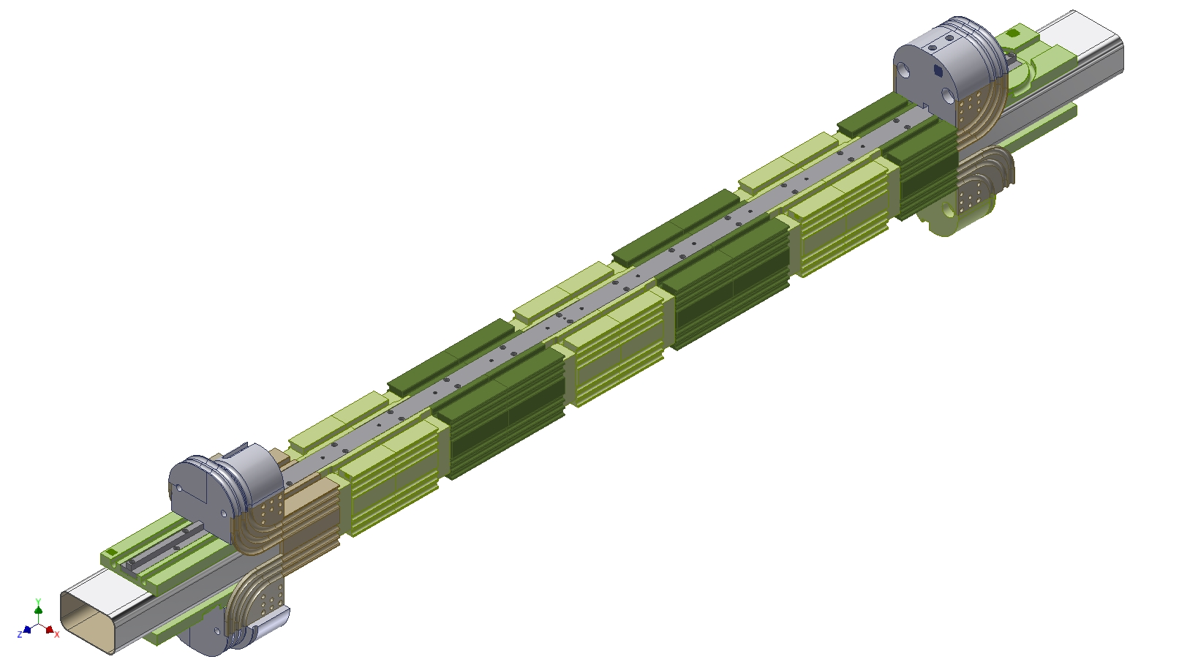
Impregnated assembly ready for layer 1

Slide 20
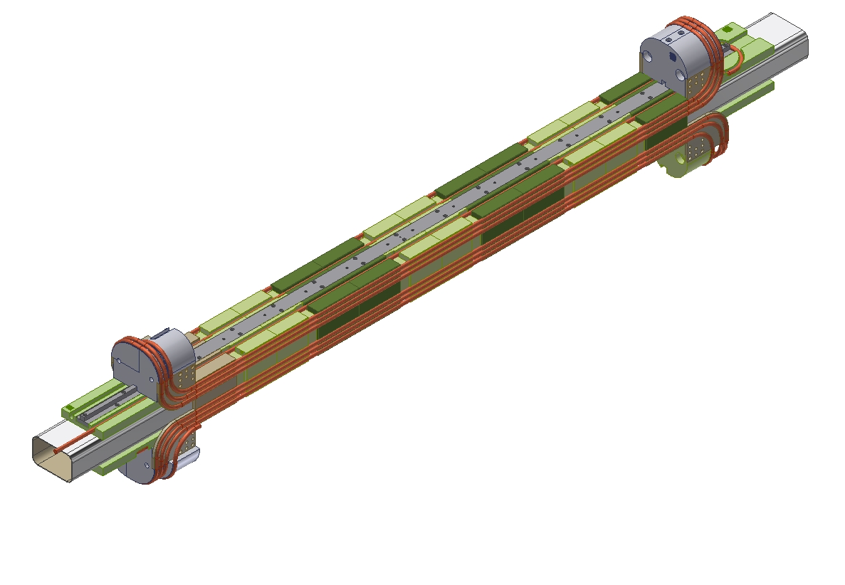
Layer 1 complete

Slide 21
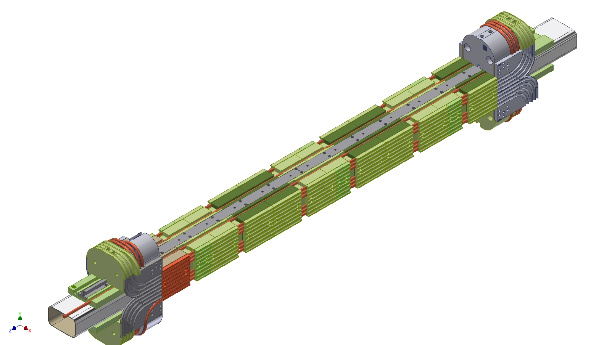
Caps/forms in place – ready to wind layer 2

Slide 22
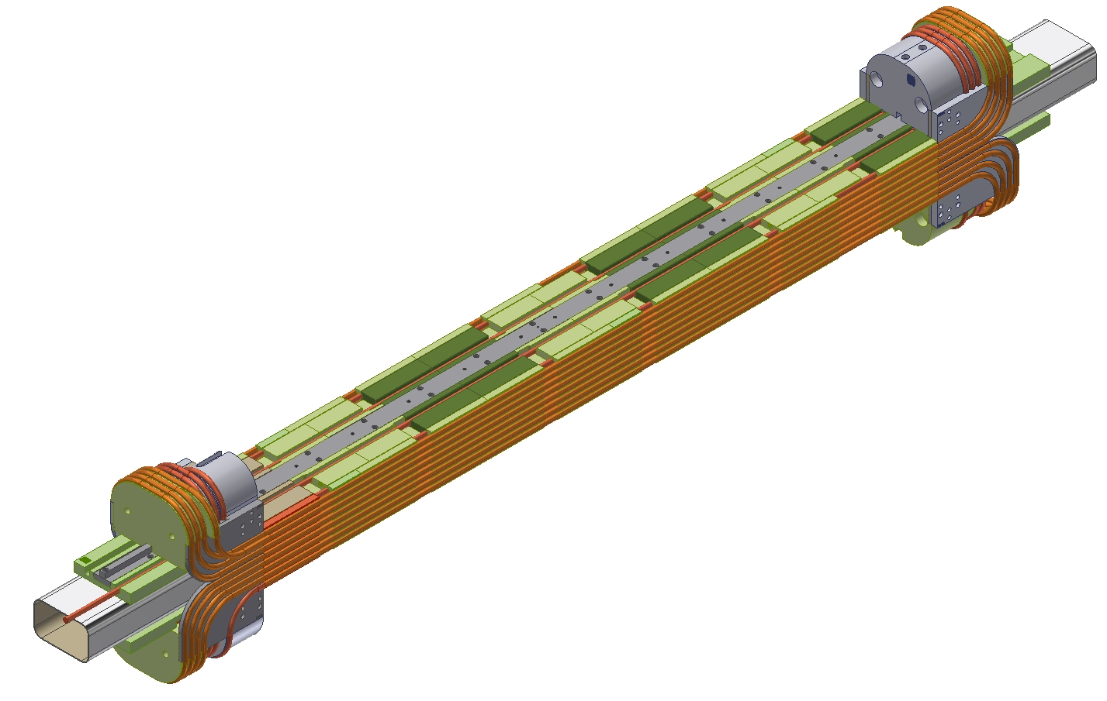
Layer 2 complete

Slide 23
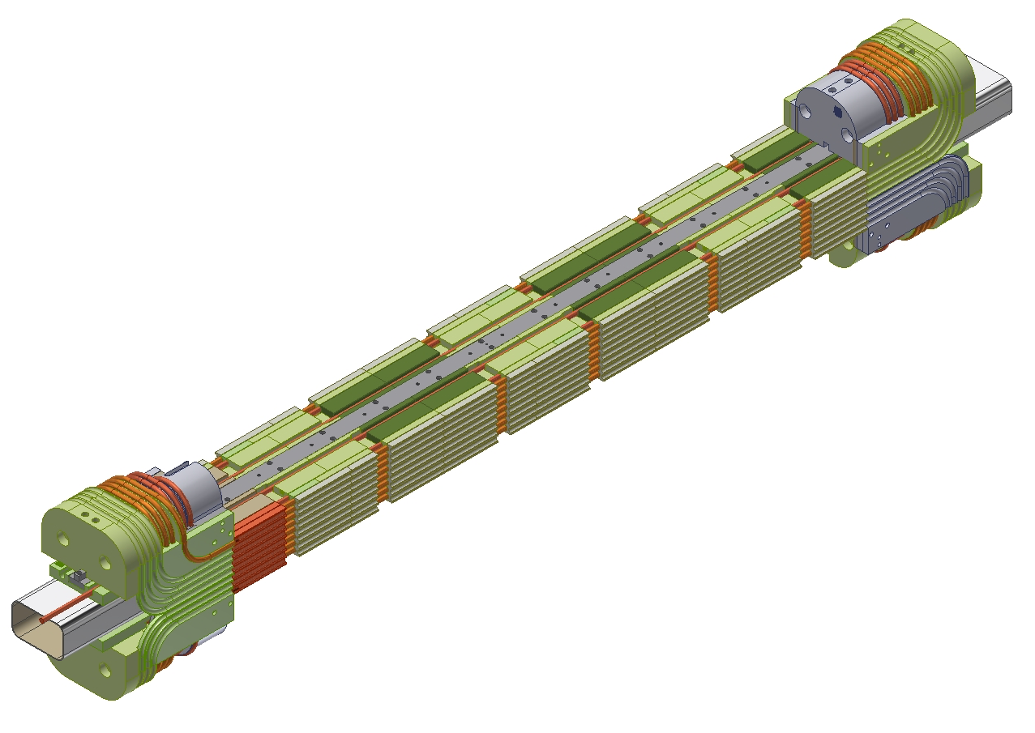
Caps/forms in place – ready to wind layer 3

Slide 24
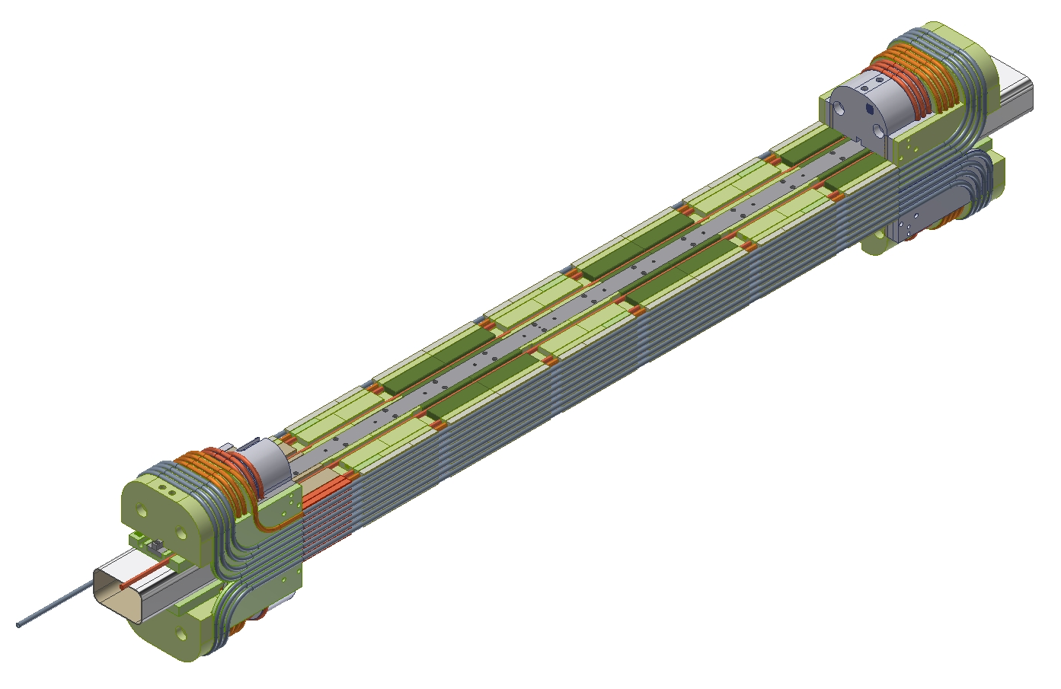
Layer 3 complete

Slide 25
Final caps in place – preload and QC
Apply flat plates to top/bottom surfaces, clamp sides and top/bottom, dilatometry of x/y cable positions through open slots in G-11 structure.

Slide 26
Superconducting Wire Spec
Option 1) - Supercon
SC-VSF-SSCI-1.20mm
1.20mm diameter bare
7,240 filaments NbTi @ 9 micron nominal diameter
Cu:SC = 1.5:1
Ic ( 5T, 4.2K): 950 A minimum
Quantity: 4 km
Unit Price: $3,780.00 / km
Option 2) - Supercon
SC-VSF-678-1.20mm
1.20 mm diameter bare
678 filaments NbTi @ 33 micron nominal diameter
Cu:SC = 0.9:1
Ic ( 5T, 4.2K): 1,500 A minimum
Quantity: 4 km
Unit Price: $3,865.00 / km

Slide 27
Fabrication of G-11 piece-parts
quoted parts | closely related parts |  |  | drawings to Precision | priority for fab | Price
HEAP-B-55-100-003 |  | 2 | Extension from body - 1 | ✓ | 1 | 255 |  | 510
 | HEAP-B-55-100-032 | 2 | End extension - 2 | ✓ | 1 |  | 255 | 510
HEAP-B-55-100-005 |  | 6 | Middle winding form - short | ✓ | 3 | 92 |  | 552
HEAP-B-55-100-006 |  | 16 | Middle winding form - long | ✓ | 3 | 75 |  | 1200
HEAP-B-55-100-007 |  | 16 | Outer winding form A - long | ✓ | 4 | 65 |  | 1040
 | HEAP-B-55-100-038 | 1 | Outer winding form A - heater cut |  | 4 |  | 65 | 65
HEAP-B-55-100-009 |  | 16 | Cap B - long | ✓ | 5 | 50 |  | 800
 | HEAP-B-55-100-008 | 6 | Cap A |  | 5 |  | 65 | 390
 | HEAP-B-55-100-039 | 1 | Cap - heater cut |  | 5 |  | 65 | 65
HEAP-B-55-100-012 |  | 1 | End form lead 1A | ✓ | 2 | 270 |  | 270
 | HEAP-B-55-100-015 | 1 | End form tail 1A | ✓ | 2 |  | 270 | 270
 | HEAP-B-55-100-024 | 1 | End form tail 2A | ✓ | 2 |  | 270 | 270
 | HEAP-B-55-100-021 | 1 | End form lead 2A | ✓ | 2 |  | 270 | 270
HEAP-B-55-100-013 |  | 1 | End form lead 1B | ✓ | 3 | 250 |  | 250
 | HEAP-B-55-100-016 | 1 | End form tail 1B |  | 3 |  | 250 | 250
 | HEAP-B-55-100-025 | 1 | End form tail 2B |  | 3 |  | 250 | 250
 | HEAP-B-55-100-022 | 1 | End form lead 2B |  | 3 |  | 250 | 250
HEAP-B-55-100-014 |  | 1 | End form lead 1C REV B | ✓ | 4 | 230 |  | 230
 | HEAP-B-55-100-017 | 1 | End form tail 1C REV-B | ✓ | 4 |  | 230 | 230
 | HEAP-B-55-100-027 | 1 | End form tail 2D REV B | ✓ | 4 |  | 230 | 230
 | HEAP-B-55-100-023 | 1 | End form lead 2C |  | 4 |  | 230 | 230
 | HEAP-B-55-100-026 | 1 | End form tail 2C REV B | ✓ | 4 |  | 230 | 230
HEAP-B-55-100-020 |  | 5 | Central winding form | ✓ | 1 | 430 |  | 2150
 | HEAP-B-55-100-019 | 1 | Central winding form - heater cut | ✓ | 1 |  | 430 | 430
 | HEAP-B-55-100-058-REV B | 6 | Central winding form - shoulder cut |  | 1 |  | 430 | 2580
HEAP-B-55-100-030 |  | 1 | Lead end flag 3 left | ✓ | 4 | 120 |  | 120
 | HEAP-B-55-100-033 | 1 | Lead end flag 1 left | ✓ | 2 |  | 120 | 120
 | HEAP-B-55-100-034 | 1 | Lead end flag 2 left |  | 3 |  | 120 | 120
 | HEAP-B-55-100-035 | 1 | Lead end flag 1 right | ✓ | 2 |  | 120 | 120
 | HEAP-B-55-100-036 | 1 | Lead end flag 2 right |  | 3 |  | 120 | 120
 | HEAP-B-55-100-037 | 1 | Lead end flag 3 right |  | 4 |  | 120 | 120
 | HEAP-B-55-100-040 | 1 | Lead end flag 4 left | ✓ | 2 |  | 120 | 120
 | HEAP-B-55-100-041 | 1 | Lead end flag 5 left |  | 3 |  | 120 | 120
 | HEAP-B-55-100-042 | 1 | Lead end flag 6 left |  | 4 |  | 120 | 120
 | HEAP-B-55-100-043 | 1 | Lead end flag 4 right | ✓ | 2 |  | 120 | 120
 | HEAP-B-55-100-044 | 1 | Lead end flag 5 right |  | 3 |  | 120 | 120
 | HEAP-B-55-100-045 | 1 | Lead end flag 6 right |  | 4 |  | 120 | 120
 | HEAP-B-55-100-046 | 1 | Tail end flag 1 left | ✓ | 2 |  | 120 | 120
 | HEAP-B-55-100-047 | 1 | Tail end flag 2 left |  | 3 |  | 120 | 120
 | HEAP-B-55-100-048 | 1 | Tail end flag 3 left |  | 4 |  | 120 | 120
 | HEAP-B-55-100-049 | 1 | Tail end flag 1 right | ✓ | 2 |  | 120 | 120
 | HEAP-B-55-100-050 | 1 | Tail end flag 2 right |  | 3 |  | 120 | 120
 | HEAP-B-55-100-051 | 1 | Tail end flag 3 right |  | 4 |  | 120 | 120
 | HEAP-B-55-100-052 | 1 | Tail end flag 4 right | ✓ | 2 |  | 120 | 120
 | HEAP-B-55-100-053 | 1 | Tail end flag 5 right |  | 3 |  | 120 | 120
 | HEAP-B-55-100-054 | 1 | Tail end flag 6 right |  | 4 |  | 120 | 120
 | HEAP-B-55-100-055 | 1 | Tail end flag 4 left | ✓ | 2 |  | 120 | 120
 | HEAP-B-55-100-056 | 1 | Tail end flag 5 left |  | 3 |  | 120 | 120
 | HEAP-B-55-100-057 | 1 | Tail end flag 6 left |  | 4 |  | 120 | 120
HEAP-B-55-100-031 |  | 1 | Middle wind form A heater cut |  | 3 | 145 |  | 145
 | HEAP-B-55-100-059 |  | Tail end flag 7 left
 | HEAP-B-55-100-060 |  | Mockup winding assembly | ✓ |  |  |  | 16547

Slide 28
QC of G-11 window-frame assembly

Slide 29
Central winding form – no QC channels

Slide 31
Central winding form – with QC channels

Slide 32
Central winding form – heater channels

Slide 33
Quench Protection
Talk this afternoon by Daniel Chavez
Quench heater foils are bonded in a 10 cm end segment of the G-11 structure on both ends of the dipole.
Every cable turn is driven normal in ~10 ms by a current pulse to the heater foils.

Slide 34
Provision for differential contraction, preload against Lorentz forces in body
Horizontal contraction
Steel
G-11
Ti
316 SS
Orient G-11 with fabric perpendicular to beam tube axis – small contraction.
Locate Ti U-channels to compensate differential contraction – warm-cold ~+.002”
Locate SS/mica paper slip plane between G-11 and steel flux return.

Slide 35
CIC Winding limits temperature rise in event of heat from beam losses
4.5 K
4.4
4.3
4.2
Simulated temperature distribution in the presence of 0.5 W heat deposition in a 4 m MEIC dipole winding.
CIC Structure controls Lorentz stress to prevent coil motion, training, error fields
X displacement (RT – 3 T) .001”
Y displacement (RT – 3 T) .001”
Multipole effects <0.2 units

Slide 36
Present status
We have improved the magnetic design so that all multipoles are <1 unit over operating range.
We have incorporated preload and differential contraction compensation so that preload is preserved over cool-down.
We have completed and impregnated the structural beam, ready to wind layer 1.
We have fabricated and assembled the two main motorized benders, and are programming their operations.
We have prepared the winding supports for cable, tensioner, and winding assembly.
We have formed sample cables with the several candidates for central core tube, tested I_{c} on extracted strands, validated that there is no strain degradation.

