Slide 1
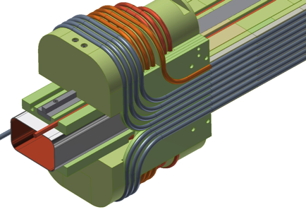
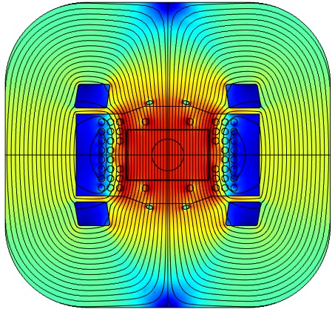
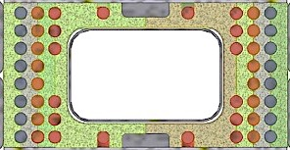
Plan for completion of Task 2

Slide 2
Major activities to date
Structural elements for winding
Develop detailed fabrication print sets for all G-11 components. ✓
Contract fabrication of one body segment, QC fabricated part to qualify vendor. ✓
Contract for fabrication of all G-11 components, in 3 priority groups:
Structural elements to be impregnated with beam tube and wind layer 1 ✓
Structural elements needed to complete layer 2 
Structural elements needed to complete layer 3 
Fabricate SS beam tube and flanking SS structural bars. ✓
Assemble priority 1 parts on beam tube and vacuum impregnate structural beam. ✓
Motorized bending tools
Develop piece-part prints for bending tools:
Main bender for 180° U-bends ✓
Compound bender for 90° flare bends with steps for transitions ✓
Special benders for dog-bone ends and for close bends 
Fabricate main bender and compound bender, integrate with motor/gearbox assys✓
Develop control programs for the required bends. 
CuNi tube for dummy cable, draw to final cable diameter ✓
Form sample cables, form 180° U-bends, extract strands, test I_{c}. ✓
Develop 3D FEA model of the dipole, evaluate support for ends. 

Slide 3
Remaining tasks
Program Motorized Benders for all winding steps
Complete special Motorized Benders for dog-bone ends, close ends.
Attach end structures for layer 1.
Wind layer 1.
QC body and end locations of all turns.
Drill holes for layer clips for layers 2,3.
Attach end structures and body caps for layer 2.
Wind layer 2.
QC body and end locations of all turns.
Attach end structures, body caps, clips for layer 3.
Wind layer 3.
QC body and end locations of all turns.
Install cover caps and clips. Mockup winding is now complete.
Compress winding package and clamp between plates. Final QC of turns.
Complete FEA model including stress/strain in end region.
Prepare report of Task 2 effort.
We plan to complete Task 2 effort by 12/31/2015.
We will have exhausted all contract $ by that date.

Slide 4
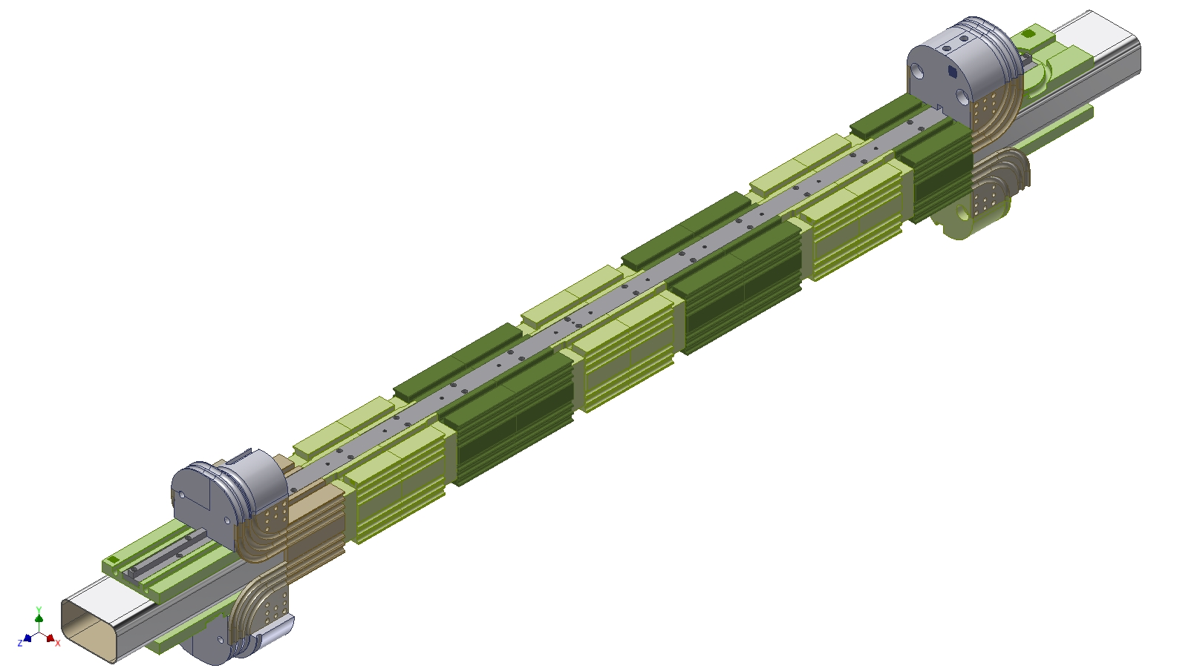
Impregnated assembly ready for layer 1

Slide 5
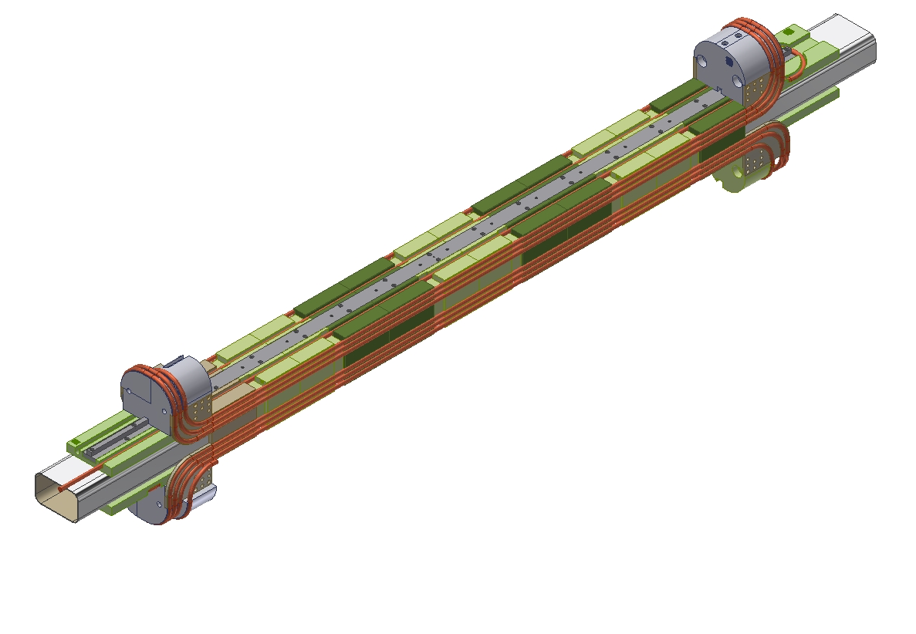
Layer 1 complete

Slide 6
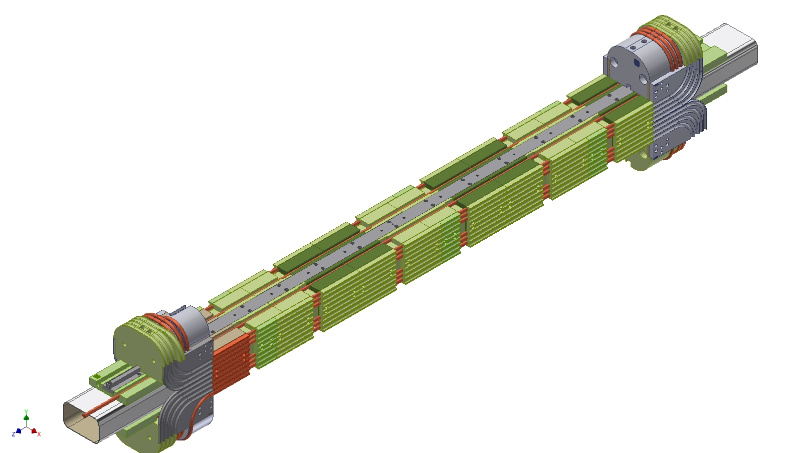
Caps/forms in place – ready to wind layer 2

Slide 7
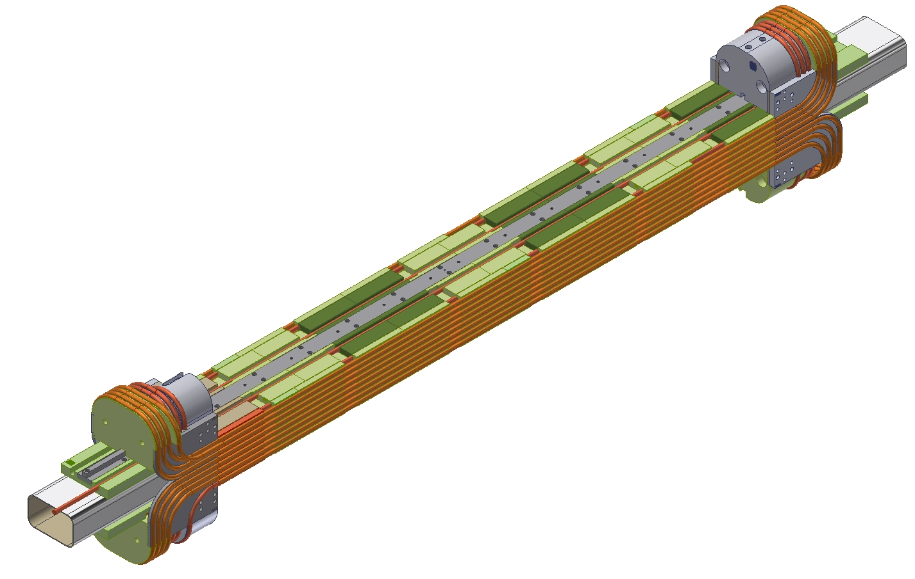
Layer 2 complete

Slide 8
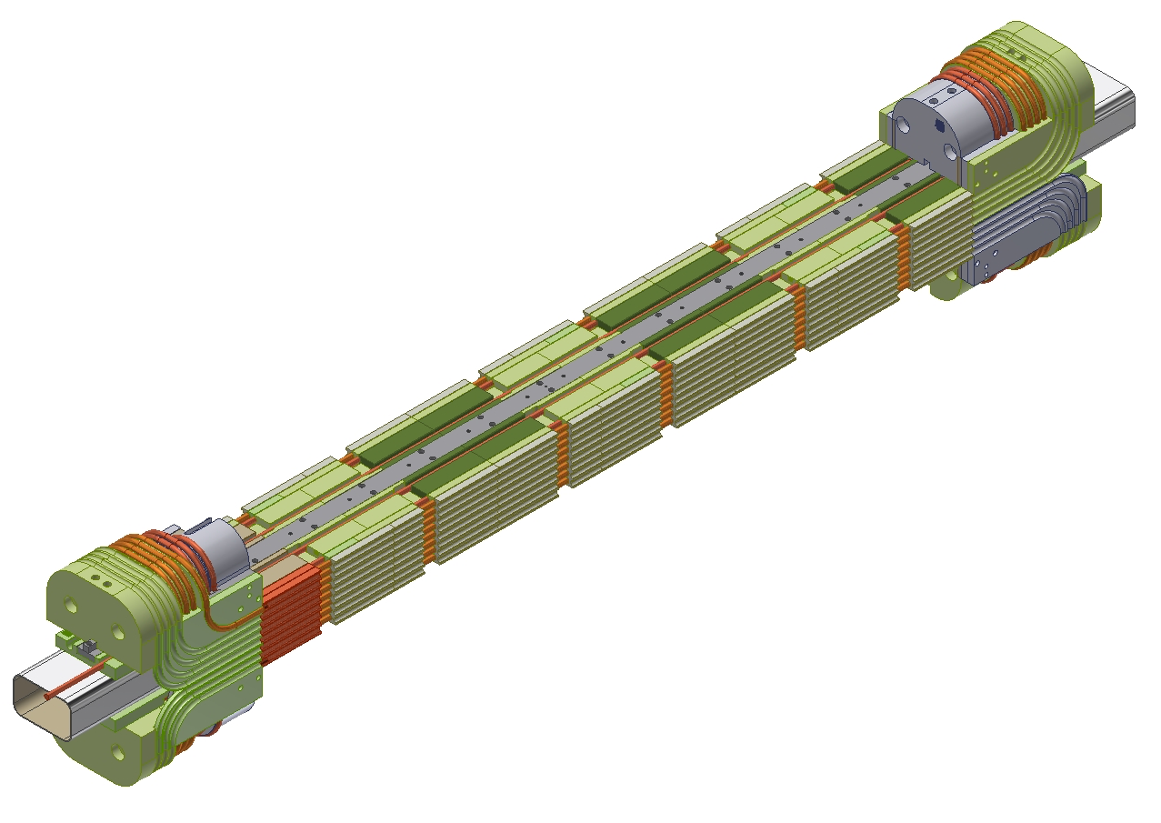
Caps/forms in place – ready to wind layer 3

Slide 9
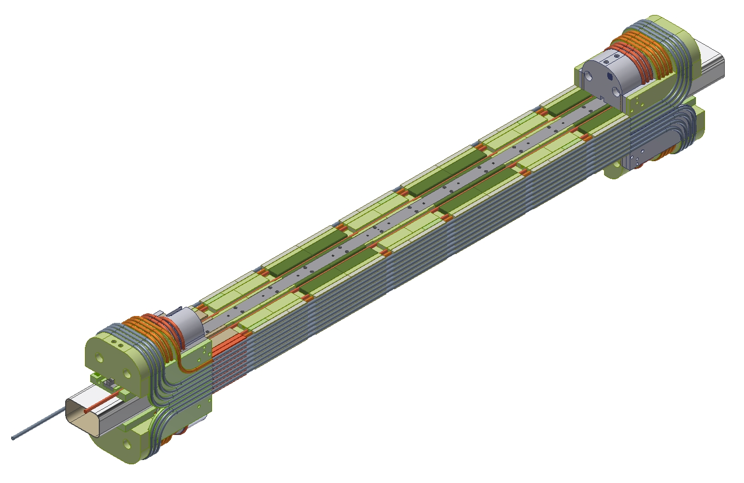
Layer 3 complete

Slide 10
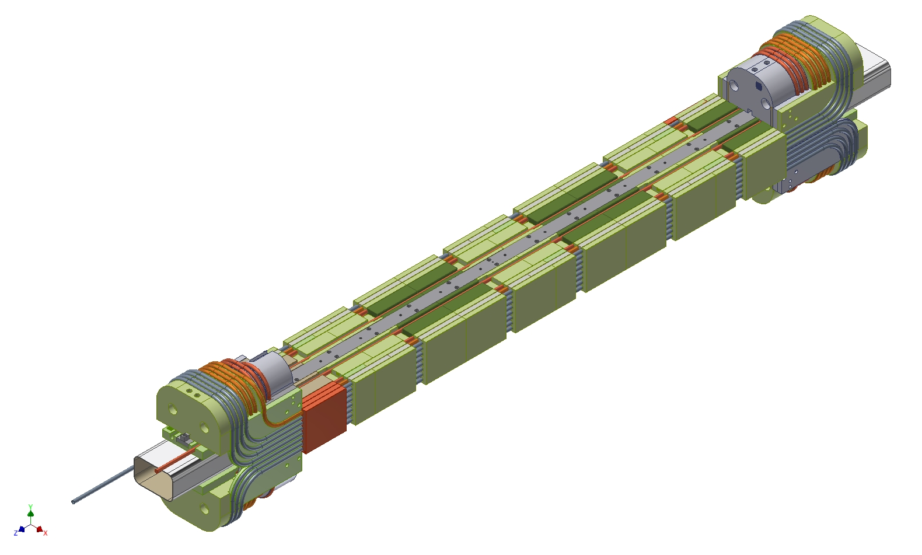
Final caps in place – preload and QC
Apply flat plates to top/bottom surfaces, clamp sides and top/bottom, dilatometry of x/y cable positions through open slots in G-11 structure.

