Slide 1
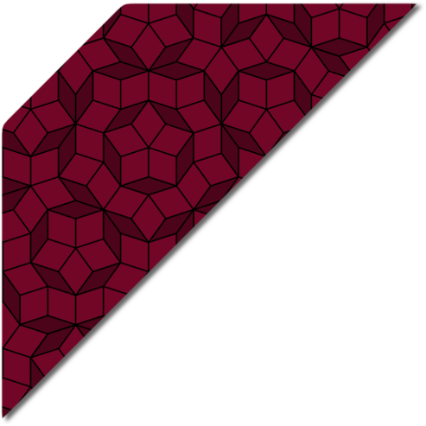
FEA simulation of end forces on MEIC dipole
James Gerity
December 2, 2015

Slide 2
Motivation
Cable is most susceptible to Lorentz force damage in the end regions
Displacements and stresses are therefore of crucial importance

Slide 3
Simulation assumptions
8-fold symmetry
Simple cable structure
Simple G11 structure
Decoupled Lorentz forces imposed from Opera Vector Fields solution
If displacements are small (< a few mils), fully coupled solution will not be substantially different.

Slide 4
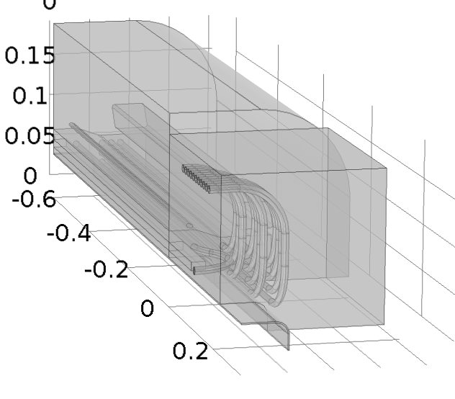
Problem geometry

Slide 5
Results
Lorentz forces on ends. Not shown is the solid block of G11 used to represent the endcap pieces. Maximum displacement ~ 4 µm

Slide 6
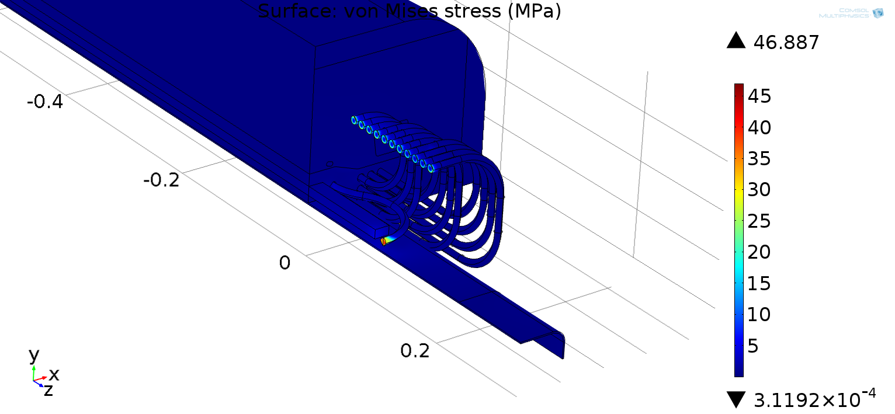
Results
Lorentz forces on ends. Not shown is the solid block of G11 used to represent the endcap pieces. Maximum stress ~ 47 MPa

Slide 7
Further work
Effects of thermal/differential contraction on support scheme
Break longitudinal symmetry assumption, show unique patterns on different end geometries

