Slide 1
A NbTi Cable-in-Conduit conductor for the
Medium-energy Electron-Ion Collider (MEIC) magnets
Daniel Chávez
Texas A&M University

Slide 2
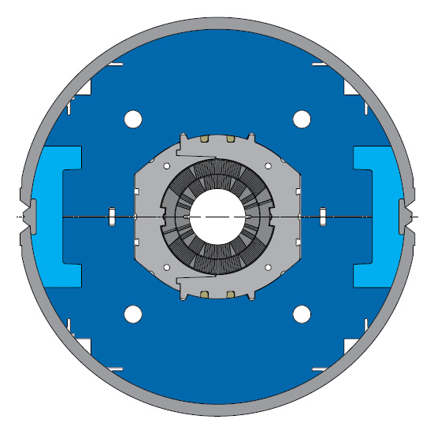
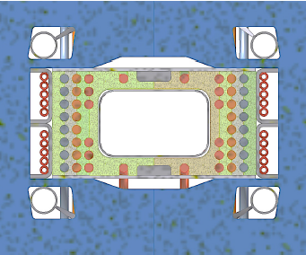
Superferric vs. Cos Ө
“Cos Ө”
“Superferric”

Slide 3
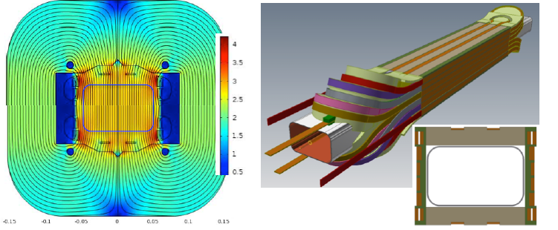
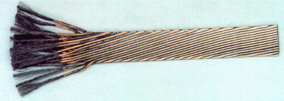
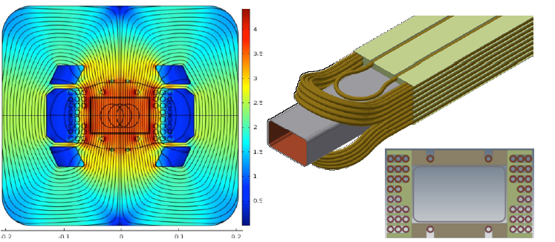
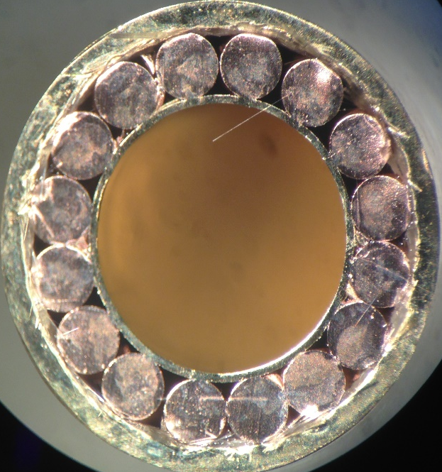
Rutherford cable vs. Cable-In-Conduit
Mechanical support
Cryogenic cooling
Quench protection

Slide 4
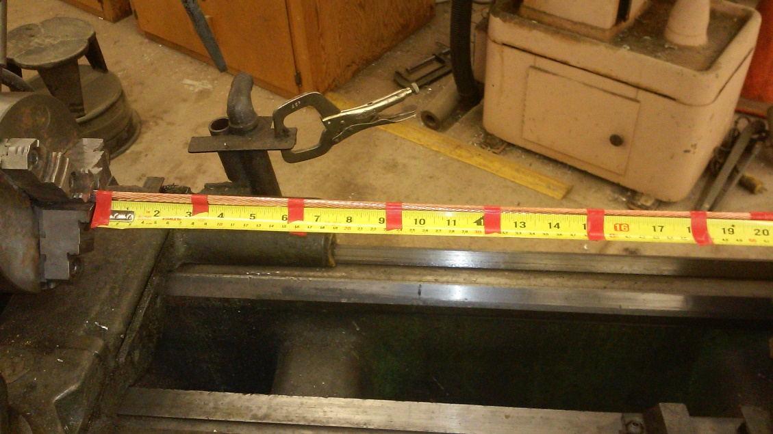
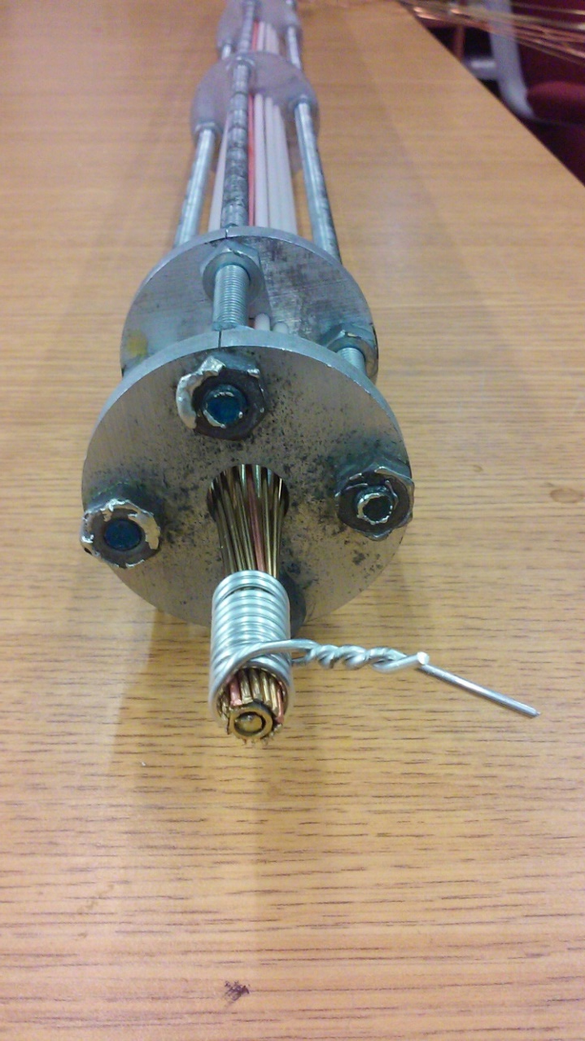
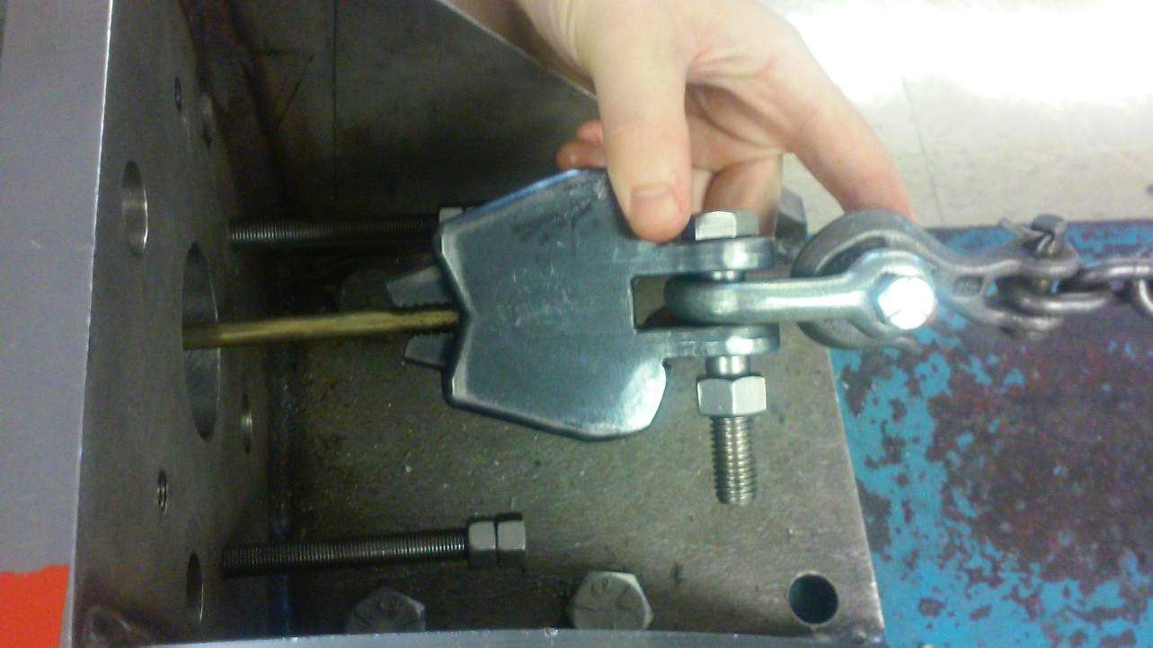
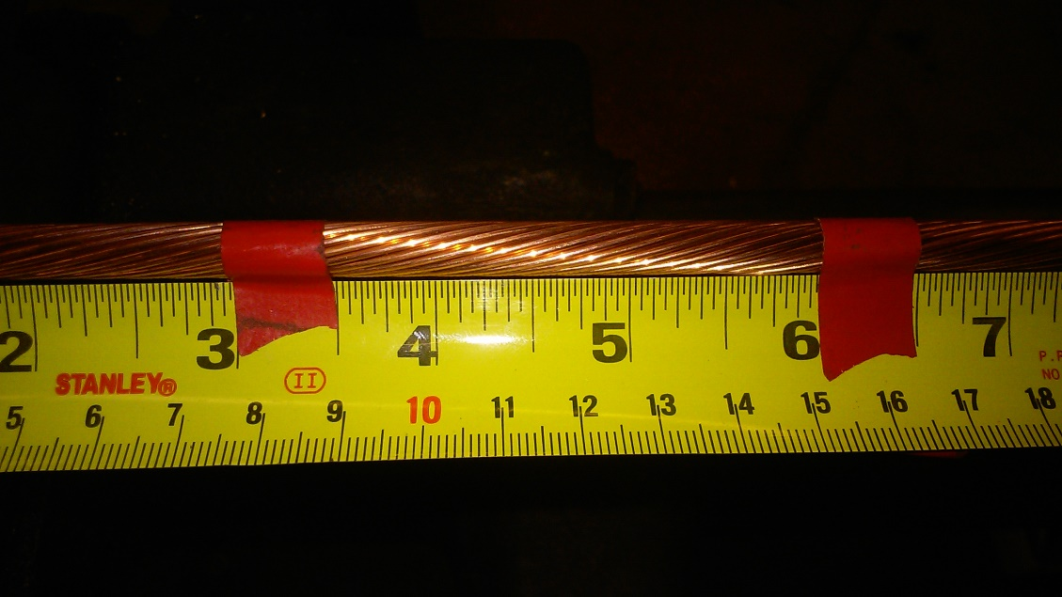
CIC R&D status: Mechanical stress
15- 1.2mm NbTi Cabled onto high strength tube.
Drawing process to compress and fix Sc.
3 inches twist pitch

Slide 5
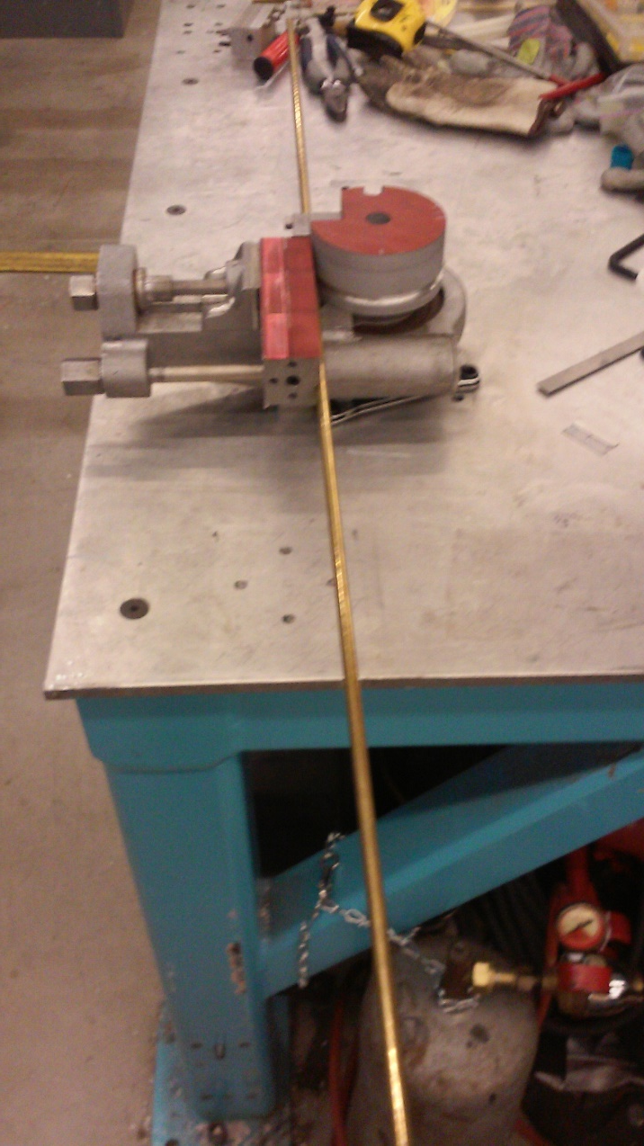
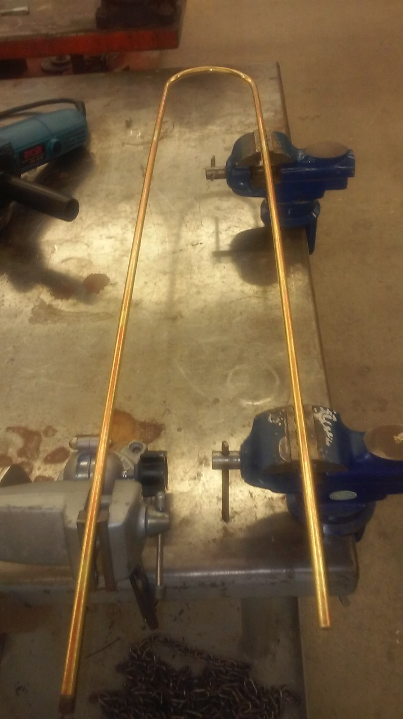
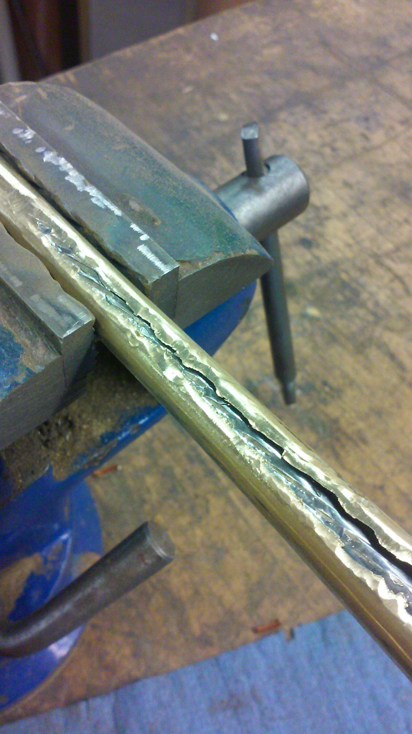
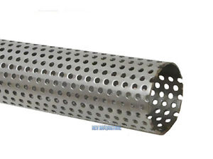
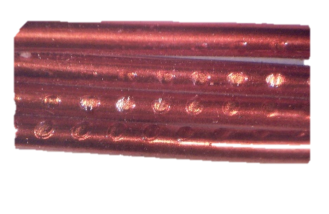
CIC R&D status: Mechanical stress
Bend 180°, 2” radius
CIC dissection for extracting strands

Slide 6
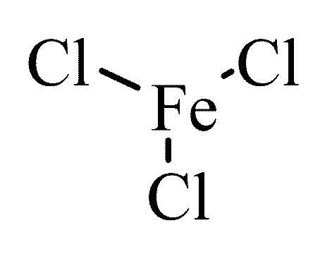
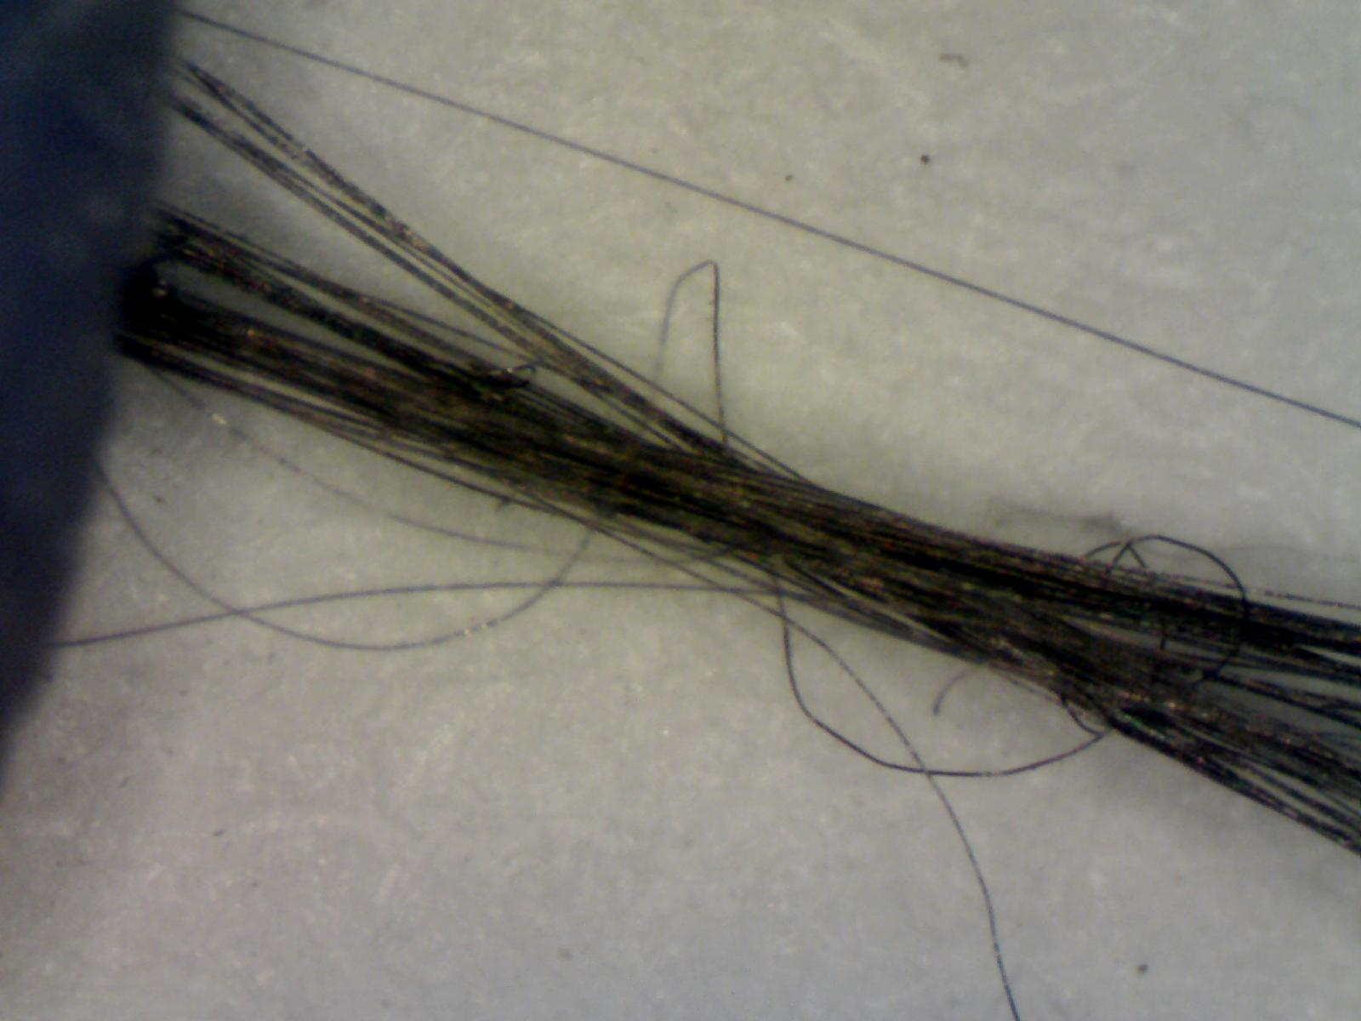
Etching the copper in the Superconductor
We etched the Cu matrix from extracted strands and from witness strands to check for
broken NbTi filaments.
Conclusions: <1% of strands are broken, # is comparable in witness strand and extracted strand.
The NbTi strand that we obtained free for these studies has significant internal strain, which limits our ability to test for slight levels of internal damage. Should repeat once we have strand that will be used for CIC cable.

Slide 7
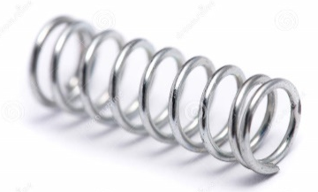
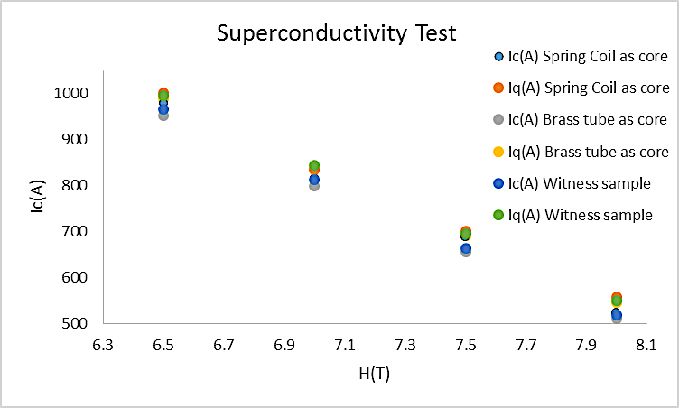
Short-sample measurements of extracted strands Tests performed at BNL Thanks immensely to Arup Ghosh!

Slide 8
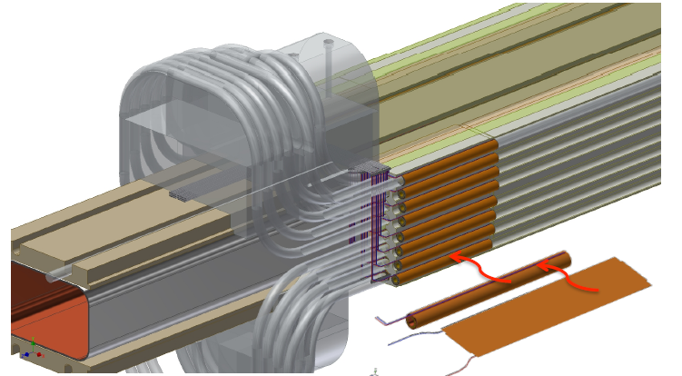
Quench
Quench heaters!
Broken filament
Current sharing

Slide 9
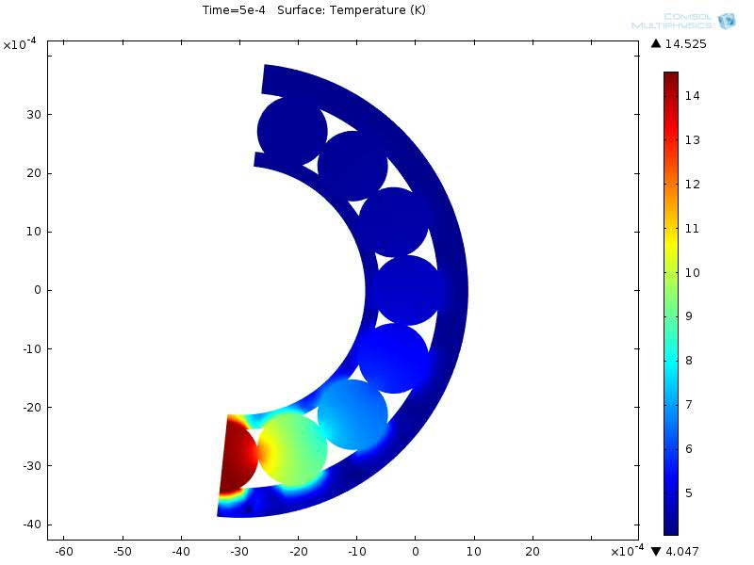
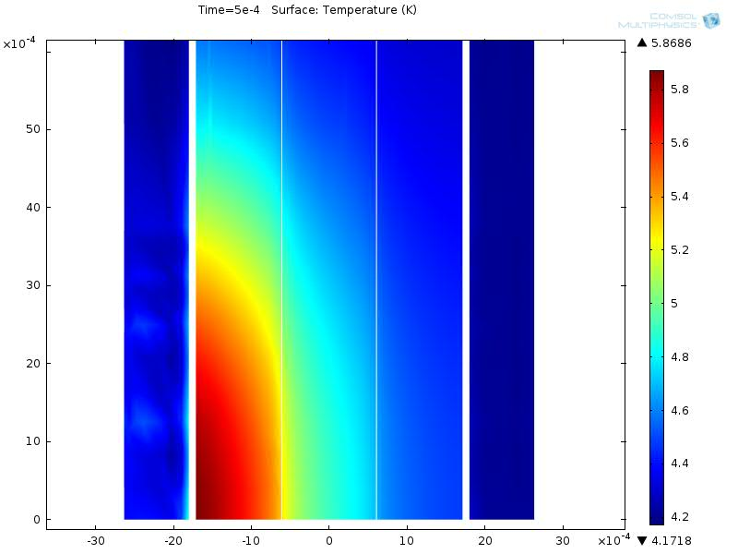
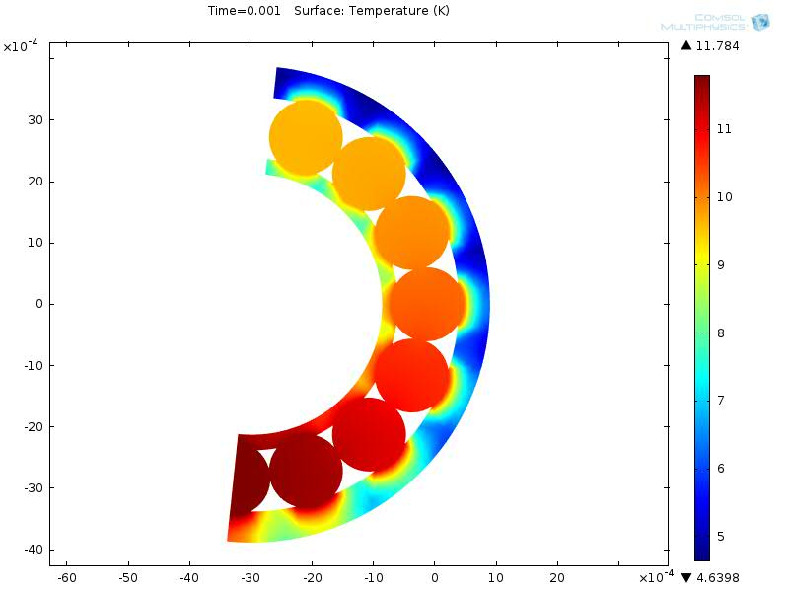
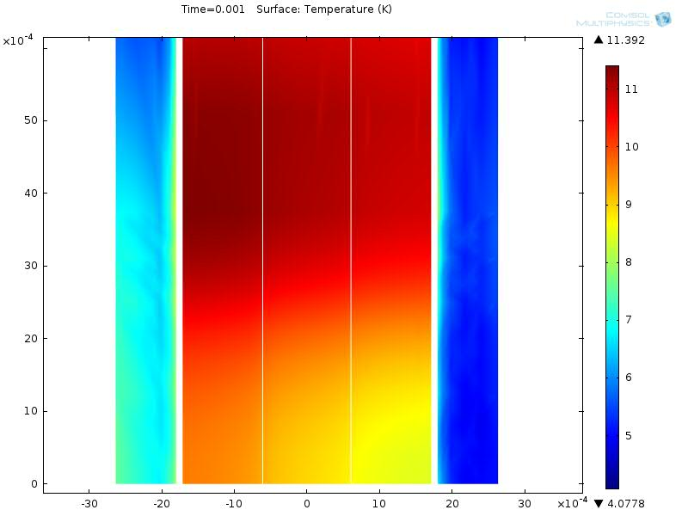
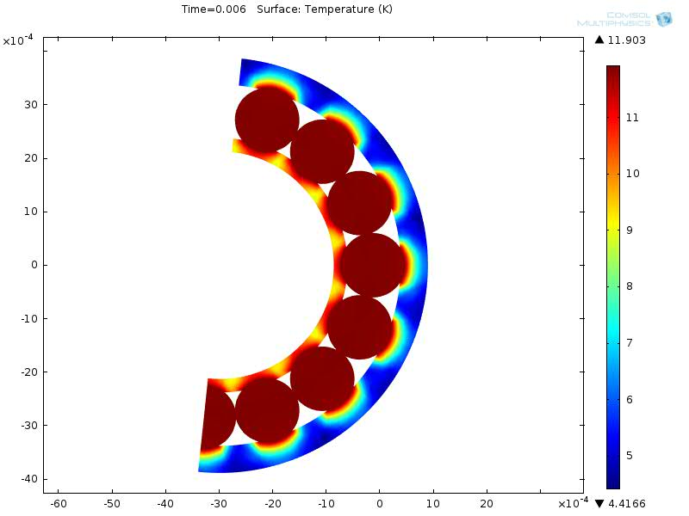
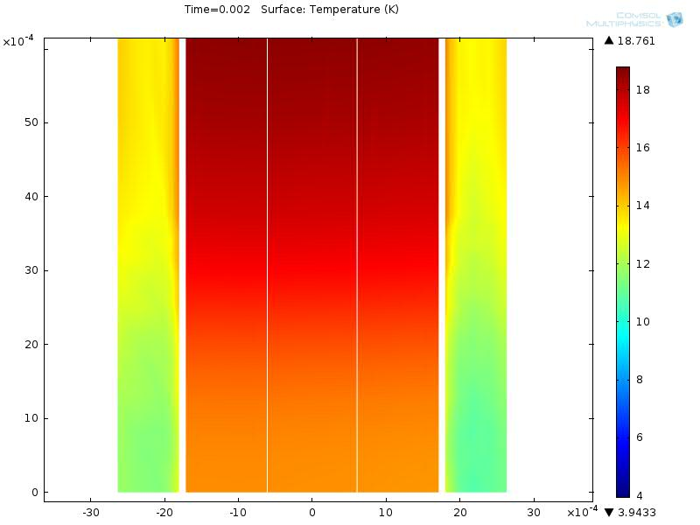
Quench: Simulations and modeling

Slide 10
Quench: Simulations and modeling

