Slide 1
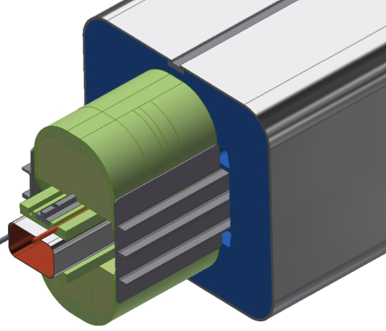
Model Dipole Fabrication & Testing
2016 Plan, Schedule, Budget

Slide 2
Proposed Plans for FY2016
Build & test 1.2 m Model Dipole
  Long-lead procurement for superconducting wire
  Long-lead scheduling of CIC fabrication sequence
  R&D for compression-molded structural elements
  Begin 1/2016… Complete dipole 9/2016
  Test dipole @ BNL Fall 2016
  Objectives:
    Determine performance: training, multipoles b_{n}(B)
    Improve cost estimation for production cost of 4 m dipoles
    Evaluate ramp rate dependence for use in Booster
    Evaluate quench protection

Slide 3
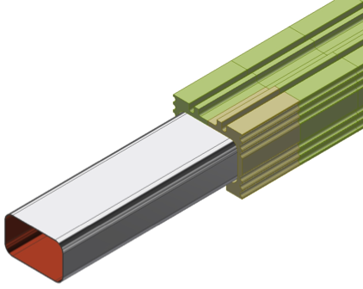
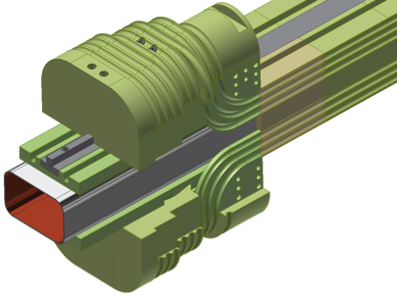
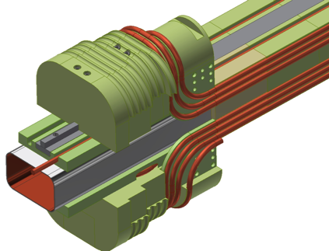
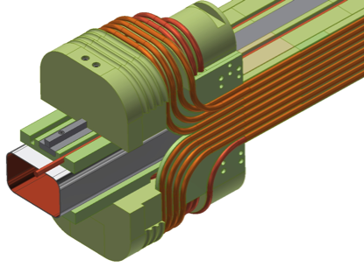
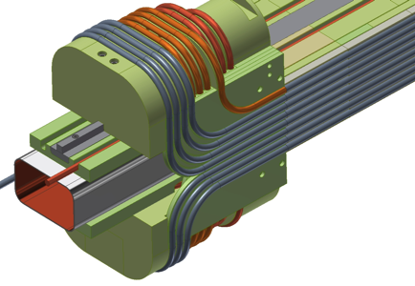
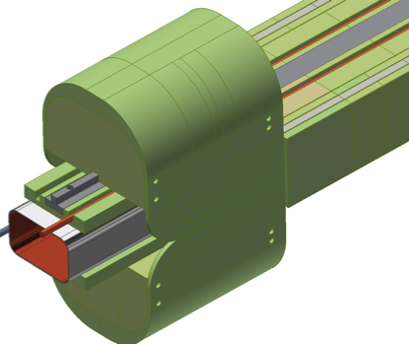
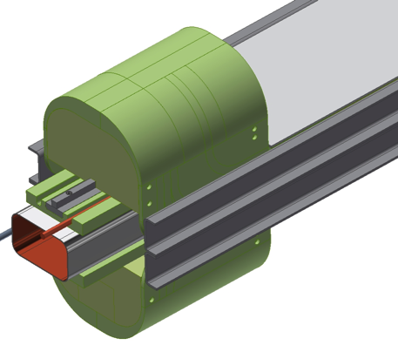
Model dipole fabrication sequence
Body segments assembled on beam tube, jig-located, epoxy-impregnated
SS bars, end frames installed, ready to wind first layer
First layer wound
Second layer wound
Third layer wound
Cable frame complete, End covers installed
Flux return halves installed and closed, SS shells welded
Ti channels, SS top/bottom skins installed

Slide 4
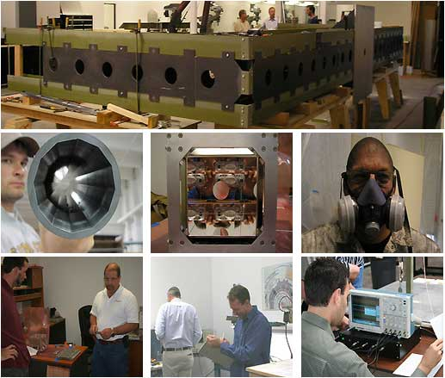
Winding R&D for cost reduction:
Compression-molded fiber-reinforced polymer parts for the CIC winding structure
RockWest fabricates FRP components by compression-molding. They have experience with cryo-compatible FRP materials, and holding tight dimensional tolerance.
Expensive at the front end to develop molds, perfect fab process for the desired parts.
Payoff is per-piece cost thereafter is ~$10,000 for 4 m body structure, vs.
~$20,000 for 4 m body structure using NC-machined G-11 parts.

Slide 5
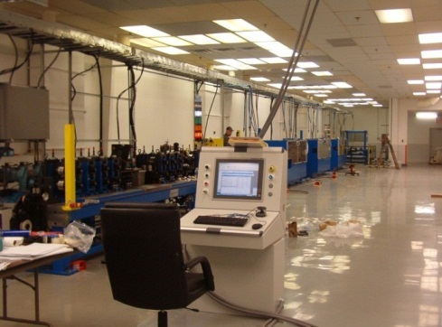
CIC Cable R&D for cost reduction:
CTFF Sheath on Cable-in-Conduit
Related SBIR proposal
Hyper Tech developed a Continuous Tube Forming and Filling machine for continuous multifilament wire encapsulation and laser sealing of multifilament wire or cables. They use the machine to manufacture multi-filament in site MgB₂ wire and cable.
We are working with them to adapt the procedure to continuously form the sheath cable onto long lengths of NbTi CIC.
The procedure would reduce cost x2 for CIC cable for MEIC magnets.
Key challenge: to demonstrate that the laser-weld is He tight warm and cold.

Slide 6
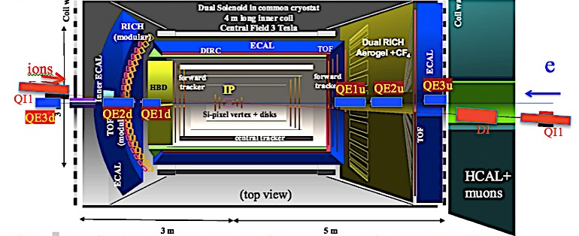
Superferric Magnets for IP
Related SBIR proposal
Quadrupoles must operate in the fringe field of the ~3 T detector solenoid.
The FF magnets must operate over a large range of beam energies: no PM.
FF quads must focus ions after IP collision must match to the collider lattice, but must have large aperture to pass scattered. QF1 requires 12 T in windings.
E, ion quads are close to one another, must not produce field on the other beam.
All FF magnets must operate with high rad damage & heat load from losses.

Slide 7
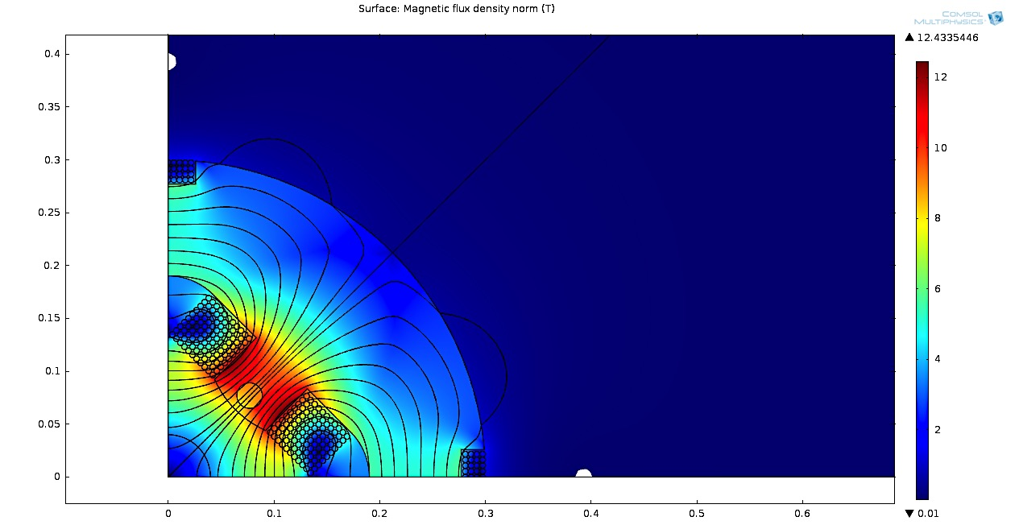
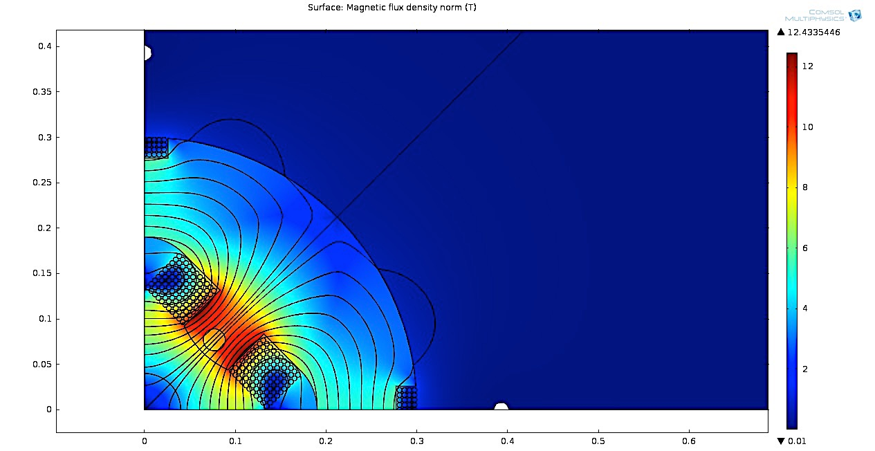
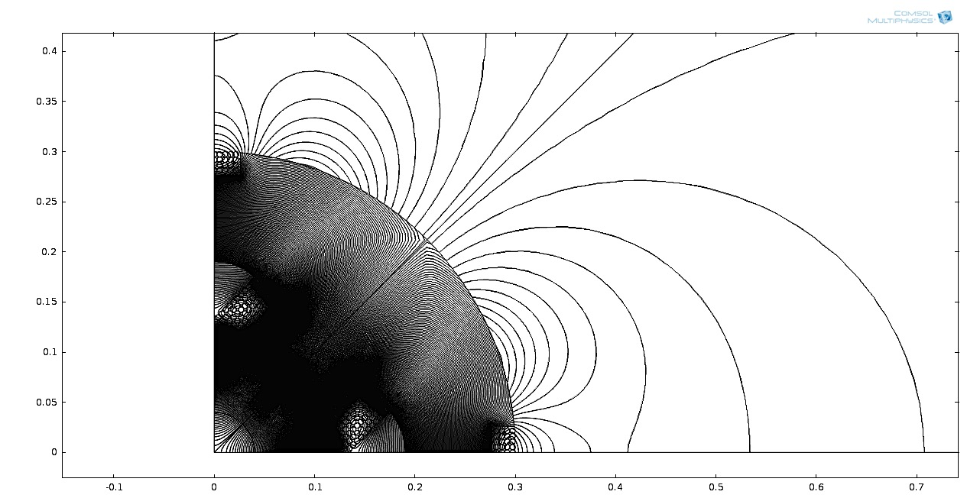
Ion beam quad QIF: 90 T/m, 17 cm half-aperture, 40 cm from e-beam
T
electron beam
Reverse-current winding kills fringe field at the location of the electron beam.
Nb₃Sn windings, 6 K

Slide 8
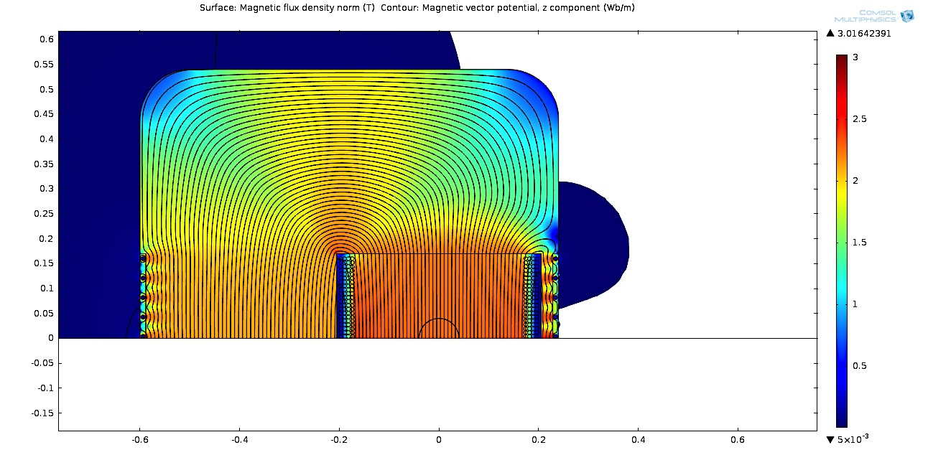
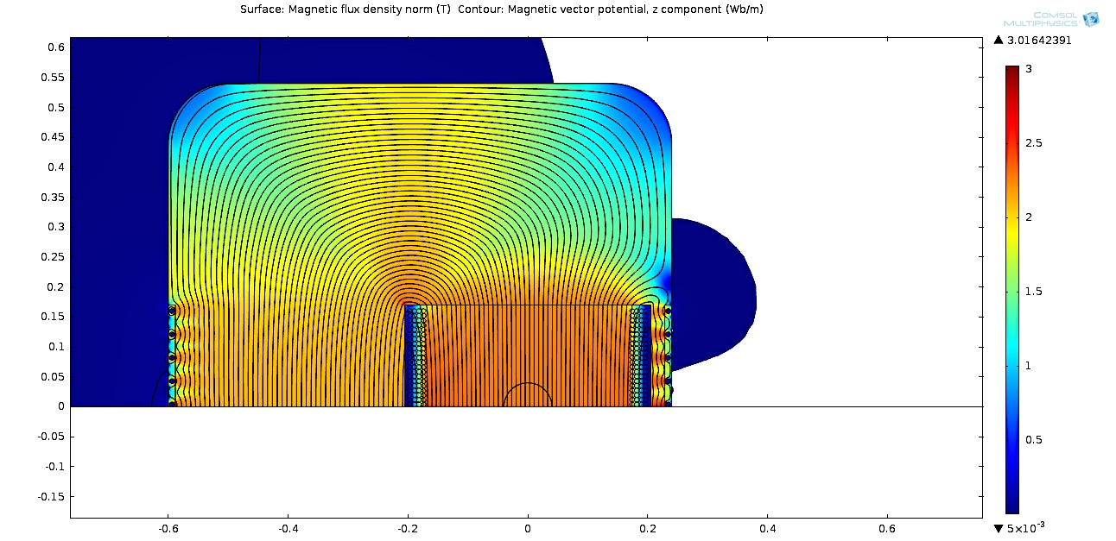
Dipole DI: 2 T, 340 mm aperture, 39 cm from the electron beam
T
electron beam
m
Window-frame C-geometry dipole configured as a Lambertson septum to suppress fringe field at electron beam.
MgB₂ windings, 20 K

Slide 9
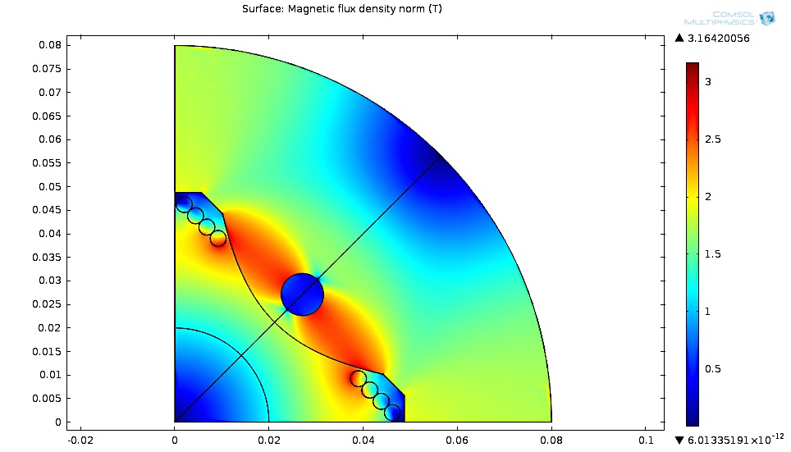

Quadrupole QE1d: 25 T/m gradient, 60 mm bore, 9 cm from the ion beam
T
T
ion beam beam
MgB₂ windings, 20 K

Slide 10
FY2015 funded NP effort
Superferric magnet R&D for MEIC arcs
  Pre-conceptual design, cost estimation (JLab) 180,000
  Conceptual design report, mockup winding 170,352
  (JLab + NP) funds received to date $350,352
Proposed FY2016 funded NP effort
Superferric magnet R&D for MEIC arcs
  Build & test 1.2 m model dipole 555,934
  R&D for compression-molded elements, CTFF 80,475
  $636,409

Slide 11
Proposed FY2016 program
Superferric CIC magnets for FF requirements
  Develop CIC conductor with Nb₃Sn, MgB₂.
  Fabricate, test MgB₂ model winding for QE1.
  Work with Machine-Detector Interface group to tune designs to IP requirements.
  Detailed design of one FF element, ready to build model magnet in Year 2.
Proposed FY2016 budget
Superferric CIC magnets for FF requirements
$183,688

Slide 12
Deliverables and Schedule
Superferric magnet R&D for MEIC arcs
  FY2015:
    Pre-conceptual design, cost estimation 1/15/2015✓
    Conceptual design report 8/31/2015✓
    Mockup winding studies 12/31/2015
  FY2016 (proposed)
    Build 1.2 m model dipole 9/30/2016
    Test 1.2 m model dipole 12/31/2016
    Compression-molded FRP structural parts 6/30/2016
    CTFF-formed sheath on CIC conductor 6/30/2016
Superferric CIC magnets for FF requirements
  FY2016:
    Develop/test CIC conductor using MgB₂ 7/30/2016
    Build/test model model winding for QE1 9/30/2016
    CDR for Di1, QE1 12/31/2016

Slide 13
Relevance to NP EIC Program
Superferric magnets for MEIC arcs
  The magnet ring for the ion ring is second-most-expensive system for MEIC (after the linac).
  The cost estimates for 3 T superferric magnets are ~half the cost of comparable cos θ magnets.
  The actual costs to date in developing the mockup winding are in-line with the cost estimates.
  There is potential for ~20% cost reduction by developing compression-molded structural elements, CTFF forming of the CIC sheath.
Superferric FF magnets
  The IP magnet requirements for MEIC and eRHIC are quite similar.
  The magnets are very challenging – huge aperture, fields at other beam, magnets in solenoids fringe field, large heat load
  Texas A&M’s pre-conceptual designs meet all challenges.

Slide 14
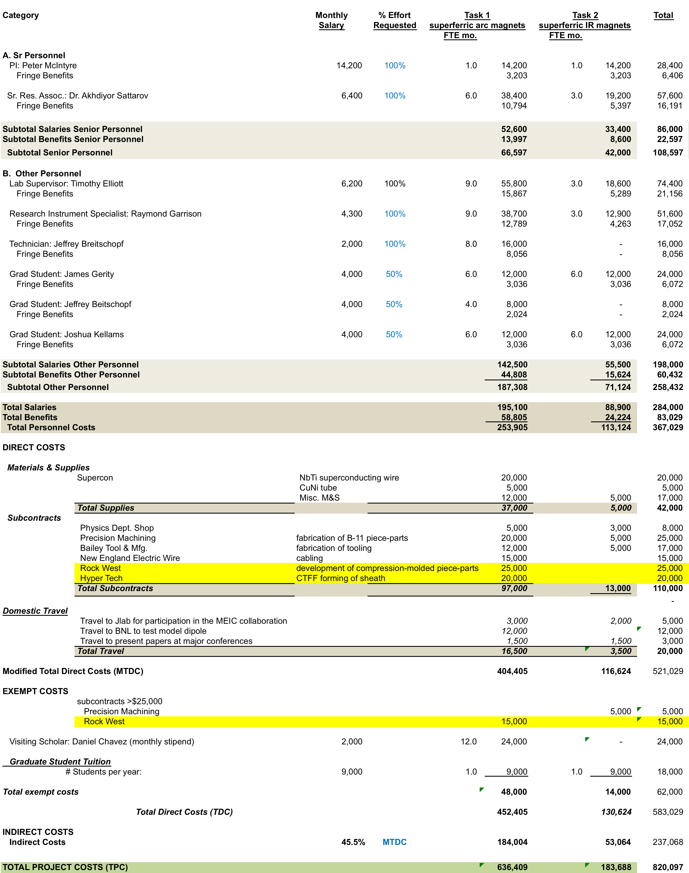
Proposed 2016 Contract

Slide 15
Involvement of our students
Graduate students
  Jeff Breitschopf
  Daniel Chavez
  James Gerity
  Joshua Kellams
Undergraduates
  Jacob Evans
  Katie O’Quinn
  Kyle Shores

Slide 16
Thoughts about questions in the Review Panel Charge
Are the cost and schedule realistic for the mock up winding?
  We quoted JLab $180K for the contract that ends with the mockup winding.
  JLab has committed to fund $170K.
  The work to complete the contract is projected to cost the full $180K.
Are there issues that must be addressed prior to committing to construction of a cold mass prototype dipole magnet?
  We have identified several areas of development that we would undertake as front-end tasks to build a model dipole:
    Detailed mechanical design for end assembly and flux return
    Procurement of superconducting strand, fabrication of CIC cable, drawing sheath on long-length CIC cable
    Repeat of mockup winding (at least half of winding) using actual cable to evaluate parameters for bend tooling, QC conductor placements.
    Integration of quench heaters, voltage taps, thermometry
  We consider that these issues are part of the job to build a model dipole.

Slide 17
What are the consequences of delaying the contract for a cold mass prototype dipole magnet by six (6) months? Are there potential mitigations to the consequences?
  Effective 1/1/2016 TAMU will have no $ from JLab.
  Since we have received no commitments for construction of a model dipole, we are exploring roles in several projects that would utilize our talents.
  If we are contracted to build a model dipole for MEIC, beginning 1/1/2016, that will be our first priority.
  If construction of a model dipole is delayed, and if we succeed in obtaining roles in other projects, those projects will be our first priorities.

