Slide 1
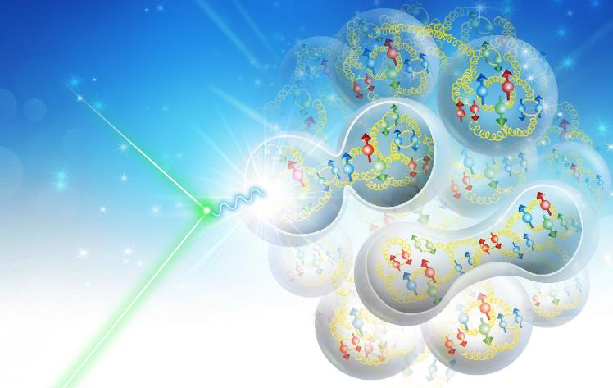

Interaction Region Magnets for Future Electron-Ion Collider at Jefferson Lab
Tim Michalski, Engineering Division
Renuka Rajput-Ghoshal, Chuck Hutton, Fanglei Lin, Vasiliy Morozov and Mark Wiseman
North American Particle Accelerator Conference
1-6 September 2019, Lansing, Michigan

Slide 2
Content
JLEIC Overview
Interaction Region
Magnet specifications for IR
Electron quadrupole
Ion quadrupole
Skew quadrupole
Solenoid magnet
Kicker magnet
Magnet-magnet interaction
Summary

Slide 3
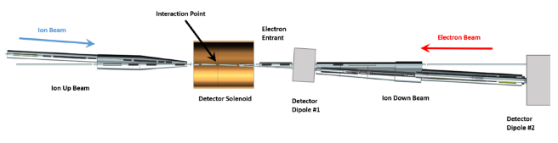
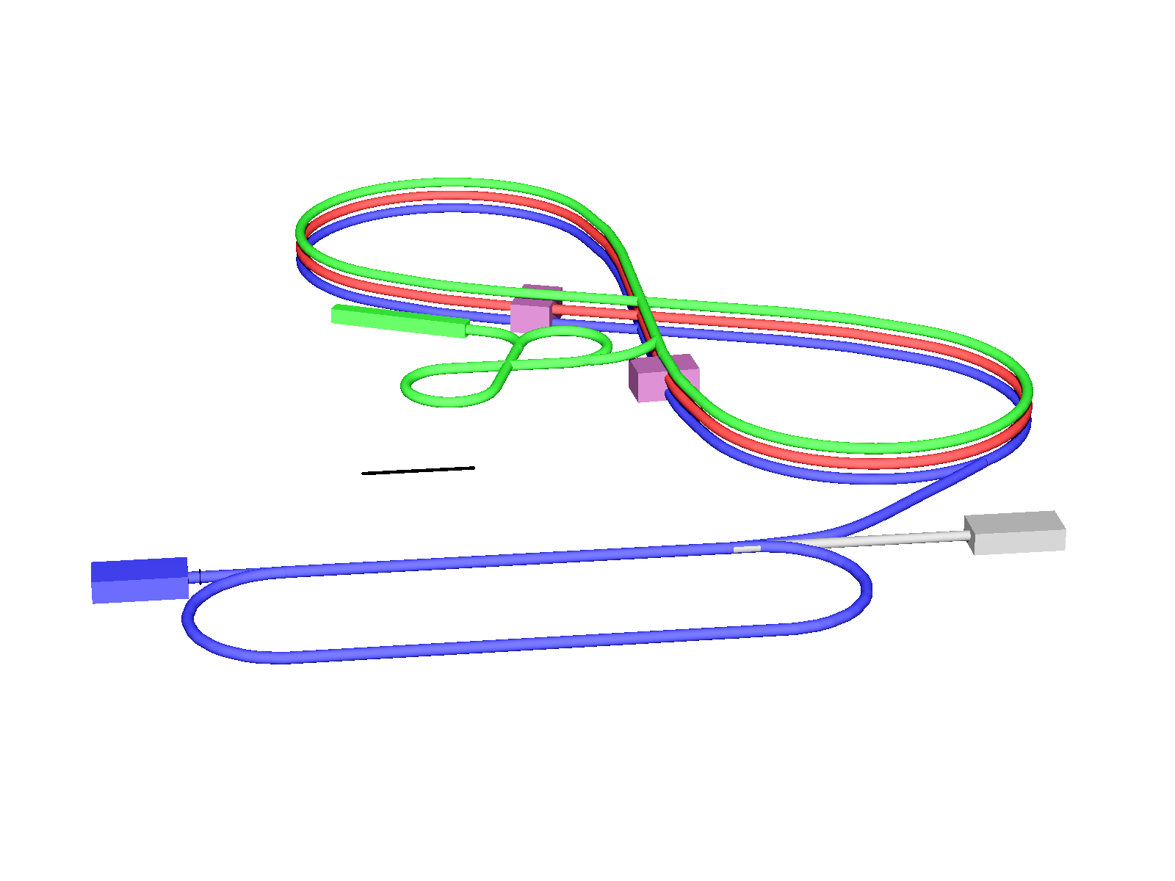
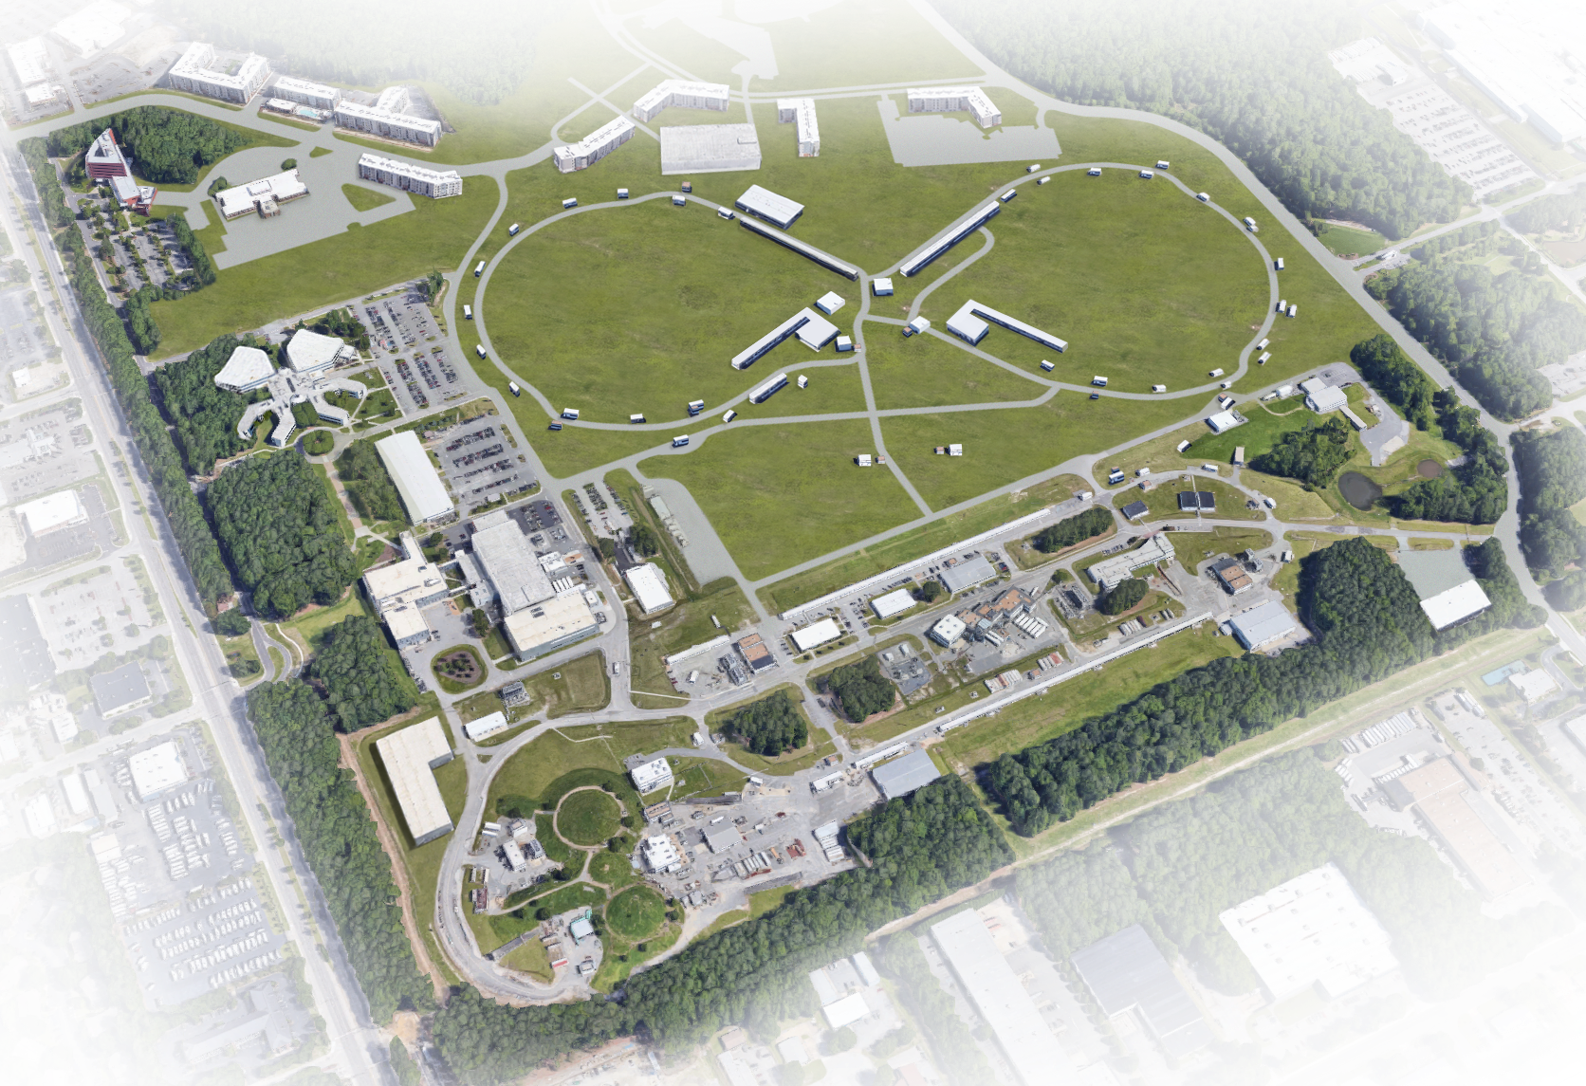
JLEIC Overview
Electron complex
  CEBAF as a full energy injector
  Electron collider ring: 3-12 GeV/c
Ion complex
  Ion source, SRF linac: 150 MeV for protons
  Low Energy Booster: 8.9 GeV/c
  High Energy Booster: 13 GeV/c
  Ion collider ring: 200 GeV/c
Up to two detectors at minimum background locations
20-100 GeV CM, Upgradable to 140 GeV CM
High Energy
Booster
(13 GeV/c)
Interaction
point
Ion collider ring (200 GeV/c)
Ion linac (150 MeV)
Interaction
point
100m
Low Energy Booster
(8.9 GeV/c)
Electron collider ring
(3-12 GeV/c)
Electron source
12 GeV CEBAF

Slide 4
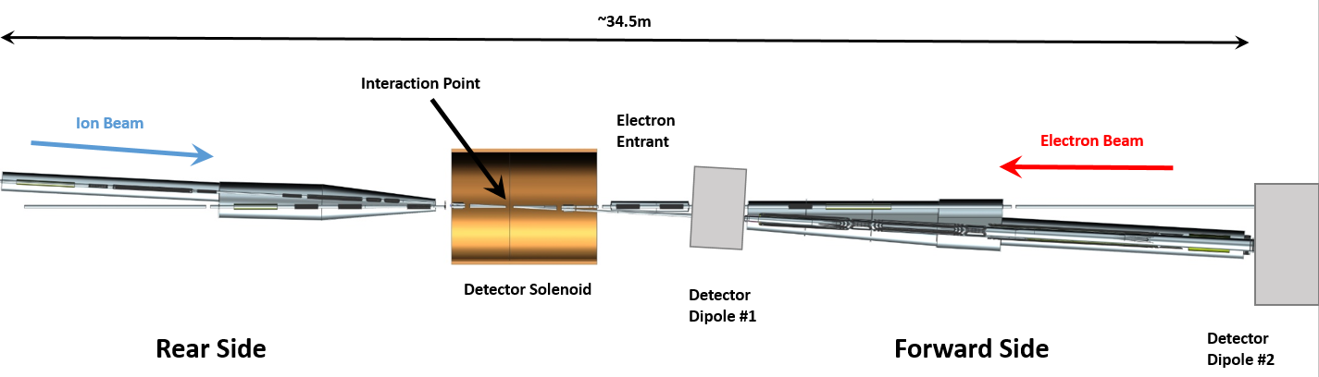
Interaction Region
The electron and ion rings intersect at the interaction point (IP) and the region around IP is called interaction region (IR).
Crossing angle is 50 mrad
The IR contains a full acceptance detector built around a detector solenoid.
Forward Side ion magnets have apertures which support ±10 mrad angular acceptance
This presentation does not cover the detector solenoid or the detector dipoles.

Slide 5
IR Magnet Specifications and Design Parameters
All final focus quadrupole magnets use NbTi conductor
Operating temperature between 4.5 K and 4.7 K
All IR magnets are designed as cold bore, to lower the peak field in the coils

Slide 6
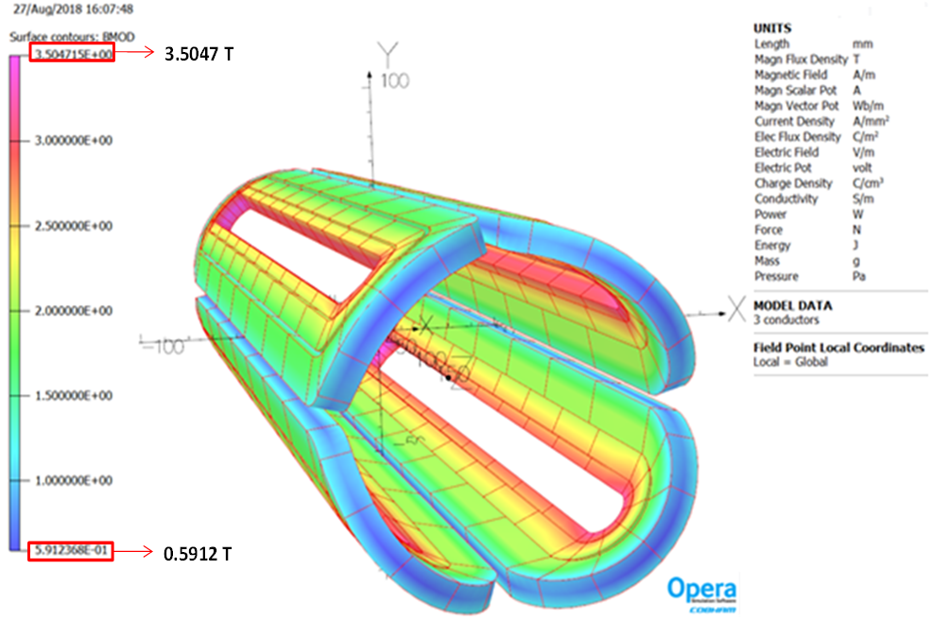
Electron Quadrupoles
The electron beam line has 6 main quadrupoles
Field gradient varies but all the magnets are designed for 45 T/m gradient
A common coil design is used for these 6 quadrupoles
The peak field in the coil is 3.6 T
The coils will be keystone Rutherford cable
Further optimization: multipole effects, field in the coil, conductor selection

Slide 7
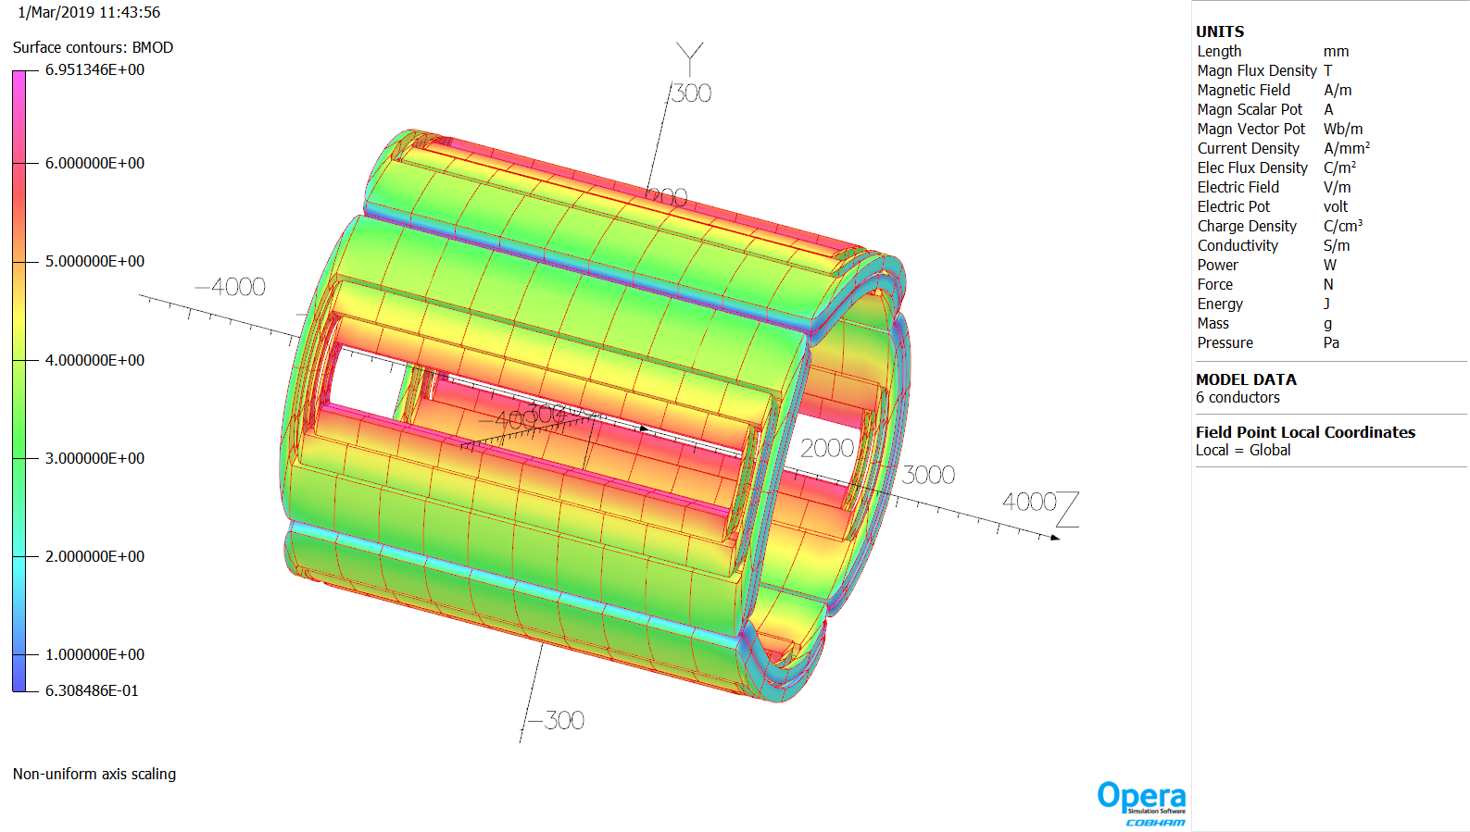
Ion Quadrupole
The ion beam line has 6 main quadrupoles; 3 upstream, 3 downstream
The upstream quadrupoles are less demanding due to their smaller apertures
The downstream quadrupoles have larger bores and are the most challenging
  iQDS1a has a gradient of 37.23 T/m and beam aperture radius of 9.2 cm
  iQDS1b has a gradient of 37.23 T/m and beam aperture radius of 12.3 cm
  iQDS2 has a gradient of 25.96 T/m and the largest beam aperture radius at 17.7 cm
The peak field in the ion quadrupole coils is 6.4-7.0 T
The coils will be keystone Rutherford cable
This coil design is optimized to the first order. Further optimization, is likely to reduce the peak field in the coils.

Slide 8
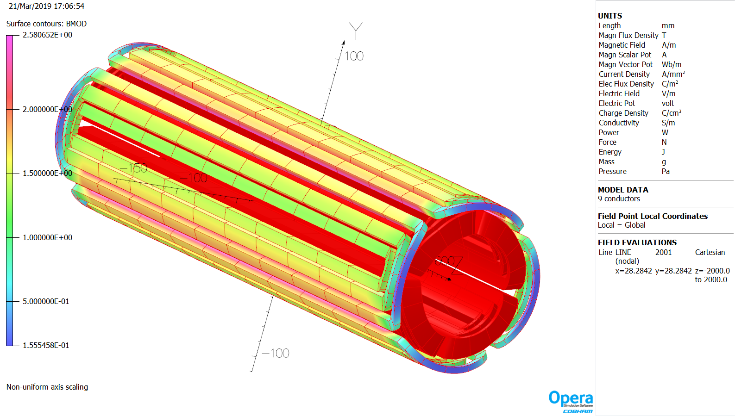
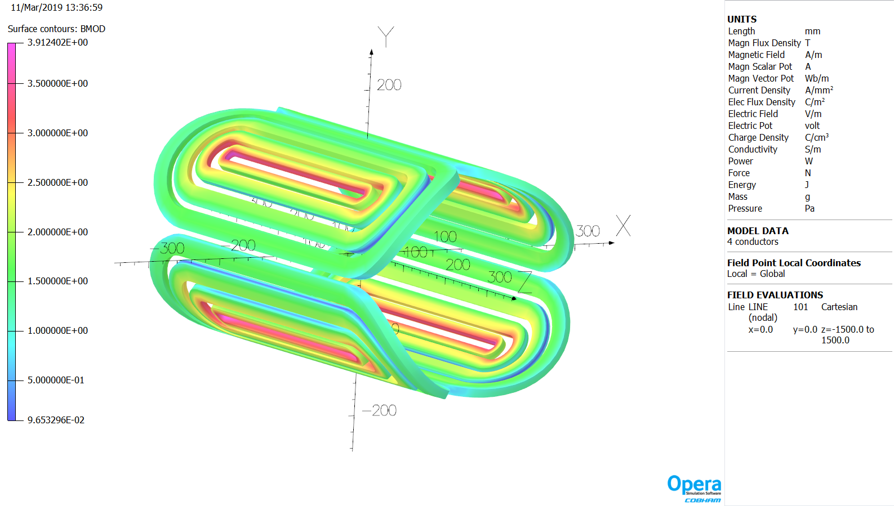
Skew Quadrupole
Electron beam line skew quadrupoles are nested around the main quadrupole
The first ion upstream and downstream skew quadrupoles are also nested coils
The other ion beam line skew quadrupoles will be independent due to the required gradient
The coil field in all the skew quadrupoles is relatively low to moderate for NbTi
The peak field in the coil for an independent skew quadrupole (iQDS1S) is 3.9 T
Skew quadrupole conductor will be standard MRI rectangular or round conductor
Nested Skew Quadrupole
Independent Skew Quadrupole

Slide 9
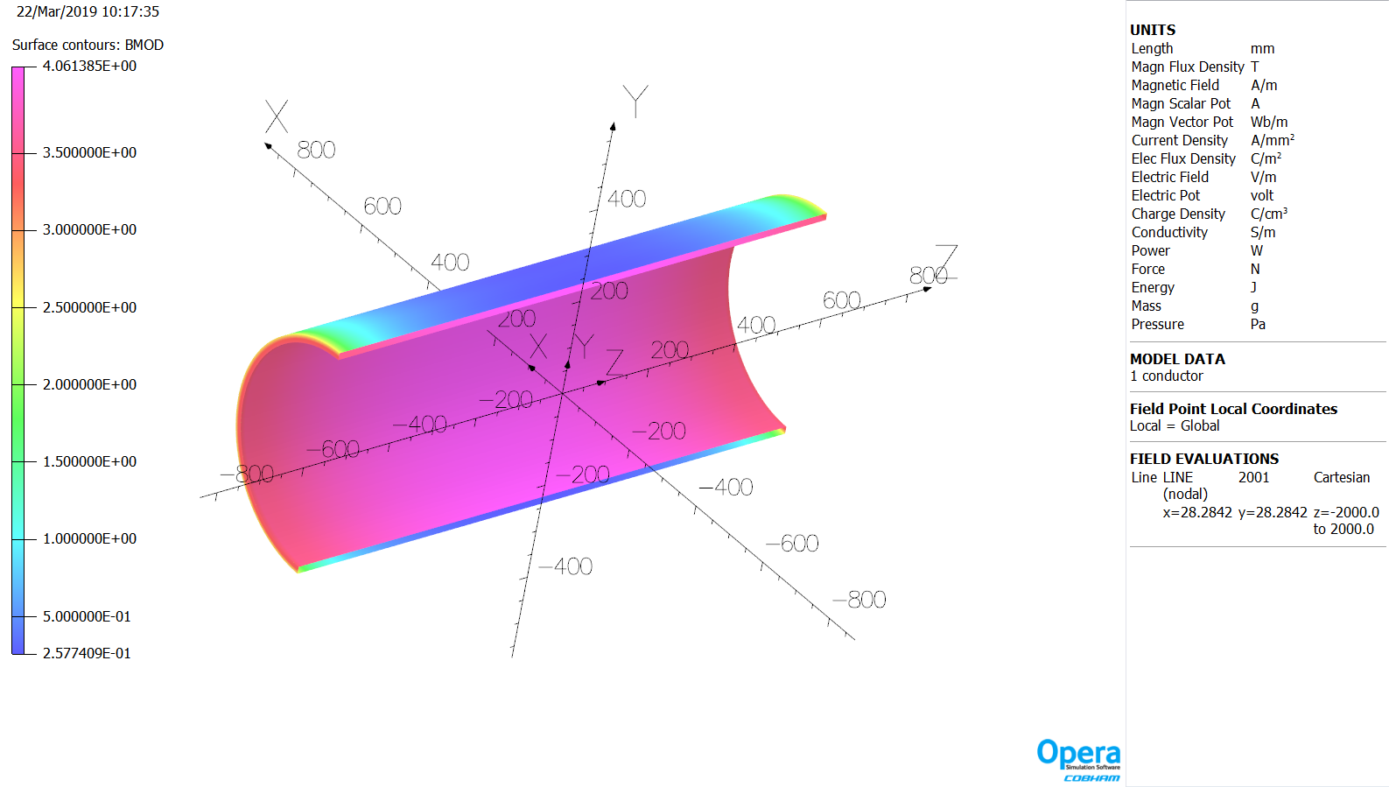
Solenoid Magnet
There are four solenoid magnets in the IR to counteract the effects of the detector solenoid
The downstream ion beam solenoid has a larger bore (19.8 cm radius), coil inner radius (22.5 cm) and it is a 4 T solenoid.
The small bore solenoids have a central field of 2T and 4T the coil inner radius is 6.0 cm
The solenoid magnets will use standard MRI NbTi rectangular conductor

Slide 10
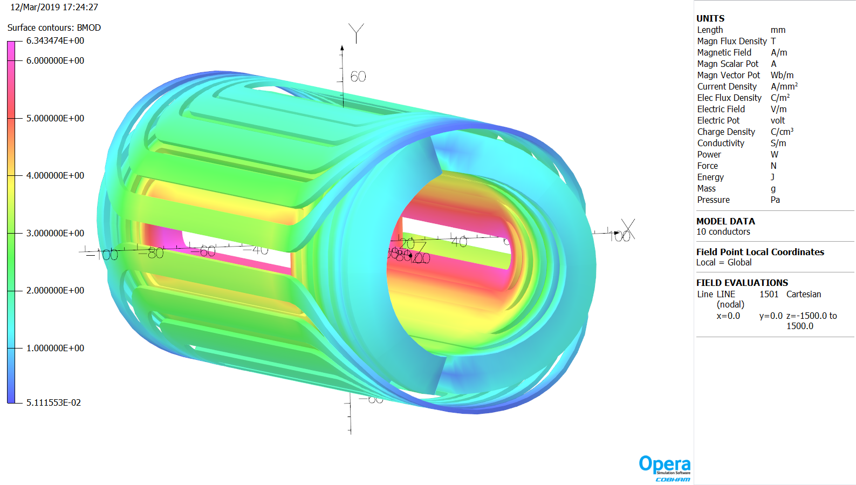
Kicker Magnet
The kicker magnets, iCUS1 and iCUS2, have slightly different field requirements
Their field directions are reversed
The designs are close enough that a single design is utilized

Slide 11
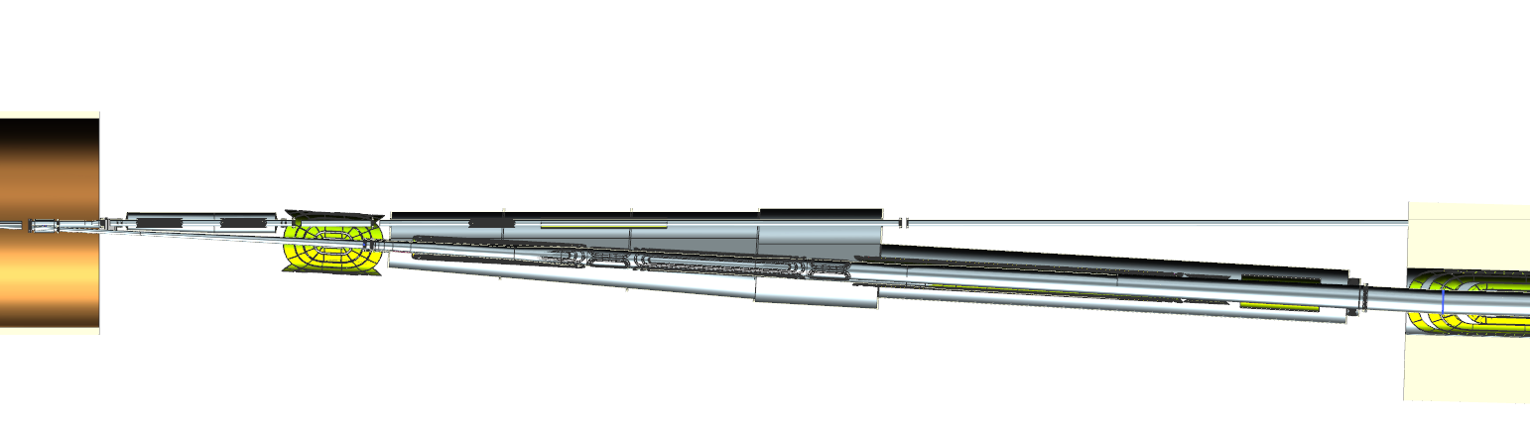
Magnet-Magnet Interaction
There are more than 24 different magnets in the IR, including nested skew quads, detector solenoid, and detector dipoles
Due to their proximity to the IP and small crossing angle, these magnets are very close to each other
The most critical interactions have been studied:
eQUS1 with ion beam line
iQDS1a, iQDS1b, eQUS3 and eASUS

Slide 12
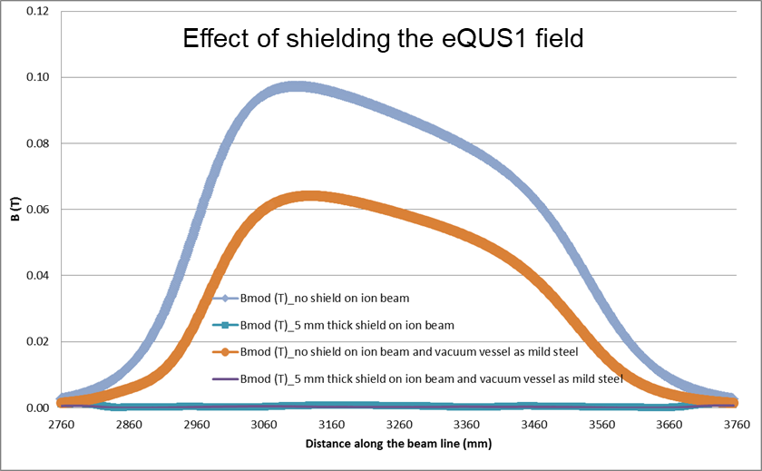
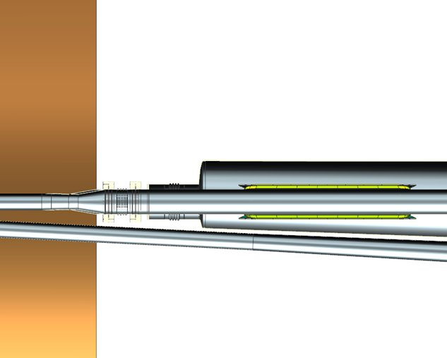
Magnet-Magnet Interaction (eQUS1 with ion beam line)
The Coils, Shield around the Ion Beam and Vacuum Vessel around the eQUS1 coils
Electrons
~4.7 cm gap
eQUS1
Ions

Slide 13
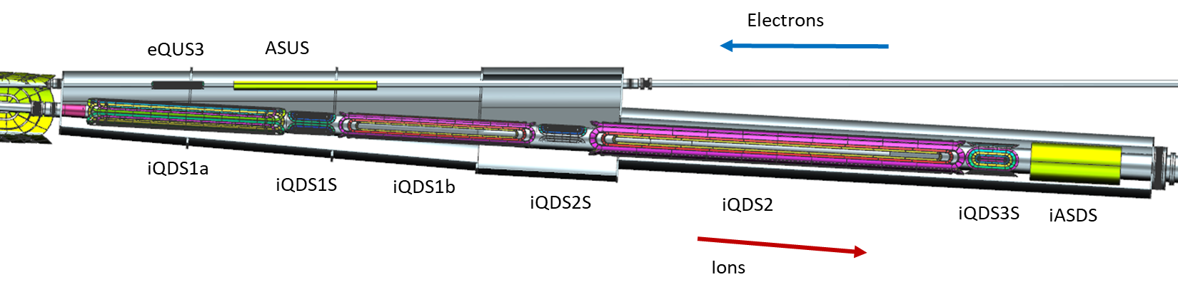
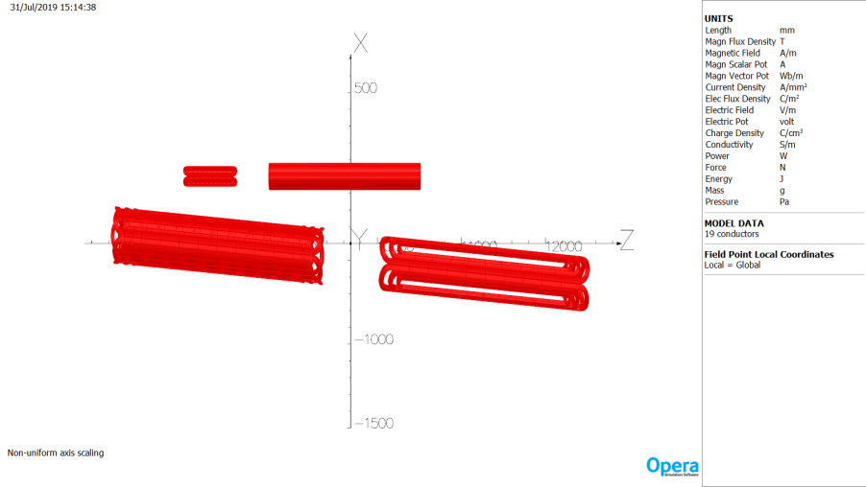
Magnet-Magnet Interaction (iQDS1a, iQDS1b, eQUS3 and eASUS )
Effect of Field on the Electron line from Ion Magnets

Slide 14
Summary
Preliminary designs for all the IR magnets are complete.
The peak fields in the coils are less than 7 T.
Acceptable shielding solutions exist for magnet-magnet and magnet-adjacent beamline interactions.
Preliminary optimizations for the coil peak field have been completed. Additional optimizations are required for detailed coil design, coil peak field, and multipoles.
The interaction between the detector magnets (main detector solenoid, and two detector dipoles) and the transport magnets remain to be studied.
The conceptual cryostat design for all IR magnets is in progress.

Slide 15
NAPAC 2019 Reference Presentations and Posters
MOOHC2 - Electron-Ion Accelerator Designs
TUZBA2 - EIC Machine Detector Interface
MOPLO13 - Field Quality Analysis of Interaction Region Quadrupoles for JLEIC
TUPLO15 - Multipole Effects on Dynamic Aperture in JLEIC Ion Collider Ring

Slide 16
Thank you for your attention.
Questions?

