Slide 1


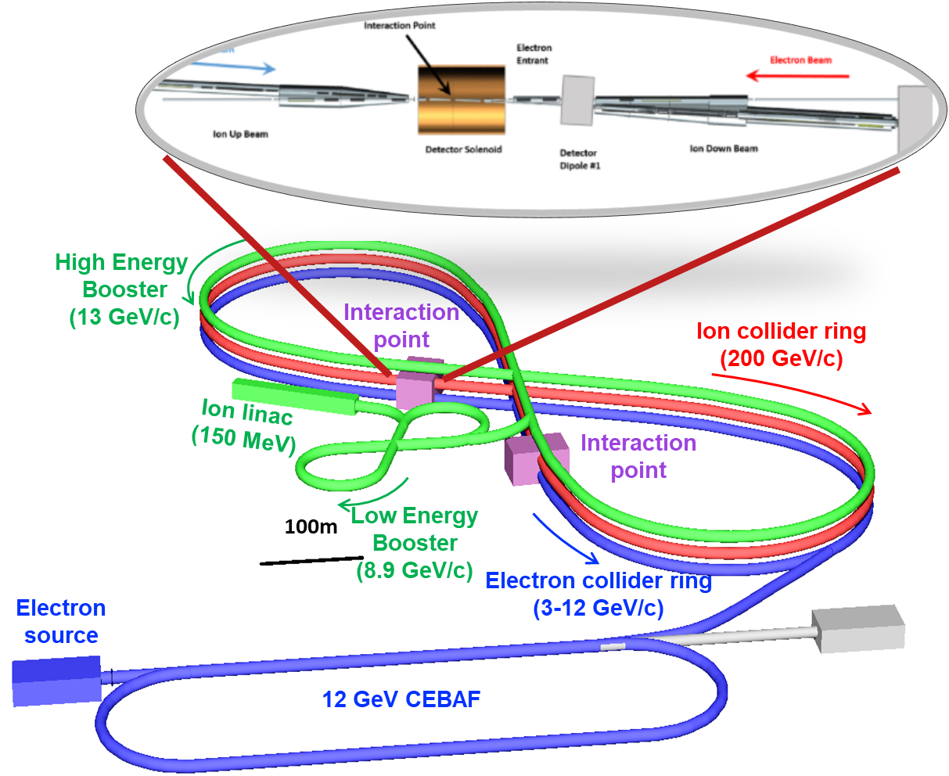
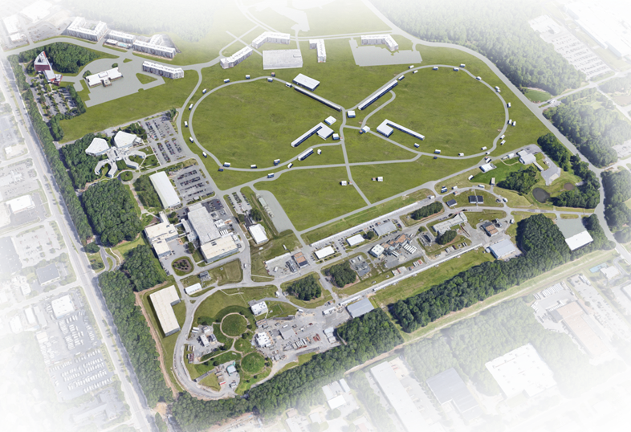
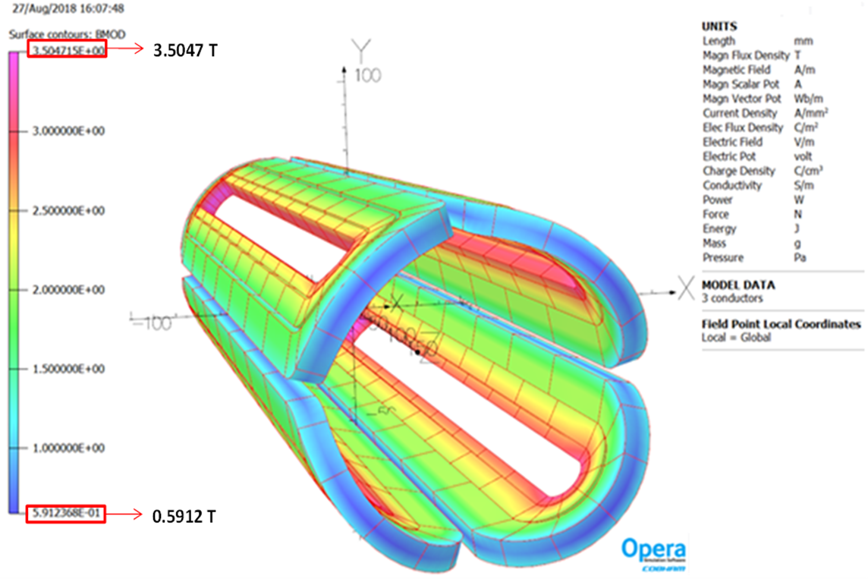
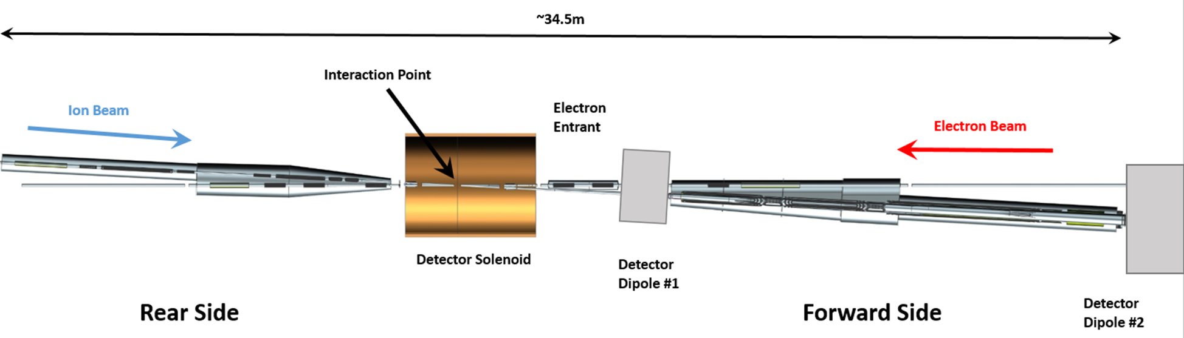
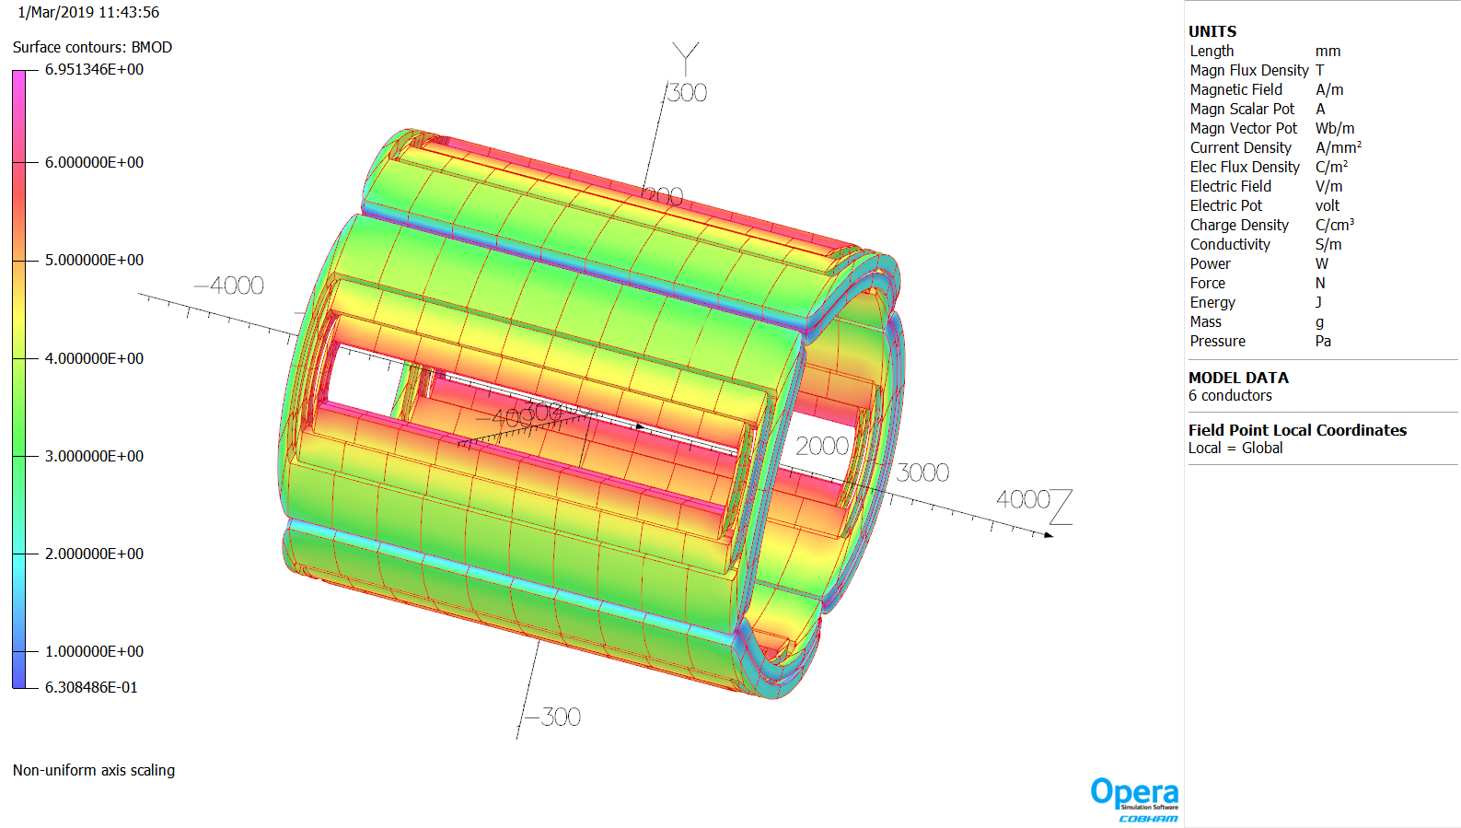
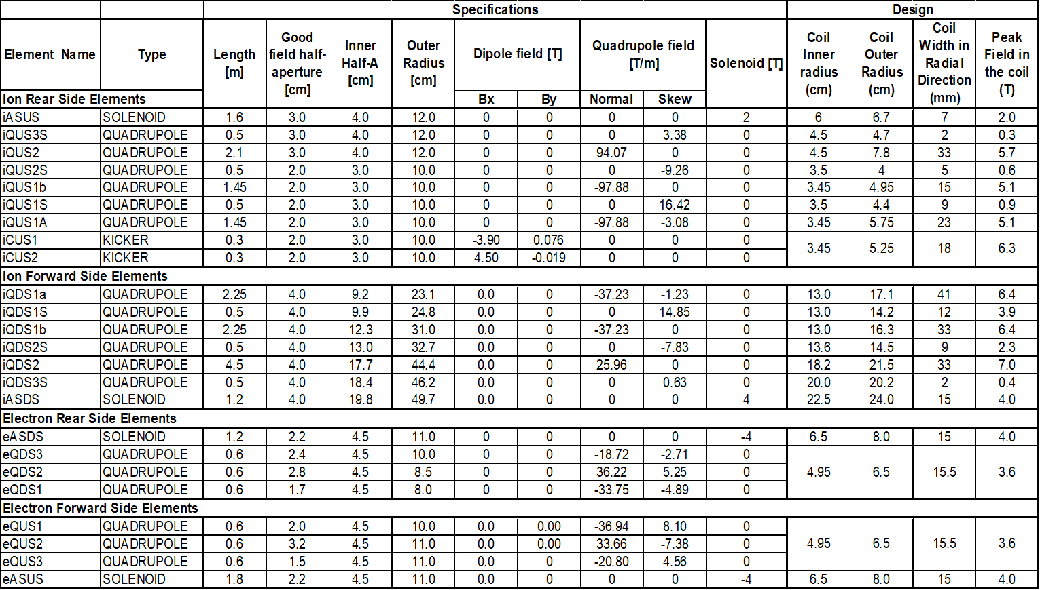
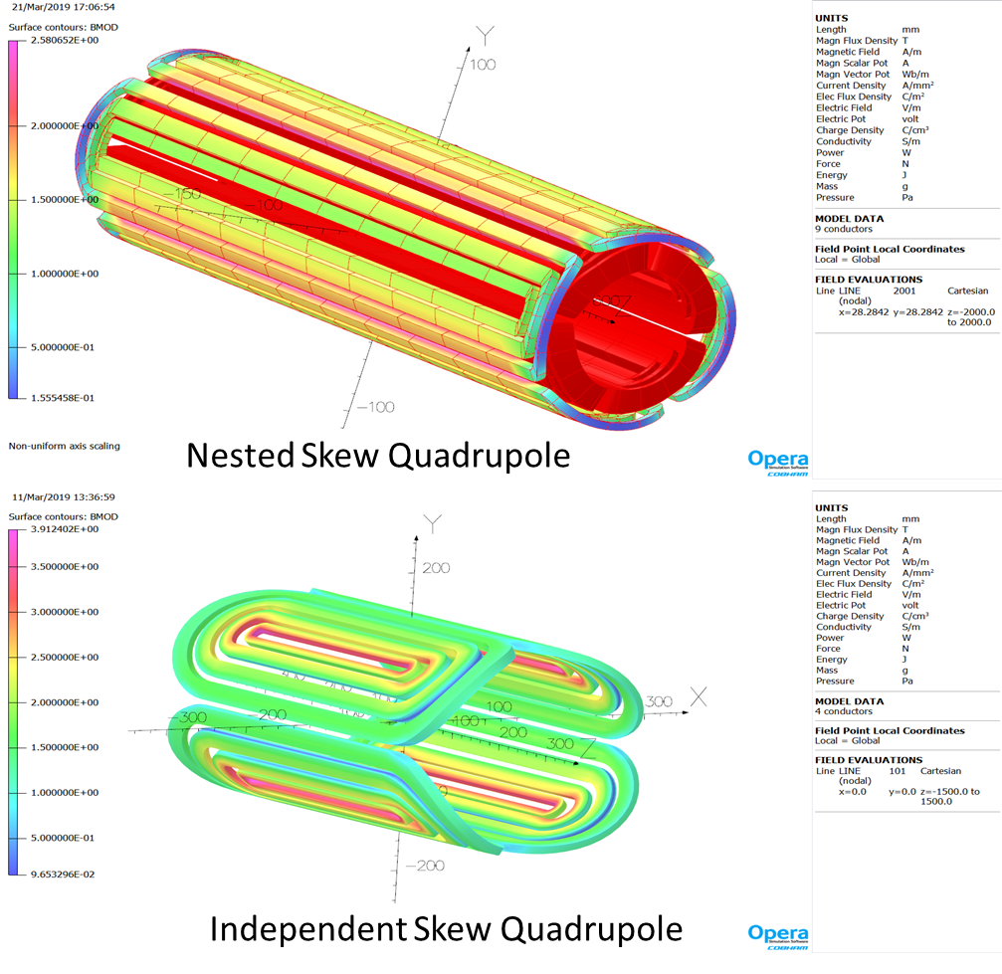
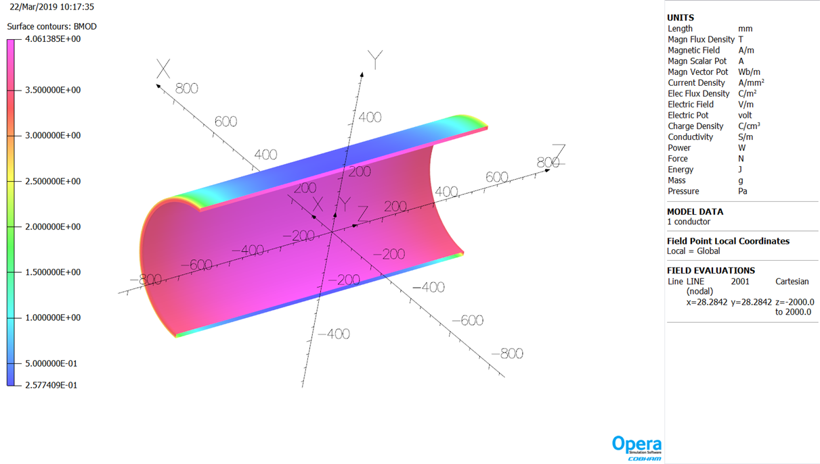
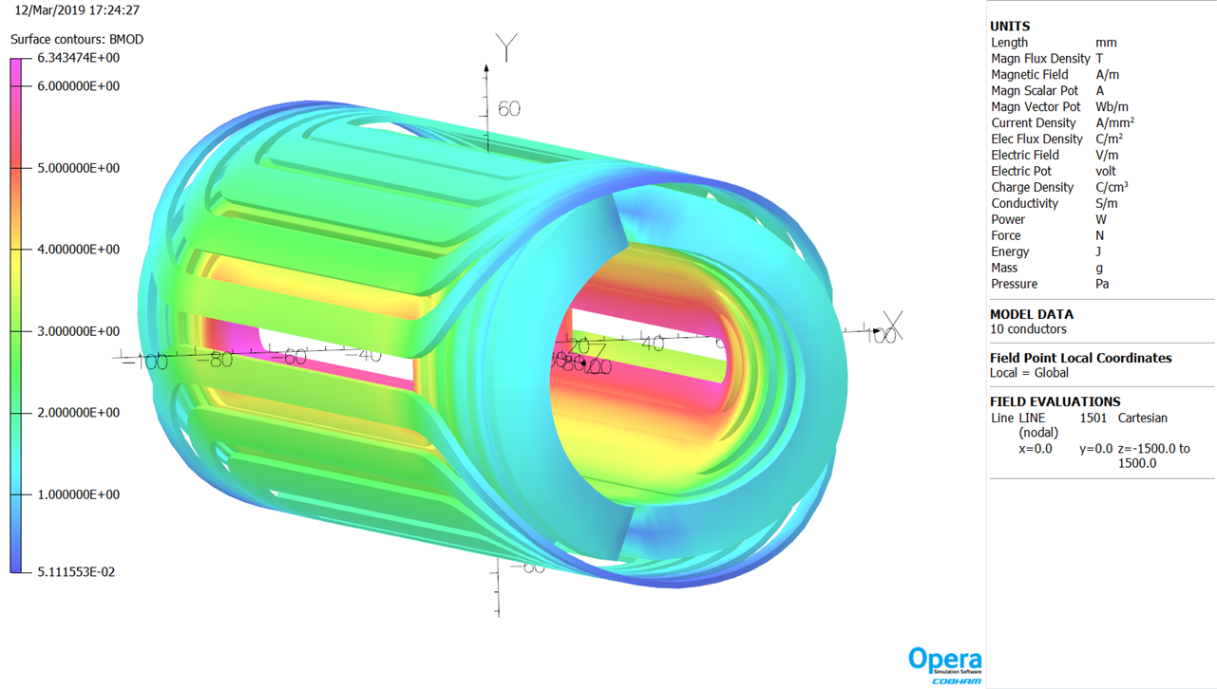
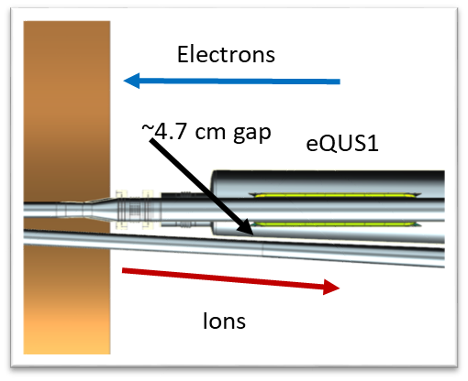
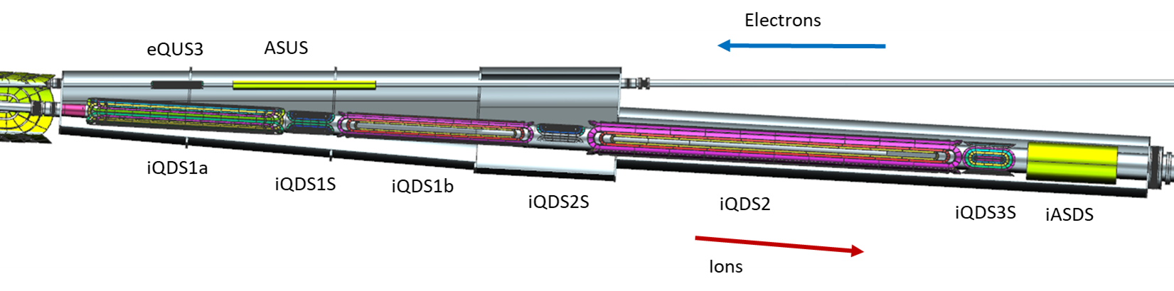
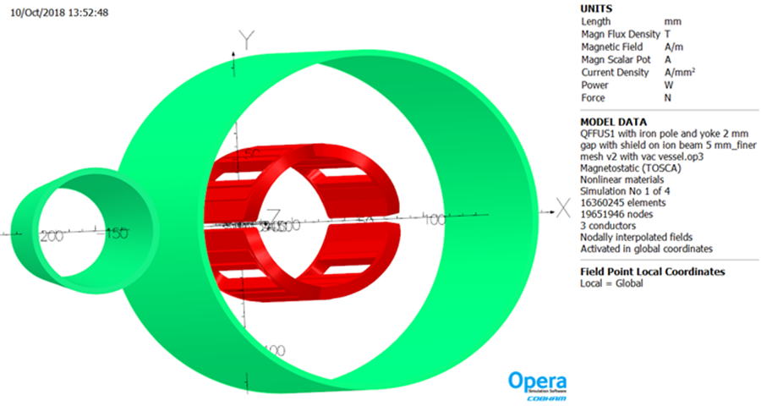
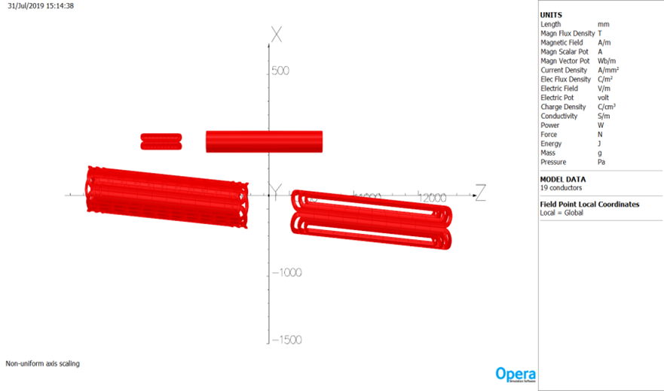
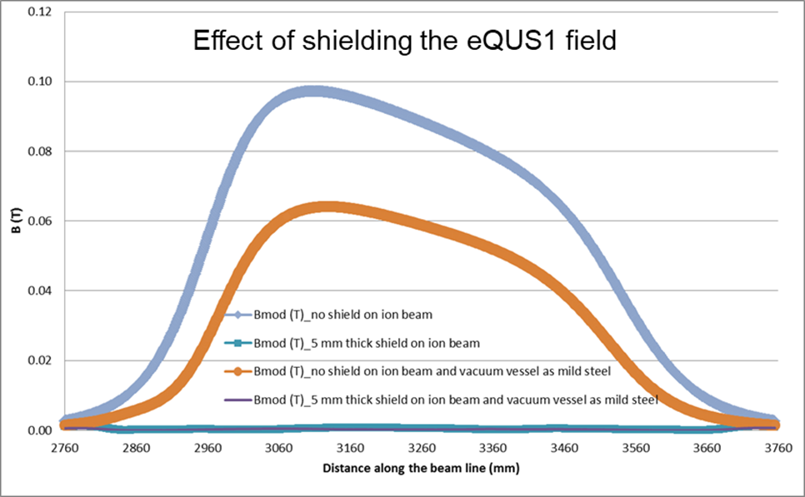
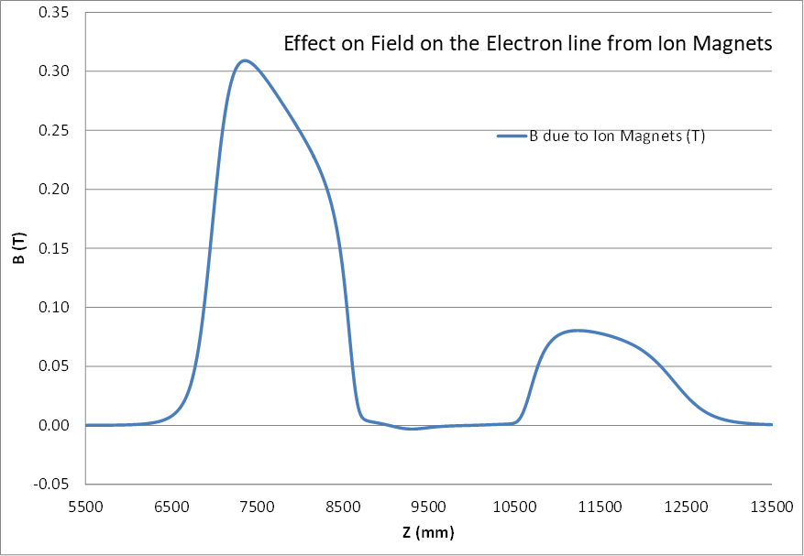
Interaction Region Magnets for Future Electron-Ion Collider at Jefferson Lab
Tim Michalski, Renuka Rajput-Ghoshal, Fanglei Lin, Vasiliy Morozov, Mark Wiseman, Chuck Hutton, Jefferson Lab, Newport News, VA, USA
TUPLO13
Abstract
The Jefferson Lab Electron Ion Collider (JLEIC) is a proposed new machine for nuclear physics research. It uses the existing CEBAF accelerator as a full energy injector to deliver 3 to 12 GeV electrons into a new electron collider ring. An all new ion accelerator and collider complex will deliver up to 200 GeV protons. The machine has luminosity goals of 10³⁴ cm⁻² sec⁻¹. The whole detector region including forward detection covers about 80 meters of the JLEIC complex. The interaction region design has recently been optimized to accommodate 200 GeV proton energy using conventional NbTi superconducting magnet technology. This paper will describe the requirements and preliminary designs for both the ion and electron beam magnets in the most complex 34.5 m long interaction region (IR) around the interaction point (IP). The interaction region has over thirty-four superconducting magnets operating at 4.5K; these include dipoles, quadrupoles, skew-quadrupoles, solenoids, horizontal and vertical correctors and higher order multipole magnets. The paper will also discuss the electromagnetic interaction between these magnets.
JLEIC OVERVIEW
Electron complex
  CEBAF as a full energy injector
  Electron collider ring: 3-12 GeV/c
Ion complex
  Ion source, SRF linac: 150 MeV for protons
  Low Energy Booster: 8.9 GeV/c
  High Energy Booster: 13 GeV/c
  Ion collider ring: 200 GeV/c
Up to two detectors at minimum background locations
20-100 GeV CM, Upgradable to 140 GeV CM
IR MAGNET DESIGNS
JLEIC INTERACTION REGION (IR) REQUIREMENTS
ELECTRON QUADRUPOLES
6 electron beam line quadrupoles
A common coil design is used for all 6 quadrupoles
Field gradient up to 45 T/m
The peak field in the coil is 3.6 T
Coils are keystone Rutherford cable
Crossing angle is 50 mrad
The IR contains a full acceptance detector built around the detector solenoid
Forward Side ion magnets have apertures which support ±10 mrad angular acceptance
All final focus quadrupole magnets use NbTi conductor
Operating temperature is between 4.5 K and 4.7 K
All IR magnets are designed as cold bore, to lower the peak field in the coils
ION QUADRUPOLES
6 ion beam line quadrupoles; 3 Rear Side, 3 Forward Side
The Forward Side quadrupoles have larger bores and are the most challenging
The peak fields in the ion quadrupole coils are 6.4-7.0 T
Coils are keystone Rutherford cable
SKEW QUADRUPOLES
Electron beam line skew quadrupoles are nested around the main quadrupole
The first ion Rear Side and Forward Side skew quadrupoles are also nested coils
The other ion beam line skew quadrupoles will be independent due to the gradient
The coil field in all the skew quadrupoles is relatively low to moderate for NbTi
SOLENOIDS
There are four solenoid magnets in the IR to counteract the effects of the detector solenoid
The Forward Side ion beam solenoid has a larger bore (19.8 cm radius), coil inner radius (22.5 cm) and it is a 4 T solenoid
MAGNET-MAGNET INTERACTIONS
eQUS1 with Ion Beam Line iQDS1a, iQDS1b, eQUS3 and eASUS
KICKER MAGNET
The kicker magnets in the ion beamline performs orbit correction
2 kicker magnets in the IR with opposite field polarity
The performance requirements are similar enough that these magnets are the same design
Acknowledgements
This material is based upon work supported by the U.S. Department of Energy, Office of Science, and Office of Nuclear Physics under Contracts DE-AC05-06OR23177 and DE-AC02-76SF00515 .
SUMMARY
All preliminary IR magnet designs are complete
The peak fields in the coils are less than 7 T
Acceptable shielding solutions exist for interactions
Preliminary optimizations have been completed
Additional optimizations are required for detailed coil design, minimizing coil peak field, and multipoles
The interaction between the detector magnets and the transport magnets remain to be studied
The conceptual cryostat designs are in progress

