Slide 1


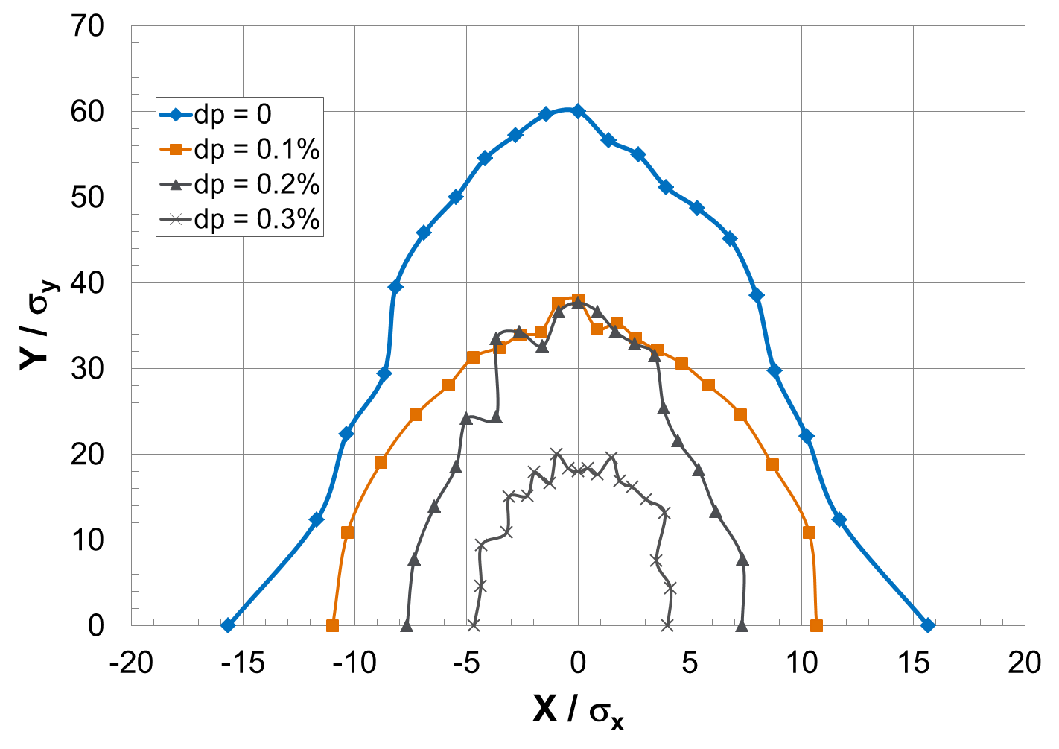
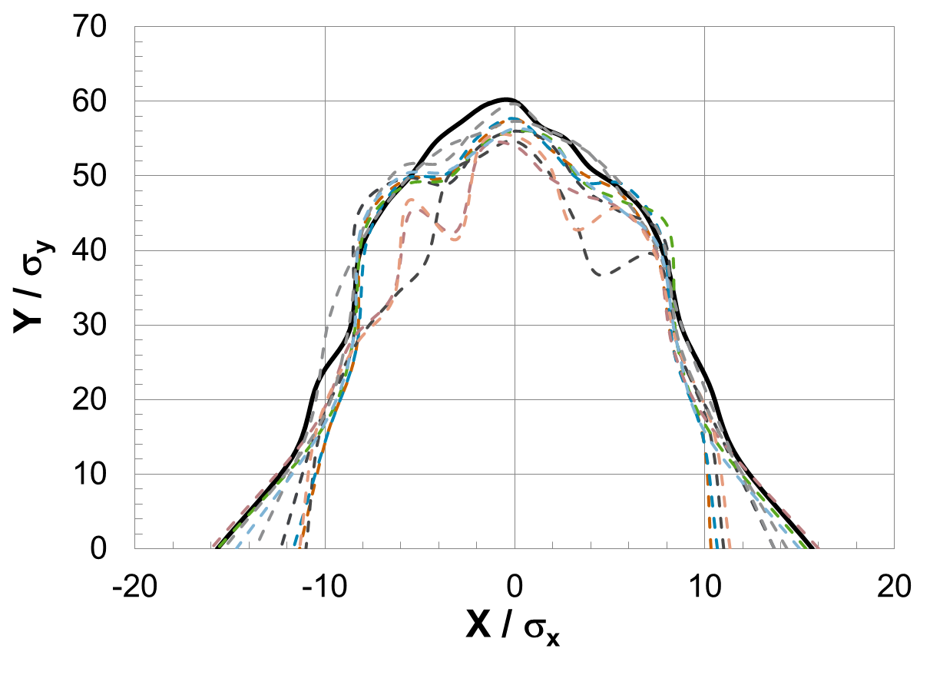
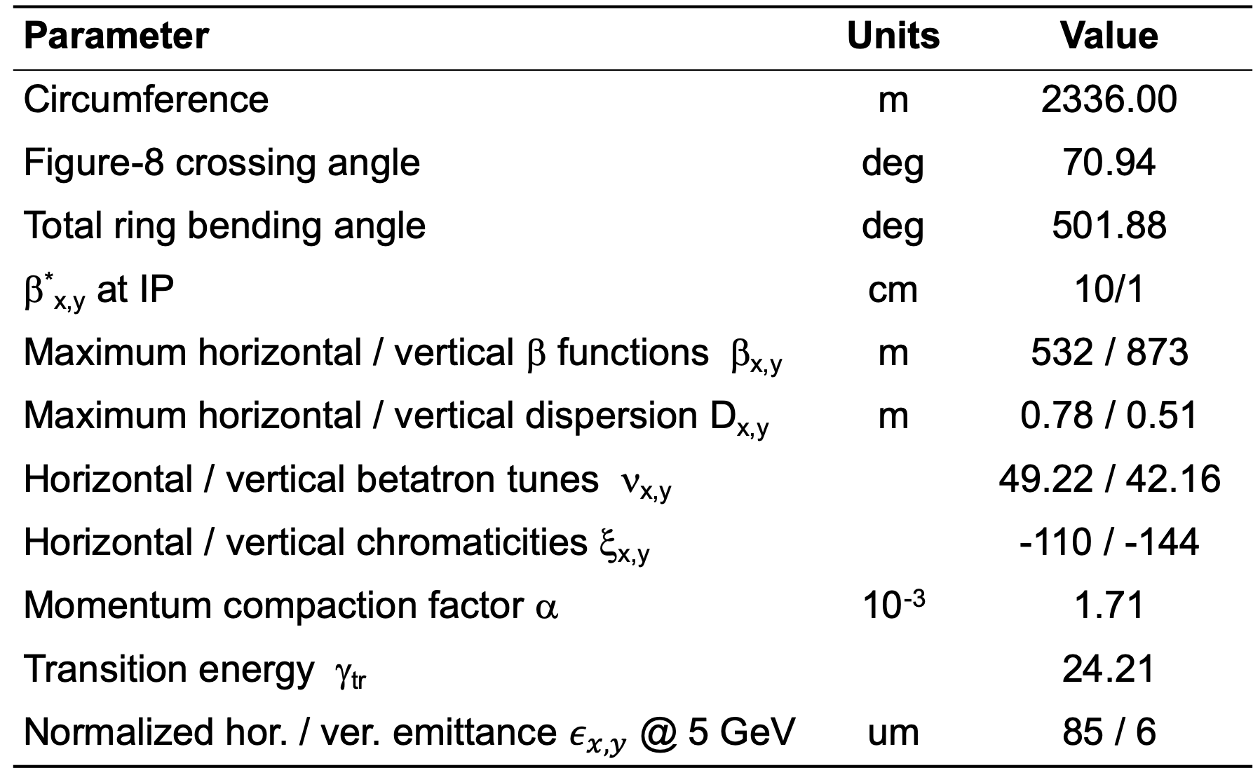
Update on the JLEIC Electron Collider Ring Design and Nonlinear Dynamics Study
Fanglei Lin, V.S. Morozov, Y. Zhang, Jefferson Lab, Newport News, VA, USA
Y. Cai, Y.M. Nosochkov, SLAC National Accelerator Laboratory, Menlo Park, CA, USA
TUPLO08
Abstract
The design concept of electron collider ring in the Jefferson Lab Electron-Ion Collider (JLEIC) is based on a small beam size at the interaction point (IP) to boost the luminosity. In this paper, we present an update on the lattice design of the electron collider ring considering not only preservation of low beam emittance, but also optimization of geometric arrangement. In particular, recently development of the lattice design has been focused on incorporating the vertical dogleg, which brings the electron beam to the ion beam plane for collisions, in the spin rotator design. The vertical dogleg is designed with no horizontal emittance growth, controlled vertical emittance and no first-order effect on the electron polarization. Single particle nonlinear beam dynamics study is also performed to explore the dynamic aperture and momentum acceptance in this design.
INTRODUCTION
The electron collider ring in the JLEIC is
designed based on a figure-8 shape, with
beam parameters of
  3 to 12 GeV energy
  3 A beam current up to 6-7 GeV
  ~ 1 cm bunch length
  small emittance
  < 10 MW synchrotron radiation power
  70% or above polarization
reducing cost by
  reusing PEP-II magnets (dipoles, most
  quadrupoles and sextupoles)
  reusing RF cavities
compact design fitting in the Jlab site
accommodating all required machine
elements
one of the main effort of
  identifying the best overall properties:
  low emittance, good chromatic
  correction and large dynamics aperture (DA).
OPTICS DESIGN
Spin rotator is designed to
rotate the spin from the vertical in arcs to the
longitudinal at the IP
transport the electron beam to the ion beam
plane for collisions at the IP
have no horizontal emittance growth, controlled
vertical emittance and no 1st order effect on the
polarization
Arc FODO cell is 15.2 m long and has a phase
advance of 108º that determines the horizontal emittance.
Interaction region is designed with
small beta-stars at the IP
forward electron tagging with enhanced momentum resolution by introducing large dispersion values
detector solenoid coupling compensation by two anti-solenoids in up- and downstream of IP and additional skew windings on the FFQs
space reserved for crab cavities with large horizontal beta functions and right phases
Complete ring optics Parameters
Parameter | Units | Value
Circumference | m | 2336.00
Figure-8 crossing angle | deg | 70.94
Total ring bending angle | deg | 501.88
β*_{x,y} at IP | cm | 10/1
Maximum horizontal / vertical β functions β_{x,y} | m | 532 / 873
Maximum horizontal / vertical dispersion D_{x,y} | m | 0.78 / 0.51
Horizontal / vertical betatron tunes ν_{x,y} |  | 49.22 / 42.16
Horizontal / vertical chromaticities ξ_{x,y} |  | -110 / -144
Momentum compaction factor α | 10⁻³ | 1.71
Transition energy γ_{tr} |  | 24.21
 | um | 85 / 6
IP
DYNAMIC APERTURE
DA w/ and w/o momentum offset
DA w/ PEP-II systematic and random field errors
DA w/ misalignment, field strength errors and non-linear field errors
Acknowledgements
This material is based upon work supported by the U.S. Department of Energy, Office of Science, and Office of Nuclear Physics under Contracts DE-AC05-06OR23177 and DE-AC02-76SF00515 .
10 random seeds

