Slide 1



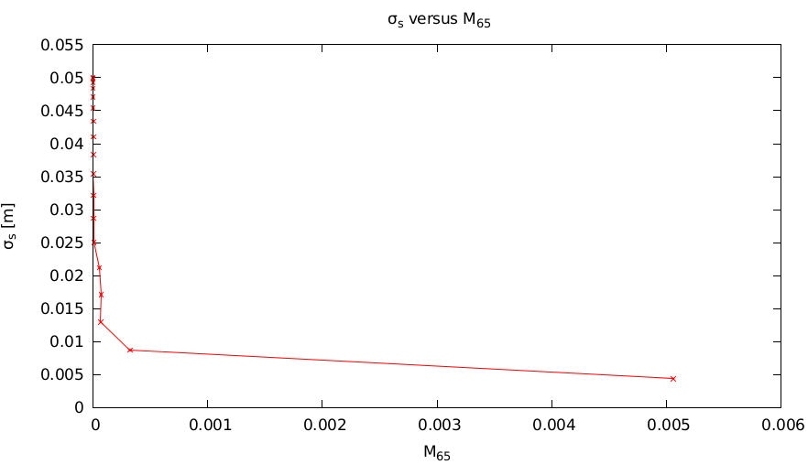
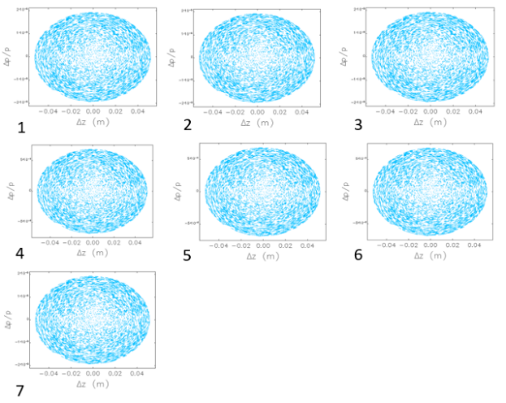
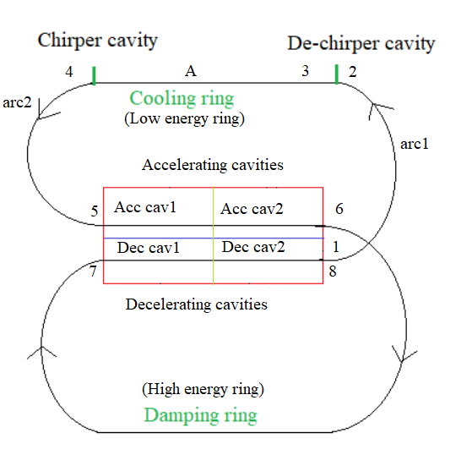
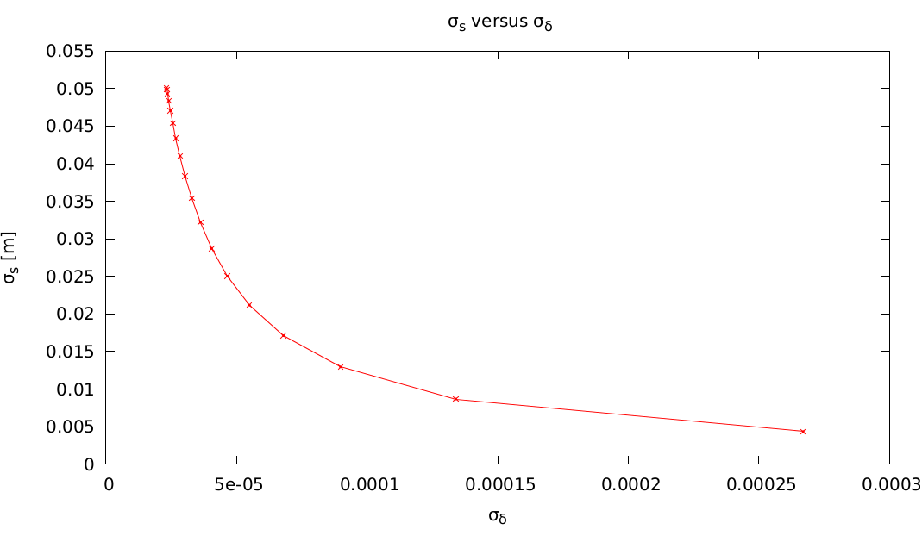
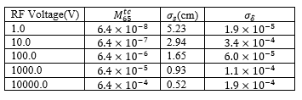
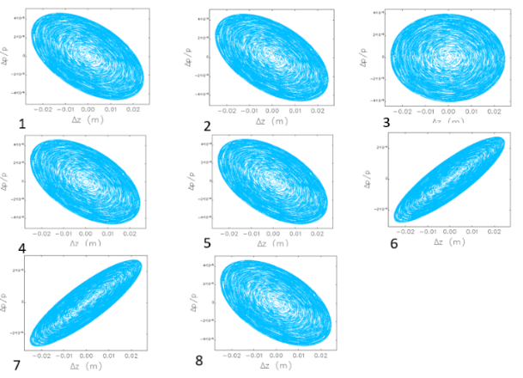
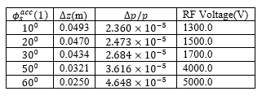
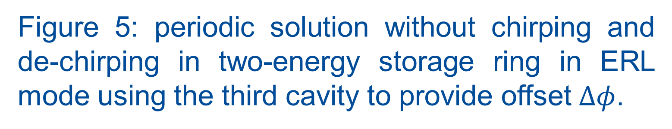

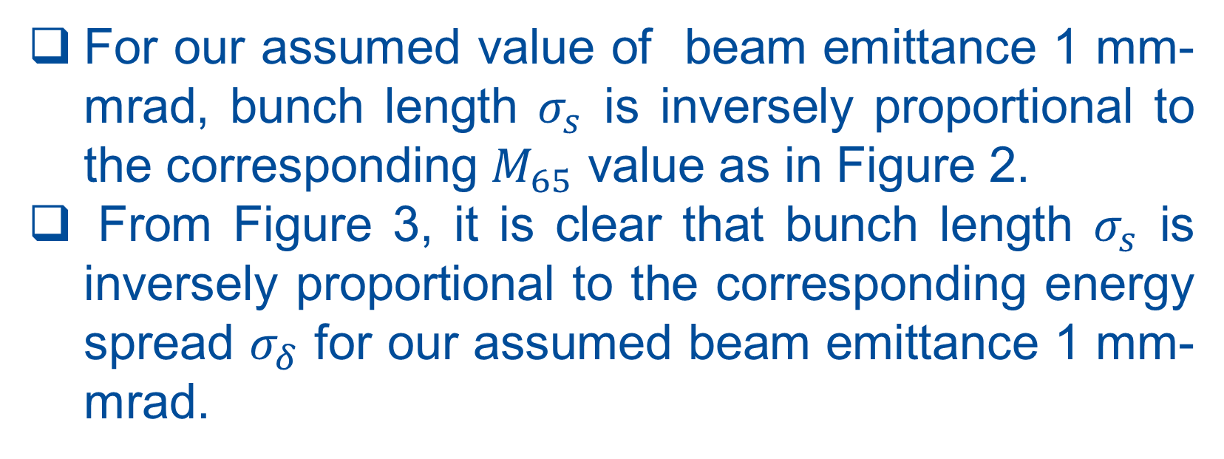
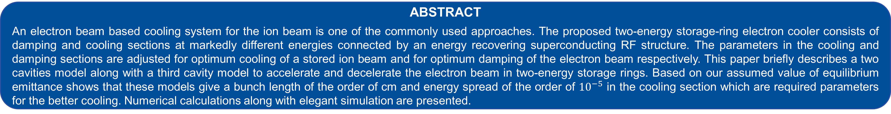

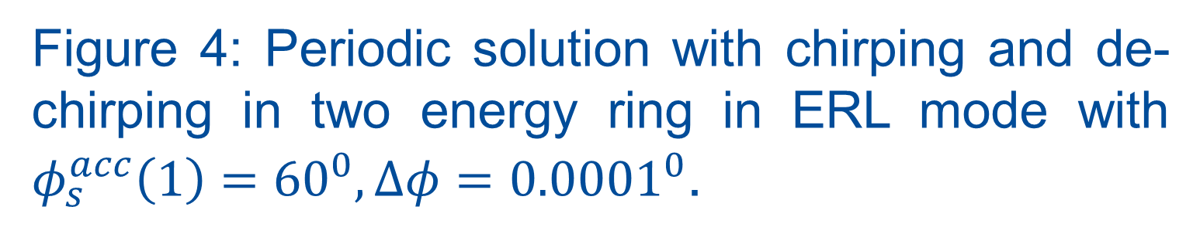

TUPLM13
TWO-ENERGY STORAGE RING COOLER FOR RELATIVISTIC ION BEAMS*
B. Dhital^{1,2 #}, J. R. Delayen^{1,2} ,Y. S. Derbenev² , D. Douglas² , G. A. Krafft^{1,2} , F. Lin² , V. S. Morozov² , Y. Zhang²
¹ Center for Accelerator Science, Old Dominion University, Norfolk, VA 23529, U.S.A.
² Thomas Jefferson National Accelerator Facility, Newport News, VA 23606, USA
ABSTRACT
An electron beam based cooling system for the ion beam is one of the commonly used approaches. The proposed two-energy storage-ring electron cooler consists of damping and cooling sections at markedly different energies connected by an energy recovering superconducting RF structure. The parameters in the cooling and damping sections are adjusted for optimum cooling of a stored ion beam and for optimum damping of the electron beam respectively. This paper briefly describes a two cavities model along with a third cavity model to accelerate and decelerate the electron beam in two-energy storage rings. Based on our assumed value of equilibrium emittance shows that these models give a bunch length of the order of cm and energy spread of the order of ${10}^{−5}$ in the cooling section which are required parameters for the better cooling. Numerical calculations along with elegant simulation are presented.
MOTIVATION
NUMERICAL CALCULATION
THIRD CAVITY MODEL
Electron cooling of ion beams is a method to shrink the ion beams emittance (size, divergence, and energy spread).
Cooling allows small transverse beam sizes at the interaction point and enhanced luminosity.
Cooling also counteracts intra-beam scattering (IBS) emittance degradation and, as a result, increases luminosity lifetime.
$$L=f\frac{n_{1}n_{2}}{4πσ_{x}^{∗}σ_{y}^{∗}}\sim f\frac{n_{1}n_{2}}{εβ_{y}^{∗}}$$
TWO ENERGY STORAGE RING COOLER: TWO CAVITIES MODEL
Figure 2: ${ σ}_{s}$ versus $M_{65}$ plot for $Δφ={0.0001}^{0}.$
Figure 5: periodic solution without chirping and de-chirping in two-energy storage ring in ERL mode using the third cavity to provide offset $Δφ$.
Figure 3: $σ_{s}$ versus $σ_{δ}$ plot for $Δφ={0.0001}^{0}$.
Table 2: Bunch length and the corresponding energy spread values for different values of applied voltage in the third cavity in two-energy storage ring in ERL mode.
For our assumed value of beam emittance 1 mm-mrad, bunch length $σ_{s}$ is inversely proportional to the corresponding $M_{65}$ value as in Figure 2.
From Figure 3, it is clear that bunch length $σ_{s}$ is inversely proportional to the corresponding energy spread $σ_{δ}$ for our assumed beam emittance 1 mm-mrad.
Figure 1: Schematic diagram for two-energy storage ring with two cavities model.
Two energy storage ring cooler consists of two loops at markedly different energies, i.e., Low energy ring $E_{L}$(55 MeV) and High energy ring $E_{H}$ (155 MeV).
Two loops use a common beamline where a superconducting linac at first accelerates the beam from $E_{L}$ to $E_{H}$ and then decelerates the beam from $E_{H}$ to $E_{L}$ in the next pass.
Small phase shift ($Δφ$) is introduced in the second accelerating cavity (Acc cav2) which provides the necessary condition for the longitudinal focusing of an electron beam and results in the longer bunch length in the cooling section.
Longer bunch length of the order of cm and a smaller value of energy spread of the order of ${10}^{−4}$ or ${10}^{−5}$ is required in the cooling section of the cooler ring for the optimal cooling of ion beams.
FUTURE WORK
PERIODIC SOLUTION WITH CHIRPING AND DE-CHIRPING
Estimation of equilibrium emittances value for two-energy storage ring.
Optimization of cooler parameters.
Analytical estimation of intra-and-inter beam scattering and space charge effects.
CONCLUSIONS
For our assumed value of equilibrium emittances, two cavities model with chirping and de-chirping scheme, we can get the bunch length of the order of cm and the energy spread of the order of ${10}^{−5}$.
Periodic solutions exist. It ensures that the two energy storage ring is longitudinally stable for both model described here.
The third cavity to provide the phase offset to the beam just after second accelerating cavity works great and also gives the similar bunch parameters in the cooling section.
The third cavity model looks better than two cavities model since it does not require any chirping and de-chirping scheme and less number of cavities works.
references
Figure 4: Periodic solution with chirping and de-chirping in two energy ring in ERL mode with $φ_{s}^{acc}\left(1\right)={60}^{0}, Δφ={0.0001}^{0}$.
1. G. A. Krafft, B. Dhital, F. Lin, V. Morozov “Multiple energy storage rings” arXiv:1907.13461v1[phys ics.acc-ph]
2. B. Dhital, J. R. Delayen, Y. S. Derbenev, D. Douglas, G. A. Krafft, F. Lin, V. S. Morozov, and Y. Zhang, “Equilibria and Synchrotron Stability in Two Energy Storage Rings”, Proc. of the 2019 Int. Part. Acc. Conf., Melbourne, Australia, 364 (2019).
3. H. Zhang et al., “Simulation study on JLEIC high energy bunched electron cooling”, in Proc. North American Particle Accelerator Conference (NAPAC'16), Chicago, IL, USA October 2016.
4. F. Lin et al., “Storage-ring Electron Cooler for Relativistic Ion Beams”, in Proc. 7th Int. Particle Accelerator Conf. (IPAC'16), Busan, Korea, May 2016, pp. 2466-2468. doi:10.18429/JACoW-IPAC2016-WEPMW020.
ACKNOWLEDGEMENT
Table 1: RF and bunch parameters in two energy storage ring in ERL mode with two cavities model.
Work supported by U.S. DOE Contract No. DE-AC05-06OR23177 and DE-AC02-06CH11357.
#bdhit001@odu.edu

