Slide 1


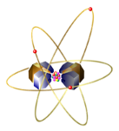

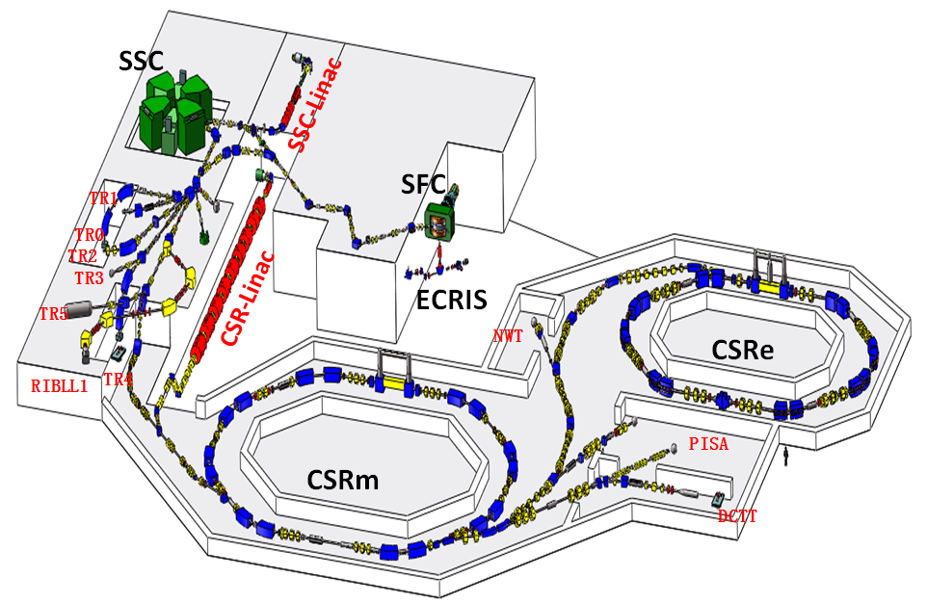
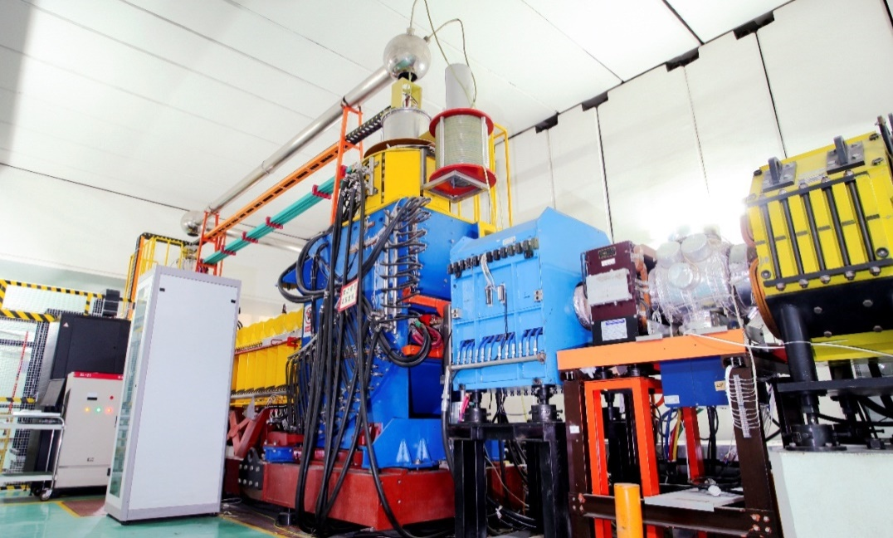
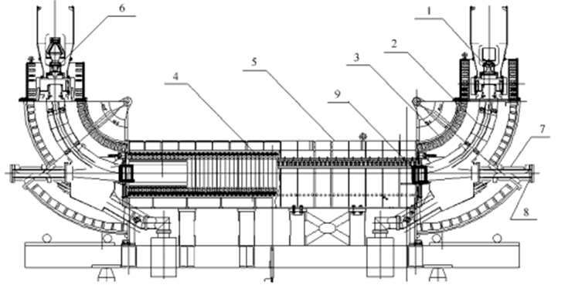
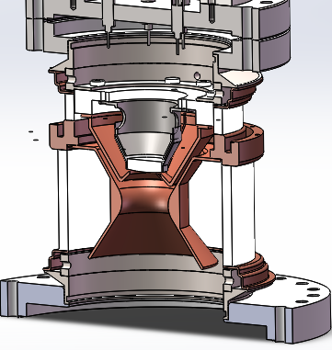
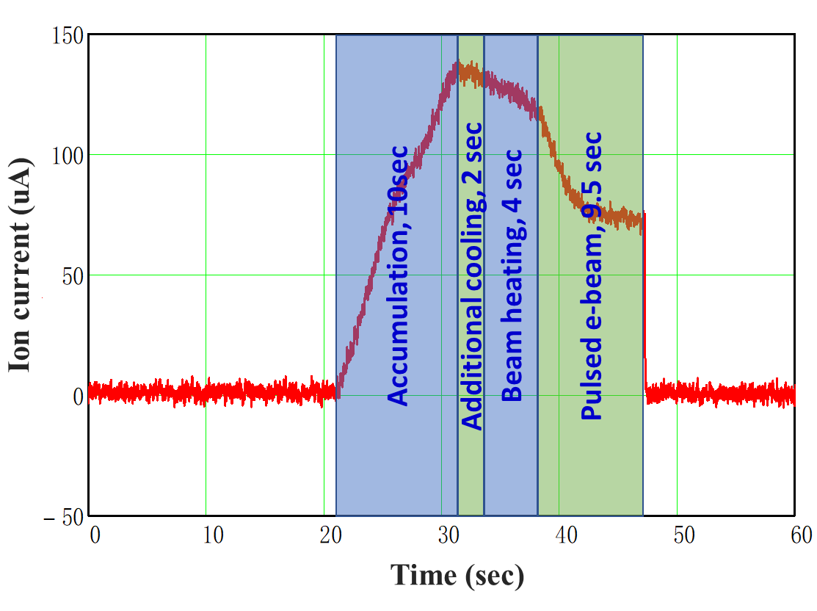
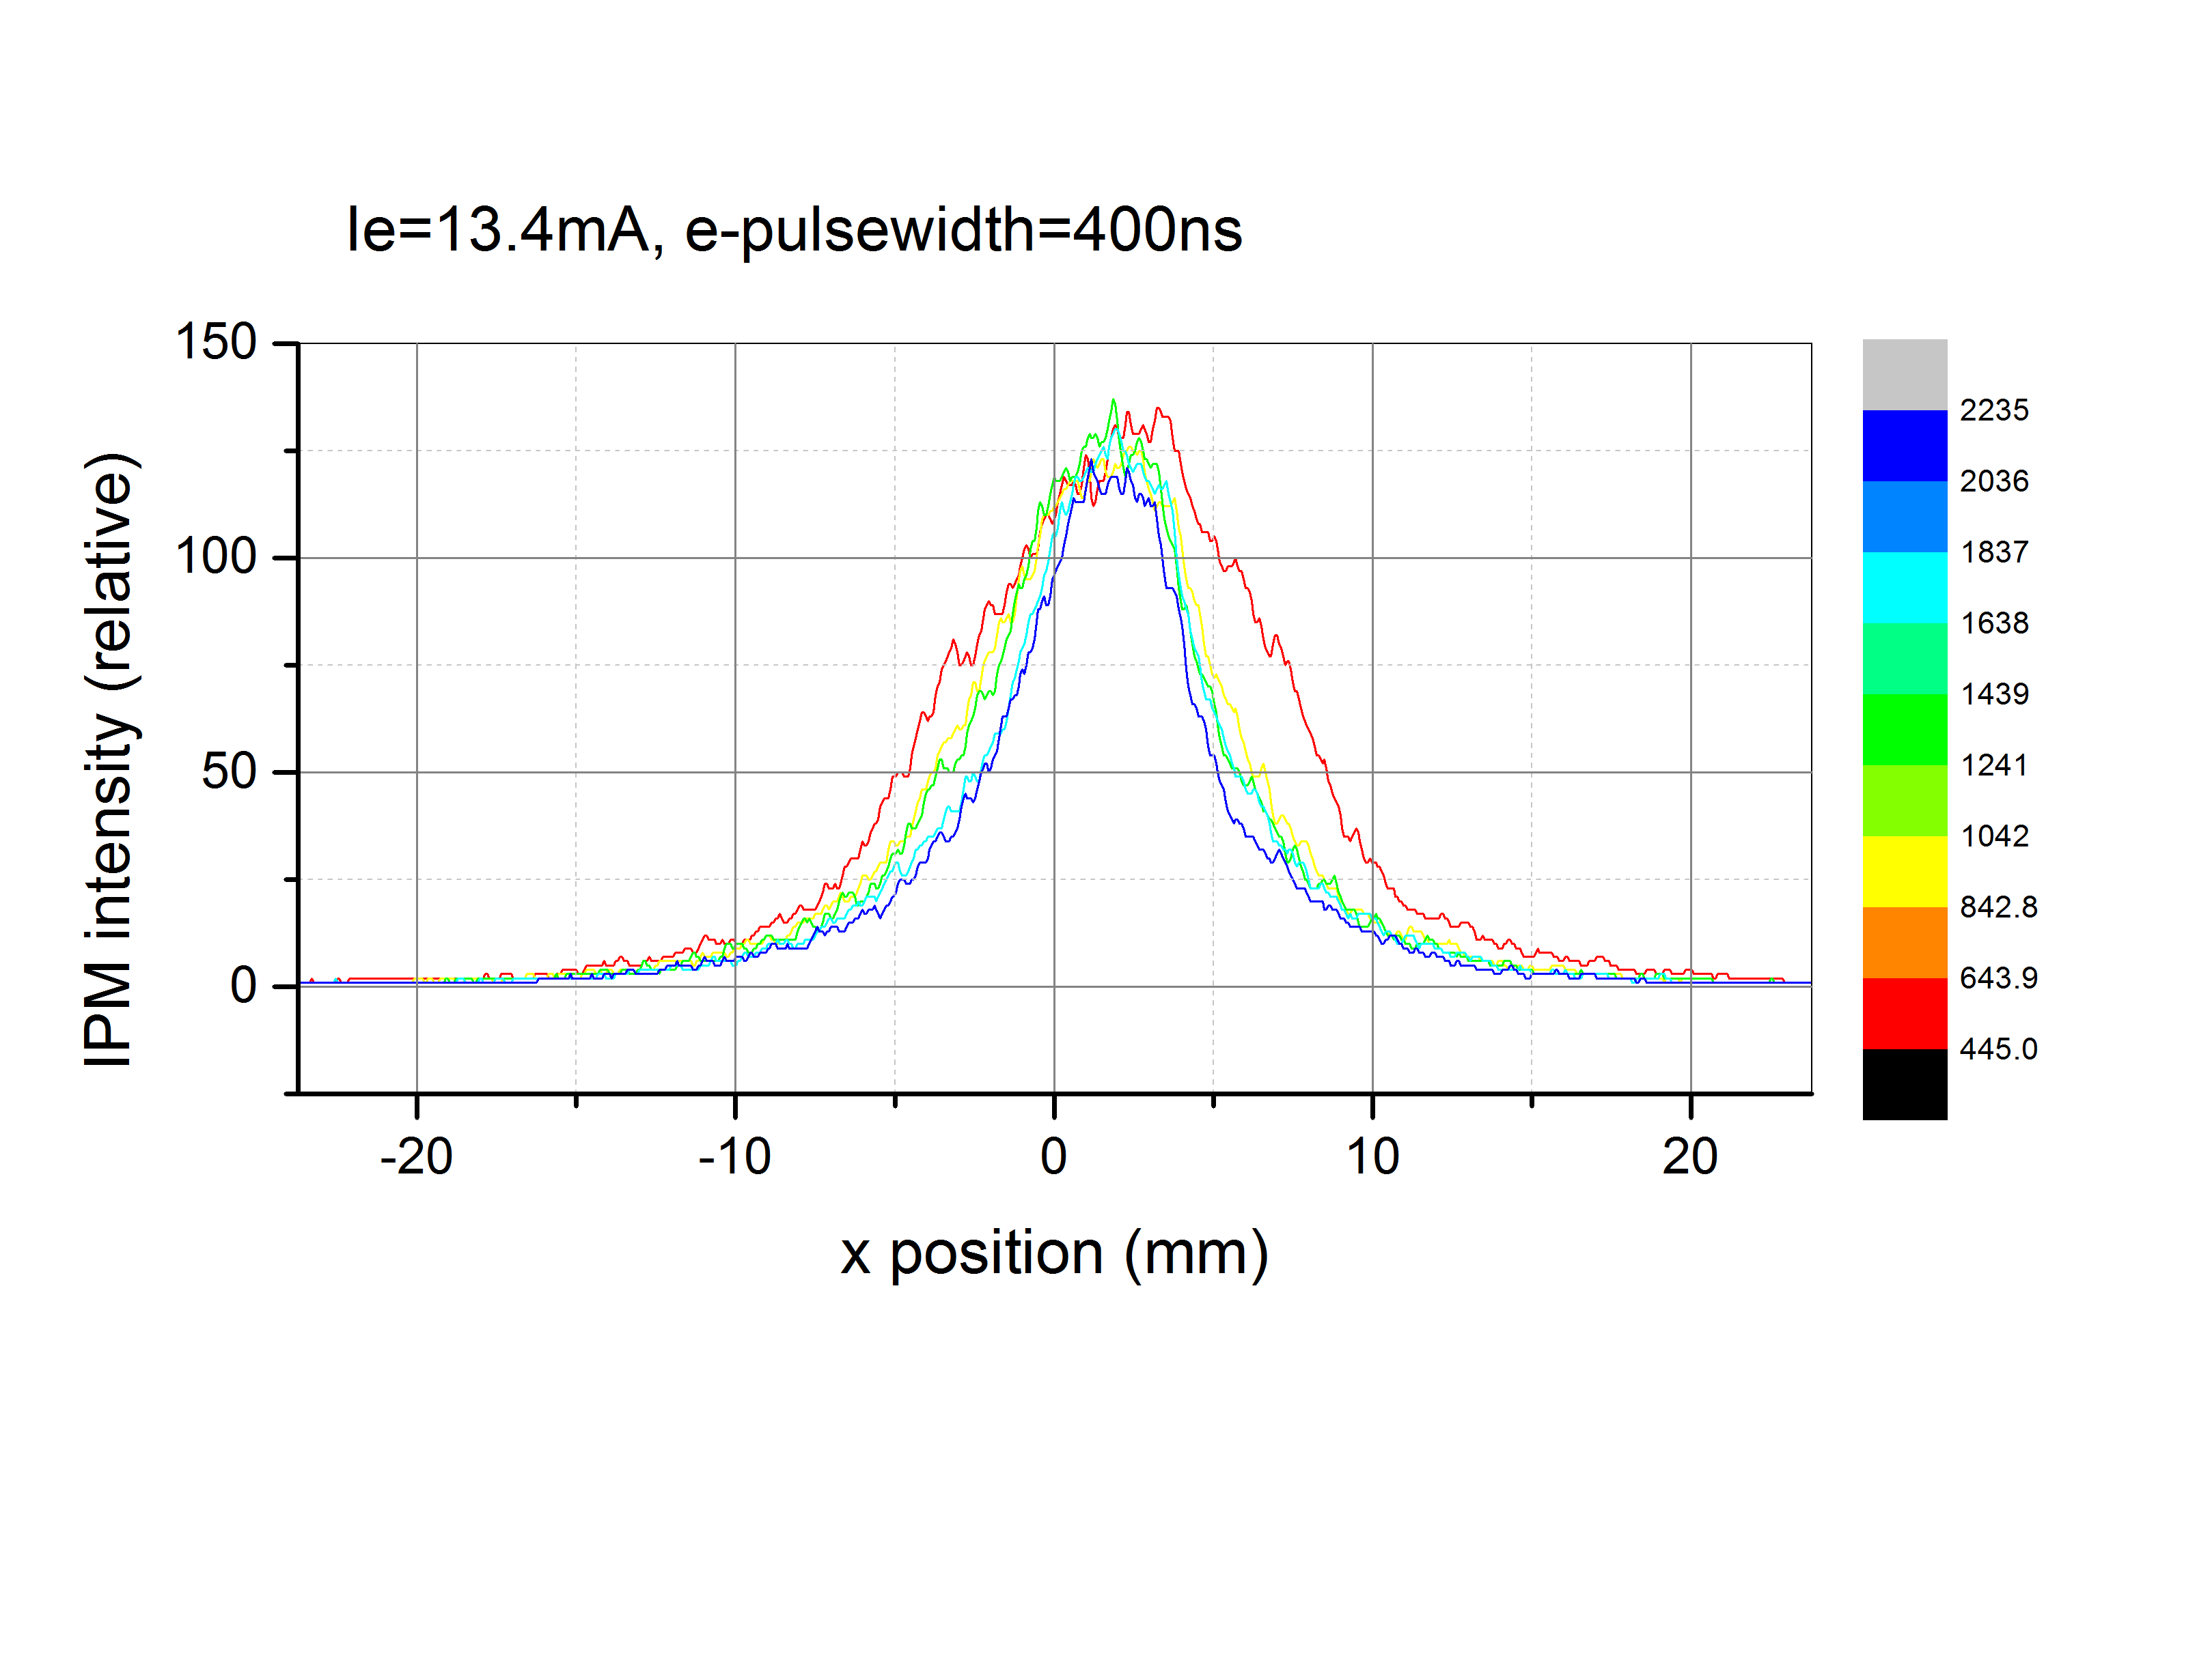
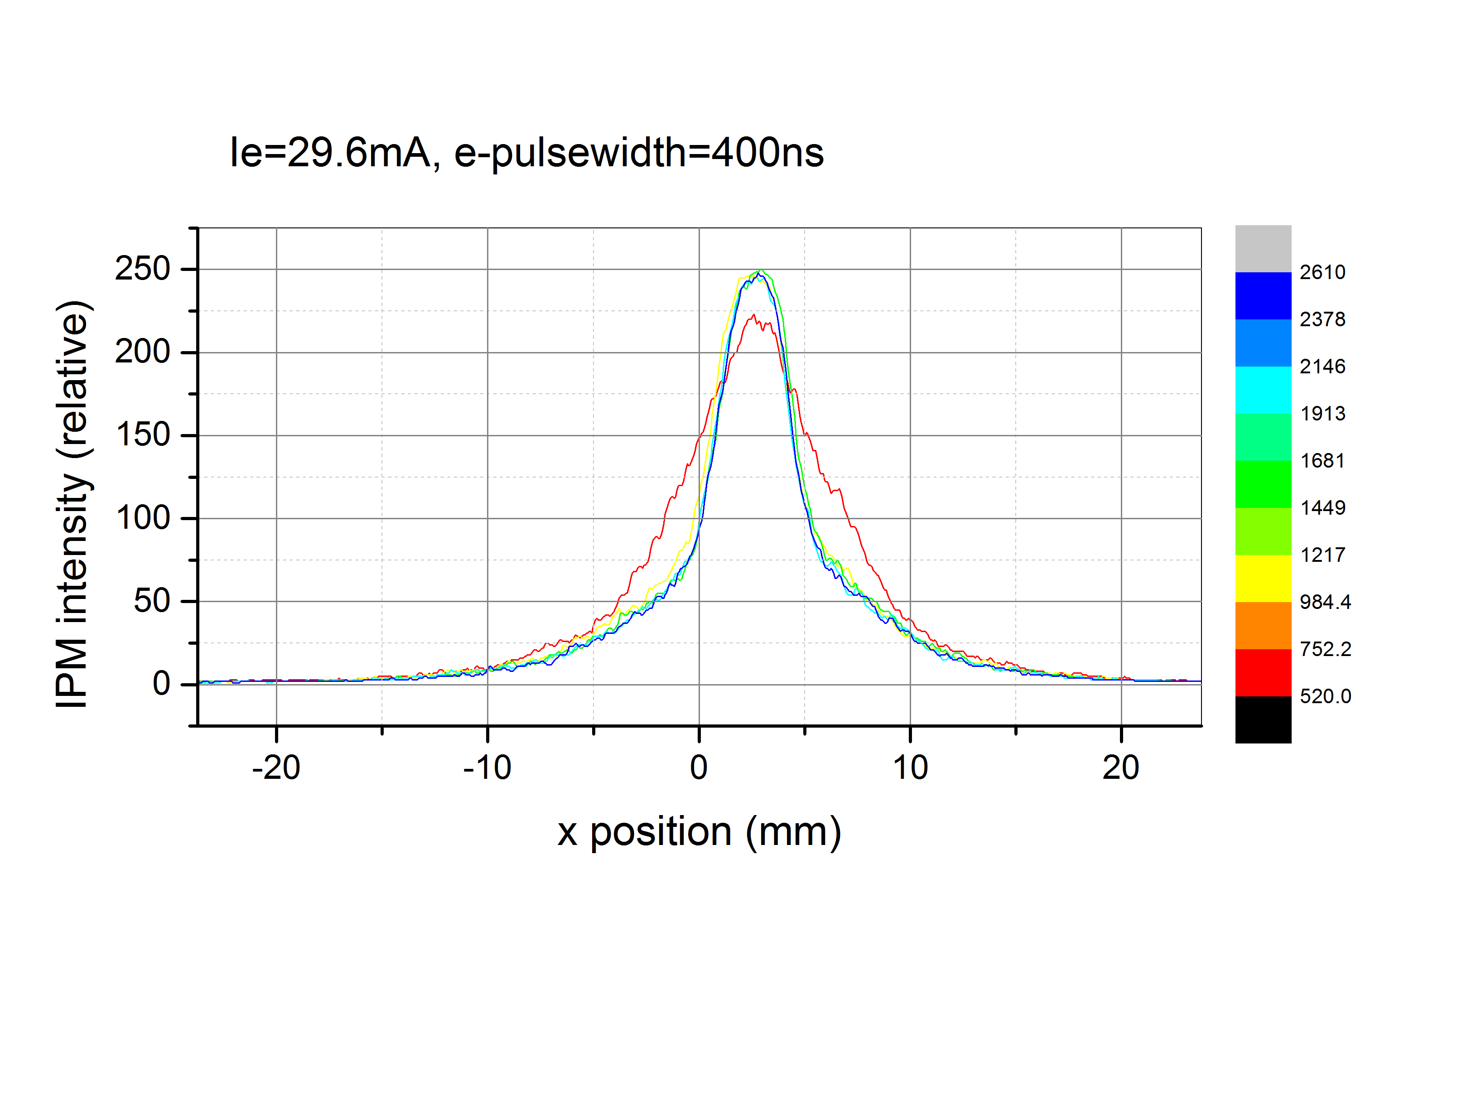
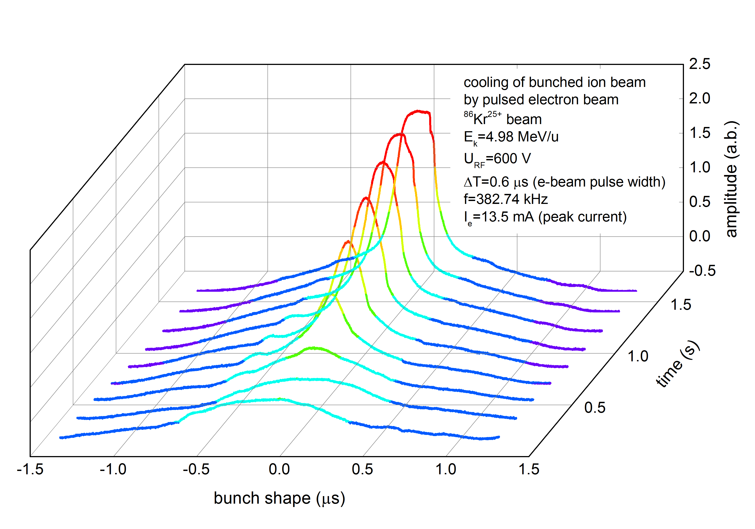
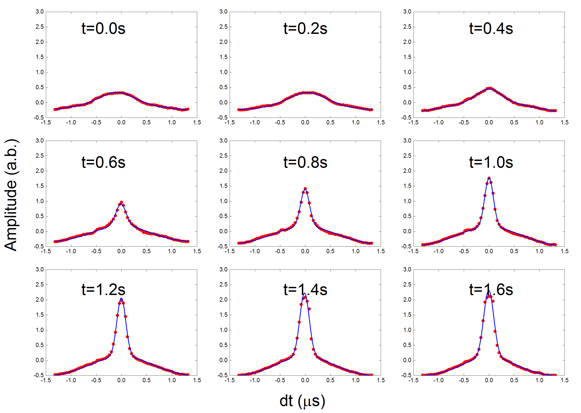
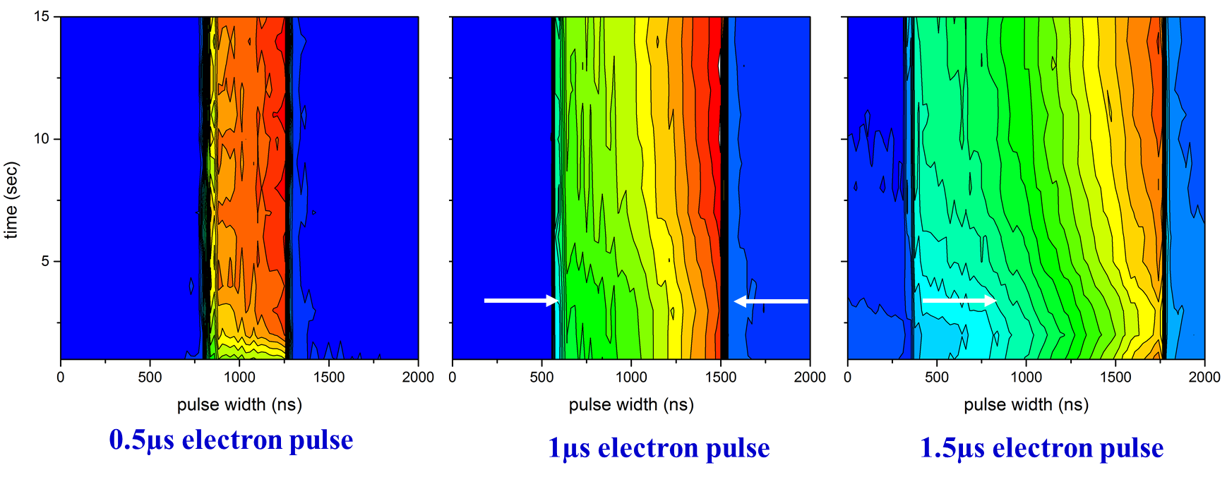
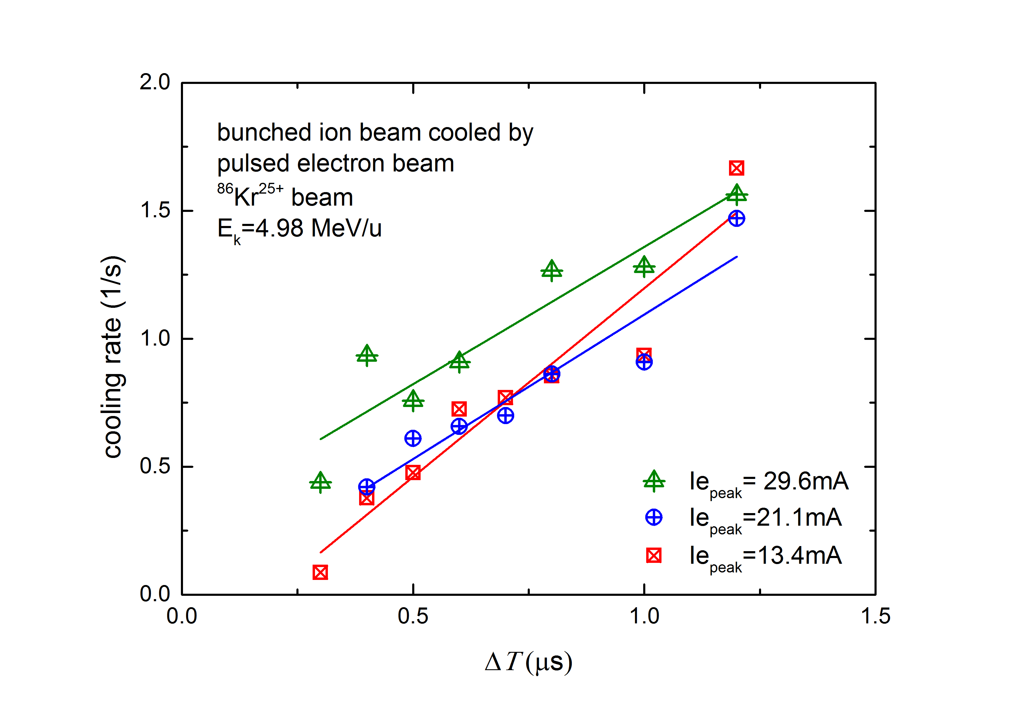
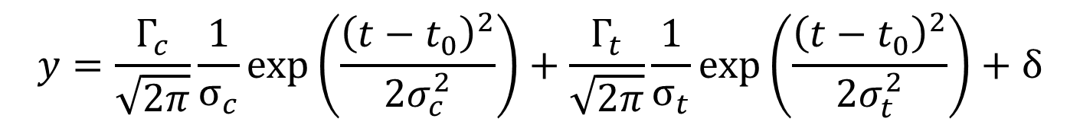
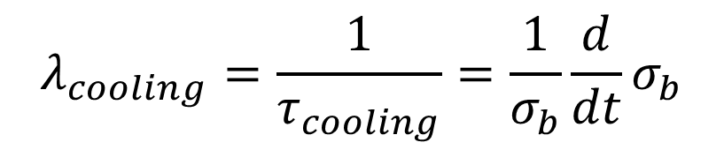
First Experimental Demonstration of Cooling of Ions
by a bunched Electron Beam*
Y. Zhang⁺, S. Benson, A. Hutton, K. Jordan, T. Powers, R. Rimmer, M. Spata, A. Sy, H. Wang, S. Wang, H. Zhang, Jefferson Lab, USA
L. Mao⁺, J. Li, X. Ma, M. Tang, J. Yang, X. Yang, H. Zhao, H.W. Zhao, Institute of Modern Physics (IMP), China
Abstract: Cooling of ion beams is essential to future electron-ion colliders reaching high luminosities. Cooling very high energy hadrons demands the use of a RF/SRF linac. It is then critical to demonstrate bunched-beam electron cooling experimentally and to benchmark simulations against this experimental data. Such studies were carried out by a Jlab-IMP collaboration, using a DC cooler at IMP. The thermionic gun of the DC cooler was modified to produce a pulsed beam with pulse length of 0.07-3.5 µs at a 383 kHz repetition frequency. The experiments clearly demonstrated cooling of a RF focused ⁸⁶Kr²⁵⁺ bunches. We present the main experiments results.
Introduction
JLEIC, a high-energy high-luminosity polarized electron-ion collider based on Jefferson Lab CEBAF SRF linac, is designed for the future QCD frontier
JLEIC relies on electron cooling to reach very high luminosities up to >10³⁴ cm⁻²s⁻¹ by achieving a substantially reduction of 6D ion beam emittance.
JLEIC adopts a multi-stage cooling scheme: 4.3 MeV DC cooling in the high energy booster for emittance reduction; high energy (up to ~85 MeV) cooling for maintaining low emittance during beam store/collision
High energy cooling by a bunched electron beam is in a parameter regime which was never done before. It is critical for JLEIC to carry out a proof-of-principle experiment to demonstrate its effectiveness.
CSRm Cooler at IMP
HIREL
Making of a Bunched Electron Beam
Experiment Parameters
Ion | ⁸⁶Kr²⁵⁺
Energy | 4.98 | MeV/u
Revolution frequency | 191.4 | kHz
Harmonic number | 2
RF voltage | 600 | V
Stored ions | ~10⁸
Electron energy | 2734.5 | V
Electron current (DC) | ~30 or less | mA
Ion RMS bunch width | ~1 | µs
Pulse width | 0.3 to 1.2 (for bunched ion beam) 0.5 to 4 (for coasting ion beam) | µs
Grid voltage from a pulse generator
Grid electrode is used to control the field at the cathode to switch on/off beam
Experimental Setup and Measurement Cycle
Beam accumulation with DC cooling, ~10s
Pre DC cooling ~2s to conditioning beam quality
Turn DC e-beam off, ion beam reheating, 4s
Turn ion RF on, ion beam is bunched, 0.5 s
Turn pulsed e-beam on, bunched cooling 9.5 s
Transverse Cooling
Observed by IPM detector
Current:13.4 mA
Pulse width: 0.4 µs
Current: 29.6 mA
Pulse width: 0.4 µs
Longitudinal Cooling
Ion bunches can be cooled by a pulsed electron beam, even if the electron pulse width is shorter than the initial ion beam bunch length
“Grouping Effect” in Bunched Cooling of a Coasting Ion Beam
The measured longitudinal density profile can be fitted by Bi-Gaussian distribution
The coasting ions can be captured in the e-pulse.
The ion pulse length is equal to the electron pulse length
$$y=\frac{Γ_{c}}{\sqrt{2π}}\frac{1}{σ_{c}}\exp\left(\frac{{\left(t−t_{0}\right)}^{2}}{2σ_{c}^{2}}\right)+\frac{Γ_{t}}{\sqrt{2π}}\frac{1}{σ_{t}}\exp\left(\frac{{\left(t−t_{0}\right)}^{2}}{2σ_{t}^{2}}\right)+δ$$
Cooling rate
$$λ_{cooling}=\frac{1}{τ_{cooling}}=\frac{1}{σ_{b}}\frac{d}{dt}σ_{b}$$
Summary
The world first experiment for bunched electron beam cooling was carried out at IMP by a JLab-IMP collaboration (May, 2016, April, 2017, Sept. and Nov., 2018)
The experiments demonstrated that both coasting and bunched ion beams can be cooled by pulsed electron beam in transverse and longitudinal phase space;
The electron pulse and ions must be synchronized to prevent ion beam loss;
Grouping effect is observed while a coasting ion beam is cooled by a bunched electron beam.
Benchmarking with simulations is in progress
simulation
* Authored by Jefferson Science Associates, LLC under U.S. DOE Contract No. DE-AC05-06OR23177; and by Institute of Modern Physics, Chinese Academy of Science under a special grant from Chinese National Science Foundation
⁺ maolijun@impcas.as.cn, yzhang@jlab.org

