Slide 1
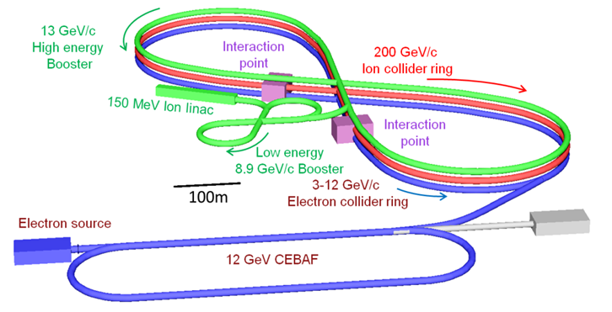
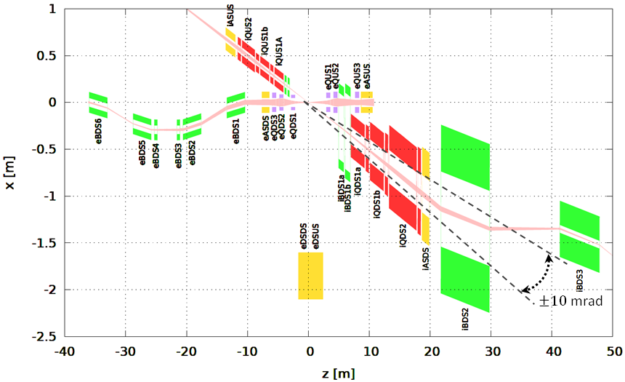
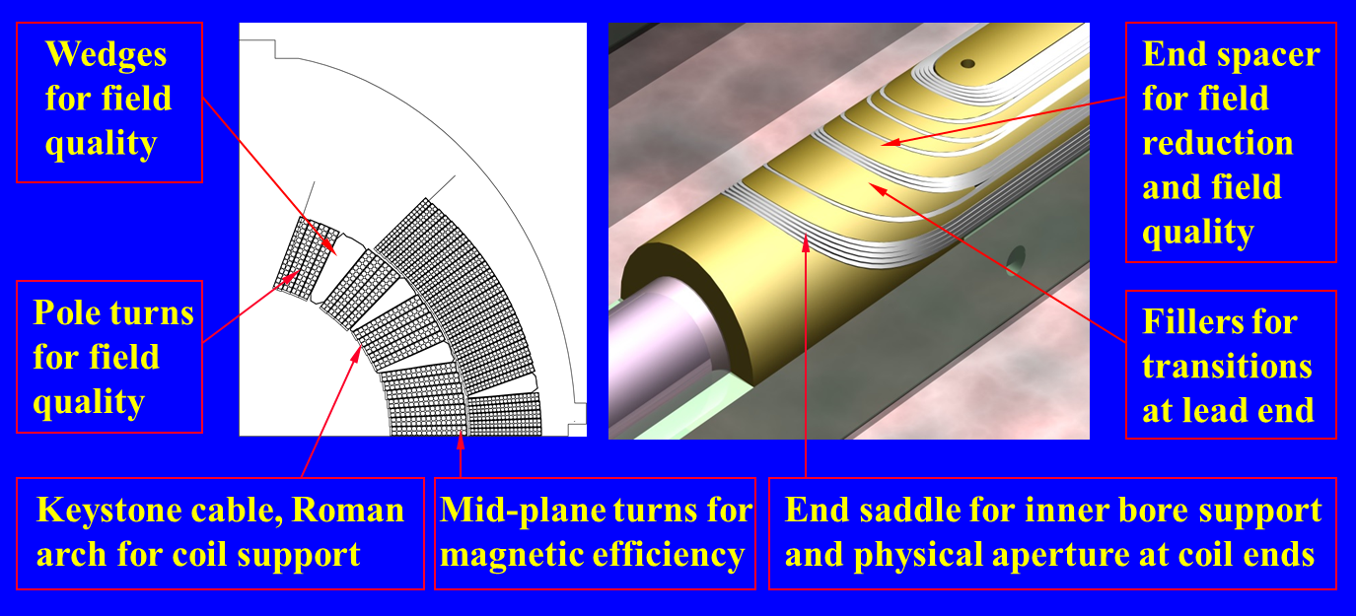
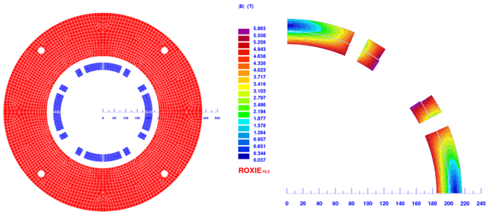
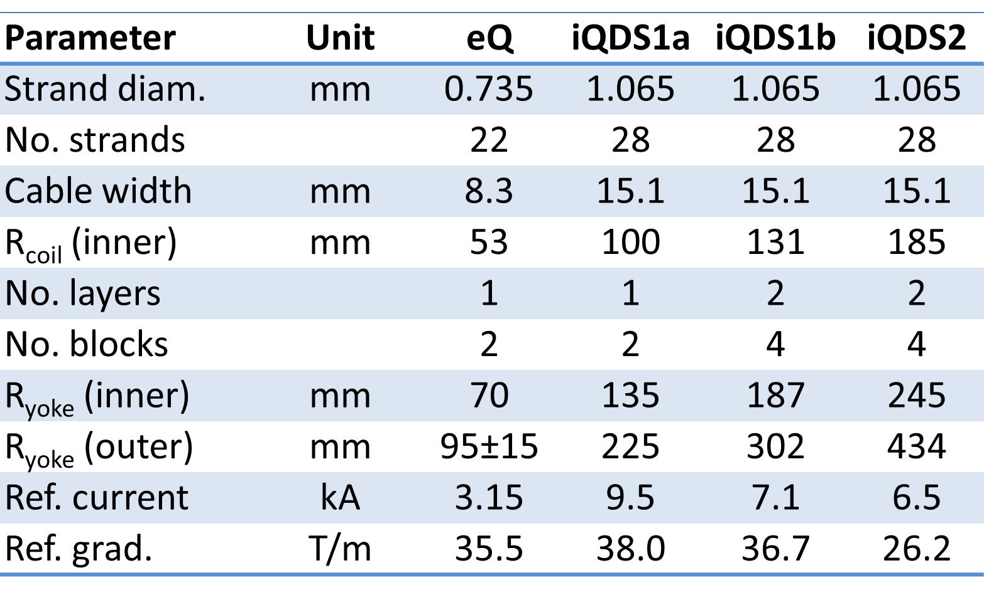
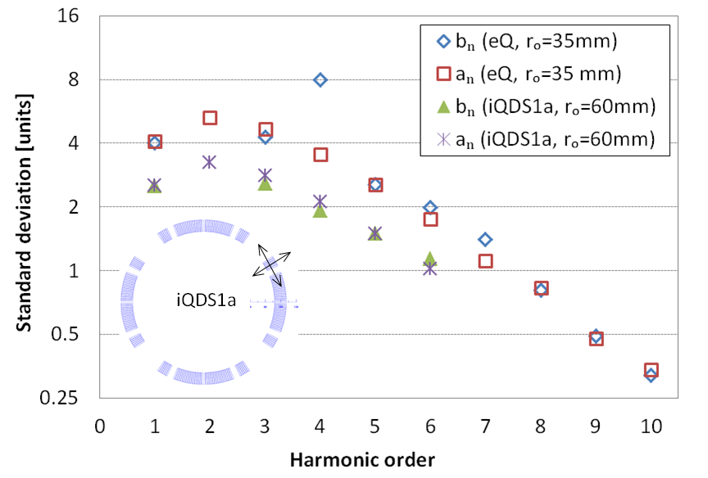
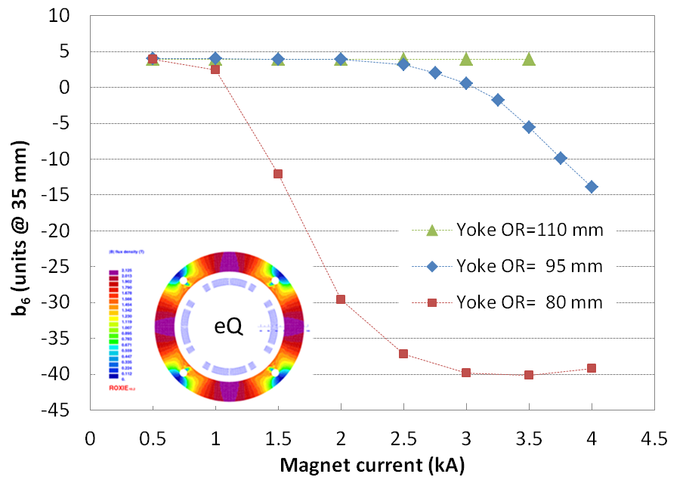
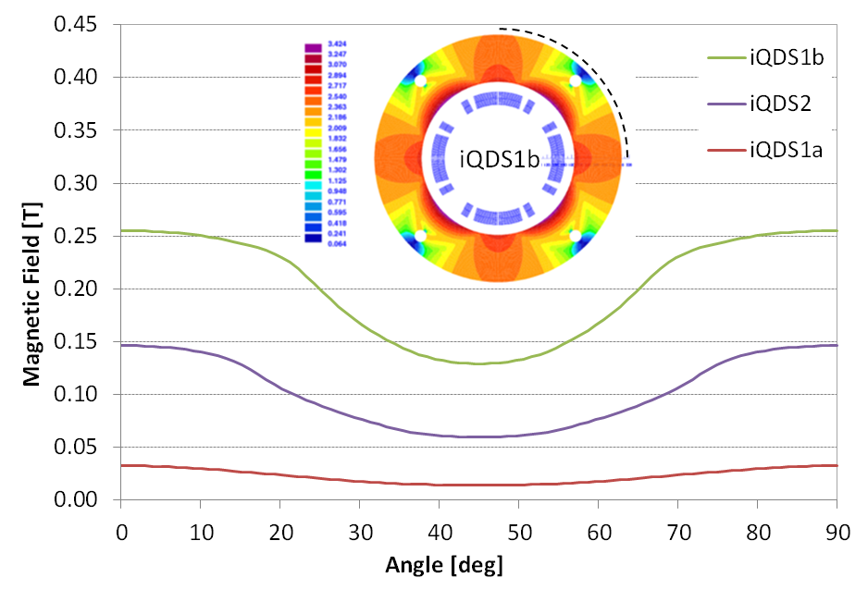
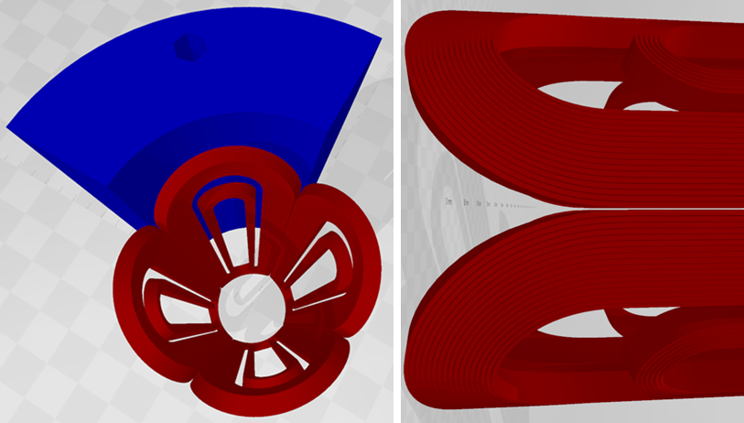
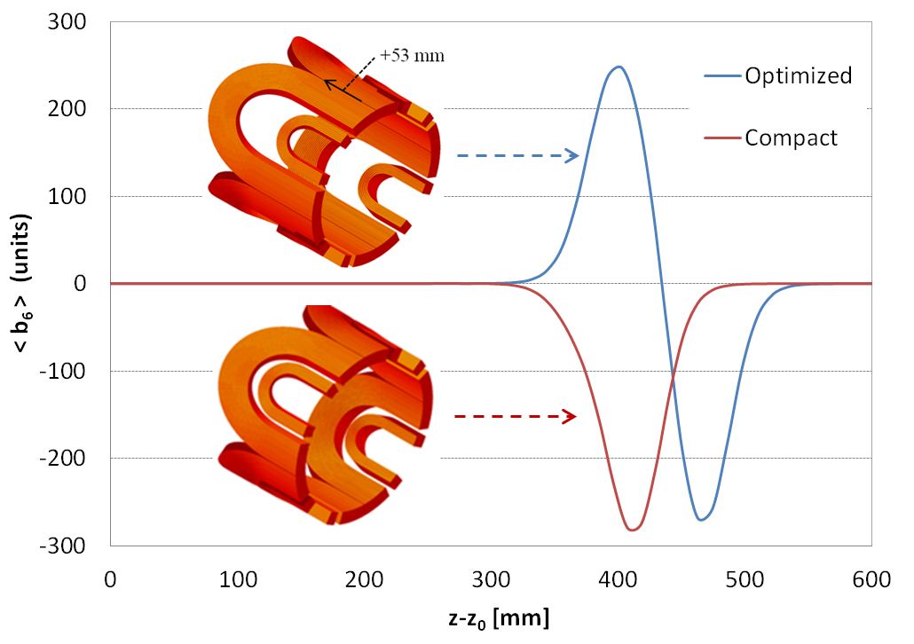
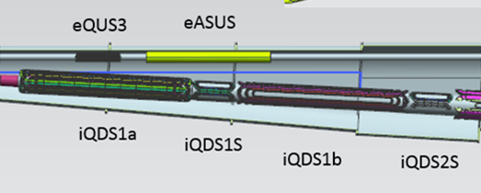
FIELD QUALITY ANALYSIS OF INTERACTION REGION QUADRUPOLES FOR JLEIC
G. Sabbi, LBNL, Berkeley, CA, USA
B.R.P. Gamage, T. Michalski, V.S. Morozov, R. Rajput-Ghoshal, M. Wiseman, Jefferson Lab, Newport News, VA, USA
Y. Nosochkov, M. Sullivan, SLAC, Menlo Park, CA, USA
Jefferson Lab Electron-Ion Collider
IR Layout
IR Quadrupole Parameters
200 GeV
protons
Element name | L_{mag} [m] | R_{bore} [cm] | R_{field} [cm] | R_{out} [cm] | G_{normal} [T/m] | G_{skew} [T/m]
iQUS1a | 1.45 | 3.0 | 2.0 | 10.0 | -97.88 | -3.08
iQUS1b | 1.45 | 3.0 | 2.0 | 10.0 | -97-88 | -
iQUS2 | 2.10 | 4.0 | 3.0 | 12.0 | 94.07 | -
eQUS1 | 0.6 | 4.5 | 2.0 | 10.0 | -36.94 | 8.10
eQUS2 | 0.6 | 4.5 | 3.2 | 11.0 | 33.66 | -7.38
eQUS3 | 0.6 | 4.5 | 1.5 | 11.0 | -20.80 | 4.56
iQDS1a | 2.25 | 9.2 | 4.0 | 23.1 | -37.23 | -1.23
iQDS1b | 2.25 | 12.3 | 4.0 | 31.0 | -37.23 | -
iQDS2 | 4.50 | 17.7 | 4.0 | 44.4 | 25.96 | -
eQDS1 | 0.6 | 4.5 | 1.7 | 8.0 | -33.75 | -4.89
eQDS2 | 0.6 | 4.5 | 2.8 | 8.5 | 36.22 | 5.25
eQDS3 | 0.6 | 4.5 | 2.4 | 10.0 | -18.72 | -2.71
10 GeV electrons
Magnet Requirements
Magnet Design: NbTi, cos2θ, Rutherford cable, collar-based mechanical structure
Experimental:
Very large aperture for acceptance of charged and neutral particles in the hadron beam forward side
Limit background and detector damage from e-beam synchrotron radiation
Integrate detector elements (e.g. spectrometers) in IR layout
Operate under high heat load from IP (cooling, radiation lifetime)
Accelerator:
Large focusing strength for small beam size at the IP and high luminosity
Operate in a wide range of beam energy/current with good field quality
Compact designs and/or interleaved electron and ion magnets in order to minimize crossing angle and crab cavity system requirements
Control magnet fringe fields to minimize perturbations on adjacent beam optics
Example: iQDS2:
Very large aperture: 37 cm coil diameter
Double-layer coil with 30 mm total width
LHC dipole inner cable with lower keystone angle
Magnetic analysis performed with ROXIE
Operating Parameters (2D) | Unit | Value
Current | kA | 6.5
Copper current density | kA/mm² | 0.42
Field at coil radius (GxR_{in}) | T | 4.85
Peak (2D) coil field | T | 5.86
Lorentz force (F_{q} 1 octant) | MN/m | 1.49
Geometric and random errors
Saturation effects
Fringe Fields
Block displacements have a flat distribution of ±100 μm in radial and azimuthal direction
Saturation curves may be shifted vertically by a fixed amount (by coil cross-section design) to optimize the DA
Main concern is the effect of high field, large bore ion quadrupole fringe fields on the adjacent electron beam
End Field Quality and Magnet Length Optimization
Longitudinal space allocation is very tight:
Coil end geometry has to be optimized for winding
Spacers to control peak field and field quality make the coil end less compact
Include space for engineering features: leads, axial force support, cryostat
Estimate field quality and allocate space for correctors
Increase operating gradient limited by NbTi properties
Coil and iron yoke model for end field analysis of iQDS1a
Local correction of b₆ requires 53 mm shift of lower block

