Slide 1
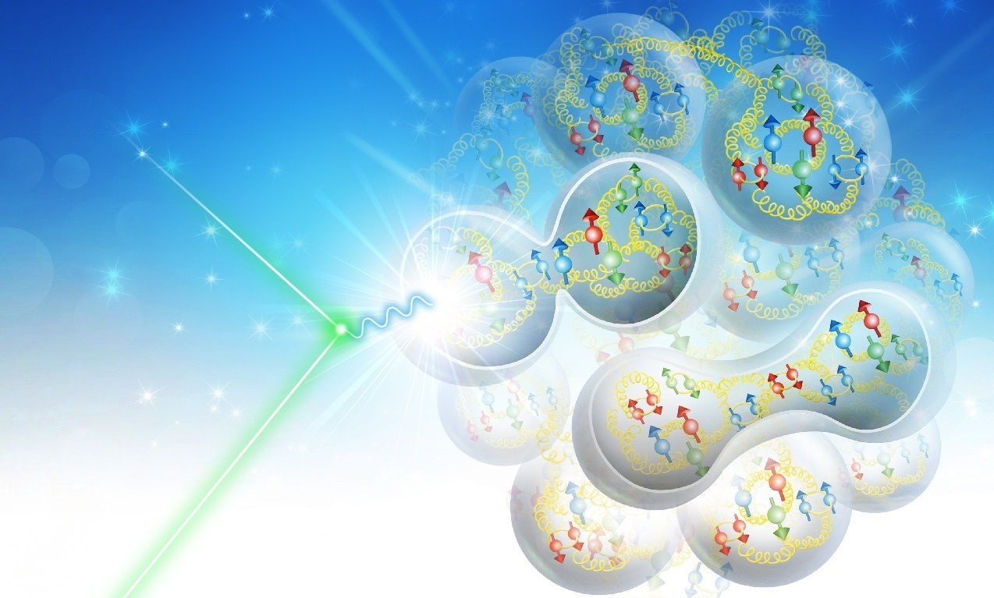

JLEIC: A High Luminosity Polarized Electron-Ion Collider at Jefferson Lab
Yuhong Zhang, Thomas Jefferson National Accelerator Facility
North American Particle Accelerator Conference
1-6 September 2019, Lansing, Michigan

Slide 2
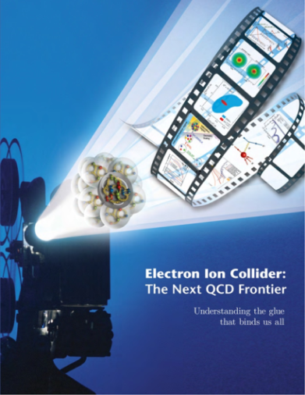

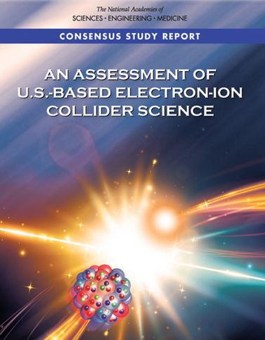
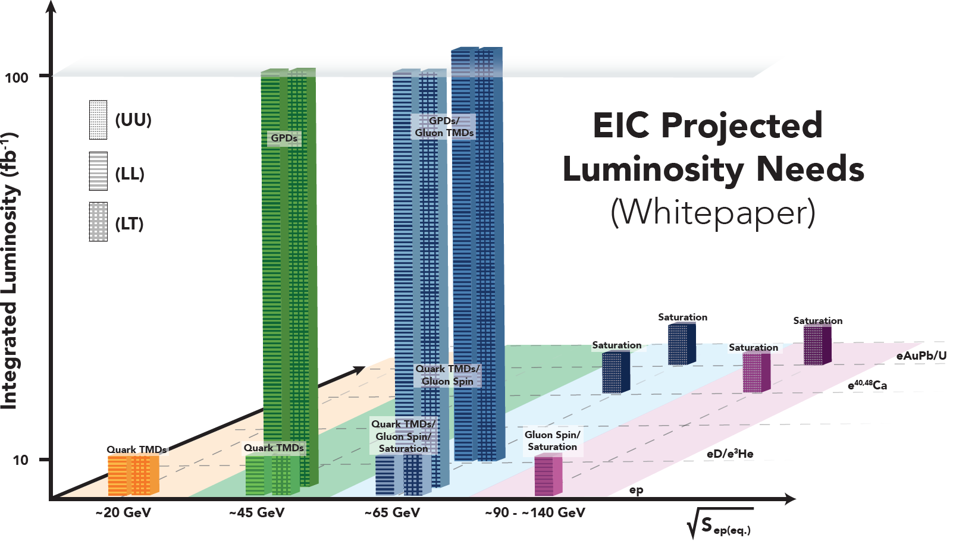
EIC for QCD Frontier
A Gluon Microscopy for Understanding the Glue that Binds Us All
A. Seryi, MOOHC2
EIC Community White Paper 2012
Highly polarized (~70%) electron and light beams
Ion beams from deuteron to the heaviest stable nuclei (U or Pb)
Variable CM energies from ~20 – ~100 GeV, upgradable to ~140 GeV
High collision luminosity ~10³³⁻³⁴ cm⁻²s⁻¹
Possibilities of having more than one interaction region
NSCA Long Range Plan 2015
A high-energy high-luminosity polarized Electron-Ion Collider for new facility construction following the completion of FRIB
95% of program is at CM energies below 100 GeV
HERA: 0.8 fb⁻¹ integrated luminosity delivered
EIC Projected Luminosity Needs
Total ~600 fb⁻¹
NAS Assessment of EIC 2018
“In summary, the committee finds a compelling scientific case for such a facility. The science questions that an EIC will answer are central to completing an understanding of atoms as well as being integral to the agenda of nuclear physics today. In addition, the development of an EIC would advance accelerator science and technology in nuclear science; it would as well benefit other fields of accelerator based science and society, from medicine through materials science to elementary particle physics.”
Total ~710 fb⁻¹

Slide 3
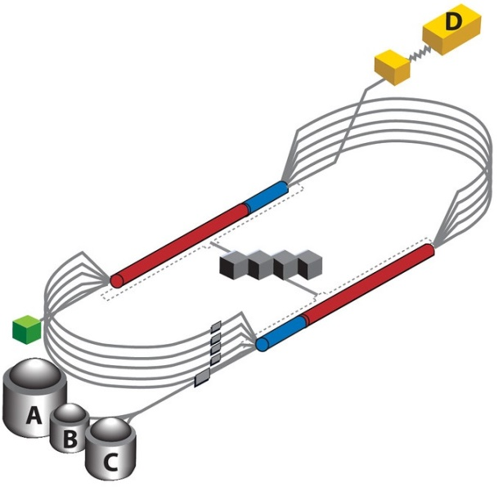
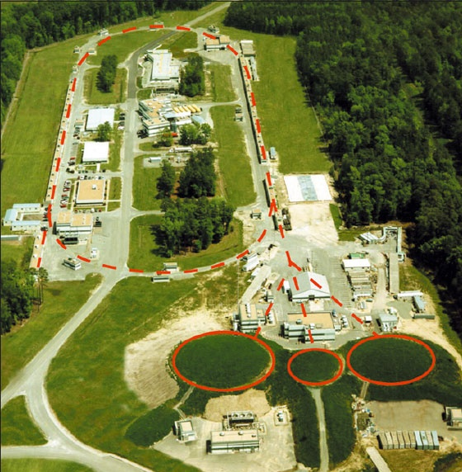
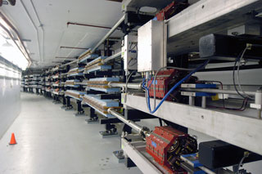
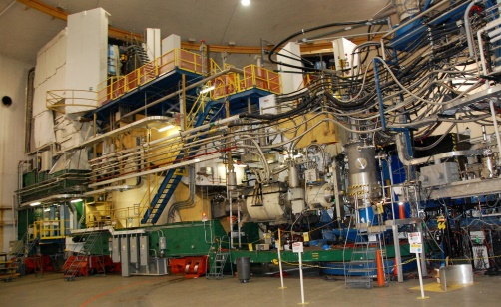
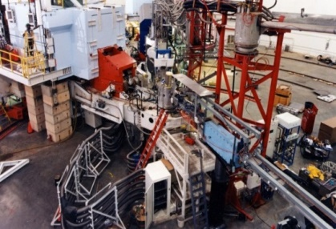
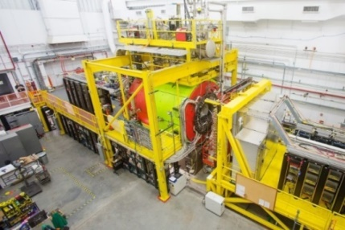
Jefferson Lab Answers EIC Science Call
Large established user community in the field
CEBAF, the world highest energy CW SRF linac
  As a full energy injector (requiring no upgrade)
  Maintains highly-polarized high-current beam in the electron collider ring using demonstrated top-up injection technique
New collider complex
  Modern design and technology, no constraints posed by existing infrastructure
  Design driven by experimental requirements
    Novel high luminosity concept
    Luminosity optimized around CM energy range of physics interest
    Novel figure-8 design for high polarization of any particles including deuterons
    Deeply integrated detector and machine design for full acceptance
  Balance of good performance and low technical risk
Up to 12 GeV @1.5 GHz

Slide 4
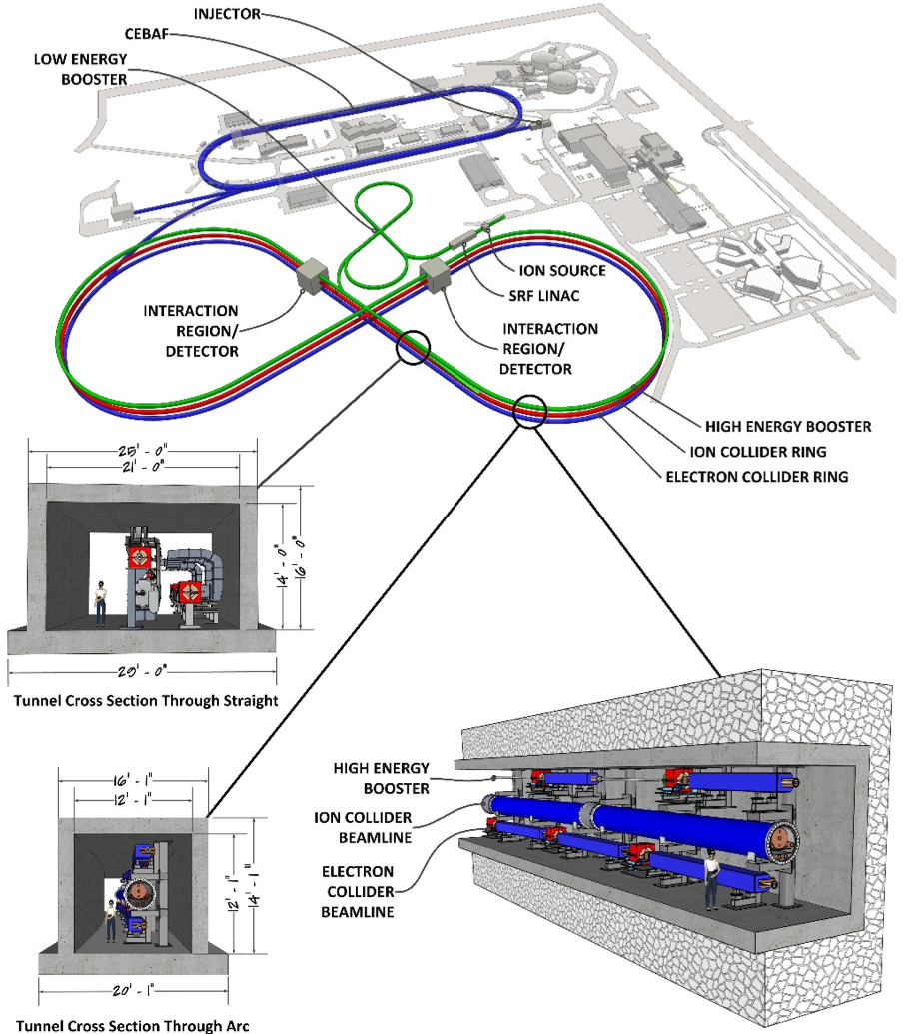
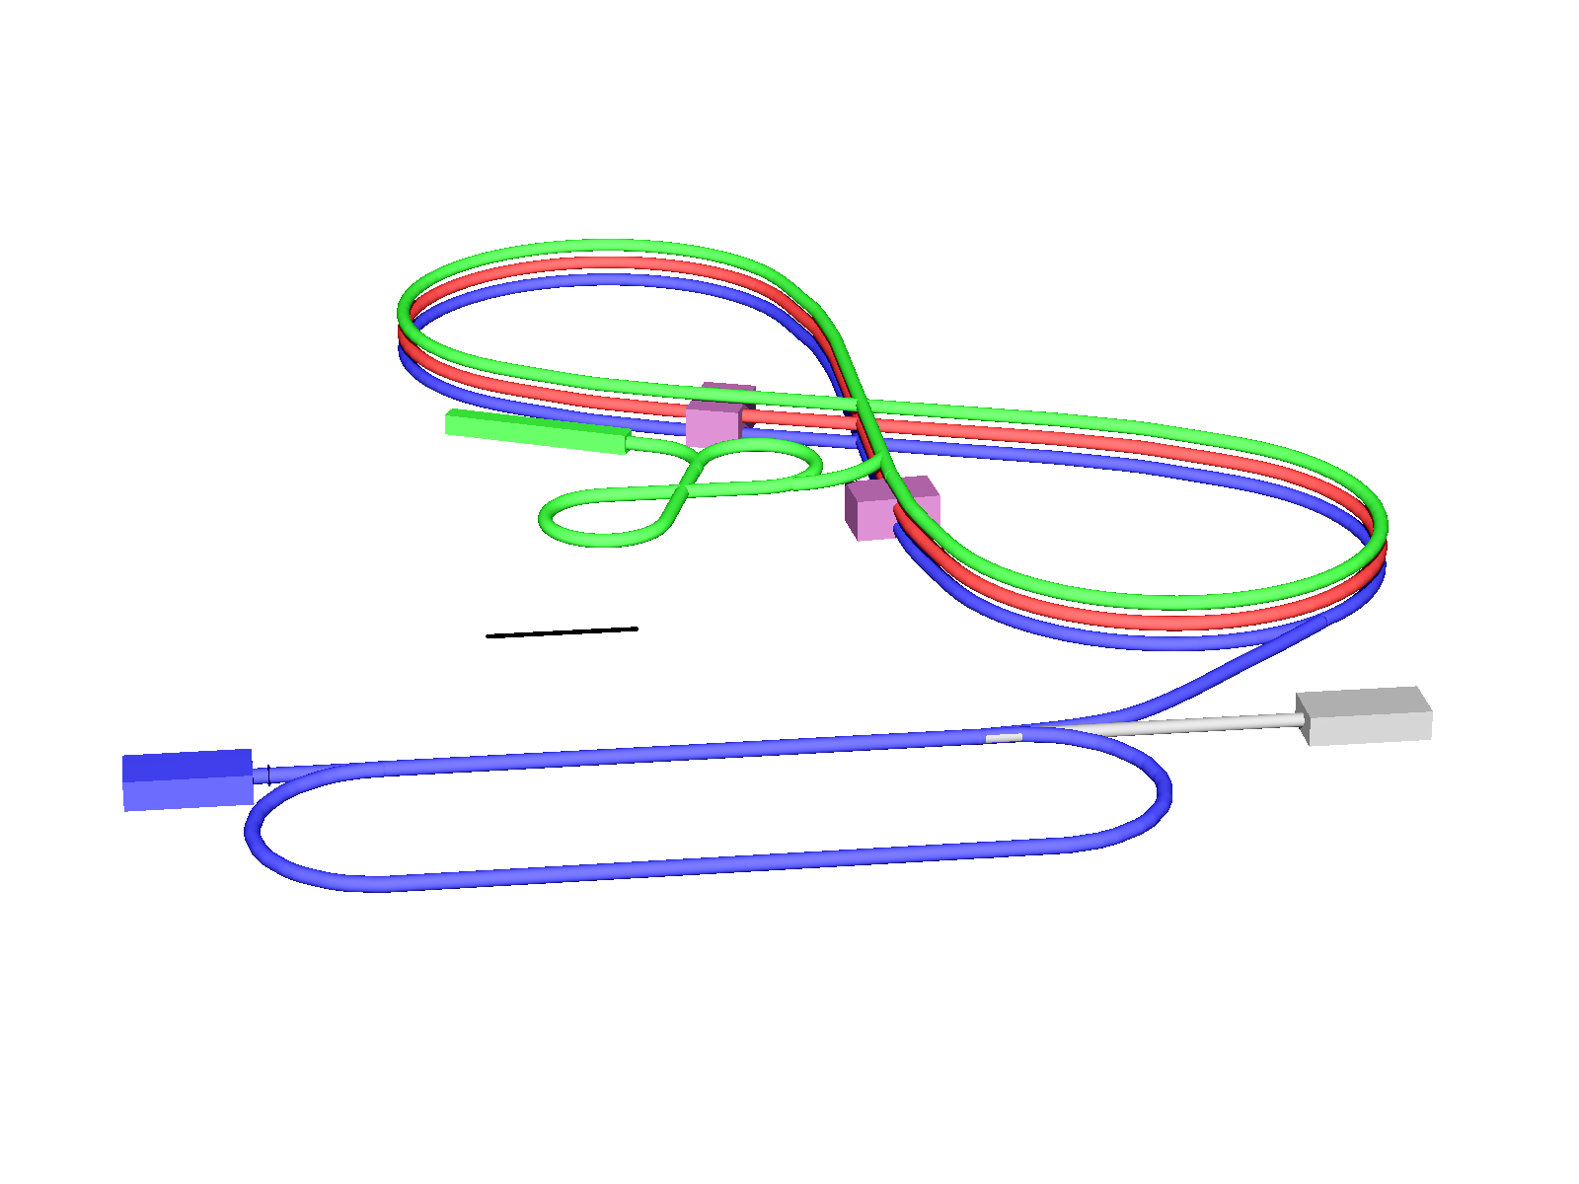
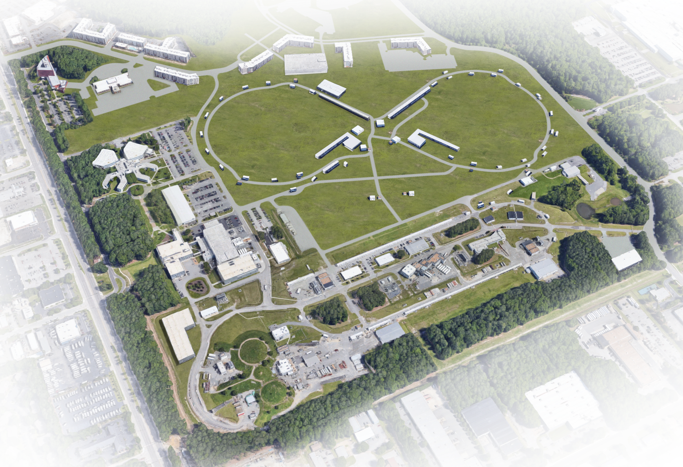
JLEIC Layout
Electron complex
  CEBAF as a full energy injector
  Electron collider ring: 3-12 GeV/c
Ion complex
  Ion source, SRF linac: 150 MeV for protons
  Low Energy Booster: 8.9 GeV/c
  High Energy Booster: 13 GeV/c
  Ion collider ring: 200 GeV/c
Up to two detectors at minimum background locations
Upgradable to 140 GeV CM
High Energy
Booster
(13 GeV/c)
Interaction
point
Ion collider ring (200 GeV/c)
Ion linac (150 MeV)
Interaction
point
100m
Low Energy Booster
(8.9 GeV/c)
Electron collider ring
(3-12 GeV/c)
Electron source
12 GeV CEBAF

Slide 5

JLEIC High Luminosity Concept: Many Small Short Bunches
Conventional approach for hadron colliders
  Few colliding bunches ➔ low bunch frequency
  High bunch intensity ➔ long bunch & large β*
JLEIC takes a new approach:
high bunch repetition rate + short bunch colliding beams
A standard approach for lepton colliders
(KEK-B reached > 2x10³⁴ /cm²/s)
JLEIC advantages
  Based on CEBAF, its beam already up to 1.5 GHz
  New green field ion complex can be designed to deliver high bunch repetition rate
Strategy: Design a lepton-hadron collider like a lepton-lepton collider
Damping Design
Synch. radiation
Beam cooling
Beam Design
High repetition rate
Low bunch charge
Short bunch length
Small emittance
IR Design
Small β*
Large beam-beam
Crab crossing
Role of cooling of ion beams
Critical for formation, emittance reduction/preservation
Electron has SR --- natural damping
No SR for protons/ions in JLEIC medium energy range
JLEIC relies on electron cooling for providing a damping mechanism
 | Bunch freq. (MHz) | Bunch intensity (10¹⁰) | Bunch length (cm) | β*_{y} (cm)
RHIC | 9.4 | 20 | - | ~90
HERA | 8.2 | 7.3 | 16 | 18
JLEIC | 476 | 1 | ~2 | 1.2
KEKB | 158 - 458 | 6.4 – 2.1 | ~0.6 | 0.59

Slide 6
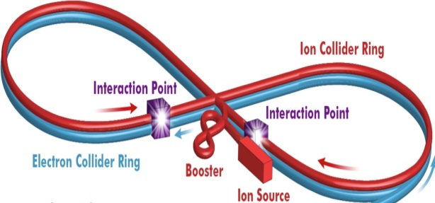
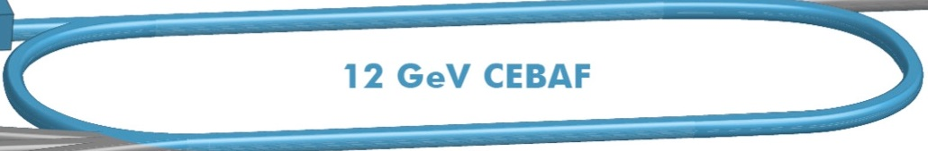
JLEIC High Polarization Concept: Figure-8 Shape Ring
Figure-8 synchrotron
Electrons, protons & light ions are injected polarized from sources
JLEIC adopted a figure-8 topology for ion rings
➔ A brilliant invention of Dr. Yaroslav Derbenev
➔ Enabled by a green field collider ring design
Spin precessions in the left & right parts of a figure-8 ring are exactly cancelled ➔ net spin precession is zero
➔ spin tune is zero
Does not cross spin resonance during energy ramp
Spin can be controlled and stabilized by compact spin rotators (e.g., rotating spin, and moving spin tune away from 0)
No need of Siberian Snakes
The only practical way to accelerate/store polarized deuterons in medium energy range (gyromagnetic ratio g-2 too small)
The electron ring follows the ion ring figure-8 foot-print
Figure-8 helps the electron polarization under spin flip
S
B
B
Spin precessions in left & right are cancelled ➔ Spin turn is zero (energy independent)
S
B
B
Conventional synchrotron
Energy dependent spin precession
Cross spin resonances during acceleration
Siberian Snake may help but still difficult

Slide 7
JLEIC Parameters and Luminosity
CM energy | GeV | 21.9 |  | 44.7 |  | 63.3 |  | 89.4 |  | 98
 |  | p | e | p | e | p | e | p | e | p | E
Beam energy | GeV | 40 | 3 | 100 | 5 | 200 | 5 | 200 | 10 | 200 | 12
Collision freq | MHz | 476 |  | 476 |  | 476/4=119 |  | 476/4=119 |  | 476/4=119
Particles/bunch | 10¹⁰ | 0.64 | 3.9 | 0.98 | 4.7 | 3 | 16.8 | 3.93 | 4.3 | 3.93 | 2.05
Beam current | A | 0.49 | 3 | 0.75 | 3.6 | 0.57 | 3.2 | 0.75 | 0.82 | 0.75 | 0.39
Polarization | % | 85 | 85 | 85 | 85 | 85 | 85 | 85 | 80 | 85 | 80
Bunch length | cm | 2.5 | 1 | 2.5 | 1 | 3.5 | 1 | 3.2 | 1 | 3.2 | 1
Norm. emitt, x | µm | 0.5 | 18 | 0.65 | 83 | 2.43 | 83 | 1.5 | 664 | 1.5 | 1145
Norm. emitt, y | µm | 0.2 | 3.6 | 0.13 | 16.6 | 0.5 | 16.6 | 0.5 | 133 | 0.5 | 229
Horizontal β* | cm | 8 | 30 | 8 | 5.72 | 28 | 14.5 | 19.2 | 4 | 27.5 | 4
Vertical β* | cm | 1.3 | 9.8 | 1.3 | 0.93 | 1.6 | 2.2 | 2.3 | 0.8 | 3.3 | 0.8
Beam-beam, x |  | 0.015 | 0.12 | 0.015 | 0.045 | 0.015 | 0.14 | 0.006 | 0.022 | 0.003 | 0.013
Beam-beam, x |  | 0.01 | 0.15 | 0.0135 | 0.041 | 0.009 | 0.09 | 0.003 | 0.022 | 0.002 | 0.013
Laslett tune-shift |  | 0.06 | small | 0.018 | small | 0.0039 | Small | 0.0051 | Small | 0.0052 | Small
Hour-glass (HG) |  | 0.85 |  | 0.73 |  | 0.84 |  | 0.66 |  | 0.67
Peak lumi., w/HG | 10³³/cm²s | 3.5 |  | 14.6 |  | 13.3 |  | 3.9 |  | 1.31
Average lumi.* | 10³³/cm²s | 2.5 |  | 10.5 |  | 8.3 |  | 2.0 |  | 0.74
* Average luminosity was calculated assuming a one or two hour proton beam store without or with high energy bunched beam electron cooling plus 5 min beam formation time (mainly due to detector overhead), and a 75% duty factor of machine operation.

Slide 8
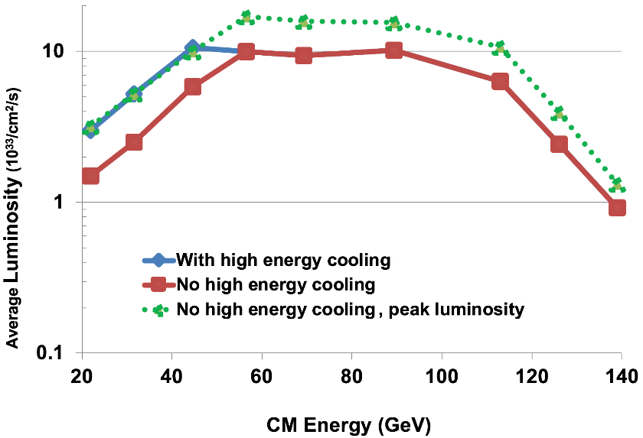

JLEIC Luminosity Performance
100 GeV CM
JLEIC has robust luminosity performance
Performance options mitigate high energy cooling risk
Beam-beam dominated
CM energy | Main luminosity limitation
low | Ion space charge
medium | Beam-beam
high | SRradiation
Space charge dominated
Synchrotron radiation dominated
Upgrade to 140 GeV CM
Average luminosity was calculated assuming a 1 or 2 hour proton beam store, without or with high energy beam electron cooling respectively, plus 5 min beam formation time (mainly due to detector overhead), and a 75% duty factor of machine operation.

Slide 9
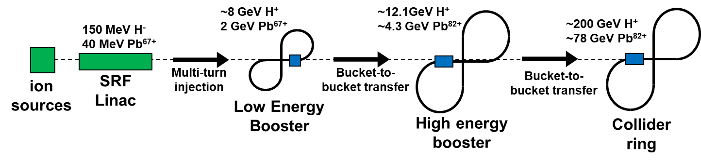
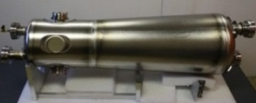
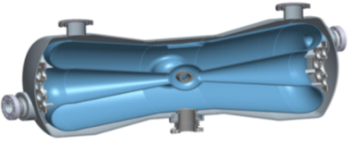
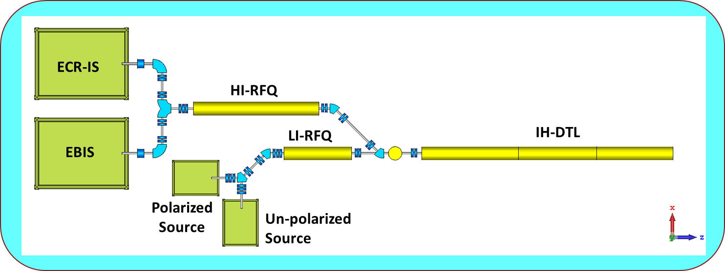
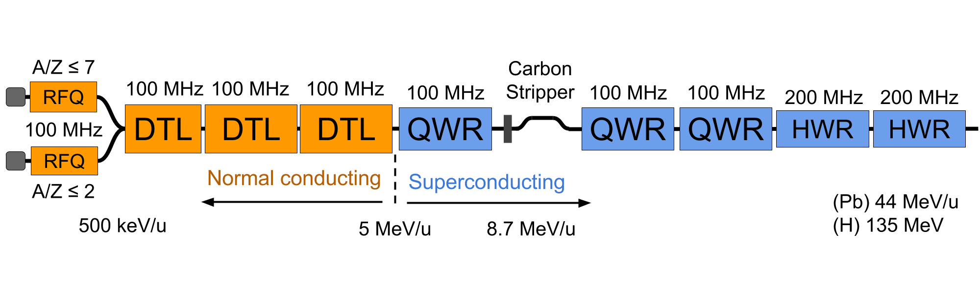
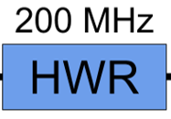
JLEIC Ion Injector: Warm/SRF Linac
B. Mustapha, TUZBA3
Quarter Wave Resonator (QWR)
Half-Wave Resonator (HWR)
Two RFQs: light ions (A/q ≤ 2) and heavy ions (A/q ≤ 7)
  Different emittances and voltage requirements
Separate LEBTs and MEBTs for light and heavy ions
RT Structure: IH-DTL with FODO focusing lattice
  significantly better beam dynamics
SRF section made of 3 QWR and 9 HWR modules
Stripper section for heavy-ions after 2nd QWR module
Pulsed Linac: up to 10 Hz rep rate, ~ 0.5 ms pulse length
Warm section
cold section
150 MeV protons
42 MeV/u Pb

Slide 10
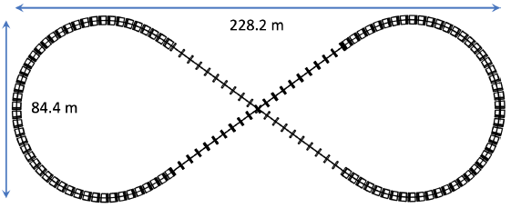
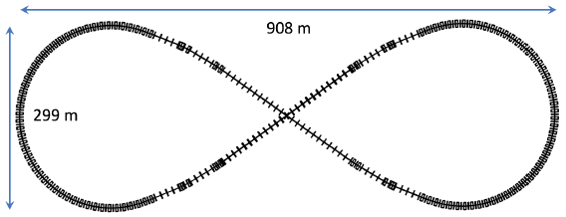
Low and High Energy Boosters, Ion Beam Formation
Low Energy Booster
150 MeV from the ion linac; extraction energy: 8 GeV
Circumference is 604 m, warm magnets & FODO lattice
γ_{t}=10.6 to avoid transition crossing for all ions
Energy
high energy booster
collider Ring
Low energy booster
Emittance preservation
bunch splitting, capture
Up to 200 GeV
Pre-bunch splitting
Bunched beam ERL cooler
Up to 110 MeV
Multi-turn injection & accumulation
Stacking & pre-cooling
20 GeV
DC cooler
21 keV
12.1 GeV
8 GeV
DC cooler
4.3 MeV
proton
150 MeV
High Energy Booster
In the tunnel along with the two collider rings.
Accelerates protons from 8 to 12.1 GeV KE
Circumference is 2336 m, warm magnets & FODO lattice
γ_{t} = 15.6 to avoid transition crossing for all ions
Energy
collider Ring
Emittance preservation
high energy booster
Low energy booster
bunch splitting, capture
Up to 78 GeV
Bunched beam ERL cooler
Up to 43 MeV
Multi-turn injection & accumulation
Stacking & pre-cooling
pre-cooling
20 GeV
4.3 GeV
2.1 GeV
DC cooler
2.3 MeV
DC cooler
4.3 MeV
41 MeV
DC cooler
1.1 MeV
DC cooler
21 keV
Lead ion

Slide 11
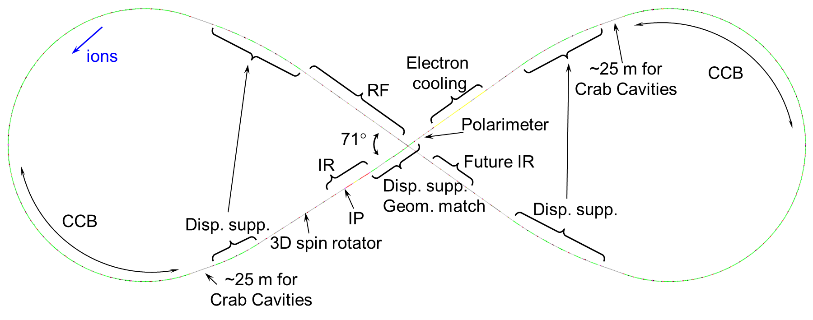
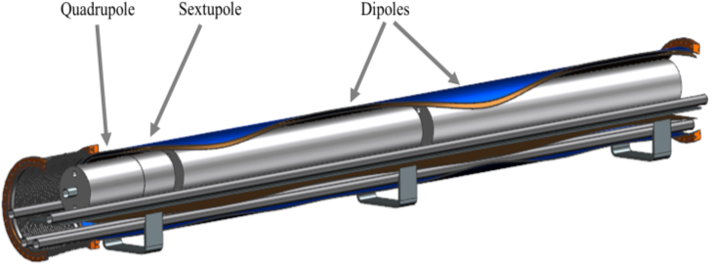
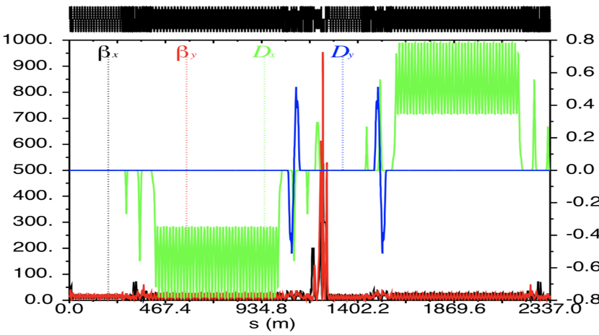
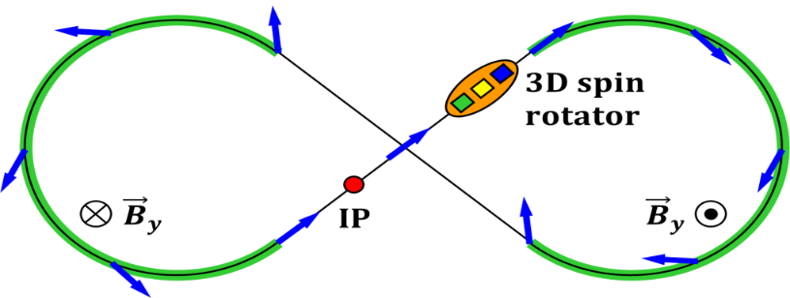
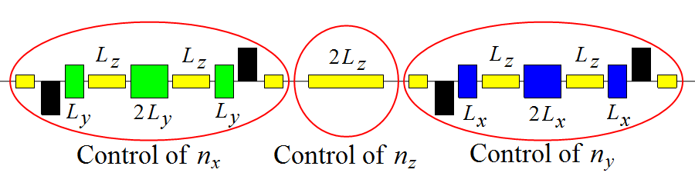
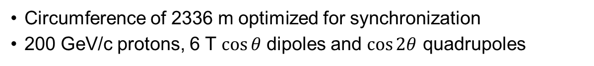
Ion Collider Ring and Ion Beam Polarization
Circumference of 2336 m optimized for synchronization
200 GeV/c protons, 6 T $\cos{θ}$ dipoles and $\cos{2θ}$ quadrupoles
Arc SC magnets: 6 T
Based on the SIS 300 prototype dipole design
SIS 300 prototype dipole
Figure-8 based polarization design
Figure-8: spin precession in one arc is exactly cancelled in the other arc
Polarized deuterons
Spin stabilization by small fields: ~3 Tm vs. < 400 Tm for deuterons at 100 GeV
Frequent adiabatic spin flips
3D spin rotator
Combination of small rotations
Provides any polarization orientation at any point in the collider ring

Slide 12
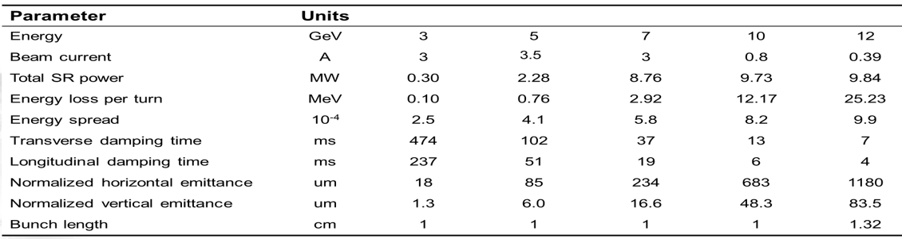
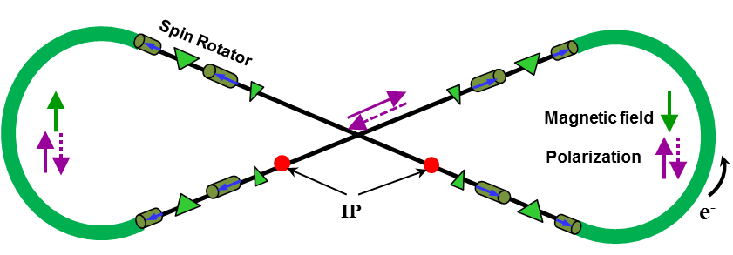
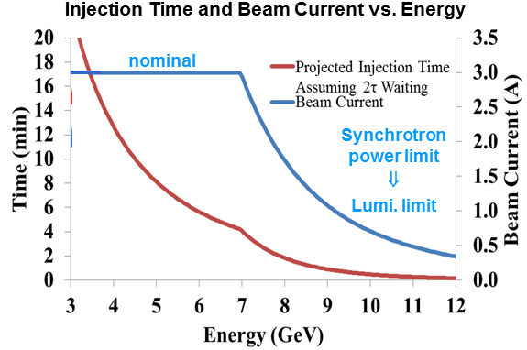
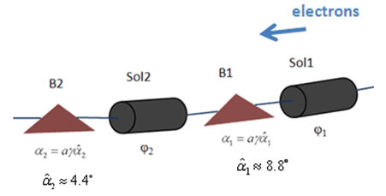


Electron Collider Ring and Electron Polarization
Same footprint as the ion collider ring, energy 3 to 12 GeV
  SR power density up to 10 kW/m, total up to 10 MW
Full energy injection from CEBAF
  New operation mode but no hardware modifications
  Fixed-target program with concurrent JLEIC operations
Electron polarization design
Electron polarization from CEBAF polarized source >85%
Spin-flip: 2 polarized bunch trains maintained by top-off injection
Figure-8 helps maintaining polarization
Minimizes spin diffusion by switching polarization orientation between vertical in arcs and longitudinal in straights
Energy (GeV) | 3 | 5 | 7 | 10
Lifetime (hours) | 66 | 8 | 2.2 | 0.3
Universal spin rotator:
geometry, optics independent of energy
E | Solenoid 1 |  | Dipole set 1 | Solenoid 2 |  | Dipole set 2
 | Spin Rotation | BDL | Spin Rotation | Spin Rotation | BDL | Spin Rotation
GeV | rad | T·m | rad | rad | T·m | rad
3 | π/2 | 15.7 | π/3 | 0 | 0 | π/6
4.5 | π/4 | 11.8 | π/2 | π/2 | 23.6 | π/4
6 | 0.62 | 12.3 | 2π/3 | 1.91 | 38.2 | π/3
9 | π/6 | 15.7 | π | 2π/3 | 62.8 | π/2
12 | 0.62 | 24.6 | 4π/3 | 1.91 | 76.4 | 2π/3
Arc
IP
$$\vec{s}$$
$$\vec{s}$$

Slide 13
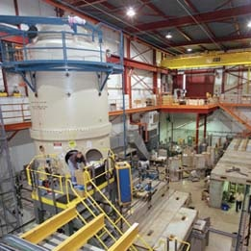
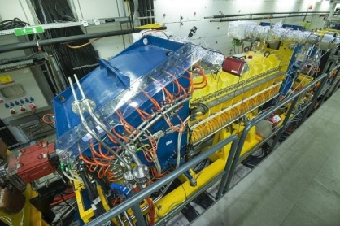
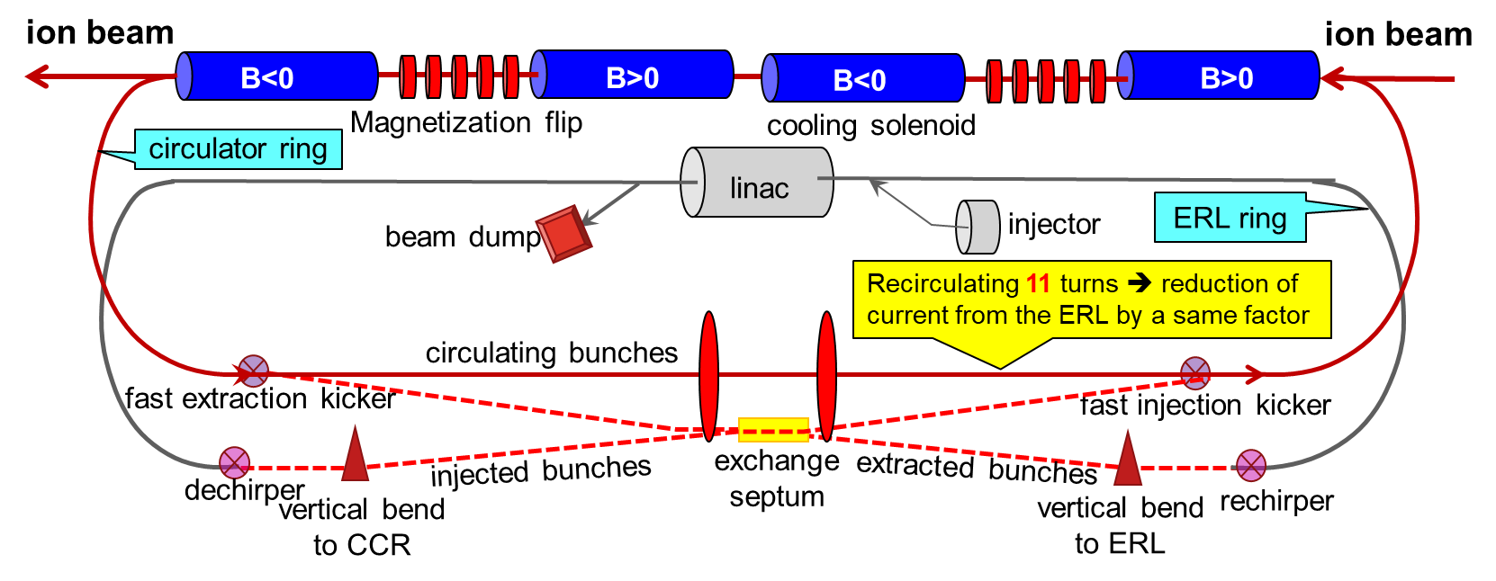
Electron Cooling and ERL Cooler
R. Suleiman, MOZBB5
S. Wijethunga, MOZBB5
Conventional electron cooling
Proved technology but in a new parameter regime
Achieving very small emittance (up to ~10 times reduction) and very short bunch (~2 cm) with SRF
Assisting injection/accumulation of heavy ions
Suppressing IBS induced emittance growth during store of beam
DC Cooler ready
I. Pogorelev, TUYBA6
COSY cooler
2 MV magnetized
Fermilab cooler
4 MV non-magnetized
Multi-phase cooling scheme
High cooling efficiency at low energy and/or low emittance
Pre-cooling at low energy critical for two order of magnitude reduction of total cooling time
High energy cooler: beyond state-of-art
Current: 1.5 A / 3.2 nC (strong cooling/baseline)
Energy: up to 82.5 MeV (must use a RF/SRF linac)
Beam power: up to 124 MW (too big to dump, must ER)
Pre-cool when energy is low
Cool at reduced emittance
(after pre-cool)
Technical approaches
Magnetized cooling (magnetized gun)
Energy recovery (power management)
Circulator ring (current management)
Harmonic kicker to inject/extract from CCR
Ring | Functions | Kinetic energy (GeV / MeV) |  |  | Cooler type
 |  | Proton | Lead ion | Electron
Low Energy Booster | Accumulation of positive ions |  | 0.1 (injection) | 0.054 | DC
High Energy booster | Maintain emitt. during stacking | 7.9 (injection) | 2 (injection) | 4.3 (proton) 1.1 (lead) | DC
 | Pre-cooling for emitt. reduction | 7.9 (injection) | 7.9 (ramp to) | 4.3
collider ring | Maintain emitt. during collision | Up to 150 | Up to 78 | Up to 81.8 | ERL

Slide 14
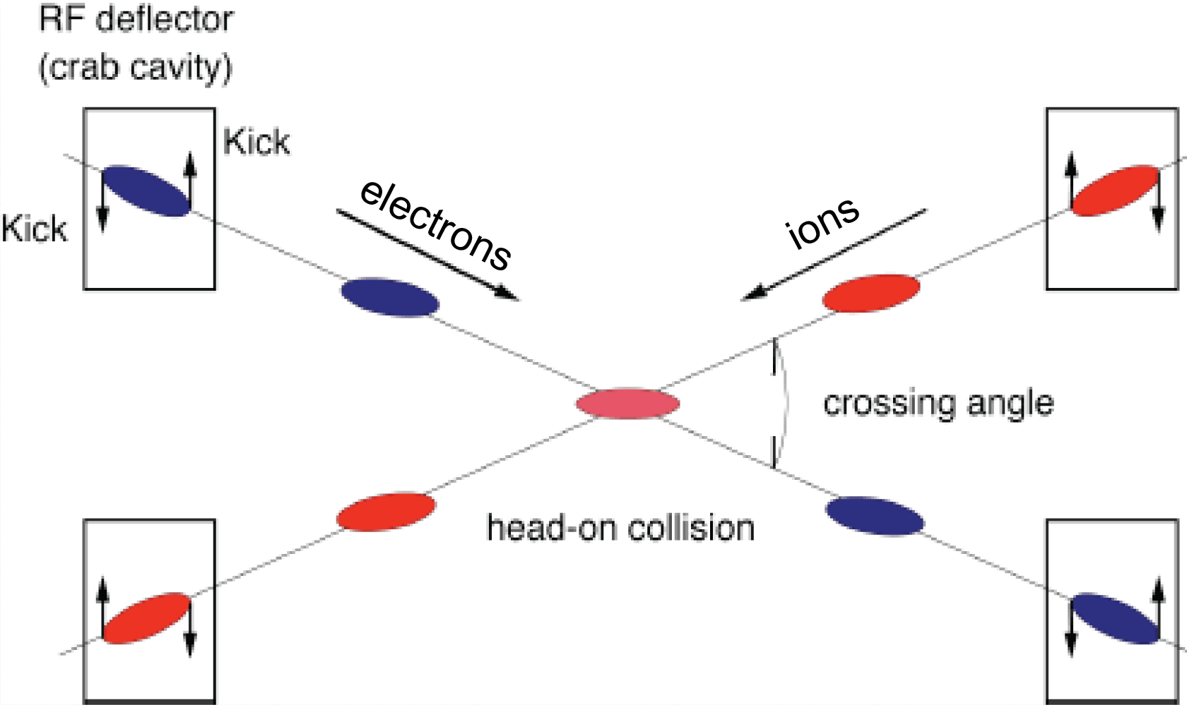
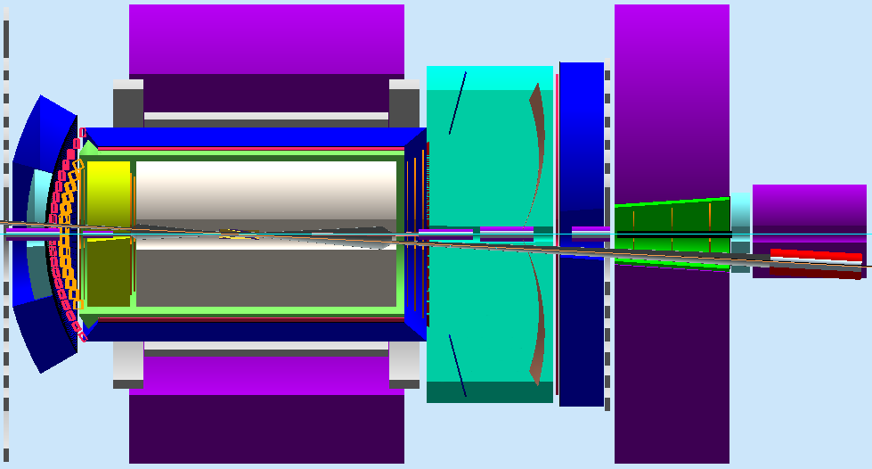
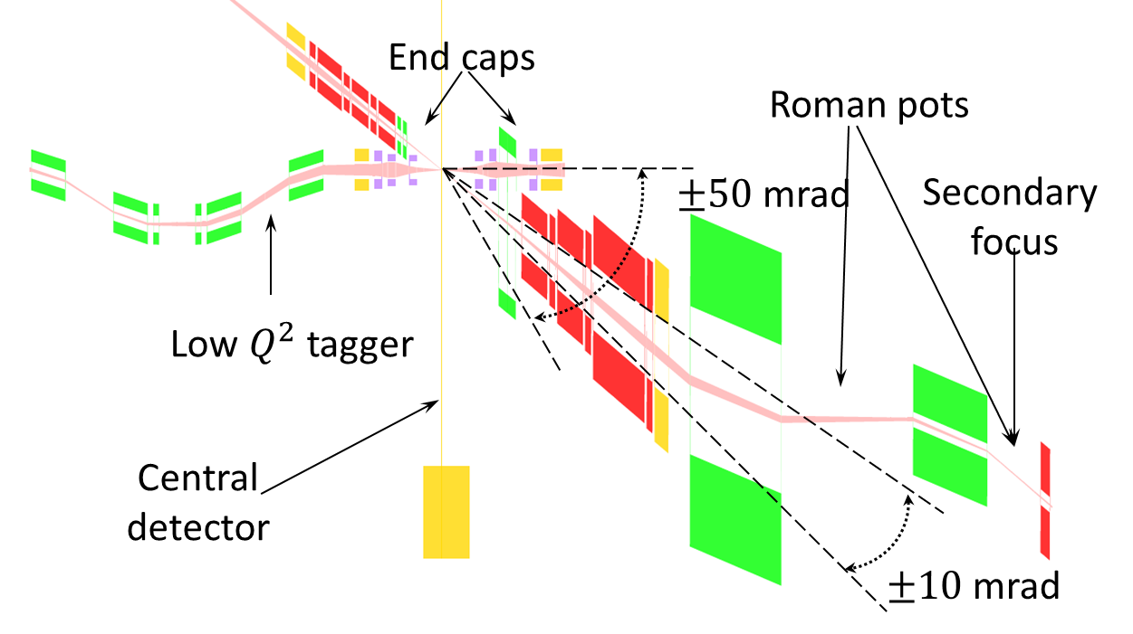





Interaction Region and Machine-Detector Interface
B. Parker, TUZBA2
T. Michalski, TUZBA4
IR designed to support full-acceptance detection ⬅ unprecedented requirement
Satisfy geometric match (elements) and beam dynamics (chromatic compensation)
Crab crossing: large (50 mrad), avoiding parasitic collisions, optimizing detections
crab crossing
Crab crossing
IR Layout
50 mrad
IP
spectrometers
electron
Compton polarimetry
forward e detection
forward ion detection
ions
dispersion suppressor/
geometric match
Central detector/solenoid
Scattered Electron
Central Detector
Ion beamline
Electron beamline
Dipole
Forward (Ion) Detector
Dipole
EIC Detection
Particles Associated
with struck parton
Particles Associated
with Initial Ion

Slide 15
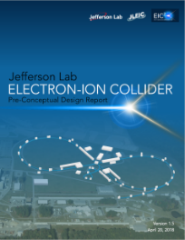
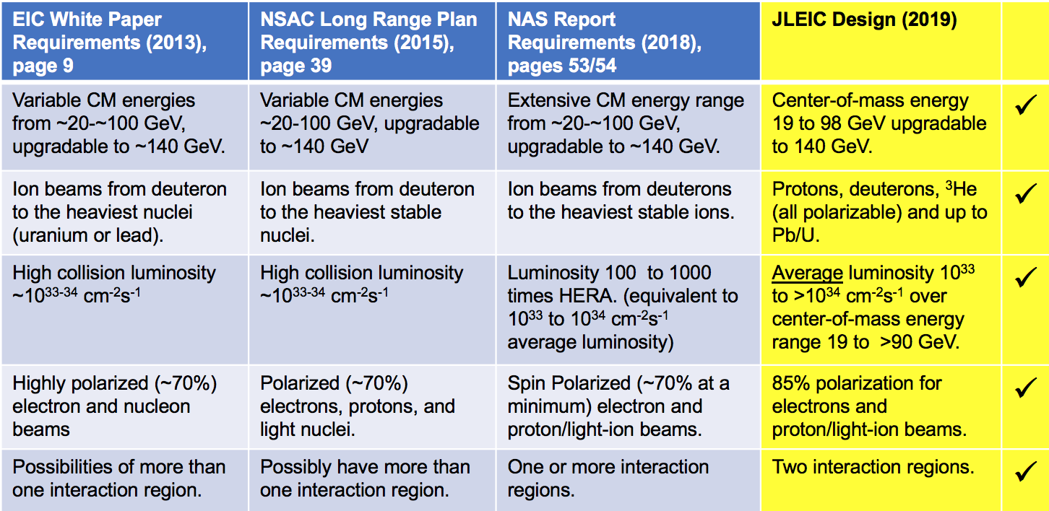
Summary
JLEIC exceeds luminosity, polarization, and detection requirements
JLEIC takes advantage of modern SRF electron linac and a green-field ion complex
Pre-CDR is completed and presently under review
Present focus: design optimization for robustness, risk reduction and cost efficiency,
accelerator R&D

Slide 16
JLEIC Collaboration
For Accelerator and Detector
S. Benson, A. Bogacz, P. Brindza, M. Bruker, A. Camsonne, P. Degtyarenko, E. Daly, Ya. Derbenev, M. Diefenthaler, K. Deitrick, D. Douglas, R. Ent, R. Fair, Y. Furletova, R. Gamage, D. Gaskell, R. Geng, P. Ghoshal, J. Grames, K. Jorden, J. Guo, F. Hanna, L. Harwood, T. Hiatt, H. Huang, A. Hutton, K. Jordan, A. Kimber, D. Kashy, G. Krafft, R. Lessiter, R. Li, F. Lin, M. Mamum, F. Marhauser, R. McKeown, T. Michalski, V. Morozov, E. Nissen, G. Park, H. Park, M. Poelker, T. Powers, R. Rajput-Ghoshal, R. Rimmer, Y. Roblin, T. Satogata, A. Seryi, M. Spata, R. Suleiman, A. Sy, C. Tennant, H. Wang, S. Wang, C. Weiss, M. Wiseman, W. Wittmer, R. Yoshida, H. Zhang, S. Zhang, Y. Zhang – JLab
Y. Nosochkov, G. Stupakov, M. Sullivan, C. Tsai, M. Wang - SLAC J. Qiang, G. Sabbi – LBNL D. Barber – DESY
M. Blaskiewicz, H. Huang, Y. Luo, Q. Wu, F. Willeke – BNL Z. Conway, B. Mustapha, U. Wienands, A. Zholents – ANL
Y. Hao, P. Ostroumov, A. Plastun , R. York - Michigan State Univ. S. Abeyratne, B. Erdelyi - Northern Illinois Univ.,
J. Delayen, C. Hyde, S. De Silva, S. Sosa, B. Terzic - Old Dominion Univ. P. Nadel-Turonski, - Stony Brook Univ.,
J. Gerity, T. Mann, P. McIntyre, N. Pogue, A. Sattarov - Texas A&M Univ. Z. Zhao - Duke Univ.
V. Dudnikov, R. Johnson - Muons, Inc., D. Abell, D. Bruhwiler, I. Pogorelov - Radiasoft, G. Bell, J. Cary - Tech-X Corp.,
A. Kondratenko, M. Kondratenko - Sci. & Tech. Laboratory Zaryad, Russia
Yu. Filatov - Moscow Institute of Physics and Technology, Russia
Y. Huang, X. Ma, L. Mao, Y. Yuan, H. Zhao, H.W. Zhao – IMP, China
Gone but not forgotten
S. Ahmed, K. Beard, A. Castilla, Y. Chao, P. Chevtsov, L. Merminga, F. Pilat, H. Sayed, G. Wei, B. Yunn,

Slide 17
JLEIC Talks/Posters in this NAPAC
Monday
Electron-Ion Accelerator Designs, by A. Seryi (JLab) MOOHC2
JLEIC: A High Luminosity Polarized Electron-Ion Collider at Jefferson Lab, by Y. Zhang (JLab) MOYBA3
Magnetized Electron Source for JLEIC Electron Cooler, by R. Suleiman (JLAB) MOZBB5
Tuesday
EIC Machine Detector Interface, by B. Parker (BNL) TUZBA2
A High-Energy Design for JLEIC Ion Complex, by B. Mustapha (ANL) TUZBA3
Interaction Region Magnets for Future Electron-Ion Collider at Jefferson Lab, by T. Michalski (JLab) TUZBA4
Computation of Magnetized Dynamic Friction Force Based on a Reduced Binary Interaction Model, by I.V. Pogorelov (RadiaSoft) TUYBA6
Space Charge Study of the Jefferson Lab Magnetized Electron Beam, by S. Wijethunga (ODU) TUZBB4
Friday
Review of Recent Advances in Cooling Techniques, by S. Nagaitsev (FNAL) FRXBA1

Slide 19
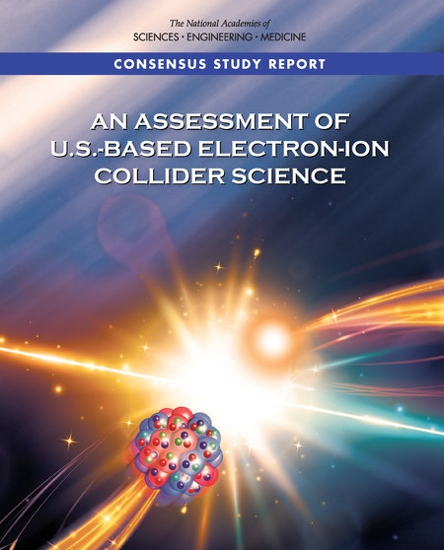
EIC Science Assessments by US NAS
Finding 1: (Science) An EIC can uniquely address three profound questions about nucleons—neutrons and protons—and how they are assembled to form the nuclei of atoms:
How does the mass of the nucleon arise?
How does the spin of the nucleon arise?
  What are the emergent properties of dense systems of gluons?
Finding 2: (Accelerator) These three high-priority science questions can be answered by an EIC with highly polarized beams of electrons and ions, with sufficiently high luminosity and sufficient, and variable, center-of-mass energy.
Finding 3: An EIC would be a unique facility in the world, and would maintain U.S. leadership in nuclear physics.
Finding 4: An EIC would maintain U.S. leadership in the accelerator science and technology of colliders, and help to maintain scientific leadership more broadly.
Finding 5: Taking advantage of existing accelerator infrastructure and accelerator expertise would make development of an EIC cost effective and would potentially reduce risk.
Finding 6: The current accelerator R&D program supported by the Department of Energy is crucial to addressing outstanding design challenges.
Finding 7: To realize fully the scientific opportunities an EIC would enable, a theory program will be required to predict and interpret the experimental results within the context of QCD, and further, to glean the fundamental insights into QCD that an EIC can reveal.
Finding 8: The U.S. nuclear science community has been thorough and thoughtful in its planning for the future, taking into account both science priorities and budgetary realities. Its 2015 Long Range Plan identifies the construction of a high luminosity polarized Electron Ion Collider (EIC) as the highest priority for new facility construction following the completion of the Facility for Rare Isotope Beams (FRIB) at Michigan State University.
Finding 9: The broader impacts of building an EIC in the U.S. are significant in related fields of science, including in particular the accelerator science and technology of colliders and workforce development.
“In summary, the committee finds a compelling scientific case for such a facility. The science questions that an EIC will answer are central to completing an understanding of atoms as well as being integral to the agenda of nuclear physics today. In addition, the development of an EIC would advance accelerator science and technology in nuclear science; it would as well benefit other fields of accelerator based science and society, from medicine through materials science to elementary particle physics.”

Slide 20
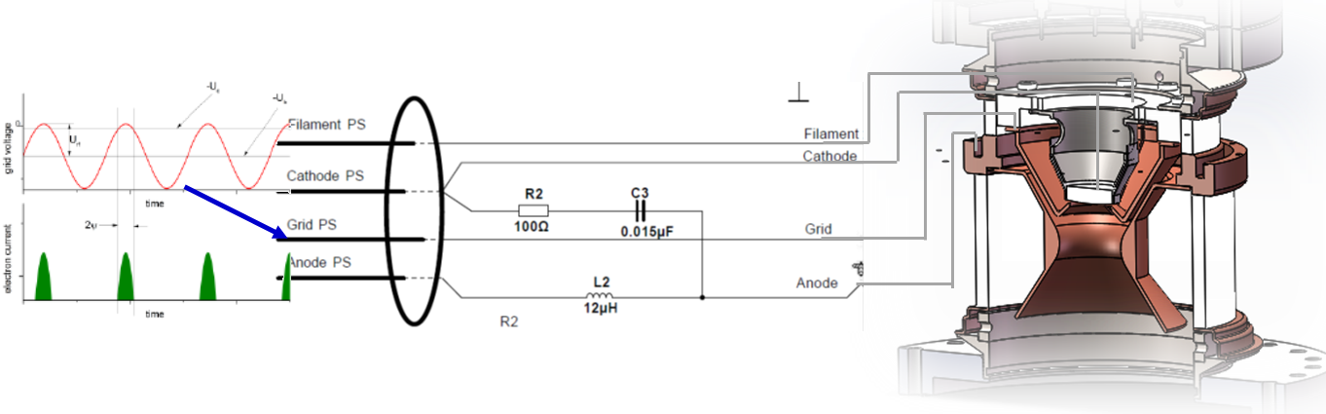
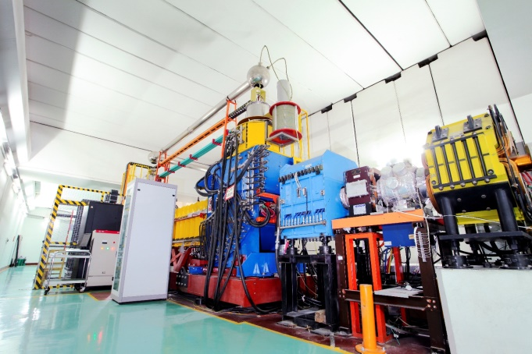
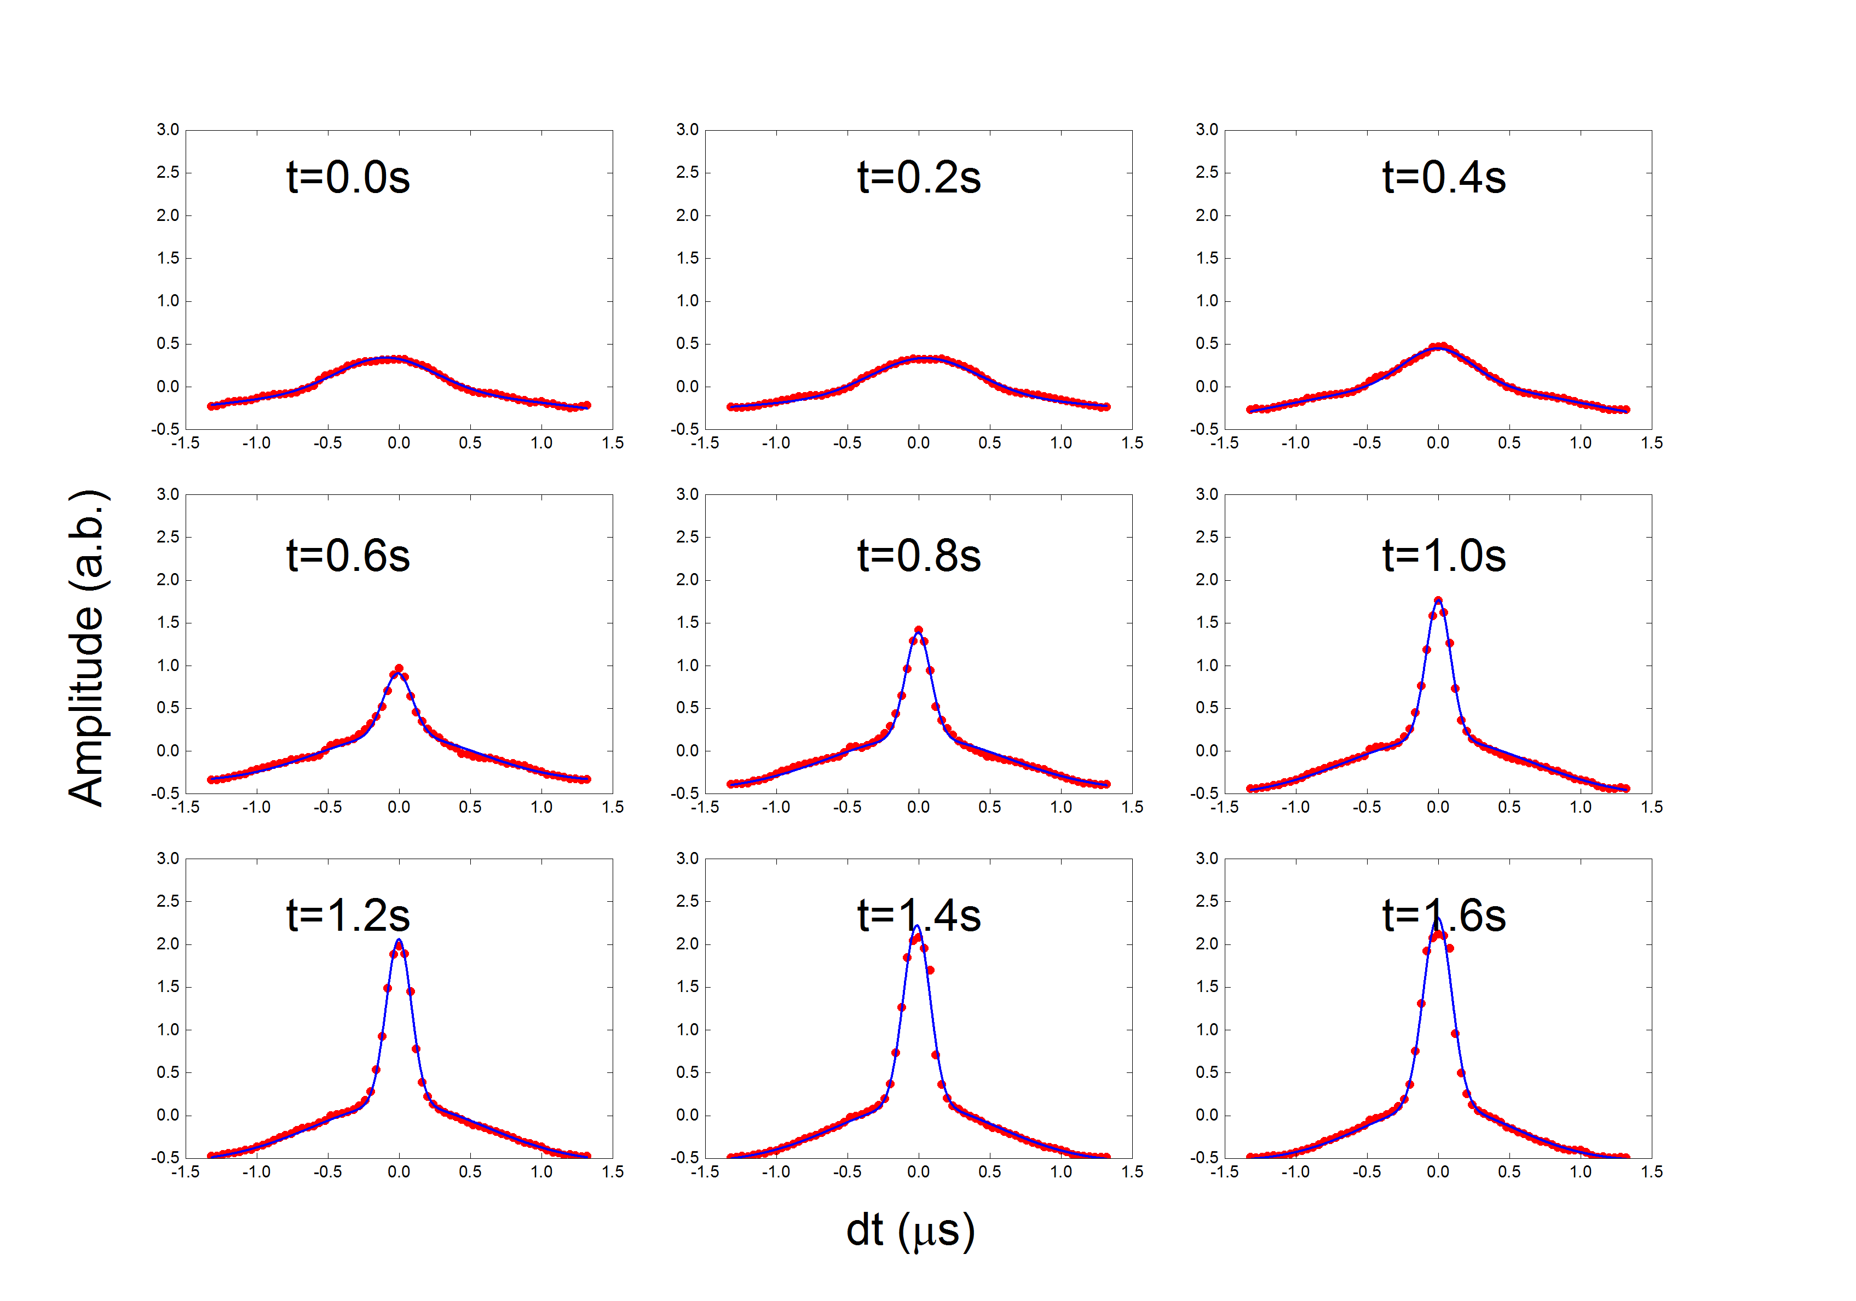
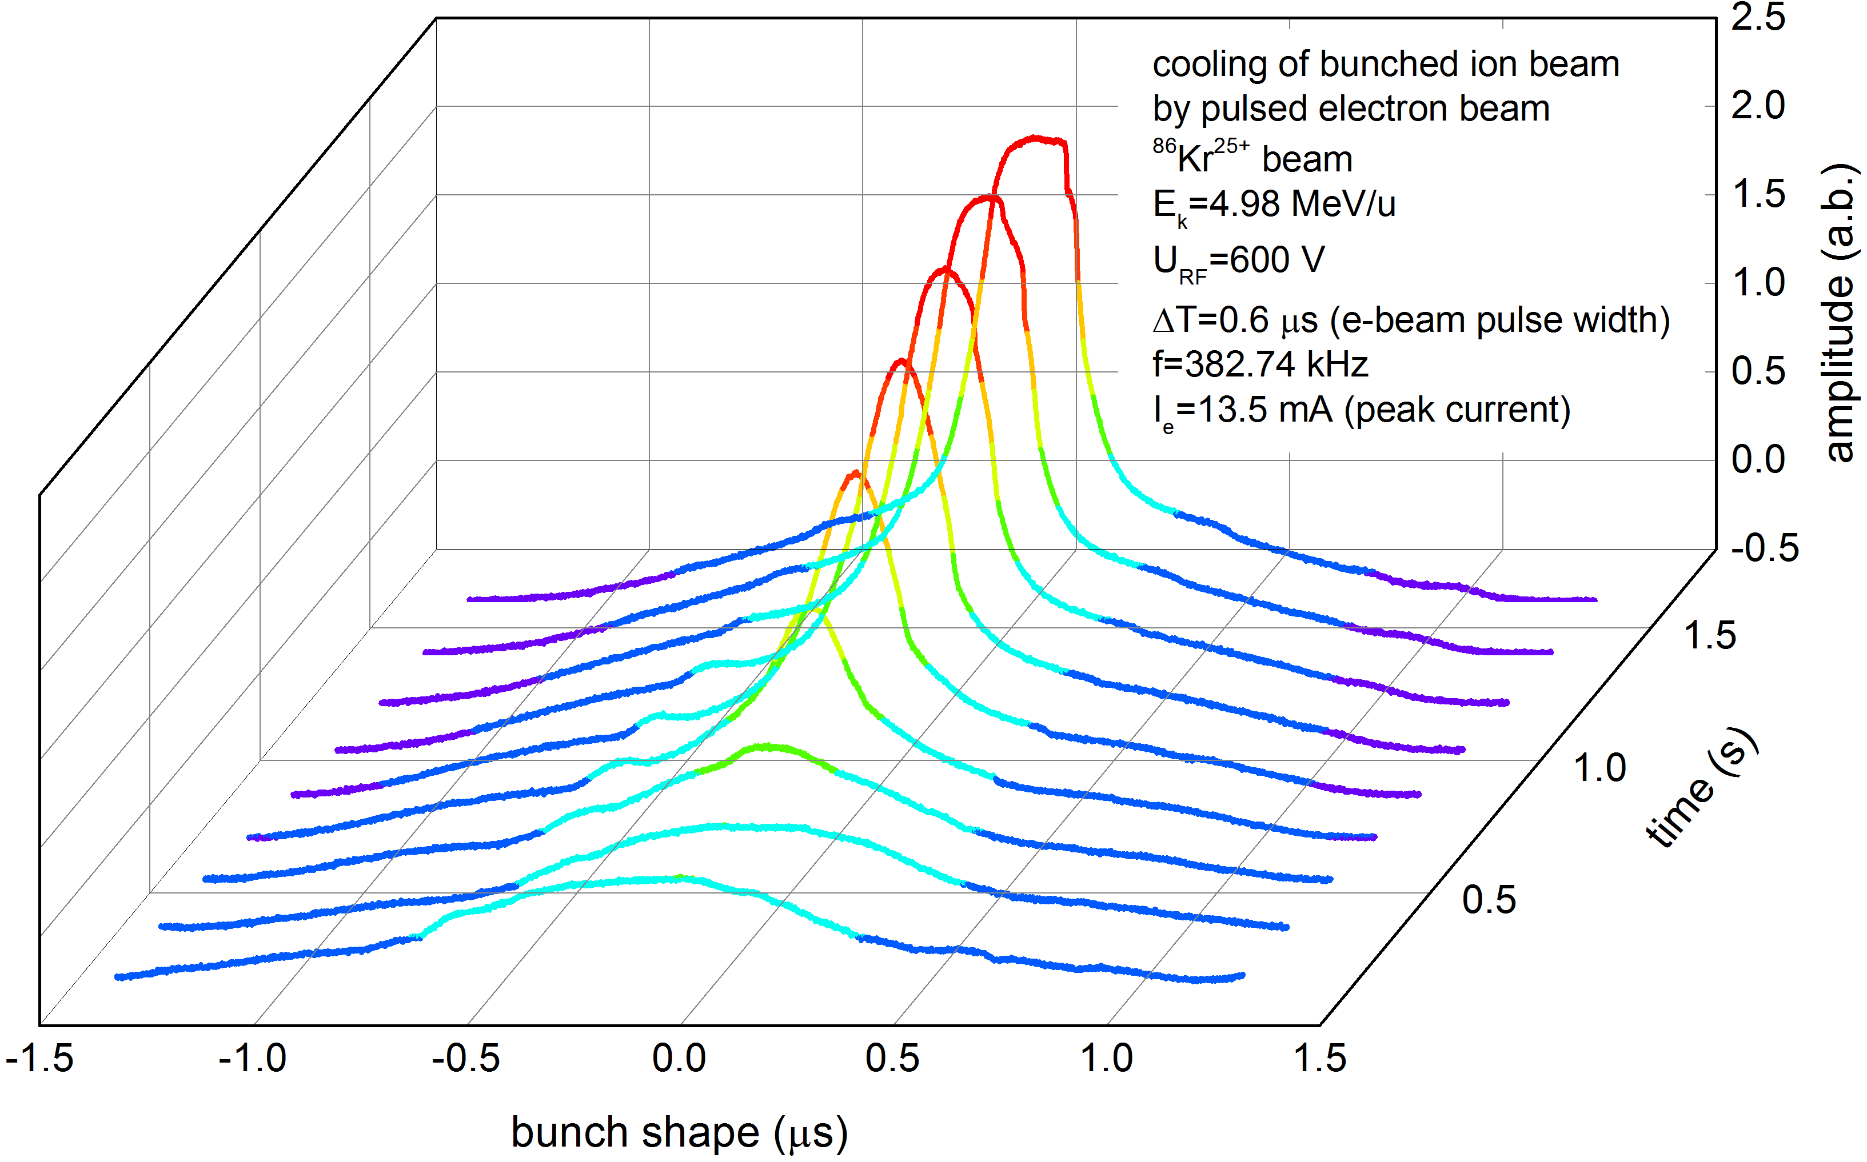
Demonstration of Cooling of Ions by a Bunched e-Beam
JLab-IMP Collaboration
Using a DC cooler to demonstrate cooling by a bunched electron beam
Pulsed electron beam from a thermionic gun by switching on/off the grid electrode
1st Experiments performed on 4/2016, follow-up experiment on 4/2017, 12/2018
thermionic gun
A DC electron cooler at Institute of Modern Physics, China
Ion | ⁸⁶Kr²⁵⁺
Energy (i/e) | 5 MeV/u & 2.7 KeV
Ion bunches | 2
RF voltage | 600 V
Stored ions | ~10⁸
Anode voltage | 400 V, 600 V, 800 V
Pulse width | 300 ns to 1200 ns
Transverse cooling
Longitudinal cooling (reduction of bunch length)

Slide 21
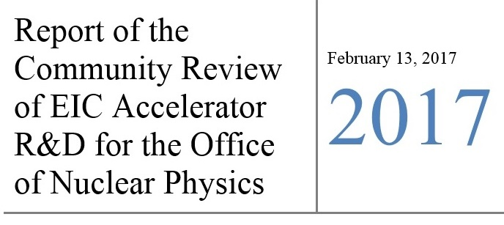
EIC R&D at Jefferson Lab with Collaborations
High-Priority EIC R&D topics defined by a community review panel (Jones panel)
Accelerator R&D funded by NP – FY17, completed
  Crab system design and experimental test
  Electron cooler design
  IR magnet design
  Simulation software development
Accelerator R&D fund by FY18-19
  Crab cavity operation in a hadron ring (BNL, JLab, ODU)
  Strong hadron cooling
    Development of innovative high-energy magnetized electron cooling for an EIC (BNL, FNAL, JLab, ODU)
    Strong hadron cooling with micro-bunched electron beams (ANL, BNL, JLab, SLAC)
  Magnet design
    High Gradient Actively Shielded Quadrupole (BNL, JLab, LBNL)
    Validation of EIC IR magnet parameters and requirements using existing magnet results (JLAB, LBNL, SLAC)
  Benchmarking of EIC simulations
    Development & test of simulation tools for EIC beam-beam interaction (BNL, JLab, LBNL MSU)
    Experimental verification of spin transparency mode in an EIC (BNL, JLab)
  Electron complex
    High Bandwidth Beam Feedback Systems for a High Luminosity EIC (ANL, JLab)
Jones panel report

