Slide 1
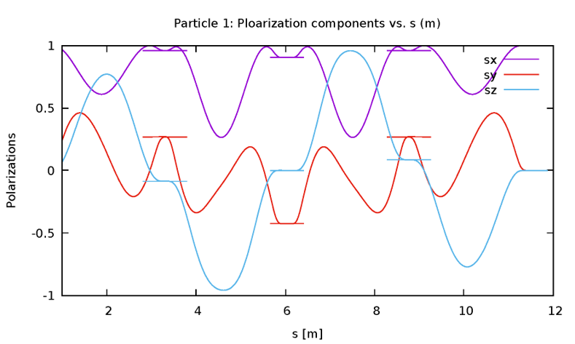
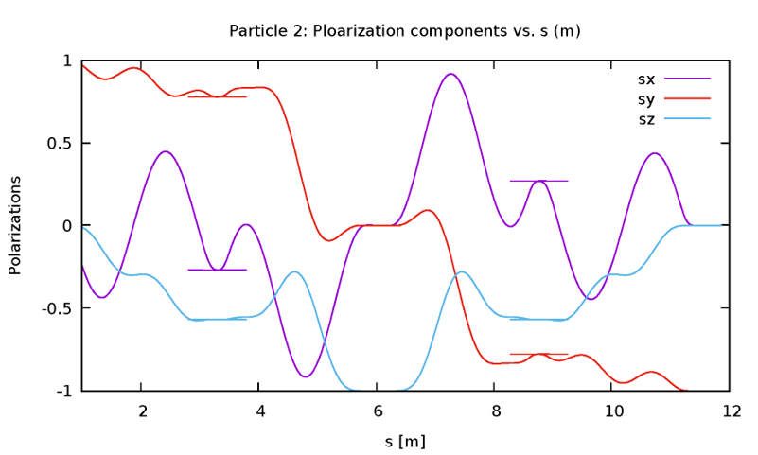
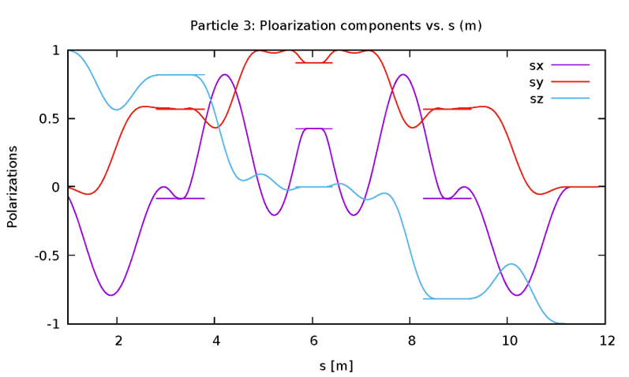
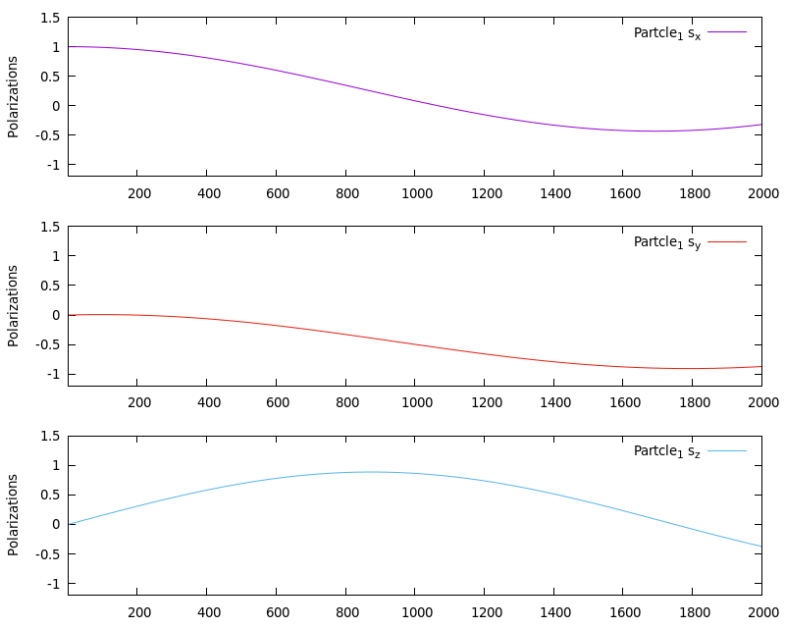
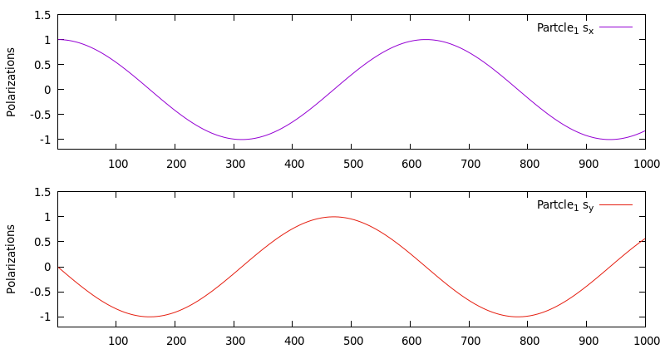
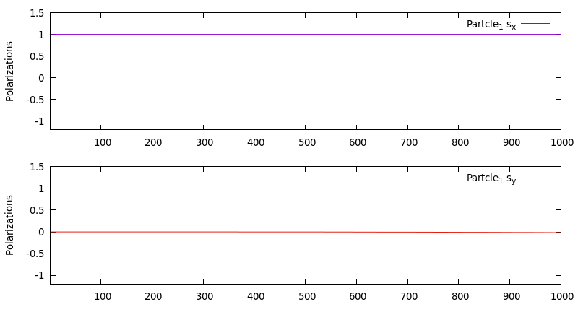
SIMULATION OF TRANSPARENT SPIN EXPERIMENT IN RHIC
H. Huang, V.S. Morozov, F. Lin, Y. Zhang, Ya.S. Derbenev, Jefferson Lab. USA
A.M. Kondratenko, M.A. Kondratenko, Sci. & Tech. Laboratory Zaryad, Novosibirsk, Russia
Yu.N. Filatov, MIPT, Dolgoprudniy, Moscow Region, Russia
P. Adams, H.X. Huang, F. Meot, V. Ptitsyn, W. Schmidke, BNL, Upton, NY, USA
Sci. & Tech. Lab. Zaryad
ABSTRACT
The transparent spin mode has been proposed as a new technique for preservation and control of the spin polarization of ion beams in a synchrotron. The ion rings of the proposed Jefferson Lab Electron-Ion Collider (JLEIC) adopted this technique in their figure-8 design. The transparent spin mode can also be setup in a racetrack with two identical Siberian snakes. There is a proposal to test the predicted features of the spin transparent mode in Relativistic Heavy Ion Collider (RHIC), which already has all of the necessary hardware capabilities. We have earlier analytically estimated the setup parameters and developed a preliminary experimental plan. In this paper we describe simulation setup and benchmarking for the proposed experiment using a Zgoubi model of RHIC.
NUMERICAL RESULTS
We use Zgoubi to simulate some of the TS mode features in RHIC lattice.
Case-1: In a principle scheme of RHIC snake (OPERA maps), two currents control the spin rotation angle and the spin rotation axis. By tracking three particles with orthogonal spins in Zgoubi, we determine the spin rotation angle and axis for a given set of snake currents. The snake currents are then varied using a fitting procedure to adjust the snake axis to 0°. The evolutions of the spin components along the helical trajectories are shown below.
The simulation in the above figure indicates a full snake with a longitudinal axis: the radial and vertical spins flip while the longitudinal spin remains longitudinal.
Case 2: The spin motion is governed by a lattice design. As a sanity check, we introduce an ideal lattice with the Siberian snakes modeled as thin spin rotators. When the snake axes are parallel, the spin tune is zero, which means the spin components do not change from turn to turn. However, an initial simulation showed a small but noticeable unphysical spin rotation about the vertical axis. It can be seen from the oscillations of the longitudinal S_{x} and radial S_{y} spin components in the figures below.
We solved this problem by precisely adjusting the total bending angle of all of the dipole magnets to $2π$. After our calibration, we observe that the RHIC ring is spin transparent: S_{x} and S_{y} are constant from turn to turn with a good numerical precision as shown below.
Case-3: We next introduced random transverse quadrupole misalignments $Δy$ and dipole roll $Δφ$ with rms magnitudes that provide 0.2 mm vertical closed orbit distortion according to a statistical model prediction. The radial y and vertical z closed orbit excursions for 10 different random seeds are shown in the figure below. Averaging over all seeds gives a rms vertical closed orbit excursion of about 0.18 mm.
Case-4: After introducing the above rms $Δy$ and $Δφ$ we determine the spin resonance strength by tracking a particle with initially longitudinal spin for 2000 turns. The particle spin processes about the spin field direction at a rate determined by the transparent spin resonance strength. An inverse of the number of turns it takes the spin to make one full oscillation is the resonance strength. The spin field direction and the resonance strength are obtained by fitting the data in the below figure to offset sine waves. The frequency of the sine wave gives the resonance strength and the offsets provide the spin field direction. The obtained resonance strength of $3.0∙{10}^{−4}$ is consistent with the theoretical prediction of $3.2⋅{10}^{−4}$. The spin field $\vec{n}=(0.53, −0.84, 0.08)$ is nearly horizontal as expected.
MOTIVATION
For Electron Ion Collider (EIC), the high electron and ion polarizations are some of the key requirements [1]. It also requires both longitudinal and transverse polarization orientations available at all interaction points (IPs), a sufficiently long polarization lifetime, and spin flipping. As a novel technique, the transparent spin (TS) mode makes the ring lattice “invisible” to the spins and allows for polarization control by small magnetic fields just slightly breaking this spin motion degeneracy. The TS mode offers unique opportunities for design of electron and ion polarization dynamics in JLEIC and electron polarization dynamics in Brookhaven’s eRHIC [2-5]. Considering all technical capabilities and investigating the current existing colliders, RHIC is a perfect place for an experimental test of the TS mode because it requires no new hardware. Making the snake axes parallel at 0° will set RHIC in the spin transparency mode. This adjustment yields minimum field integral, minimum orbit excursion and requires no flip of the field sign and power supply polarities. The snake currents can be changed dynamically at 1 A/s. The existing polarimeter can provide a fast polarization measurement. Only relative measurement is needed.
MODEL OF TRANSPARENT SPIN MODE
The rms strength of the spin resonance due to 𝑄 uncorrelated segments of length 𝑙_{𝑘} with radial fields $h_{k}≡h_{x}(z_{k})$ normalized to 𝐵𝜌/𝑅 where 𝑅 is the average radius for circumference 𝐶=2𝜋𝑅 is
$$\overline{{{|ω}_{coh}|}^{2}}={\left(γG\right)}^{2}\sum_{k=1}^{Q}{{\left(\frac{l_{k}}{C}\right)}^{2}\overline{h_{k}^{2}} {\left|F_{k}\right|}^{2}}$$
where F_{k} is spin response function. The rms vertical excursion of the closed orbit is
$$\overline{y^{2}(z)}=\frac{π^{2}β_{y}(z)}{2\sin^{2}{πν_{y}}}\sum_{k=1}^{Q}{{\left(\frac{l_{k}}{C}\right)}^{2}\overline{h_{k}^{2}} β_{k}}$$
For the expected closed orbit excursion, one can estimate the expected coherent component of the zero-integer spin resonance strength. The total zero-integer spin resonance strength includes two parts, the coherent part and the incoherent part: $ω=ω_{coherrent}+ω_{emittance}$.
The spin stability criterion is that the spin tune induced by a spin rotator must significantly exceed the strength of the incoherent part of the zero-integer spin resonance. In our simulation, the absolute value of the coherent part of the ST-resonance strength |𝜔_{coh}| for RHIC’s injection lattice is evaluated based on the statistical model:
$$|ω_{coh}| =\sqrt{\frac{1}{4π^{2}}\sum_{elements}{\overline{∆B_{x}^{2}}{|F|}^{2}L_{x}^{2}}}$$
where 𝐿_{𝑥} is the element’s length and $\overline{∆B_{x}^{2}}$ is the square of the rms error of the element’s radial magnetic field. $\overline{∆B_{x}^{2}}$ depends on transverse quadrupole misalignments $Δy$ and dipole roll $Δφ$ [4].
CONCLUSIONS
The spin tracking validates the polarization control parameters for the transparent spin experiment in RHIC. We adjusted the snake axes and corrected their orbital effect. Thus, we obtained an accurate model of RHIC’s ring with the snakes specified by field maps. Random quadrupole misalignments and dipole roll were introduced in RHIC’s lattice. A closed orbit was determined and the transparent spin resonance strength was obtained by spin tracking. Both the rms closed orbit and resonance strength are consistent with the statistical model predictions reported earlier [3,4].
REFERENCE
Ya.S. Derbenev, A.M. Kondratenko, A.N. Skrinsky, “Particle spin motion in storage ring with arbitrary field”, Dokl. Akad. Nauk SSSR, v.192, p.1255(1970) [Sov. Phys. Dokl., v.15, p.583 (1970)].
F. Lin, et al, “Study of electron polarization dynamics in the JLEIC at JLab”, in Proc. of IPAC2017, Copenhagen, Denmark, WEPIK114, p. 3218
V.S. Morozov et al, “Experimental Verification of Transparent Spin Mode in RHIC”, in Proc. of IPAC2019, Melbourne, Australia, WEPGW122, p. 2783.
A.M. Kondratenko, M.A. Kondratenko, et al, “Spin Response Function for Spin Transparency Mode of RHIC”, in Proc. of IPAC2019, Melbourne, Australia, WEPGW124, p. 2791.
V.S. Morozov et al, “Theoretical and Experimental Study of the Spin Transparency Mode in an EIC”, Proposal supported by the U.S. DOE under Contracts No. DE-AC05- 06OR23177 and DE-AC02-98CH10886.
ACKNOWLEDGMENTS
Work supported by the U.S. DOE under Contracts No. DE-AC05- 06OR23177 and DE-AC02-98CH10886.

