Slide 1

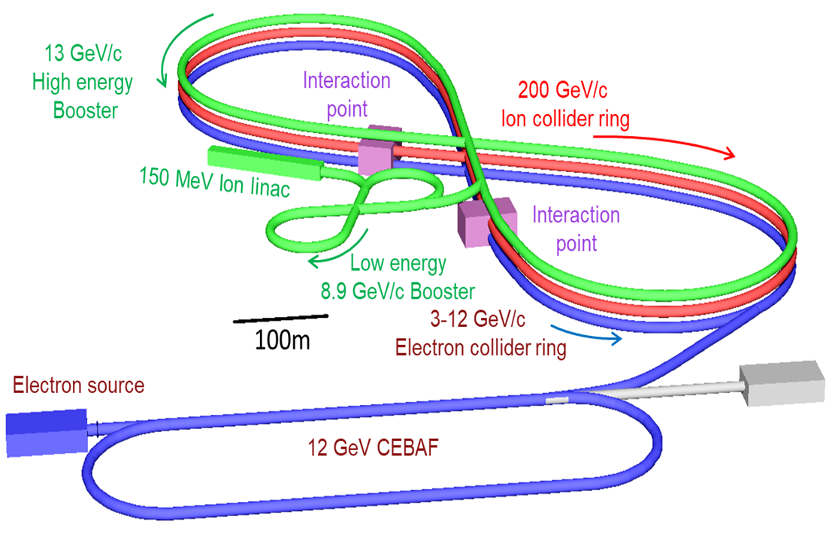


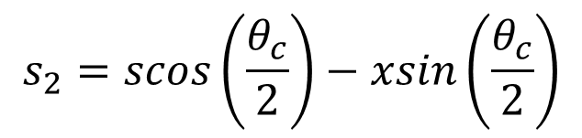
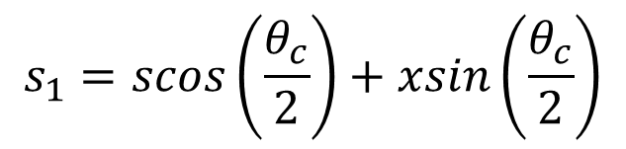
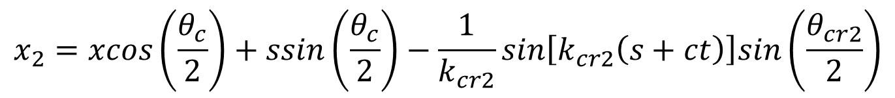
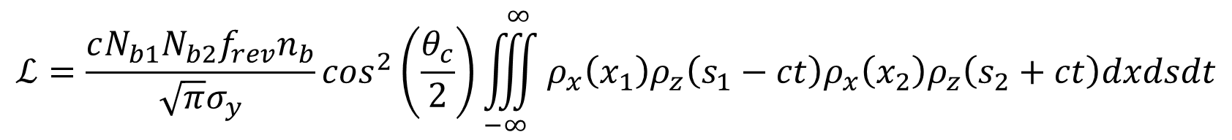
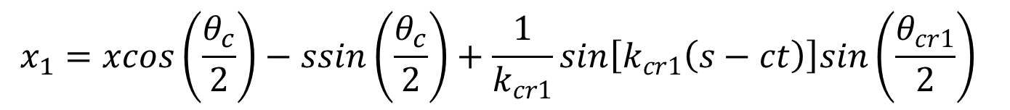

WEPTS082
Luminosity Studies of Asymmetric Crab Crossing in JLEIC*
E. Nissen
Thomas Jefferson National Accelerator Facility
Newport News, Virginia, USA
Managed by the Jefferson Science Associates,
LLC for the U.S. Department of Energy Office of Science
Abstract
The proposed Jefferson Lab Electron Ion Collider (JLEIC) currently plans to use a crab crossing scheme to maximize the available luminosity. It had been suggested that space and cost savings, as well as hadron beam quality improvements, could be realized by leaving the ion beam un-crabbed and increasing the crabbing angle of the electron beam. This and variations in-between equal and totally one-sided crabbing are examined for both JLEIC and LHC parameters, with various changes in crabbing angle and frequency studied to maximize luminosity.
The Proposed JLEIC Complex
The Model in Use
The JLEIC Case
This system makes use of a previously developed model for the luminosity of a crabbed beam, but in this case we change the parameters such that the crabbing can be different in each beam. θ_{c} is the crossing angle and θ_{cr1} and θ_{cr2} are the crabbing angles for bunches 1 and 2 respectively. The terms k_{cr1} and k_{cr2} are the wave numbers for the crabbing cavities for bunches 1 and 2 respectively.
 | Value
N_{b1} | 0.98x10¹⁰
N_{b2} | 0.93x10¹⁰
θ_{c} | 25 mr
f_{crab} | 952.6 MHz
σ_{x}, σ_{y} | 30 μm
σ_{z} | 1 cm
$$x_{1}=xcos\left(\frac{θ_{c}}{2}\right)−ssin\left(\frac{θ_{c}}{2}\right)+\frac{1}{k_{cr1}}sin\left[k_{cr1}\left(s−ct\right)\right]sin\left(\frac{θ_{cr1}}{2}\right)$$
Luminosity (m⁻²s⁻¹)
$$x_{2}=xcos\left(\frac{θ_{c}}{2}\right)+ssin\left(\frac{θ_{c}}{2}\right)−\frac{1}{k_{cr2}}sin\left[k_{cr2}\left(s+ct\right)\right]sin\left(\frac{θ_{cr2}}{2}\right)$$
$$s_{1}=scos\left(\frac{θ_{c}}{2}\right)+xsin\left(\frac{θ_{c}}{2}\right)$$
Crabbing Angle (fraction of θ_{c}/2)
$$s_{2}=scos\left(\frac{θ_{c}}{2}\right)−xsin\left(\frac{θ_{c}}{2}\right)$$
$$ρ_{q}\left(q\right)=\frac{1}{σ_{q}\sqrt{2π}}e^{−\frac{q^{2}}{2σ_{q}^{2}}}$$
JLEIC uses very short bunches with a large crossing angle of 25 mr. As a result the peak of partial crabbing would still be a 2/3 reduction in the total luminosity.
$$ℒ=\frac{cN_{b1}N_{b2}f_{rev}n_{b}}{\sqrt{π}σ_{y}}\cos^{2}\left(\frac{θ_{c}}{2}\right)\iiint_{−∞}^{∞}{ρ_{x}\left(x_{1}\right){ρ_{z}\left(s_{1}−ct\right)ρ}_{x}\left(x_{2}\right)ρ_{z}\left(s_{2}+ct\right)dxdsdt}$$
Crabbing Angle (fraction of θ_{c}/2)
Crabbing Angle (fraction of θ_{c}/2)
The LHC 400 MHz Case
The LHC 800 MHz Case
 | Value
N_{b1} | 1.15x10¹¹
N_{b2} | 1.15x10¹¹
θ_{c} | 0.285 mr
f_{crab} | 800 MHz
σ_{x}, σ_{y} | 17 μm
σ_{z} | 7.55 cm
 | Value
N_{b1} | 1.15x10¹¹
N_{b2} | 1.15x10¹¹
θ_{c} | 0.285 mr
f_{crab} | 800 MHz
σ_{x}, σ_{y} | 17 μm
σ_{z} | 7.55 cm
Luminosity (m⁻²s⁻¹)
Luminosity (m⁻²s⁻¹)
Crabbing Angle (fraction of θ_{c}/2)
Crabbing Angle (fraction of θ_{c}/2)
In the LHC 400 MHz regime we can actually get a peak with a slight overcrabbing of the beam. In this case the bunches are very long, and the crossing angle is small, so we don’t see major changes in the luminosity with different values of the crabbing angle.
The 800 MHz crabbing of the LHC system shows a lower overall luminosity than the 400 MHz, this is due to the way that the ends of the bunch are shaped by the crabbing cavity. However this shaping does increase the total amount of overcrabbing for peak luminosity than that seen in the 400 MHz LHC or in JLEIC.
Crabbing Angle (fraction of θ_{c}/2)
Crabbing Angle (fraction of θ_{c}/2)
Crabbing Angle (fraction of θ_{c}/2)
Crabbing Angle (fraction of θ_{c}/2)
*Authored by Jefferson Science Associates, LLC under U.S. DOE Contract No. DE-AC05-06OR23177. The U.S. Government retains a non-exclusive, paid-up, irrevocable, world-wide license to publish or reproduce this manuscript for U.S. Government purposes.

