Slide 1




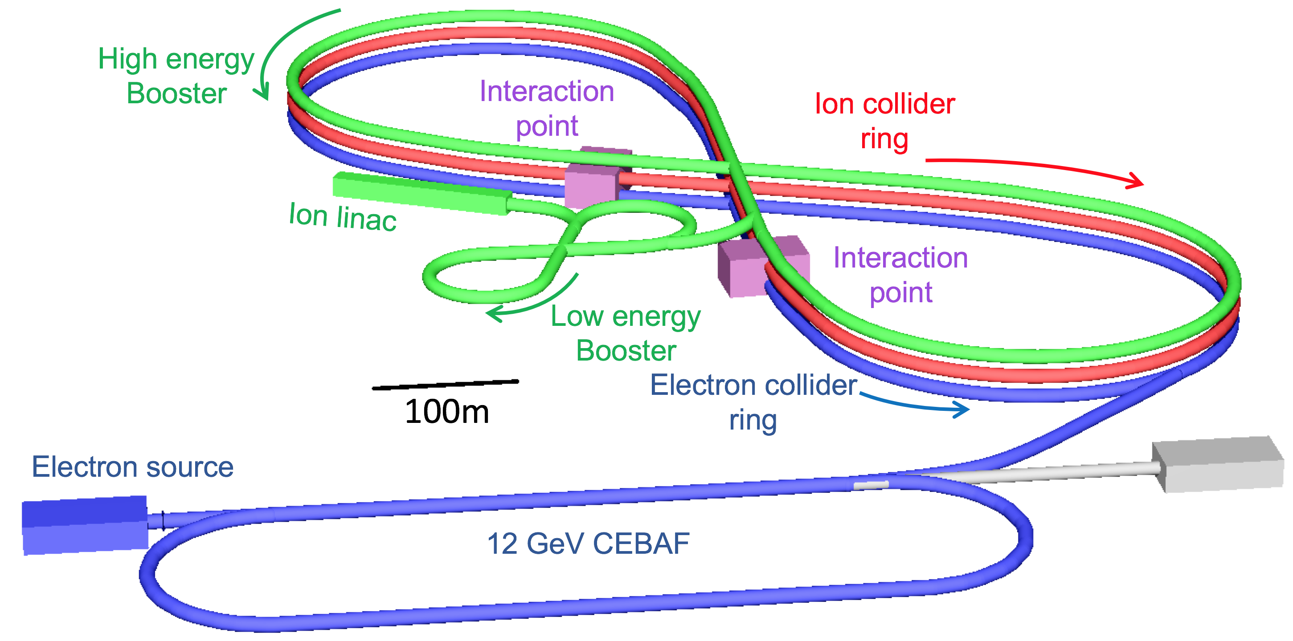
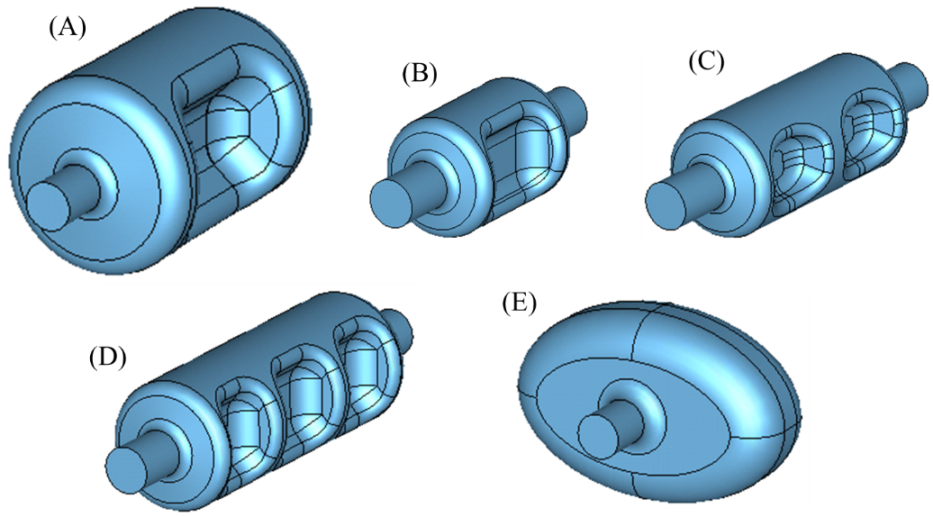
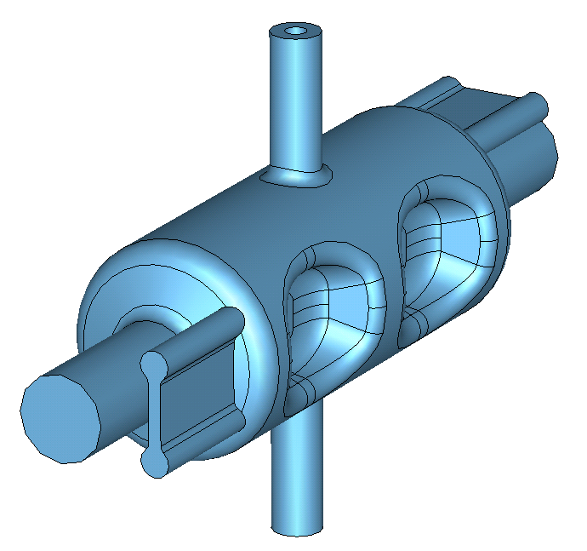
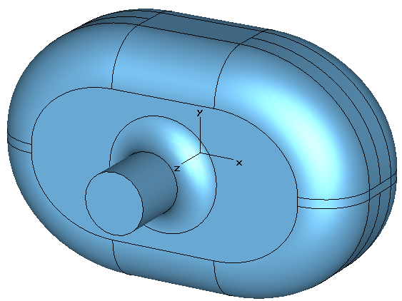

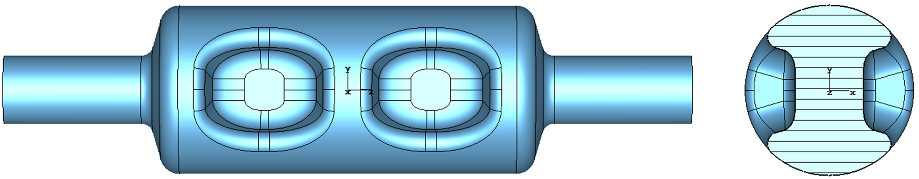
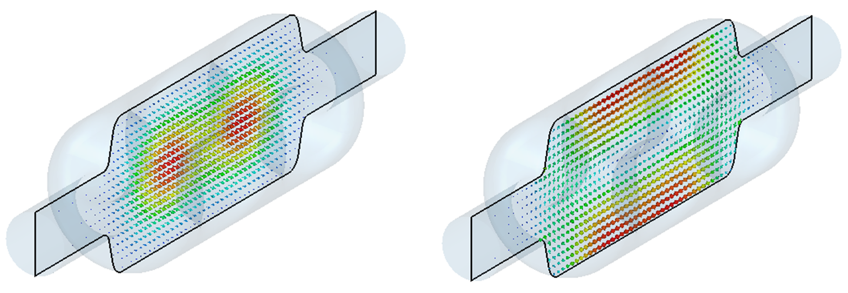
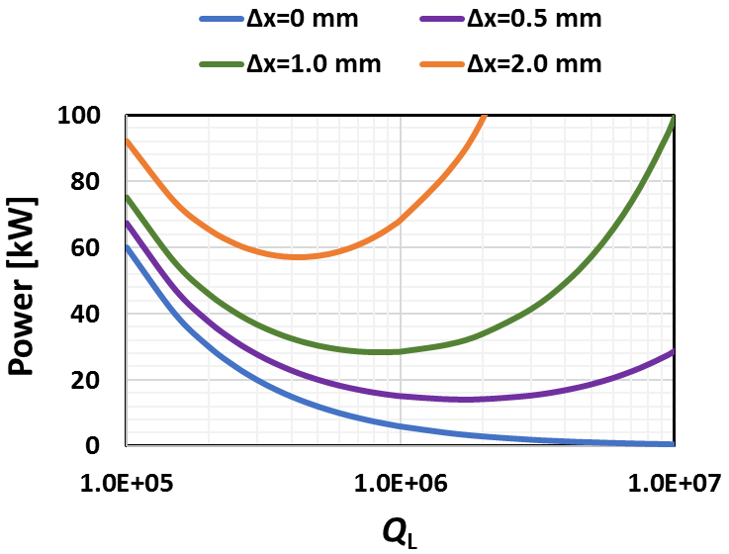
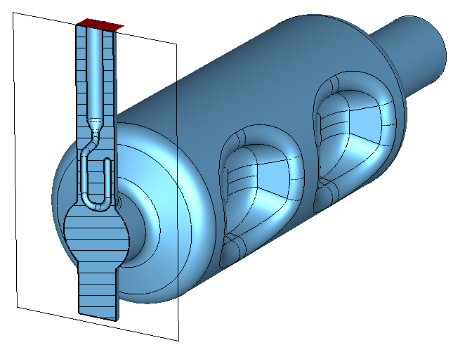
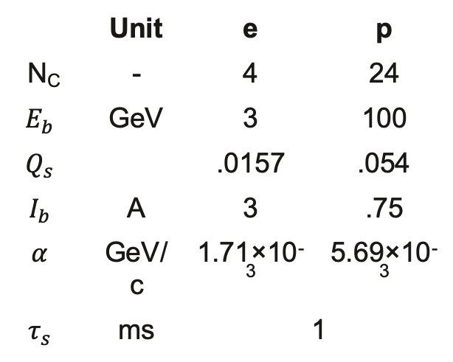
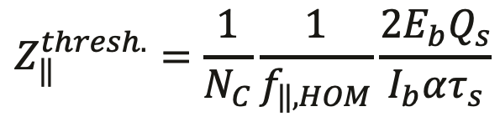
Design of a Proof-of-principle Crabbing Cavity
for the Jefferson Lab Electron-ion Collider*
HyeKyoung Park^{1,2 #}, S.U. De Silva¹, S. Sosa Guitron¹, J.R. Delayen¹,
¹ Center for Accelerator Science, Old Dominion University, Norfolk, VA 23529, U.S.A.
² Thomas Jefferson National Accelerator Facility, Newport News, VA 23606, USA
ABSTRACT
Jefferson Lab design for an electron-ion collider (JLEIC) requires crabbing of the electron and ion beams in order to achieve the design luminosity. Center for Accelerator Science at Old Dominion University has designed, fabricated and successfully tested a crab cavity in 2014 (???) under very early machine design. The JLEIC machine design and parameters have matured over a couple of years. The crab cavity design has also evolved to provide the best crabbing option. A number of options for the crabbing cavities have been explored, and the one which has been selected for the proof-of-principle is a 952 MHz, 2-cell rf-dipole (RFD) cavity. This paper summarizes the electromagnetic design of the cavity and its HOM characteristics.
JLEIC machine layout
machine parameters
 | Electron |  |  |  | Proton
Beam energy [GeV] | 3 | 5 | 10 | 12 | 40 | 100 | 200
Beam current [A] | 3 | 3.5 | 0.8 | 0.39 | 0.45 | 0.75 | 0.75
Frequency (f_{rf}) [MHz] | 952.6
Crossing angle (φ_{crab}) [mrad] | 50.0
β_{x}*[cm] | 30 | 5.72 | 9.1 | 6.6 | 8 | 8 | 2.1
β_{x}^{c} [m] | 200 | 200 | 200 | 200 | 650 | 650 | 650
Total crabbing voltage (V_{t}) (per side per beam) [MV] | 0.5 | 1.9 | 3.0 | 4.2 | 7.0 | 17.4 | 21.5
952.6 MHz
Superconducting
Crab cavities
Crabbing kick:
RF frequency 476.3 MHz.
Crab cavity with 952.6 MHz anticipating future machie upgrade.
Cavity beam aperture 70 mm in diameter determined by the bunch size of the proton beam at the time of the injection to the collider ring.
R. Rimmer, JLEIC Collaboration Meeting April 2019
CRAB CAVITY DESIGN
Hom damping (properties?)
Design Exploration (name each type without A-E)
Design Choice : 956.2 MHz Two-Cell RFD Cavity
Cavity RF Properties
HOM Properties with 2 hook coupler and 2 wave guides
Wakefields - Longitudinal
Fundamental mode
SOM
$$Z_{‖}^{thresh.}=\frac{1}{N_{C}}\frac{1}{f_{‖,HOM}}\frac{2E_{b}Q_{s}}{I_{b}ατ_{s}}$$
 | Unit | e | p
N_{C} | - | 4 | 24
$$E_{b}$$ | GeV | 3 | 100
$$Q_{s}$$ |  | .0157 | .054
$$I_{b}$$ | A | 3 | .75
$$α$$ | GeV/c | 1.71×10⁻³ | 5.69×10⁻³
$$τ_{s}$$ | ms | 1
423 mm
Ø 173 mm
RF INPUT POWER AND COUPLING
Electric Field Magnetic Field
 | Electron |  |  |  | Proton
Beam energy [GeV] | 3 | 5 | 10 | 12 | 40 | 100 | 200
Total crabbing voltage (per side per beam) [MV] | 0.5 | 1.9 | 3.0 | 4.2 | 7.0 | 17.4 | 21.5
Voltage per cavity [MV] | 0.5 | 0.95 | 1.5 | 1.4 | 1.9 | 1.9 | 1.9
No. of cavities | 1 | 2 | 2 | 3 | 4 | 10 | 12
Peak electric field (E_{p}) | 10 | 18 | 28 | 26 | 35 | 35 | 35
Peak magnetic field (B_{p}) | 19 | 36 | 56 | 53 | 71 | 71 | 71
Surface resistance (R_{s}) [nΩ] | 95.0 | 95.0 | 95.0 | 95.0 | 95.0 | 95.0 | 95.0
Shunt impedance (R_{t}) [TΩ] | 0.27 | 0.27 | 0.27 | 0.27 | 0.27 | 0.27 | 0.27
P_{diss} [W] | 1.0 | 3.4 | 8.4 | 7.3 | 13.4 | 13.4 | 13.4
Maximum power requirement case
at 200 GeV 0.75 A proton beam
This particular geometry Q_{ext}=8.25×10⁴
Power coupler location and coupling capacity, preferably same type and location for both electron and ion cases.
Electron ring Q_{L}=6×10⁴ – 2×10⁵
Ion ring Q_{L}=4×10⁵ – 2×10⁶
* Authored by Jefferson Science Associates, LLC under U.S. DOE Contract No. DE-AC05-06OR23177. REFERENCES
The U.S. Government retains a non-exclusive, paid-up, irrevocable, world-wide license to publish or [1] Cryogenic Test of a 750 MHz Superconducting RF Dipole Crabbing Cavity, A. Castilla et al, IPAC2014
reproduce this manuscript for U.S. Government purposes. [2] MEIC Design Summary, S. Abeyratne et al, arXiv:1504.07961
#hkpark@jlab.org

