Slide 1



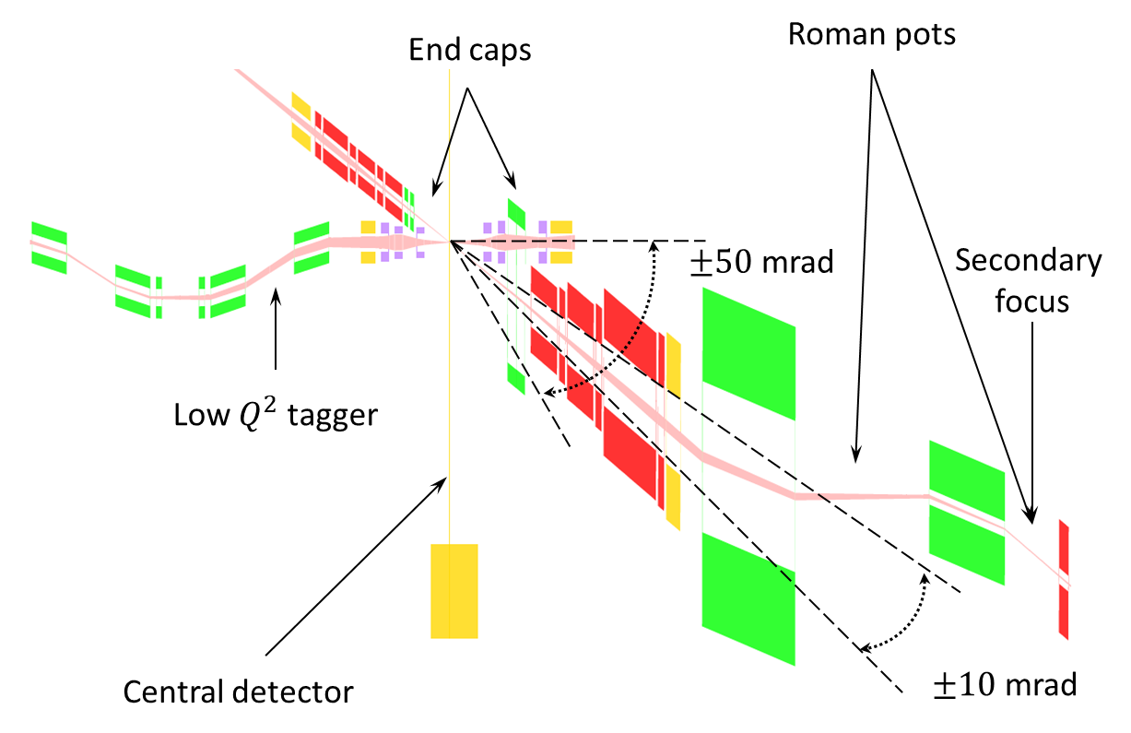
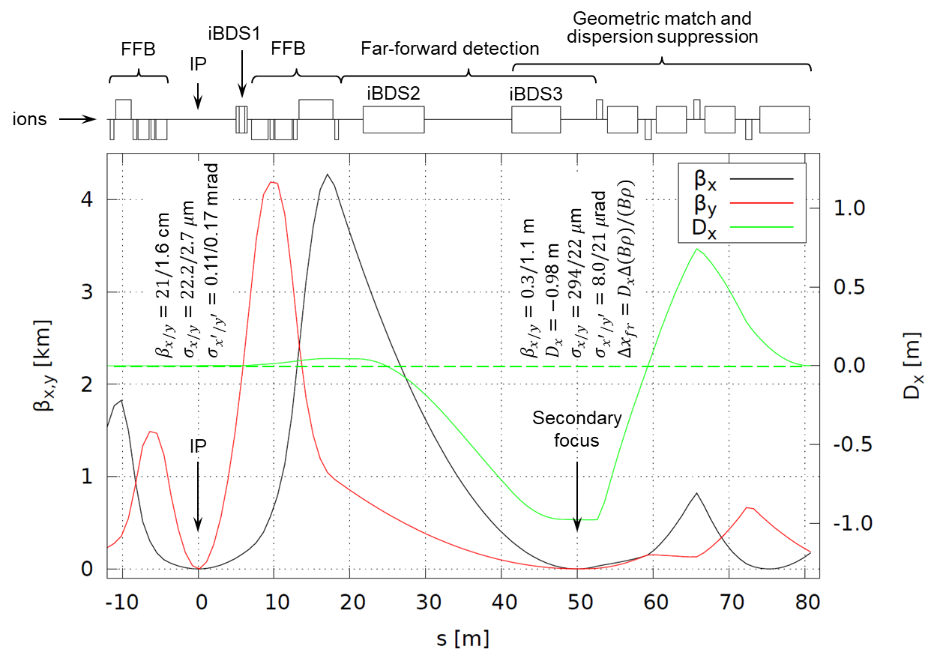
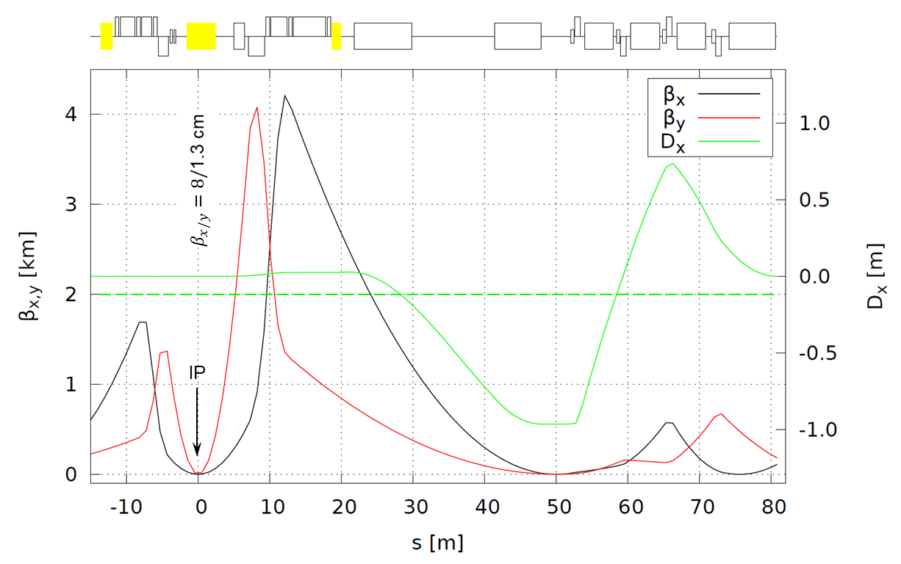
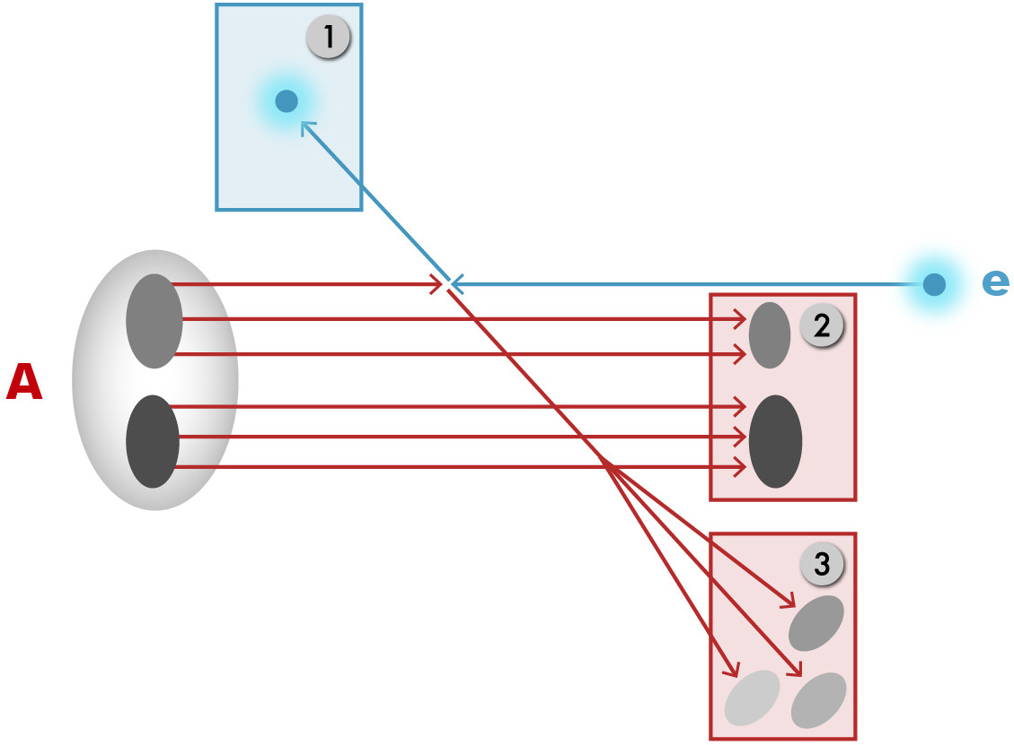
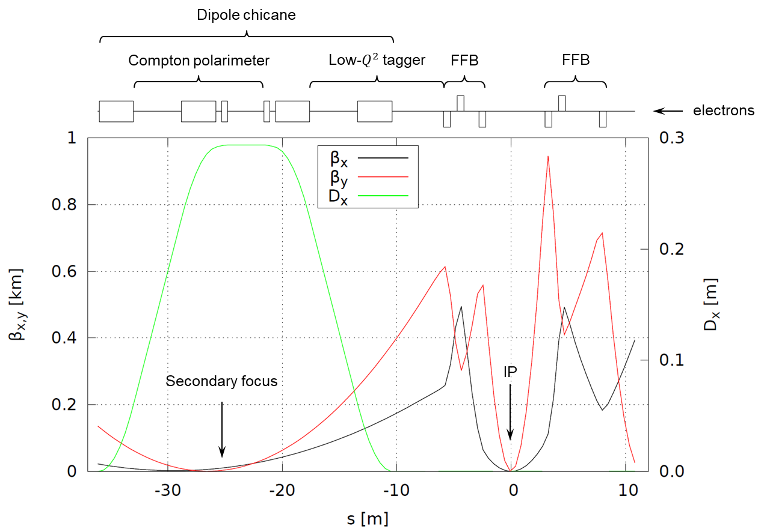
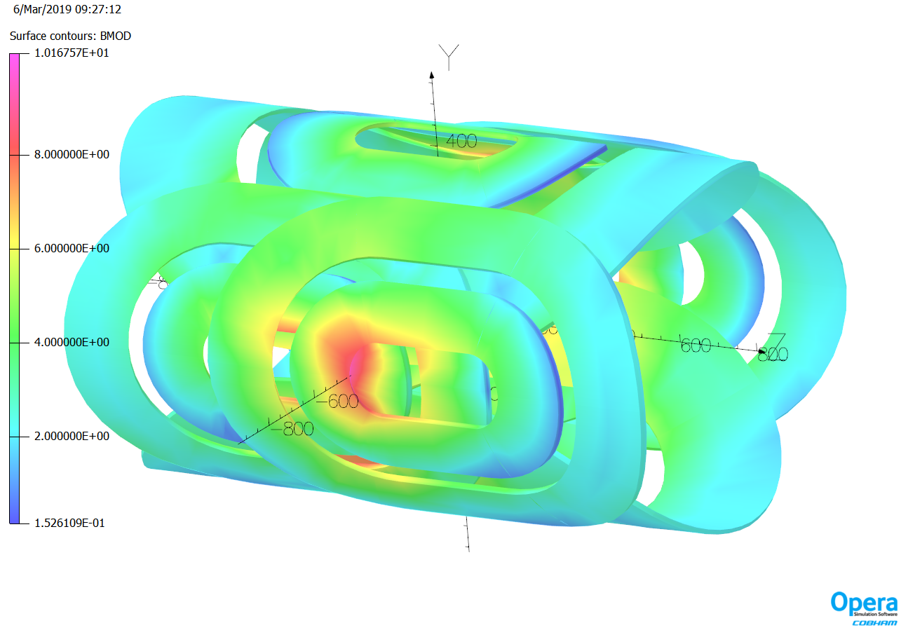



FULL ACCEPTANCE
INTERACTION REGION DESIGN OF JLEIC
V.S. Morozov¹, R. Ent¹, Y. Furletova¹, F. Lin¹, T. Michalski¹, R. Rajput-Ghoshal¹,
M. Wiseman¹, R. Yoshida¹, Y. Zhang¹, Y. Cai², Y. Nosochkov², M. Sullivan², and G.-L. Sabbi³
¹Jefferson Lab, Newport News, VA, ²SLAC, Menlo Park, CA, ³LBNL, Berkeley, CA
MOPRB095
ABSTRACT Nuclear physics experiments envisioned at a proposed future Electron-Ion Collider (EIC) require high luminosity of 10³³-10³⁴ cm⁻²s⁻¹ and a full-acceptance detector capable of reconstruction of a whole electron-ion collision event. Due to a large asymmetry in the electron and ion momenta in an EIC, the particles associated with the initial ion tend to go at very small angles and have small rigidity offsets with respect to the initial ion beam. They are detected after they pass through the apertures of the final focusing quadrupoles. Therefore, the apertures must be sufficiently large to provide the acceptance required by experiments. In addition, to maximize the luminosity, the final focusing quadrupoles must be placed as close to the interaction point as possible. A combination of these requirements presents serious detection, optics and engineering design challenges. We present a design of a full-acceptance interaction region of Jefferson Lab Electron-Ion Collider (JLEIC). The poster presents how this design addresses the above requirements up to an ion momentum of 200 GeV/c. We summarize the magnet parameters, which are kept consistent with the Nb-Ti superconducting magnet technology.
JLEIC FULL-ACCEPTANCE DETECTOR
The luminosity at the interaction point is (to first order) inversely proportional to the distance between the last upstream and first downstream final focusing block. However, the closer the beam elements are to the IP, the more they restrict the size of the detector and compromise the measurements. The solution to achieve the necessary high luminosity while maintaining a full acceptance detector, is to let the small-angle particles pass through the nearest machine elements, which perform the function of angle and momentum analyzer for the small angle reaction products as illustrated in the below figure.
We have chosen a crossing angle of 50 mrad between the electron and ion beams to accommodate the FFBs with large enough aperture, particularly in the ion-forward direction, and field strength consistent with the detector space of 10.5 m. With this design, the beam elements of the electron and ion beams are interleaved but independent, reducing engineering complexity. The crossing angle also eliminates parasitic collisions of closely-spaced bunches and reduces the detector background by shortening the section of the detector beam pipe common for both beams.
The detection regions extend 30–50 m in either direction from the central detector. Momentum analysis of the particles moving in the forward ion direction is first done by a 3 mrad spectrometer dipole. It has a round aperture with an opening angle of $±50$ mrad. There is a shielded region inside the dipole aperture for the electron beam to pass through. Particles that are not detected after the first dipole travel through the apertures of the forward ion final focusing quadrupoles with an opening angle of
$±10$ mrad. They are then momentum analyzed by the second 53 mrad spectrometer dipole. There is a long drift space after the second dipoles to let the dispersion build up to about 1 m. The dispersion slope is compensated by the third 53 mrad spectrometer dipole. The ion beam is focused after the third dipole at a dispersive location to separate the particles with a relative magnetic rigidity offset of greater than 1% from the beam.
ION INTERACTION REGION
Optics of the ion integration region is based on the doublet final focusing quadrupole configuration. There are three physical quadrupoles. Up to 100 GeV ion energy, the field integrals of the two quadrupoles nearest to the interaction point on each side of it are sufficient to run them with opposite polarities as a doublet. In the 100 to 200 GeV energy range, the first two quadrupoles on each side of the interaction point are run with the same polarities thus together forming the first quadrupole of an effective doublet. The third physical quadrupole is run as the second quadrupole of the effective doublet as shown below. Thus, the doublet’s focal parameter can be adjusted in the two energy ranges. It is shorter at up to 100 GeV enhancing the luminosity in the low half of the energy range where it tends to suffer more from collective effects. The beam is refocused about 50 m downstream of the interaction point for far-forward detection of small-rigidity-offset particles.
100-200 GeV
30-100 GeV
INTRODUCTION
The basic process at the EIC, deep inelastic scattering, is illustrated below. An ion, composed of nucleons, in turn composed of partons (quarks and gluons), moves to the right and collides with an electron moving to the left. The electron interacts with a parton within the ion in a hard collision and excites the ion to a state with high invariant mass. We can, qualitatively, define three classes of particles in the final state:
The scattered electron,
Particles associated with the initial state ion, and
Particles associated with the struck parton.
All three classes of final-state particles carry information about the inner structure of the ions in the collisions and allow to investigate the quark-gluon structure of the nucleons and nuclei.
We define the concept of a total acceptance detector as one that achieves close to 100% acceptance for all three classes of particles. The final state electron and the particles associated with the struck parton are scattered at relatively high angles with respect to be beam direction and can be detected in a conventional collider detector using a solenoidal field. The particles associated with the initial-state ion, however, tend to be nearly collinear with the ion-beam direction. Collider detectors in the past have had rather small acceptance for these particles.
The main requirements to an EIC interaction region design are:
Close to 100% acceptance for all three classes of particles,
High luminosity of 10³³-10³⁴ cm⁻²s⁻¹, in the entire center-of-mass energy range of 20 to 100 GeV,
Use of conventional technologies as much as possible.
ELECTRON INTERACTION REGION
The electron final focusing quadrupoles are placed closer to the IP than the ion ones. The downstream electron final focusing block is followed by a 4-dipole chicane housing a low-$Q^{2}$ tagger and a Compton polarimeter and creating space for a luminosity monitor.
Nb-Ti MAGNET TECHNOLOGY
To minimize the technical risk associated with the interaction region magnet designs, all magnet parameters are chosen to be consistent with the Nb-Ti super-conducting magnet technology. This is verified by preliminary magnet designs. Below is a 3D model of the first spectrometer dipole.
CONCLUSION
The JLEIC interaction region design integrates a full-acceptance detector, provides large forward acceptance and momentum analysis of the forward particles. It is integrated into the collider rings optically and geometrically. The parameters of all integration region elements are consistent with the conventional Nb-Ti superconducting magnet technology.
REFERENCES
[1] V.S. Morozov et al., IPAC’12, TUPPR080, p. 2011.
[2] F. Lin et al., PAC’13, TUPAC28, p. 508.
[3] V.S. Morozov et al., IPAC’14, MOPRO005, p. 71.
10th International Particle Accelerator Conference Melbourne, Australia, May 19-24, 2019
This material is based upon work supported by the U.S. DoE under Contracts No. DE-AC05-06OR23177, DE-AC02-76SF00515, and DE-AC03-76SF00098.

