Slide 1

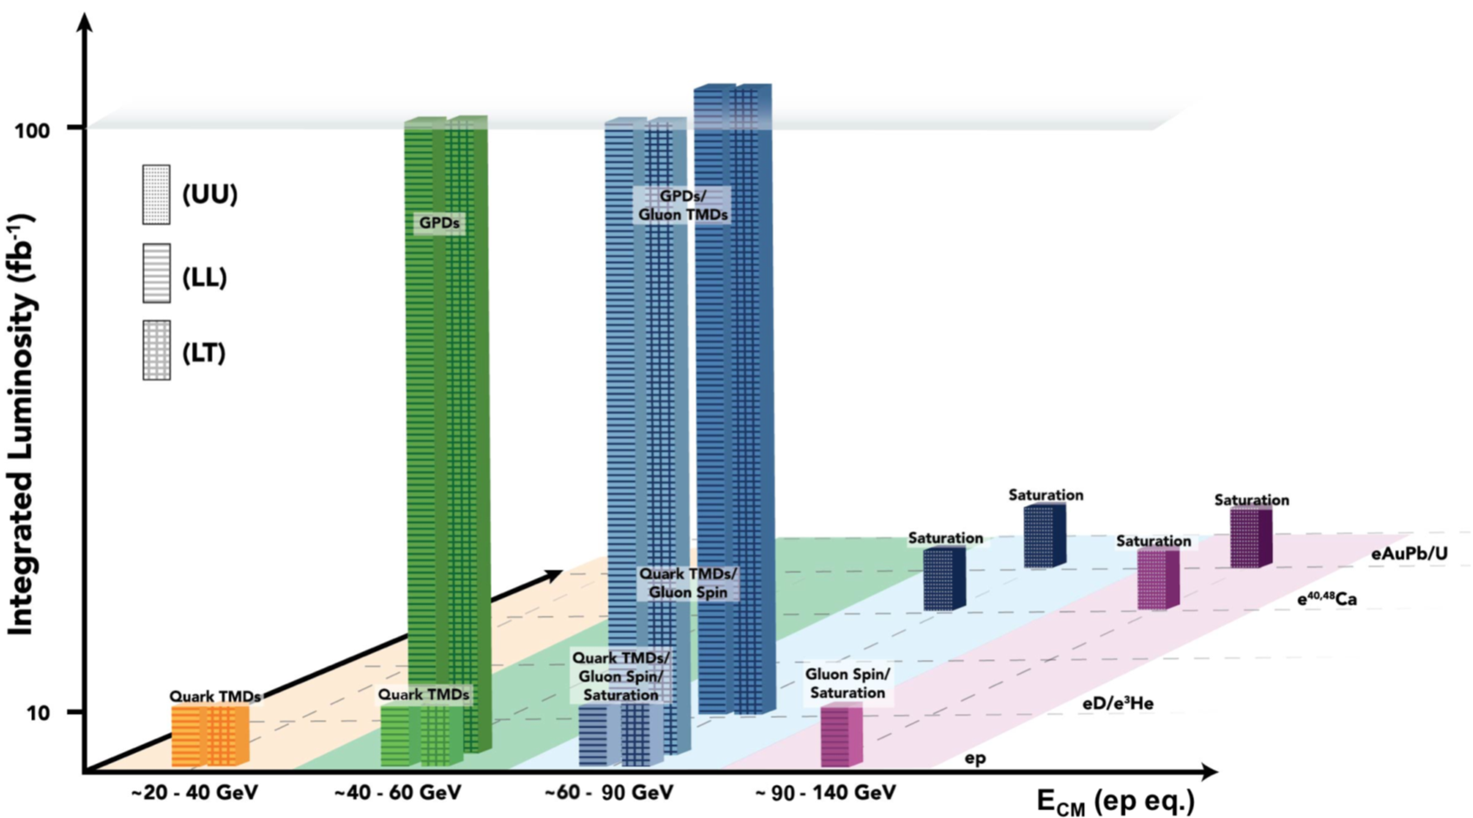
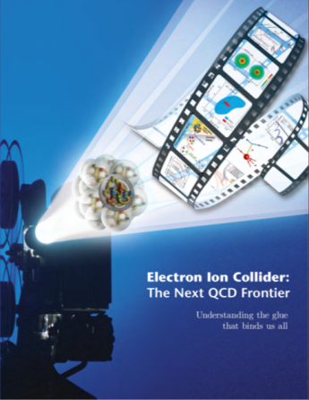
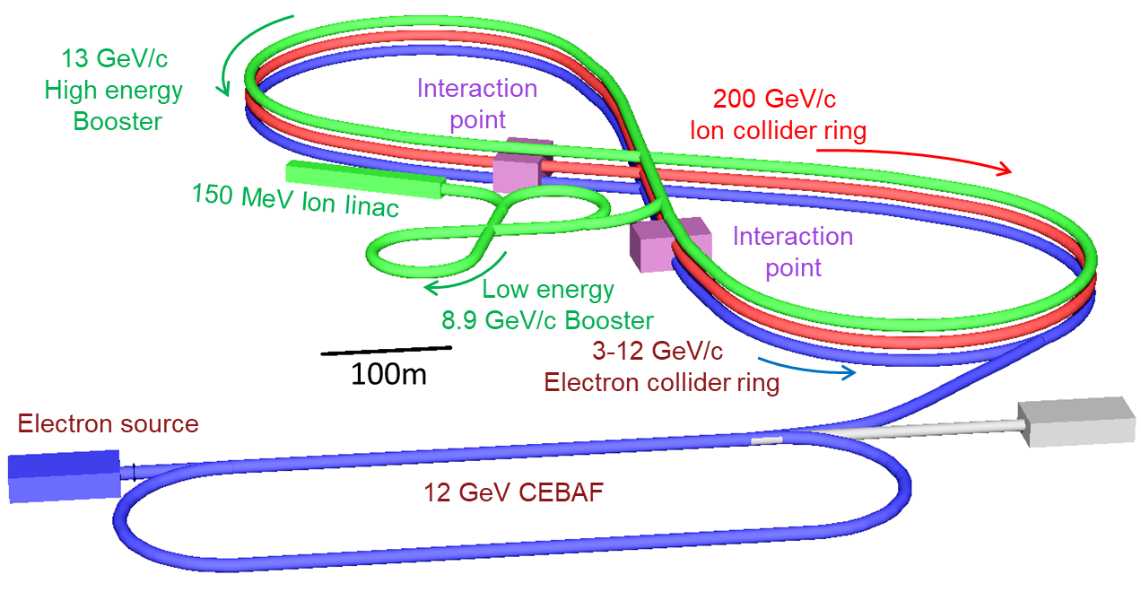
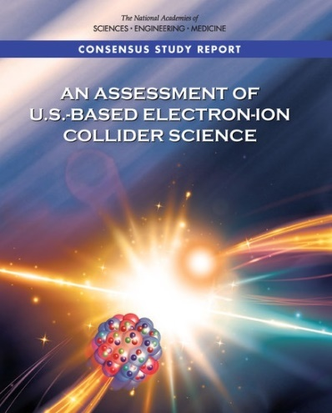
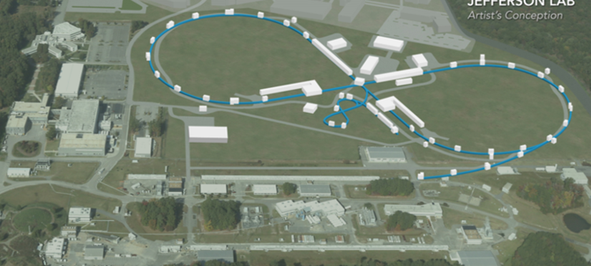
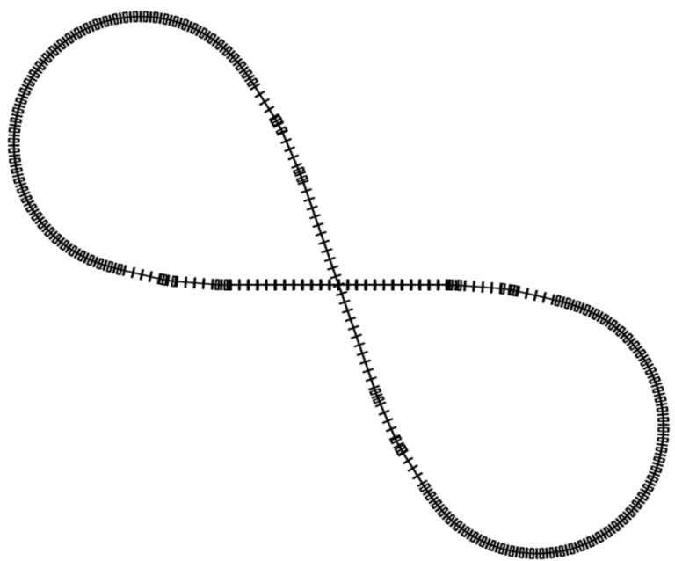
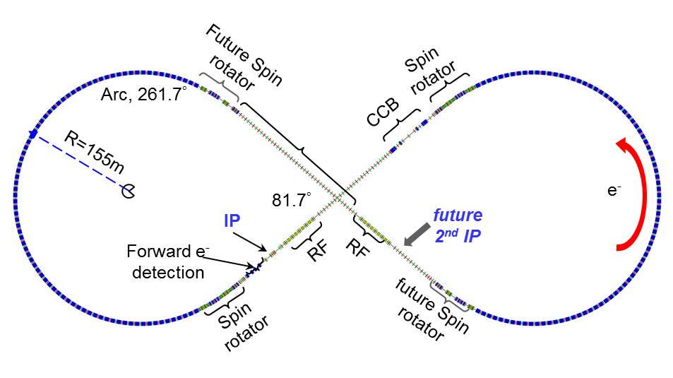
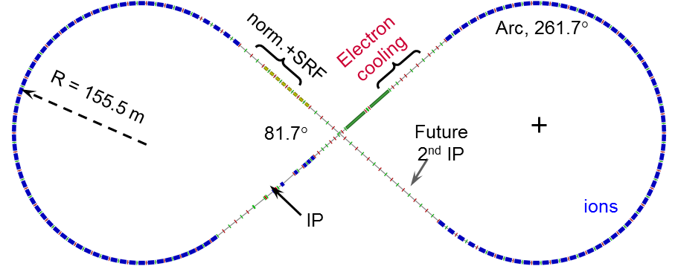
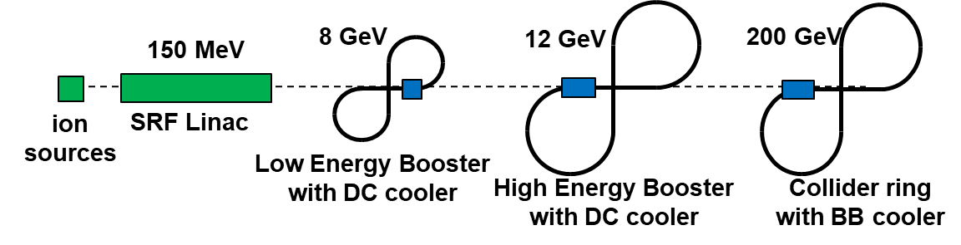
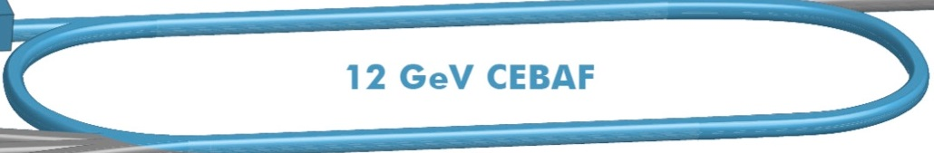
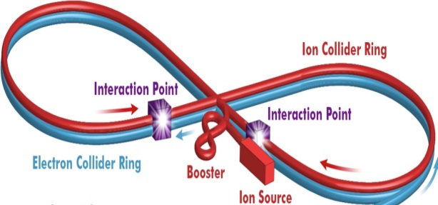
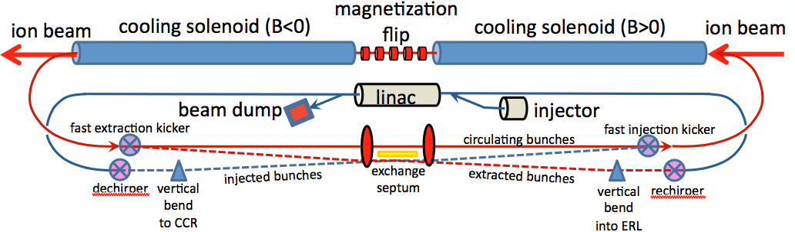
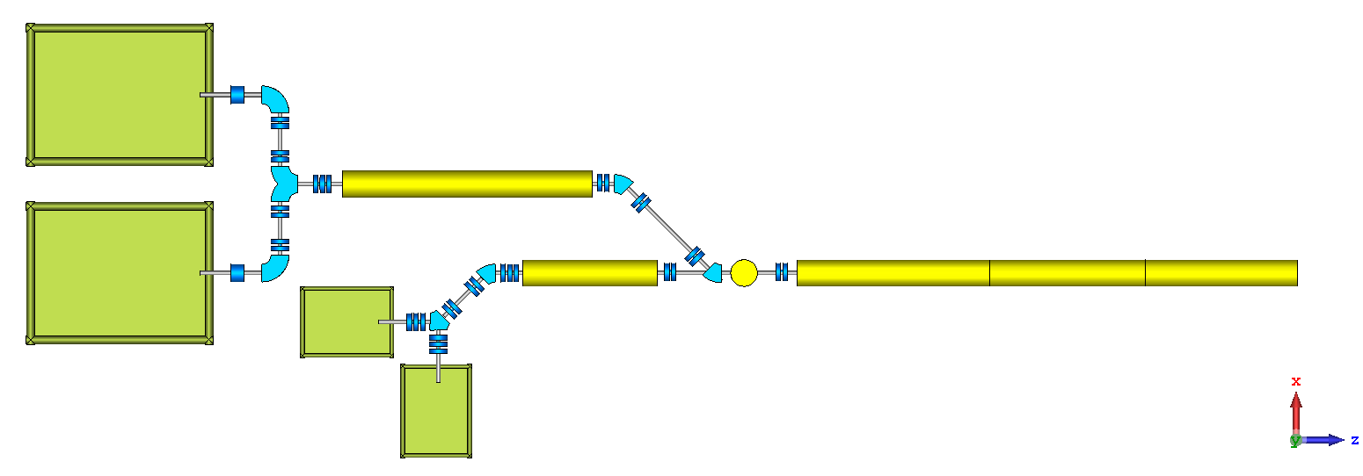
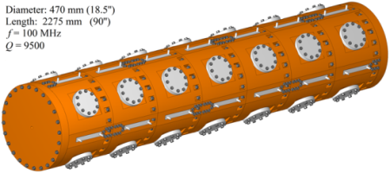
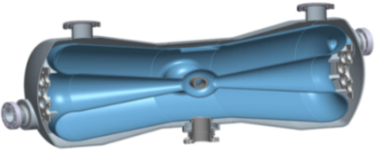
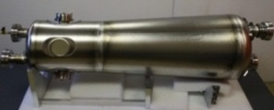
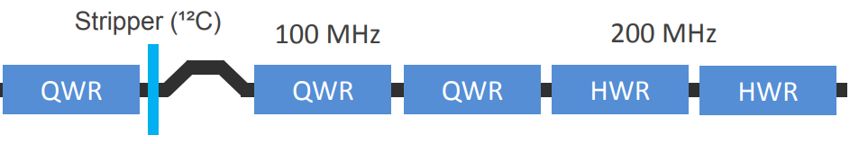
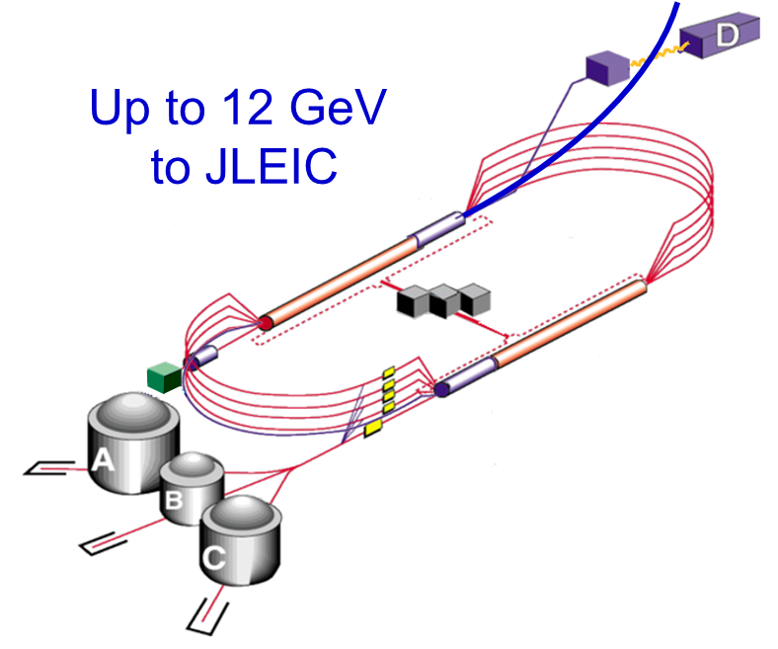
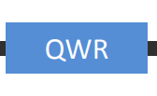
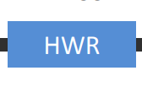
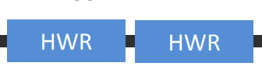
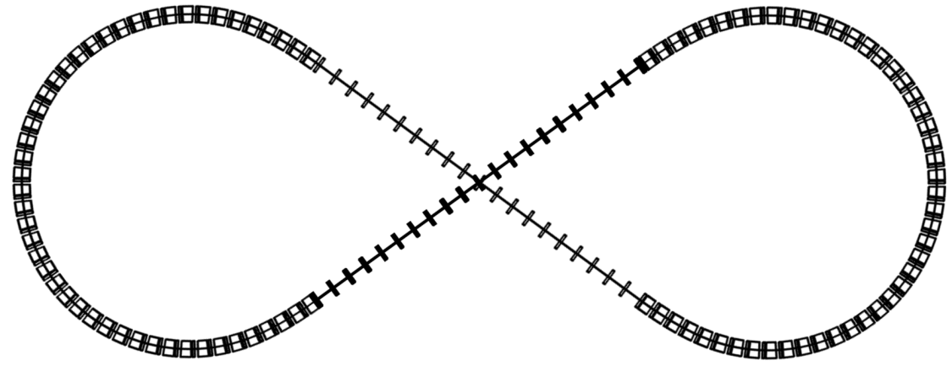
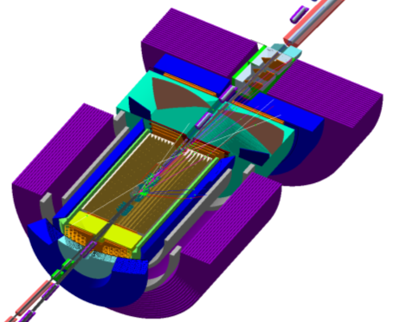
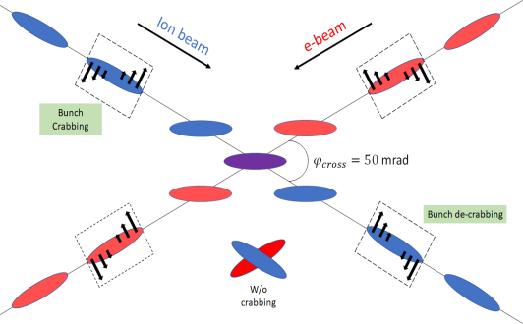
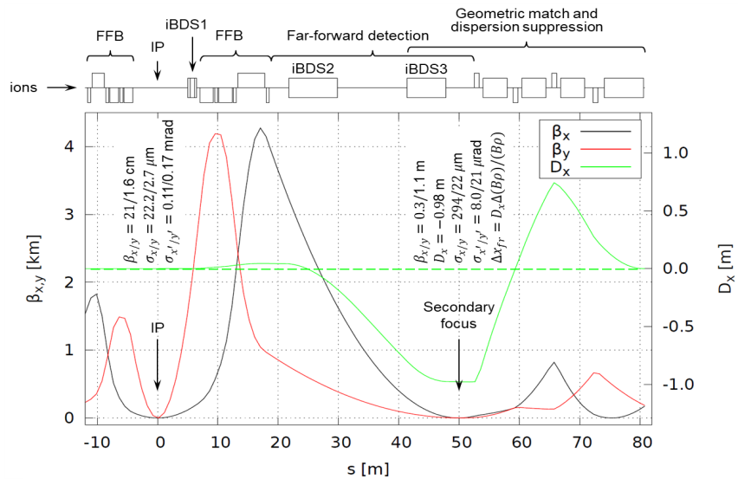
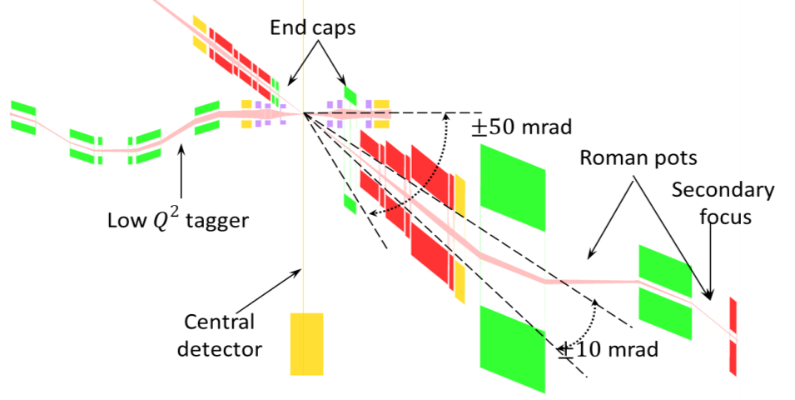
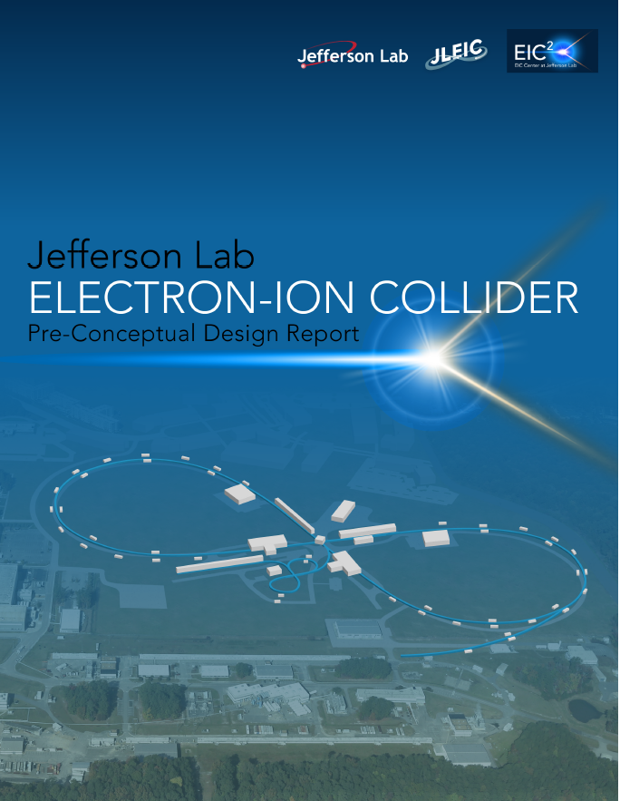
JLEIC Design by JLEIC Collaboration
Thomas Jefferson National Accelerator Facility, Newport News, Virginia, USA, Managed by the Jefferson Science Associates, LLC for the U.S. DOE
Abstract The recent NAS Review concluded an electron-ion collider are significant to advancing our understanding of the atomic nuclei that make up all visible matter in the universe. To meet this science need, a high luminosity polarized electron-ion collider (JLEIC) was envisioned at JLab based on the existing CEBAF SRF linac. Over the past 16 years, JLab has been actively engaged in the design study and accelerator R&D for JLEIC. Here we present a summary of the JLEIC baseline design and also discuss the accelerator R&D.
EIC for QCD Frontier
EIC science is compelling, fundamental and timely
EIC would be a unique facility to help maintain U.S. scientific leadership in nuclear physics
The technological benefits are enormous, both for basic science and for applied areas
EIC would boost the U.S. STEM workforce
JLEIC Layout and Design Parameters
CM energy | GeV | 21.9 |  | 44.7 |  | 63.3 |  | 89.4 |  | 98
 |  | p | e | p | e | p | e | p | e | p | E
Beam energy | GeV | 40 | 3 | 100 | 5 | 200 | 5 | 200 | 10 | 200 | 12
Collision freq | MHz | 476 |  | 476 |  | 476/4=119 |  | 476/4=119 |  | 476/4=119
Particles/bunch | 10¹⁰ | 0.59 | 3.9 | 0.98 | 4.7 | 3 | 8.9 | 3.93 | 4.2 | 3.93 | 2.05
Beam current | A | 0.45 | 3 | 0.75 | 3.6 | 0.57 | 1.7 | 0.75 | 0.8 | 0.75 | 0.39
Polarization | % | 85 | >85 | 85 | >80 | 85 | >80 | 85 | ~80 | 85 | ~80
Bunch length | cm | 2.5 | 1 | 2.5 | 1 | 3.2 | 1 | 3.2 | 1 | 3.2 | 1
Norm. emitt, x | µm | 0.5 | 18 | 0.65 | 83 | 1.26 | 83 | 1.5 | 664 | 1.5 | 1145
Norm. emitt, y | µm | 0.2 | 3.6 | 0.13 | 16.6 | 0.5 | 16.6 | 0.5 | 133 | 0.5 | 229
Horizontal β* | cm | 8 | 30 | 8 | 5.72 | 21 | 14.5 | 19.2 | 4 | 27.5 | 4
Vertical β* | cm | 1.3 | 9.8 | 1.3 | 0.93 | 1.6 | 2.2 | 2.3 | 0.8 | 3.3 | 0.8
Beam-beam, x |  | 0.015 | 0.12 | 0.015 | 0.045 | 0.015 | 0.136 | 0.006 | 0.022 | 0.003 | 0.013
Beam-beam, x |  | 0.01 | 0.15 | 0.014 | 0.041 | 0.0065 | 0.120 | 0.003 | 0.022 | 0.002 | 0.013
Laslett tune-shift |  | 0.055 | small | 0.018 | small | 0.0039 | small | 0.005 | small | 0.005 | small
Hour-glass (HG) |  | 0.85 |  | 0.73 |  | 0.84 |  | 0.66 |  | 0.67
Peak lumi. w/HG | 10³³/cm²s | 3.2 |  | 14.6 |  | 9.84 |  | 3.8 |  | 1.31
Average lumi.* | 10³³/cm²s | 2.3 |  | 10.5 |  | 8.2 |  | 1.9 |  | 0.74
JLEIC: An Advanced EIC at JLab
Based on the existing CEBAF recirculator SRF linac
Designed for delivering high luminosity, high polarization and full detector acceptance
Design concept stable over the last 10 years
The implementation updated/optimized to enhance performance, mitigate technical risk and reduce costs
Luminosity & Upgrade Potential
High Energy Booster
Placed in the main tunnel along with
the two collider rings.
Accelerate protons (and ion equivalents)
from 8 GeV E_{k} to 12.1 GeV E_{k}
FODO lattice with 𝛾_{𝑡}=15.6
  Meet EIC White Paper Requirement
Many-Small-Bunches for High Luminosity
Conventional approach for hadron colliders
  Few colliding bunches ➔ low bunch frequency
  High bunch intensity ➔ long bunch and large β*
JLEIC approach: high bunch repetition rate + short bunch colliding beams
Traditional approach for lepton-lepton colliders
(KEK-B > 2x10³⁴ /cm²/s)
JLEIC advantages
  Based on CEBAF, already up to 1.5 GHz
  New green field ion complex can be designed to deliver high bunch repetition rate
Collider Rings
Two rings have same footprint, stack vertically
Electrons take vertical excursion to the plane of the ion collider ring for horizontal crab crossing
Normal technology SC magnets for collider ring, 6T cos⁡𝜃 dipoles and cos⁡2𝜃 quadrupoles
Supports two IPs, horizontal crab crossing at IPs
Baseline Achieved Design Goals
Energy: full coverage of CM energy from 20 to ~100 GeV ➔ e: 3-12 GeV, p: up to 200 GeV, ions up to ~80 GeV/u
Ion species: polarized p, d, 3He, un-polarized up to A=200
Support 2 detectors with full acceptance capability
Luminosity: 10³³⁻³⁴ /cm²s/IP in a broad CM energy range,
Polarization: > 80% and spin flip
  At IP: longitudinal for both, transverse for ions only
  Upgradable to higher CM energy (~150 GeV CM)
  e: 12 GeV, p: up to 400 GeV, ions up to 140 GeV/u
Beam Design
High repetition rate
Low bunch intensity
Short bunch length
Small emittance
IR Design
Very small β*
Crab crossing
Arc 250.94º
 |  | p | e
Circum. | m | 2336
Crossing |  | 70.94º
Lattice |  | FODO
Dipole | m | 4x2 | 5.4
Quad | m | 0.8 | 0.56
Cell length | m | 22.8 | 15.2
Max. dipole | T | 6 | 0.4
SR power | kW/m |  | 10
Transition γ_{tr} |  | 12.5 | 21.6
Damping Design
Synchrotron radiation
Electron cooling
70.94º
New Ion Injector Complex
70.94º
Arc 250.94º
Staged Electron Cooling
Achieving very small emittance (order of magnitude reduction in all dimensions), short bunch length ~2 cm
Suppressing IBS induced emittance degradation
Figure-8 Ring for High Polarization
Enabled by a green field collider ring design
Spin precessions in the left & right parts of a figure-8 ring are exactly cancelled -> net spin precession (tune) is zero
No cross of spin resonance during energy ramp
Spin can be controlled/stabilized by compact spin rotators The only practical way to accelerate/store polarized deuterons in medium energy range
The electron ring follows the footprint of the ion ring, figure-8 helps the electron polarization under spin flip
Beam Formation w/ Cooling
Ring | Functions | Kinetic energy (GeV / MeV) |  |  | Cooler type
 |  | Proton | Lead ion | Electron
Low Energy Booster | Accumulation of positive ions |  | 0.1 (injection) | 0.054 | DC
High Energy booster | Maintain emitt. during stacking | 7.9 (injection) | 2 (injection) | 4.3 (proton) 1.1 (lead) | DC
 | Pre-cooling for emitt. reduction | 7.9 (injection) | 7.9 (ramp to) | 4.3
collider ring | Maintain emitt. during collision | Up to 150 | Up to 60 | Up to 81.8 | ERL
Low Energy Booster
High Energy Booster
collider Ring
Emittance preservation
Accumulation from linac
Charge strip injection
Stacking/Pre-cool
Emittance preservation
Pre-bunch splitting
bunch splitting
Up to 200 GeV
8 GeV
DC cooler
4.3 MeV
12.1 GeV
~20 GeV
BB cooling
ERL cooler
Up to 109 MeV
150 MeV
collider Ring
proton
Low Energy booster
High Energy booster
Bunch splitting
emittance preservation
Stacking, emittance preservation
Up to 78 GeV/u
ERL-Circulator Cooler
S
Accumulation from linac
Phase painting
Pre-bunch splitting
~20 GeV
BB cooling
B
S
Figure-8 synchrotron
4.3 GeV
ERL cooler
Up to 43 MeV
B
2.08 GeV
Pre-cool
Lead ion
41 MeV/u
DC cooler
1.1 MeV
DC cooler
Conventional synchrotron
DC cooler
Ion Linac
Spin tune energy dependent
Cross spin resonances during acceleration
Siberian Snake may help
B
Un-polarized
Source
Options for RFQ: 4-vane bolted
ERL ring
Circulator cooler ring
Spin turn is zero (energy independent)
ECR-IS
HI-RFQ
IH-DTL
Interaction Regions
Achieve full acceptance detection, forward tagging
Designed to satisfy geometric match and beam dynamics
50 mrad crab crossing with crab cavities, avoid parasitic collisions, optimize detection
CEBAF as a Full Energy Injector
Extensive fixed-target science program, compatible
with concurrent JLEIC operations
Full energy injector
Fast fill of collider ring
~85% polarization
Enables top-off/continuous injection
New operation mode, but no hardware
modifications
EBIS
LI-RFQ
QWR
Polarized
Source
βG=0.3
HWR
150 MeV p
42 MeV/u Pb
βG=0.15
Low Energy Booster
Extraction energy: 8 GeV
Circumference: 604 m
Warm magnets, FODO lattice
IP
spectrometers
dispersion suppressor/
geometric match
e
γ_{T}~10.6
Compton polarimetry
forward e detection
forward ion detection
ions
JLEIC Collaboration (accelerator part)
S. Benson, A. Bogacz, P. Degtyarenko, E. Daly, Ya. Derbenev, D. Douglas, R. Fair, B.R.P. Gamage, R. Geng, P. Ghoshal, J. Grames, K. Jordan, J. Guo, F. Hannon, L. Harwood, T. Hiatt, H. Huang, A. Hutton, A. Kimber, G. Krafft, R. Li, F. Lin, Md.A. Mamum, F. Marhauser, T. Michalski, V. Morozov, E. Nissen, G. Park, H. Park, M. Poelker, T. Powers, R. Rajput-Ghoshal, R. Rimmer, Y. Roblin, T. Satogata, A. Seryi, M. Spata, R. Suleiman, A. Sy, C. Tennant, H. Wang, S. Wang, W. Wittmer, M. Wiseman, H. Zhang, S. Zhang, Y. Zhang, JLab;
Y. Cai, Y. Nosochkov, G. Stupakov, M. Sullivan, M. Wang, SLAC; M. Blaskiewicz, H. Huang, Y. Luo, Q. Wu, F. Willeke, BNL; J. Qiang, G. Sabbi, LBNL; Z. Conway, S. Manikonda, B. Mustapha, A. Zholents, ANL; D. Barber, DESY; Y. Hao, P. Ostroumov, A. Plastun, Michigan State Univ.; B. Erdelyi, P. Piot, Northern Illinois Univ; J. Delayen, S. De Silva, S. Sosa, B. Terzic, Old Dominion Univ.; J. Gerity, T. Mann, P. McIntyre, N. Pogue, A. Sattarov, Texas A&M Univ.; V. Dudnikov, R. Johnson, Muons, Inc.; D. Abell, D. Bruhwiler, I. Pogorelov, Radiasoft, Inc.; G. Bell, J. Cary, Tech-X Corp..; A. Kondratenko, M. Kondratenko, Sci. & Tech. Lab Zaryad, Russia; Yu. Filatov, Moscow Institute of Physics & Technology, Russia; Y. Huang, X. Ma, L. Mao, Y. Yuan, H. Zhao, H.W. Zhao, IMP, China;
Gone/not forgotten S. Ahmed, K. Beard, A. Castilla, Y. Chao, P. Chevtsov, K. Deitrick, L. Merminga, F. Pilat, H. Sayed, C. Tsai, G. Wei, B. Yunn
Work supported by U.S. DOE Contract No. DE-AC05-06OR23177
Outlook
JLEIC conceptual design is complete
preCDR to be released soon
Current work
Performance and cost optimization
Evaluation of engineering challenges
Perform key accelerator R&D

