Slide 1
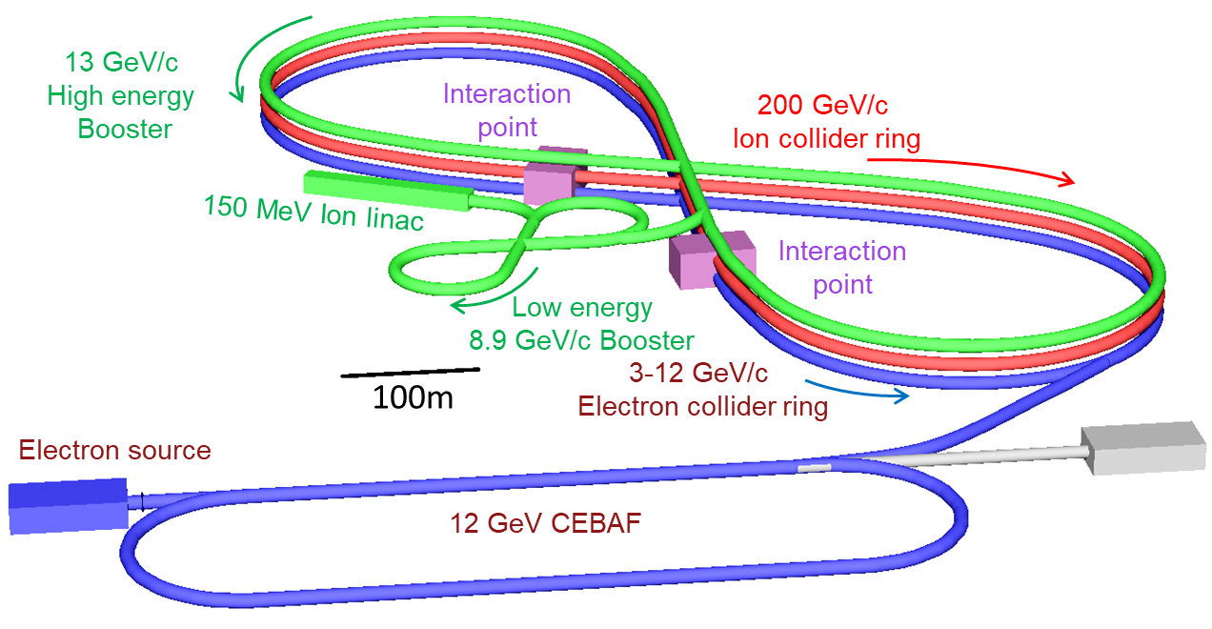
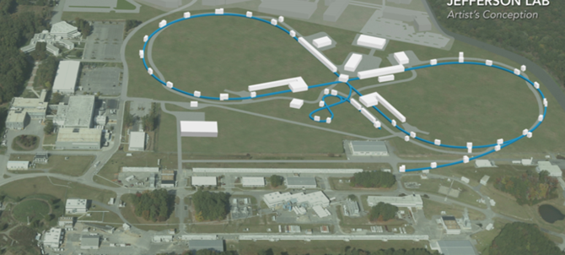
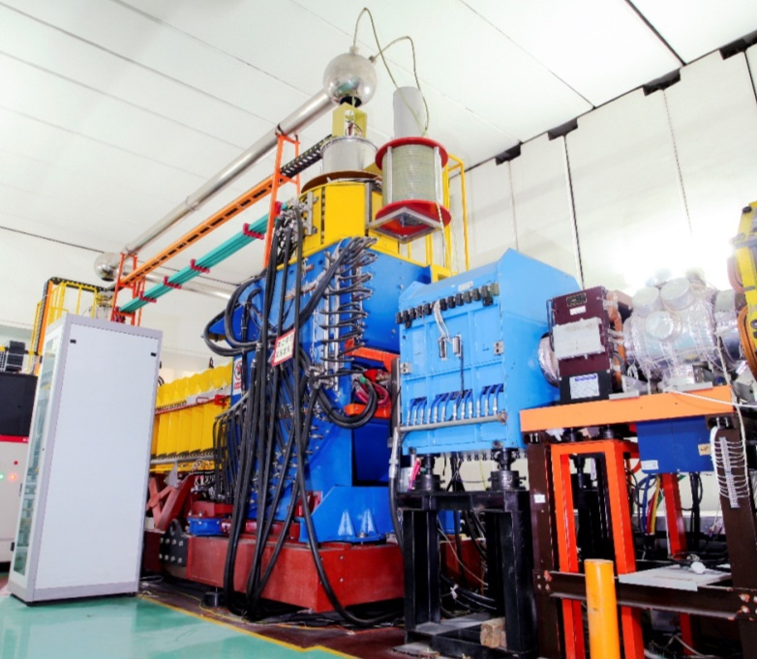
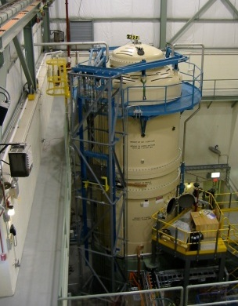
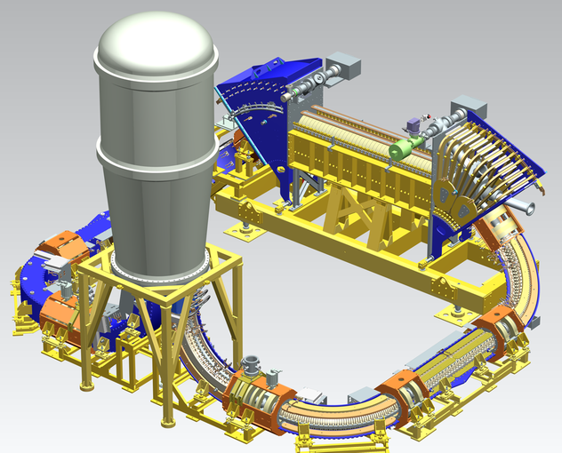
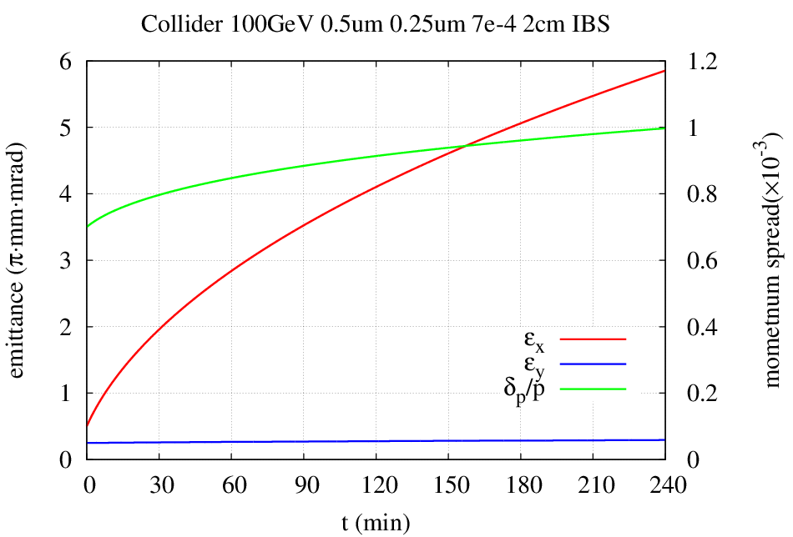
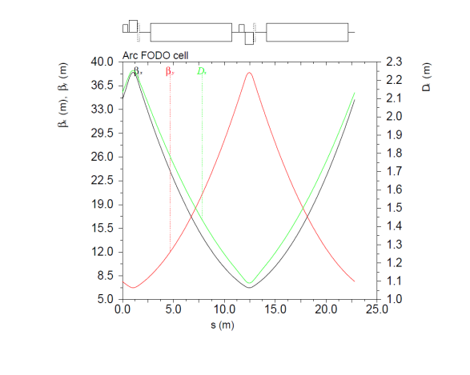
SC Magnets with Small Apertures for JLEIC*
Thomas Jefferson National Accelerator Facility,
Managed by the Jefferson Science Associates, LLC for the U.S. Department of Energy, Office of Science
Yuhong Zhang, Jefferson Lab, Newport News, VA 23606, USA
* Work supported by U.S. DOE Contract No. DE-AC05-06OR23177.
Abstract: An important feature of the JLEIC design is multi-staged cooling of ion beams such that emittance of the cooled beams is reduced to and maintained at roughly an order of magnitude smaller than uncooled beams in all three directions. As a consequence, cooled ion beams require a substantially smaller beam-stay-clear for the SC magnets in the collider ring. We present two design concepts that take such an advantage. The 1st concept proposes a factor of two reduction of physical aperture of the arc SC magnets from the present JLEIC ion collider baseline while the 2nd concept considers reusing some existing/decommissioned ion ring magnets for the JLEIC ion collider ring. Both concepts could achieve a substantial cost reduction. We present a study of minimum magnet aperture for the ion collider ring that can support full collider operation throughout the life of the machine's JLEIC.
JLEIC: a High Luminosity Polarized Electron-Ion Collider in QCD Frontier
RHIC Magnets for JLEIC Ion Collider Ring w/ Small Aperture
About 4 years ago, we had explored whether the RHIC magnets can be used for the JLEIC ion collider ring
We took advantage of small aperture by cooling
CM energy | GeV | 21.9 |  | 44.7 |  | 63.3 |  | 89.4 |  | 98
 |  | p | e | p | e | p | e | p | e | p | E
Beam energy | GeV | 40 | 3 | 100 | 5 | 200 | 5 | 200 | 10 | 200 | 12
Collision freq | MHz | 476 |  | 476 |  | 476/4=119 |  | 476/4=119 |  | 476/4=119
Particles/bunch | 10¹⁰ | 0.59 | 3.9 | 0.98 | 4.7 | 3 | 8.9 | 3.93 | 4.2 | 3.93 | 2.05
Beam current | A | 0.45 | 3 | 0.75 | 3.6 | 0.57 | 1.7 | 0.75 | 0.8 | 0.75 | 0.39
Polarization | % | 85 | >85 | 85 | >80 | 85 | >80 | 85 | ~80 | 85 | ~80
Bunch length | cm | 2.5 | 1 | 2.5 | 1 | 3.2 | 1 | 3.2 | 1 | 3.2 | 1
Norm. emitt, x | µm | 0.5 | 18 | 0.65 | 83 | 1.26 | 83 | 1.5 | 664 | 1.5 | 1145
Norm. emitt, y | µm | 0.2 | 3.6 | 0.13 | 16.6 | 0.5 | 16.6 | 0.5 | 133 | 0.5 | 229
Horizontal β* | cm | 8 | 30 | 8 | 5.72 | 21 | 14.5 | 19.2 | 4 | 27.5 | 4
Vertical β* | cm | 1.3 | 9.8 | 1.3 | 0.93 | 1.6 | 2.2 | 2.3 | 0.8 | 3.3 | 0.8
Beam-beam, x |  | 0.015 | 0.12 | 0.015 | 0.045 | 0.015 | 0.136 | 0.006 | 0.022 | 0.003 | 0.013
Beam-beam, x |  | 0.01 | 0.15 | 0.014 | 0.041 | 0.0065 | 0.120 | 0.003 | 0.022 | 0.002 | 0.013
Laslett tune-shift |  | 0.055 | small | 0.018 | small | 0.0039 | small | 0.005 | small | 0.005 | small
Hour-glass (HG) |  | 0.85 |  | 0.73 |  | 0.84 |  | 0.66 |  | 0.67
Peak lumi. w/HG | 10³³/cm²s | 3.2 |  | 14.6 |  | 9.84 |  | 3.8 |  | 1.31
Average lumi.* | 10³³/cm²s | 2.3 |  | 10.5 |  | 8.2 |  | 1.9 |  | 0.74
d
L₀
d₀
Good field
JLEIC collider ring
Injection kinetic energy | GeV | 7.9
Injection emittance | µm | ~0.5
Largest betatron | m | 30
Largest RMS beam size | mm | 1.1
Beam star-clear (10σ) | Mm | ~11
Beam steering | mm | +/-0.5
Mini aperture (diameter) | mm | 32
Maxi allowable sagitta | cm | 8
Minimum bending radius | M | 139
L
new orbit
design orbit
(ρ₀=243 m)
α
ρ
α₀
ρ₀
(9.45 m, bent w/ 4.85 cm sagitta)
JLEIC CM Energy Reach
Full coverage of CM energy from ~20 to ~100 GeV
e: 3-12 GeV, p: up to 200 GeV, ion: up to 80 GeV/u
Ion collider ring dipole magnets: up to 6 T
Future upgrade to ~140 GeV CM
e: 3-12 GeV, p: up to 400 GeV, ion: up to 80 GeV/u
Approach: ion collider ring dipole magnets: up to 12 T
Magnets with Small Physical Aperture
Fact (Experiences taught us)
“Magnet cost is roughly linearly proportional to its physical aperture, some time can be even worse”
Idea
Aperture of magnets is made much smaller, then we may be able to save the magnet cost substantially
Opportunity
JLEIC ion beam has a much smaller emittance achieved by pre-cooling and on energy cooling
JLEIC Collider Ring by RHIC Magnets
Proton |  | RHIC | JLEIC |  |  | Baseline
Maxi. kinetic energy | GeV | 275 | 160 | 175 | 200 | 100
Max CM energy |  |  | 87.6 | 91.7 | 97.9 | 69.3
Dipole length | m | 9.45 | 9.45 | 9.45 | 9.45
Dipole max. field | T | 3.77 | 3,77 | 3.77 | 3.77
Dipole bending | m | 243 | 141 | 156 | 177
Dipole bending |  | 2.23° | 3.83° | 3.50 | 3.06
Cell length & packing | m | 29.6 & 0.638
Figure-8 angle |  | -- | 100° | 104° | 114° | 81.7°
Cells in each arc |  | 13.5 | 36.6 | 40.6 | 47.8
Total dipoles |  | 162(x2) | 146 | 162 | 191
Arc length | m | 400 | 1082 | 1200 | 1415
Arc radius | m | 381 | 221 | 242 | 277
Straight length | m |  | 372 | 378 | 366 | 360
Ring circumference | m | 3840 | 2907 | 3158 | 3564 | 2140
Enlarged by |  |  | 1.4 | 1.5 | 1.7
Footprint, length x width | m |  | 1021 x 443 | 1099 x 484 | 1217 x 554 | 787x310
New Ion Injector Complex
What Affects Magnet Aperture
Beam stay-clear
Transverse emittance/beam size (betatron & dispersion)
Orbital steering (+/- 5 mm)
Number of sigma (10)
Good field (dynamic aperture with low beta insertions)
Injection (beta-squeeze easies the problem)
Collimation (transverse tails)
Beam Formation w/ Cooling
Low Energy Booster
High Energy Booster
collider Ring
Emittance preservation
Accumulation from linac
Charge strip injection
Stacking/Pre-cool
Emittance preservation
Pre-bunch splitting
bunch splitting
Up to 200 GeV
Dipole Aperture: Analyses/Opportunity
Ways for Reducing Footprint
RHIC cell: 29.6 m, 3.77 T, 3.06° x 2 = 6.12°
New magnet cell: 29.6 m, 7.54 T, 6.12° x 2 = 12.24°
8 GeV
DC cooler
4.3 MeV
12.1 GeV
~20 GeV
BB cooling
ERL cooler
Up to 109 MeV
Cooling |  | No |  |  |  | Yes
Kinetic energy | GeV | 7.9 | 50 | 100 | 200 | 7.9 | 50 | 100 | 200
CM energy (e energy) | GeV |  | 24.7 (3) | 69.6 (12) | 100.6 (12) |  | 24.7 (3) | 69.6 (12) | 100.6 (12)
Emitt., norm | µm | 2.5 | 2.5 | 2.5 | 2.5 | 0.5 | 0.5/0.25 | 0.5/0.1 | 0.5/0.1
Emitt., unnorm. | nm | 266.9 | 46.1 | 23.2 | 11.7 | 53.4 | 9.2/4.6 | 4.6/ 0.9 | 2.2/0.4
Energy spread | 10⁻⁴ | 10 | 10 | 10 | 10 | 3 | 3 | 3 | 3
Maxi. beta | m | 38 | 38 | 38 | 38 | 38 | 38 | 38 | 38
Maxi dispersion | m | 2.2/0 | 2.2/0 | 2.2/0 | 2.2/0 | 2.2/0 | 2.2/0 | 2.2/0 | 2.2/0
Max beam size | mm | 3.9/3 | 2.6/1.3 | 2.4/0.9 | 2.3/0.7 | 1.4/1.3 | 0.8/0.38 | 0.7/0.2 | 0.7/0.1
Beam stay-clear in arc (10 σ) | mm | 39/32 | 26/13 | 24/9.4 | 23/6.7 | 14/13 | 8.2/3.8 | 7.3/1.7 | 6.6/1.1
Magnet sagitta | mm | 18.3 | 18.3 | 18.3 | 18.3 | 18.3 | 18.3 | 18.3 | 18.3
Beam steering | mm | ± 5 | ± 5 | ± 5 | ± 5 | ± 5 | ± 5 | ± 5 | ± 5
Required phys. Aperture | mm | 101x42 | 69x37 | 68x29 | 67x23 | 52/36 | 40/18 | 38/13 | 37/12
150 MeV
collider Ring
proton
Low Energy booster
High Energy booster
Bunch splitting
emittance preservation
RHIC cell
New magnet cell
Stacking, emittance preservation
Up to 78 GeV/u
Accumulation from linac
Phase painting
Pre-bunch splitting
~20 GeV
BB cooling
4.3 GeV
ERL cooler
Up to 43 MeV
Dipole |  | RHIC | New
Length | m | 9.45 | 9.45
Field | T | 3.77 | 7.54
Bending (@200 GeV) |  | 3.06° | 6.12°
Radius | m | 176.9 | 88.5
Seggitta | mm | 6.31 | 12.6
2.08 GeV
Pre-cool
Lead ion
41 MeV/u
DC cooler
1.1 MeV
DC cooler
DC cooler
Staged Electron Cooling
Achieving very small emittance (order of magnitude reduction in all dimensions), short bunch length ~1 cm
Suppressing IBS induced emittance degradation
Pre-cooling for emittance reduction
Bunched beam cooling for maintaining small emittance
100mm x 60mm is the present baseline
52% x 85%
Is a 52mm x 36mm aperture enough?
Proton energy | GeV | 200 | 200 | 200 | 200
RHIC & new dipole field | T | 3.8/7.5 | 3.8/7 .5 | 3.8/7 .5 | 3.8/7 .5
RHIC cells in super-period |  | 1 | 1 | 2 | 4
New cell in super-period |  | 0 | 1 | 1 | 1
Total cells in super-period |  | 1 | 2 | 3 | 5
Length of super-period | m | 29.6 | 59.2 | 88.8 | 148
Total bend/super-period |  | 6.12° | 18.36° | 24.5° | 36.7°
Figure-8 crossing angle |  | 114° | 91° | 97.5° | 103.5°
Arc length | m | 1415 | 874 | 1007 | 1143
Super-periods per arc |  | 47.8 | 47.8 | 11.3 | 7.72
RHIC & New dipole in ring |  | 191 & 0 | 59 & 59 | 91 & 45 | 123 & 31
Arc radius | m | 277 | 185 | 208 | 231
Straight length | m | 366 | 363 | 364.5 | 364.1
Ring circumference | m | 3564 | 2474 | 2742 | 3013
Footprint, length x width | m | 1217x554 | 888x370 | 969x416 | 1050x462
Upgrade, p & CM energy (e energy 14 GeV) | GeV | 478/164 | 292/130 | 339/138 | 385/147
Ring | Functions | Kinetic energy (GeV / MeV) |  |  | Cooler type
 |  | Proton | Lead ion | Electron
Low Energy Booster | Accumulation of positive ions |  | 0.1 (injection) | 0.054 | DC
High Energy booster | Maintain emitt. during stacking | 7.9 (injection) | 2 (injection) | 4.3 (proton) 1.1 (lead) | DC
 | Pre-cooling for emitt. reduction | 7.9 (injection) | 7.9 (ramp to) | 4.3
collider ring | Maintain emitt. during collision | Up to 150 | Up to 60 | Up to 81.8 | ERL
Propose: 60mm x 42mm
Risk Factor and Mitigation
Without cooling during collision, emittance grows due to IBS
Cut-off emittance: beam too fat to fit into the aperture?
Would e-Cooling become a single point total failure for a design with small SC dipole aperture?
 |  | Design | Cut-off | Design | Cut-off | Design | Cut-off
Energy | GeV | 50 | 50 | 100 | 100 | 210 | 210
Emitt, norm | µm | 0.5/0.25 | 5/4.5 | 0.5/0.1 | 10/7.5 | 0.5 / 0.1 | 24/20
Growth ratio |  |  | 10/18 |  | 20/75 |  | 48/40
Beam size | mm | 0.82/0.38 | 1.8/1.5 | 0.73x0.17 | 1.8x1.5 | 0.66x0.11 | 1.8/1.5
DC e-Cooler: Matured Technology
IBS Emittance Growth without Cooling During Collision
IMP
Fermilab
COSY
Conclusion for Concept 2: Reusing RHIC Magnets
Reusing RHIC magnets for JLEIC figure-8 ion collider ring is possible, however it requires a large circumference
Bending angle of RHIC dipoles is limited by magnet sagitte
To reduce the footprint/circumference substantially, one may mix the RHIC dipoles with new high field dipoles.
Perhaps the best approach is alternating cell based, i.e., RHIC cells and non-RHIC cells
Upgrade approach: replacing the RHIC magnets with new high field magnets
Present Ion Collider Ring Arc Cell
50 mm x 30 mm should give 8σ_{x} and 8σ_{y} for dipoles
Conclusion for Concept 1: Value Engineering of New Magnets
Reduce physical aperture ➔ reduce the cost
Key is preserving small emittance in the entire cycle
Requires DC cooling in the high energy booster and bunched ERL cooing during collision
Without ERL cooling is not a show-stopper. Emittance will grow due to IBS, the ion beam must be frequently replaced
 |  | x | y
Max beta | m | 38 | 38
Dispersion | T | 2,2 | 0
Acknowledgement
A. Hutton and Ya. Derbenev (JLab) for suggestion of an exploratory study of reusing the existing ion rings (including RHIC) for the JLEIC ion collider ring
T. Roser (BNL) also suggested exploring small aperture of JLEIC collider ring magnets
*Work supported by U.S. DOE Contract No. DE-AC05-06OR23177.

