Slide 1
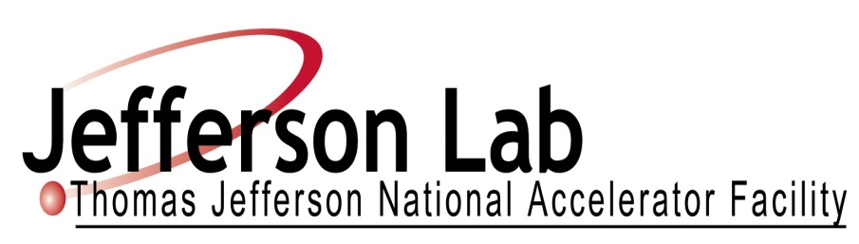
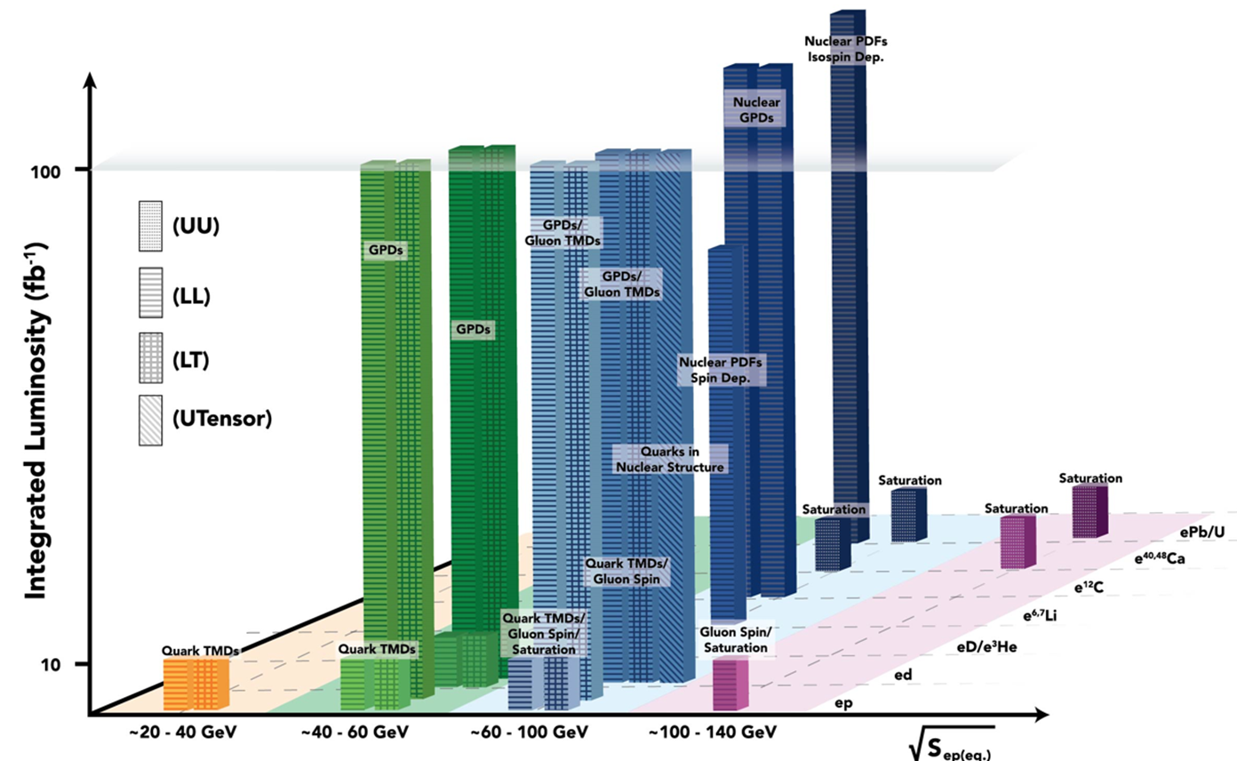
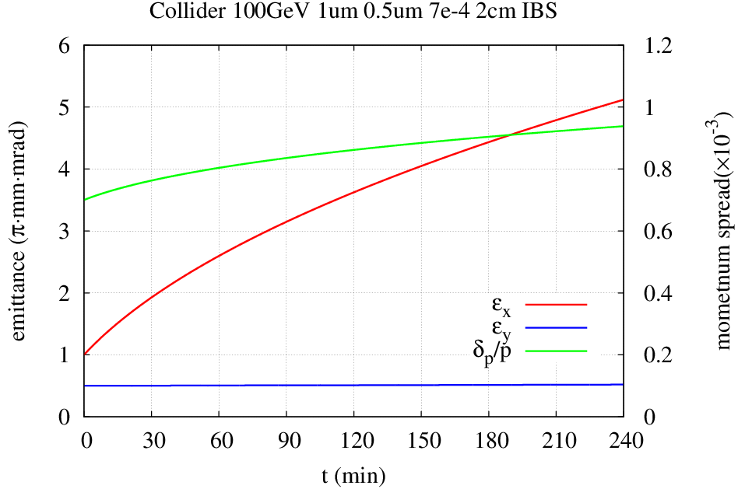
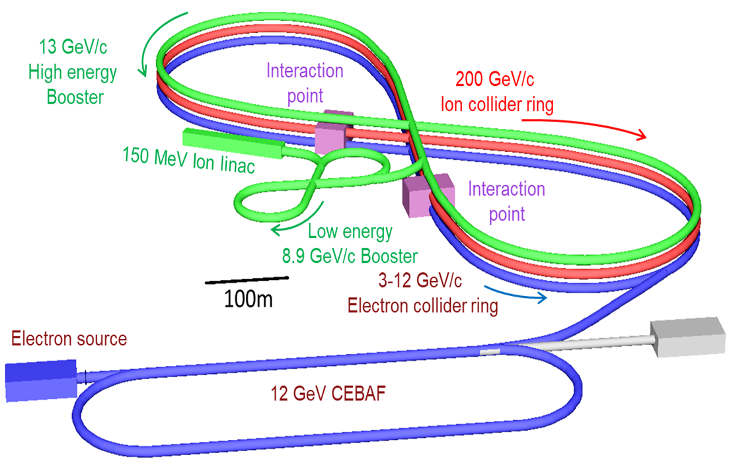
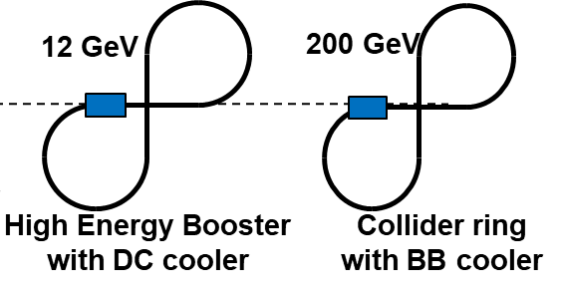
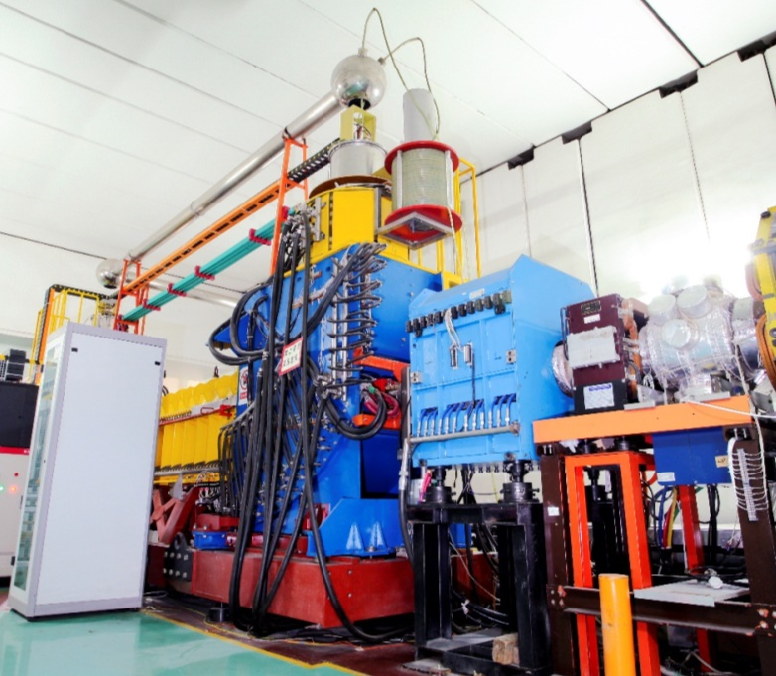
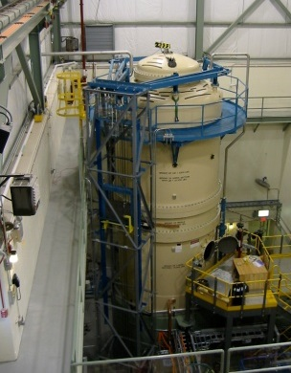
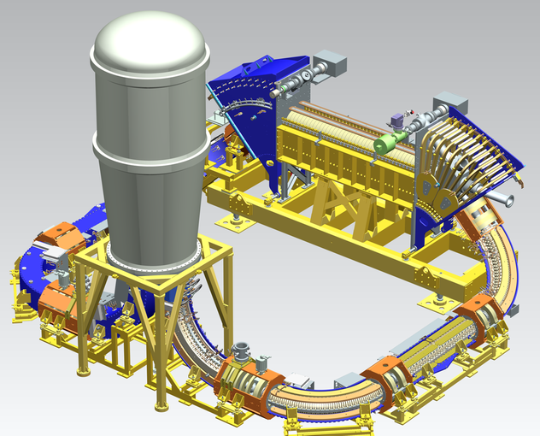
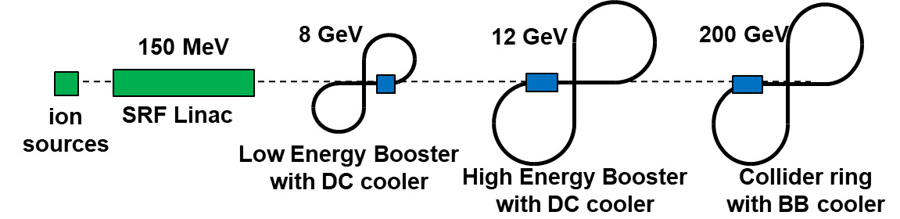
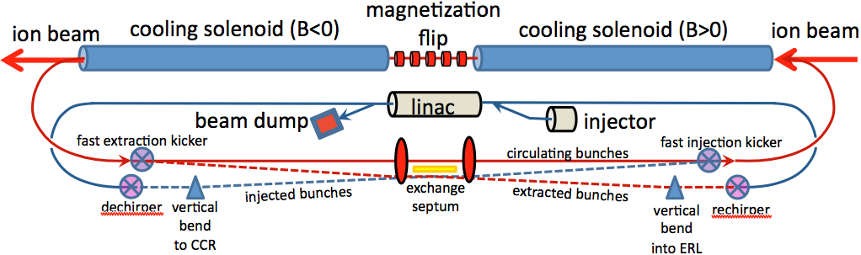
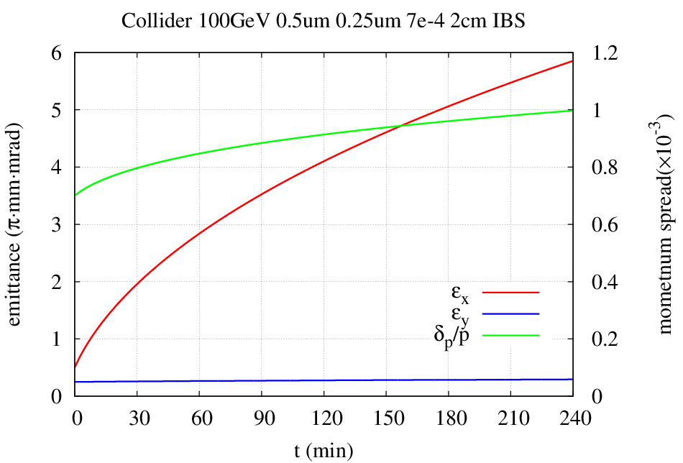
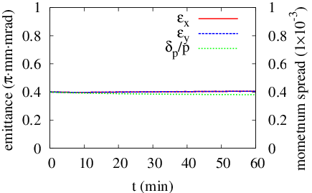
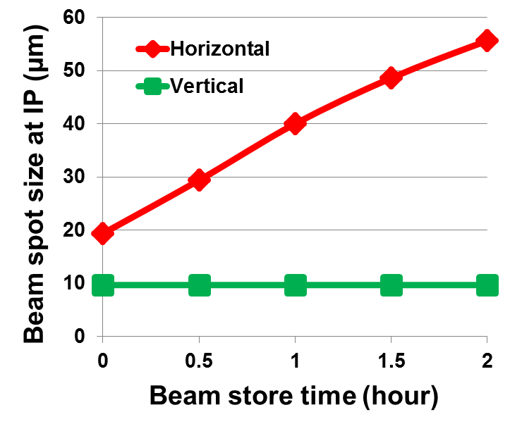
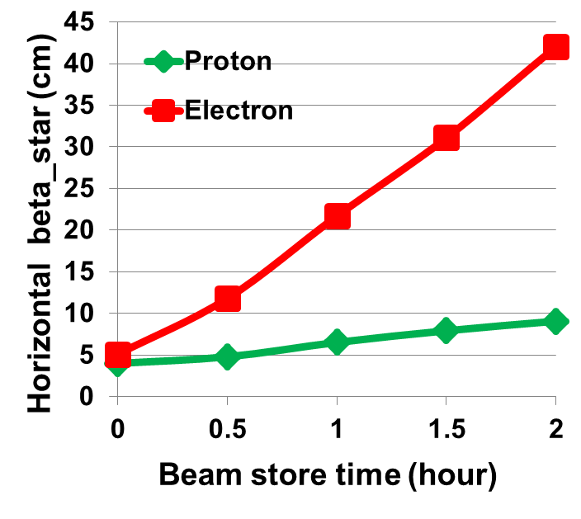
Optimization of JLEIC Integrated Luminosity Without On-Energy Cooling*
Thomas Jefferson National Accelerator Facility, Virginia, USA, Managed by the Jefferson Science Associates, LLC for the U.S. Department of Energy
Yuhong Zhang, Jefferson Lab, USA
* Work supported by U.S. DOE Contract No. DE-AC05-06OR23177
Abstract Jefferson Lab electron-ion collider (JLEIC) is designed to reach high luminosity for physics program. An challenging R&D for JLEIC is development of advanced cooling technologies. Here we present schemes for optimizing JLEIC integrated luminosity performance without cooling of ion beams during collisions.
JLEIC for QCD Frontier
Adjusting IR optics (β*) of both beams dynamically for
Matching spot size at IP ➔ optimizing beam-beam
Control beam sizes at final focusing quads ➔ satisfying magnet apertures
Instance Luminosity
Optimization 4: Full Size HE Booster
Beam formation time (including detector turn-around) affects average (integrated) luminosity
The high energy booster is same size of the collider ring
A new beam is made while another one is in collision
The effective beam formation time is reduced to ~5 min from 30 min normal beam formation time
High luminosity ~10³³⁻³⁴/cm²/s
High polarization > 80%
Full acceptance detection
Emittance Evolution If No Cooling
Longitudinal IBS effect is modest ~20% growth in 2 h
120 min
150 min
180 min
210 min
240 min
30 min
60 min
90 min
start with 1 µm (by DC cooling)
Vertical emittance has no growth
IBS calculation by JSPEC
beam store: 60 min
Many-Small-Bunches for High Lumi.
A new beam is being formed
One beam in collision
Beam Design
High repetition rate
Low bunch intensity
Short bunch length
Small emittance
IR Design
Very small β*
Crab crossing
Damping
Synchrotron radiation
Electron cooling
Initial emittance 1 µm and 0.5 µm
Optimization 5: Beam-Beam Leveling
Beam-beam parameters are true beam physics limit
When proton emittance degrades, spot sizes of both electron and proton beam increases, leading to decrease of beam-beam parameters
This provides opportunity to increase electron current (top-off by a full energy injector) to boost proton beam-beam parameter
Ion Beam Formation w/ e-Cooling
Low Energy Booster
High Energy Booster
collider Ring
Emittance preservation
Stacking/Pre-cool
Emittance preservation
Pre-bunch splitting
bunch splitting
Up to 200 GeV
Accumulation from linac
12.1 GeV
~20 GeV
BB cooling
ERL cooler
Up to 109 MeV
Average luminosity: 4.6 ➔9.7
150 MeV
8 GeV
DC cooler
4.3 MeV
proton
Low Energy booster
High Energy booster
collider Ring
emittance preservation
Stacking, emittance preservation
Pre-bunch splitting
Bunch splitting
Up to 78 GeV/u
Accumulation from linac
Phase painting
~20 GeV
BB cooling
4.3 GeV
ERL cooler
Up to 43 MeV
2.08 GeV
Pre-cool
Optimization 6: Unmatched Beam Spot Size at IP
In strong beam-beam region, matching beam spot sizes is a must in order to mitigate this nonlinear effect. Such requirement can be relaxed in weak beam-beam region
Smaller beam spot size could boost luminosity
41 MeV/u
DC cooler
1.1 MeV
DC cooler
Lead ion
DC cooler
Staged Electron Cooling
Low voltage DC cooling: assisting accumulation
High voltage DC cooling: 6D emittance reduction
High energy ERL cooling: maintain emittance
Optimization 1: Short beam store in Ion Collider Ring
Ring | Functions | Kinetic energy (GeV / MeV) |  |  | Cooler type
 |  | Proton | Lead ion | Electron
Low Energy Booster | Accumulation of positive ions |  | 0.1 (injection) | 0.054 | DC
High Energy booster | Maintain emitt. during stacking | 7.9 (injection) | 2 (injection) | 4.3 (proton) 1.1 (lead) | DC
 | Pre-cooling for emitt. reduction | 7.9 (injection) | 7.9 (ramp to) | 4.3 | DC
collider ring | Maintain emitt. during collision | Up to 100 | Up to 40 | Up to 54.5 | ERL
4.6
What really matters is integrated luminosity (average luminosity over machine run)
3.8
3.3
2.9
3.0
Average luminosity: 1 ➔1.1
2.6
2.2
2.0
DC e-Cooler: Matured Technology
JLEIC Luminosity Performance
IMP
COSY
Optimization 2: pre-Cooling
Take advantage of DC cooling at the HE booster
Achieve very small (initial) emittance
Harvest high contribution of initial instant Luminosity
Evolution of Instance Luminosity
Fermilab
ERL-Circulator Cooler: Critical R&D
Design specs: 1.5 A, 3.2 nC, 225 MW CW, 476 MHz
Technology: magnetized source, ERL, circulator ring
Good performance for up to 150 GeV for p, heavy ions
With ERL cooling
Longitudinal IBS effect is modest
150 min
210 min
240 min
60 min
90 min
120 min
180 min
Average luminosity was calculated assuming
2 hr. proton store with high energy bunched beam electron cooling
1 hr. proton store without high energy bunched beam electron cooling
5 min beam formation time (mainly due to detector overhead)
75% duty factor of machine operation.
Circulator cooler ring
30 min
Vertical emittance has no growth
ERL ring
If start with 0.5 / 0.25 µm (prepared by DC cooling)
IBS calculation by JSPEC codes
More Optimization Ideas: Beam Reconditioning by DC Cooling
Reconditioning time: should be 5 min or less
Ideally, ramp down/up ~ 1 minute
top-off (optional) ~ a few seconds
DC cooling ~ a couple of mins,
Could be useful if the high energy booster is not full size
Cooling Cancels IBS (<150 GeV)
 |  | IBS | ECOOL
R_{H} | 1/s | 4.7E-3 | -2.4E-3
R_{V} | 1/s | -1.7E-5 | -2.3E-3
R_{L} | 1/s | 1.2E-3 | -3.0E-3
8.4
6.2
High contribution
8.8
Collision Energy
4.8
4.0
3.5
Bunch Split
Collision
Bunch Merge
KE_{p}=100 GeV, I_{p}=0.5 A, I_{ec}=1.05 A
2.9
2.6
3.0
Energy ramp Up
Reconditioning by DC cooling
Energy ramp down
Injection Energy
Injection
Dump and refill
Store ~8 hours
Optimization 3: Reduction of Bunch Repetition Rate
Ion bunch charge is limited by high energy electron cooling (electron bunch charge due to e-gun and transport in ERL/circulator ring)
If no such cooling, bunch repetition rate can be reduced
Smaller repetition rate boosts luminosity L ~ I_{e} I_{p} / f
Conclusions
JLEIC integrated luminosity without cooling during collision is still able to meet EIC science requirement.
The luminosity performances can be improved with short beam store, pre-cooling by a DC cooler, reducing bunch repetition rate, full size high energy booster, beam-beam leveling and un-matching of beam spot sizes at IP.
No Cooling in Collision (>150 GeV)
Simulations show cooling driven by an ERL-Circulator Cooler is not effective to suppress IBS at high energy
Such cooler is also high cost and technical challenges
We must consider an operation scenario with no cooling
Thank Ya. Derbenev, P. McIntyre for helpful discussions, and V. Morozov, H. Zhang for assistance in IBS estimate

