Slide 1
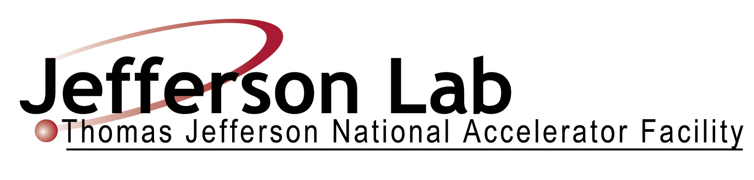
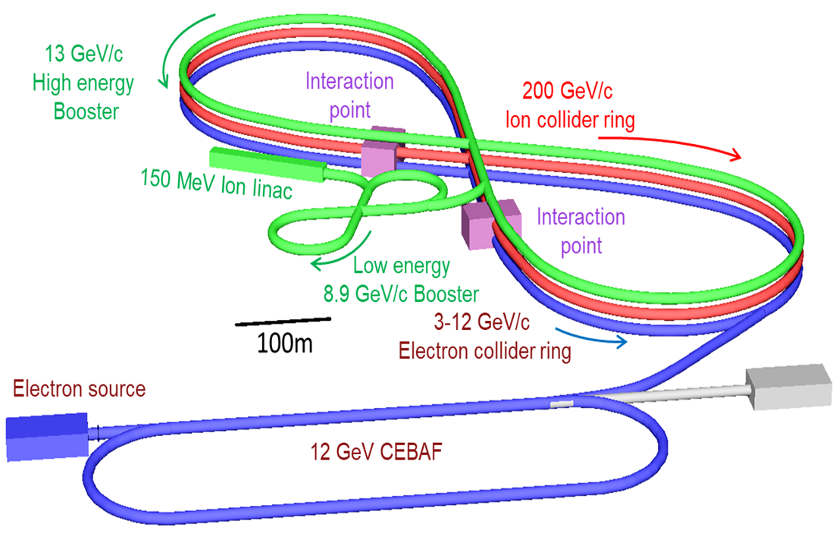


MOPRB098
An Increased Extraction Energy Booster Complex For The Jefferson Lab Electron Ion Collider*
E. Nissen
Thomas Jefferson National Accelerator Facility
Newport News, Virginia, USA
Managed by the Jefferson Science Associates,
LLC for the U.S. Department of Energy Office of Science
Abstract
The proposed Jefferson Lab Electron Ion Collider (JLEIC) envisions an ion complex composed of an ion linac, two booster synchrotrons and a collider ring. The evolving design of the JLEIC booster required an increase in the extraction energy of the booster from 8 to 12.1 GeV kinetic energy, necessitating two machines instead of one. The decision was also made to switch to warm magnets, thus increasing the total radius of the 8 GeV booster, with the second booster being the same size as the collider rings. In this work we present the new designs for JLEIC’s Low Energy Booster (LEB) and High Energy Booster (HEB).
The Proposed JLEIC Complex
The Low Energy Booster (LEB)
The Low Energy Booster (LEB) is the first part of the new booster stack in JLEIC. It will,
Bring the beam’s kinetic energy from 150 MeV to 8 GeV for protons (or ions of equivalent rigidity)
Avoid transition crossing throughout the span of the machine (γ_{t}=10.6)
Have a circumference of 604m
Use warm magnets in a FODO configuration
The High Energy Booster (HEB)
The High Energy Booster (HEB) is the second part of the new booster stack in JLEIC. It will,
Bring the beam’s kinetic energy from 8 GeV to 12.101 GeV (13 GeV/c) for protons (or ions of equivalent rigidity)
Avoid transition crossing throughout the span of the machine (γ_{t}=14.745)
Have a circumference of 2341m, matching the footprint of the electron collider ring
Use warm magnets in a FODO configuration
Matched Geometry to Electron Collider Ring
The electron collider ring has spin rotators at the ends of each arc, these include bending in them which necessitates additional bending to match the geometry. This extra bending is used to suppress the dispersion coming from the arcs.
FODO Arcs
The arcs use a FODO cell with a phase advance per cell of 108°/cell. This arc uses 2 HEB cells for each 3 electron collider ring cells. Matching the geometry of the dispersion suppressors thus requires different bending at the ends of the arcs. This means that dispersion is not fully suppressed in the arcs, and it must be done in the spin rotator section.
*Authored by Jefferson Science Associates, LLC under U.S. DOE Contract No. DE-AC05-06OR23177. The U.S. Government retains a non-exclusive, paid-up, irrevocable, world-wide license to publish or reproduce this manuscript for U.S. Government purposes.

