Slide 1




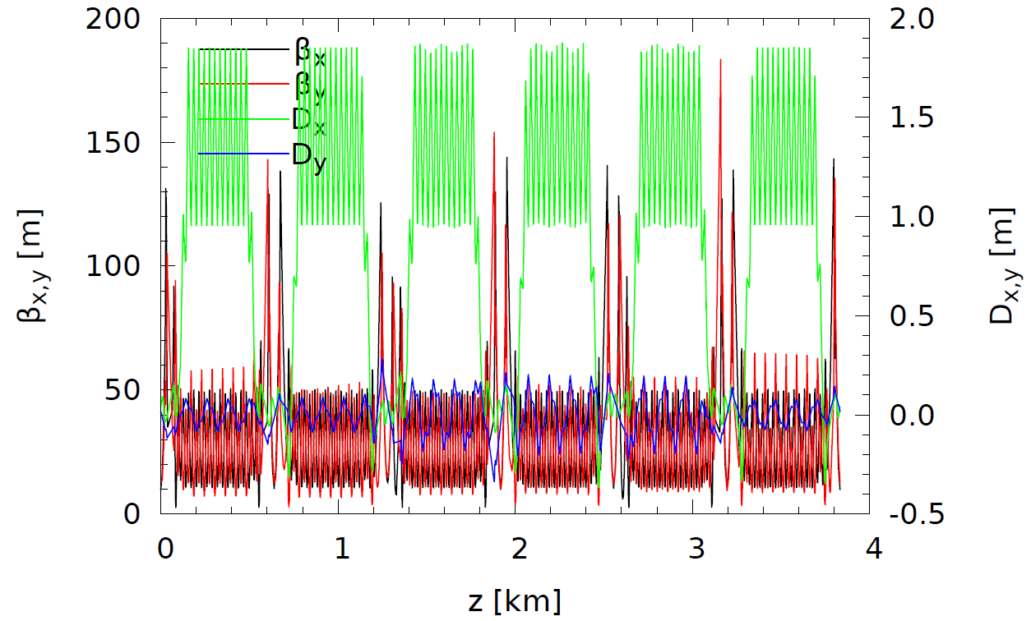
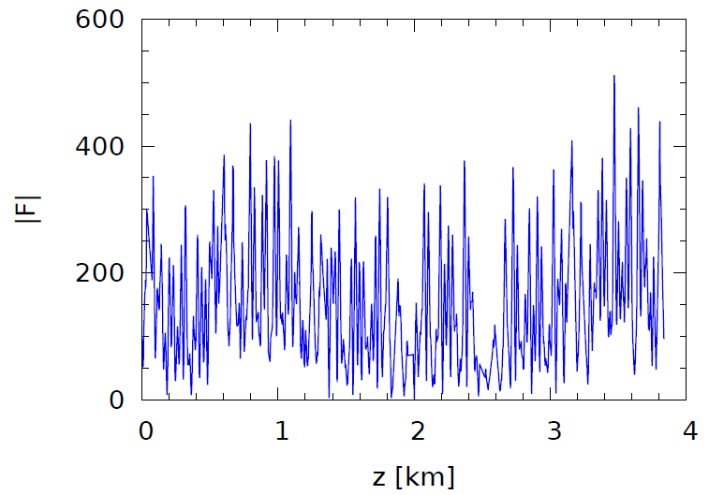

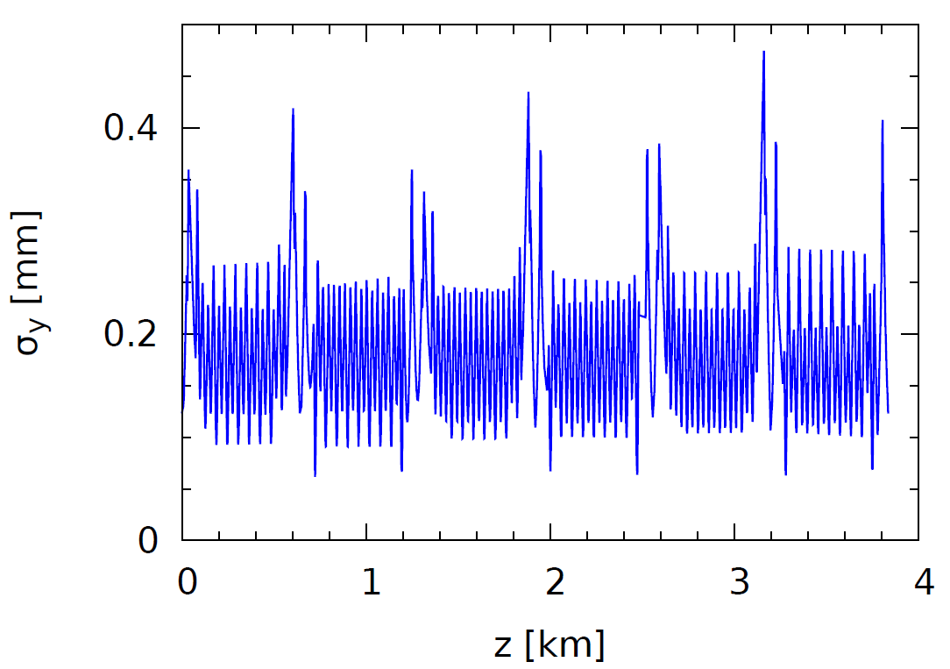
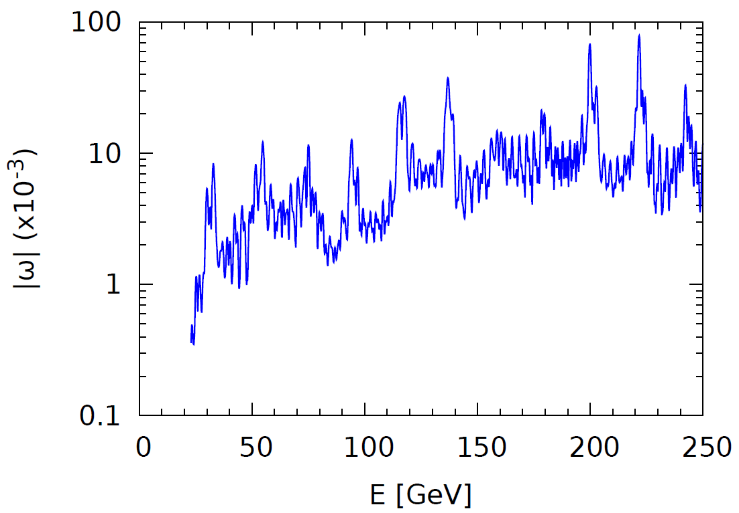




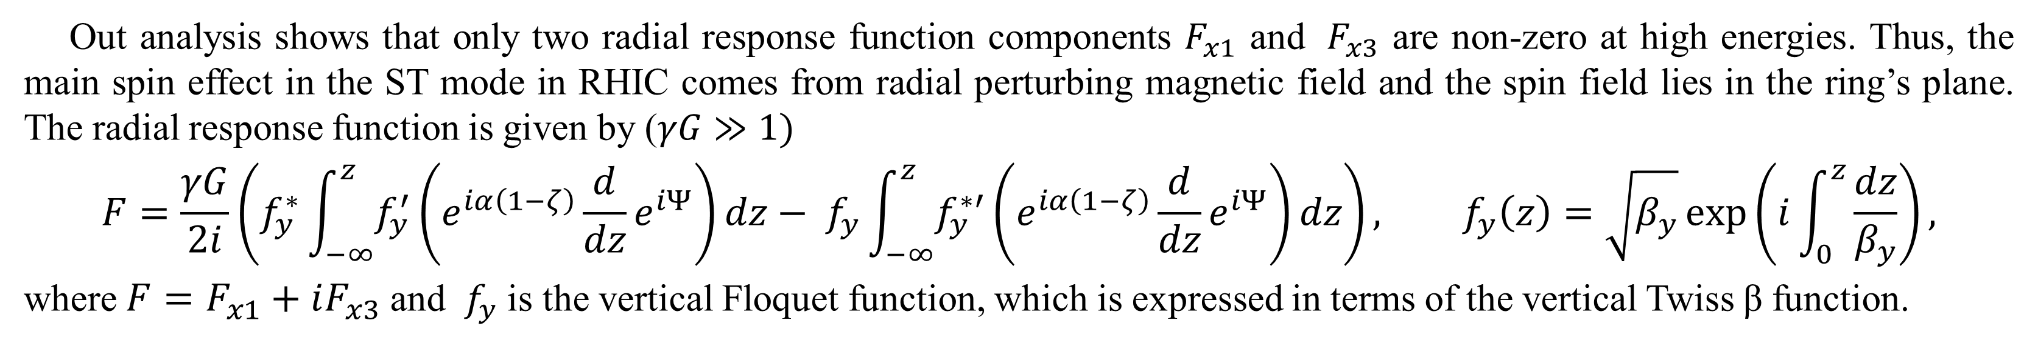

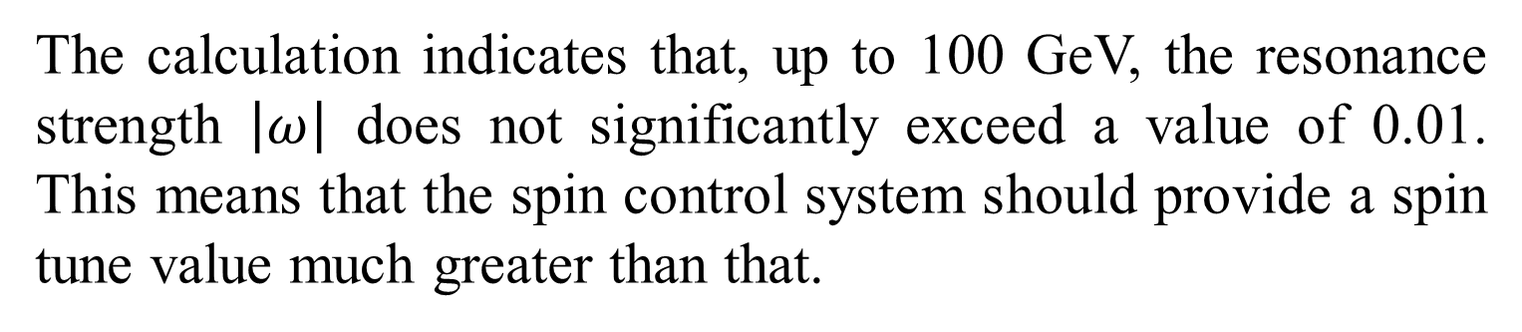

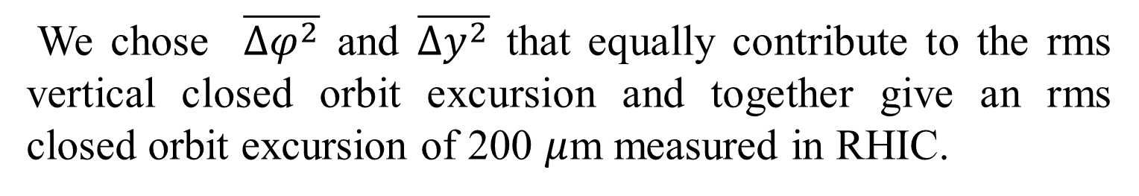
SPIN RESPONSE FUNCTION FOR
SPIN TRANSPARENCY MODE OF RHIC
A.M. Kondratenko^{1,2}, M.A. Kondratenko^{1,2}, Yu.N. Filatov² , Ya.S. Derbenev³, F. Lin³,
V.S. Morozov³, Y. Zhang³, P. Adams⁴, H. Huang⁴, F. Meot⁴, V. Ptitsyn⁴, W. Schmidke⁴ , and H. Huang⁵
¹STL “Zaryad”, Russia, ²MIPT, Russia, ³Jefferson Lab, USA, ⁴BNL, USA, ⁵Old Dominion University, USA
MOPRB096
ABSTRACT In the Spin Transparency mode (ST mode) of RHIC, the axes of its Siberian snakes are parallel. The spin tune in the ST mode is zero and the spin motion becomes degenerate: any spin direction repeats every particle turn. In contrast, the lattice of a conventional collider determines a unique stable periodic spin direction, so that the collider operates in the Preferred Spin (PS) mode. Contributions of perturbing magnetic fields to the spin resonance strengths in the PS mode are usually calculated using the spin response function. However, in that form, it is not applicable in the ST mode. This paper presents a response function formalism expanded for the ST mode of operation of conventional colliders with two identical Siberian snakes in the highly-relativistic limit. We present calculations of the spin response function for RHIC in the ST mode.
SPIN TRANSPARENCY MODE IN RHIC
spin transparent ring. To regain control of the spin motion, one must introduce relatively weak magnetic elements into the ring whose spin effect is still relatively small but is much greater than the spin effect of the imperfections. To determine the required magnetic field integrals of the spin control elements, one must be able to accurately estimate the expected effect of imperfections, which can be characterized by an average spin field, or a zero-integer spin resonance strength (an absolute value of the average spin field).
The resonance strength can be most conveniently calculated using a periodic spin response function [4, 5]. The response function is a spin Green’s function describing the effect of a
δ-function-like magnetic field perturbation on the spin at a certain location in the ring. It takes into account the spin effect of the whole ring in response to a local field perturbation. The response function describes the spin effect in the linear approximation and can be calculated using the ring’s linear optics. The total effect of the ring imperfections in terms of the spin resonance strength can be obtained by integrating the spin effects of all imperfections around the ring using the response function. This can be done in a statistical sense [6]. A generalized spin response function has earlier been derived for a ring with a preferred spin orientation [7]. However, that formalism has been developed under the assumption of a non-resonant case with an existing unique stable spin direction and is not directly applicable to a resonant case without a preferred spin direction such as the ST mode. In this paper, we present spin response formalism for RHIC with two identical Siberian snakes at opposite locations.
ST MODE SPIN REFERENCE FRAME
An experimental test of a new polarization control mode, the Spin Transparency (ST) mode, is planned in RHIC [1]. RHIC is a collider with two helical Siberian snakes. Its spin tune is determined by the angle $φ$between the snake axes and the stable polarization is vertical in the collider’s arcs:
$$ν=φ/π, { \vec{n}}_{arc}={±\vec{e}}_{y}$$
Thus, the spin tune equals one half (RHIC’s regular PS mode of operation) if the angle between the snake axes is π/2. To convert RHIC to the ST mode, when the spin tune is zero, the angle between the snake axes must be set to zero, i.e. the snakes must be identical. From the spin dynamics point of view, RHIC then becomes equivalent to a figure-8 collider [2]. While geometrically obviously still different, the two kinds of rings have identical topologies of the spin motion. The two snakes located opposite to each other in a circular ring divide the ring into two 180◦ arcs. Due to the action of the snakes, the spin sees opposite fields in the two arcs in exactly the same way as it happens in a figure-8 ring. JINR (Dubna, Russia) develops the NICA collider project with two solenoidal snakes set in the ST mode [3].
The ST mode of a ring removes the integral effect of the whole ring lattice on the spin. In an ideal case, any spin direction on the closed design orbit of a spin transparent ring is periodic. In a realistic case, the spin dynamics is governed by lattice imperfections such as dipole roll and quadrupole misalignments. The spin effect of such imperfections is typically small. However, it breaks the degeneracy of a perfectly
We introduce a system of periodic spin unit vectors ${\vec{e}}_{i}^{s}$ to describe the spin motion. The spin reference frame is periodic in the lab frame and therefore in the accelerator frame because any spin direction in the ST mode repeats itself every particle turn. The choice of the spin unit vectors is arbitrary: for example, it is convenient to align them with the accelerator unit vectors $\{{\vec{e}}_{x}, {\vec{e}}_{y}, {\vec{e}}_{z}\}$. at the observation point. The spin unit vectors ${\vec{e}}_{i}^{s}$ are then oriented in the detector along the radial, vertical, and longitudinal directions, respectively. In the spin reference frame, changes in the spin components can only be caused by perturbing fields arising either due to deviation of the particle motion from the design orbit (associated with the beam emittances) or due to construction and alignment errors of the ring’s magnetic elements..
Spin unit vectors are defined in RHIC with its two Siberian snakes in the following way. Vector ${\vec{e}}_{2}^{s}= ζ {\vec{e}}_{2}$ is vertical in the arcs and changes sign $ζ=±1$ when passing through a snake from one arc into the other. The two other basis vectors ${\vec{e}}_{1}^{s}$ and ${\vec{e}}_{3}^{s}$ lie in the ring’s plane making many turns in the arcs
$${\vec{e}}_{1}^{s}+i {\vec{e}}_{3}^{s}=e^{iα(1−ζ)}e^{iΨ}\left({\vec{e}}_{1}+i ζ{\vec{e}}_{3}\right),$$
where $Ψ=γG\int_{0}^{z}{K_{y} ζdz}$ is the phase, which is a periodic function of the ring $Ψ(z)=Ψ(z+L)$, $L$ is the orbit length, and $α$ is the angle the snake axes $\vec{m}$ make in the ring’s plane with the radial direction ($m_{x}+im_{z}=e^{iα}$).
RESPONSE FUNCTIONS IN ST MODE
Out analysis shows that only two radial response function components $F_{x1}$ and ${ F}_{x3}$ are non-zero at high energies. Thus, the main spin effect in the ST mode in RHIC comes from radial perturbing magnetic field and the spin field lies in the ring’s plane. The radial response function is given by ($γG≫1)$
$$F=\frac{γG}{2i}\left(f_{y}^{∗}\int_{−∞}^{z}{f_{y}^{′}}\left(e^{iα\left(1−ζ\right)}\frac{d}{dz}e^{iΨ}\right)dz− f_{y}\int_{−∞}^{z}{f_{y}^{∗′}}\left(e^{iα\left(1−ζ\right)}\frac{d}{dz}e^{iΨ}\right)dz\right), f_{y}\left(z\right)=\sqrt{β_{y}}\exp\left(i\int_{0}^{z}{\frac{dz}{β_{y}}}\right),$$
where $F=F_{x1}+iF_{x3}$ and $f_{y}$ is the vertical Floquet function, which is expressed in terms of the vertical Twiss β function.
In the general case, effect of periodic perturbing fields $∆B_{x}$, $∆B_{y}$, and $∆B_{z}$on the spin is described in the ST mode by three vector response functions, radial ${\vec{F}}_{x}$, vertical ${\vec{F}}_{y}$, and longitudinal ${\vec{F}}_{z}$, which are determined by the ring’s lattice [8]:
$$\vec{ω}=\frac{1}{2π}\int_{0}^{L}{\left[\frac{∆B_{x}}{Bρ} {\vec{F}}_{x} +\frac{∆B_{y}}{Bρ}{\vec{F}}_{y}+\frac{∆B_{z}}{Bρ}{\vec{F}}_{z} \right]}dz.$$
where $Bρ$ is the magnetic rigidity. In the spin reference frame, the spin motion represents rotation about the average spin field $\vec{ω}$, whose magnitude is equal to the zero-integer spin resonance strength (ST-resonance strength):$ω=|\vec{ω}|$.
The longitudinal response function components do not grow with energy. To the contrary, the transverse response functions change proportionally to energy.
We used RHIC’s injection optics shown in left Figure in the above equations to obtain RHIC’s response function in the ST mode. The absolute value of the response function is plotted in the right Figure for RHIC’s injection at $γG = 45.5$
ST-RESONANCE STRENGTH
We chose $\overline{{Δφ}^{2}}$ and $\overline{{Δy}^{2}}$ that equally contribute to the rms vertical closed orbit excursion and together give an rms closed orbit excursion of 200 $μ$m measured in RHIC.
CONCLUSION
We used the statistical model to evaluate the coherent part of the ST-resonance strength $|ω_{coh}|$ for RHIC’s injection lattice. This is the dominant component of the resonance strength. It assumes independent random errors and treats them in a statistical sense. It predicts a resonance strength of
$$\left|ω_{coh}\right|=\sqrt{\frac{1}{4π^{2}{\left(Bρ\right)}^{2}}\sum_{elements}{\overline{∆B_{x}^{2}}{ \left|F\right|}^{2}L_{x}^{2}}}$$
where ${\left(\overline{∆B_{x}^{2}}\right)}^{1/2}$ is the rms error of the radial magnetic field in an element, and $L_{x}$ is the element’s length. The radial error magnetic fields arise in a ring due to dipole roll and vertical quadrupole misalignments
$$\overline{∆B_{x}^{2}}L_{x}^{2}=θ^{2} \overline{{Δφ}^{2}} {\left(Bρ\right)}^{2}, \overline{∆B_{x}^{2}}L_{x}^{2}={\left(k_{1}L_{x}\right)}^{2}\overline{{Δy}^{2}}{\left(Bρ\right)}^{2}$$
where $θ$ is the dipole bending angle, ${\left(\overline{∆φ^{2}}\right)}^{1/2}$ is the dipole’s rms roll angle, $k_{1}L_{x}$ is the integrated normalized quadrupole gradient, and ${\left(\overline{∆y^{2}}\right)}^{1/2}$ is the rms vertical quadrupole misalignment. The most probable vertical orbit excursion is given by
$$σ_{y}=\sqrt{\frac{β_{y}\left(z\right)}{8\sin^{2}\left(πν_{y}\right)}\sum_{elements}{\frac{\overline{∆B_{x}^{2}}L_{x}^{2}}{{\left(Bρ\right)}^{2}}β_{y}\left(z_{j}\right)}}$$
Our earlier estimates were based on a spin tune of 0.05 [1], which can be set in RHIC using the existing Siberian snakes and spin rotators. The calculation of ST-resonance strength confirms that a spin tune of 0.05 is sufficient for complete control of the proton polarization at least up to 100 GeV. Above 100 GeV, aside for a few interference peaks, the resonance strength stays at the level of about 0.01. The coherent part of the resonance strength does not cause depolarization. Therefore, it may still be possible to go to higher energies and control the polarization between the interference peaks with a small spin tune. This possibility requires further study.
The calculation indicates that, up to 100 GeV, the resonance strength $\left|ω\right|$ does not significantly exceed a value of 0.01. This means that the spin control system should provide a spin tune value much greater than that.
REFERENCES
[1] V. S. Morozov et al., “Experimental Verification of Spin Transparency Mode in RHIC”, presented at IPAC’19, Melbourne, Australia, May 2019, paper MOPRB094, this conference.
[2] V. S. Morozov et al., “Baseline Scheme for Polarization Preservation and Control in the MEIC Ion Complex”, in Proc. IPAC’15, Richmond, VA, USA, May 2015, pp. 2301–2303.
[3] Yu.N. Filatov et al., “Spin transparency mode in the NICA collider”, EPJ Web Conf., vol. 204, p. 10014, 2019.
[4] A. M. Kondratenko, “Polarized beams”, Ph.D. thesis, (Budker) Institute of Nuclear Physics, Siberian Br. USSR Academy of Sciences, Novosibirsk, 1982
[5] A. M. Kondratenko et al., “Ion Polarization Scheme for MEIC”, 2016. arXiv:1604.05632[physics.acc-ph]
[6] V. S. Morozov et al., “Acceleration of Polarized Protons and Deuterons in the Ion Collider Ring of JLEIC”, in Proc. IPAC’17, Copenhagen, Denmark, May 2017, pp. 3014–3017.
[7] V. I. Ptitsin, Yu. M. Shatunov, and S. R. Mane, “Spin response formalism in circular accelerators”, Nucl. Instr. Meth. A, vol.608, no. 2, pp. 225-233, 2009.
[8] Yu.N. Filatov et al., “Spin Transparency Method for Spin Control of Hadron Beam in Synchrotrons”, to be published
10th International Particle Accelerator Conference
Melbourne, Australia, 2019 May 19—24
Authored by Jefferson Science Associates, LLC under U.S. DOE Contract No. DE-AC05-06OR23177 and by Brookhaven Science Associates, LLC under Contract No. DE-AC02-98CH10886 with the U.S. Department of Energy

