Slide 1




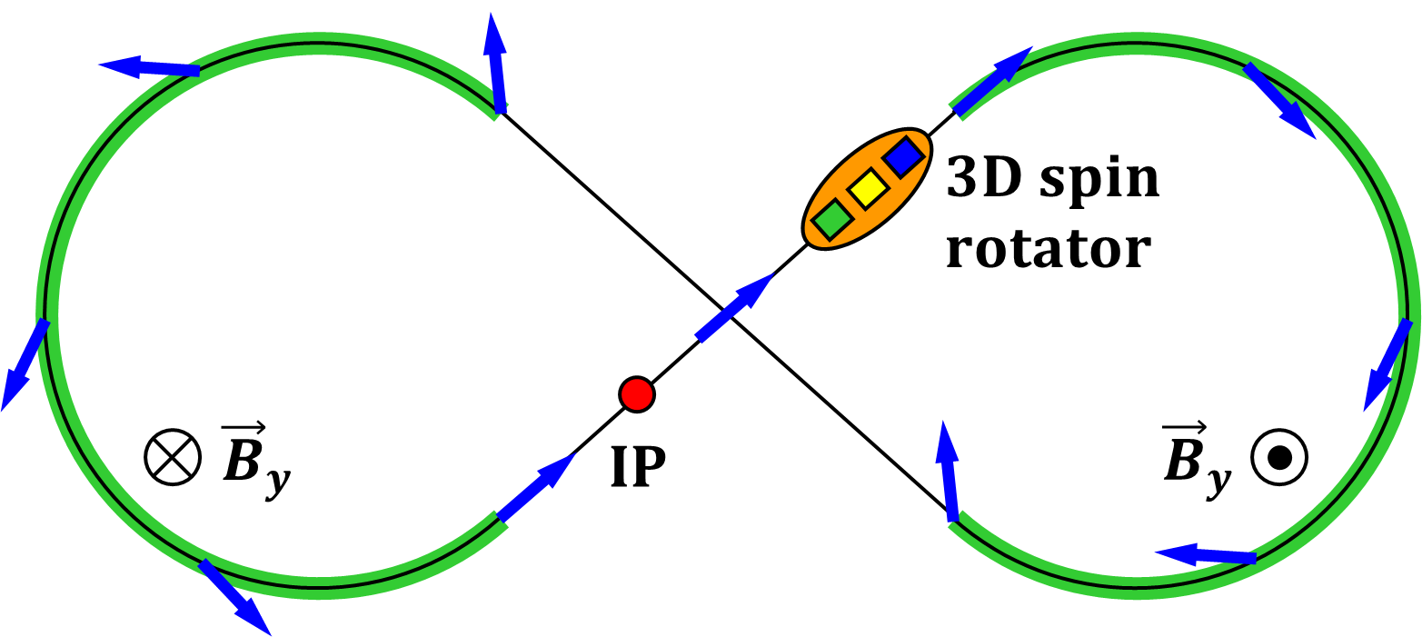
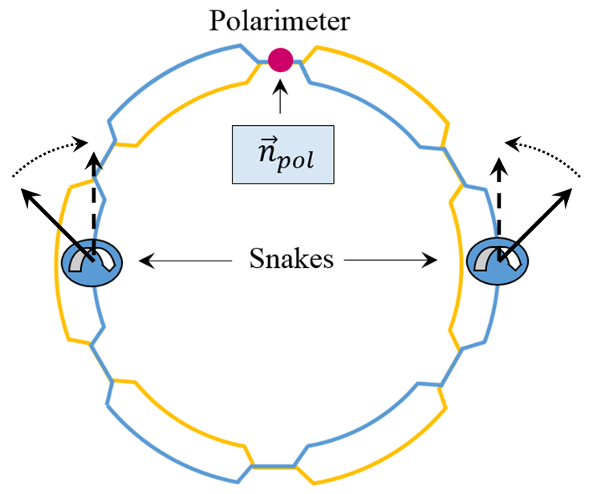
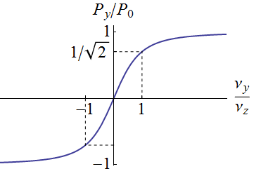
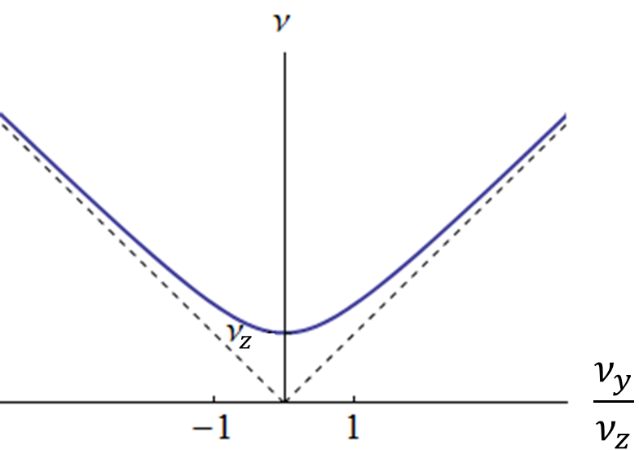





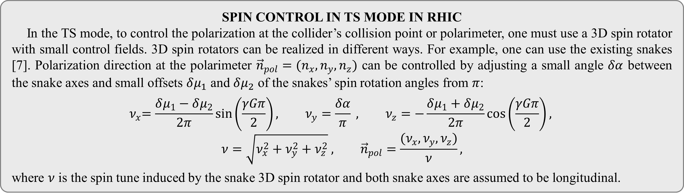
EXPERIMENTAL VERIFICATION OF
TRANSPARENT SPIN MODE IN RHIC
V.S. Morozov¹, Ya.S. Derbenev¹, F. Lin¹, Y. Zhang¹, P. Adams², H. Huang², F. Meot²,
V. Ptitsyn², W. Schmidke², A.M. Kondratenko^{3,4}, M.A. Kondratenko^{3,4}, Yu.N. Filatov⁴, and H. Huang⁵
¹Jefferson Lab, USA, ²BNL, USA, ³STL “Zaryad”, Russia, ⁴MIPT, Russia, ⁵Old Dominion University, USA
MOPRB094
ABSTRACT High electron and ion polarizations are some of the key design requirements of a future Electron Ion Collider (EIC). The transparent spin mode, a concept inspired by the figure 8 ring design of JLEIC, is a novel technique for preservation and control of electron and ion spin polarizations in a collider or storage ring. It makes the ring lattice “invisible” to the spin and allows for polarization control by small quasi-static magnetic fields with practically no effect on the beam’s orbital characteristics. It offers unique opportunities for polarization maintenance and control in Jefferson Lab’s JLEIC and in BNL’s eRHIC. The transparent spin mode has been demonstrated in simulations and we now plan to test it experimentally. We present a design of an experiment using a polarized proton beam stored in one of the RHIC rings. In the experiment, one of the RHIC rings is configured in the transparent spin mode by aligning the axes of its two Siberian snakes. The experiment goals, procedures, hard-ware requirements and expected results are presented.
DIRECT SPIN AND TRANSPARENT SPIN MODES
A particle moving on a closed orbit in a ring has a unique “distinct” periodic spin precession axis $\vec{n}$ [1] except when it is in an integer spin resonance. In an integer spin resonance, the direction of the periodic spin precession axis $\vec{n}$ is degenerate. Any spin direction repeats after a particle turn, i.e., the collider becomes “transparent” to the spin. Thus, rings can operate in two polarized beam modes, namely, “Distinct Spin” (DS) mode and “Transparent Spin” (TS) mode. In the DS mode, the periodic spin motion along the closed orbit is unique, i.e. the static magnetic lattice determines a single stable orientation of the beam polarization. In the TS mode, the spin direction is stabilized by introducing small-integral static magnetic fields [2]. This provides a lot of flexibility when designing injection, polarimetry and spin-flipping systems. For polarization stability in the TS mode, the spin tune induced by the weak control fields must significantly exceed the resonance strength, which consists of two parts: a coherent part $ω_{coh}$ arising due to spin perturbing transverse and longitudinal fields on the distorted closed orbit and an incoherent part $ω_{emitt}$ associated with the beam emittances. In practice, the coherent part significantly exceeds the incoherent one: $ω_{coh}≫ω_{emitt}$ [3].
TS MODE IN JLEIC
A natural example of a collider transparent to the spin is the proposed Jefferson Lab Electron Ion Collider
(JLEIC) with figure-8 shaped rings [4]. In such a collider, effect of one arc on the spin is compensated by the other arc as illustrated below.
To obtain any polarization direction at the collision point for any particle species including deuterons, the universal 3D spin rotator includes three modules, which can rotate the spin about three orthogonal axes $(n_{x}, n_{y}, n_{z})$. They are built using weak solenoids and stabilize a given polarization direction $\vec{P}=\vec{n}$. The 3D rotator can flip the polarization by adiabatically reversing $\vec{n}$ while keeping the spin tune constant.
TS MODE IN RHIC AND ERHIC
The existing snakes can also be used for operation of RHIC in the TS mode. The spin rotation axes of the helical snakes lie in the collider’s plane and are set by the snakes’ magnetic fields [5]. The spin tune is determined by the angle $φ$ between the snake axes and the stable polarization in the collider’s arcs is vertical:
$$ν=\frac{φ}{π} , {\vec{n}}_{arc}=±{\vec{e}}_{y}$$
The spin tune equals one half (RHIC’s regular mode of operation) if the angle between the snake axes is $π/2$. To convert RHIC to the TS mode, when the spin tune is zero (or one), the angle between the snake axes must be set to zero (or $π$), i.e. the snakes must be identical. The effect of the strong fields in the arcs and snakes on the spin reduces to zero over one orbit turn, any polarization direction repeats after each orbit turn.
Although not included in the present eRHIC design [6], the TS mode can be arranged in the eRHIC collider rings by appropriately configuring snakes and spin rotators. The benefits of such a configuration could be similar to those of the JLEIC figure-8 rings.
SPIN CONTROL IN TS MODE IN RHIC
In the TS mode, to control the polarization at the collider’s collision point or polarimeter, one must use a 3D spin rotator with small control fields. 3D spin rotators can be realized in different ways. For example, one can use the existing snakes [7]. Polarization direction at the polarimeter ${\vec{n}}_{pol}=(n_{x}, n_{y},n_{z})$ can be controlled by adjusting a small angle $δα$ between the snake axes and small offsets $δμ_{1}$ and $δμ_{2}$ of the snakes’ spin rotation angles from $π$:
$${ ν}_{x}=\frac{δμ_{1}−δμ_{2}}{2π}\sin\left(\frac{γGπ}{2}\right), ν_{y}=\frac{δα}{π} , ν_{z}=−\frac{δμ_{1}+δμ_{2}}{2π}\cos\left(\frac{γGπ}{2}\right),$$
$$ν=\sqrt{ν_{x}^{2}+ν_{y}^{2}+ν_{z}^{2}} , {\vec{n}}_{pol}=\frac{{(ν}_{x}, ν_{y},ν_{z})}{ν},$$
where $ν$ is the spin tune induced by the snake 3D spin rotator and both snake axes are assumed to be longitudinal.
EXPERIMENTAL SCENARIOS
Vertically polarized protons are injected from the AGS into a collider ring. To match the injected polarization direction, the 3D spin rotator must provide vertical polarization in the collider’s arcs. To meet this requirement, the spin rotation angle offsets $δμ_{1}=δμ_{2}=0$ and the angle between the snake axes should be of the order of ${10}^{∘}$, which provides a spin tune $ν=ν_{y}≈ 0.05$ $\left(ν_{z}=0, { \vec{n}}_{pol}={\vec{e}}_{y}\right)$. To preserve the polarization, one must avoid crossing of spin resonances during acceleration. To accomplish this, it is sufficient to maintain a constant spin tune (angle between the snake axes).
Proton polarization control can be demonstrated by an example of reversing the vertical polarization component at the polarimeter. The polarization reversal is produced by a small variation of the angle between the snake axes with the spin rotation angle offsets $δμ_{1}=δμ_{2}$ fixed ($γG≠k$). The vertical polarization component at the polarimeter is
$${\left(n_{pol }\right)}_{y}={ν_{y}}/{\sqrt{{ ν}_{y}^{2}+ν_{z}^{2}}}.$$
The dependencies of the vertical polarization component at the polarimeter and of the spin tune on the angle between the snake axes at fixed $δμ_{1}=δμ_{2}$ are shown below. An adiabatic change of the angle between the snake axes from ${−10}^{∘}$ to ${10}^{∘}$ causes polarization flip. In principle, such an experiment with $δμ_{1}=δμ_{2}=0$ allows one to measure the strength of the zero-integer spin resonance through the characteristic width of the polarization reversal region: $ν_{min}=ω$.
CONCLUSION
A new mode of RHIC operation with a polarized proton beam, a transparent spin mode, has been proposed. It offers new opportunities for manipulation of the proton polarization at any location in the collider. BNL’s RHIC has all of the necessary components for an experimental test of the new mode. Potential experimental scenarios have been presented. Experimental parameters are being developed [8]. The experiment will validate the TS concept as a new tool for polarization preservation and control in the existing and future synchrotrons.
REFERENCES
[1] Ya.S. Derbenev et al., Sov. Phys. Dokl. v. 15, p. 583 (1970).
[2] A.M. Kondratenko et al., arXiv:1604.05632 [physics.acc-ph] (2016).
[3] Yu.N. Filatov et al., “Response function formalism for the transparent spin mode”, to be published.
[4] S. Abeyratne et al., arXiv:1504.07961 [physics.acc-ph] (2015).
[5] V. Ptitsin and Y. Shatunov, NIM A 398, 126 (1997).
[6] C. Montag and V. Ptitsyn, ICFA Beam Dynamics Newsletter 74 (2018), p. 23.
[7] F. Meot et al., BNL Tech. Note C-A/AP/590 (2017).
[8] A.M. Kondratenko et al., “Spin response function for spin transparency mode of RHIC”, presented at this conference.
10th International Particle Accelerator Conference Melbourne, Australia, May 19-24, 2019
Authored by Jefferson Science Associates, LLC under U.S. DOE Contract No. DE-AC05-06OR23177 and by Brookhaven Science Associates, LLC under Contract No. DE-AC02-98CH10886 with the U.S. DOE

