Slide 1


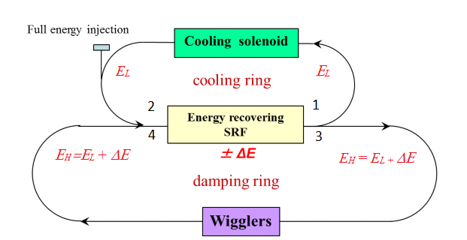
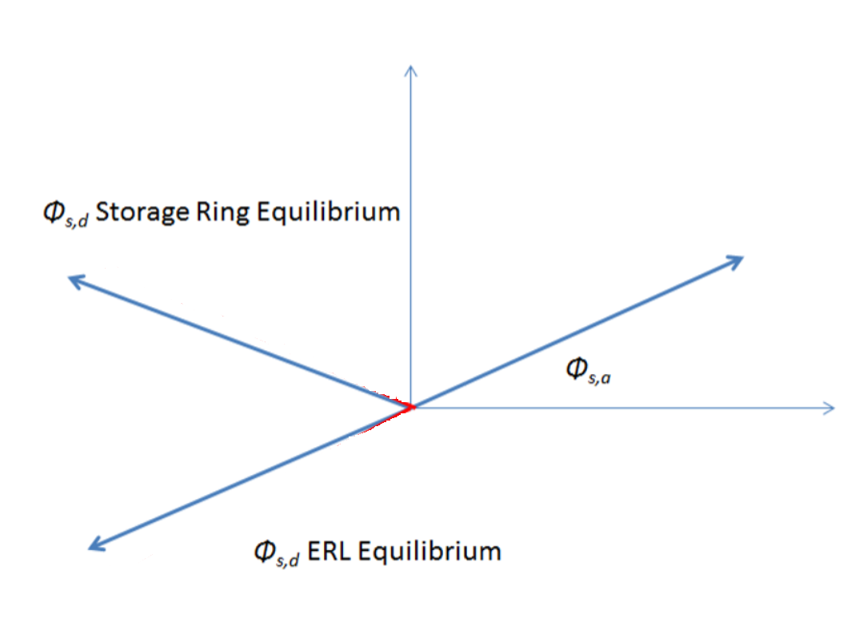
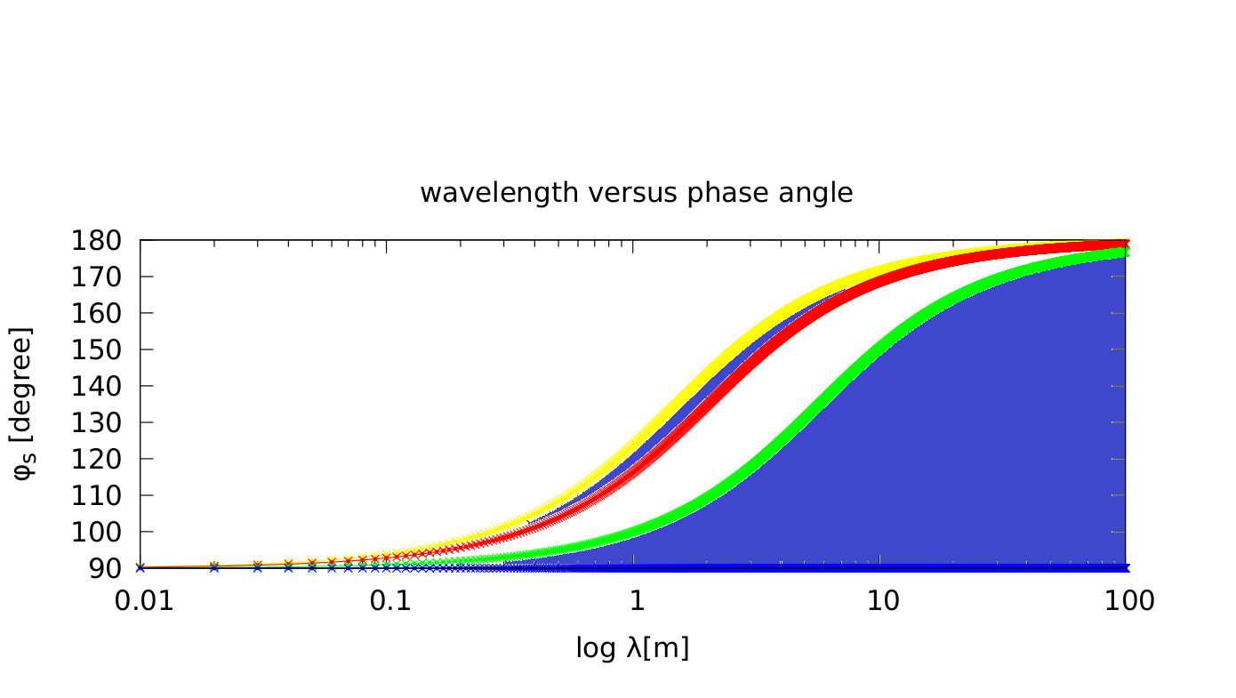
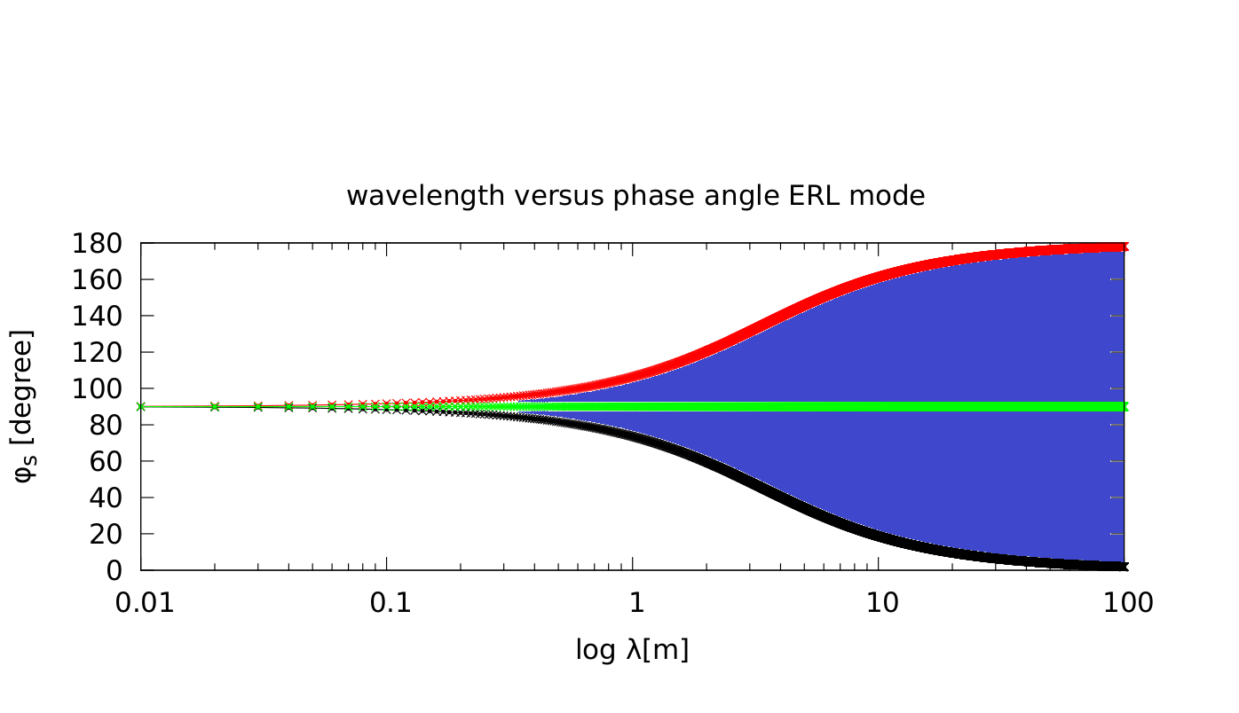
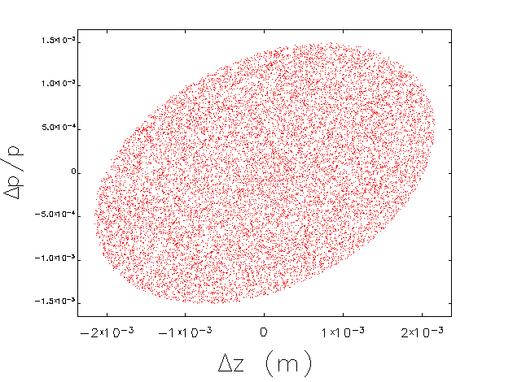

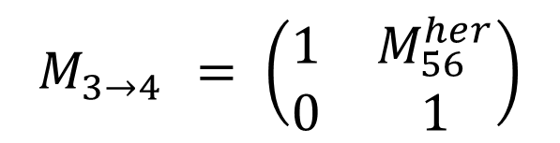
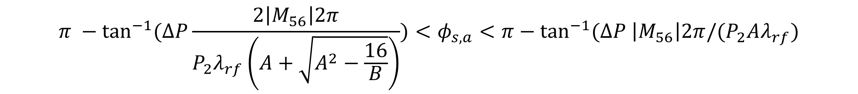
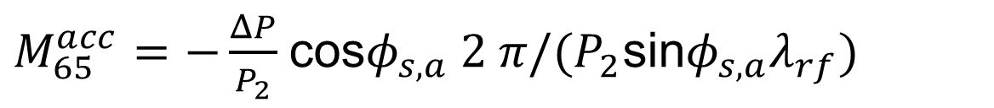

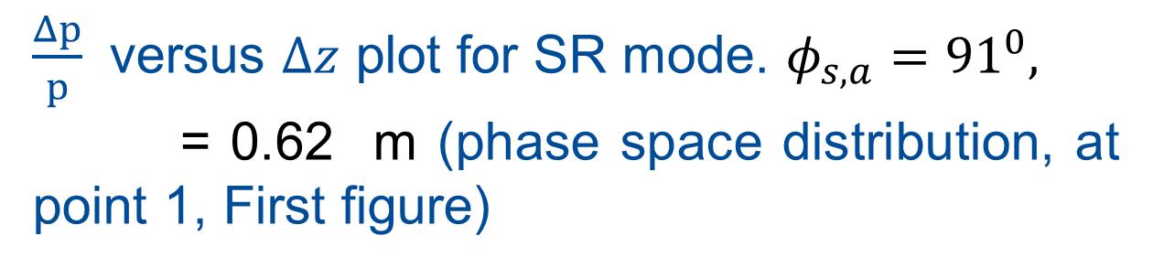


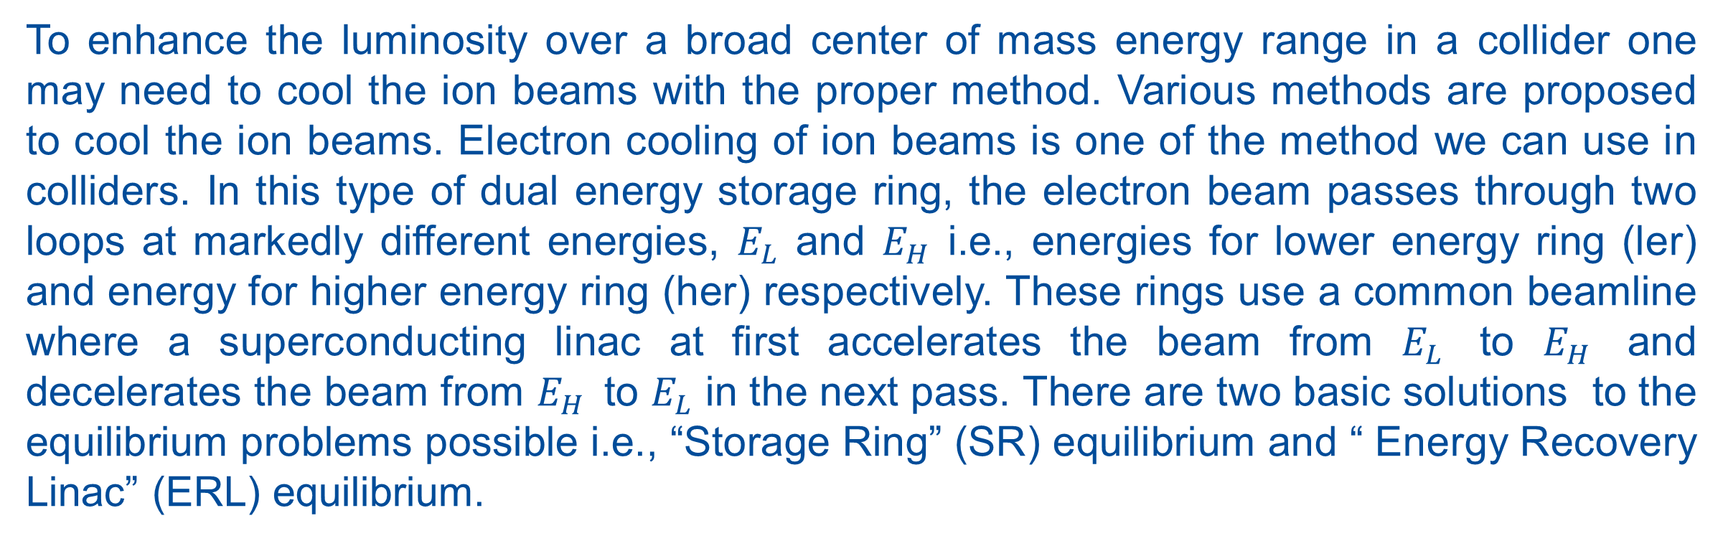
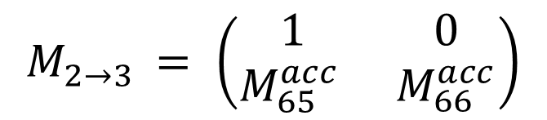
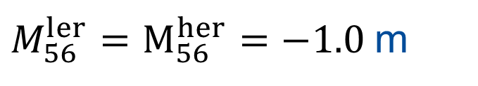

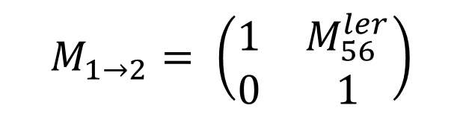
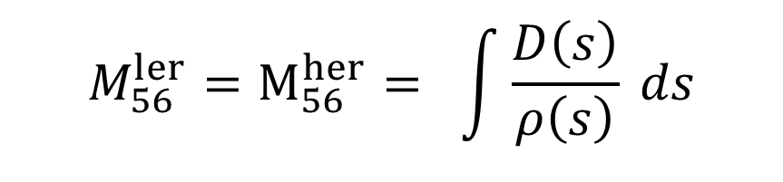



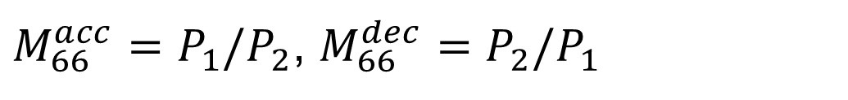
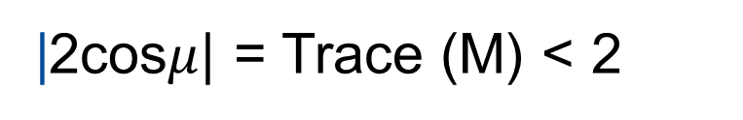

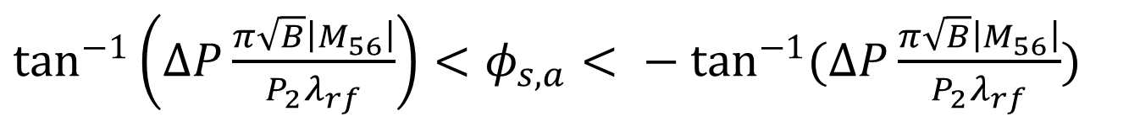
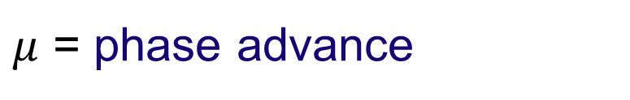
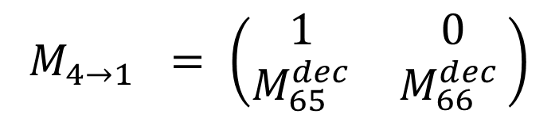


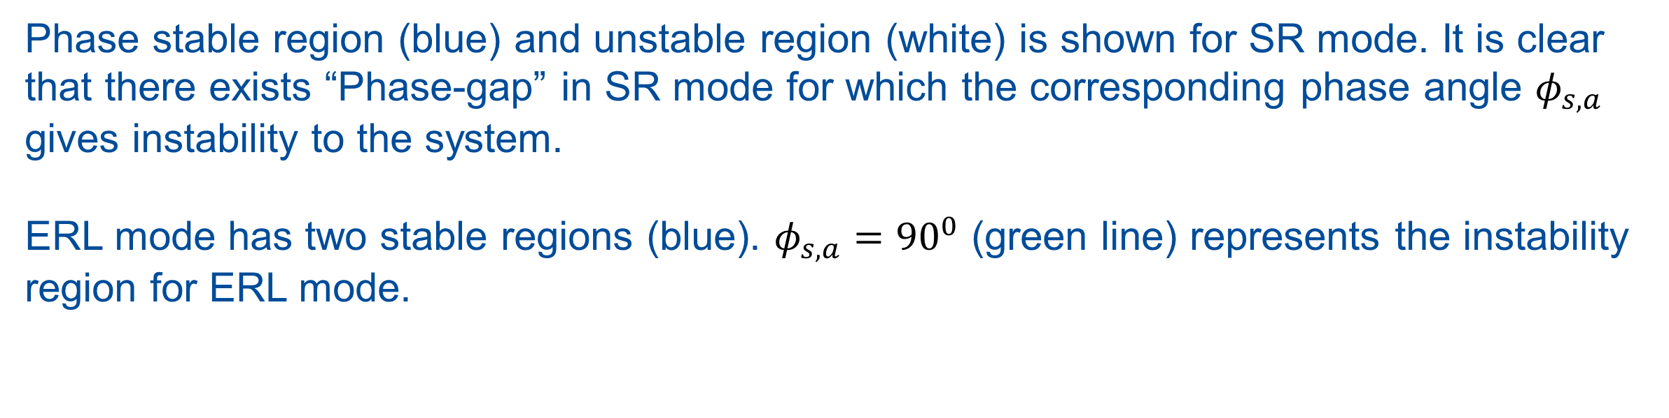
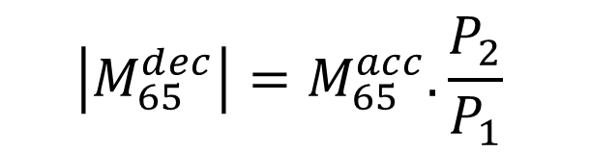


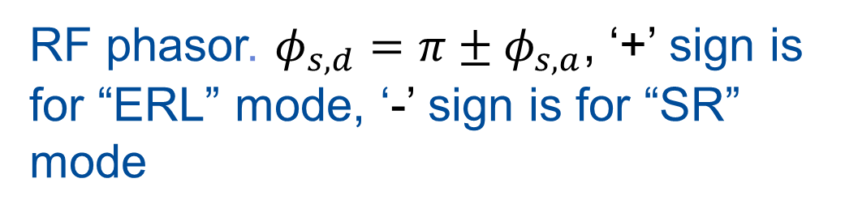
EQUILIBRIA AND SYNCHROTRON STABILITY IN TWO ENERGY STORAGE RINGs*
B. Dhital^{1,2 #}, J. R. Delayen^{1,2} ,Ya. S. Derbenev² , D. Douglas² , G. A. Krafft^{1,2} , F. Lin² , V. S. Morozov² , Y. Zhang²
¹ Center for Accelerator Science, Old Dominion University, Norfolk, VA 23529, U.S.A.
² Thomas Jefferson National Accelerator Facility, Newport News, VA 23606, USA
ABSTRACT
Two-energy storage rings cooler may be one of the future possible electron based cooler to cool the ion beams. Calculation has been done based on linear transfer matrix formalism to verify that longitudinal synchrotron stability exists in a dual energy storage rings. An elegant simulation has been performed to demonstrate that the periodic solution exists. Calculations show that longitudinal stability exists for both SR mode and ERL mode in a two energy storage rings.
Introduction
To enhance the luminosity over a broad center of mass energy range in a collider one may need to cool the ion beams with the proper method. Various methods are proposed to cool the ion beams. Electron cooling of ion beams is one of the method we can use in colliders. In this type of dual energy storage ring, the electron beam passes through two loops at markedly different energies, $E_{L}$ and $E_{H}$ i.e., energies for lower energy ring (ler) and energy for higher energy ring (her) respectively. These rings use a common beamline where a superconducting linac at first accelerates the beam from $E_{L}$ to $E_{H}$ and decelerates the beam from $E_{H}$to $E_{L}$ in the next pass. There are two basic solutions to the equilibrium problems possible i.e., “Storage Ring” (SR) equilibrium and “ Energy Recovery Linac” (ERL) equilibrium.
SR mode more resembles the usual single ring storage ring with strong synchrotron motion and ERL mode is the case where RF in two beam passes nearly cancels. In SR mode, beam is longitudinally focused in both accelerating and decelerating passes. In ERL mode, one of the accelerating and decelerating passes is longitudinally focusing while the other is defocusing.
The essential point in two energy storage rings is to understand the stability. In this paper we use a linear transfer matrix method to test the stability criteria for both SR mode and ERL mode. We derive the conditions on RF phase that determines the stability in dual energy storage rings. Finally we use elegant simulation to verify that periodic solutions exist for both SR mode and ERL mode in two energy storage rings.
Dual Energy Storage Ring Cooler
Phase angle versus wavelength
The total one turn transfer matrix in two energy storage rings is defined by matrix M (1)
In our system $P_{2}$=155 MeV/c for her, $P_{1}$ = 55 MeV/c for ler . is the accelerating phase angle to be applied at the energy recovering SRF structure. is the RF wavelength.
Stability criteria is given by (2)
In SR mode equilibrium, we assume that . We then apply the stability criteria (2) which results the following two inequalities:
(3)
(4)
Here, , . We assume that
We solve the above inequalities (3) and (4) for the different values of wavelength that ranges between to m. A plot of versus is made showing the stability limit corresponding to different wavelengths.
RF phasor. $φ_{s,d}=π±φ_{s,a}$, ‘+’ sign is for “ERL” mode, ‘-’ sign is for “SR” mode
Phase angle $φ_{s,a}$ versus $λ_{rf}$ plot for SR mode
Phase angle $φ_{s,a}$ versus $λ_{rf}$ plot for ERL mode
Schematic drawing of two energy storage rings cooler
Phase stable region (blue) and unstable region (white) is shown for SR mode. It is clear that there exists “Phase-gap” in SR mode for which the corresponding phase angle $φ_{s,a}$ gives instability to the system.
ERL mode has two stable regions (blue). $φ_{s,a}={90}^{0}$ (green line) represents the instability region for ERL mode.
$$M=M_{4→1}M_{3→4}M_{2→3}M_{1→2}$$
$$M_{1→2}= \left(\begin{matrix}1 & M_{56}^{ler} \\ 0 & 1\end{matrix}\right)$$
$$M_{2→3 }= \left(\begin{matrix}1 & 0 \\ M_{65}^{acc } & M_{66}^{acc}\end{matrix}\right)$$
$$M_{3→4 }= \left(\begin{matrix}1 & M_{56}^{her} \\ 0 & 1\end{matrix}\right)$$
Periodic solution
$$M_{4→1 }= \left(\begin{matrix}1 & 0 \\ M_{65}^{dec} & M_{66}^{dec }\end{matrix}\right)$$
$$M_{56}^{ler}=M_{56}^{her}= \int{\frac{D\left(s\right)}{ρ\left(s\right)} ds}$$
$$\left|M_{65}^{dec}\right|=M_{65}^{acc}.\frac{P_{2}}{P_{1}}$$
A plot of $\frac{Δp}{p}$ versus $Δz$ for SR mode is shown. We create a longitudinal beam distribution for the given values of Twiss parameters from our calculation. Then we performed elegant simulations for different number of passes. All passes result the same phase space distribution (as shown in left figure). This ensures that the periodic solution exists.
$M_{65}^{acc}=−\frac{ΔP}{P_{2}}$cos$φ_{s,a} 2 π/(P_{2}$sin$φ_{s,a}λ_{rf})$
$M_{66}^{acc}=P_{1}/P_{2}$, $M_{66}^{dec}=P_{2}/P_{1}$
$$λ_{rf}$$
$$φ_{s,a}$$
$μ$ = phase advance
|2cos$μ$| = Trace (M) < 2
SR mode equilibrium
$${ M}_{65}^{dec}=M_{65}^{acc} .P_{2}/P_{1}$$
$\frac{Δp}{p}$ versus $Δz$ plot for SR mode. $φ_{s,a}={91}^{0},$
= 0.62 m (phase space distribution, at point 1, First figure)
$\frac{π}{2}<φ_{s,a}<π −\tan^{−1}(ΔP\frac{2\left|M_{56}\right|2π}{P_{2}λ_{rf}\left(A −\sqrt{A^{2}−\frac{16}{B}}\right)})$
$$λ_{rf}$$
$$π −\tan^{−1}(ΔP\frac{2\left|M_{56}\right|2π}{P_{2}λ_{rf}\left(A+\sqrt{A^{2}−\frac{16}{B}}\right)})<φ_{s,a}<π−\tan^{−1}(ΔP \left|M_{56}\right|2π/(P_{2}Aλ_{rf})$$
conclusion
Longitudinal stability exists in two energy storage rings for both SR mode and ERL mode.
ERL mode has larger stable regions than SR mode.
Elegant simulations ensure that periodic solutions exist for both SR mode and ERL mode.
For different wavelength (frequency) values, we have different choices for accelerating and decelerating RF phase to accelerate and decelerate the electron beam in two energy storage rings.
$$B=P_{2}/P_{1}$$
$$A=2(1+B)/B$$
$M_{56}^{ler}=M_{56}^{her}=−1.0$m
$$λ_{\min{ }}=0.01$$
$$λ_{\max{ }}=100.0$$
$$φ_{s,a}$$
$$λ_{rf}$$
ERL MODE EQUILIBRIUM
In ERL mode equilibrium, we assume that . We follow the same procedure and apply the stability criteria (2) which results the following inequalities:
(5)
$${ M}_{65}^{dec}=−M_{65}^{acc} .P_{2}/P_{1}$$
references
$\tan^{−1}\left(ΔP\frac{π\sqrt{B}\left|M_{56}\right|}{P_{2}λ_{rf}}\right)<φ_{s,a}< − \tan^{−1}(ΔP\frac{π\sqrt{B}\left|M_{56}\right|}{P_{2}λ_{rf}})$
[1] S. Abeyratne et al., arXiv:1209.0757 [physics.acc-ph]
[2] Y. S. Derbenev, Nucl. Instr. Meth. Phys. Res. A 532, 307(2004)
[1] F. Lin et.al, Proc. of IPAC2016,Busan, Korea, paper WEPMW020
[2] G. A. Krafft and V. Morozov, Private communications
* Research Supported by DOE contract No. DE – AC05 – 06OR23177 and DE – AC02 – 06CH11357.
#bdhit001@odu.edu

