Slide 1

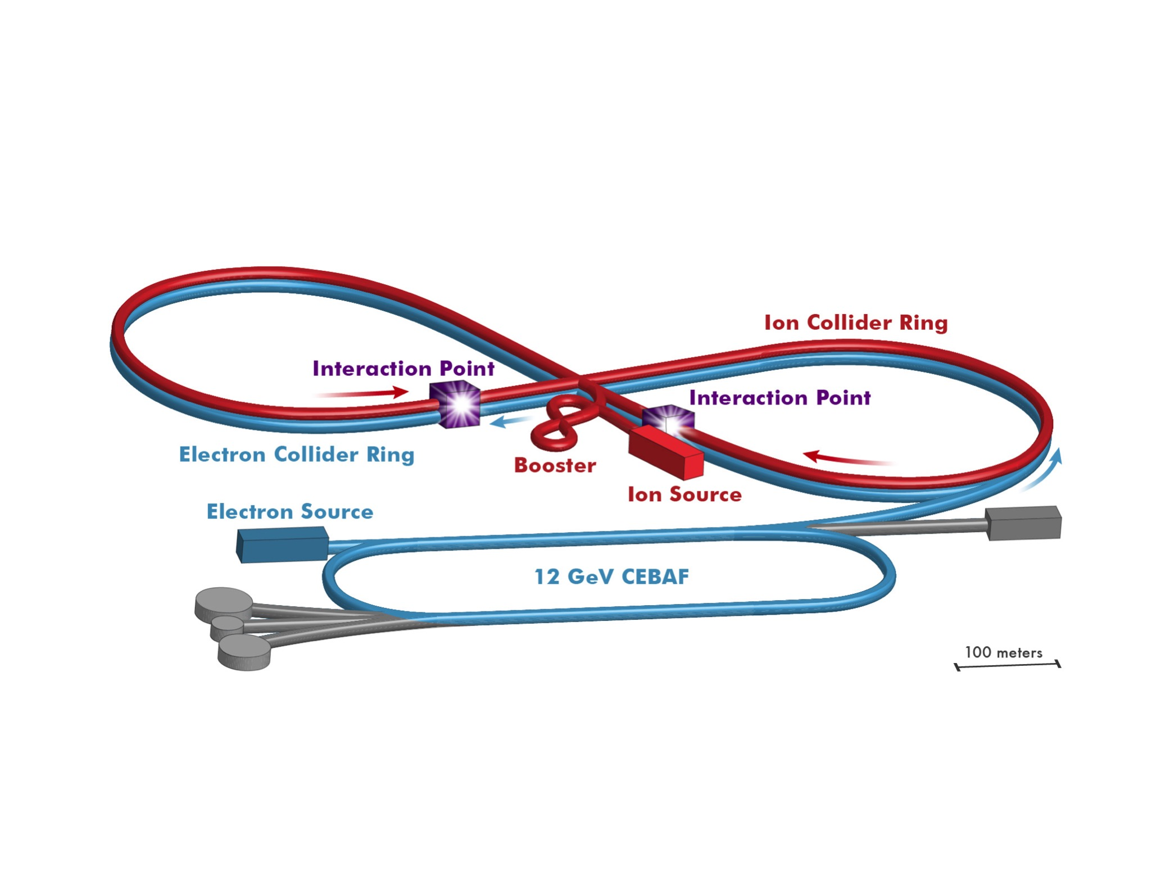
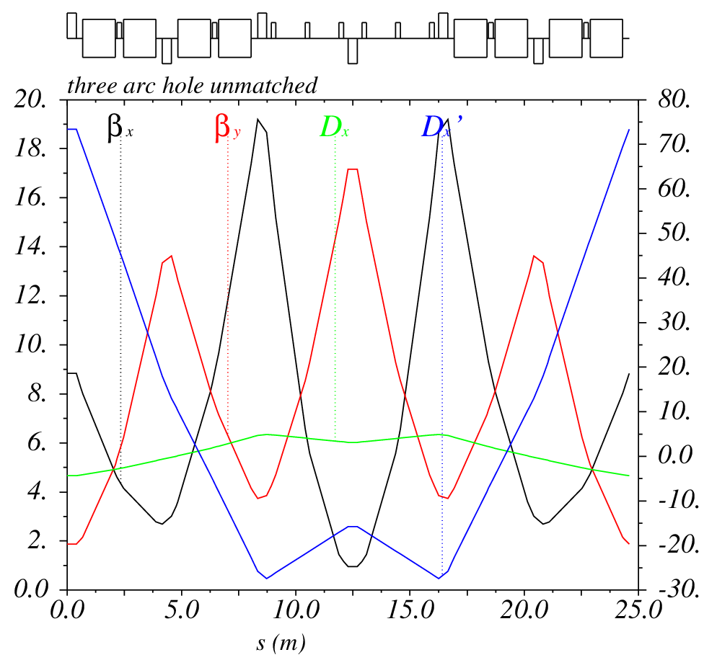
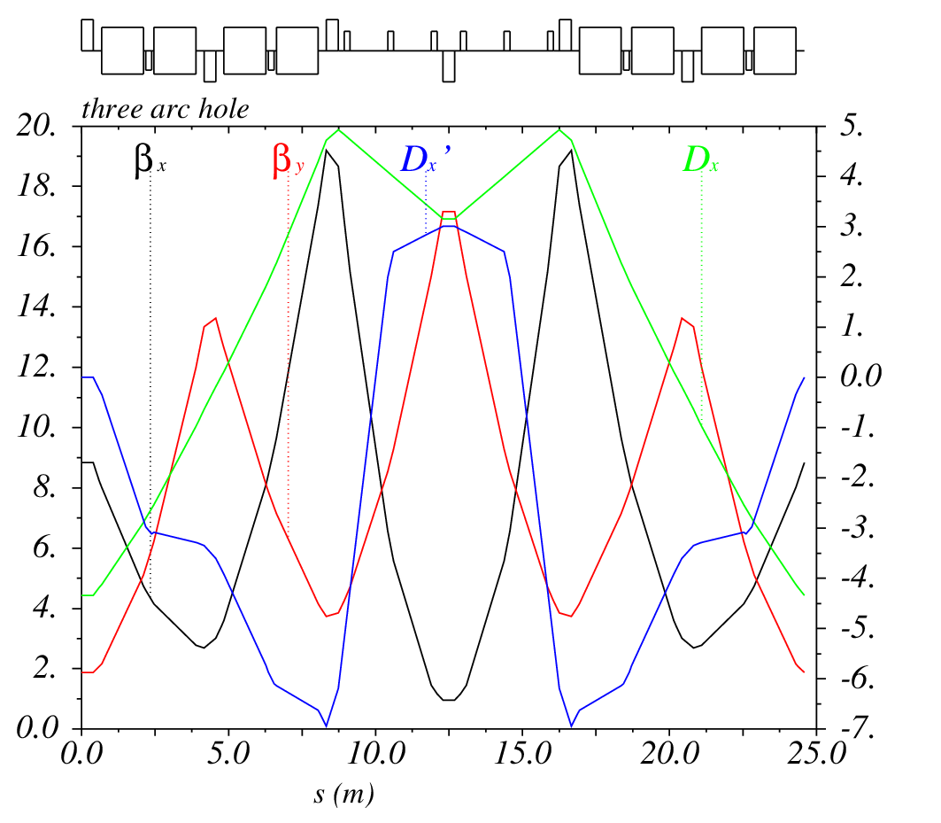


Revised Optics Design for the JLEIC Ion Booster*
E. Nissen and T. Satogata
Thomas Jefferson National Accelerator Facility
Newport News, Virginia, USA
Managed by the Jefferson Science Associates,
LLC for the U.S. Department of Energy Office of Science
Abstract
In this work we outline the recently redesigned booster for the proposed Jefferson Lab Electron Ion Collider (JLEIC). This booster will inject protons (or ions of equivalent rigidity) at 280 MeV and accelerate them to 8 GeV kinetic energy. In order to avoid a transition crossing, the booster uses Flexible Momentum Compaction (FMC) lattices to raise the transition gamma above the reach of the machine. We also include several families of sextupoles to simultaneously control the chromaticities, and nonlinear dispersions that were excited by the FMC cells.
The Proposed JLEIC Complex
8-100 GeV
3-10 GeV
8 GeV
Linac
Straight Sections
The straight sections use triplet cells to provide large enough drift spaces to house RF acceleration, electron cooling, injection and extraction. Each drift is 6.98m long. They also will act as knobs to help tune the machine. Currently, the phase advances have been chosen to map the exit of one arc exactly to the entrance of the other arc, future changes are possible.
Redesign Criteria
Top energy raised from 7.1 GeV to 8 GeV for protons, or ions of equivalent rigidity.
Transition crossing not allowed throughout the energy range of the booster.
Maximum Dipole field of 3 T.
Circumference at or below 320 m.
Room for possible upgrade path if higher field dipoles become available.
Arcs
The arcs are made with Flexible Momentum Compaction (FMC) cells. In this design we use a simple 3 FODO design with the magnets removed from the center FODO cell, and the phase advance over this gap adjusted to the desired momentum compaction.
Full Machine
The use of FMC cells can allow for varied γ_{t} values in a small footprint. It also can cause issues with non-linear dispersions. As can be seen above, correct use of sextupoles can bring this nonlinear dispersion under control outside of the arc cells. The dispersion suppressors take a similar layout to the bending arcs, and have their own sextupoles to suppress both the linear and nonlinear dispersions.
The full machine has a length of 313.49m, a γ_{t} of 18.64, and maximum beta functions no higher than 27m in both dimensions. The maximum gradient for the quadrupoles is 29.6 T/m.
Future Work
Find optimum working point for the machine
Simulate stripping injection with space charge
Simulate RF ramping with space charge
*Authored by Jefferson Science Associates, LLC under U.S. DOE Contract No. DE-AC05-06OR23177. The U.S. Government retains a non-exclusive, paid-up, irrevocable, world-wide license to publish or reproduce this manuscript for U.S. Government purposes.

