Slide 1


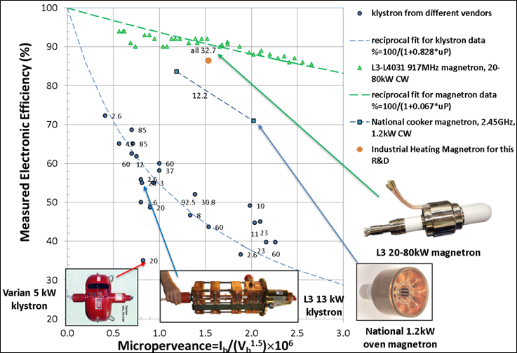
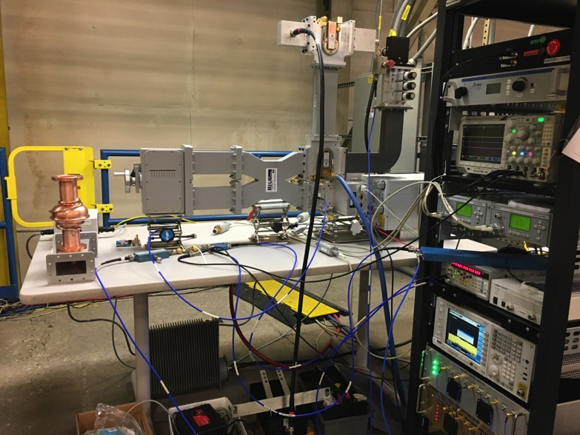
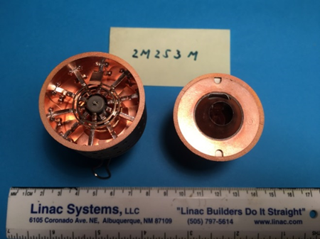
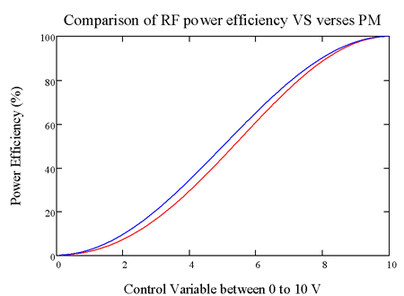
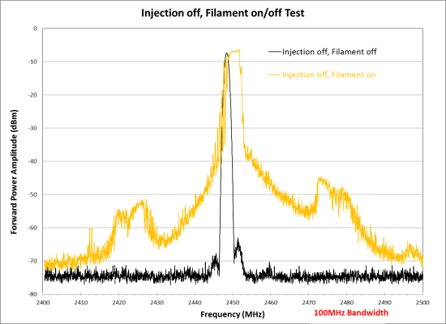
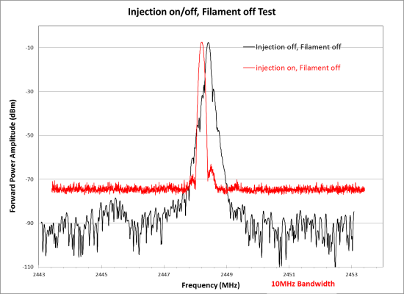
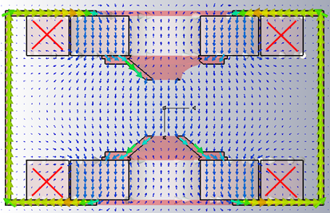
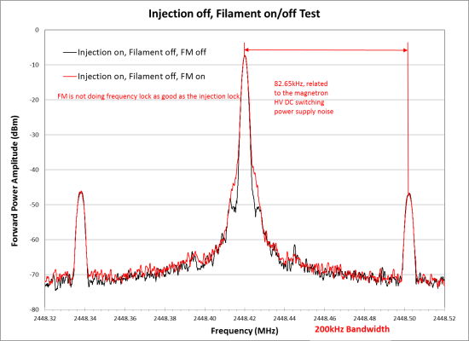
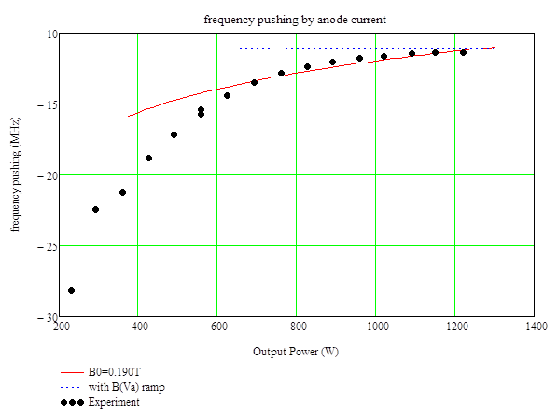
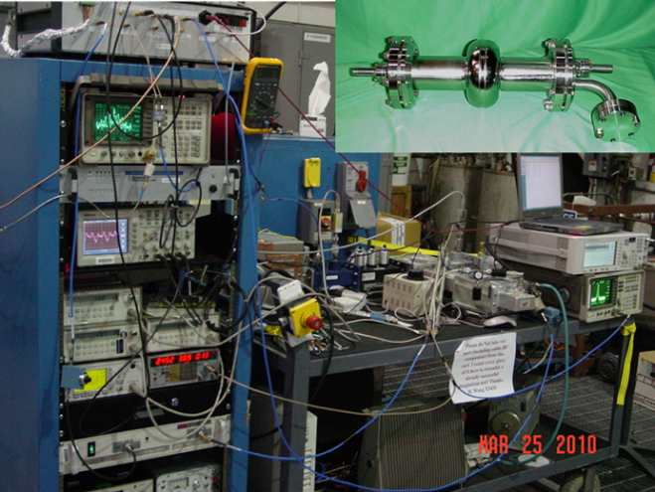
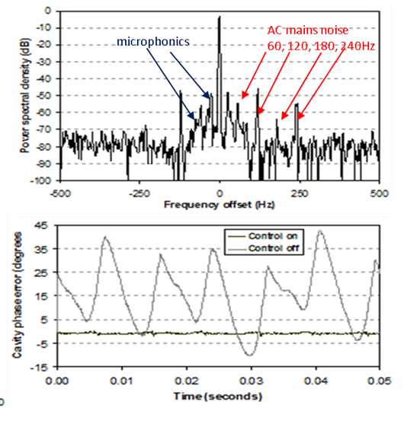
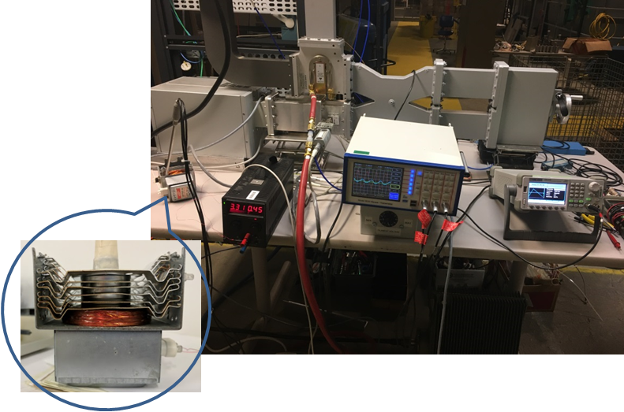
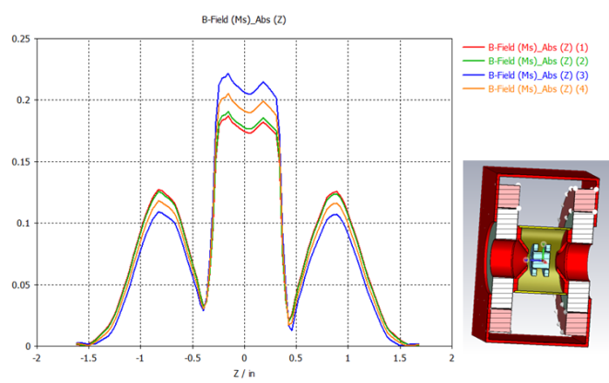
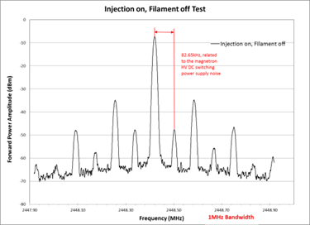
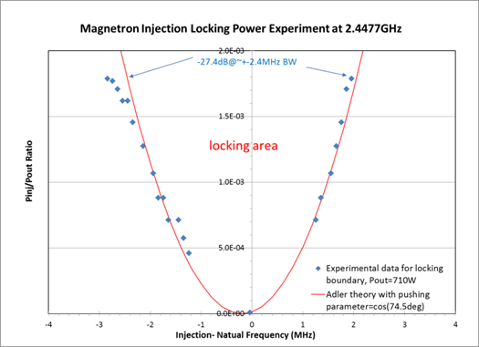
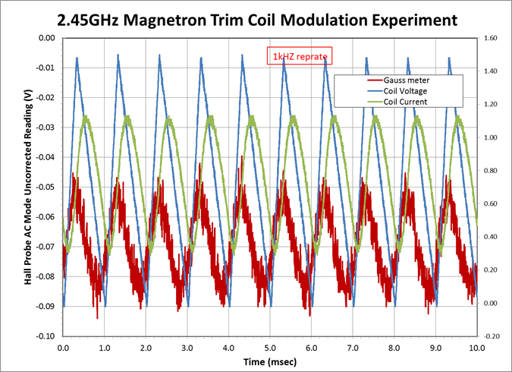
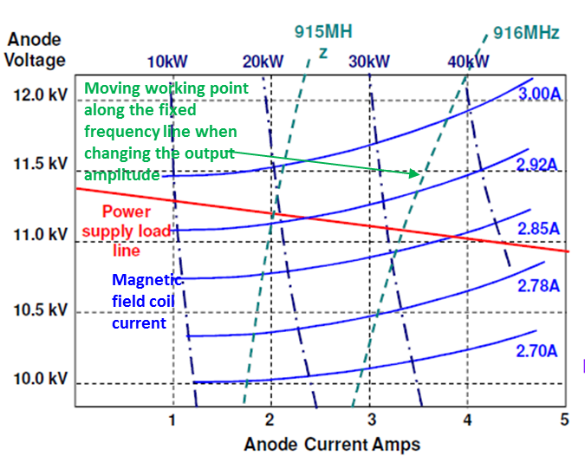
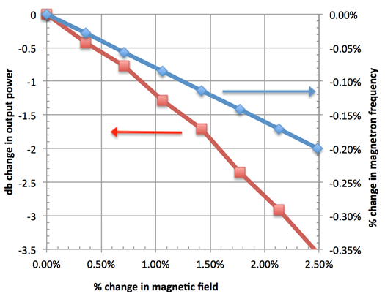
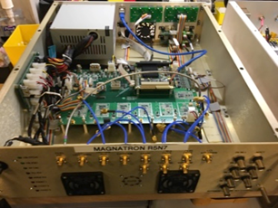
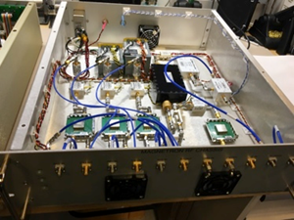
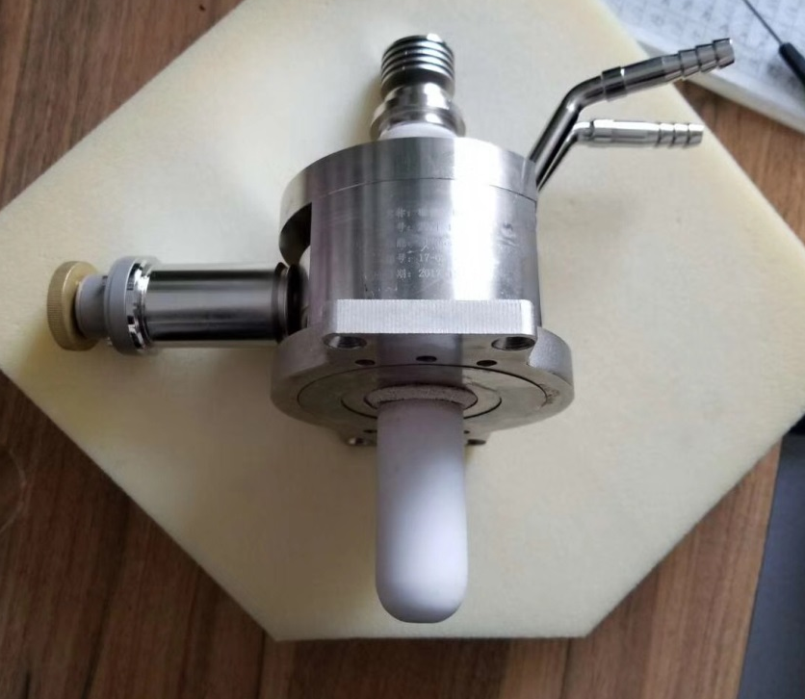
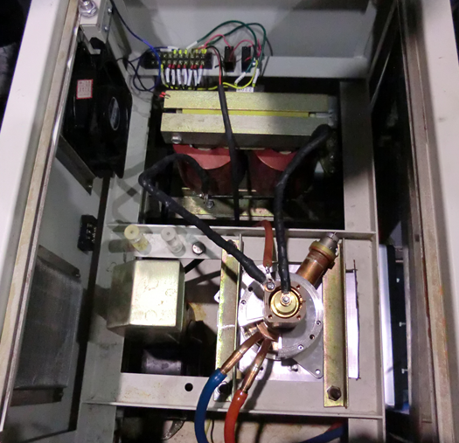
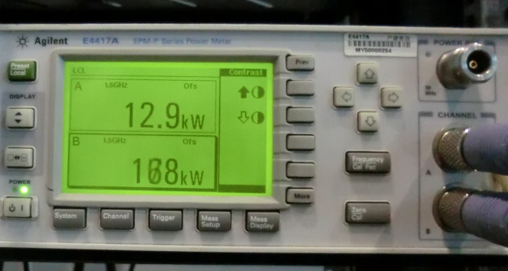

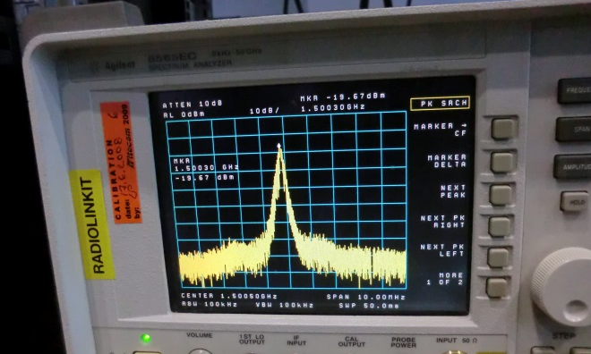



Magnetron R&D toward the Amplitude Modulation Control for SRF Accelerator*
H. Wang#, R. A. Rimmer, T. Plawski
Jefferson Lab, Newport News, VA 23606, USA
M. Neubauer, A. Dudas, S. Kahn
Muons, Inc., Batavia, IL 60510, USA
Abstract: The scheme of using a high efficiency magnetron to drive a superconducting radio frequency (SRF) accelerator cavity needs not only the injection phase locking but also the amplitude modulation to compensate the cavity’s microphomics caused cavity voltage change and the beam loading variation. To be able to do a fast and efficient modulation, the magnetron’s magnetic field has to be trimmed by an external coil to compensate the frequency pushing effect due to the anode current change [1]. A low eddy current magnetron body has been designed and built [2]. This paper will present the analytical prediction, simulation and experimental results on the 2.45 GHz magnetron test stand with the modulation frequency up to 1 kHz. In addition, the progresses on the injection lock to a copper cavity, new 1497 MHz magnetron prototype, 13 kW high power magnetron test stand development and newly built low level RF (LLRF) controller for the amplitude modulation will be reported.
Magnetrons vs Klystrons on Efficiencies and Frequencies
2.45GHz Magnetron Test Stand
Phase Modulation and Vector Sum Schemes for AM
Magnetron system efficiency using PM (red) or VS (blue) scheme, control variable from 0 to 10 V represents the power amplitude from 0 to 100%.
Due to the microphonic vibration of a SRF cavity, the cavity with or without beam loading mostly operates at <40% of saturated klystron power level.
The efficiency of such PM or VS magnetron system will be less than 30% in normal operation.
For both SRF and NCRF accelerators, the variation to the lower beam energy and beam current would bring the magnetron system efficiency down much less than 30% if using the PM scheme.
Actual magnetron power amplitude is not reduced and the power is not saved.
Matched Load with back injection setup
Comparison of tube efficiencies between klystrons and magnetrons with their wavelength in cm marked next to their data points
CST magnetic circuit design for the 2.45GHz magnetron with a pair of bucking coils of ~700 A-turns to trim +-10% of 0.19T field
Injection Phase Lock of Magnetron
$$sin∅=2Q_{L}cosα\sqrt{\frac{P_{out}}{P_{inj}}}\frac{ω_{0}−ω_{i}}{ω_{0}}$$
Injection Phase Lock Demonstration in 2010 at JLab
Trim Coil Modulation experiment
where P_{inj} is locking power, P_{out} is output power, Q_{L} is the loaded Q of the magnetron, ω_{i} is the angular frequency of the injection signal, and ω₀ is the instantaneous natural angular frequency of the magnetron. α is pushing angle defined by Chen [3]
Up to 1kHz modulation frequency of asymmetric saw-tooth pulse shape has been tested in the setup (left) indicating the Hall probe signal can follow the drive pulses from 50Hz to 1kHz with AC to DC trim of 2.92% to 1.26%.
Left: magnetron test stand setup for a cold cavity (shown in insert) vertically test at 2ºK Dewar behind the test stand.
Right top: Cavity spectral output (dB) with injection locked magnetron and a DSP control, RBW=3 Hz.
Right bottom: Phase jitter measurement from the cavity output with injection lock on and off.
Left: magnetron output power spectrum with injection on and filament off. Right: injection signal is -27.4dB to lock the output power at 710W with a typical rms phase error of 0.5º.
Moving Working Point for AM Control
References
Digital Controller
M. Neubauer et al, Magnetron Design for Amplitude Modulation, THPIK123, Proceedings of IPAC 2017, Copenhagen, Denmark
S. A. Kahn et al, Eddy Current Analysis for A 1.495 GHz Injection-Locked Magnetron, THPIK121, Proceedings of IPAC 2017, Copenhagen, Denmark
Shien Chi Chen, “Growth and Frequency Pushing Effects in Relativistic Magnetron Phase-Locking”, IEEE Trans on Plasma Science Vol. IX. N0. 3. June, 1990
Lecture notes from Professor Amos Dexter, Lancaster University, “Lecture 5, High Power Processes, 2008”
Left: Typical I-V curve of a 915 MHz magnetron with the working point tunable by the magnetic field trim current following the constant frequency line [4]. Right: Magnetic field trimming curves for lowering the 915MHz magnetron output power (red) and pushing to lower frequency (blue).
Test a 1497MHz Magnetron at Vendor Site
JLab C100 style digital RF FPGA control chassis and 2.45GHz front end for the R&D magnetron test stand
Conclusions
R&D tests are in a good progress toward the amplitude control of injection phase locked 2.45GHz magnetron
-27.4dB injection signal can phase lock the magnetron within ±2.4MHz bandwidth with a 58dB S/N ratio
Up to 1kHz current modulation to the trim coil of magnetron can change the magnetic filed by 10% with ~700A-turns
A 1497MHz, 13kW prototype magnetron has been successfully tested at the vendor’s place and is ready for shipping to JLab for a further technical evaluation
* Authored by Jefferson Science Associates, LLC under U.S. DOE Contract No. DE-AC05-06OR23177 and SBIR grant DE-SC0013203
# haipeng@jlab.org

