Slide 1



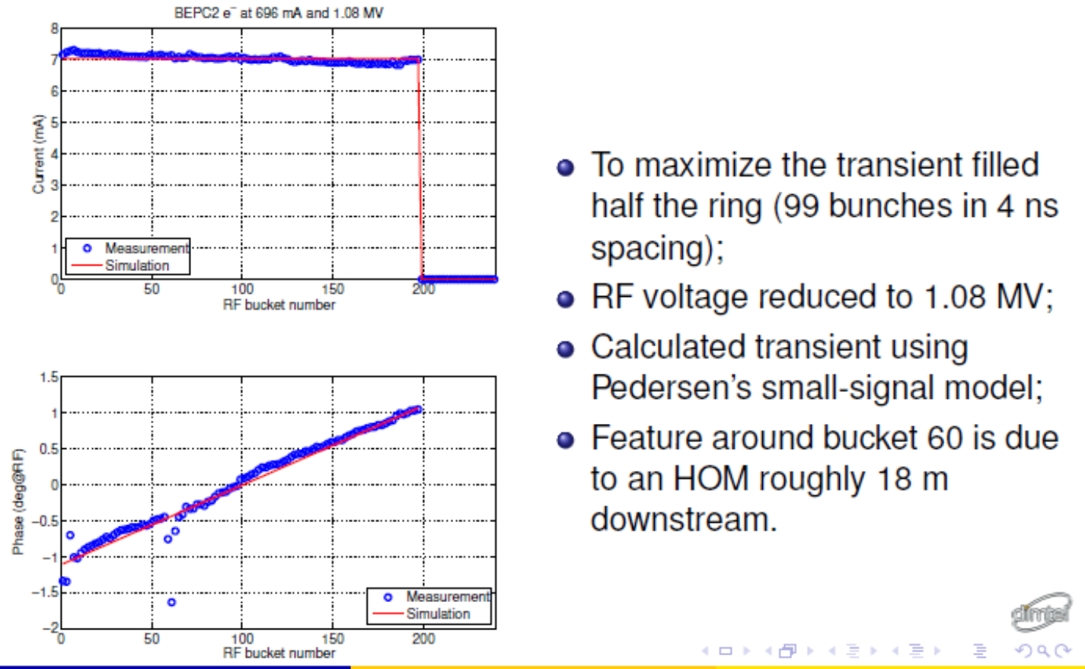
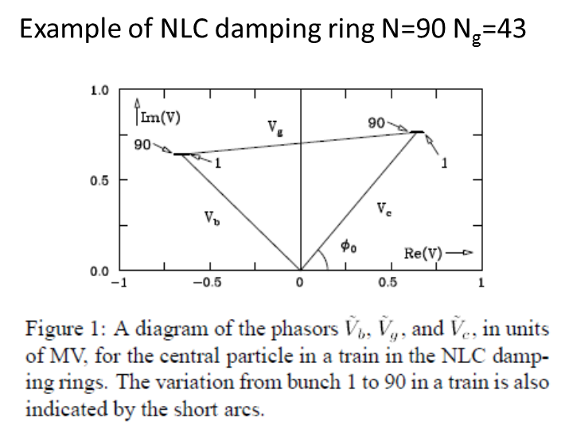
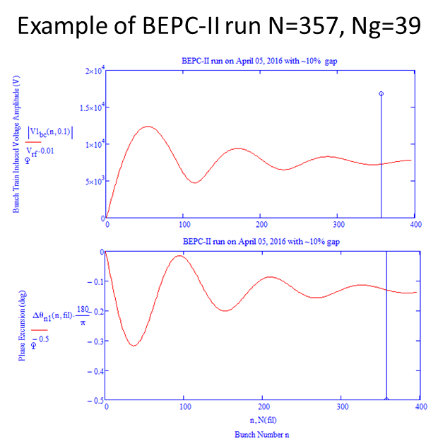
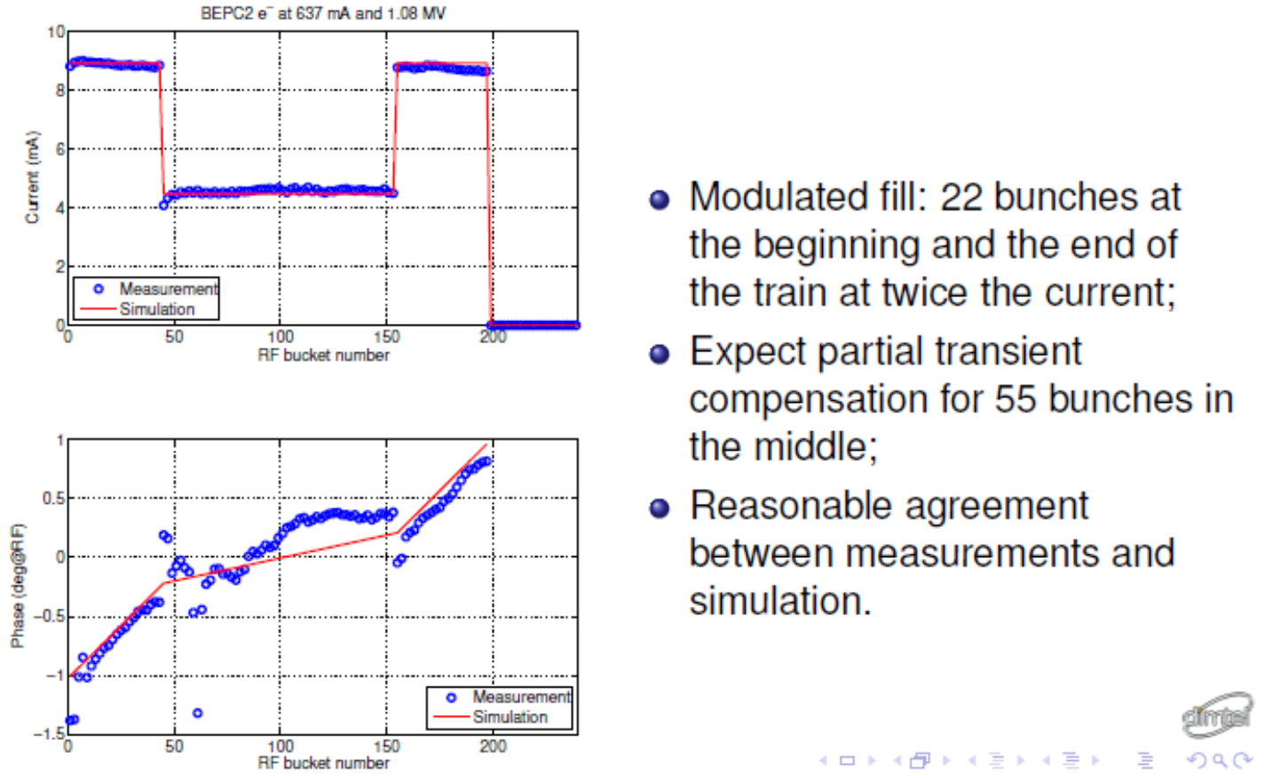
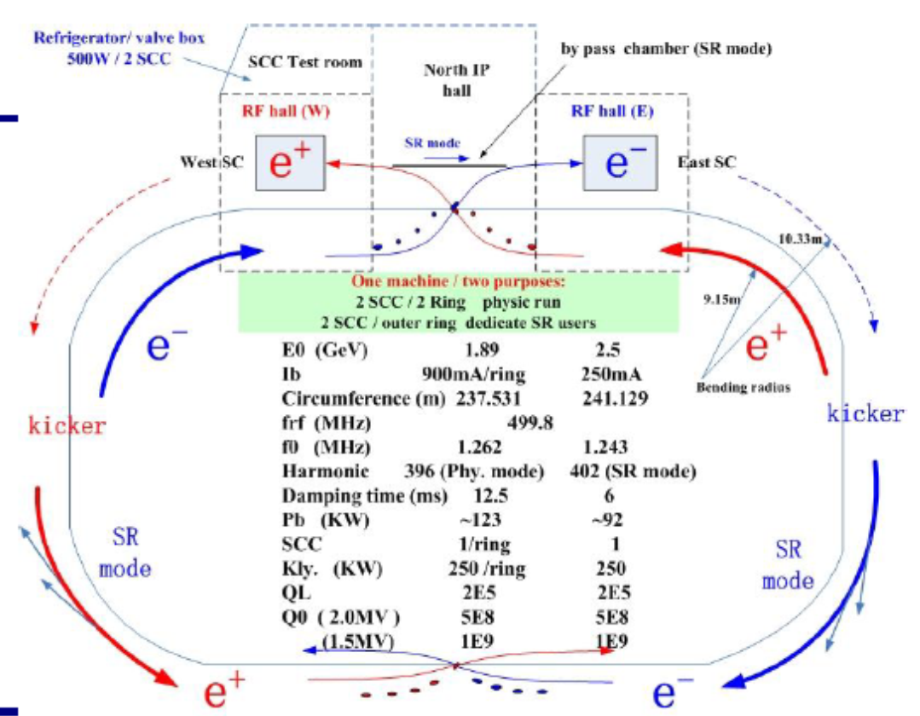
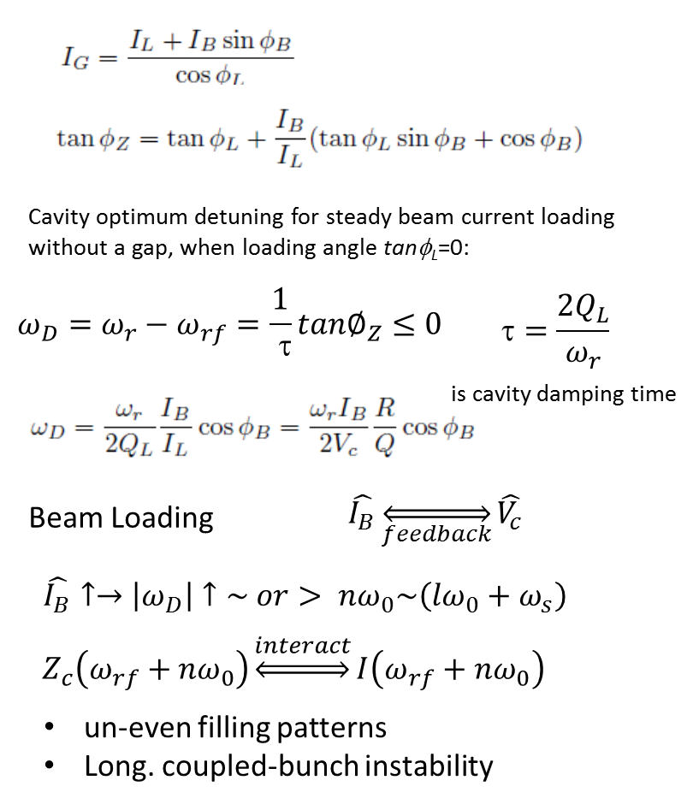
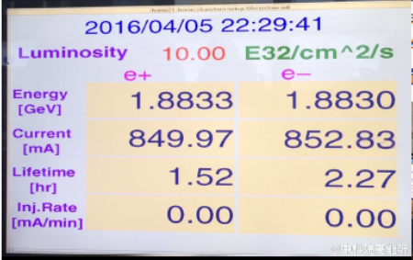
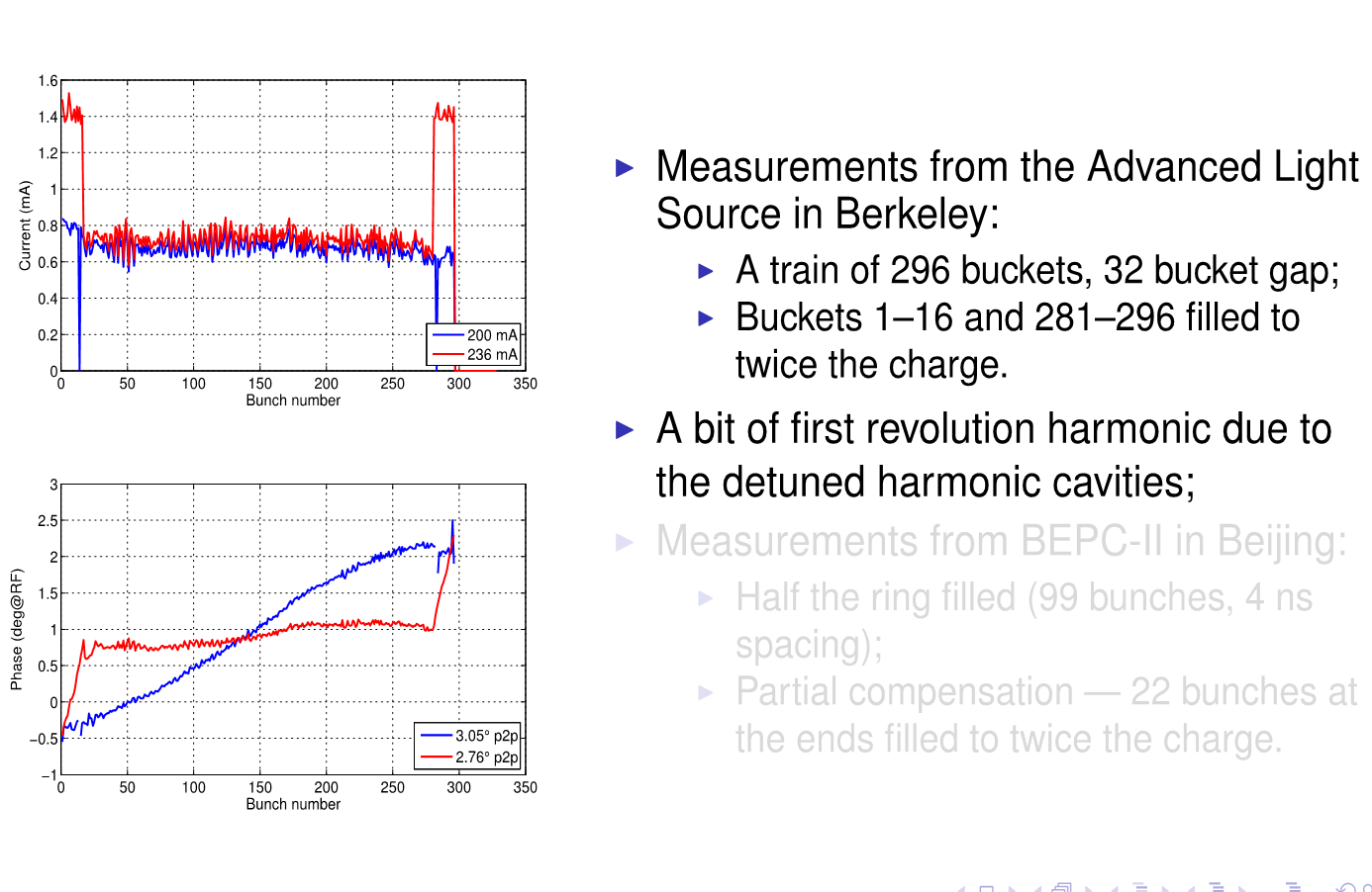
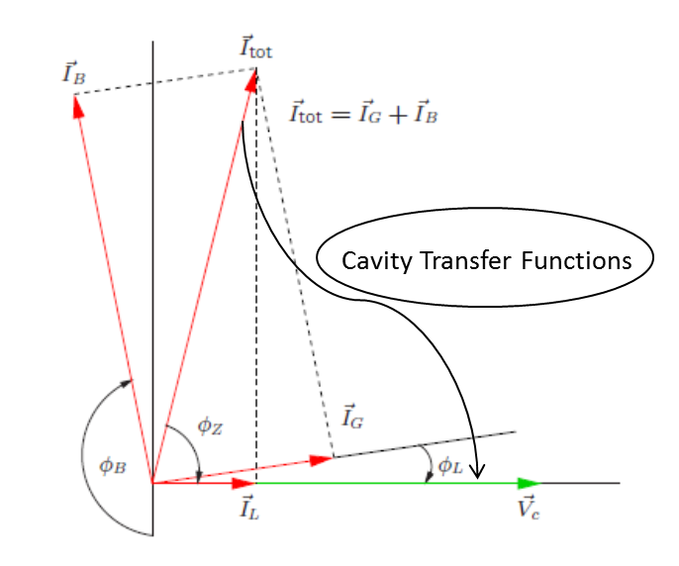
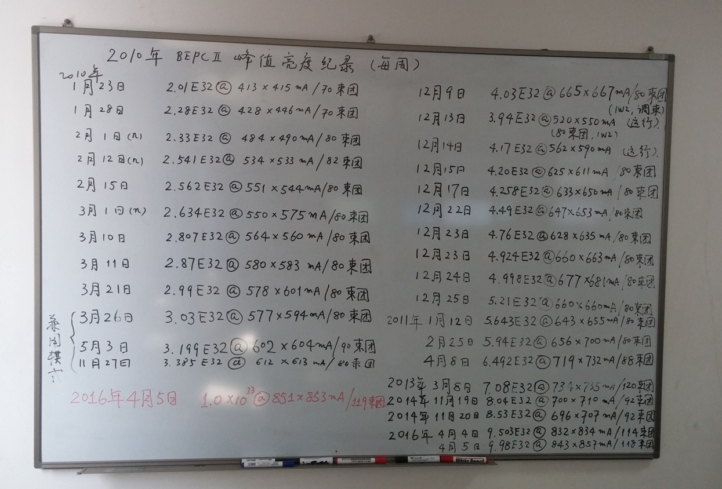
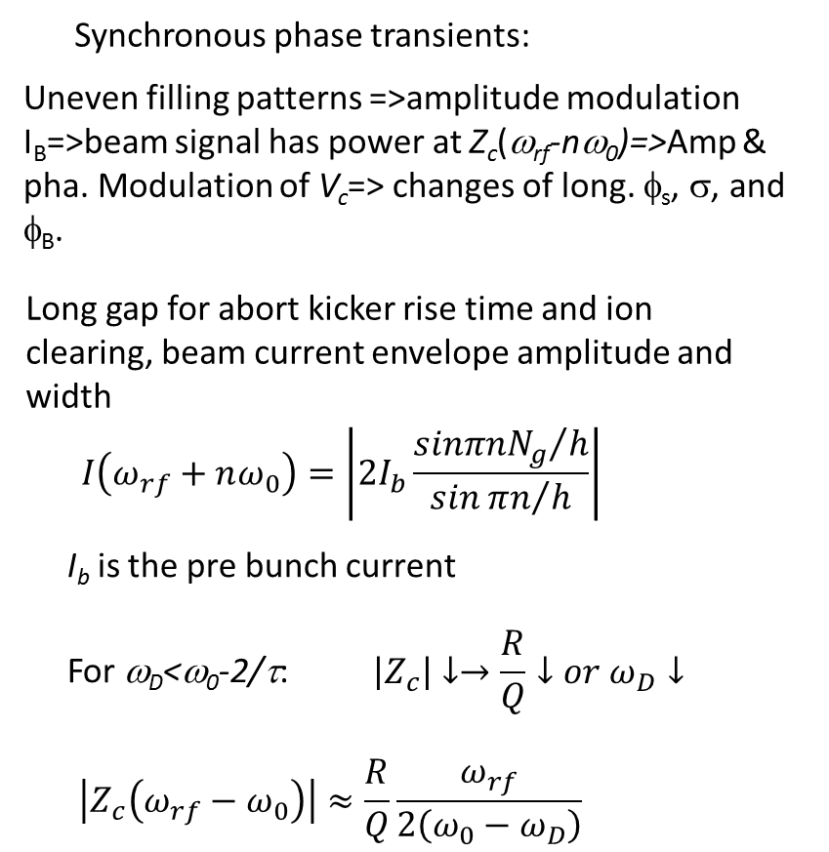
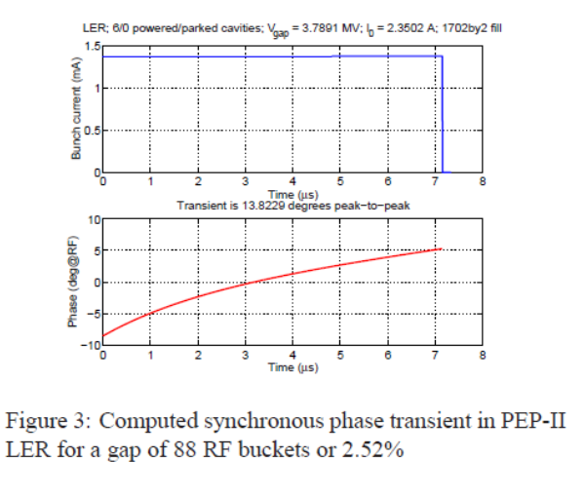
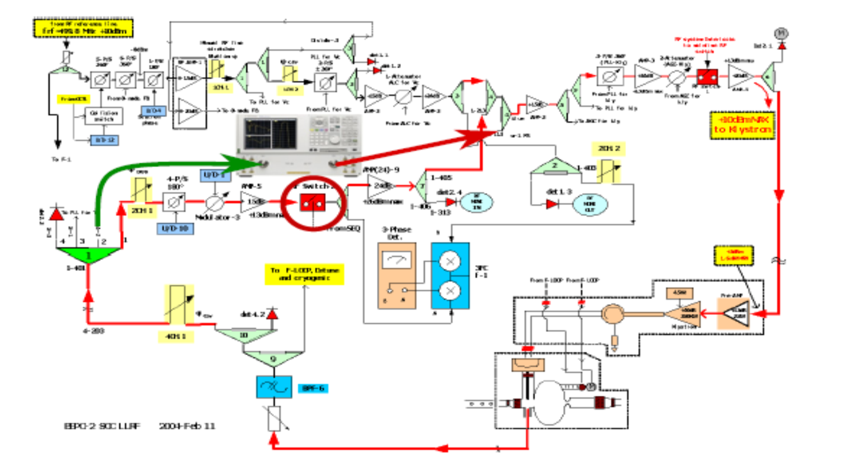
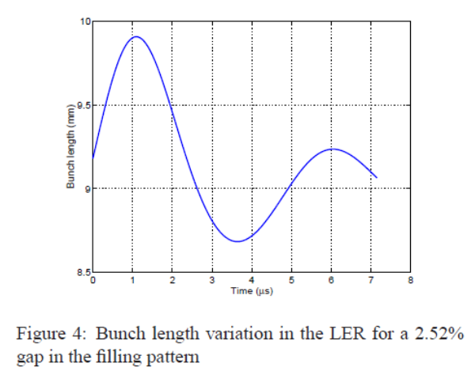
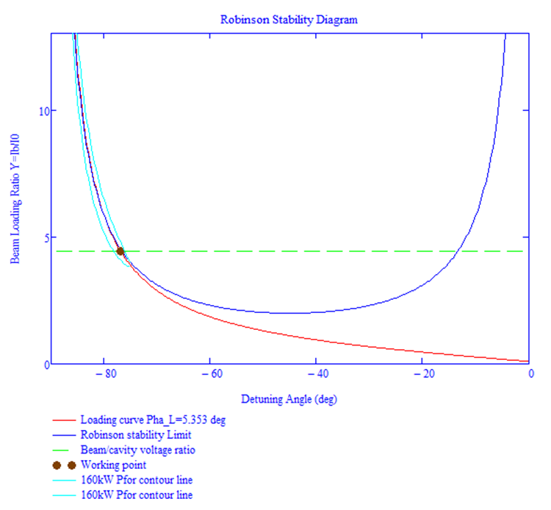
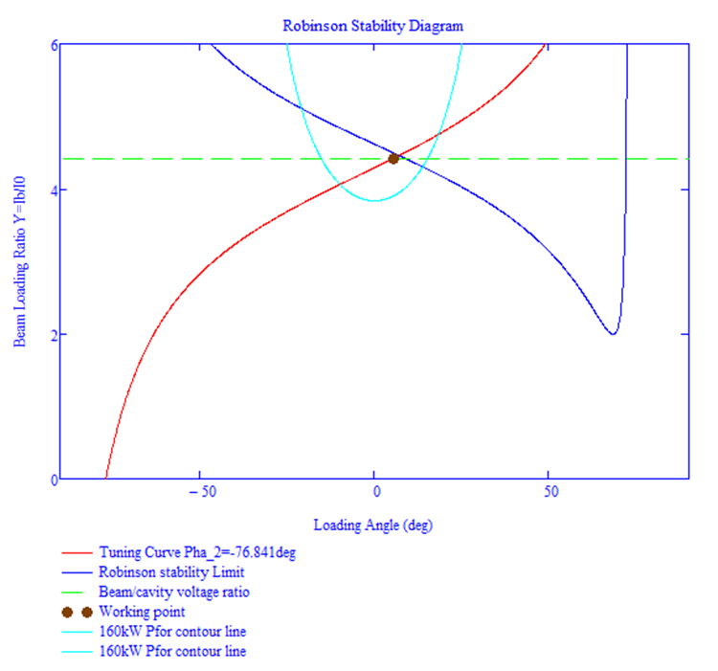
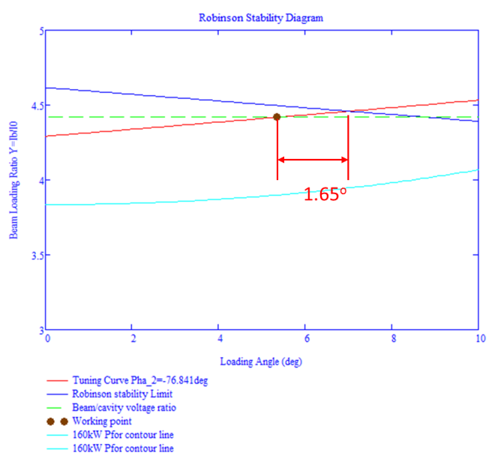
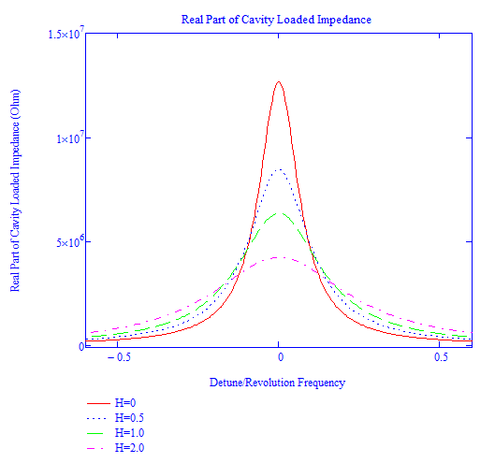



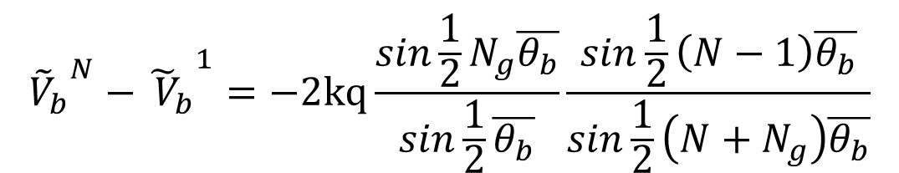
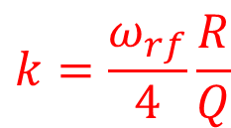

Transient Beam Loading due to the Bunch Train Gap and its Compensation Experiments at BEPC-II and ALS*
H. Wang#, R.A. Rimmer, S. Wang, Jefferson Lab, Newport News, VA 23606 USA
D. Teytelman, Dimtel Inc., San Jose, CA 95124, USA
Y. Zhang, J. Yue, J. Dai, J. Xing, Q. Qin, Institute of High Energy Physics, Beijing 1000049, China
Abstract: Non-uniform bunch fill patterns in storage rings, driven by the need to provide gaps for beam aborting and ion clearing cause a large beam loading change in the RF cavities. The induced turn-periodic transient in the cavity voltage modulates longitudinal beam properties along the train, such as synchronous position and bunch length. In the EIC design, due to the asymmetric bunch train structure between the electron and the ion beam, such modulation results in shifting collision point and leads to reduced luminosity. We have carried out the beam based experiments at BEPC-II and ALS using bunch-by-bunch diagnostic capabilities of the coupled-bunch feedback systems to study this transient effect. A modulated bunch filling pattern with higher charge density around the gap has been demonstrated to be effective in partially compensating this transient modulation. Details of the experimental setups and the data analysis will be presented to this conference.
Motivation and Experiment Goals
Beam Gap Transient in Steady State
Experiment Results at BECP-II
Electron bunch train structure changes in the collider ring like a gap for beam aborting and ion clearing, charge variation from bunch to bunch, the phase slippage due to injection or beam optic abbreviation can cause a large beam loading change to the (S)RF cavity and feedback control system
The induced cavity voltage change can also cause the longitudinal beam dynamic change, such as the beam bunch centroid deviation from synchrotron phase and Robinson instability
In the EIC design, due to the asymmetric bunch train structure between the electron and ion beam. The collision luminosity could be also reduced due to such transient beam loading
We have studied the longitudinal beam instability in steady states with open loop (Robinson model) and with feedback loops (Pederson and Heifets models).
We also carried out beam loading experiment at BECP-II with a direct feedback for different bunch filling pattern at IHEP. The beam gap transient detection and compensation by uneven bunch charge techniques have been also investigated experimentally.
We used Dimtel’s bunch-by-bunch feedback system to diagnose both transient response and the beam loss due to unknown instability which had limited the BECP-II to achieve the highest luminosity.
Voltage difference induced across a bunch train:
$$∆θ\text{1}\text{N}\text{′}≈\frac{2kI_{0}T_{g}}{V_{c0}sin∅_{0}}$$
Simulation (red) vs bunch-by-bunch Measurement (blue)
$${{{{\tilde{V}}_{b}}_{}^{N}−\tilde{ V}}_{b}}_{}^{1}=−2kq\frac{sin\frac{1}{2}N_{g}\overline{θ_{b}}}{sin\frac{1}{2}\overline{θ_{b}}}\frac{sin\frac{1}{2}\left(N−1\right)\overline{θ_{b}}}{sin\frac{1}{2}\left(N+N_{g}\right)\overline{θ_{b}}}$$
This formula can be used for either N>>1 or N_{g}>>1
$$k=\frac{ω_{rf}}{4}\frac{R}{Q}$$
Uniform Fill Pattern with Half Ring Empty
Simulation (red) vs bunch-by-bunch Measurement (blue)
BECP-II: High Luminosity Operation
Beam Cavity Interaction
Achieved luminosities:
May 29, 2009: 3.3×10³² cm⁻²s⁻¹
April 5, 2016: 1.0×10³³ cm⁻²s⁻¹
Modulated Train Fill Pattern with Double Charge between Gap
Experiment Results at ALS
History of Bunch Filling Patterns and Luminosities
Increased bunch numbers
Reduced bunch spacings
Increased Luminosities
More stable machine operation in collision mode
Does Fill Pattern Modulation Work? Yes!
Beam Loading Transient
BECP-II DF Loop Setup
Transient Analysis for Steady State Conditions
Data example of BEPC-II run at 1.89GeV on April 05, 2016
Open up the gap to see the loading angle transient?
Robinson stability or power limits?
Increase the DFB gain
Conclusions
* Authored by Jefferson Science Associates, LLC under U.S. DOE Contract No. DE-AC05-06OR23177.
# haipeng@jlab.org
Very successful transient beam loading and beam loss experiment with a large gap at high beam current
Experimentally confirmed Robinson instability due to the transient loading phase change
Charge density modulation works both at BECP-II and ALS as expected
Both analytical and simulation tools can predict the bunch train gap transient to the cavity voltage. Such benchmarks can be used for the JLEIC transient feedback system designs
Phase transients at BECP-II are small and was difficult to measure
IHEP will improve the BECP-II SRF cavity and direct feedback systems in order to achieve further higher luminosity

