Slide 1


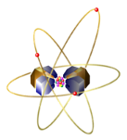
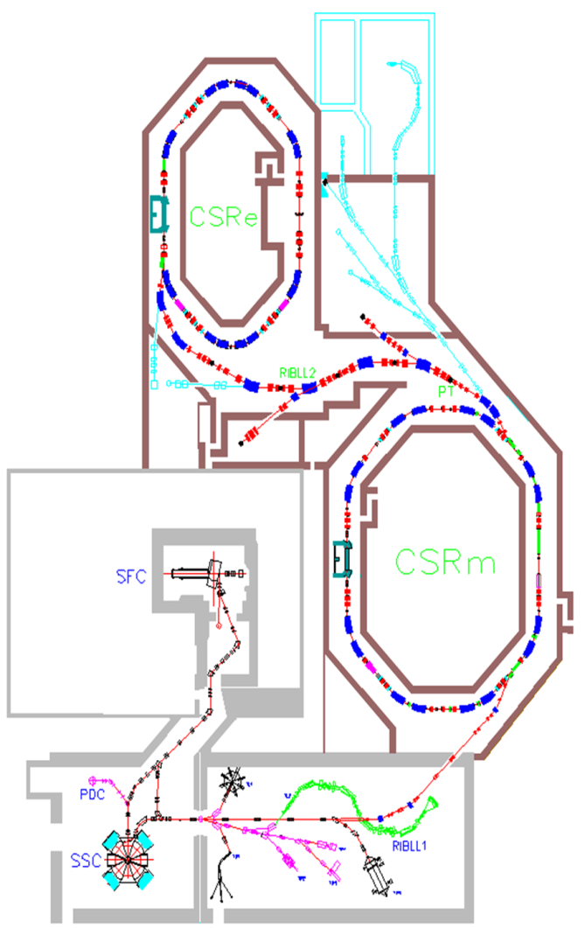
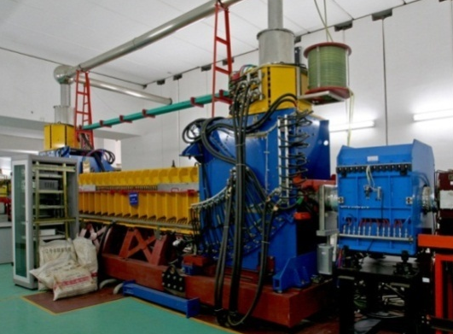
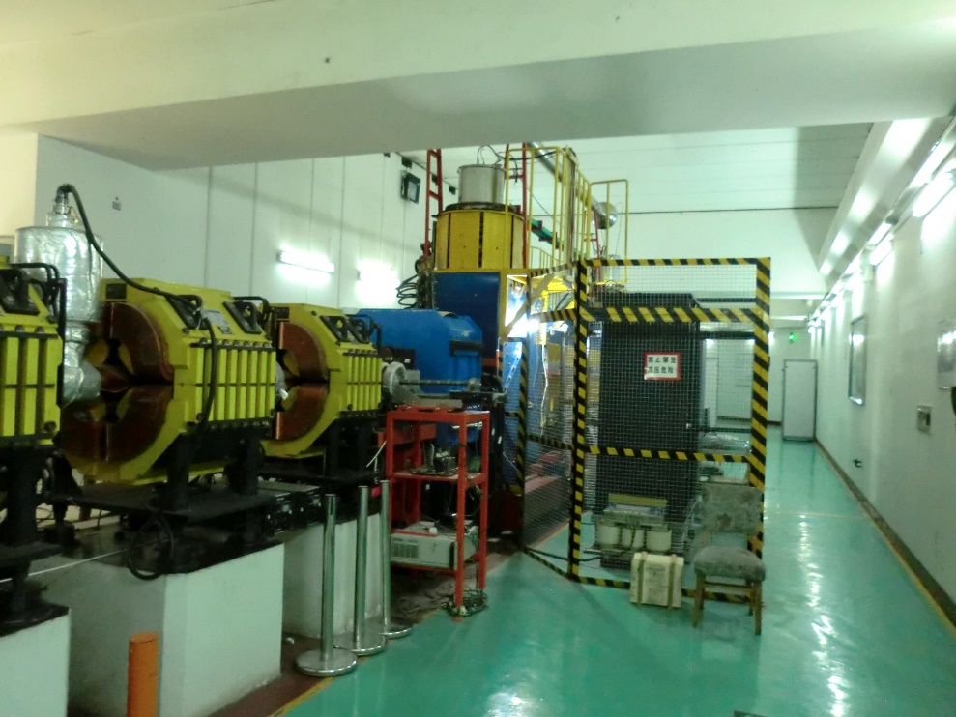
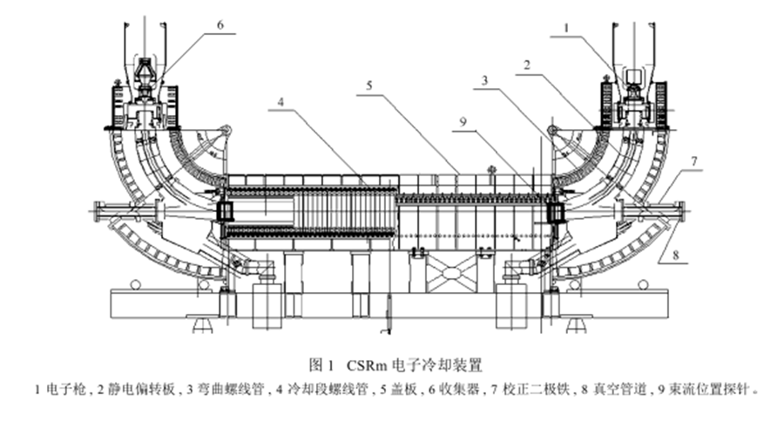
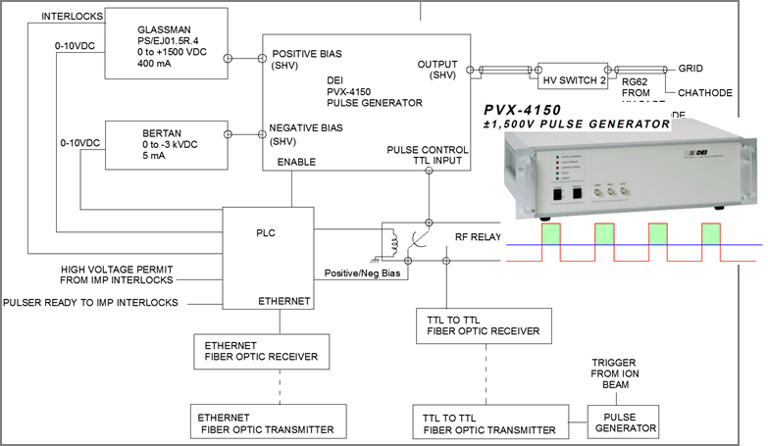
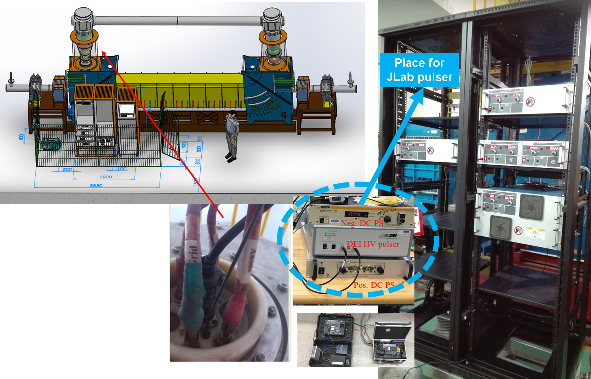
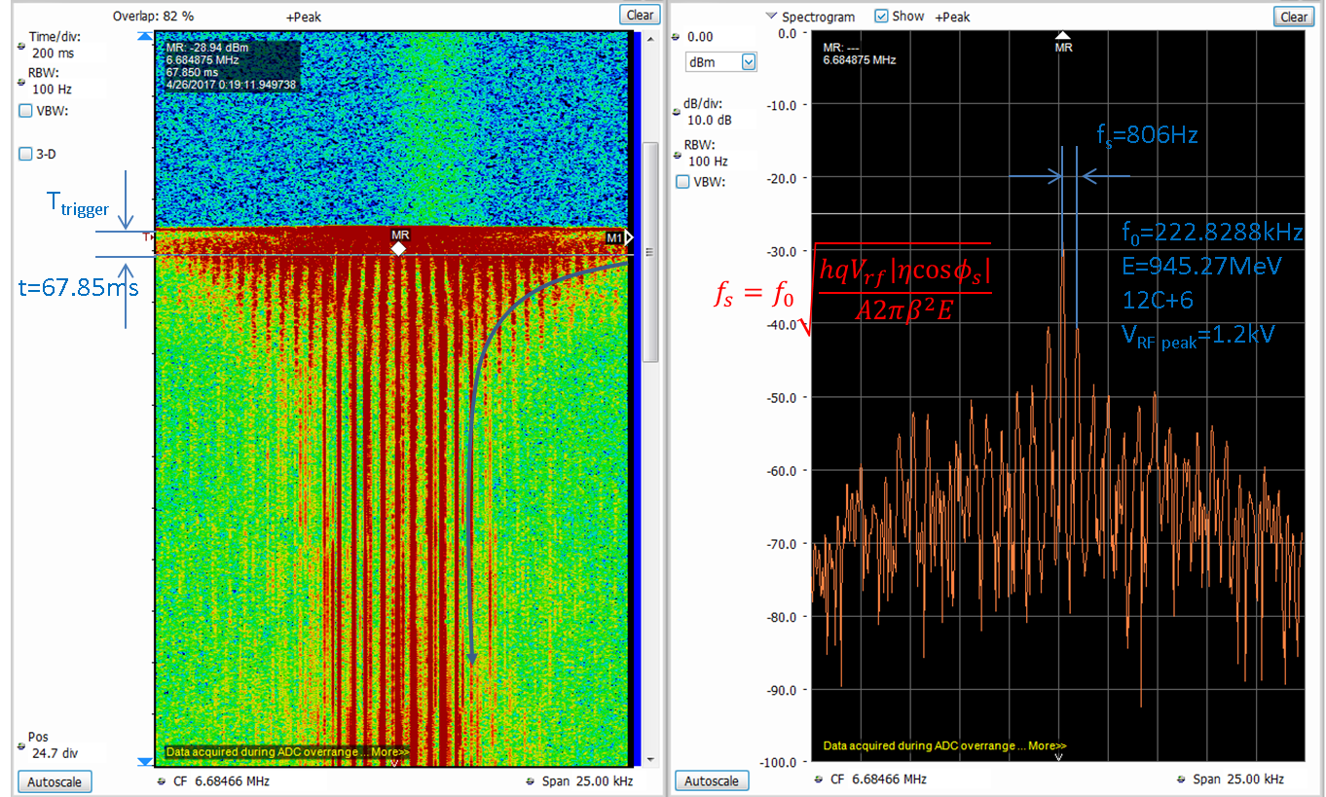
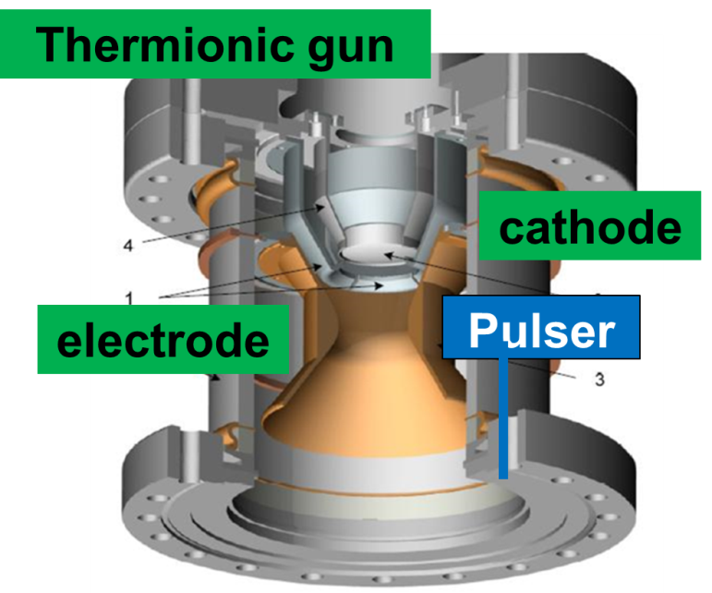
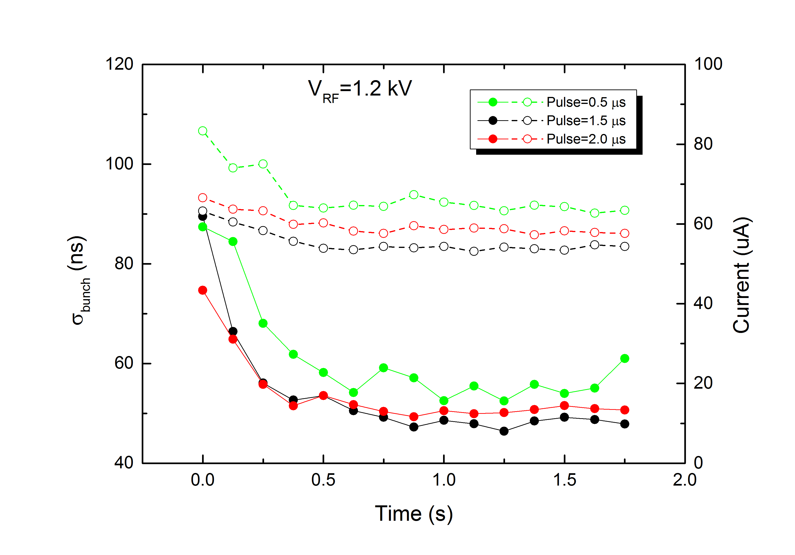
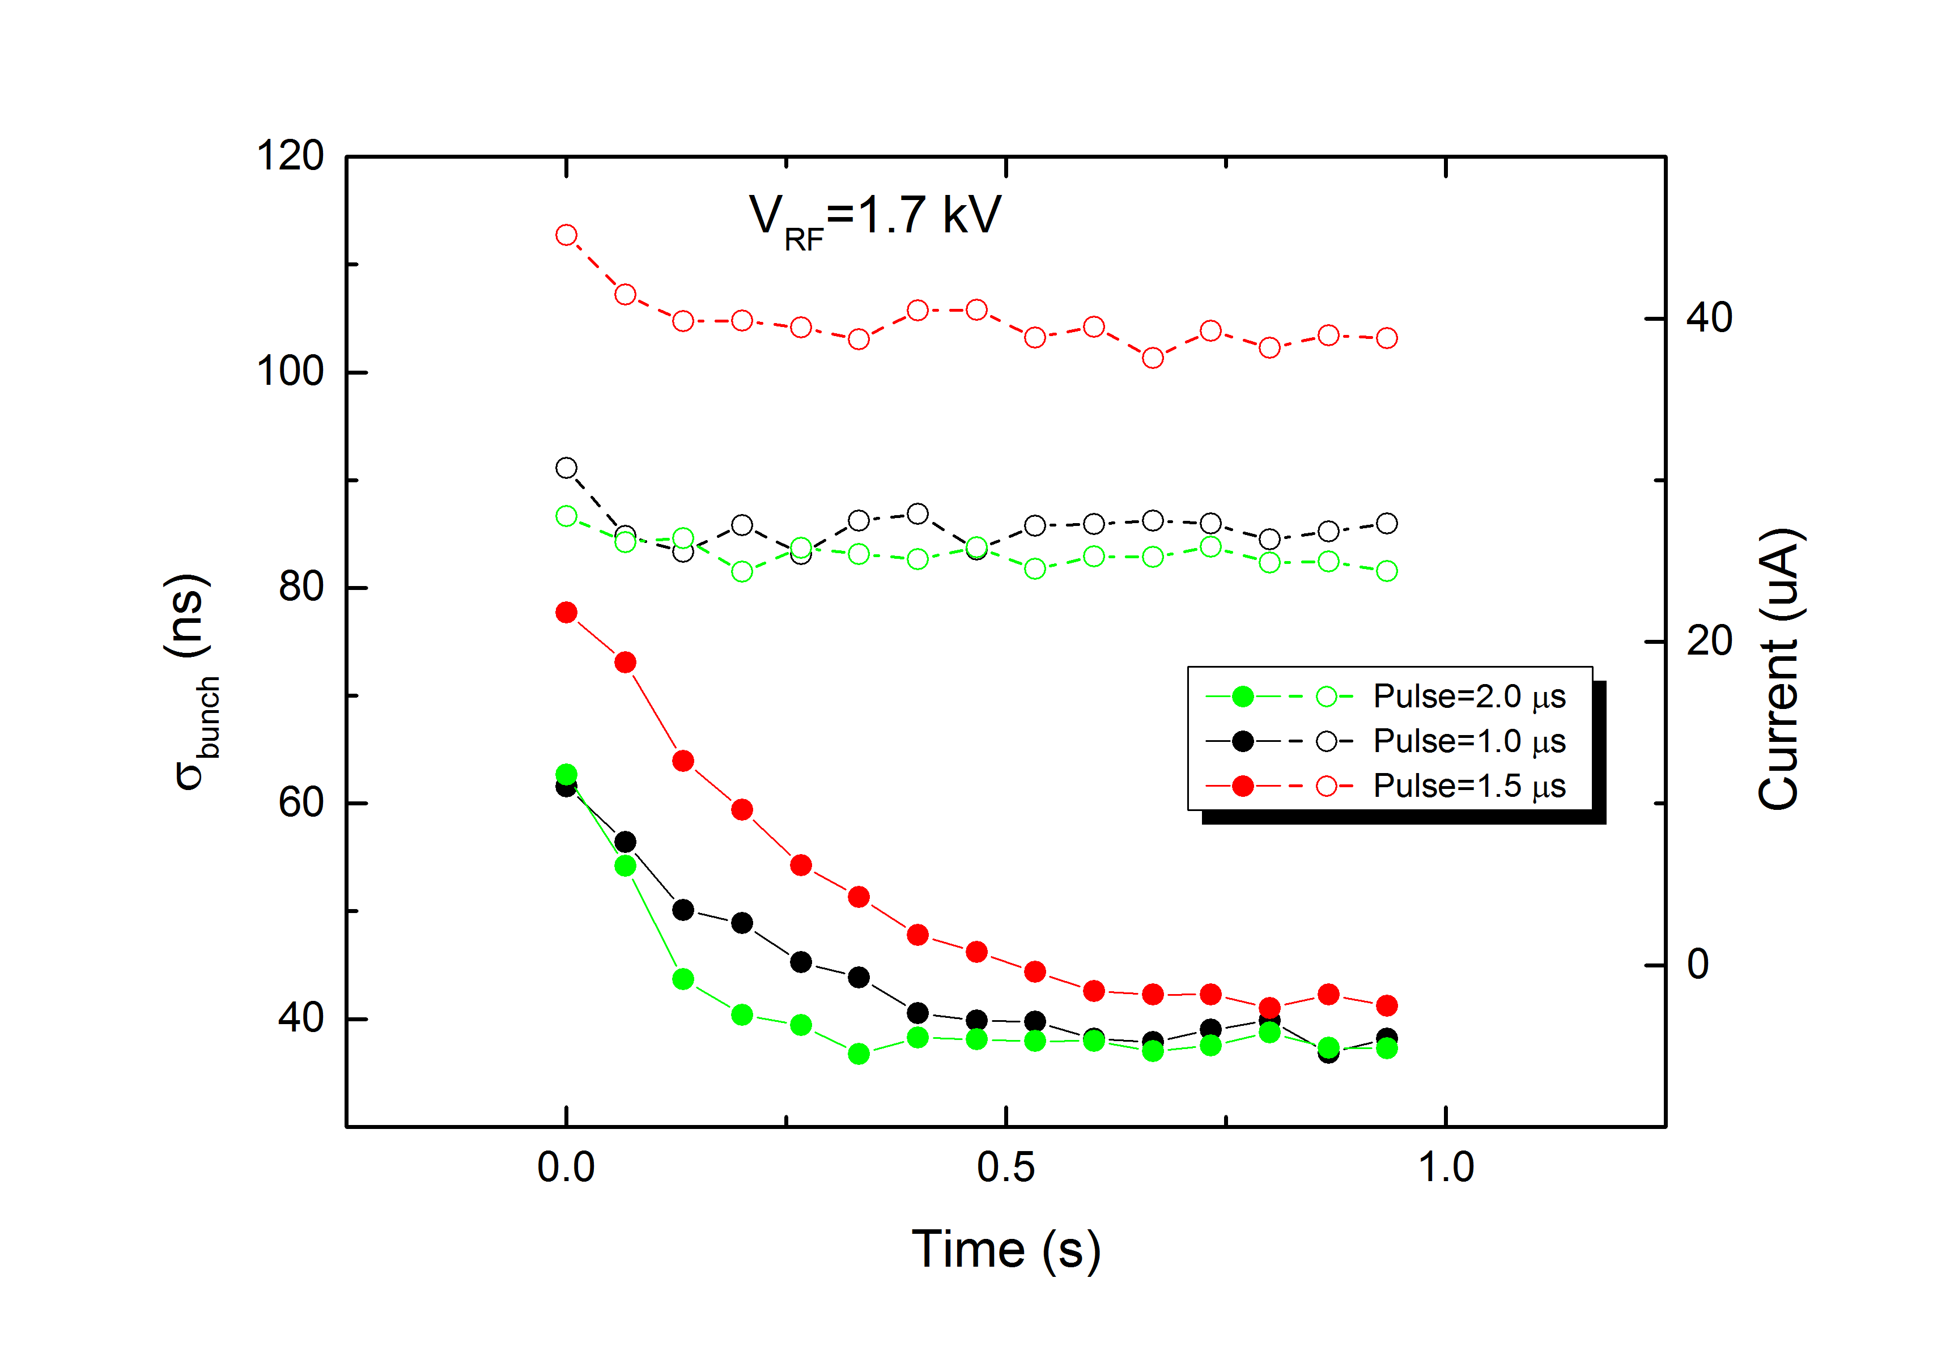
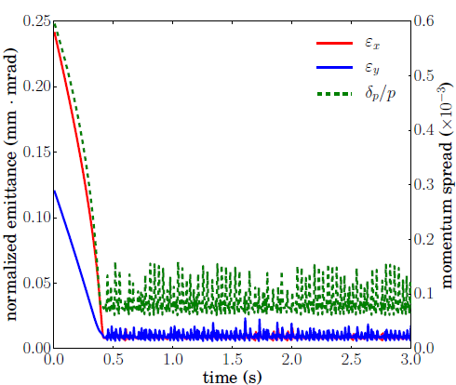
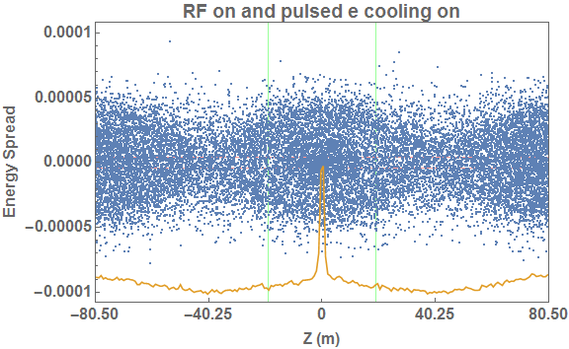
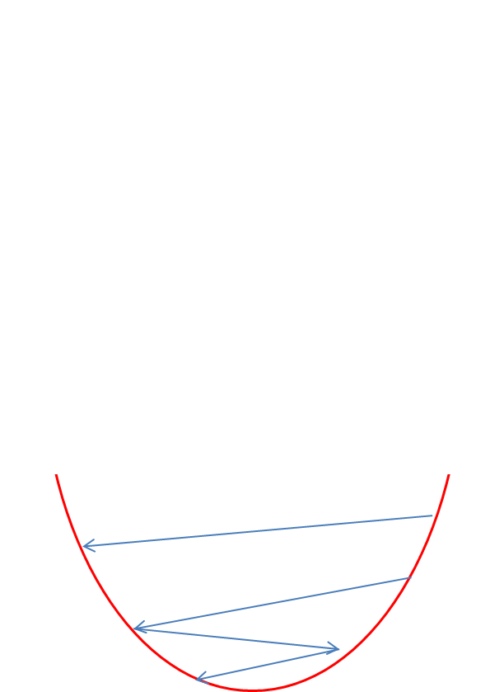
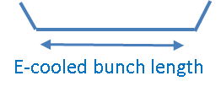
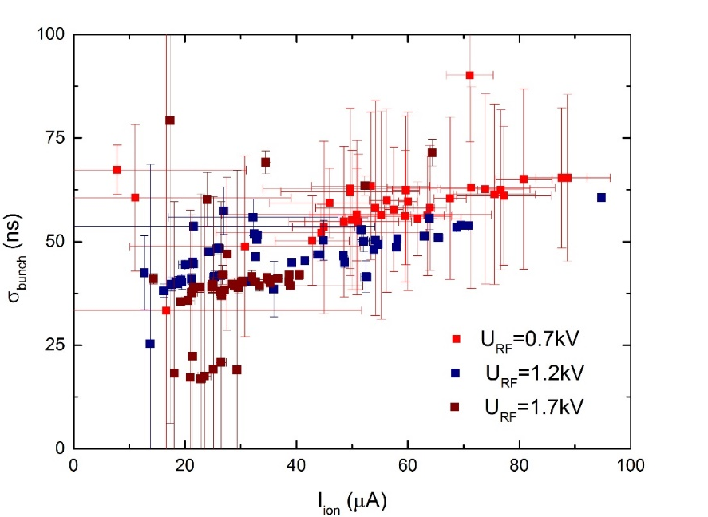
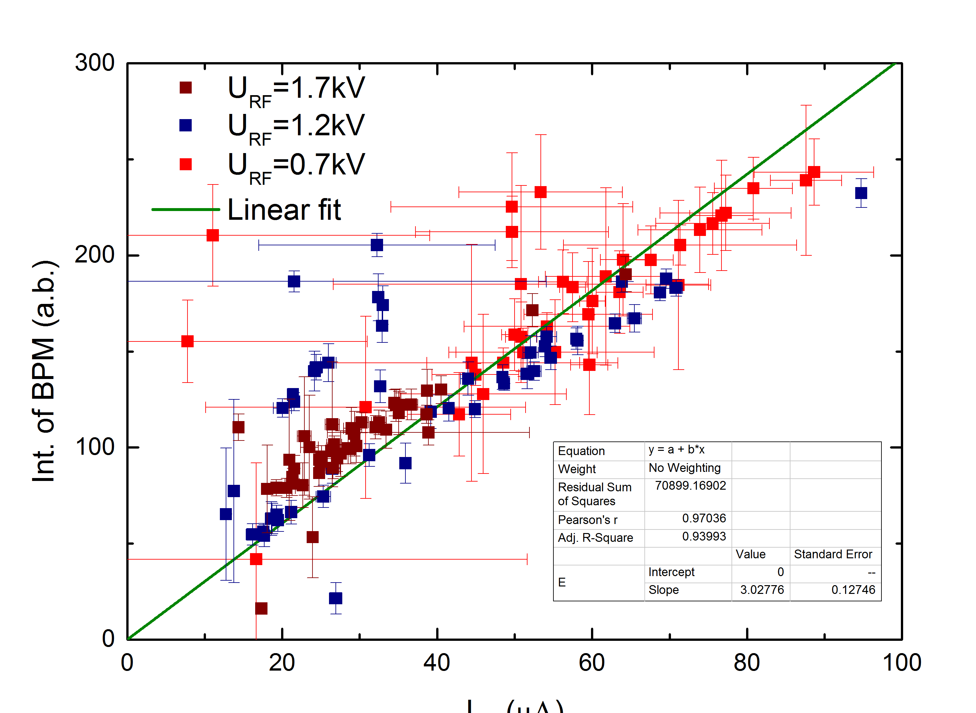



Experimental Demonstration of Ion Beam Cooling with Pulsed Electron Beam*
Y. Zhang, A. Hutton, K. Jordan, T. Powers, R. A. Rimmer, M. Spata, H. Wang, S. Wang, H. Zhang
Jefferson Lab, Newport News, VA 23606, USA
L.J Mao, H. Zhao, M.T Tang, J. Li, X.M. Ma, X.D. Yang, J.C. Yang, H.W. Zhao
Institute of Modern Physics, Lanzhou 730000, China
Abstract: Cooling ion beams at high energy is presently considered for several ion colliders, in order to achieve high luminosities by enabling a significant reduction of emittance of hadron beams. Electron beam at cooling channel in a few to tens MeV can be accelerated by a RF/SRF linac, and thus using bunched electrons to cool bunched ions. To study such cooling process, the DC electron gun of EC35 cooler at the storage ring CSRm, IMP was modified by pulsing the grid voltage. A 0.07-3.5 μs electron pulse length with a repetition frequency of less than 250 kHz and synchronized with the ion revolution frequency was obtained. The first experimental demonstration of cooling of a bunched ion beam by a pulsed electron beam was carried out. Data analysis indicates the bunch length shrinkage and the momentum spread reduction of bunched 12C+6 ion beam as evidence of cooling. A longitudinal grouping effect of the coasting ion beam being cooled by the pulsed electron beam has also been observed [1]. In this paper, we will present experimental results and comparison to the simulation modelling, particularly on the bunched electron cooling data after carefully analyzing the beam diagnostic signals.
Motivation
JLEIC design needs a bunched electron at 55MeV to cool ions to compensate the luminosity loss due to the IBS and counter balance the space charge effect on the beam emittance grow
Purpose of this experiment was using existing IMP’s SC 35 cooler at CSRm ring modified to make the pulsed electron beam to demonstrate the cooling of the ion beam from a coasting to an equivalent bunch length
Although the beam energy and bunch length is far from the JLEIC cooler design. Understanding the strong bunched beam cooling principle, benchmark simulation tools with right the physics model is the primary goal this experiment
CSRm Cooler at IMP
Experiment Parameters
HIREL@IMP
CSRm Cooler
SC 35 DC Cooler
Experiments Done So Far
May 2016, 1st experiment: bunched beam electron was formed by JLab’s HV pulser cooling was observed for the 1st time. Data was taken at different injection fills
April 2017, 2rd experiment: improved triggering control and beam instrumentation for taking data in the same injection fill so cooling process was more clearly observed
Schottky Signal Data Analysis
Simulations vs Experiment Data
dp/p reduction ~ from 2e-3 to 6e-4
Cooling rate: ~ 0.5sec
Agree with 3D pulsed cooling model and 1D pulse + RF focusing models simulations but all of them are lack of quantitative benchmark
Schottky signal intensity ∝J_{u}(ma) has significant magnitude only for µ≤ma. Synchrotron side-bands extends up to µ_{m}ω_{s}(0)≅ma_{m}ω_{s}(0)=mΔω_{max}
m Δω_{max} : coasting beam freq. spread
Δω_{max}: max instant. ang. velocity spread in the bunch
a_{m} is the max. synchrotron motion amplitude in the bunch (rad)
The profile of the Schottky band at m*f₀ (m=30) harmonic duplicates the longitudinal velocity distribution of the bunch
Width of each peak dominated by the signal RBW and coherence of the uncooled bunch in the same revolution
Ion BPM Data Analysis
Conclusions
Bunched electron beam cooling 12C+6 ion beam at 7MeV/u has been demonstrated at CSRm ring at IMP, China by our IMP/JLab collaboration team
With the help of RF focusing, the Ion bunch length has been reduced from the coasting to ~3m long by a longer electron bunch but as short as 18m within about 0.5 second
The longitudinal cooling of momentum spread has been reduced from ~2e-3 to ~6e-4 with a similar cooling rate
The simulation models developed so far agree with the measurement results qualitatively.
Beam diagnostics like ion BPM and Schottky signals strongly support these evidences but obtained data so far lacks of calibrations and measurement accuracies for a further quantitatively benchmark for the simulation codes.
Beam instrumentation improvement both in hardware and software has been designed and planned for the next experiment in 2018
Pushing the next phase of experiment to be done in 2019-2020 at CSRe ring with a higher ion energy, modifying the SC-300 Cooler, and a better beam diagnostics are envisioned and funded
IMP in China is still the best place and the fastest way to demonstrate the strong bunched beam cooling in order to benchmark our cooling simulation tools for our CCR/ERL E-cooler design for JLEIC
Electron potential well is much shallow compare to RF potential well
3D
RF potential well
12C6+ 7MeV
RF bunched length
Cooling process
Physical Picture of simulation Model
1D with synchrotron motion
References
L.J Mao et al, Experimental Demonstration of Electron Cooling with Bunched Electron Beam, TUP1, Proceedings of COOL2017, Bonn, Germany
* Authored by Jefferson Science Associates, LLC under U.S. DOE Contract No. DE-AC05-06OR23177.
# yzhang@jlab.org
DCCT ion current=43.78uA
e energy=3.74keV
e DC collector current=67.2mA
e average pulsed current=19.3mA
RF Frequency=445.6577kHz
e-pulse width=1.0us
e-pulse frequency=222.8288kHz
RF Voltage=1.49/1.2kV (W/R)
ion signal
BPM April, 2017 data from same injection fill

