Slide 1

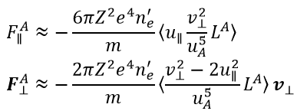
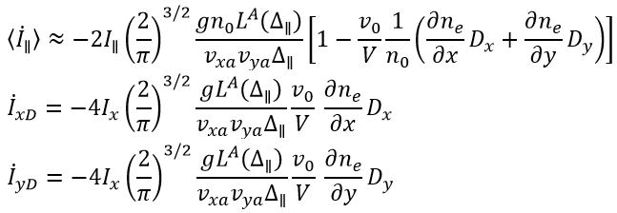
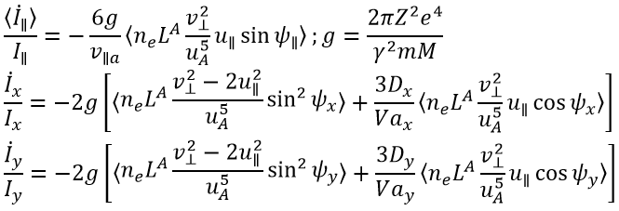
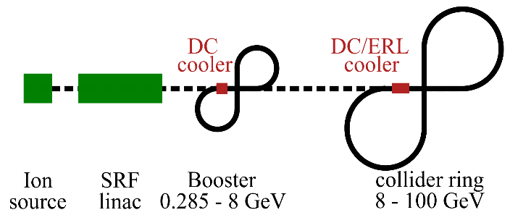
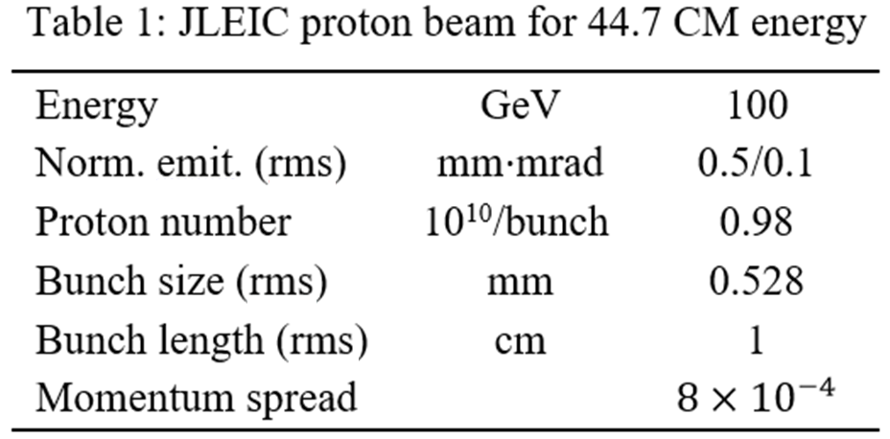
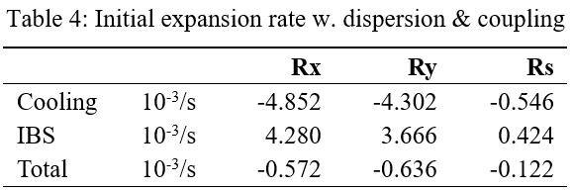
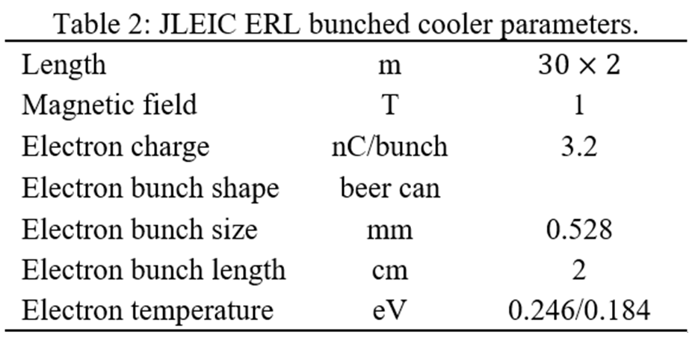
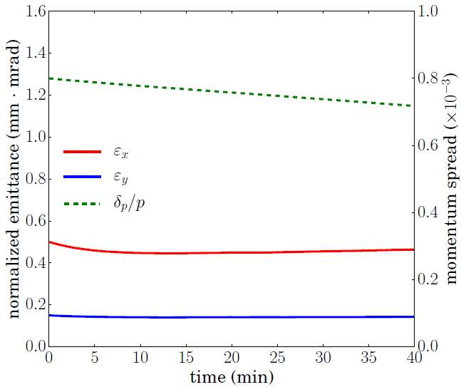
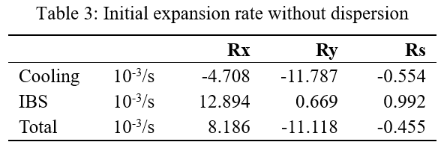


DISPERSIVE ELECTRON COOLING FOR JLEIC
H. Zhang, Ya. Derbenev, Y. Zhang
Jefferson Lab, Newport News, VA 23606, USA
Abstract
JLEIC is the electron ion collider under design at Jefferson Lab, which will provide a luminosity up to 10³⁴ cm⁻²s⁻¹. To reach the high luminosity, short ion and electron bunches with high charge density colliding in high frequency are proposed in JLEIC design. The high charge density of the ion beam leads to strong intrabeam scattering effect, which enlarges the ion beam emittance and ruins the luminosity if not mitigated. Magnetized electron cooling is implemented to overcome the intrabeam scattering effect and to reduce or maintain the ion beam emittance. In this paper, we discuss the redistribution of the cooling effects in the longitudinal and the transverse directions by introducing the dispersion of the ion beam in the cooling section. When the charge density of the cooling electron beam varies, the dispersion of the ion beam leads to an increase of the transverse cooling rate and a reduction of the longitudinal cooling rate, while the total decrement of the Courant-Snyder invariant of the ion beam increases. Both theoretical analysis and numerical calculation are presented.
Dispersive Electron Cooling
Electron cooling
A method to reduce the emittance of an ion beam.
Introducing an accompany electron beam of lower temperature into a straight section of the ion orbit.
Ion beam transfer energy to the electron beam and thus the emittance is reduced.
Dispersive electron cooling
The asymmetry in cooling rates can be corrected by introduction of the following measurements:
1. split in average longitudinal velocity of ion beam to electron beam: $f\left(v_{e∥}\right)=\frac{1}{\sqrt{2π}Δ_{∥}}\exp{[−\frac{{\left(v_{e∥}−v_{0}\right)}^{2}}{2Δ_{∥}}]}$,
2. ion dispersion function in cooling section, plus
3. transverse space-gradient of the longitudinal friction force.
Introduce the transverse gradient of the longitudinal friction force via the gradient of electron density as follow:
Dispersive contribution to cooling rate:
Limit our conditions: $v_{xa},v_{ya}≫|U_{∥}|$ and $v_{0}, v_{∥a}≪Δ_{∥}$. The integration over betatron phases is concentrated near $ψ_{x}=ψ_{y}=0$, it is reduced to averaging over the electron velocities distribution and synchrotron oscillations of ions. Performing final averaging in asymptotic situations $v_{0},v_{∥a}≪Δ_{∥}$, we obtain:
Magnetized electron cooling
Longitudinal magnetic field helps to compensate the repulsion of electrons by the space charge field, as well as an angular beam divergence.
Collision in magnetic field can be divided into two types:
1. Fast oscillation with effective interaction time small compared to the electron Larmor period.
2. Adiabatic collision with Larmor circles.
Contribution of the fast oscillations is the same as non-magnetized cooling.
Friction force due to the adiabatic collision:
JLEIC Cooling Scheme
JLab Electron Ion Collider (JLEIC):
In the current baseline design, JLEIC can deliver a luminosity up to 4.6$×$10³³ cm⁻²s⁻¹ with a full-acceptance detector at the medium center-of-mass energy of approximately 45 GeV. The luminosity is proposed to be above 10³⁴ cm⁻²s⁻¹ in future upgrade. JLEIC offers an electron energy up to 11 GeV, a proton energy up to 100 GeV, and corresponding energies per nucleon for heavy ions with the same magnetic rigidity.
Coolers on JLEIC:
Electron cooling is essential to reduce the ion beam emittance, to compensate the intrabeam scattering (IBS) effect and to maintain the high luminosity during cooling.
Three coolers on JLEIC:
Low energy DC cooler in booster for heavy ion accumulation.
DC cooler in collider ring to reduce the normalized emittance before accelerating the ion beams to collision energy.
ERL based bunched beam cooler in collider ring for emittance/luminosity maintenance during collision.
High energy (up to 55 MeV) bunched electron beam will be implemented to cool the ion beam in the collider ring. An energy-recovery-linac (ERL) based electron cooler has been proposed in the baseline design. A circulator ring will be deployed for future luminosity upgrade.
Electron cooling rate
Calculate the cooling rate of a focused beam in a ring, averaging over the betatron oscillation, as follows:
JLEIC DISPERSIVE COOLING
Cooling during collision (CM energy 44.7 GeV)
Proton beam parameters at the cooler in table 1.
Cooler and electron beam parameters in table 2.
Expansion rate without dispersion and coupling in table 3.
The horizontal IBS exceeds cooling.
Extra cooling in the other two directions.
Redistribute cooling and IBS
Introducing dispersion at the cooler helps to (1) transfer extra longitudinal cooling to the transverse direction and (2) prevent overcooling in longitudinal direction.
Transverse coupling redistributes IBS to the vertical direction.
For example, a proton beam with slightly reduced current (82%), dispersion (1.8/0.3 m) and coupling (40%) is cooled in all directions (table 4). Emittance is maintained during collision (Fig. 3).
Fig. 1 JLEIC ion complex layout
Cooling section
Fig. 3 Cooling rate changes with the bunch length, for cylindrical electron bunch with difference radius
ion bunch
solenoid
electron bunch
Fast kicker
circulator ring
Fast kicker
injector
SRF Linac
dump
Fig. 2 Schematic drawing of bunched electron cooler base on an ERL, with upgrade circulator ring connection in green.
Fig. 3 Cooling during collision with dispersion & coupling.
Acknowledgement
Work supported by the Department of Energy, Laboratory Directed Research and Development Funding, under Contract No. DE-AC05-06OR23177.
Summary
Ion beam dispersion at the cooling section redistributes the cooling effect between the transverse and the longitudinal directions. For JLEIC, the proton beam at the collision energy has much stronger IBS effect in the horizontal direction than the other directions. Dispersive cooling, together with other means, e.g. transverse coupling, helps to find a preferred equilibrium, which maintains the emittance during the collision.

