Slide 1







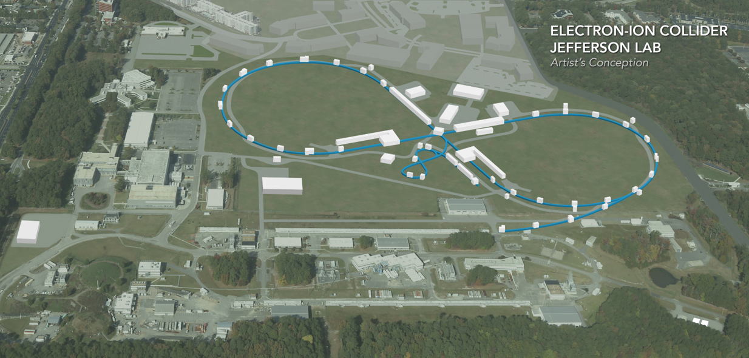
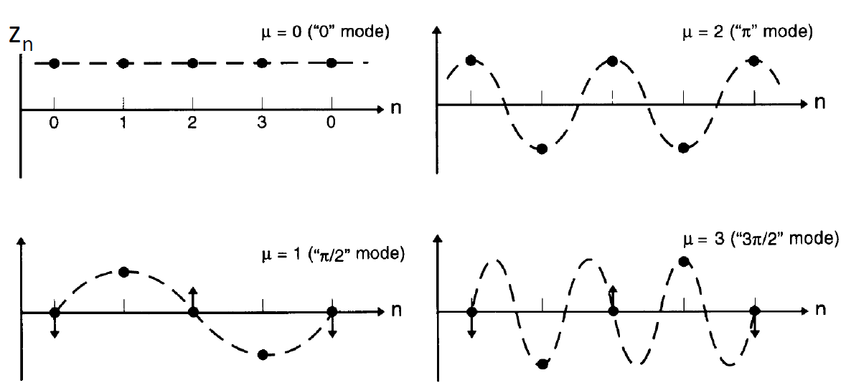
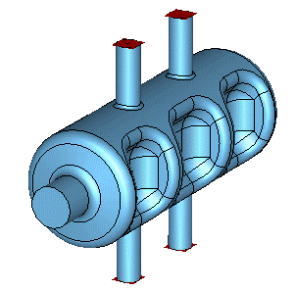
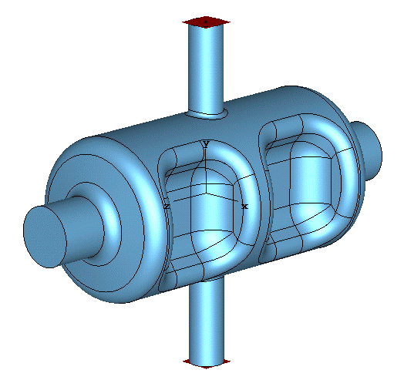
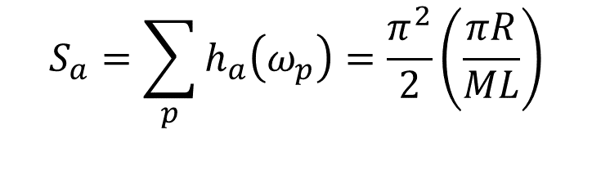
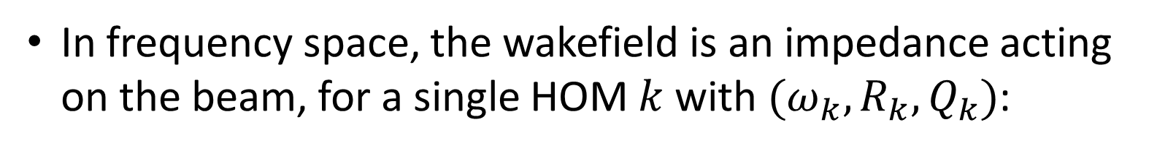




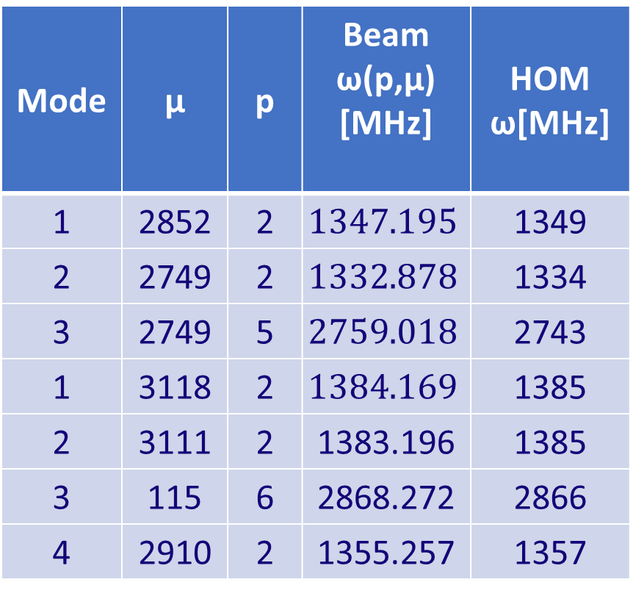


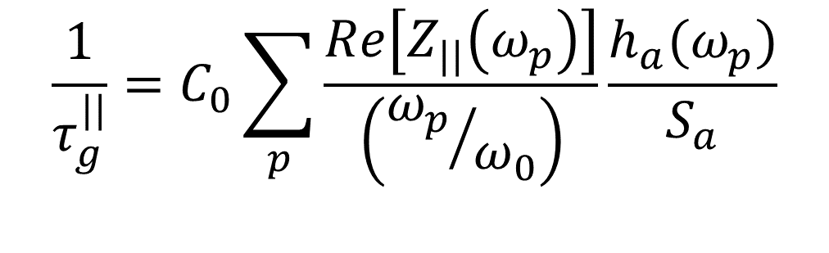

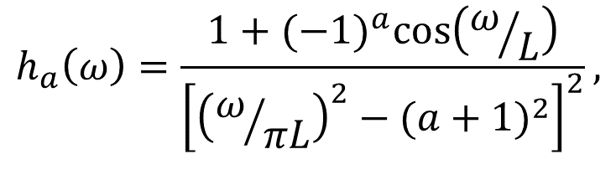
  Coupled bunch instability
  from JLEIC crab cavity high order modes
  S. I. Sosa^{1,2 #}, R. Li², H. Park^{1,2}, S. De Silva^{1,2}, V. S. Morozov², J. R. Delayen^{1,2}
¹ Center for Accelerator Science, Department of Physics, Old Dominion University, Norfolk, VA 23529, USA
² Thomas Jefferson National Accelerator Facility, Newport News, VA 23606, USA
Summary
Particle bunches traveling in a ring can excite wakefields inside any radio-frequency element present. These electromagnetic modes can resonate long enough and interact with subsequent passing bunches. A coherent oscillation between bunches can quickly give rise to an instability and needs to be controlled. The Jefferson Lab electron-ion collider (JLEIC) has a large 50 mrad crossing angle and thus relies on bunch crabbing to achieve high luminosity. Bunch crabbing is done with compact superconducting rf dipole cavities. We study coupled bunch oscillations driven by the higher order modes (HOM) of multi-cell rfd crab cavities under study for JLEIC, we calculate the instability growth time assuming a symmetric beam spectrum and identify the HOM driving the instability.
Coupled bunch instability
A bunch travelling through the ring can induce wakefields along different structures; beam pipe, tapers, bellows, and high-Q elements, i.e. rf cavities.
This induced electromagnetic field can resonate long-enough and couple to subsequent bunches.
$$W_{cav}(t)$$
Bunch 2
$$t$$
Bunch 1
Crabbing system for EIC
Bunch 1
Bunch 2
JLEIC has a high luminosity requirement over 10³⁴ cm⁻²s⁻¹ and a large crossing angle of 50 mrad at the collision point.
Crab cavities are required in order to compensate for luminosity loss due to the crossing angle.
In frequency space, the wakefield is an impedance acting on the beam, for a single HOM $k$ with $(ω_{k},R_{k},Q_{k})$:
$$Z_{||}(ω^{′})=\frac{R_{k}}{1+iQ_{k}\left(\frac{ω_{k}}{ω^{′}}−\frac{ω^{′}}{ω_{k}}\right)}$$
Crab cavity
  Assuming an even bunch fill, the beam frequencies are $ω_{p,μ}^{′}=(pM+μ)ω_{0}+ω_{s}$
    M number of bunches, μ is the coupled bunch mode (CBM) number $0≤μ<M$.
Ion beam
e-beam
Crab parameters for JLEIC
    Different CBMs represent different phase advances $Δφ_{μ}=\frac{2πμ}{M}$ between consecutive bunches.
    This bunch oscillation can grow coherently and become an instability.
    Stability condition is: $τ_{i,growth}>τ_{damp}.$
Bunch Crabbing
$φ_{cross}=50$ mrad
Parameter | Electron | Proton | Proton | Unit
Energy | 5 | 100 | 100 | GeV
Frequency | 952.6 |  |  | MHz
Crossing angle | 50 |  |  | mrad
β*_{x} | 0.1 |  |  | m
β^{crab}_{x} | 200 |  | 363 | m
Crab voltage | 1.5 |  | 20.82 | MV
Bunch de-crabbing
W/o crabbing
Local bunch crabbing scheme for EIC.
Crab cavity designs
Calculation and results
Cavities are modelled using CST Microwave Studio.
Two crab cavity designs for EIC presented: a 3-Cell and 2-cell rf dipole cavities with 70 mm beam aperture. HOM hooks and probes added for this study.
Solve for the frequencies of oscillation corresponding to each CBM. The imaginary part of the frequency gives the growth rate of oscillation for that mode.
Use bunch centroid motion only, or include bunch structure using Sacherer’s formula:
$$C_{0}=\frac{I_{b}ω_{0}^{2}η}{6{\left(\frac{L}{2πR}\right)}^{3}2πβ^{2}(E/e)ω_{s}}$$
$$\frac{1}{τ_{g}^{||}}=C_{0}\sum_{p}{\frac{Re\left[Z_{||}\left(ω_{p}\right)\right]}{\left({ω_{p}}/{ω_{0}}\right)}\frac{h_{a}(ω_{p})}{S_{a}}}$$
Parabolic bunch:
$$h_{a}\left(ω\right)=\frac{1+{(−1)}^{a}\cos\left(ω/L\right)}{{\left[{\left(ω/{πL}\right)}^{2}−{(a+1)}^{2}\right]}^{2}},$$
3-Cell crab cavity design.
2-Cell crab cavity design.
$$L=\frac{βc}{2\sqrt{2}σ_{s}}$$
$$S_{a}=\sum_{p}{h_{a}\left(ω_{p}\right)=\frac{π^{2}}{2}\left(\frac{πR}{ML}\right)}$$
Number of cavities required per beam per side: 7 for 3-cell vs. 11 for 2-cell.
Scan over all beam sampling frequencies and evaluate the growth rate , given an arbitrary set of HOM.
Longitudinal HOM
ID of HOM driving CBI
μ=2852
μ=3118
Mode | μ | p | Beam ω(p,μ) [MHz] | HOM ω[MHz]
1 | 2852 | 2 | $$1347.195$$ | 1349
2 | 2749 | 2 | $$1332.878$$ | 1334
3 | 2749 | 5 | $$2759.018$$ | 2743
1 | 3118 | 2 | $$1384.169$$ | 1385
2 | 3111 | 2 | 1383.196 | 1385
3 | 115 | 6 | 2868.272 | 2866
4 | 2910 | 2 | 1355.257 | 1357
μ=3111
μ=115
μ=2910
μ=2749
Impedance from longitudinal trapped HOM up to 3 GHz. Yellow line shows the threshold impedance based on the state of the art rf feedback system used at PEP-II.
Negative rates (not shown) represent damped, or stable modes.
Comments
We calculate CBI growth time for 2 cavity designs and identify the driving HOM.
The fastest instability growth time is 0.25 ms (3-cell) and 0.38 ms (2-cell). Optimization of the HOM couplers will lower the impedance of HOM and thus the growth time of CBI could be managed by a PEP-II type bunch to bunch feedback system.
Beam model: An even bunch fill of the ring gives an overestimation of CBI growth, in reality the beam structure is uneven and beam gaps need to be included.
Impedance model: The narrow-band impedance model used does not account for HOM having different phases. A direct calculation of the time-domain wakefields excited by a bunch needs to be done numerically to get a more accurate HOM impedance of the cavities and the HOM power that needs to be extracted.
Acknowledgements
Authored by Jefferson Science Associates, LLC under contract DE-AC05-06OR23177. The U.S. Government retains a non-exclusive, paid-up, irrevocable, world-wide license to publish or reproduce this manuscript for U.S. Government purposes.
Travel to IPAC'18 supported by the United States National Science Foundation, the Division of Physics of Beams of the American Physical Society, and TRIUMF. #salvaisg@jlab.org

