Slide 1
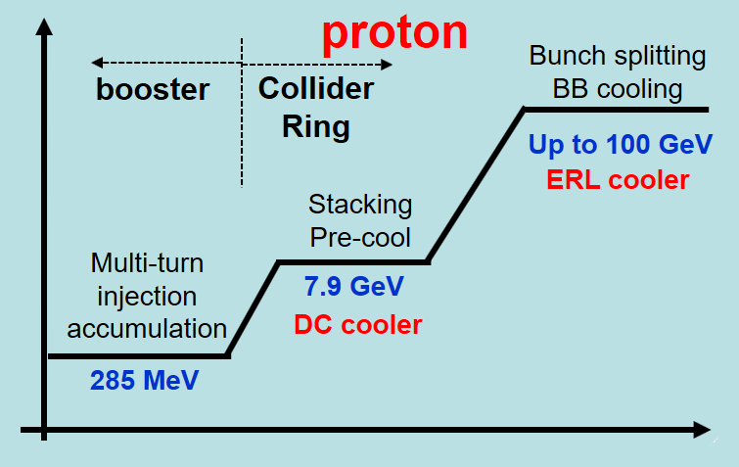
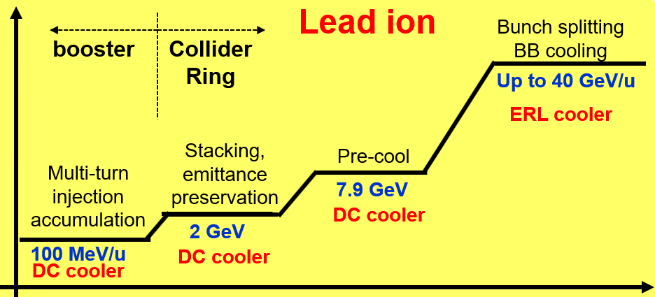
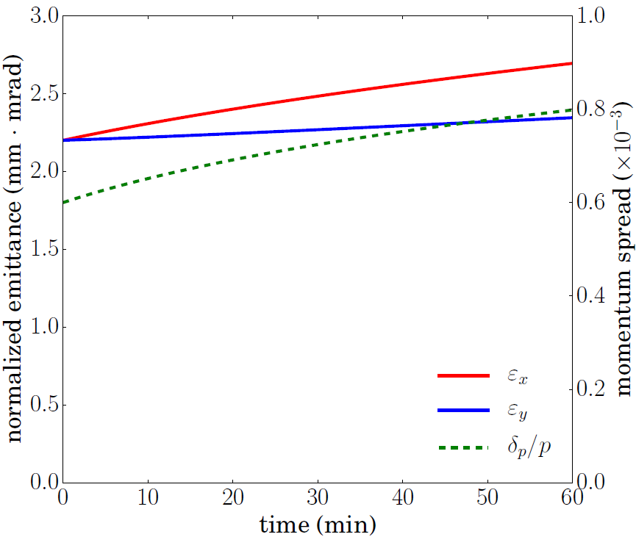
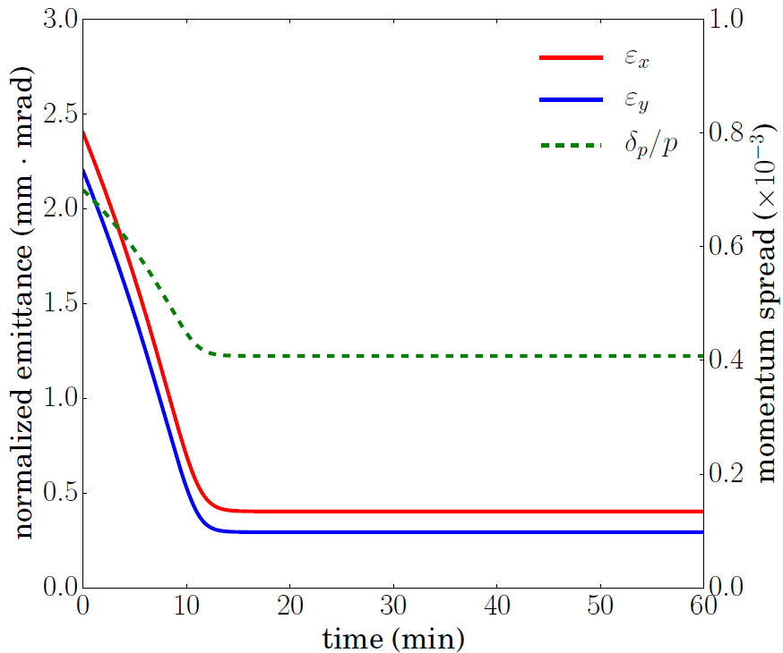
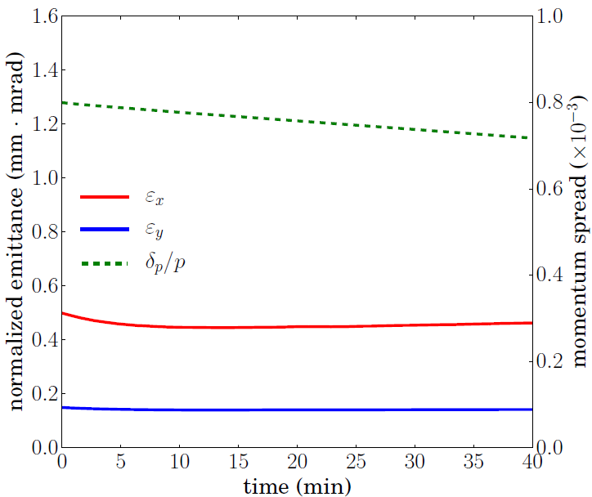
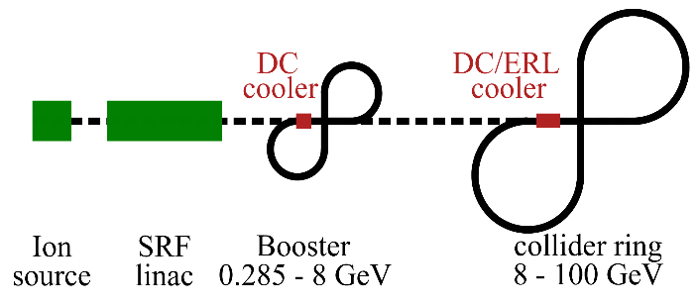
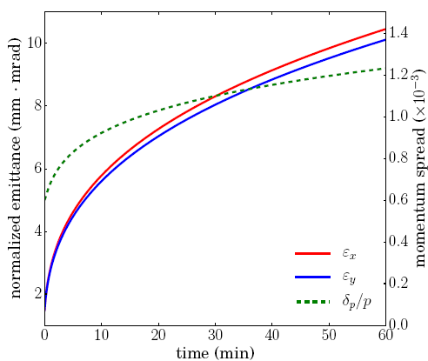
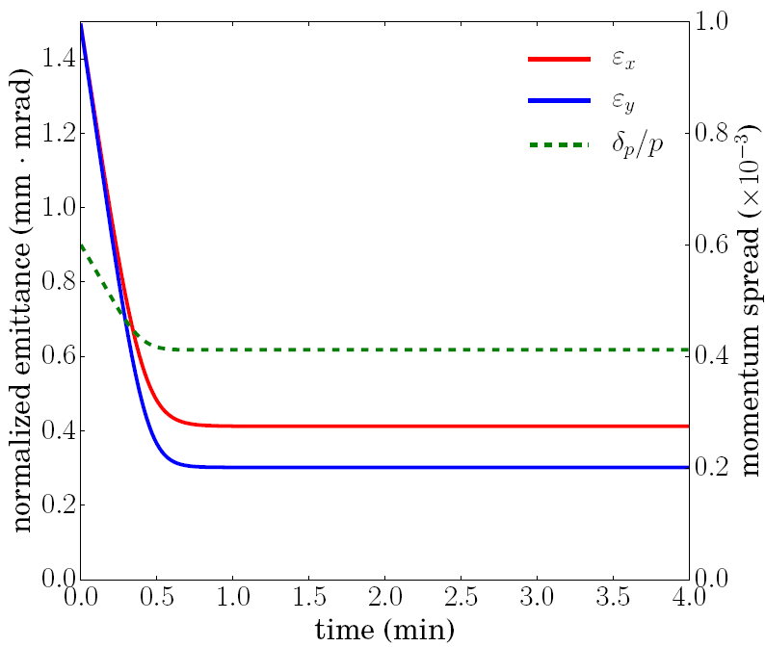
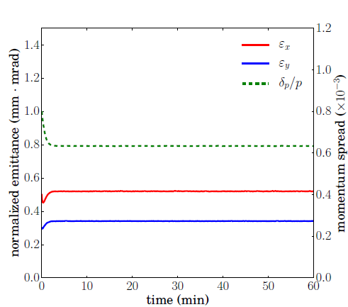
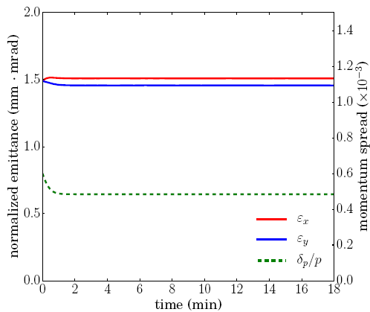
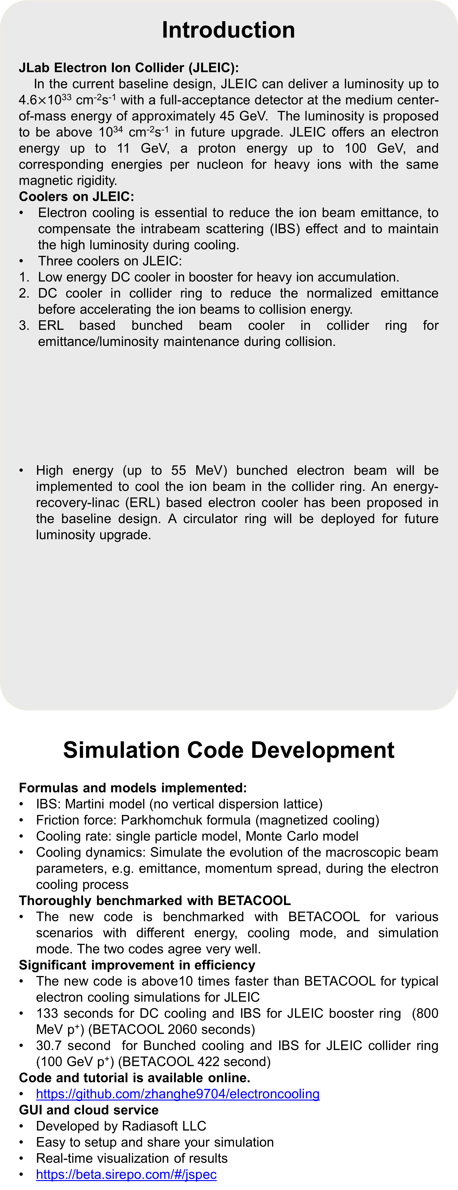

MULTI-STAGE ELECTRON COOLING SCHEME FOR JLEIC
H. Zhang, Y. Zhang, Ya. Derbenev, S. Benson, Y. Roblin
Jefferson Lab, Newport News, VA 23606, USA
Abstract
JLEIC is the future electron ion collider under design at Jefferson Lab, which will provide a luminosity up to 10³⁴ cm⁻²s⁻¹. Electron cooling is essential for JLEIC to overcome the intrabeam scattering effect, reduce the ion beam emittance and thus achieve the high luminosity. The cooling time is approximately in proportion to the square of the energy and the 6D emittance. To avoid the difficulty of cooling the ion beam with large emittance at high energy, a multi-stage cooing scheme was designed for JLEIC. The ion beam was cooled at the low energy to reduce the emittance. Then it was ramped up to the collision energy. During the collision, electron cooling is implemented to maintain the emittance and the luminosity. Simulations for proton beam and lead ion beam at various stages are presented in this paper.
Multi-Stage Cooling Scheme
Multi-Stage Cooling
Cooling time is proportional to $γ^{2}$ and 6D emittance: $τ_{cool}∝γ^{2}\frac{Δγ}{γ}σ_{z}ε_{4d}$.
Pre-cooling at low energy to reduce the emittance to desired value.
Keep cooling at collision energy to maintain the already reduced value.
Avoid the most difficult scenario: cool high energy beam with large emittance.
Cooling Stages in Ion Beam Formation Cycle
Table 1. Cooling stages for proton beam and lead ion beam
Introduction
JLab Electron Ion Collider (JLEIC):
In the current baseline design, JLEIC can deliver a luminosity up to 4.6$×$10³³ cm⁻²s⁻¹ with a full-acceptance detector at the medium center-of-mass energy of approximately 45 GeV. The luminosity is proposed to be above 10³⁴ cm⁻²s⁻¹ in future upgrade. JLEIC offers an electron energy up to 11 GeV, a proton energy up to 100 GeV, and corresponding energies per nucleon for heavy ions with the same magnetic rigidity.
Coolers on JLEIC:
Electron cooling is essential to reduce the ion beam emittance, to compensate the intrabeam scattering (IBS) effect and to maintain the high luminosity during cooling.
Three coolers on JLEIC:
Low energy DC cooler in booster for heavy ion accumulation.
DC cooler in collider ring to reduce the normalized emittance before accelerating the ion beams to collision energy.
ERL based bunched beam cooler in collider ring for emittance/luminosity maintenance during collision.
High energy (up to 55 MeV) bunched electron beam will be implemented to cool the ion beam in the collider ring. An energy-recovery-linac (ERL) based electron cooler has been proposed in the baseline design. A circulator ring will be deployed for future luminosity upgrade.
Simulation Code Development
Formulas and models implemented:
IBS: Martini model (no vertical dispersion lattice)
Friction force: Parkhomchuk formula (magnetized cooling)
Cooling rate: single particle model, Monte Carlo model
Cooling dynamics: Simulate the evolution of the macroscopic beam parameters, e.g. emittance, momentum spread, during the electron cooling process
Thoroughly benchmarked with BETACOOL
The new code is benchmarked with BETACOOL for various scenarios with different energy, cooling mode, and simulation mode. The two codes agree very well.
Significant improvement in efficiency
The new code is above10 times faster than BETACOOL for typical electron cooling simulations for JLEIC
133 seconds for DC cooling and IBS for JLEIC booster ring (800 MeV p⁺) (BETACOOL 2060 seconds)
30.7 second for Bunched cooling and IBS for JLEIC collider ring (100 GeV p⁺) (BETACOOL 422 second)
Code and tutorial is available online.
https://github.com/zhanghe9704/electroncooling
GUI and cloud service
Developed by Radiasoft LLC
Easy to setup and share your simulation
Real-time visualization of results
https://beta.sirepo.com/#/jspec
Ring | Functions | Proton kinetic E (GeV) | Lead ion kinetic E (GeV/u) | Electron kinetic E (MeV) | Cooler type
booster ring | Accumulation of positive ions |  | 0.1 (injection) | 0.054 | DC
collider ring | Maintain emittance during stacking |  | 2 (injection) | 1.1 | DC
 | Emittance reduction | 7.9 (injection) | 7.9 (ramp to) | 4.3 | DC
 | Maintain emittance during collision | Up to 100 | Up to 40 | Up to 54.5 | ERL
Simulation for Proton Beam Cooling
Fig. 1 JLEIC ion complex layout
No cooling needed for stacking (~10 min) in the collider ring at 7.9 GeV.
Pre-cooling with DC cooler in the collider ring to reduce the emittance at 7.9 GeV.
Cooling with ERL bunched cooler during collision in the collider ring at 100 GeV.
Proton beam (pre-cooling):
  Injection Energy: 7.9 GeV
  Proton number: 6.58x10¹¹
  Normalized emit. (rms): 2.2 μm
  Momentum spread: 6x10⁻⁴
  Bunch length (rms): 7 m
Proton beam (cooling in collision):
  Injection Energy: 100 GeV
  Proton number: 0.804x10¹⁰
  Normalized emit. (rms): 0.50/0.15 μm
  Momentum spread: 8x10⁻⁴
  Bunch length (rms): 2.5 cm
  Transverse coupling: 38%
DC cooler:
  Current: 3 A
  Length: 30 m
  Magnetic field: 1T
ERL bunched cooler:
  Bunch charge: 3.2 nC
  Length: 60 m
  Magnetic field: 1T
Cooling section
ion bunch
solenoid
electron bunch
Simulation for Lead Ion Beam Cooling
Fast kicker
circulator ring
Fast kicker
injector
SRF Linac
dump
Fig. 2 Schematic drawing of bunched electron cooler base on an ERL, with upgrade circulator ring connection in green.
DC cooling to maintain emittance in stacking.
Fig. 3 Cooling rate changes with the bunch length, for cylindrical electron bunch with difference radius
IBS expansion for stacking (~10 min) in the collider ring at 2 GeV/u. Cooling needed.
Pre-cooling with DC cooler in the collider ring to reduce the emittance at 7.9 GeV/u.
Cooling with ERL bunched cooler during collision in the collider ring at 40 GeV/u.
²⁰⁸Pb⁸²⁺(stacking & pre-cooling):
  Injection Energy: 2 & 7.9 GeV/u
  Proton number: 8.26x10⁹
  Normalized emit. (rms): 1.5 μm
  Momentum spread: 6x10⁻⁴
  Bunch length (rms): 7 m
²⁰⁸Pb⁸²⁺ beam (cooling in collision):
  Injection Energy: 40 GeV/u
  Proton number: 1.20x10⁸
  Normalized emit. (rms): 0.50/0.3 μm
  Momentum spread: 8x10⁻⁴
  Bunch length (rms): 1 cm
DC cooler (stacking &
pre-cooling):
  Current: 0.62 & 2 A
  Length: 30 m
  Magnetic field: 1T
ERL bunched cooler:
  Bunch charge: 0.8 nC
  Length: 60 m
  Magnetic field: 1T
Summary
A multi-stage cooling scheme has been proposed and simulated for both the proton beam and the lead ion beam. In this scheme, the emittance of the ion beam is reduced to the desired value by pre-cooling at the lower energy (7.9 GeV/u). Then the ion beam is accelerated to the collision energy. During the collision, we keep cooling the ion beam to compensate the IBS effect and to maintain the already reduced emittance.. Preliminary simulations suggest the JLEIC design parameters are achievable.
Work supported by the Department of Energy, Laboratory Directed Research and Development Funding, under Contract No. DE-AC05-06OR23177.

