Slide 1



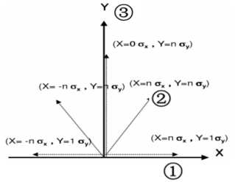
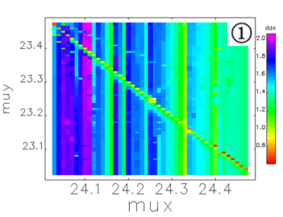
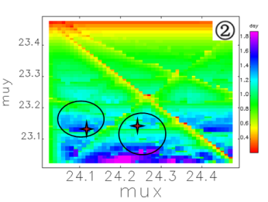
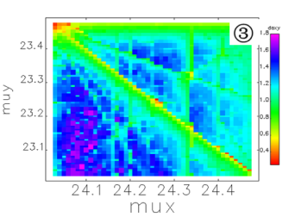
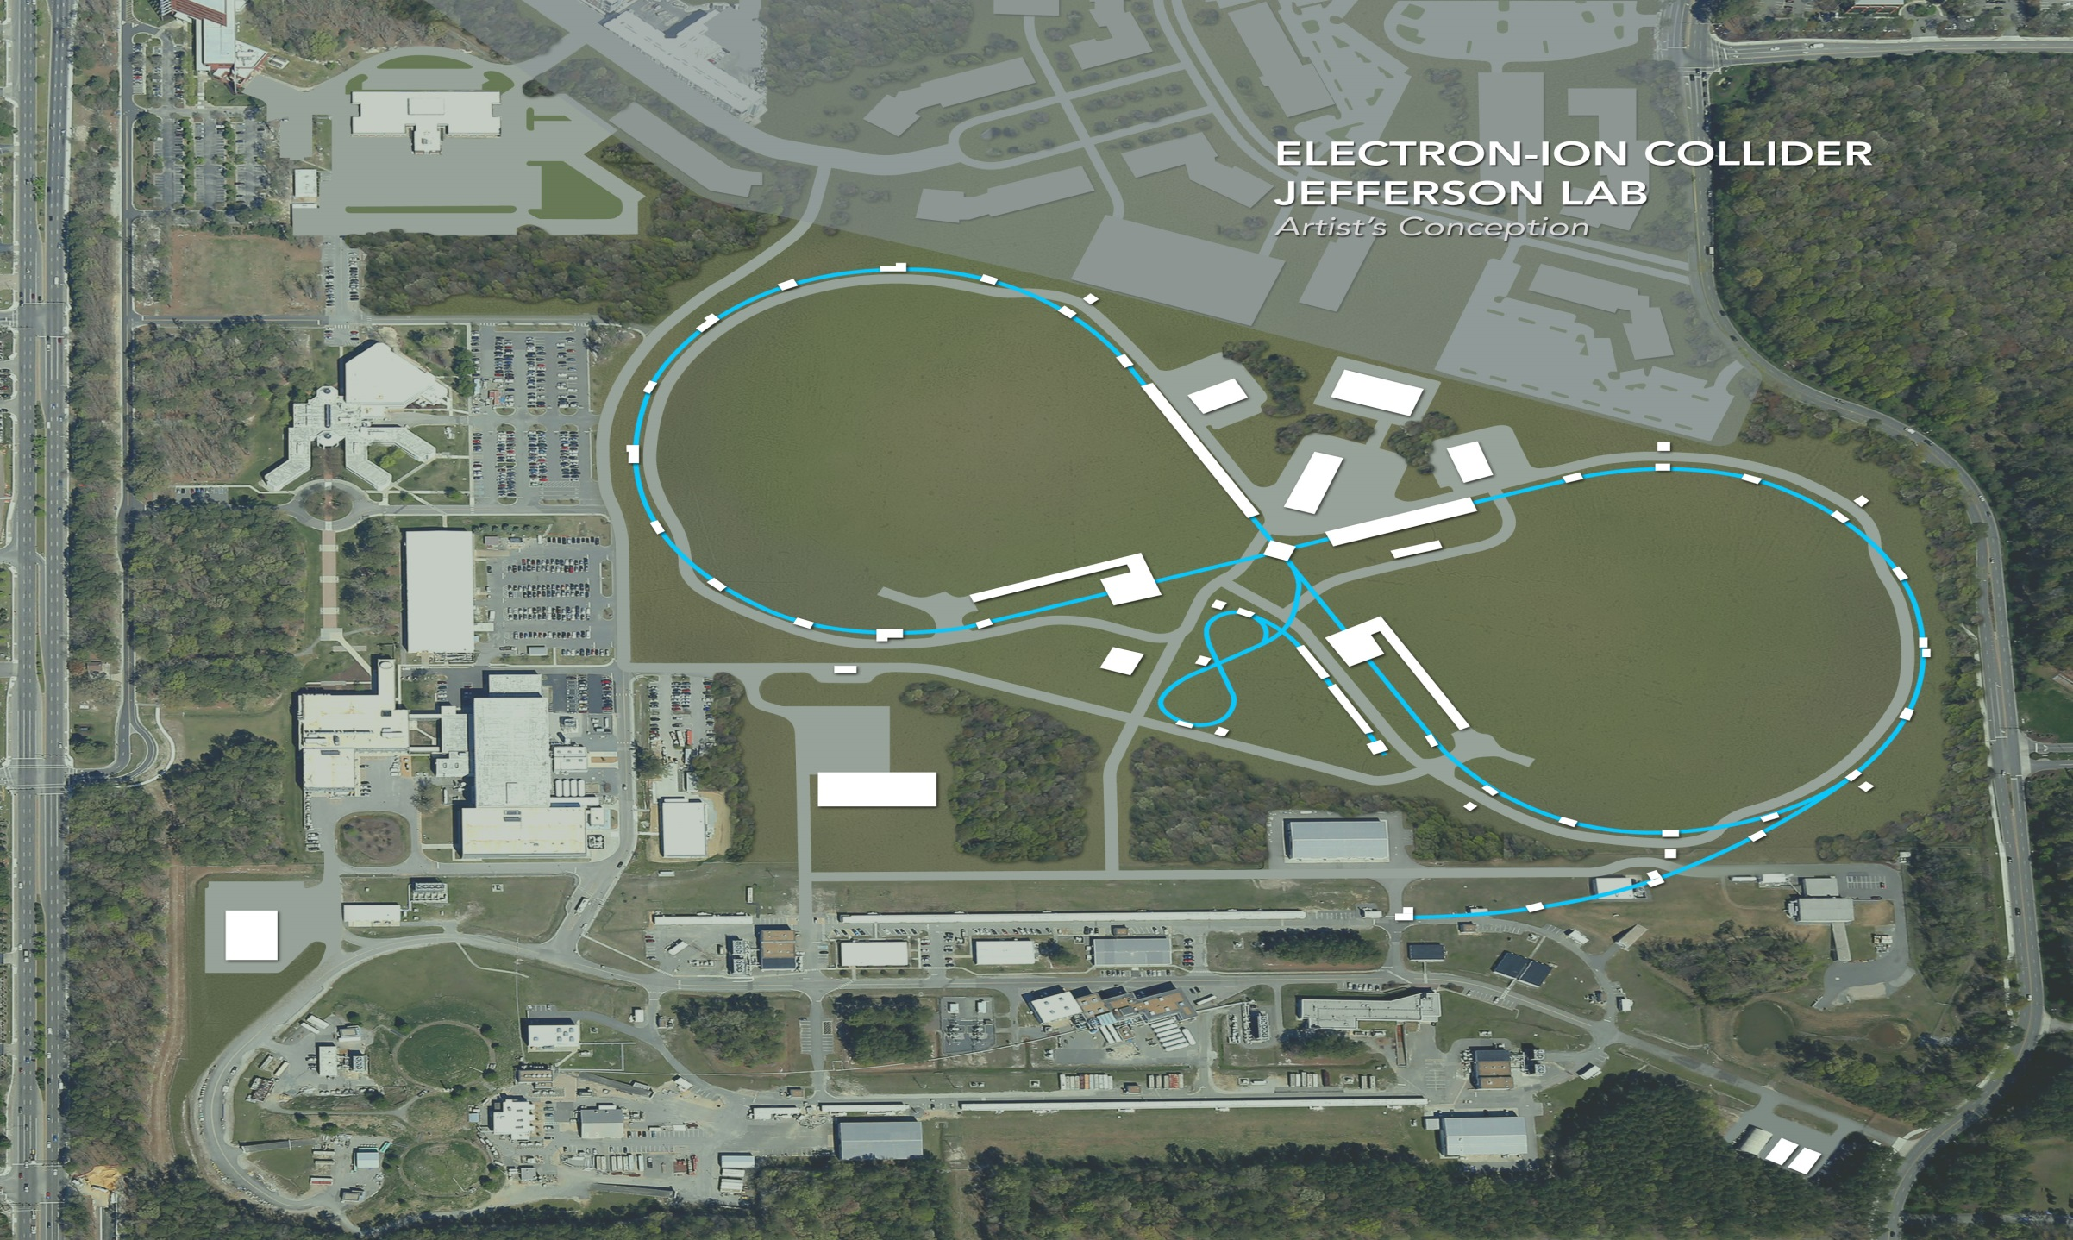
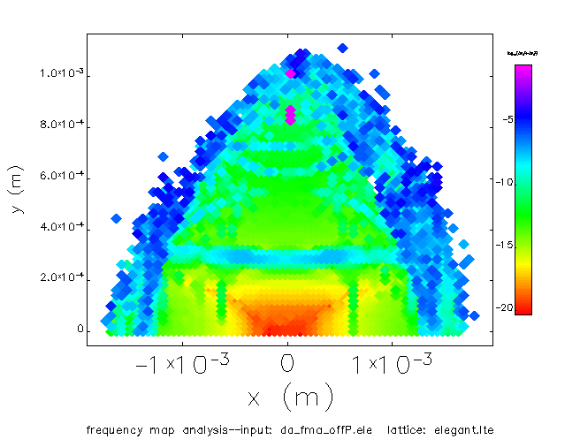
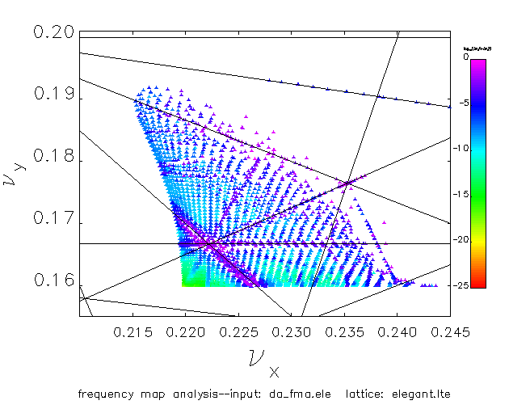
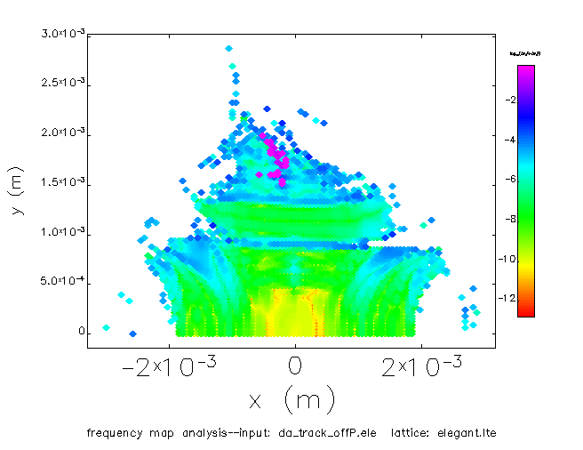
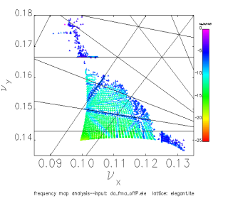
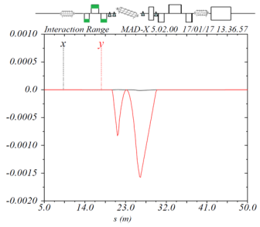
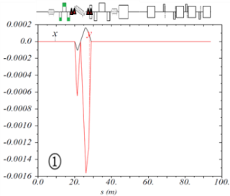
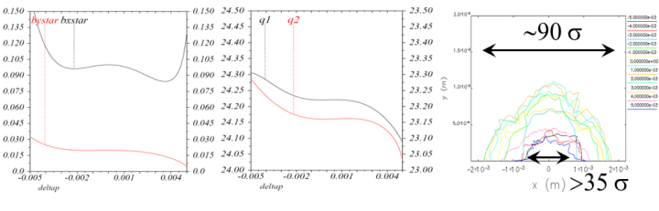
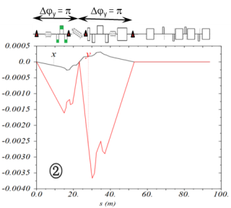
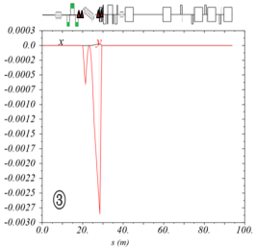
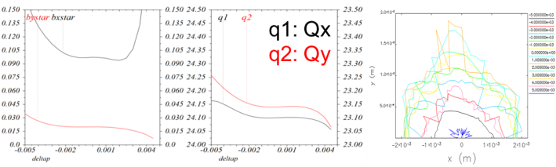
MOPML002
Status of the JLEIC Ion Collider Ring Design
Guohui Wei, Vasiliy Morozov, Fanglei Lin, Yuhong Zhang
JLAB, Newport News, VA, USA Yunhai Cai, Yuri Nosochkov, SLAC, Menlo Park, CA, USA
*Acknowledgements
Authored by Jefferson Science Associates, LLC under U.S. DOE Contract No. DE-AC05-06OR23177, DE-AC02-06CH11357, and DE-AC02-76SF00515.
Abstract
This paper presents an update on the design of the ion collider ring of the Jefferson Lab Electron Ion Collider (JLEIC). Based on the existed lattice and optics with chromaticity compensation, tune optimization was studied. We investigate the dependence of the dynamic aperture on the betatron tune in order to search for a large dynamic aperture. Dynamic analysis with on-momentum and off-momentum are included. Meanwhile, the several correction scenarios of coherent orbits caused by detector solenoid and the crossing angle of 50 mrad are also presented.
Dynamic Aperture with Tune Scanning
the tune scanning range is (24.0, 23.0) to (24.5, 23.5). Here the tune scanning step is 0.01 for both Qx and Qy, so that totally there are about 2500 working points. And we choose the interaction point (IP) as the dynamic aperture study position.
We calculate the dynamic aperture along three directions. As shown in right, we selected x direction with a vertical offset of 1 sigma of vertical beam size, a 45° direction, and vertical direction.
Two areas are selected to make further study. They are centred by tune (24.22, 23.16) and tune (24.1, 23.14).
DA survey method
JLEIC & Its Ion Collider Ring
JLEIC is designed as a ring-ring collider. Its central part is a set of figure-8 collider rings as shown in the below figure.
DA survey along X direction
DA survey along 45° direction
DA survey along Y direction
On-momentum Analysis
We use frequency map to study the dynamic aperture and tune footprint for the tune (24.22, 23.16) (lower 2 figures) and the tune (24.1, 23.14) (upper 2 figures). The FMA diffusion rate is plotted as a colour weighted value. We can find a bigger dynamic aperture with the tune (24.1, 23.14), but a more stable core area of dynamic aperture with the tune (24.22, 23.16).
In the tune footprint, several resonance lines can be identified for these two tunes, like νx+6νy, 7νx, and 3νx-2νy for the tune (24.1, 23.14), and 3νx, 3νx+2νy, and 2νx-5νy for the tune (24. 22, 23.16).
Compensation scenarios of detector solenoid effects
The detector solenoid causes coherent orbit distortion. The orbit correction of the beam orbit uses two dipole correctors on each side of the IP to make not only orbit but also orbit slope to be 0 at IP. And coherent orbit is controlled between the two FFQ triplets in IR. But in one hand, the IR area is so tight especially the downstream section of the IP, we should make correctors comfortably aligning in the area; in another hand, the nuclear physics and magnet requirement want weak fields of these correctors. Thus we studied four options for detector solenoid compensation.
DA (Left) & tune footprint (right) for (24.22, 23.16)
DA (Left) & tune footprint (right) for (24.1, 23.14)
Off-momentum Analysis
we can see the tune (24.1, 23.14) has asymmetric dynamic apertures between positive and negative momentum offset, especially at ± 0.5 %. Meanwhile the tune (24.22, 23.16) has dynamic apertures of larger than 35 sigma of beam size at ± 0.5 %, and about 90 sigma of beam size with on-momentum beam.
the tune (24.1, 23.14) has larger dynamic aperture at ± 0.3 %, which makes it a good option also.
a short-corrector scenario
a long-corrector scenario
β∗ (left), tune (middle), & DA (right) to δp for (24.22, 23.16)
a pi phase advance corrector scenario
a scenario of 1st dipole nested with a corrector
β∗ (left), tune (middle), & DA (right) to δp for (24.1, 23.14)

