Slide 1

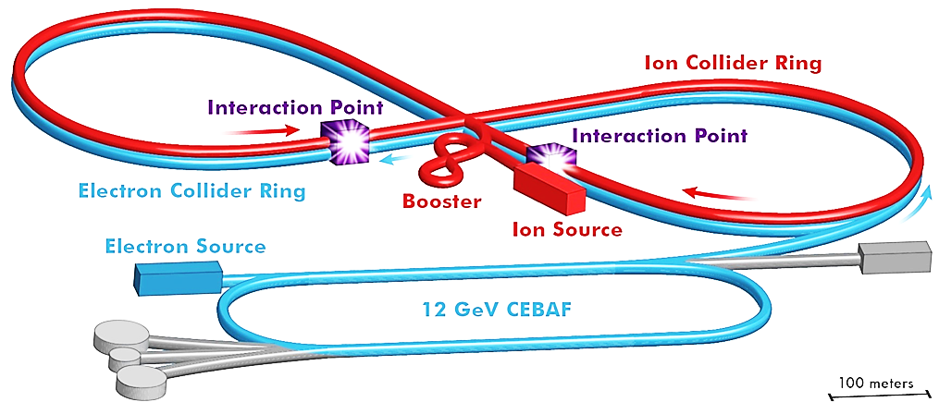
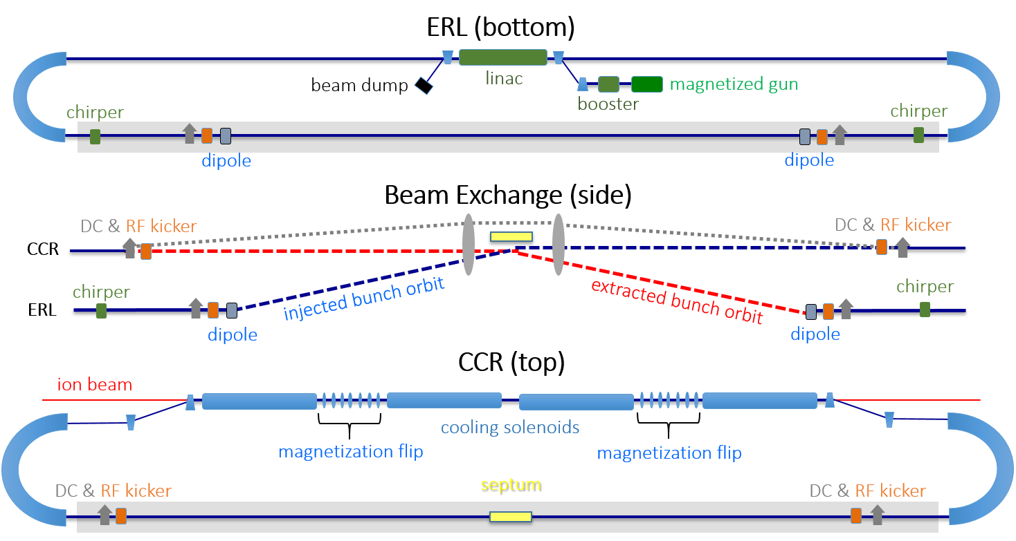
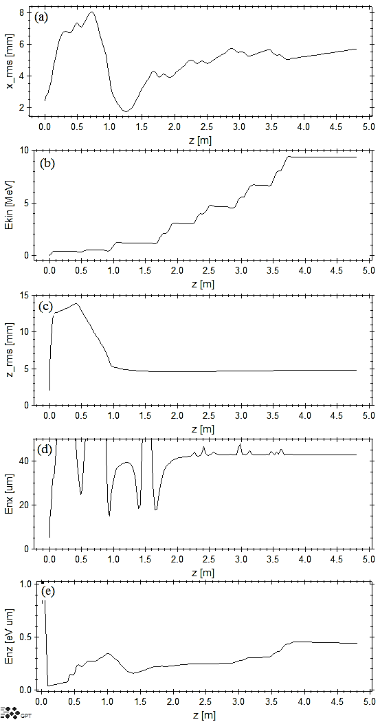
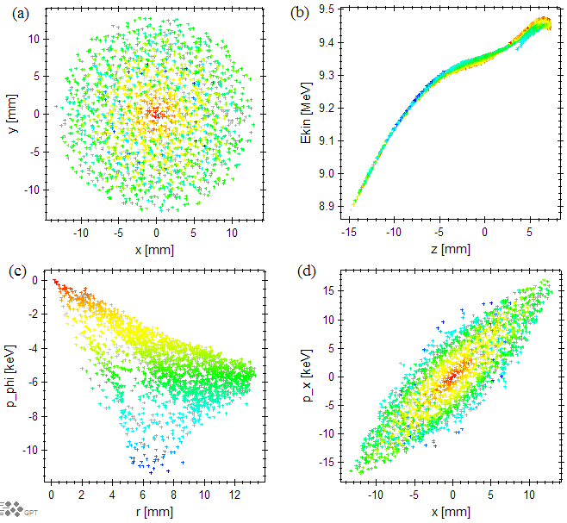
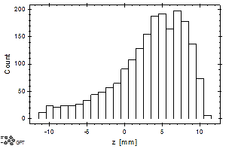
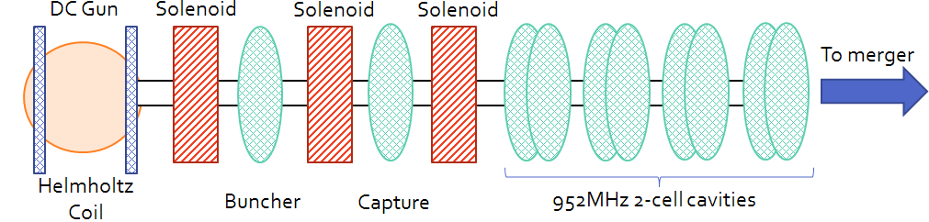
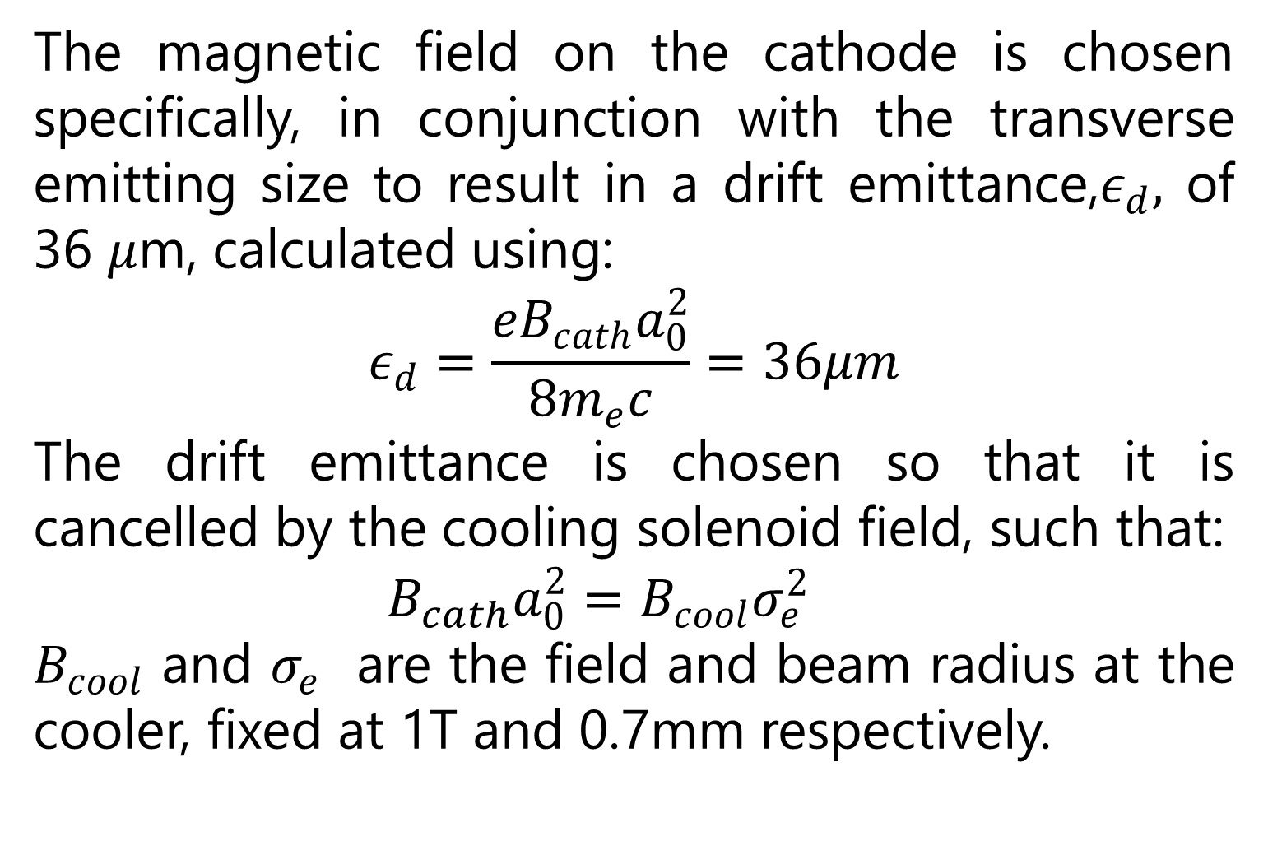
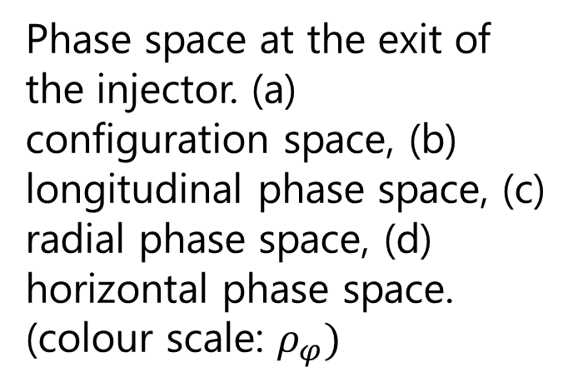
A schematic of the JLEIC accelerator complex. The Circulating Cooling Ring (CCR) is shown in yellow
Jefferson Lab is in the process of designing an electron ion collider, JLEIC, to be built on site utilizing existing accelerator facilities. The proposal for this machine is to have unprecedented luminosity at a 45GeV center-of-mass energy. The luminosity is heavily dependent on ion cooling in both the booster and the storage ring of the accelerator. The injector for the Circulating Cooling Ring is presented:
Parameter Specifications
Energy at the cooler | 20-55 MeV
Bunch charge | 3.2 nC
CCR bunch frequency | 476 MHz
Bunch length at cooler (full) | 2 cm
Injector bunch frequency | 43.3 MHz
Drift emittance | 36 mm-mrad
Gun voltage (DC) | 400 kV
CCR
To achieve the high luminosity for 45GeV center-of-mass collisions, the ion beam must be continuously cooled. The proton energy is up to a maximum of 100GeV/u, which therefore requires the electron cooling bunches to have an energy up to 55MeV such that they co-propagate in the cooling solenoid channel. To improve the cooling efficiency, a magnetized electron beam is used, The electron bunches are produced in the presence of a uniform longitudinal magnetic field. When the electrons exit this field they acquire angular momentum, which if preserved throughout the CCR, will be removed as the beam enters the fringe field of the cooling solenoid.
The magnetic field on the cathode is chosen specifically, in conjunction with the transverse emitting size to result in a drift emittance,$ε_{d},$ of 36 $μ$m, calculated using:
$$ε_{d}=\frac{{eB}_{cath}a_{0}^{2}}{8m_{e}c}=36μm$$
The drift emittance is chosen so that it is cancelled by the cooling solenoid field, such that:
$B_{cath}a_{0}^{2}=B_{cool}σ_{e}^{2}$
$B_{cool}$ and $σ_{e}$ are the field and beam radius at the cooler, fixed at 1T and 0.7mm respectively.
Circulating Cooling Ring (stacked vertically)
A 400kV DC gun is immersed in the field of a Helmholtz coil (magnetizing solenoid), which is assumed to give a uniform longitudinal magnetic field over the diameter of the photocathode. This is followed by an additional traditional solenoid, buncher cavity, further focusing, a capture cavity, a final solenoid and a booster unit containing 4 double-cell cavities. The fundamental frequency of the RF is 952MHz to be compatible with the ion complex frequency.
Phase space at the exit of the injector. (a) configuration space, (b) longitudinal phase space, (c) radial phase space, (d) horizontal phase space.
(colour scale: $ρ_{φ})$
Histogram of the bunch, longitudinally.
Uncorrelated transverse emittance
Bunch evolution through the injector beamline. (a) horizontal rms beam size, (b) average kinetic energy, (c) longitudinal rms beam size, (d) horizontal normalised rms emittance, (e) longitudinal normalised rms emittance.
Notice: Authored by Jefferson Science Associates, LLC under U.S. DOE Contract No. DE-AC05-06OR23177. The U.S. Government retains a non-exclusive, paid-up, irrevocable, world-wide license to publish or reproduce this manuscript for U.S. Government purposes.

