Slide 1
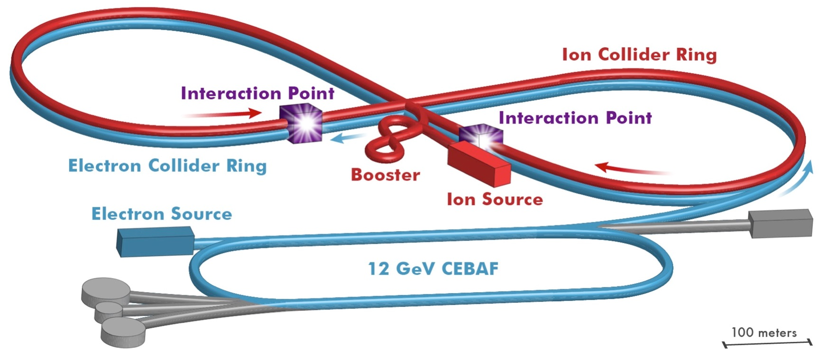
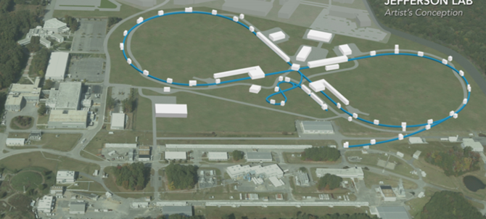
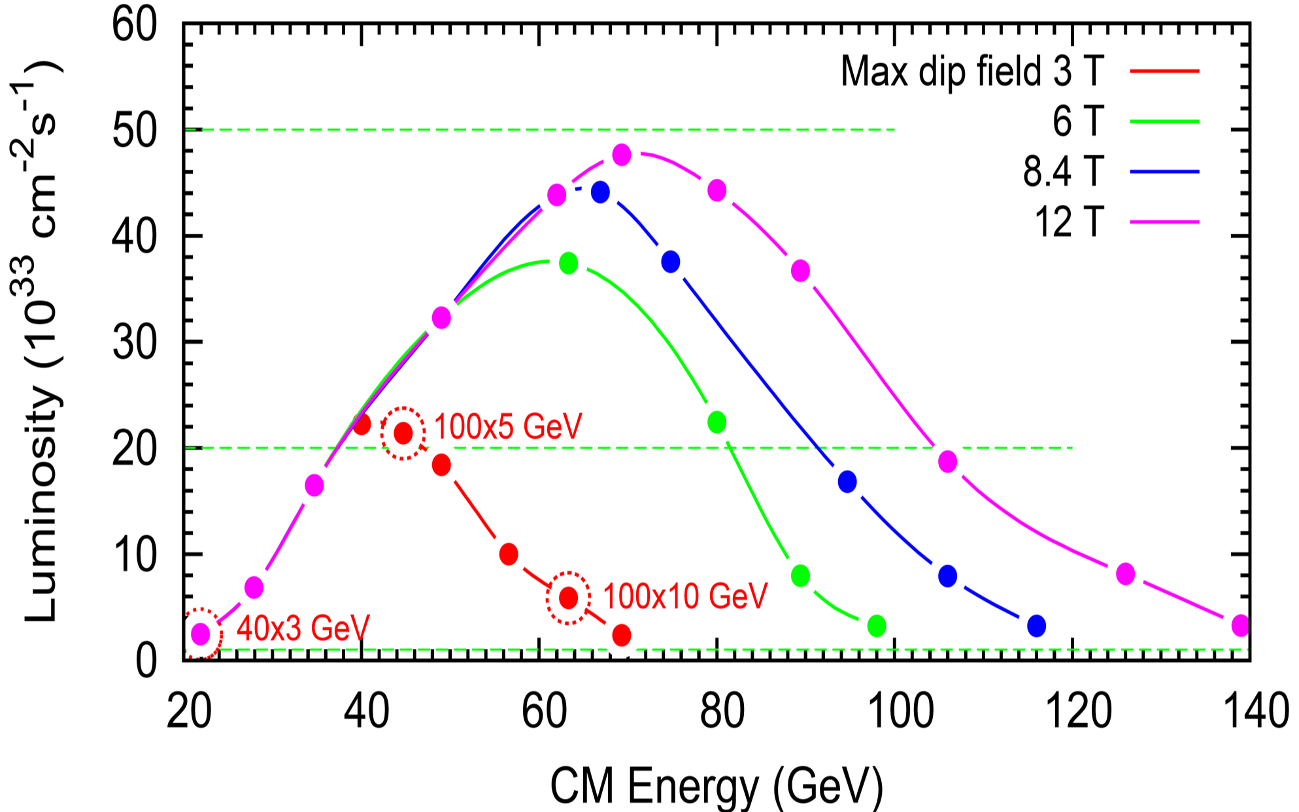
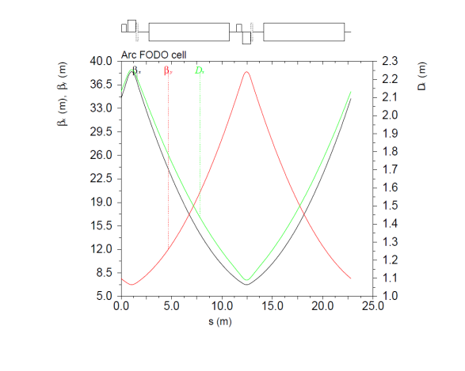
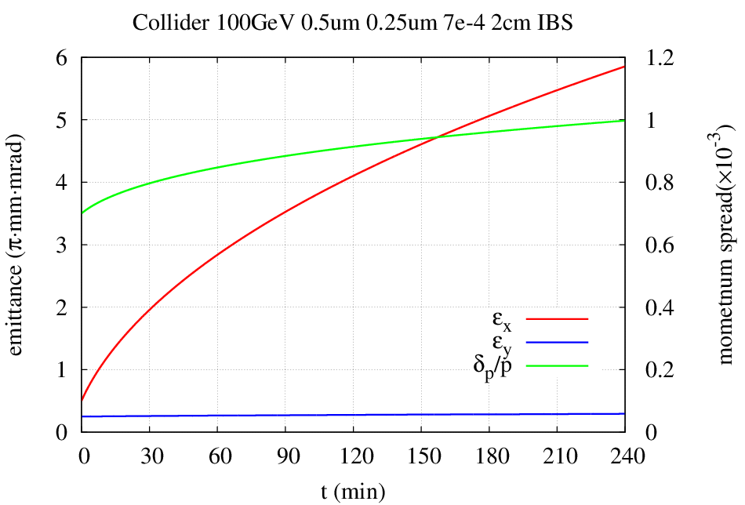
JLEIC Ion Collider Ring with Small Aperture Magnets*
Yuhong Zhang, Jefferson Lab, Newport News, VA 23606, USA
Thomas Jefferson National Accelerator Facility,
Managed by the Jefferson Science Associates, LLC for the U.S. Department of Energy, Office of Science
* Work supported by U.S. DOE Contract No. DE-AC05-06OR23177.
Abstract: One important feature of the JLEIC design is ultra small emittance of ion beams after multi-staged strong cooling. This results ultra small beam sizes in the ion collider ring, thus requires smaller beam stay-clear, and smaller physical aperture of magnets. Here we present two design concepts that take such advantage. The first concept proposes a factor of two reduction of physical aperture of ion arc magnets from the present JLEIC baseline design while the second concept explores reusing the RHIC ion ring magnets for the JLEIC ion collider ring. It is expected that both design concepts should achieve a substantial cost reduction of JLEIC.
JLEIC Layout & on Site Map
Dipole Aperture: Analyses & Opportunity
RHIC Magnets for JLEIC Ion Collider Ring w/ Small Aperture
About 4 years ago, we explored whether the RHIC magnets can be used for the JLEIC ion collider ring
We had assume a small aperture requirement
8-100 GeV
Cooling |  | No |  |  |  | Yes
Kinetic energy | GeV | 8 | 50 | 100 | 210 | 10 | 50 | 100 | 210
CM energy (e energy) | GeV |  | 24.7 (3) | 69.6 (12) | 100.6 (12) |  | 24.7 (3) | 69.6 (12) | 100.6 (12)
Emitt., norm | µm | 2.5 | 2.5 | 2.5 | 2.5 | 0.5 | 0.5/0.25 | 0.5/0.1 | 0.5/0.1
Emitt., unnorm. | nm | 266.9 | 46.1 | 23.2 | 11.1 | 43.0 | 9.2/4.6 | 4.6/ 0.9 | 2.2/0.4
Energy spread | 10⁻⁴ | 10 | 10 | 10 | 10 | 3 | 3 | 3 | 3
Maxi. beta | m | 38 | 38 | 38 | 38 | 38 | 38 | 38 | 38
Maxi disp. | m | 2.2 / 0 | 2.2 / 0 | 2.2 / 0 | 2.2 / 0 | 2.2 / 0 | 2.2 / 0 | 2.3 / 0 | 2.2 / 0
Max beam size | mm | 3.9/ 3 | 2.6/1.3 | 2.4/0.9 | 2.3/0.7 | 1.4/1.3 | 0.9/0.42 | 0.8/0.2 | 0.7/0.1
Beam stay-clear in arc | mm | 39/32 (10 σ) | 26/13 (10 σ) | 24/ 9.4 (10 σ) | 24/6.5 (10 σ) | 8.2/7.7 (6 σ) | 5.3/2.5 (6 σ) | 4.7/1.1 (6 σ) | 4.3/0.8 (6 σ)
Magnet sagitta | mm | 18.3 | 18.3 | 18.3 | 18.3 | 18.3 | 18.3 | 18.3 | 18.3
Beam steering | mm | ± 5 | ± 5 | ± 5 | ± 5 | ± 5 | ± 5 | ± 5 | ± 5
Required phys. Aperture | mm | 106x74 | 80 x 37 | 76 x 29 | 74 x 23 | 46/25 | 39 / 15 | 38 x 12 | 37 / 12
3-10 GeV
8 GeV
d
L₀
d₀
Good field
JLEIC collider ring
Injection kinetic energy | GeV | 7.9
Injection emittance | µm | ~0.5
Largest betatron | m | 30
Largest RMS beam size | mm | 1.1
Beam stay-clear (10σ) | Mm | ~11
Beam steering | mm | 10
Mini aperture (diameter) | mm | 32
Maxi allowable sagitta | cm | 8
Minimum bending radius | M | 139
Linac
L
new orbit
design orbit
(ρ₀=243 m)
α
ρ
Luminosity & Upgrade Potential
100mm x 60mm is the present baseline
42% x 34%
Is a 50mm x 30mm aperture enough?
α₀
ρ₀
Baseline
Propose: 70mm x 45mm
(9.45 m, bent w/ 4.85 cm sagitta)
100 GeV CM
Ion Collider Ring Arc Cell
RHIC Magnets Only
140 GeV CM
115 GeV CM
(LHC SC magnet)
50 mm x 30 mm should give 8σ_{x} and 8σ_{y} for dipoles
Proton |  | RHIC | JLEIC |  |  | Baseline
Maxi. kinetic energy | GeV | 275 | 160 | 175 | 200 | 100
Max CM energy |  |  | 87.6 | 91.7 | 97.9 | 69.3
Dipole length | m | 9.45 | 9.45 | 9.45 | 9.45
Dipole max. field | T | 3.77 | 3,77 | 3.77 | 3.77
Dipole bending | m | 243 | 141 | 156 | 177
Dipole bending |  | 2.23° | 3.83° | 3.50 | 3.06
Cell length & packing | m | 29.6 & 0.638
Figure-8 angle |  | -- | 100° | 104° | 114° | 81.7°
Cells in each arc |  | 13.5 | 36.6 | 40.6 | 47.8
Total dipoles |  | 162(x2) | 146 | 162 | 191
Arc length | m | 400 | 1082 | 1200 | 1415
Arc radius | m | 381 | 221 | 242 | 277
Straight length | m |  | 372 | 378 | 366 | 360
Ring circumference | m | 3840 | 2907 | 3158 | 3564 | 2140
Enlarged by |  |  | 1.4 | 1.5 | 1.7
Footprint, length x width | m |  | 1021 x 443 | 1099 x 484 | 1217 x 554 | 787x310
JLEIC Baseline e-p Parameters
Staged Electron Cooling
Achieving very small emittance (order of magnitude reduction in all dimensions), short bunch length ~1 cm
Suppressing IBS induced emittance degradation
CM energy | GeV | 21.9 (low) |  | 44.7 (medium) |  |  | 63.3 (high)
 |  | p | e | p |  | e | P | e
Beam energy | GeV | 40 | 3 | 100 |  | 5 | 100 | 10
Collision frequency | MHz | 476 |  | 476 |  |  | 476/4=119
Particles per bunch | 10¹⁰ | 0.98 | 3.7 | 0.98 | 3.7 |  | 3.9 | 3.7
Beam current | A | 0.75 | 2.8 | 0.75 | 2.8 |  | 0.75 | 0.71
Bunch length, RMS | cm | 3 | 1 | 1 | 1 |  | 2.2 | 1
Norm. emitt., (x/y) | μm | 0.3 | 24/24 | 0.5/0.1 | 54/10.8 |  | 0.9/0.18 | 432/87
Horiz. & vert. β* | cm | 8/8 | 13.5 | 6/1.2 | 5.1/1 |  | 10.5/2.1 | 4/0.8
Vert. beam-beam |  | 0.015 | 0.09 | 0.015 | 0.068 |  | 0.008 | 0.034
Laslett tune-shift |  | 0.06 |  | 0.055 |  |  | 0.056
Lumi/IP, w/HG,10³³ | cm⁻²s⁻¹ | 2.5 |  | 21.4 |  |  | 5.9
Ring | Functions | Kinetic energy (GeV / MeV) |  |  | Cooler type
 |  | Proton | Lead ion | Electron
booster ring | Accumulation of positive ions |  | 0.1 (injection) | 0.054 | DC
 | Pre-cooling for emitt. reduction | 2 (injection) |  | 1.1 | DC
collider ring | Maintain emitt. during stacking | 7.9 (injection) | 2 (injection) | 4.3 (proton) 1.1 (lead) | DC
 | Pre-cooling for emitt. reduction |  | 7.9 (ramp to) | 4.3 | DC
 | Maintain emitt. during collision | Up to 100 | Up to 40 | Up to 54.5 | ERL
JLEIC CM Energy Reach
Present baseline
Full coverage of CM energy from 20 to ~70 GeV
e: 3-12 GeV, p: up to 100 GeV, ion: up to 40 GeV/u
Approach: 3 T ion ring dipole magnets
Leading option for future energy upgrade
Full coverage of CM energy up to ~100 GeV
e: 3-12 GeV, p: up to 200 GeV, ion: up to 80 GeV/u
Approach: 6 T ion ring dipole magnets
This could be an alternate design for the JLEC baseline
Ways for Reducing Footprint
RHIC cell: 29.6 m, 3.77 T, 3.06° x 2 = 6.12°
New magnet cell: 29.6 m, 7.54 T, 6.12° x 2 = 12.24°
Beam Formation w/ Cooling
RHIC cell
New magnet cell
proton
booster
collider Ring
Bunch splitting,
emittance preservation
Multi-turn injection accumulation
Fast ramp
Stacking,
Emittance preservation
Up to 100 GeV
Pre-cool
8 GeV
10 GeV
ERL cooler
up to 56 MeV
Dipole |  | RHIC | New
Length | m | 9.45 | 9.45
Field | T | 3.77 | 7.54
Bending (@200 GeV) |  | 3.06° | 6.12°
Radius | m | 176.9 | 88.5
Segitta | mm | 6.31 | 12.6
~2 GeV
DC cooler 5.4 MeV
285 MeV
DC cooler
1.1 MeV
Small Physical Aperture Magnets
Fact (Experiences taught us)
“Magnet cost is roughly linearly proportional to its physical aperture, some time can be even worse”
Idea
Aperture of magnets is made much smaller, then we may be able to save the magnet cost substantially
Opportunity
JLEIC ion beam has a much smaller emittance achieved by cooling
Lead ion
booster
collider Ring
Bunch splitting,
Emittance preservation
Stacking, emittance preservation
Pre-cool
Up to 40 GeV/u
Multi-turn injection accumulation
Fast ramp
8 GeV
ERL cooler
21.8 MeV
DC cooler
2 GeV/u
DC cooler
1 MeV
DC cooler
4.3 MeV
Proton energy | GeV | 100 | 200 | 200 | 200 | 200
RHIC & new dipole field | T | 3.8/ 7 .5 | 3.8/ 7 .5 | 3.8/ 7 .5 | 3.8/ 7 .5 | 3.8/ 7 .5
RHIC cells in super-period |  | baseline | 1 | 1 | 2 | 4
New cell in super-period |  |  | 0 | 1 | 1 | 1
Total cells in super-period |  |  | 1 | 2 | 3 | 5
Length of super-period | m |  | 29.6 | 59.2 | 88.8 | 148
Total bend/super-period |  |  | 6.12° | 18.36° | 24.5° | 36.7°
Figure-8 crossing angle |  | 81.7° | 114° | 91° | 97.5° | 103.5°
Arc length | m |  | 1415 | 874 | 1007 | 1143
Super-periods per arc |  |  | 47.8 | 47.8 | 11.3 | 7.72
RHIC & New dipole in ring |  |  | 191 & 0 | 59 & 59 | 91 & 45 | 123 & 31
Arc radius | m |  | 277 | 185 | 208 | 231
Straight length | m | 360 | 366 | 363 | 364.5 | 364.1
Ring circumference | m | 2140 | 3564 | 2474 | 2742 | 3013
Footprint, length x width | m | 787x310 | 1217x554 | 888x370 | 969x416 | 1050x462
Upgrade, p & CM energy (e energy 14 GeV) | GeV | 251 / 119 | 478 / 164 | 292 / 130 | 339 / 138 | 385 / 147
100 MeV/u
Risk Factor & Fall Back
Without cooling, emittance will grow due to IBS
Cut-off emittance: beam too fat to fit into the aperture?
Would e-Cooling become a single point total failure for a design with small SC dipole aperture?
What Affects Dipole Aperture Size?
Beam stay-clear
Transverse emittance & beam size (betatron & disp.)
Orbital steering (+/- 5 mm)
Number of sigma (6 to 10)
Dynamic aperture (with low beta insertions)
Injection (beta-squeeze easies the problem)
Collimation (transverse tails)
Collective effects and scatterings (beam life-time)
 |  | Design | Design | Cut-off | Design | Cut-off
Energy | GeV | 10 | 50 | 50 | 210 | 210
Emitt, norm | µm | 0.5 | 0.5/ 0.25 | 2.3 / 2.3 | 0.5 / 0.1 | 9.7 / 9.7
Growth ratio |  |  |  | 4.7 / 9.2 |  | 19.4 / 97
Beam spot | mm | 1.4 / 1.3 | 0.9x0.42 | 1.4x1.3 | 0.7x0.13 | 1.4 / 1.3
Emittance Evolution w/o Cooling During Collision
Conclusion for Concept 2
Reusing RHIC magnets for JLEIC figure-8 ion collider ring is possible, however it requires a large footprint (circumference) if using RHIC dipole magnet alone
Bending angle of RHIC dipoles is limited by magnet sagitte
To reduce the footprint/circumference substantially, one may mix the RHIC dipoles with new high field dipoles.
Perhaps the best approach is alternating cell based, i.e., RHIC cells and non-RHIC cells
There is a natural upgrade approach by replacing the RHIC magnets
JLEIC New Ion Injector
JLEIC ERL-Circulator Cooler
Conclusion for Concept 1
Reduce physical aperture by half ➔ reduce the cost
Key is preserving small emittance in the entire beam cycle in the collider ring, otherwise the beam will lost
Requires multi-step cooling, both DC cooling in the booster and bunched ERL cooing during collision
Without ERL cooling is not a show-stopper. Emittance will grow due to IBS, the ion beam must be frequently replaced ➔ a fall-back of the design
Acknowledgement
A. Hutton (JLab) for suggestion of an exploratory study of reusing the existing ion rings (including RHIC) magnets for the JLEIC ion collider ring
T. Roser (BNL) also suggested exploring small aperture of JLEIC collider ring magnets
ERL ring
Circulator cooler ring

